Slide 1


College of Business and Economics
Departement of Management
CHAPTER 3: BUSINESS FORMATION

Slide 2
_{Chapter Learning Outcomes}
After completing this chapter, students should be able to:
  •Explain the Concept of Business Development;
  •Identify the Forms of Business Ownership;
  •Analyze the Importance/Role of MSEs;
  •Set Up Small Scale Business;
  •Distinguish the Failure and Success Factors of MSEs;
  •Identify the Problems of Small Scale Business in Ethiopia; and
  •Develop Organizational Culture.

Slide 3
3.1 Introduction
A business formation deals with the formalization and actual implementation of business ideas in to practice.
Small businesses are creating new jobs.
Large businesses continue eliminating jobs.
They are more flexible in the products and services they offer.

Slide 4
Introduction
In this chapter, the following are discussed:
The issues of business development and the different legal forms of business.
• The concept of MSEs in the Ethiopian and international context.
• The importance/roles and set up of MSEs.
• The success and failure factors of MSEs.
• The common problems of MSEs in Ethiopia.

Slide 5
1.2 The Concept of Small Business Development
Size and standards to define small business are arbitrary.
Different countries adopt different standards based on socio-economic conditions.
Size criteria include number of employees and startup capital.
Size alone does not reflect the true nature of an enterprise.
Qualitative characteristics differentiate small businesses from others.
Economic/control definitions include market share, independence, and personalized management.

Slide 6
Micro and Small Enterprises (MSEs)
MSEs cover a wide range of industries and play an important role in all economies.
In Ethiopia, MSEs occupy a prominent position in economic development.
Small entrepreneurs can start with less capital, get quick returns, and adapt to market changes.
Common problems include lack of finance, poor operations, lack of experience, and weak financial management.
Setting up a venture begins with searching for opportunities using environmental scanning, creativity, and innovation.

Slide 7
1.3 Forms of Business (A Short Explanation)
There are three basic legal forms of business formation with some variations available depending on the entrepreneurs’ needs.
The three basic legal forms are:-
  1)Proprietorship,
  2)Partnership, and
  3)Corporation
Variations exist particularly in partnerships and corporations.

Slide 8
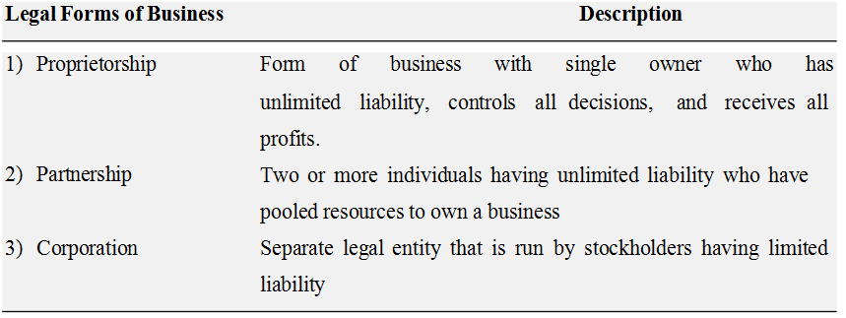
Forms of Business

Slide 9
Comparing Legal Forms of Business
These three basic legal forms are compared with regard to;
  ownership,
  liability,
  start-up costs,
  continuity,
  transferability of interest,
  capital requirements,
  management control,
  distribution of profits, and
  attractiveness for raising capital.
Entrepreneurs must carefully evaluate the pros and cons of each legal form.

Slide 10
Timing of Legal Form Decision
The decision on legal form should be made before submitting a business plan.
It is important for entrepreneurs seeking venture capital.
A table comparison of the three legal forms against the above factors is presented as follows.

Slide 11
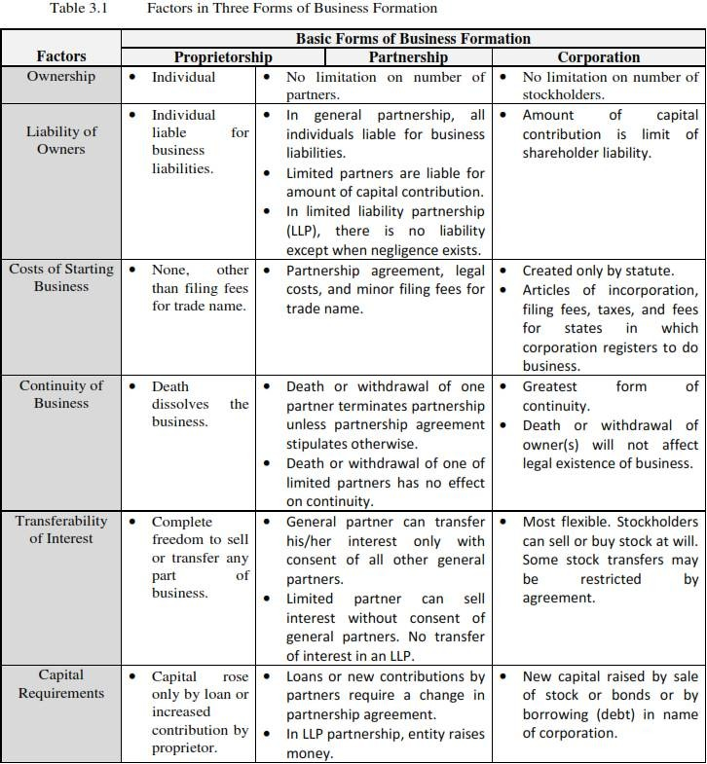
Table 3.1 Factors in three forms of Business Formation

Slide 12
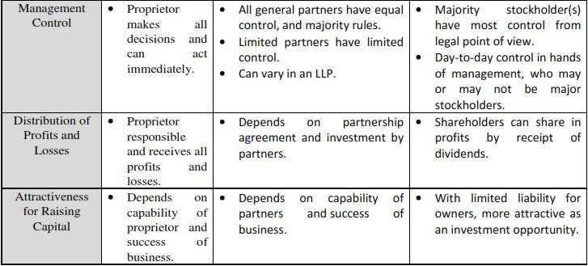
Factors in three forms of Business Formation

Slide 13
1.4Definition and Role/Importance of MSEs in Developing Countries
Small businesses play a vital role in industrial economies, especially in developing countries.
Predominant even in developed countries such as USA and Japan.
Difference between small business and entrepreneurial ventures:
Entrepreneurial ventures: growth-oriented, innovative, new offerings, rapid growth, high uncertainty.
Small businesses: incremental growth, known products/services, focus on sales, marketing, and market expansion.

Slide 14
Defining Small Business
Specifying size and standard is necessary; standards differ by purpose and viewpoint.
Examples:
  Legislators may define a small firm as having ≤10 employees.
  Businesses may be “small” relative to large firms, but “large” relative to smaller ones.
Two main approaches:
  Size Criteria
  Economic/Control Criteria

Slide 15
Size Criteria
Financing supplied by one individual or small group (≤15–20 owners).
Operations are geographically localized (except marketing).
Small compared to largest firms in the industry.
Usually fewer than 100 employees.
Criteria vary by country: employees, capital investment, or both.

Slide 16
Economic/Control Criteria
Market Share: Cannot influence national prices.
Independence: Owner controls major decisions.
Personalized Management: Owner actively manages all major decisions; little delegation.
Technology: Mostly labor intensive; few are technology intensive.
Geographical Area: Operations often local; privately owned with low sales volume.

Slide 17
1.4.2Role/Importance of MSEs in Developing Countries
MSEs cover a wide range of industries and play an important role in both developed and developing economies.
In Ethiopia, MSEs occupy a prominent position in economic development.
The number of MSEs is growing over time.
MSEs need strong socio-economic and political support.

Slide 18
Role/Importance of MSEs
Large Employment Opportunities: MSEs are labor-intensive and generate more jobs per unit of capital than large-scale industries.
Economical Use of Capital: Require relatively small investment; suitable for capital-scarce countries.
Balanced Regional Development: Located in villages and small towns, reducing urban migration and regional disparities.
Equitable Distribution of Wealth: Decentralizes economic power; promotes wider income distribution and harmonious worker-employer relations.

Slide 19
Role/Importance of MSEs
Promote Equality and Harmony: MSEs disperse income widely, reduce concentration of economic power, foster harmonious worker-employer relations, and encourage competitiveness and self-development.
Dispersal over Wide Areas: MSEs spread across regions, aiding industrialization.
Higher Standard of Living: Increase national income and purchasing power in rural and semi-urban areas.
Mobilization of Local Resources & National Identity: Locally owned, promote savings, investment, and cultural traditions.

Slide 20
Role/Importance of MSEs
Innovation and Simple Technology: Easily adopt new, simple production techniques; highly innovative without heavy R&D.
Less Dependence on Foreign Capital / Export Promotion: Use locally made machinery, open export opportunities.
Promotion of Self-Employment: Fosters individual initiative and employment for educated/professional class.
Environmental Protection: Helps reduce pollution.

Slide 21
Role/Importance of MSEs
Shorter Gestation Period: Investment projects start generating output quickly.
Facilitate Development of Large Enterprises: Provide inputs and intermediate goods.
Individual Tastes, Fashions, Personalized Services: Flexible to adapt to market or technological changes.
More Employment Creation Capacity: Labor-intensive, create more jobs per unit of capital than large-scale industries.

Slide 22
1.5Classification of Micro and Small Enterprises
1. In Case of Manufacturing Enterprise (Manufacturing, Construction and Mining):
Micro Enterprise:
  Investment in plant and machinery ≤ Birr 100,000
  Operates with 5 people including the owner
• Small Enterprise:
  Investment in plant and machinery > Birr 100,000 and ≤ Birr 1.5 million
  Operates with 6–30 persons

Slide 23
Classification of Micro and Small Enterprises
2.In Case of Service Enterprise (Retailing, Transport, Hotel and Tourism, ICT and Maintenance):Micro Enterprise:
  Total asset value ≤ Birr 50,000
  Operates with 5 persons including the owner
Small Enterprise:
  Total asset value > Birr 100,000 and ≤ Birr 1.5 million
  Operates with 6–30 persons

Slide 24
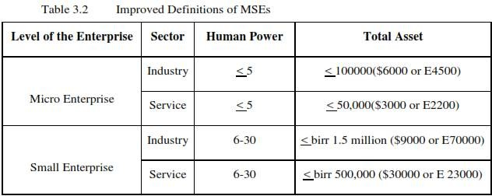
Table 3.2 Improved defintitions of MSEs

Slide 25
Priority Sectors for MSEs in Ethiopia
• Manufacturing Sector:
  Textile and garment, leather and leather products, food processing and beverage, metal works and engineering, wood works (furniture and ornaments), agro-processing.
• Construction Sector:
  Sub-contracting, building materials, traditional mining works, cobblestone, infrastructure sub-contract, prestigious goods.
• Trade Sector:
  Wholesale of domestic products, retail sale of domestic products, raw materials supply.

Slide 26
Priority Sectors for MSEs in Ethiopia
• Service Sector:
  Small and rural transport, café and restaurants, store service, tourism, canning/packing, management, municipality, project engineering, product design & development, maintenance, beauty salon, electronics/software development, decoration, internet café.
• Agriculture Sector (Urban Agriculture):
  Modern livestock rearing, bee production, poultry, modern forest development, vegetables and fruits, modern irrigation, animal food processing.

Slide 27
•Levels of MSEs in Ethiopia
Start-up Level:
  Enterprises with people interested in establishing MSEs or skilled individuals from institutions.
  Begin production or service under a legal framework or entity.
Growth Level:
  Enterprises competent in price, quality, and supply; profitable using support provided.
  Larger manpower and total assets than start-up level.
  Uses bookkeeping systems.

Slide 28
•Levels of MSEs in Ethiopia
Maturity Level:
  Enterprises are profitable and able to invest further.
  Fulfill sector definitions and utilize provided support.
Growth-Medium Level:
  Small enterprises transform into medium level.
  Competent in price, quality, and supply using available support.

Slide 29
1.6 Setting up Small Scale Business
Entrepreneurship involves establishing an enterprise to be a job provider.
Setting up a small enterprise is challenging but rewarding.
Careful identification of the product or service is critical to avoid costly mistakes.
After identifying 4–5 ideas, conduct a detailed assessment and feasibility study.
Feasibility study helps select one idea objectively and systematically.

Slide 30
Stages of Entrepreneurial Process
Three Key Stages:
  Discovery – Identify business opportunities.
  Evaluation – Assess feasibility and potential success.
  Implementation – Launch the enterprise.
These stages can be further divided into seven detailed steps for systematic planning.

Slide 31
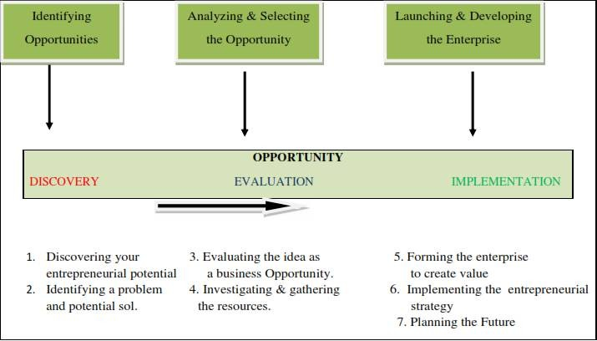
Stages of Entrepreneurial Process

Slide 32
Entrepreneurial Process : Discovery Stage
Step 1 : Discovering Entrepreneurial Potential:
  Assess personal resources, strengths, and challenges.
Step 2 : Identifying a Problem & Solution:
  Select an idea that solves a real problem and meets a genuine need.

Slide 33
Entrepreneurial Process : Evaluation Stage
Step 3 – Evaluating the Idea:
  Check market need, feasibility (technical, economic, social, legal).
Step 4 – Investigating Resources:
  Identify required resources and plan how to deliver product/service to market.

Slide 34
Entrepreneurial Process : Exploitation Stage
Step 5 – Forming the Enterprise:
  Establish business entity and protect intellectual property.
• Step 6 – Implementing Strategy:
  Execute marketing, operations, and financial plans.
• Step 7 – Planning the Future:
  Visualize growth and future direction.

Slide 35
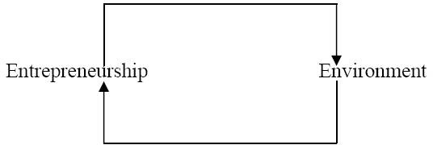
Environmental Analysis
Macro Environment: Political, technological, social, legal, and economic factors affect the venture.
Sectoral Analysis: Study industry trends, competition, substitutes, entry barriers, and sector-specific policies.
SWOT Analysis:
Strengths: Internal positive factors to leverage.
  Weaknesses: Internal negative factors to overcome.
  Opportunities: External factors to exploit.
Threats: External risks like competition, policy changes, or technology shifts.
Combine environmental opportunities with personal strengths to launch products/services aligned with capabilities and societal needs.

Slide 36
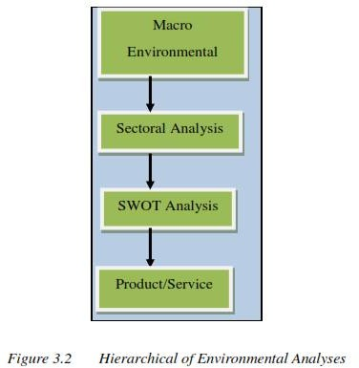
Figure 3.2 Hierarchial of Enviromental Analysis

Slide 37
1.7 Small Business Failure and Success Factors
Business failure occurs when a business closes due to bankruptcy, foreclosure, voluntary withdrawal, or court action (receivership/reorganization).
Common Causes of Failure:
  Inadequate management
  Inadequate financing
  Industry weakness or high competition
  High operating expenses and low profit margins
Other Causes:
  Neglect: owner does not pay attention to the business.
  Fraud: intentional misrepresentation or misuse of business funds.
  Disaster : unforeseen events like fires, storms, theft, or strikes.

Slide 38
Business Termination versus Failure
Business Termination: Occurs when a business no longer exists for any reason.
  Reasons include sale of the business, retirement, loss of interest, market changes, or restructuring.
  May involve changing form (e.g., partnership → corporation) or relocation.
Business Failure:Occurs when a business closes with a financial loss to a creditor.
  Not all closures are failures; termination can happen for positive or neutral reasons.

Slide 39
Common Mistakes Leading to Business Failure
Neglecting Future Planning: Failing to plan the direction and growth of the business.
Underestimating Commitment: Not recognizing the long hours and hard work required.
Poor Delegation: Not hiring additional staff or using employees effectively; resisting delegation.

Slide 40
Common Mistakes Leading to Business Failure
Financial Mismanagement: Inaccurate cash flow estimates and capital requirements; insufficient cushion for unexpected events.
Ignoring Reality: Failing to take strategic action; leaders must ask:
  “If you weren’t already in this business, would you enter it today?”
  If no, decide to fix, sell, or close the business.

Slide 41
1.7.2 Small Business Success Factors
Identify Competitive Advantage:
  Remain flexible, innovative, and customer-focused.
Symbiotic Relationship with Large Businesses:
Small businesses supply parts, distribution, and services, enabling large firms to focus on core competencies.
Efficiency and Skills:
  Small businesses often perform better in distribution, customer service, and adaptability.
  Basic business skills like accounting and quality orientation are critical.

Slide 42
Key Success Categories
1. Conducive Environment:
Political climate: Positive government measures, liberal investment policy, industrial estates, low-cost loans.
Economic environment: Helps in investment, market measurement, and forecasting.
Technology: Adapt and utilize advances to improve operations.
Socio-cultural factors: Influence enterprise survival and growth.
2. Adequate Credit Assistance:
Timely supply of credit, lower interest rates, relaxed collateral requirements, and project preparation support.
3. Markets and Marketing Support:
Small businesses can collaborate to market products collectively.
Government assistance in marketing and promotion can strengthen competitiveness.

Slide 43
1.8 Main Supporting Packages for MSEs Development in Ethiopia
Awareness creation about the sector
Provision of legal services for forming legal enterprises
Technical and business management training
Financial support: 20% personal saving, 80% loan from MFIs
Facilitation of working premises
Industry extension services and Business Development Services (BDS)
Bookkeeping and audit services

Slide 44
1.9 Problems of Small Scale Business in Ethiopia
Small-scale businesses contribute less to economic development due to financial, production, and marketing problems.
Financial Problems: Limited access to capital; reliance on traditional money lenders with high interest.
Production Problems: Difficulty getting good quality raw materials; outdated production techniques; inability to buy new equipment reduces productivity.
Management Challenges: Owners need to know the business in depth, develop a solid business plan, manage financial resources, understand financial statements, and manage people effectively.

Slide 45
3.9 Organizational Structure and Entrepreneurial Team Formation
3.9.1 Introduction
Employees’ loyalty and commitment are crucial for success.
Investors look for management team’s full-time dedication and modest salary expectations.
Large salaries or part-time involvement may signal lack of commitment.
Strong management is key to attracting investors and ensuring venture stability.

Slide 46
3.9.2 Designing the Organization
Initial structure often simple, entrepreneur may handle all tasks.
As workload grows, expand roles with defined responsibilities.
Key elements:
  Organization structure & chart
  Planning, measurement, evaluation
  Rewards (promotions, bonuses, recognition)
  Selection criteria & training
Roles of entrepreneur/manager: Adaptor, Allocator, Negotiator.

Slide 47
3.9.3Building the Management Team and a Successful Organization Culture
Team must:
  Execute the business plan
  Identify fundamental changes in the business
  Adjust strategies based on market and environment
Consider skills, personality, and character for effective team formation.
Ensure proper delegation and defined responsibilities.

Slide 48
3.9.3Building the Management Team and a Successful Organization Culture
Culture = attitudes, behaviors, dress, communication.
Entrepreneur strategies:
  Align culture with business strategy (Core Family Values)
  Motivate and reward employees
  Encourage flexibility and innovation
  Invest time in hiring for skills and character
Leadership reinforces culture and promotes job satisfaction.
Effective team + positive culture = critical to venture success.

Slide 49


