Slide 1

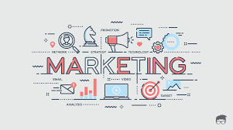
College of Business and Economics
Departement of Management
CHAPTER 5: MARKETING

Slide 2
_{Chapter Learning Outcomes}
After completing this chapter, students should be able to:
Define marketing concepts.
Analyze marketing philosophies.
Describe the role of marketing in achieving the goals of a business enterprise.
Assist in conducting marketing research.
Make competitive analysis of the level,
Implement marketing intelligence in their organization,
Apply the various marketing mixes and strategies in their businesses.
Understand and implement selling and customer service skills.

Slide 3
3.1 Introduction
Business firms and non-profit organizations engage in marketing.
Products marketed include goods, services, ideas, people, and places.
Marketing activities target markets consisting of purchasers and groups influencing organizational success.

Slide 4
Introduction
The foundation of marketing is exchange.
Exchange involves one party giving something of value in return for something else of value.
Marketing includes all activities designed to generate or facilitate exchange to satisfy human needs.

Slide 5
Introduction
The concept of market is central in marketing.
American Marketing Association defines a market as the aggregate demand of potential buyers for a product or service.
Philip Kotler defines a market as an area of potential exchanges.
A market consists of buyers and sellers negotiating terms of purchase or sale.

Slide 6
Introduction
Negotiations may occur:
  Face-to-face
  Through correspondence, phone, or cable
  Through business middlemen such as brokers and commission agents
The chapter discusses marketing and its basic components

Slide 7
5.2Meaning and Definitions of Marketing
Marketing occurs when one social unit exchanges something of value with another.
The essence of marketing is transaction or exchange.
Marketing includes activities designed to generate and facilitate exchange to satisfy human needs and wants.
Business and non-profit organizations engage in marketing.
Products include goods, services, ideas, people, and places.

Slide 8
Definitions of Marketing
1. Marketing is a social and managerial process by which an individual or group obtain what they need and want through creating, offering and exchanging of product of values with others (Philip Kotler,2012).
2.Marketing is the total business activity designed to plan, price, promote and distribute want satisfying products to target market to achieve organizational goal (William J.Stanton, 1984).
3.Marketing is the creation and delivery of standard of living to society (Paul. Mazor, 2005).
4.Marketing management is the process of planning and executing, the conception, pricing, promoting and distributing of ideas, goods and services to create an exchange that satisfy individual or group objectives (American marketing Association, 2015).
5. Marketing is the effort to identify and satisfy customers’ needs and wants. It involves finding out who your customers are, what they need and want, the prices, the level of competition. It involves the knowledge and all the processes you undertake to sell your product.ation and delivery of standard of living to society (Paul. Mazor, 2005).

Slide 9
Definitions of Marketing
The above definitions of marketing reset on the following core concepts:
  Needs, wants, and demands
  Products (goods, services, ideas)
  Value, cost, and satisfaction
  Exchange and transaction
  Relationships and networks
  Market
  Marketers and prospects

Slide 10
Key Marketing Questions
Who are my customers?
What are my customers’ needs and wants?
How can I satisfy my customers?
How do I make a profit while satisfying customers?

Slide 11
Who Are Your Customers?
People or businesses who want your products/services and are willing to pay.
Include:
  Current customers
  Potential future customers
  Former customers you want to regain

Slide 12
What are my customer’s needs and wants?
Customers compare different products before choosing.
Some prefer different designs.
Others prefer high quality and are willing to pay more.

Slide 13
How can I satisfy my customers’?
Identify who your customers are and what they need and want.
Determine:
  Products/services customers want
  Price customers are willing to pay
  Business location (Place)
  Promotion methods to inform and attract customers

Slide 14
5.3 Core Concepts of Marketing
5.3.1 Needs, Wants, and Demand
Marketing begins with human needs and wants.
People need food, air, water, clothing, and shelter to survive.
Beyond basic needs, people desire recreation, education, and other services.

Slide 15
Key Terms
Need: State of deprivation for basic satisfaction (food, clothing, shelter, safety, belonging, esteem).
Want: Desires for specific satisfiers shaped by social forces (e.g., need food → want spaghetti).
Demand: Wants backed by ability and willingness to buy.

Slide 16
Key Terms
Product: Anything offered to satisfy a need or want (tangible or intangible).
Value: Consumer’s estimate of a product’s ability to satisfy needs.
  DeRose: Satisfaction at lowest cost of acquisition, ownership, and use.
Cost: Money expended or incurred to acquire a product.

Slide 17
Key Terms
Exchange: Obtaining a desired product by offering something in return.
Transaction: Trade of values between two parties.
Market: All potential customers sharing a need or want and willing/able to engage in exchange.

Slide 18
5.4 Importance of Marketing
About 50 cents of every consumer dollar goes to marketing costs.
Marketing covers:
  Product design to meet needs
  Making products available when/where needed
  Informing consumers about products and benefits
Marketing creates utility, which makes products satisfying to customers.

Slide 19
Types of Utility in Marketing
Form Utility
  Physical or chemical changes that make a product more valuable.
  Example: Timber made into furniture.
  Marketing aids in product design, color, and quantity decisions.

Slide 20
Types of Utility in Marketing
Place Utility
  Product is readily accessible to customers.
  Moving products to nearby stores adds value.
Time Utility
  Product available when the customer wants it.
  Requires inventory management and anticipating customer needs.

Slide 21
Types of Utility in Marketing
Information Utility
  Informing buyers that a product exists and its benefits.
  Includes advertising and sales support.
  Image Utility: Emotional or psychological value from brand reputation.
Possession Utility
  Created when ownership is transferred to the buyer.
  Requires a transaction, exchanging money for the product.

Slide 22
5.5 Marketing Philosophies
Marketing requires a well-thought philosophy for efficiency, effectiveness, and social responsibility.
Six main marketing concepts:
  Production Concep
  Product Concept
  Selling/Sales Concept
  Marketing Concept
  Societal Marketing Concept
  Relationship Marketing Concept

Slide 23
1. Production Concept
Consumers favor widely available, low-cost products.
Focus: High production efficiency and wide distribution.
Applies when:
  Demand exceeds supply (e.g., developing countries)
  High product costs need reduction to expand market

Slide 24
2. Product Concept
Consumers favor products with high quality, performance, or innovation.
Focus: Making superior products and continuous improvement.
Assumes buyers can appraise quality and are willing to pay extra.
Often minimal customer input; engineers guide design.

Slide 25
3. Selling/Sales Concept
Consumers will not buy enough unless prompted.
Requires aggressive selling and promotion.
Assumes buyers show inertia or resistance.
Common for:
  Unsought goods (insurance, encyclopedias, funeral plots)
  Firms with overcapacity aiming to sell what they make

Slide 26
4. Marketing Concept
Achieve goals by satisfying target market needs better than competitors.
Expressed as:
  “Meeting needs profitably”
  “Find wants and fill them”
  “Love the customers, not the product”
Focus: Customer needs and integrated marketing activities

Slide 27
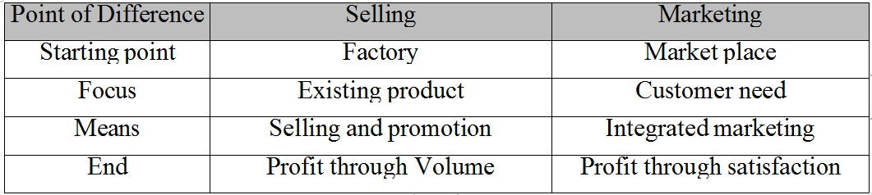
Table 5.1 Selling and Marketing Concept Contrasted

Slide 28
5. Societal Marketing Concept
Deliver desired satisfactions efficiently while enhancing consumer and societal well-being.
Considers:
  Environmental issues
  Resource shortages
  Population growth
  Economic and social problems
Ensures long-term consumer welfare, not just short-term wants

Slide 29
6. Relationship Marketing
Build long-term, satisfying relationships with customers, suppliers, and distributors.
Retain long-term preferences and business.
Outcome: Unique marketing network.
Customer experience is more critical than customer satisfaction.

Slide 30
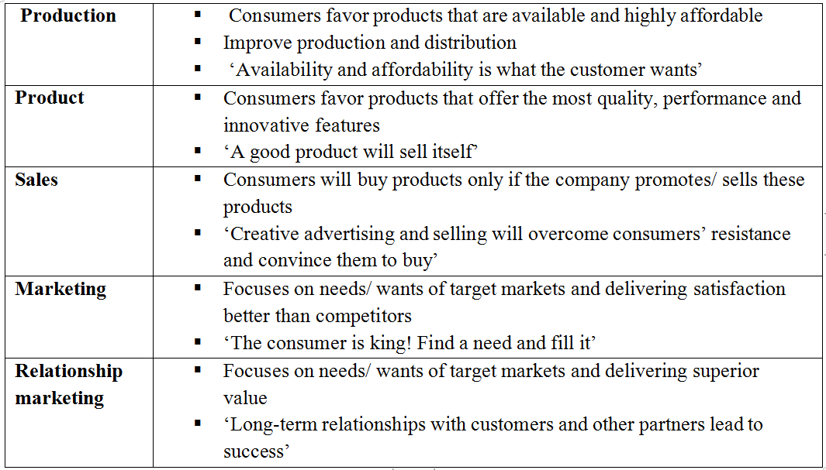
Table 5.2: Summary of the Evolution of Marketing

Slide 31
5.6 Marketing Information Systems
Organizes information flow to marketing managers.
Consists of people, equipment, and procedures to:
  Gather, sort, analyze, evaluate, and distribute timely, accurate information.
Supports marketing managers in analysis, planning, implementation, and control.
Sources of information:
  Internal company records
  Marketing intelligence
  Marketing research
  Marketing decision support analysis

Slide 32
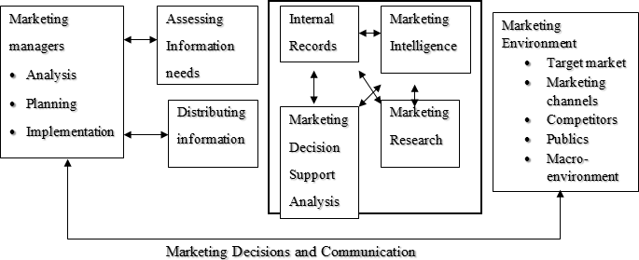
Figure 5.1 Marketing information systems

Slide 33
5.6.1 Marketing Research
Systematic and objective process to collect, analyze, and disseminate information.
Supports decision-making for identifying and solving marketing problems and opportunities.
Research is methodologically sound, documented, and uses the scientific method.
Objective: Provide accurate, impartial information.

Slide 34
Role of Marketing Researcharch
Three functional roles:
Descriptive Function – Gather and present statements of fact.
Diagnostic Function – Explain data.
Predictive Function – Use data to predict results of planned marketing decisions.

Slide 35
Marketing Research Components
Market Size: Number/value of units sold in a period.
Market Share: Company’s share of total market.
Market Penetration: Strategy to increase market share, e.g., by lowering prices.
Brand Equity Research: Measures consumer perception of a brand.
Buyer Decision Process Research: Identifies motivations and decision-making process of buyers.

Slide 36
5.6.1.3 Customer Satisfaction Research
Distribution Channel Audits: Assess distributor/retailer attitudes.
Marketing Effectiveness & Analytics: Evaluate marketing activity results.
Mystery Shopping: Research competitors or quality control.
Positioning Research: Understand brand perception vs competitors.
Price Elasticity Testing: Measure sensitivity to price changes.
Sales Forecasting: Predict sales based on demand and marketing factors.
Segmentation Research: Identify demographic, psychographic, behavioral characteristics.
Test Marketing: Small-scale launch to assess market acceptance.

Slide 37
5.6.1.4 Marketing Research Process
Step 1: Define Research Purpose/Objectives
Key questions to establish objectives:
  Where do potential customers buy the product?
  Why do they purchase there?
  What is the market size? How much can your business capture?
  How does your business compare with competitors?
  What is the impact of promotion on customers?
  What types of products are desired by potential customers?

Slide 38
Marketing Research Process
Step 1: Define Research Purpose/Objectives
Key questions to establish objectives:
  Where do potential customers buy the product?
  Why do they purchase there?
  What is the market size? How much can your business capture?
  How does your business compare with competitors?
  What is the impact of promotion on customers?
  What types of products are desired by potential customers?

Slide 39
Marketing Research Process
Step 2 – Research Design Formulation
Research design: Blueprint for conducting marketing research.
Key elements:
  Study period and location
  Qualitative data collection methods
  Quantitative methods: survey, observation, experimentation
  Define required information
  Questionnaire design
  Measurement and scaling procedures
  Sampling process and sample size
  Data analysis plan

Slide 40
Marketing Research Process
Step 3 – Gather Secondary Data
Secondary data: Collected by others but useful for current study.
Advantages:
  Less expensive
  Accessible internally or externally
Limitations:
  May be outdated
  Less valid

Slide 41
Marketing Research Process
Step 4 – Gather Primary Data
Primary data collection techniques:
  Observational: No direct contact with respondents
  Focus groups
  Experimentation: Tests cause-effect relationships
  Survey techniques: Ask questions and record responses
Survey examples:
  Mail questionnaires
  Telephone interviews
  Personal interviews (drop-off/pick-up or in-person)

Slide 42
Marketing Research Process
Step 5 – Data Processing and Analysis
Data Processing: Editing, coding, transcription, verification
Data Analysis: Follow plan of analysis to interpret results
Results are evaluated in response to research objectives

Slide 43
Marketing Research Process
Step 6 – Report Preparation and Presentation
Research report includes:
  Research questions
  Research approach and design
  Data collection methods and sampling procedures
  Data processing and analysis
  Major findings and action suggestions
Oral presentation recommended using tables, figures, and graphs for clarity and impact

Slide 44
5.6.2 Marketing Intelligence
Systematic process of gathering, analyzing, and applying information about the external market environment.
Purpose:
  Identify current and future market needs
  Monitor environmental changes affecting market size and nature

Slide 45
5.6.2.1The Importance of Marketing Intelligence
Promotes market and customer orientation
Identifies new opportunities
Enables smart segmentation
Provides early warning of competitor moves
Minimizes investment risks
Delivers information quickly, efficiently, and cost-effectively

Slide 46
5.6.2.2Ways to Undertake Marketing Intelligence
Unfocused scanning: Gather any potentially useful information without a specific purpose.
Semi-focused scanning: Focus on specific media types without targeting particular info.
Informal search: Limited, unstructured information gathering for a specific purpose.
Formal search: Systematic, purposeful search by the manager (less rigorous than research).

Slide 47
5.6.3 Competitive Analysis
Purpose: Identify competitors’ strengths and weaknesses; design strategies to exploit opportunities and counter threats.
Benefits:
Understand competitive advantages/disadvantages
Learn competitors’ past, present, and future strategies
Develop informed strategies for competitive advantage
Forecast returns from future investments

Slide 48
5.6.3.1Uses of Competitive Analysis
Purpose: Identify competitors’ strengths and weaknesses; design strategies to exploit opportunities and counter threats.
Benefits:
Understand competitive advantages/disadvantages
Learn competitors’ past, present, and future strategies
Develop informed strategies for competitive advantage
Forecast returns from future investments

Slide 49
Competitive Analysis Questions
Who are your competitors?
What customer needs are being addressed?
How do their products/services compare to yours?
What are their strengths and weaknesses?
How do their prices compare to yours?
How will you compete uniquely (quality, price, support, access)?

Slide 50
5.6.3.3 Steps of Competitive Analysis
Purpose: Understand competitors and position strategically.
Identify Competitors: Local & international; anything that can draw customers away.
Gather Information: Markets served, benefits offered, products/services, pricing, promotion.
4)Gathering Information on Competitors: Competitor websites, trade shows, media, suppliers, customers, employees.
Analyze Competition: How to compete, overlooked segments, unmet customer needs.
Develop Pricing: Base on market value, costs, overhead, and profit; highlight value, don’t underprice.
Goal: Expand competitive advantage by turning competitors’ weaknesses into strengths.

Slide 51
5.6.3.3 Steps of Competitive Analysis
Purpose: Understand competitors and position strategically.
Identify Competitors: Local & international; anything that can draw customers away.
Gather Information: Markets served, benefits offered, products/services, pricing, promotion.
4)Gathering Information on Competitors: Competitor websites, trade shows, media, suppliers, customers, employees.
Analyze Competition: How to compete, overlooked segments, unmet customer needs.
Develop Pricing: Base on market value, costs, overhead, and profit; highlight value, don’t underprice.
Goal: Expand competitive advantage by turning competitors’ weaknesses into strengths.

Slide 52
5.7The Marketing Mix and Marketing Strategies
5.7.1The 4 P’s Of Marketing/The Marketing Mix
The Marketing Mix consists of marketing variables that managers can control to influence customer purchase decisions.
The 4 P’s:
  Product
  Pricing
  Place (Distribution)
  Promotion

Slide 53
1. Product
Goods/services produced for sale
Must meet customer needs and wants
Key questions:
What products/services do I sell?
Do I have the products customers want?
Are there products that do not sell well?
Actions:
Listen to customer preferences
Adapt products/services to changing needs
Research and find new customers if needed

Slide 54
2. Pricing
Process of setting a price for products/services
Prices must be:
  Low enough to attract customers
  High enough to earn profit
To set price, know:
  Costs
  Customer willingness to pay
  Competitors’ prices
  How to make prices attractive

Slide 55
2. Pricing
Process of setting a price for products/services
Prices must be:
  Low enough to attract customers
  High enough to earn profit
To set price, know:
  Costs
  Customer willingness to pay
  Competitors’ prices
  How to make prices attractive

Slide 56
3. Place (Distribution):
Inform and attract customers to buy
Includes:
  Advertising, Sales Promotion, Publicity, Personal Selling
Examples:
  Signs, posters, handouts, business cards, photos, pricelists
  Sales promotion: displays, trials, competitions, demonstrations, complementary productson

Slide 57
4. Promotion:
Ways to deliver products to customers
Methods:
  Direct: Selling to consumers directly
  Indirect: Retail and wholesale distribution

Slide 58
5.7.2 What Is Marketing Strategy?
A process to focus limited resources on the greatest opportunities to increase sales and achieve competitive advantage.
Combines: Product development, Promotion, Distribution, Pricing, Relationship management
Defines:
  Target market segments
  Positioning
  Marketing mix
  Resource allocation
Works best as part of the overall firm strategy to engage customers, prospects, and competitors.

Slide 59
1.Pricing Strategy
Price is the value exchanged for satisfaction and utility (can include prestige or barter)
Directly affects: Total Revenue (TR = Price × Quantity),
Profit t = TR – TC
  Where, TR=Total Revenue, TC=Total Cost
Common strategies:
Price Skimming – High price for buyers who value uniqueness
Penetration Pricing – Lower than competitors to gain market share
Cost-plus Pricing – Price above unit cost
Mark-up Pricing – Add percentage to unit cost
Competition-Oriented Pricing – Focus on competitors’ prices
Odd-even Pricing – Psychological pricing (e.g., $49.95 instead of $50)

Slide 60
Common strategies:
Price Skimming : High price for buyers who value uniqueness
Penetration Pricing :Lower than competitors to gain market share
Cost-plus Pricing : Price above unit cost
Mark-up Pricing –:Add percentage to unit cost
Competition-Oriented Pricing : Focus on competitors’ prices
Odd-even Pricing : Psychological pricing (e.g., $49.95 instead of $50)

Slide 61
2. Promotion Strategy
Promotion is the communication of the company and its products to customers
An organization’s promotional strategy can consist:
  Advertising :Paid, non-personal, mass communication
  Personal Selling : Two-way, face-to-face interaction
  Public Relations : Shape perceptions of company and products
  Sales Promotion : Short-term incentives (discounts, samples, prizes)

Slide 62
3. Distribution Strategy
A successful product/service means nothing unless its benefits are communicated clearly to the target market.
For product-focused companies, establishing the most appropriate distribution strategies is key to maximizing sales and profits.
Common problems identified by researchers:
  Unwillingness to establish different channels for different products
  Fear of multiple channels due to distributor loyalty or inter-channel cannibalization
  Failure to periodically update strategies
  Lack of creativity
  Resistance to change

Slide 63
Marketing Channels
Marketing channels are individuals/organizations involved in making the product available for use or consumption.
Channels improve exchange efficiency.
Types of channels:
  Direct channels: Producers and end users interact directly
  Indirect channels: Intermediaries between seller and buyer
  Examples: Merchant wholesalers, retailers, dealers, agents, brokers, manufacturer branches/offices

Slide 64
Channel Decision Importance
Decisions about marketing channels are among the most critical tasks for management.
Channel choice affects all other marketing decisions:
  Pricing (direct vs. indirect channels)
  Sales force requirements
  Advertising strategies
Example: Pricing depends on whether using direct channel, discount merchants, or high-quality boutiques.

Slide 65
Factors for Choosing Channels
Factors to consider for the best distribution strategy:
  Company Factors: Financial, human, and technological capabilities
  Market Characteristics: Geography, market density, market size, target market
  Product Attributes: Perishability, value, sophistication
  Environmental Forces: Competition, technology, culture

Slide 66
5.8Selling and of Customer Service
Many employees do not fully understand what customer service is.
Customer service issues affect an organization’s success.
How service providers do their jobs, process paperwork, pursue accounts, and develop customer loyalty determines success.
Poor understanding of service delivery causes programs to fail.
Customer service is what happens between customer needs and receiving desired benefits.

Slide 67
5.8.1 The Concept of Service
Service:
  Activity undertaken to fulfill customer needs.
  Intangible, may or may not be tied to a physical product.
  Features: intangibility, inseparability, variability, perishability.
  Characterized as: situational, difficult to measure, subjective, influenced by provider.
Customer:
  Person or organization buying a product/service for use or resale.
  Can be internal (within organization) or external.
  Understanding customers is key to delivering quality service.

Slide 68
5.8.2 The Concept of Customer
Customer:
  Person or organization buying a product/service for use or resale.
  Can be internal (within organization) or external.
  Understanding customers is key to delivering quality service.

Slide 69
5.8.3Strategic Activities needed for Quality Customer Service Delivery
Strategic activities for consistent and excellent service delivery:
Establish a clear customer service strategy
Ensure correct people with the right skills are in place
Establish clear material service delivery processes
Continuous process improvement, quality monitoring, and recovery
Participatory management
Customer handling and satisfaction:
  Retain existing customers; they are also sources of potential new customers.
  Avoid poor service, poor quality, and rude behavior.
  Customer retention and satisfaction require time, effort, and investment.

Slide 70
5.8.4 Customer Handling and Satisfaction
Customer handling and satisfaction is key for successful organizations.
Managers and employees must work together to improve service delivery.
Existing customers must be satisfied with current service.
Existing customers are also sources of potential new customers.

Slide 71
Consequences of Poor Customer Service
Poor/defective service causes loss and bankruptcy.
Organizations spend heavily on advertising to gain customers, but losing customers is costly.
Retaining existing customers requires systematic handling.
Customer satisfaction must be prioritized over short-term gains.

Slide 72
Customer Retention and Acquisition
Organizations should aim to retain every customer.
Attracting new customers depends on keeping existing customers satisfied.
Poor customer handling leads to loss of revenue not just for one year, but over the customer’s lifetime.
Major reasons for losing customers:
  Poor service
  Poor quality
  Rude behavior

Slide 73
Customer Handling and Satisfaction
Customers as invaluable assets:
  One customer’s value is infinite: lifetime sales + referrals.
Reducing complaints:
  Complaints are opportunities to improve.
  Quick resolution improves return rates:
    91% of dissatisfied customers may leave, but 82% return if resolved quickly.
  Treat customer satisfaction as an investment.
Place yourself in the customer’s shoes:
  Choose customers carefully but maintain service quality.
  Part with unwanted customers tactfully.
  Follow the principle: “Do unto your customer as you would have done unto you.”

Slide 74


