Slide 1


College of Business and Economics
Departement of Management
CHAPTER 7 MANAGING GROWTH AND TRANSITION

Slide 2
_{Chapter Learning Outcomes}
After completing this chapter, students should be able to:
Identify factors that affect business growth,
Understand business expansion strategies,
Know & internalize business ethics & social responsibilities.

Slide 3
3.1 Introduction
Entrepreneurs initially focus on resource mobilization.
At the growth stage, businesses must continue expanding with proper management and leadership.
Success depends on:
  Controllable variables – decisions, management, leadership.
  Uncontrollable variables – market conditions, regulations, external environment.
In developing countries like Ethiopia, growth is challenged by a business-unfriendly environment.
Key focus areas for growing businesses:
  Challenges of growth
  Business ethics
  Corporate social responsibility (CSR)

Slide 4
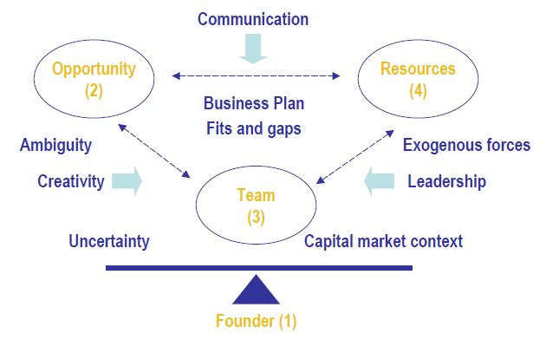
1.2Timmons Model of Entrepreneurship
What key aspects does an entrepreneur need to manage to start and grow a business?
Figure 7.1 Timmons model of entrepreneurship

Slide 5
Timmons Model of Entrepreneurship
Developed by Jeffry Timmons (2006)
Originated from doctoral thesis
Enhanced through further research and case studies
Serves as a guide to increase chances of entrepreneurial success
Focuses on central themes driving the dynamic entrepreneurial process

Slide 6
Core Themes of the Timmons Model
Opportunity
Lead entrepreneur & entrepreneurial team
Creativity
Careful use of money
Integrated, holistic, sustainable, and balanced approach
Controllable components that can be assessed and influenced
Entrepreneur risks career, personal cash flow, and net worth

Slide 7
Three Key Components for Venture Success
To create a successful venture, entrepreneurs must balance:
  Opportunities
  Teams
  Resources
These are dynamic and interdependent
Changes in one factor affect the others

Slide 8
1. Opportunities
Entrepreneurship is opportunity driven
Process does not start with:
  Business plan
  Money
  Strategy
  Networks
    Team
First step: Identify and evaluate a viable market opportunity
Problems in the environment become opportunities

Slide 9
Opportunity vs. Idea
Right opportunity ensures long-term success
Opportunity is more essential than talent or competence
A good idea ≠ a great business
Excellent idea:
  Creates or adds customer value
  Attractive, durable, and timely

Slide 10
Examples of Opportunities (Ethiopian Context)
Quality problems in education Tutorial programs
Shortage of housemaids Daycare centers
Weak textbook preparation Supplementary textbooks
  Question banks
  Solved problems
Environmental problems transformed into business opportunities

Slide 11
2. Teams
Critical after identifying opportunity
Team members have defined roles
Individuals have strengths and weaknesses
No one is complete in all aspects
Teams evolve through stages toward maturity

Slide 12
Importance of the Entrepreneurial Team
Lead entrepreneur must:
  Identify opportunity
  Gather required resources
  Assemble best talent
Team size & background depend on opportunity size and nature
Good team Great success
Poor team Waste of great idea

Slide 13
Major Roles of the Team
Reduce ambiguity and uncertainty
  Apply creativity (inventiveness)
Provide leadership
  Manage resources effectively
  Interact with external forces
  Respond to changing capital market context

Slide 14
3.Resources
Finding and managing resources requires specific skills
Equally important as managing people
Two main types:
Tangible Resources
  Buildings
  Land
  Information technology
  Human resources
  Money
Intangible Resources
  Knowledge
  Goodwill
  Information

Slide 15
Balancing the Three Factors
Success depends on balancing:
  Opportunities
  Team
  Resources
Managed through:
  Creativity
  Communication
  Leadership
Transforms opportunity into viable business model

Slide 16
Qualities of Entrepreneurs
Entrepreneurs tend to have:
  Industry knowledge
  Understanding of user needs
  Sense of timing
  Market entry awareness
  Ability to handle uncertainty and change
  Capacity to capitalize on favorable events

Slide 17
Key Features of the Timmons Model
Focuses on opportunities rather than threats
Academically tested approach
Encourages identifying fits and gaps among:
  Opportunity
  Team
  Resources
Venture creation is an evolutionary process
Factors are dynamic and interrelated

Slide 18
1.3 New Venture Expansion Strategies
1.3.1 Introduction
All successful small businesses eventually face growth
Expansion brings opportunities and perils
Often increases financial returns for:
  Owners
  Employees
Validates entrepreneur’s original vision and effort

Slide 19
Challenges of Business Growth
Growth creates managerial, legal, and financial challenges
Hiring new employees Need for stronger leadership
Management becomes less centralized
Increased:
  Internal politics
  Protectionism
  Disagreements over goals and projects

Slide 20
Structural & Financial Implications of Growth
Expanded market share New strategies against larger competitors
Additional capital required
New responsibilities to:
  Shareholders
  Investors
  Institutional lenders
Changes in company structure, needs, and objectives

Slide 21
Managing Growth Effectively
Growth must align with meaningful long-term objectives
Profitable growth is a by-product of:
  Effective management
  Proper planning
  Careful handling of key factors
Requires understanding strengths and weaknesses

Slide 22
1.3.2 Methods of Growth
Small businesses expand through incremental or strategic approaches:
  Increasing product inventory
  Expanding services rendered
  Studying broader growth options over time

Slide 23
Common Routes of Expansion
Acquisition of smaller existing businesses
Offering franchise ownership
Licensing intellectual property (common in software products)
Establishing distributorships and dealerships
Pursuing new marketing routes (e.g., catalogs)

Slide 24
Additional Growth Options
oining industry cooperatives:
  Advertising savings
  Purchasing advantages
Public stock offerings
Employee Stock Ownership Plans (ESOPs):
  Shares given/sold to employees
  Common in social enterprises and Chinese firms

Slide 25
Preparing for Growth
Before pursuing expansion:
  Conduct honest assessment of:
    Strengths
    Weaknesses
  Identify key markets and opportunities
  Develop structures and processes
  Complete long-range planning (3–5 years)
  Agree on key future strategies
  Organic growth as one method

Slide 26
1.3.3The Ansoff Matrix – Growth Strategy
Strategic planning tool for future growth
Developed by Igor Ansoff
Also known as the Product/Market Matrix
Focuses on:
  What is sold (product growth)
  Who it is sold to (market growth)

Slide 27
Four Generic Growth Strategies
The Ansoff Matrix outlines four strategies with different risk levels:
  Market Penetration
  Market Developmen
  Product Development
  Diversification

Slide 28
Four Generic Growth Strategies
1. Market Penetration / Consumption
  Existing products
  Existing market segments
  Aim: Increase market share
  Low risk (high experience with product and market)
2. Market Development
  Existing products
  New market segments
  Medium to high risk
3. Product Development
  New products
  Existing market segments
  Medium to high risk (limited experience with new product)
4. Diversification
  New products
  New markets
  High risk (no experience with product and market)

Slide 29
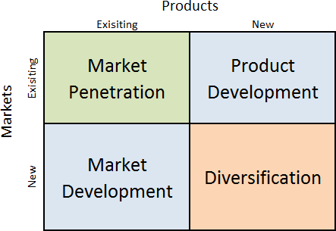
Four Generic Growth Strategies
Figure 7.2 Ansoff’s Matrix

Slide 30
1.3.3.1Selecting a Product-Market Growth Strategy
Four strategic options for growth:
  Market Penetration / Consumption
  Market Development
  Product Development
  Diversification

Slide 31
I) Market Penetration / Consumption
Existing products in existing markets
No major product change required
Growth through:
  Promotional methods
  Attractive pricing policies
  Extensive distribution
Encourage increased product usage
Example: Toothbrush size influencing toothpaste consumption
Lowest risk (familiar product and market)

Slide 32
II) Market Development
Existing products New markets
Assumes current markets are fully exploited
Achieved through:
  New geographical markets
  New distribution channels (e-commerce, mail order)
  New product packaging
  Different pricing policies
Example: Guinness expanding into African markets including Ethiopia
Medium to high risk

Slide 33
III) Product Development
New or modified products
Targeted to existing markets
Modification may include:
  Improved presentation
  Better performance
  Higher quality
Example: Car manufacturers offering additional car parts
Medium to high risk

Slide 34
IV) Diversification
New products New markets
Most risky strategy
Two major unknowns:
  Product development problems
  Unknown market characteristics
Requires clear objectives and risk assessment

Slide 35
Types of Diversification
1. Related Diversification
  Within same industry
  Example: Cake manufacturer Fresh juice production
2. Unrelated Diversification
  No previous industry/market experience
  Example: Richard Branson
  Virgin brand diversified into:
    Entertainment
    Air and rail travel
    Foods
  Over 400 companies

Slide 36
1.3.4 Expansion Issues
I) Growing Too Fast
Rapid growth can overwhelm business
Demand may exceed production capacity
Operational strain
Requires effective research and long-term planning

Slide 37
II)Recordkeeping and Other Infrastructure Needs
Need updated systems for:
  Cash flow monitoring
  Inventory tracking
  Financial management
  HR information
Investment in advanced communication systems

Slide 38
III)Expansion Capital
Growth requires additional financing
Can be frustrating if unprepared
Revise business plan annually
Update marketing strategies
Secure financing under favorable terms

Slide 39
IV)Personnel Issues
Hiring new staff for:
  Production
  Marketing
  Administration
Careful hiring essential during expansion
Growth creates opportunities for early employees
Some employees may leave due to change

Slide 40
V) Customer Service
Customer service often declines during rapid growth
Increased workload Delayed responses
Risk of losing existing and new clients
Maintain adequate staffing levels

Slide 41
VI)Disagreements among Ownership
Early ownership arrangements may become problematic
Differences in:
  Contribution levels
  Vision for company direction
Possible partner departure for unified direction

Slide 42
VII)Family Issues
Expansion requires sacrifice of time and money
Growing family responsibilities
Pressure to balance home and business
Entrepreneurs must decide on personal sacrifices

Slide 43
VIII)Transformation of Company Culture
Harder to maintain early values
Growth leads to:
  Larger staff
  Expanding markets
  More deadlines
Owners must actively shape company culture

Slide 44
IX)Changing Role of Owner At The Initial State
Shift from hands-on role to CEO role
Focus on:
  Leadership
  Strategy
  Planning
Delegate daily operations
Seek external expertise (legal, accounting)

Slide 45
1.3.5 Choosing not to Grow
Some owners avoid expansion despite opportunity
Growth reduces:
  Close relationships with customers
  Direct employee interaction
Avoid stress and management headaches
Desire to balance family and personal interests

Slide 46
1.4Business Ethics and Social Responsibility
Learning Objectives
Define and discuss the three main theories of corporate social responsibility (CSR).
Explain why CSR ultimately benefits both companies and their stakeholders.

Slide 47
1.4.1 Introduction
Business organizations, as established by their entrepreneurs, are expected to do their businesses in a sustainable and ethical manner. For this there are certain theories that we should understand.
These theories have been evolving through time as business practices mature and grow as well as societal and government influence increase.

Slide 48
1.4.2Three Approaches to Corporate Responsibility
Traditional view:
  Corporation exists primarily to make profits
  Supported by stockholder theory
Broader view includes:
  Corporate Social Responsibility (CSR)
  Triple Bottom Line
  Stakeholder Theory

Slide 49
1. Corporate Social Responsibility (CSR)
Meaning of CSR: General theory emphasizing:
  Profit responsibility
  Ethical responsibility to community
Philosophy requiring companies to:
  Produce reliable products
  Charge fair prices
  Pay fair wages
  Protect environment
  Address social concerns

Slide 50
Four Obligations of CSR
Economic Responsibility
  Make profits to survive
  Without profit no business
2. Legal Responsibility
  Follow laws and regulations
  Obey both letter and spirit of the law
  Accept rules as social good

Slide 51
Four Obligations of CSR
3. Ethical Responsibility
  Do what is right even if not legally required
  Corporate culture as responsible citizen
  Example: Safe disposal of toxic waste
4. Philanthropic Responsibility
  Voluntary contributions to society
  Support community projects
  Independent of daily business operations

Slide 52
2. The Triple Bottom Line
Expanded form of CSR
Measures performance in three areas:
  Economic
  Social
  Environmental
Results reported separately
Focus on sustainability

Slide 53
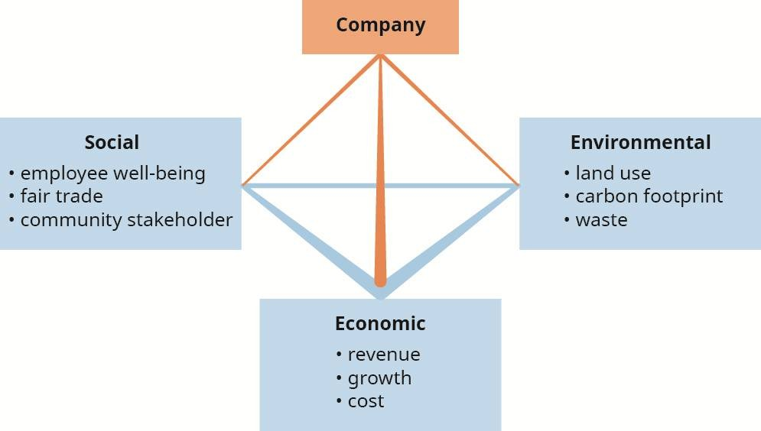
The Triple Bottom Line
Figure 7.3 Triple bottom lines

Slide 54
Economic Sustainability
Emphasizes long-term financial stability
Avoids volatile short-term profits
Favors durable business plans
Reduces risk of collapse

Slide 55
Social Sustainability
Promotes balance in people’s lives
Encourages fair distribution of wealth
Supports dignity of work
Fair trade example:
  Ethiopian specialty coffee farmers receive over 30% more than normal prices
Maintain healthy community relationships

Slide 56
Environmental Sustainability
Natural resources are limited
Promote conservation and renewable energy
Limit pollution and toxic waste
Support recycling and environmental renewal
Preserve livable planet

Slide 57
CSR vs Triple Bottom Line
CSR:
  Focus on corporate obligations
  More American-oriented
Triple Bottom Line:
  Focus on sustainability
  More European-oriented
Both see corporation as community participant

Slide 58
3. Stakeholder Theory
Developed by Edward Freeman
Starts from those affected by business actions
Asks:
  Who is affected?
  What rights do they have?
Those affected have moral claim to participate

Slide 59
Who Are Stakeholders?
Examples include:
  Owners/shareholders (reasonable profit)
  Employees (reasonable salaries)
  Customers (quality & fair prices)
  Suppliers (fair input prices)
  Community residents (clean environment)
  Creditors
  Government (fair taxes)
  Local businesses
  Competitors (fair competition)

Slide 60
Key Features of Stakeholder Theory
Stakeholders treated similar to shareholders
Managers balance interests of all groups
Profit defined as human welfare
Emphasizes transparency
Collective bottom line approach

Slide 61
1.4.3 Business Ethics Principles
Ethical principles = standards of behavior guiding managers
Define what ethical executives should and should not do
Honesty
  Truthful in all dealings
  No deception, misrepresentation, or selective omission
2. Integrity
  Do what is right even under pressure
  Principled, honorable, upright
  Do not sacrifice values for convenience
3. Promise-Keeping & Trustworthiness
  Fulfill commitments in letter and spirit
  Provide accurate and relevant information
  Avoid technical excuses to escape obligations

Slide 62
Business Ethics Principles
4. Loyalty
  Faithful to company and colleagues
  Protect confidential information
  Avoid conflicts of interest
5. Fairness
  Just and impartial decision-making
  No abuse of power
  Equal treatment and openness to change
6. Concern for Others
  Caring and compassionate behavior
  Apply the Golden Rule
  Seek least harm and greatest good

Slide 63
Business Ethics Principles
7. Respect for Others
  Respect dignity, autonomy, and rights
  Equal treatment regardless of background
8. Law Abiding
  Comply with laws, rules, and regulations
  Ensure lawful business practices
9. Commitment to Excellence
  Pursue high standards of performance
  Stay informed and prepared
  Continuously improve competence

Slide 64
Business Ethics Principles
10. Leadership
  Serve as ethical role models
  Promote ethical reasoning and decision-making
11. Reputation and Morale
  Protect company reputation
  Maintain employee morale
  Prevent and correct misconduct
12. Accountability
  Accept responsibility for decisions and actions
  Accountable to colleagues, company, and community

Slide 65


