Slide 1


LinkForge
Smart Internal Linking for Any Website
AI-powered SEO tool that crawls your site, discovers orphan pages, and generates contextual internal link suggestions with optimal anchor text.
✦
Product Demo
Notes:
Welcome to the LinkForge product demo. LinkForge is an AI-powered SEO tool that helps website owners improve their internal linking structure. It crawls your site automatically, discovers orphan pages that have zero internal links, and generates smart, contextual link suggestions with optimized anchor text. This demo will walk you through how the tool works, from adding your site to getting actionable link recommendations. Let's dive in and see how LinkForge can help boost your search rankings by fixing one of the most overlooked SEO problems — orphan pages.

Slide 2
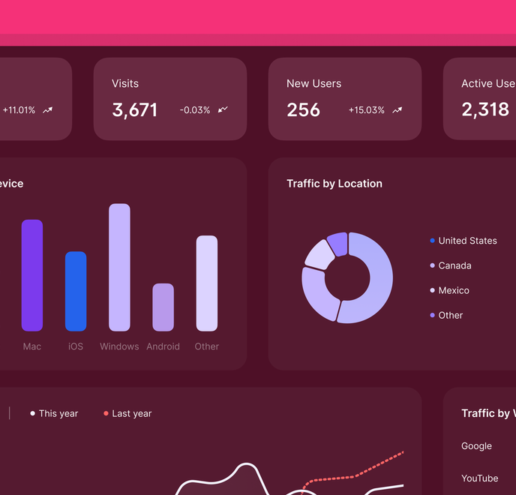
The Hidden SEO Problem
⚠
47% of website pages have zero internal links — Google may never find them.
⌘
Without internal links, page authority doesn't flow — every page competes alone.
⚒
Manual internal linking is tedious, inconsistent, and doesn't scale.
Notes:
Here's the core problem LinkForge solves. Studies show that nearly half — 47 percent — of pages on a typical website have zero internal links pointing to them. These are called orphan pages, and they're a massive, often invisible SEO problem. When a page has no internal links, Google's crawler may never discover it, meaning it won't appear in search results at all. Even for pages that are found, without internal links, there's no page authority flowing to them — each page is essentially competing on its own. And fixing this manually? It's incredibly tedious. You have to read through pages, figure out which ones should link to each other, write the anchor text, and then update the content. It doesn't scale beyond a handful of pages. That's exactly why we built LinkForge.

Slide 3

How LinkForge Works
Three simple steps to better internal linking.
1
2
3
◯
⌕
⌘
Add Your Site
Crawl & Analyze
Get Smart Links
Enter your website URL. LinkForge works with WordPress, Shopify, Webflow, Ghost, or any custom site — no plugins needed.
Our engine discovers your pages via sitemap, crawls content, and uses AI to understand semantic relationships between pages.
Receive AI-generated internal link suggestions with optimal anchor text, relevance scores, and surrounding context — ready to apply.
Notes:
So how does LinkForge actually work? It comes down to three simple steps. Step one: you add your website URL. That's it — no plugins to install, no API keys to configure. LinkForge is platform agnostic and works with WordPress, Shopify, Webflow, Ghost, or any custom-built site. Step two: our engine goes to work. It starts by reading your sitemap.xml to discover every URL on your site, then it actually crawls and reads the content of each page. We use AI to analyze the semantic relationships between all your pages — understanding topics, context, and which pages are topically related. Step three: you get smart link suggestions. The AI generates internal link recommendations with optimal anchor text that reads naturally, plus a relevance score so you can prioritize, and surrounding context so you know exactly where each link fits. It's really that straightforward.

Slide 4


Smart Crawling — Works With Any Website
◯
Real Web Crawling
Platform Agnostic
LinkForge actually fetches and reads your pages using advanced page reading technology. It starts with your sitemap.xml, discovers every URL, then crawls each page to analyze content, headings, and structure. No APIs, no plugins — just your URL.
✦
WordPress
🛒
Shopify
✦
Webflow
▤
Ghost
⚒
Custom
Works out of the box with any website — no plugins, extensions, or API keys required.
⚡
Concurrent Crawling
✦
Auto-Discovery
Crawls up to 3 pages simultaneously for fast results, even on large sites with hundreds of URLs.
Automatically finds pages through sitemap.xml and homepage link analysis. No manual URL entry needed.
Notes:
Here's what makes LinkForge's crawling fundamentally different from other SEO tools. First, we do real web crawling — not just sitemap parsing. LinkForge actually fetches and reads every page on your site, analyzes the content, headings, and structure. It starts with your sitemap.xml to discover every URL, then crawls each one individually. No APIs, no plugins, no CMS integrations — you just give us your URL and we handle the rest. This means it works with absolutely any platform: WordPress, Shopify, Webflow, Ghost, or any custom-built site. We're completely platform agnostic. Under the hood, we crawl up to three pages concurrently, so even large sites with hundreds of URLs get processed quickly. And through our auto-discovery engine, we automatically find all your pages through sitemap analysis and homepage link scanning — you don't need to manually enter URLs. Just drop in your domain and let LinkForge do the heavy lifting.

Slide 5

AI-Powered Link Suggestions
LinkForge uses advanced LLM technology to generate natural, contextually relevant internal link suggestions.
✦
Natural Anchor Text
AI generates 2-5 word anchor text that reads naturally within your existing content.
▤
Source:
Complete Guide to On-Page SEO
→
⌘
Target:
Internal Linking Best Practices
▦
Relevance Scoring
Anchor text:
internal linking strategy
92%
Pending
Every suggestion includes a TF-overlap relevance score. Green (>80%), Amber (>50%), Red (≤50%).
Surrounding context preview:
"...implementing a solid internal linking strategy can significantly boost your page authority and help search engines..."
▤
Batch Operations
Approve all, export to CSV or JSON, or review one by one — full control over your workflow.
Notes:
This is the core of what makes LinkForge so powerful — our AI-powered link suggestion engine. We use advanced large language model technology to analyze the actual content on every page of your site, understand the semantic relationships, and then generate internal link suggestions that feel completely natural. Let me walk you through what a suggestion looks like. On the left, you can see a real example: LinkForge suggests linking from "Complete Guide to On-Page SEO" to "Internal Linking Best Practices" using the anchor text "internal linking strategy." Notice how the anchor text is contextual — it's not keyword-stuffed, it reads like something a human editor would write. Every suggestion comes with a relevance score — in this case 92%, shown in green — based on TF-overlap analysis. You can quickly see which suggestions are strongest and which need review. And for efficiency, you can approve all suggestions at once, export everything to CSV or JSON, or review each one individually. The choice is yours.

Slide 6

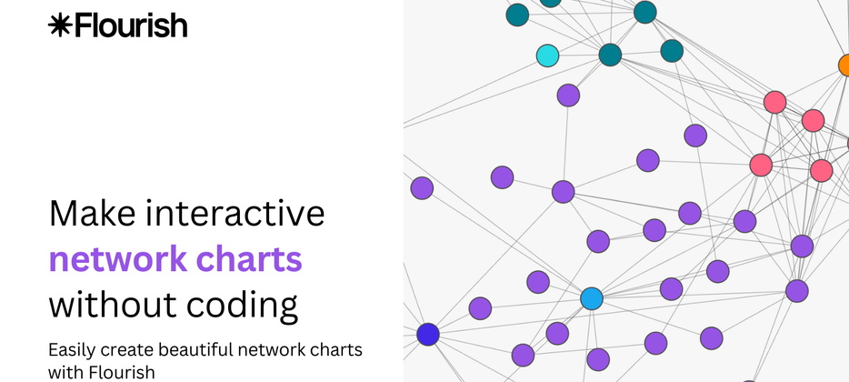
Interactive Link Network Graph
Visualize your entire site's internal link structure as an interactive force-directed graph.
Orange nodes = orphan pages (no incoming links) — instantly see what needs attention.
Teal nodes = well-linked pages — your strongest content hubs.
Pan, zoom, and hover for detailed page info including word count and link counts.
TOTAL INTERNAL LINKS
PAGES INDEXED
1,247
386
ORPHAN PAGES
AVG LINKS/PAGE
182
3.2
Notes:
One of the most powerful features in LinkForge is the interactive link network graph. Instead of scrolling through spreadsheets, you can see your entire site's internal link structure visualized as a force-directed graph — and it's fully interactive. The color coding makes it immediately actionable. Orange nodes represent orphan pages — pages with zero incoming internal links. These are the pages Google may never discover, and they're the biggest quick-win opportunities. Teal nodes represent your well-linked pages, your strongest content hubs that are already distributing authority effectively. You can pan around, zoom in on clusters, and hover over any node to see detailed information — including word count, total links, and link counts. Below the graph, you'll find key metrics at a glance: total internal links across your site, how many pages are indexed, how many orphans need attention, and your average links per page. In this example, you can see 182 orphan pages out of 386 indexed — nearly half the site needs internal linking work.

Slide 7


Never Lose a Page Again
Orphan pages have zero incoming internal links — Google may never discover them.
47%
INDUSTRY AVERAGE
of website pages are orphans
⚠
☰
⚡
Instant Detection
Filter & Sort
One-Click Fix
LinkForge flags every orphan page with a warning badge across all views — Pages, Suggestions, and Analytics graph.
Quickly filter to see only orphan pages. Sort by word count, URL, or title to prioritize which to link first.
AI suggests the best internal links for each orphan page. Approve and export — done.
Notes:
This slide highlights one of the most critical features of LinkForge — orphan page detection. Studies show that nearly half of all website pages have zero incoming internal links, meaning Google may never discover or rank them. That 47% figure is an industry average backed by multiple SEO audits. LinkForge solves this in three ways. First, Instant Detection: every orphan page is automatically flagged with a warning badge across all views — whether you're browsing the Pages list, reviewing Suggestions, or looking at the Analytics graph. You don't have to go looking for orphans; they find you. Second, Filter & Sort: once detected, you can quickly isolate orphan pages and sort them by word count, URL, or title. This makes it easy to prioritize — for example, you might want to link high-word-count pages first since they likely represent your most valuable content. Third, One-Click Fix: the AI engine suggests the best internal links for each orphan page based on semantic relevance. You simply review, approve, and export. No manual guesswork required.

Slide 8

Simple, Transparent Pricing
Start free. Upgrade when you're ready.
Free Forever
Most Popular
Best Value
Enterprise
Starter
Pro
Business
Enterprise
Free
$49
$149
Custom
/month
/month
✓ 1 site
✓ 50 pages
✓ 100 suggestions/mo
✓ 5 sites
✓ 500 pages
✓ 2,000 suggestions
✓ AI-powered suggestions
✓ Auto-apply
✓ Priority support
✓ 25 sites
✓ 5,000 pages
✓ 10,000 suggestions
✓ Bulk actions
✓ Analytics
✓ API access
✓ White-label
Unlimited everything
✓ SOC 2
✓ SSO
✓ Plugin SDK
✓ Dedicated support
Notes:
Here's our pricing — four tiers designed to grow with you. Starter is completely free forever: one site, fifty pages, and a hundred suggestions per month. It's perfect for trying LinkForge on a personal blog or small project. Our most popular plan is Pro at forty-nine dollars a month. You get five sites, five hundred pages, and two thousand AI-powered suggestions. This tier also includes auto-apply for one-click implementation and priority support. For agencies and growing teams, Business at one forty-nine per month gives you twenty-five sites, five thousand pages, ten thousand suggestions, plus bulk actions, full analytics, API access, and white-label capabilities — ideal if you're serving multiple clients. Finally, Enterprise is custom-priced for large organizations that need SOC 2 compliance, SSO, a plugin SDK for custom integrations, and a dedicated support contact. All plans start with a fourteen-day free trial, and you can cancel anytime. There are no hidden fees, no long-term contracts, and no credit card required to get started.

Slide 9


Ready to Fix Your Internal Links?
Join thousands of SEO professionals using LinkForge to boost their rankings.
Get Started Free — No Credit Card Required
View Full Demo at linkforge.digital
✓
14-Day Free Trial
◯
Works With Any CMS
⛨
Cancel Anytime
Notes:
And that brings us to the close. If you've been manually managing internal links or, worse, ignoring them entirely, now is the time to act. LinkForge takes what used to be hours of tedious work and turns it into a few minutes of review and approval. Click the primary button to get started completely free — no credit card required. You'll have full access to all Starter features, including AI-powered suggestions on up to fifty pages. Prefer to see the product in action first? Hit the secondary button to view the full interactive demo at linkforge.digital. And just to give you peace of mind: every plan comes with a fourteen-day free trial, LinkForge works with any CMS — WordPress, Shopify, Webflow, Ghost, or fully custom setups — and you can cancel anytime with no questions asked. There's really no reason not to try it. Thank you for watching, and I look forward to seeing you on the platform.

