Slide 1
Update as of 23 Mar

Slide 2
Indeed Jobs Updates Regularity
17 march baseline
18 march about 5952 new updates
20 march about 4644 new updates
21 march about 3938 new updates
22 march about 4206 new updates

Slide 3

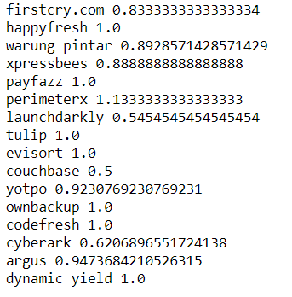
Indeed versus Glassdoor
19 portfolio companies found in Glassdoor not found in Indeed
3 portfolio companies found in Indeed not found in Glassdoor
16 common portfolio companies

Slide 4
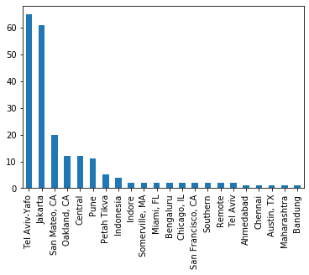
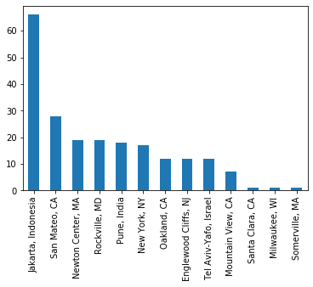
Indeed versus Glassdoor (Deeper Analysis)
Job Location with high similarity
Company Headquarter with high similarity
Glassdoor Text is always English

Slide 5
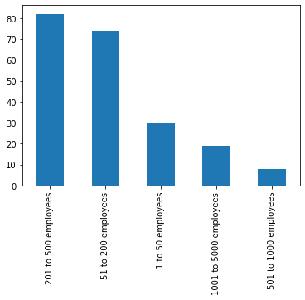
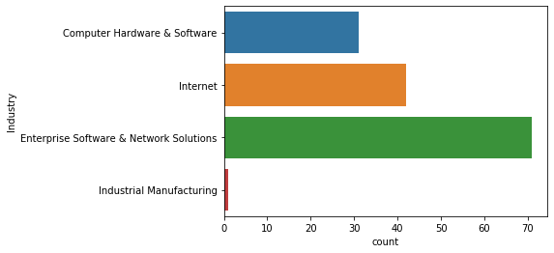
Indeed versus Glassdoor (Deeper Analysis)
Company Size with high similarity
Company Industry with high similarity

Slide 6

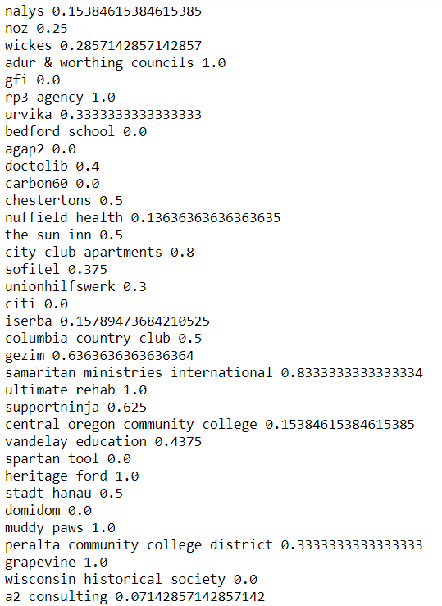
Indeed versus Glassdoor (2k+ random samples)
(Larger Universe, Additional Request)
73 companies found in Glassdoor not found in Indeed
67 companies found in Indeed not found in Glassdoor
38 common companies

Slide 7
Companies – Indeed versus Glassdoor Fields
Common Fields: Company Name, Headquarters, Size, Industry Sector, Revenue, URL
Missing Fields (In Glassdoor not in Indeed): Type of ownership, Year Founded, Competitors

Slide 8
Reviews – Indeed versus Glassdoor Fields
Common Fields: Overall Rating, Recommend CEO Approval Rating, Company Benefits Rating, Culture Values Rating, Career Opportunities Rating, Work Life Balance Ratings, Senior Management Approval Rating

Slide 9
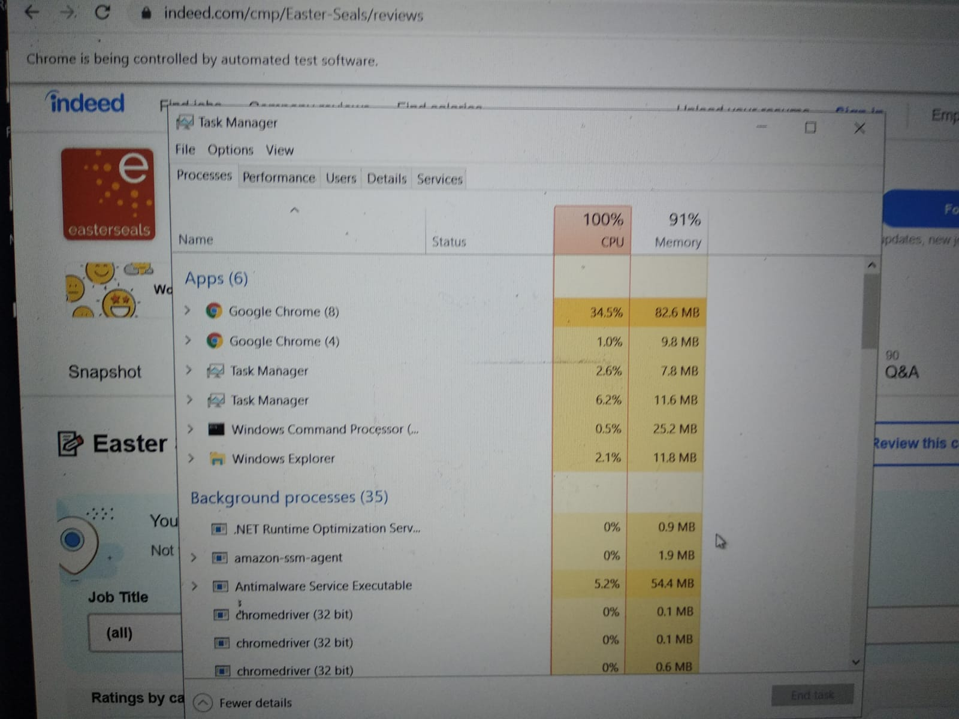
Progress Update
Wave 1 in progress
Wave 2 slower than expected
(1 free instance can scrape about 1000 companies a day only)

