Slide 1

iScan CRDMS
Civil Registry Records Management System
A concise tour of the four modules, workflow, security, and recovery controls.
MUNICIPAL CIVIL REGISTRAR'S OFFICE
Municipality of Baggao
iScan CRDMS | Civil Registry Records Management System
01 / 12
Notes:
Today I will show the four core civil registry modules, how a record moves through the system, and the controls that keep the records available and accountable.

Slide 2
CORE MODULES
Four civil registry modules
Each module uses the same controlled record workflow.
01
Birth Certificate
02
Death Certificate
Capture birth records and their scanned PDF.
Encode death records and supporting documents.
03
Marriage Certificate
04
Marriage License
Manage marriage records and verification.
Process marriage license applications.
iScan CRDMS | Civil Registry Records Management System
02 / 12
Notes:
These are the four core modules: Birth Certificate, Death Certificate, Marriage Certificate, and Marriage License. They share the same storage, search, review, and security controls, so staff do not need a separate process for each module.

Slide 3
PURPOSE
What problem does iScan solve?
It turns scattered paper and PDF handling into one accountable workflow.
Before
With iScan
• Paper files are slow to locate.
• Records are searchable by key fields.
• PDFs and record data can be separated.
• PDFs stay linked to the record.
• Actions are difficult to trace.
• Workflow and audit actions are visible.
One local system for encoding, finding, checking, and protecting records.
iScan CRDMS | Civil Registry Records Management System
03 / 12
Notes:
The purpose is simple: keep the record data and its PDF together, make the record easy to find, and show who performed each important action. The application and archive run on the office NAS.

Slide 4
ARCHITECTURE
How the system works
The browser is the work surface; the NAS stores the application, data, and PDFs.
Synology NAS
Staff browser
MariaDB
PDF archive
→
→
Web Station + PHP
scanner service
Forms • folder tree • viewer
record data
uploads + backups
Online
https://iscan.cdrms.online
Local LAN
NAS IP + Web Station port
iScan CRDMS | Civil Registry Records Management System
04 / 12
Notes:
Staff work through the browser. The Synology NAS runs the PHP application and scanner service, while MariaDB stores structured record data and the PDF archive stores uploaded documents. Internet access uses the public URL; local LAN access uses the NAS address and port.

Slide 5
RECORD LIFECYCLE
From paper to searchable archive
Every record moves through visible stages.
1
2
3
4
5
→
→
→
→
Capture
Encode
Review
Approve
Archive
Scan or upload
Enter record data
Compare PDF and fields
Role-based transition
Searchable record
Draft → Pending Review → Verified → Approved → Archived
Reject and reopen actions remain traceable with notes and timestamps.
iScan CRDMS | Civil Registry Records Management System
05 / 12
Notes:
This is the record lifecycle. A document is captured, encoded, checked against its PDF, moved through the approval role, and then archived for search. Rejected or reopened records keep their notes and timestamps.

Slide 6
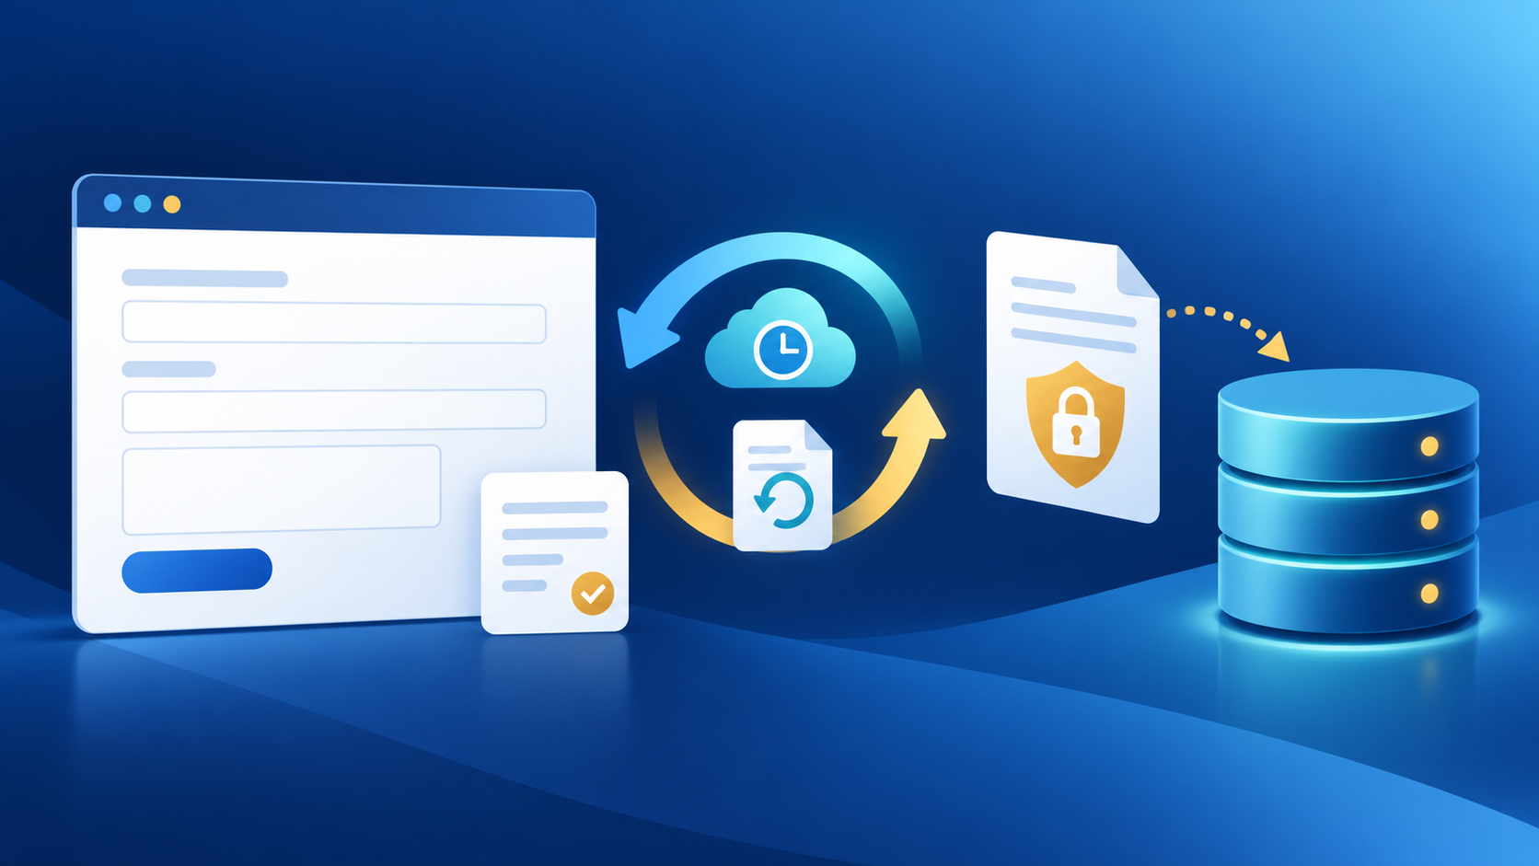
RECOVERY
Auto-save and restore
A browser draft protects work in progress before the official Save.
1 Enter
→
2 Auto-save
→
3 Restore
→
4 Save
Form fields change
Draft stays in browser storage
User is offered the draft
Database commit
• Saved records clear their draft.
• Edit mode clears stale draft data.
• Default session timeout: 60 minutes of inactivity.
iScan CRDMS | Civil Registry Records Management System
06 / 12
Notes:
Auto-save is a recovery aid, not the official record. If the browser closes or the laptop restarts, the user can restore the draft; the database record is created only after the Save action succeeds. The default session timeout is 3600 seconds, or 60 minutes of inactivity.

Slide 7

ORGANIZED STORAGE
Automatic folders and Folder Browser
The upload path follows the record itself.
How it is created
birth / 1972 / TARUBAL /
• Year comes from the event date when available.
certificate.pdf
• Last name is normalized for a safe folder name.
type / year / normalized last name
• Folder is created on first upload and reconciled after edits.
The database remains the source of truth; the folders make browsing practical.
iScan CRDMS | Civil Registry Records Management System
07 / 12
Notes:
The system creates the upload path from the certificate type, the event year, and the normalized last name. This gives staff a predictable folder structure while the database remains the authoritative source for the record.

Slide 8
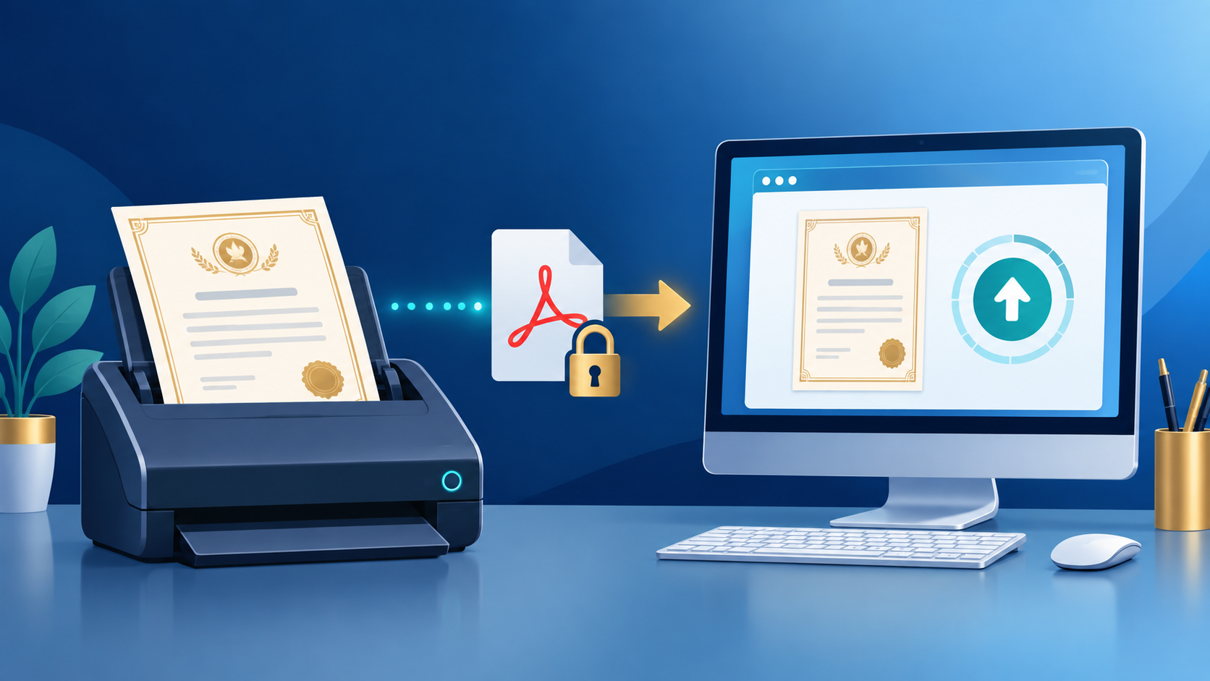
CAPTURE
Scanning, PDF upload, and OCR
Paper certificates enter through the scanner or the browser.
1
Scan or choose a PDF
2
Validate the file
Type and content checks run before storage.
3
Review OCR suggestions
The encoder verifies every extracted value.
iScan CRDMS | Civil Registry Records Management System
08 / 12
Notes:
The Epson DS-530 II can send a scan back to the browser, or staff can choose a PDF directly. The file is checked before storage, then OCR suggestions can reduce retyping; the encoder still verifies the original document.

Slide 9
RETRIEVAL
Search and PDF verification
Find the record, then check the data against the original document.
Search records
PDF Comparison Viewer
Name / registry number / date
Search
Original
PDF
Encoded
fields
• Folder Browser
• Advanced Search
Review before approval
iScan CRDMS | Civil Registry Records Management System
09 / 12
Notes:
Search starts with the fields staff already know, such as the name, registry number, date, or location. The comparison viewer keeps the original PDF beside the encoded values so the reviewer can verify before approval.

Slide 10

DEFENSE IN DEPTH
Security, roles, and deletion
Controls protect the account, the request, the file, and the audit trail.
Rate limiting
Session timeout
5 login attempts / 5-minute window
60 minutes inactive by default
Roles
Audit logs
Admin • Encoder • Viewer
User • action • IP • device • time
Permanent delete
Soft delete → Trash → Admin restore or permanent delete
Admin only
iScan CRDMS | Civil Registry Records Management System
10 / 12
Notes:
Rate limiting allows a maximum of five login attempts in the configured five-minute window. Sessions expire after 60 minutes of inactivity by default, and expired pages return to login while expired API calls return an authentication error. Admin, Encoder, and Viewer have different permissions; permanent record deletion is restricted to Admin, and every important action is logged with the user, action, IP address, device, and timestamp. Other controls include bcrypt passwords, CSRF protection, prepared SQL, and MIME/path checks.

Slide 11
RESILIENCE
Backup and online/offline continuity
Recovery protects both the current file and the ability to return to a known-good state.
Backup and integrity
• PDF backups keep the prior version.
• SHA-256 detects changed or corrupted PDFs.
Continuity
• Local LAN access works without internet.
• Remote Cloudflare access returns when internet returns.
iScan CRDMS | Civil Registry Records Management System
11 / 12
Notes:
Backups provide a return point for both the database and the document archive. SHA-256 makes file changes detectable. When the internet is unavailable, staff can continue through the NAS local address; the public remote URL becomes available again when the connection returns.

Slide 12
PRESENTATION FLOW
A short live demonstration
Show the complete value in five minutes.
1
Login and show the role-based dashboard
Key takeaway
2
Create a record and demonstrate auto-save
Faster to encode.
Easier to find.
Safer to protect.
3
Scan or upload a PDF and review OCR
4
Open Folder Browser and search the record
5
Show the security log and deletion policy
Use the system screens to prove each step, then keep the explanation short.
iScan CRDMS | Civil Registry Records Management System
12 / 12
Notes:
For the live demo, start with the dashboard, create a record, show the auto-save behavior, scan or upload the PDF, open Folder Browser, search for the record, and finish with the security log and deletion policy. The closing message is that iScan makes records faster to encode, easier to find, and safer to protect.

