Slide 1

iScan CRDMS
Civil Registry Records Management System
System features, operating workflow, security, backup, and online/offline use
Municipal Civil Registrar's Office | Municipality of Baggao
Notes:
Source: SYSTEM_SHOWCASE_SUMMARY.md; SYSTEM_OVERVIEW.md. The deck describes the deployed iScan CRDMS and its documented features.

Slide 2
SYSTEM PURPOSE
CRDMS at a glance
A single workspace for capturing, encoding, reviewing, finding, and protecting civil registry records.
Birth
Marriage
Death
Marriage License
Certificate of Live Birth
Certificate of Marriage
Certificate of Death
Application for Marriage License
Runs on the office NAS with a local database and local PDF storage. Authorized staff can use the public Cloudflare URL or the local LAN address.
The result is a searchable digital registry with a controlled record lifecycle and a clear accountability trail.
iScan CRDMS | Civil Registry Records Management System
02 / 17
Notes:
Source: SYSTEM_OVERVIEW.md sections 1 and 4; SYSTEM_SHOWCASE_SUMMARY.md. Four certificate categories are documented.

Slide 3

ARCHITECTURE
How the system works
The browser is the work surface. The NAS holds the application, database, and PDF archive.
Synology NAS
Staff browser
Web Station + PHP
scanner service
MariaDB
PDF archive
Forms, folder tree, viewer
Structured record data
Uploads and backups
Remote access
Cloudflare Tunnel → https://iscan.cdrms.online
Local access
Same-LAN access → NAS IP and Web Station port
iScan CRDMS | Civil Registry Records Management System
03 / 17
Notes:
Source: SYSTEM_OVERVIEW.md sections 2, 3, 12, and 19; NAS_DEPLOYMENT_GUIDE.md. The Cloudflare route is for remote access; the local route remains available on the LAN.

Slide 4
FROM PAPER TO ARCHIVE
The record workflow
Each record follows a visible path so staff can see what needs encoding, review, approval, or correction.
1
2
3
4
5
Capture
Encode
Review
Approve
Archive
Scan or upload PDF
OCR assists data entry
Compare PDF and fields
Role-based transition
Searchable record
Draft → Pending Review → Verified → Approved → Archived
Reject and reopen branches remain traceable with the responsible user, timestamp, and notes.
iScan CRDMS | Civil Registry Records Management System
04 / 17
Notes:
Source: SYSTEM_OVERVIEW.md section 13; COMPLETE_FEATURES_LIST.md Phase 3. The workflow states and transition tracking are documented in the repository.

Slide 5

DRAFT RECOVERY
Auto-save and restore
Auto-save protects work in progress when a browser closes, a laptop restarts, or a user needs to return later.
1 Enter
2 Auto-save
3 Restore
4 Save
Form fields change
Draft stays in browser storage
User is offered the draft
Database commit
Draft keys are scoped to the user/session and certificate type.
Saved records clear their draft; edit mode clears stale draft data.
Auto-save is a recovery aid. The official record is created only after the Save action succeeds.
iScan CRDMS | Civil Registry Records Management System
05 / 17
Notes:
Source: assets/js/certificate-form-handler.js auto-save/restore implementation; public/logout.php cleanup; docs/NARRATIVE_REPORT.md section 9.4. The deck distinguishes draft recovery from a database save.

Slide 6

ORGANIZED STORAGE
Automatic folders and Folder Browser
The upload path follows the record itself, so staff can browse by certificate type, year, and last name.
How folders are created
birth / 1972 / TARUBAL /
The system derives the year from the event date when available.
It normalizes the last name for a consistent folder name.
The directory is created on first upload and reconciled when a record's name or date changes.
Folder Browser counts and filters records without exposing raw server paths.
cert_...pdf
type / year / normalized last name
This structure makes historical records easier to browse while the database remains the source of truth.
iScan CRDMS | Civil Registry Records Management System
06 / 17
Notes:
Source: includes/functions.php upload_sub_dir(), reconcile_pdf_folder(), and upload_file(); public/folder_browser.php; docs/UPLOAD_FOLDER_REORGANIZATION.md.

Slide 7

CAPTURE
Scanning and PDF upload
Paper certificates can enter the system through a connected Epson DS-530 II scanner or a normal PDF upload.
Epson DS-530 II
Browser
Validation
Archive
Scanner service
300 dpi / color or BW
Scan Document
or Choose File
PDF only
25 MB max
Hash +
folder
The scanner service returns a PDF to the browser for review.
The upload path validates file type and size before it is stored.
The file receives a SHA-256 hash and is checked for duplicate attachment.
iScan CRDMS | Civil Registry Records Management System
07 / 17
Notes:
Source: SYSTEM_OVERVIEW.md section 12; scanner_service/scanner_service.py; includes/config.php MAX_FILE_SIZE; includes/functions.php compute_file_hash() and check_pdf_duplicate().

Slide 8
ACCURACY
OCR-assisted encoding and verification
OCR reduces retyping, while the encoder remains responsible for checking every extracted value.
Scanned PDF
Suggested fields
Child name Juan Dela Cruz
CERTIFICATE
OF LIVE BIRTH
Date of birth 12 May 1972
Confidence 94% • Verify
PDF Comparison Viewer places the original document beside the encoded fields for final checking.
iScan CRDMS | Civil Registry Records Management System
08 / 17
Notes:
Source: assets/js/ocr-processor.js; assets/js/ocr-form-integration.js; public/pdf_comparison_viewer.php; COMPLETE_FEATURES_LIST.md Phases 2 and 4. OCR suggestions require encoder verification.

Slide 9
RETRIEVAL
Search and record access
Records can be found by folder, name, registry number, date, location, or parent information.
Folder Browser
Advanced Search
Records Viewer
Action
Type → Year → Last name
Counts and quick selection
Exact multi-token match
Fuzzy fallback
Paging, filters, previews
Controlled PDF access
View, edit, archive
or restore
Two-pass search starts with strict multi-field matching, then falls back to fuzzy matching when needed.
The viewer keeps the record data and PDF reference together for a faster retrieval process.
iScan CRDMS | Civil Registry Records Management System
09 / 17
Notes:
Source: public/folder_browser.php; public/advanced_search.php; public/records_viewer.php; SYSTEM_OVERVIEW.md sections 6 and 15.

Slide 10
CONTROL
Roles, approvals, and accountability
The system limits what each user can do and records the actions that matter.
Admin
Encoder
Viewer
Every significant action
Manage users, settings,
restore, delete
Create and update
assigned records
Read and retrieve
permitted records
user • action • IP • device • timestamp
Workflow states
Draft → Pending Review → Verified → Approved → Archived
Reject and Reopen transitions retain notes and timestamps for follow-up.
iScan CRDMS | Civil Registry Records Management System
10 / 17
Notes:
Source: includes/auth.php; includes/permissions.php; admin/activity_logs.php; public/workflow_dashboard.php; SYSTEM_OVERVIEW.md sections 9, 10, and 13.

Slide 11
RESILIENCE
Backup, restore, and document integrity
Backups protect both the current file and the ability to return to a known-good state.
Replace PDF
Backup old PDF
Verify hash
Restore
New attachment arrives
Timestamped backup
keeps prior version
SHA-256 detects
change or corruption
Admin
action
PDF Backup Manager supports verification, restore, and cleanup of orphaned files.
Soft-deleted records remain restorable through Trash; permanent deletion is restricted.
NAS deployment backups include a verified file archive and a database dump for rollback planning.
iScan CRDMS | Civil Registry Records Management System
11 / 17
Notes:
Source: includes/functions.php backup_pdf_file(); admin/pdf_backup_manager.php; admin/pdf_integrity_report.php; public/trash.php; SYSTEM_OVERVIEW.md section 14. NAS file/database backup statements refer to the documented deployment procedure and the verified pre-update backups created for this deployment.

Slide 12
DEFENSE IN DEPTH
Security controls
Controls are layered so the system does not rely on one safeguard alone.
Accounts
Permissions
Requests
bcrypt passwords
rate limits
session timeout
Admin / Encoder / Viewer
per-record checks
admin-only delete
CSRF tokens
prepared SQL
MIME + path checks
Browser
Evidence
Integrity
CSP
HSTS
frame and type headers
activity logs
security logs
IP + device trail
SHA-256 PDFs
duplicate checks
backup restore
Security is an operating practice: review logs, keep backups, test restores, and update the deployment deliberately.
iScan CRDMS | Civil Registry Records Management System
12 / 17
Notes:
Source: includes/security.php; includes/security_headers.php; includes/auth.php; docs/NAS_SECURITY_REMEDIATION.md; docs/SECURITY_AUDIT_2026-09-07.md. Present these as implemented application controls, with operational review and restore testing still required.

Slide 13
CONTINUITY
Online and offline operation
The same local system supports remote access when internet is available and LAN access when it is not.
With internet
Without internet
Use https://iscan.cdrms.online
Cloudflare Tunnel provides remote access
CDN assets can load normally
Staff can connect from outside the office
Use the NAS local IP and Web Station port
Database, PDFs, folders, and core PHP remain local
Set OFFLINE_MODE=true after local vendor assets are prepared
Remote Cloudflare access is unavailable until internet returns
Offline readiness is a deployment setting to verify before relying on it during an outage.
iScan CRDMS | Civil Registry Records Management System
13 / 17
Notes:
Source: includes/asset_urls.php; .env.example OFFLINE_MODE; docs/SYNOLOGY_NAS_DEPLOYMENT.md sections 10 and 17; NAS_DEPLOYMENT_GUIDE.md. Offline mode requires locally downloaded assets and a local access path.

Slide 14
BEYOND THE CORE WORKFLOW
Additional features worth highlighting
These modules show how the platform can support daily operations and future scale.
1
Batch upload
2
Duplicate detection
Process historical files with progress tracking and optional OCR.
Flag probable duplicate registrations before they create confusion.
3
Analytics
4
Record deletion control
View trends, demographics, quality metrics, and encoder activity.
Only administrators can permanently delete records; other roles do not receive delete permission.
5
Device lock
6
Calendar and notes
Restrict login to administrator-approved devices when enabled.
Keep operational reminders beside the registry workflow.
For the presentation, show the features that match the office's current operating scope, then label future modules as planned or optional.
iScan CRDMS | Civil Registry Records Management System
14 / 17
Notes:
Source: includes/permissions.php; public/trash.php; admin/activity_logs.php. RA 9048 is intentionally out of scope for this presentation.

Slide 15
PRESENTATION FLOW
Suggested live demonstration
A short sequence can show the full value without opening every module.
1
Login and show the role-based dashboard
5
Find the record with search and open the PDF comparison
2
Create a record and demonstrate auto-save / restore
6
Show the workflow state and activity/security log
3
Scan or upload a PDF, then show OCR suggestions
7
Explain public URL versus local LAN access
4
Save and open Folder Browser: type, year, last name
The message to leave with the audience: records become faster to encode, easier to find, and safer to protect.
iScan CRDMS | Civil Registry Records Management System
15 / 17
Notes:
Source: deck content synthesized from the system repository and deployment notes. Use only features that have been tested in the current NAS deployment during the live presentation.

Slide 16
ACCESS POLICY
Who can delete records?
Deletion follows a controlled path so accidental removal does not become permanent loss.
Admin
Only Admin can permanently delete a record.
Encoder
Viewer
create / update assigned records
read-only access
Soft delete → Trash → Admin restore or permanent delete
Every delete and restore action is logged with the user, IP address, device, and timestamp.
iScan CRDMS | Civil Registry Records Management System
16 / 17
Notes:
Source: includes/permissions.php; public/trash.php; admin/activity_logs.php; SYSTEM_OVERVIEW.md sections 9, 10, and 14. Permanent delete is restricted to administrators; soft-deleted records remain restorable through Trash.

Slide 17
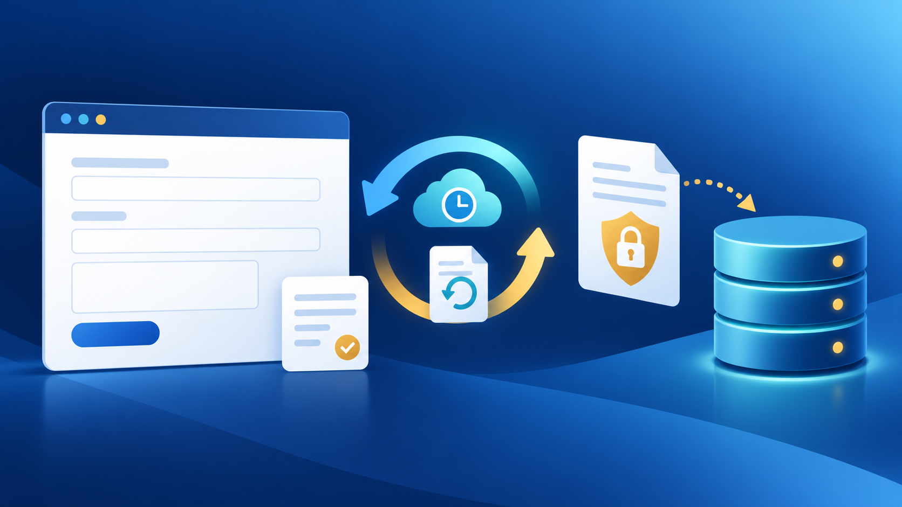

VISUAL TOUR
How the features look in practice
The same workflow connects folders, scanning, recovery, and security.
Folder Browser
Scanner → PDF archive
Auto-save and restore
Roles, audit trail, and security
iScan CRDMS | Civil Registry Records Management System
17 / 17
Notes:
Visuals generated for this presentation with OpenAI image generation. Feature descriptions remain based on the iScan CRDMS repository and deployment notes.

