Slide 1

iScan CRDMS
Civil Registry Records Management System
A guided introduction to the records, workflow, and controls.
MUNICIPAL CIVIL REGISTRAR'S OFFICE
Municipality of Baggao
iScan CRDMS | Civil Registry Records Management System
01 / 21
Notes:
Magandang araw. This presentation introduces iScan, the four civil registry modules, and the complete path from a scanned document to a protected, searchable record.

Slide 2
ROADMAP
What we will cover
The presentation follows the same order a staff member follows in the system.
Understand
Use
01
Purpose
04
Record workflow
What problem iScan solves
Capture to archive
02
Core modules
05
Controls
The four civil registry records
Security, backup, continuity
03
System map
06
Live demo
Browser, NAS, database, archive
Show the real screens
iScan CRDMS | Civil Registry Records Management System
02 / 21
Notes:
Ito ang outline. Uunahin natin ang purpose and modules, then the system map, the record workflow, the security and recovery controls, and finally the live demonstration.

Slide 3
INTRODUCTION
What is CRDMS and why iScan?
CRDMS means Civil Registry Document Management System.
What CRDMS does
Why the name iScan?
It is a digital system that scans, encodes, organizes, searches, verifies, and protects civil registry documents.
BROWSER + NAS
iScan comes from pa-scan. In Ilokano, i-scan is an action word: scan this document for processing and registration.
Scan -> organize -> verify -> protect.
iScan CRDMS | Civil Registry Records Management System
03 / 21
Notes:
CRDMS means Civil Registry Document Management System. In simple terms, it is the office system for scanning, encoding, organizing, searching, verifying, and protecting civil registry documents. The name iScan comes from pa-scan; in Ilokano, i-scan is an action word for scanning a document for processing and registration.

Slide 4
WHY IT MATTERS
From scattered files to an accountable record
The system solves a records-handling problem before it becomes a retrieval problem.
Before iScan
With iScan
• Paper and PDFs are stored in different places.
• The record and PDF stay linked.
→
• Finding a record depends on memory and manual checking.
• Search, folders, and verification use the same record.
• It is difficult to prove who changed or removed a record.
• Roles, logs, and approvals make actions accountable.
iScan CRDMS | Civil Registry Records Management System
04 / 21
Notes:
Dito makikita ang reason for the system. The benefit is not only faster encoding; it is also a more reliable way to find, verify, and account for every record.

Slide 5
CORE MODULES
Four civil registry modules
The same controlled workflow supports each record type.
01
Birth Certificate
02
Death Certificate
Birth records and scanned certificates
Death records and supporting documents
03
Marriage Certificate
04
Marriage License
Marriage records and verification
Marriage license applications
One record standard: data + PDF + workflow + audit trail.
iScan CRDMS | Civil Registry Records Management System
05 / 21
Notes:
These are the four core modules. Kahit anong certificate type, the staff follow the same pattern for capture, encoding, review, approval, search, and protection.

Slide 6
SYSTEM MAP
How the parts work together
The browser is the work surface; the NAS is the office system of record.
Synology NAS
Staff browser
MariaDB
PDF archive
→
→
Web Station + PHP
scanner service
forms • search • viewer
record data
uploads + backups
Online
iscan.cdrms.online
Local LAN
NAS IP + Web Station port
iScan CRDMS | Civil Registry Records Management System
06 / 21
Notes:
This is the system map. The browser sends requests to the PHP application on the NAS; MariaDB stores structured values and the PDF archive stores the documents. Online and local LAN access use the same application.

Slide 7
RECORD LIFECYCLE
The end-to-end record flow
The record becomes official only after the correct review and save steps.
1
2
3
4
5
→
→
→
→
Capture
Encode
Review
Approve
Archive
Scan or upload
Enter record data
Compare PDF and fields
Role-based transition
Searchable record
Draft → Pending Review → Verified → Approved → Archived
iScan CRDMS | Civil Registry Records Management System
07 / 21
Notes:
This is the main flow to remember. The document is captured, encoded, checked against the PDF, routed through the approval role, and archived. Rejected or reopened records remain traceable.

Slide 8
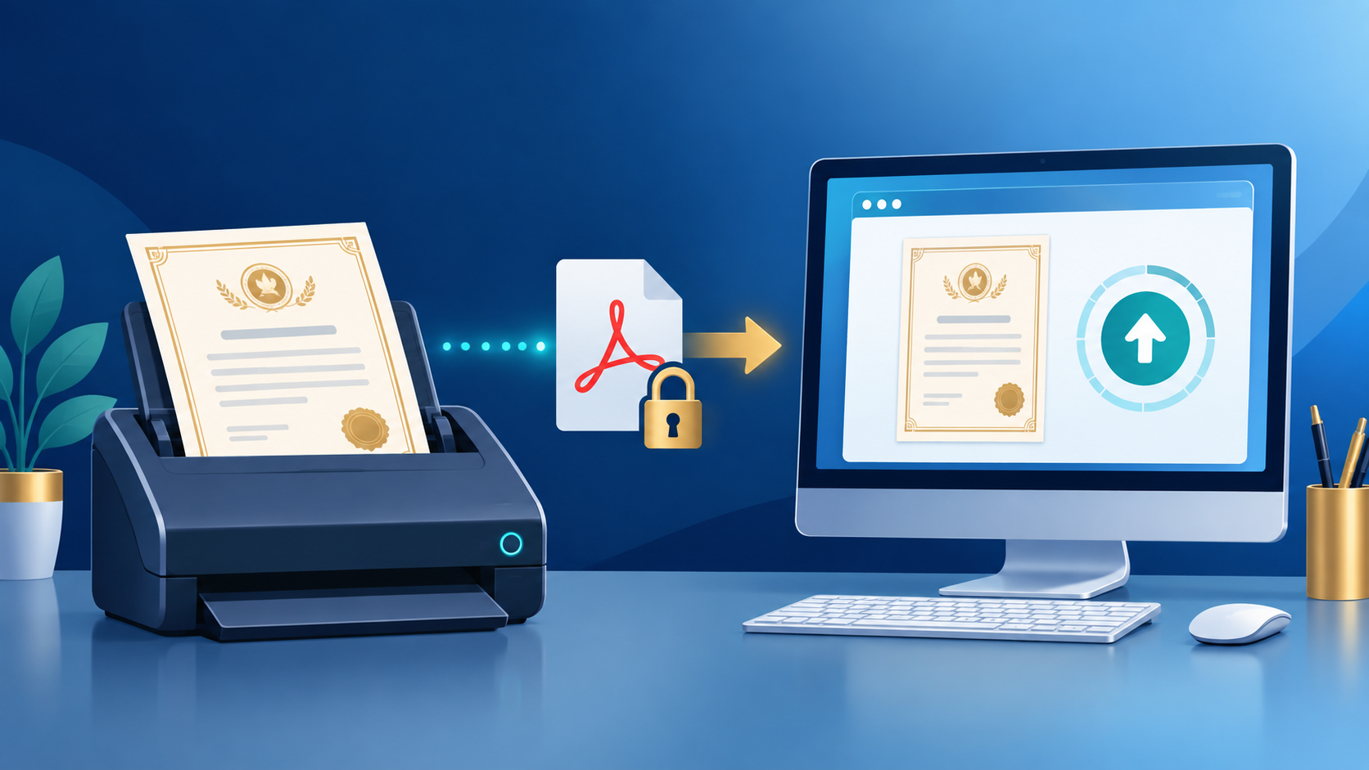
STEP 1
Capture: scan, upload, and OCR
Paper certificates enter through the Epson DS-530 II or a browser PDF upload.
1
Scan or choose a PDF
2
Validate the file
Type, size, and content checks run first.
3
Review OCR suggestions
Verify every value against the original.
iScan CRDMS | Civil Registry Records Management System
08 / 21
Notes:
Staff can scan from the Epson DS-530 II or select a PDF. The system validates the upload, then OCR can suggest values; the encoder still checks every extracted value before saving.

Slide 9
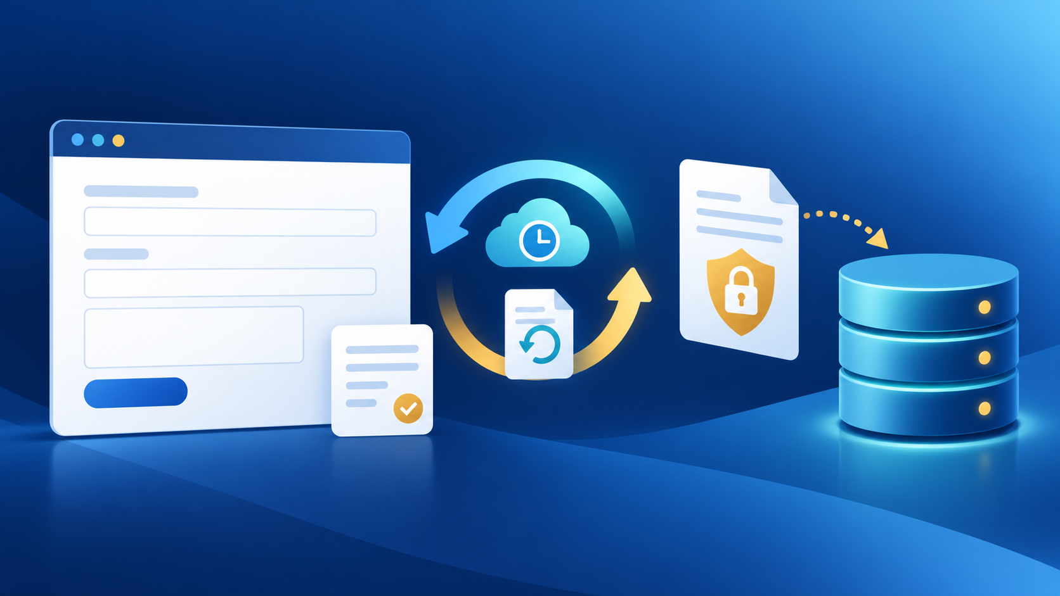
STEP 2
Encode with recovery built in
Auto-save protects work in progress; the database Save creates the official record.
1 Enter
2 Auto-save
3 Restore
4 Save
→
→
→
Fields change
Draft stays in browser storage
Draft can return after interruption
Database commit
• Saved records clear their draft.
• Edit mode clears stale draft data.
• Default inactivity timeout: 60 minutes.
iScan CRDMS | Civil Registry Records Management System
09 / 21
Notes:
Auto-save is only a recovery aid. If the browser closes or the laptop restarts, the draft can be restored; the official database record exists only after Save succeeds. The default inactivity timeout is 60 minutes.

Slide 10

STEP 3
Automatic folders and Folder Browser
The upload path follows the certificate type, year, and normalized last name.
How browsing works
birth / 1972 / TARUBAL /
• Folder is created on first upload.
certificate.pdf
• Names are normalized for safe, predictable paths.
type / year / normalized last name
• Folder Browser gives a visual route to the record.
Database = source of truth | Folders = practical browsing
iScan CRDMS | Civil Registry Records Management System
10 / 21
Notes:
The system creates the folder path from the record. Staff can browse by type, year, and last name, while the database remains the source of truth for the official record.

Slide 11
STEP 4
Search, compare, and verify
Retrieval is a verification step, not only a lookup step.
Search records
PDF Comparison Viewer
Name / registry no. / date / folder
Search
Original
PDF
Encoded
fields
• Folder Browser
• Advanced Search
Compare before approval
iScan CRDMS | Civil Registry Records Management System
11 / 21
Notes:
Search can use the name, registry number, date, folder, or location. The reviewer then compares the original PDF with the encoded fields before approving the record.

Slide 12

CONTROLS
Security, roles, and deletion
Each control answers a clear question: who can enter, what can they change, and what history remains.
Rate limiting
Session timeout
Blocks login after 5 failed tries in 5 minutes.
Logs out after 60 minutes idle; the next request returns to login.
Roles
Audit logs
Admin manages/deletes; Encoder enters/updates; Viewer reads.
Records who did what, from which IP/device, and when.
Permanent delete
Other roles send records to Trash; Admin can restore or permanently delete.
Admin only for permanent delete.
iScan CRDMS | Civil Registry Records Management System
12 / 21
Notes:
The active controls include five login attempts within five minutes, a default 60-minute inactivity timeout, and role-based access. Permanent deletion is Admin-only; soft deletion goes to Trash first. The system also uses bcrypt password hashing, CSRF protection, prepared SQL, MIME/path checks, security logs, and audit logs.

Slide 13
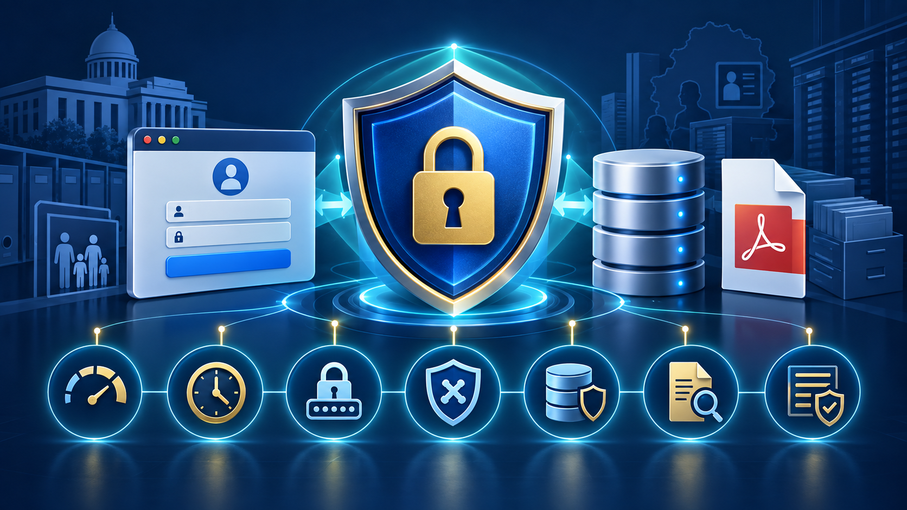
SECURITY - TECHNICAL VIEW
How the controls work
Technical view: what each control checks, blocks, or records.
Authentication
Request protection
bcrypt hash + 5-try rate limit + 3600 s idle timeout.
CSRF token + prepared SQL + security headers + login checks.
File protection
Accountability
MIME/path/size checks reject unsafe files; SHA-256 detects changes.
Role checks enforce actions; logs record user, action, IP, device, time.
Permanent delete
Trash first; Admin restores or permanently deletes.
Admin only.
iScan CRDMS | Civil Registry Records Management System
13 / 21
Notes:
This is the technical view. The login flow uses bcrypt password hashes, active rate limiting, and a 3600-second session timeout. Requests use CSRF protection and prepared SQL; uploads use MIME/path and size checks; PDF hashes and backups help detect file changes; roles and audit/security logs make actions accountable. The 15-minute account-lockout constant is not presented as an active separate control.

Slide 14

SECURITY - PLAIN-LANGUAGE VIEW
What security means to staff
Think of iScan as a locked records office with a sign-in desk, checklist, and history book.
Right people
Roles decide who may view, encode, approve, restore, or permanently delete a record.
Too many tries
After five login attempts in five minutes, the system rate-limits more attempts.
Auto logout
After 60 minutes without activity, the user is returned to login on the next request.
Checked files
The system checks the document type and path; PDF hashes expose changed files.
History and recovery
Actions are logged; soft delete goes to Trash; Admin controls permanent deletion.
Safe records = right access + checked files + visible history.
iScan CRDMS | Civil Registry Records Management System
14 / 21
Notes:
For non-IT staff: think of the system as a locked records office. The right people get the right access, too many failed keys slow further attempts, an idle desk logs out, every file is checked before filing, and the history book records important actions. Sa madaling salita, security protects the record without making the daily work confusing.

Slide 15
CONTROLS
Backup and online/offline continuity
The office can recover records and keep working through a network interruption.
Backup and integrity
• PDF and database backups support recovery.
• SHA-256 detects changed or corrupted PDFs.
Continuity
• Local LAN access works without internet.
• Remote Cloudflare access returns with internet.
iScan CRDMS | Civil Registry Records Management System
15 / 21
Notes:
Backups create a recovery point for both database and PDFs. If internet access is unavailable, staff can continue through the NAS local address; remote access returns when connectivity is restored.

Slide 16
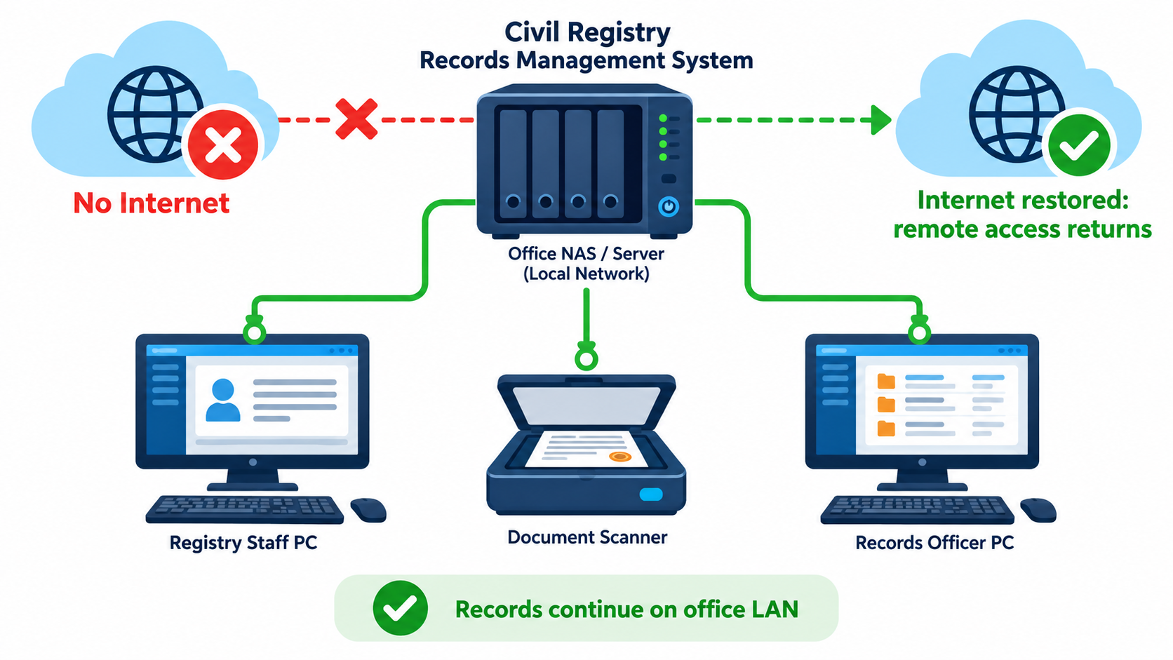
CONTINUITY
Works Without Internet
The office NAS keeps local records available during an internet outage
How access is separated
Local LAN path. Workstations and the scanner connect to the NAS/Web Station over the office network.
Internet path. The public URL and remote access need internet connectivity.
Recovery. When internet returns, remote access resumes; local records remain on the NAS.
Plain-language explanation
If the internet goes down, staff inside the office can still encode, scan, search, and open records through the NAS. Users outside the office reconnect when the internet is restored.
Local access
Use the NAS IP address and Web Station port from an office computer.
iScan CRDMS | Civil Registry Records Management System
16 / 21
Notes:
This slide separates local office access from remote internet access. The browser, scanner, PHP application, database, and PDF archive communicate across the office LAN and NAS, so staff can continue work during an internet outage. Cloudflare or other public access is unavailable during the outage, but it returns when the internet connection is restored. In simple terms, the records stay inside the office and the internet is only needed for outside access.

Slide 17
BEYOND THE CORE FLOW
Supporting tools around the record
These functions help administrators and staff manage the system at scale.
Search and dashboards
Workflow and archive
Advanced Search | Analytics Dashboard | Records Viewer | PDF Comparison Viewer
Workflow Dashboard | Archive | Trash | Restore
Upload and PDF tools
Relationships and notes
Batch Upload | PDF Backup Manager | PDF Integrity Tools | Reorganize Uploads
Double Registration Linking | Family Relations | Calendar | Notes
Administration and security
Reports and maintenance
Device registration / approval / locking | User Management | System Settings | Security Logs
Reports | Data Export | Error Log Viewer | Maintenance Mode
Every supporting tool serves the same four civil registry records and their audit trail.
iScan CRDMS | Civil Registry Records Management System
17 / 21
Notes:
This slide lists the supporting tools explicitly: Advanced Search, Analytics Dashboard, Records Viewer, PDF Comparison Viewer, Workflow Dashboard, Archive, Trash and Restore, Batch Upload, PDF Backup Manager, PDF Integrity Tools, Reorganize Uploads, Double Registration Linking, Family Relations, Calendar, Notes, device registration/approval/locking, User Management, System Settings, Security Logs, Reports, Data Export, Error Log Viewer, and Maintenance Mode.

Slide 18
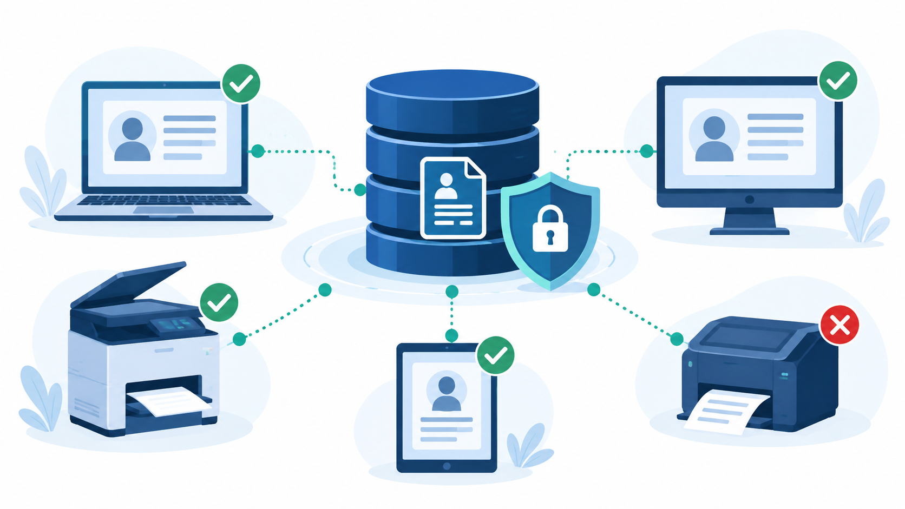
ADMINISTRATION / ACCESS CONTROL
Registered Devices
Manage which physical devices are allowed to access the system
Technical description
Device fingerprint registry. The system records each registered browser or workstation.
Admin actions. Register, review last seen, revoke, or remove a device.
Device Lock. When enabled, only approved devices may log in.
Plain-language explanation
The office keeps a list of allowed computers. An unregistered or revoked device can be blocked when Device Lock is enabled.
Current-state note
The screen shows Device Lock disabled. Register the current device before enabling the restriction.
iScan CRDMS | Civil Registry Records Management System
18 / 21
Notes:
Registered Devices gives administrators a device registry. The system stores a browser or workstation fingerprint, and an administrator can register, review, revoke, or remove entries. Device Lock is optional, so the screenshot correctly shows that all devices may still log in until an administrator enables the restriction. In simple terms, the office can keep a list of approved computers and block unknown devices after the lock is turned on.

Slide 19

FILE MAINTENANCE
Reorganize Uploads
Move existing PDFs into the correct year and last-name folder structure
How the tool works
Dry Run. Scans records and previews the proposed file moves without changing anything.
Apply. Moves PDFs and updates database paths after an explicit UNDERSTAND confirmation.
Folder scheme. {type}/{year}/{LAST_NAME}/, with the event date taking priority when available.
Plain-language explanation
It works like a filing-cabinet cleanup: the system shows what it plans to move first, then applies the changes only after confirmation.
Example
birth / 2014 / DELOS_SANTOS / certificate.pdf
iScan CRDMS | Civil Registry Records Management System
19 / 21
Notes:
Reorganize Uploads helps clean up older PDFs that are in the wrong folder. Dry Run shows the proposed moves without changing files or database paths. Apply performs the move and updates the database only after the user types UNDERSTAND, which gives staff a review step before the change.

Slide 20
FILE MAINTENANCE / ADMIN TOOL
Reorganize Uploads: What It Actually Does
Corrects existing PDF locations without copying the whole uploads folder.
Scope
Folder decision
Scans existing PDFs linked to Birth, Death, Marriage, and Marriage License records. Moves only files whose current folder is wrong; it is not a new upload tool and does not copy the whole uploads folder. Updates only pdf_filename and pdf_filepath; it does not delete certificate records.
Birth: DOB + child last name Death: date of death + deceased last name Marriage: date of marriage + husband last name License: application date + groom last name The event date supplies the year; registry number is the fallback.
Dry Run / Apply
Checks and results
Dry Run lists proposed moves without changing files or database. Apply creates folders, moves PDFs, and updates database paths. Apply requires Admin access, CSRF validation, and exact I UNDERSTAND confirmation.
Already correct = skipped Missing source = skipped Destination exists = collision Errors are logged; Apply logs are saved in scripts/logs.
Example: birth/2014/DELOS_SANTOS/cert_xxx.pdf • Use Dry Run first, review results, then Apply.
iScan CRDMS | Civil Registry Records Management System
20 / 21
Notes:
Reorganize Uploads is an administrator maintenance tool. It scans the four certificate modules for existing PDF references, computes the correct folder from the event date and normalized last name, and moves only files whose current path is wrong. It does not upload new files, copy the entire uploads folder, or delete certificate records. Dry Run shows proposed moves without changes. Apply creates missing folders, moves PDFs, updates pdf_filename and pdf_filepath, and requires Admin access, CSRF validation, and the exact I UNDERSTAND confirmation. Missing files, destination collisions, and errors are reported, and Apply writes a timestamped log under scripts/logs.

Slide 21
LIVE DEMONSTRATION
Show the system in the same order
A clear demo follows the record instead of jumping between unrelated screens.
1
Login and show the role-based dashboard
Key takeaway
2
Create a record and demonstrate auto-save
Faster to encode.
Easier to find.
Safer to protect.
3
Scan or upload a PDF and review OCR
4
Open Folder Browser and search the record
5
Show verification, audit log, and deletion policy
The flow is: understand → create → verify → protect → recover.
iScan CRDMS | Civil Registry Records Management System
21 / 21
Notes:
For the demo, follow this exact order: dashboard, record creation, auto-save, scan or upload, Folder Browser, search and verification, then security logs and deletion policy. That order makes the value easy to follow for the audience.

