Slide 1
Cloud Tasks
A cloud-native Task Manager application allowing to create and manage everyday tasks.
built with Python Flask and React, containerized with Docker, and deployed on AWS using Kubernetes and Terraform.
The app includes an AI-powered assistant (OpenAI GPT-4o) that gives productivity advice on tasks.

Slide 2
Contributors
Shay haba
https://github.com/shayhaba
Solomon Yaakobov
https://github.com/solomonyaa

Slide 3
Tech Stack
Layer | Technology
Backend | Python, Flask
Frontend | React, Vite
Database | PostgreSQL (local: Docker, production: AWS RDS)
Containerization | Docker, Docker Compose
Container Orchestration | Kubernetes (AWS EKS)
Infrastructure as Code | Terraform
Cloud | AWS
CI/CD | GitHub Actions
Version Control | Git, GitHub
AI | OpenAI GPT-4o, Claude
Monitoring | Prometheus, Grafana

Slide 4
Cloud Architecture
AWS VPC — 10.0.0.0/16 · us-east-1
Public Subnets (us-east-1b / us-east-1c)
Private Subnets (us-east-1b / us-east-1c)
Load Balancer
NGINX Ingress Controller (installed via Helm)
EKS Worker Nodes — cloudtasks-cluster · 2 × t3.medium
Bastion Host — SSM only, no SSH, no public IP
SSM tunnel :5432
NAT Gateway
Outbound internet for private subnets
RDS PostgreSQL — taskdb · KMS-encrypted · private only
VPC Interface Endpoints — SSM · KMS · CloudWatch · S3
Amazon S3 — cloudtasks-tfstate · Terraform remote state (outside the VPC)
Provisioned by terraform-apply.yml · Destroyed by terraform-destroy.yml

Slide 5
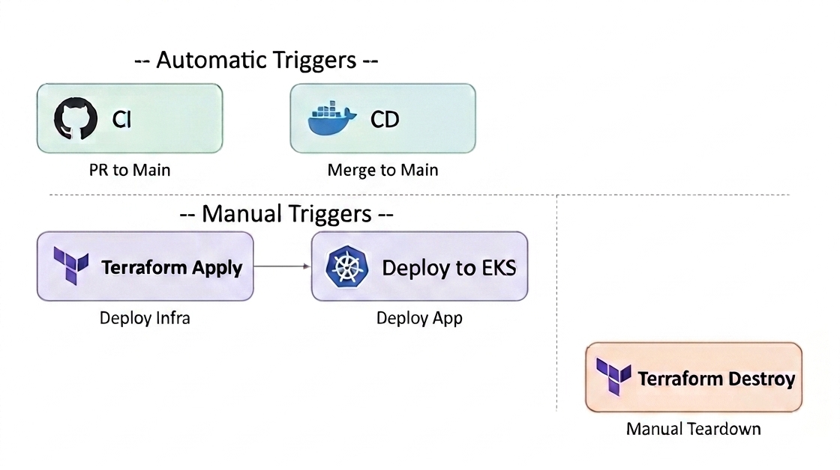
Github Workflows

Slide 6
CI Workflow
CI (ci.yml) — triggers on every Pull Request to main
Lint with Flake8
Run pytest unit tests with SQLite in memory
Build and start full Docker stack with PostgreSQL using docker compose
Integration tests for all API endpoints
Verify DB state after each operation
Cleanup

Slide 7
CD Workflow
CD (cd.yml) — triggers on merge to main (Main branch is protected and requires a review to merge)
Login to Docker Hub
Build Docker image using Dockerfile (multi-stage image building – react (frontend) and python (backend)
Push to Docker Hub with two tags:
latest — always the newest version
<commit-sha> — unique tag per commit for rollback

Slide 8
Terraform Apply
Terraform Apply (terraform-apply.yml) — manual trigger
Configure AWS credentials
Create S3 state bucket if not exists (used for uploading the TF state file for synching the terraform state)
Terraform init, format, validate, import existing resources, plan
Terraform apply
Show terraform outputs, Save RDS endpoint to GitHub Secrets so deploy-to-eks can use it (using Personal Access Token)
Update kubeconfig and verify EKS connection
Install NGINX Ingress Controller, Prometheus and Grafana
Get app load balancer URL

Slide 9
Deploy to EKS
Deploy to EKS (deploy-to-eks.yml) — manual trigger
Configure AWS credentials
Update kubeconfig so kubectl knows to talk to cloudtasks-cluster
Create DockerHub pull secret so the cluster can pull the image from DockerHub
Create Kubernetes secret with DB and OpenAI credentials so pods can use them
Apply Kubernetes manifests (namespace, deployment, service, ingress)
Deploy latest image to EKS
Print app URL and Grafana URL
Debug pods status on failure

Slide 10
Terraform Destroy
Terraform Destroy (terraform-destroy.yml) — manual trigger with confirmation (Requires typing "destroy")
Configure AWS credentials
Terraform Init - connects to the S3 backend and loads the TF state file, so Terraform knows what resources exist
Terraform plan destroy - previews what will be deleted
Update kubeconfig — writes the EKS cluster connection details to ~/.kube/config so Helm can reach the cluster
Uninstall Helm releases (NGINX, Prometheus, Grafana)
Terraform Destroy

Slide 11
The Dockerfile
A Multi-Stage Build – first the frontend and then the backend
Spins up a temporary Node.js environment, named frontend-builder
Copies and Installs dependencies
Copies the frontend’s (React) source code
Runs Vite's build, producing a dist/ folder of static HTML/CSS/JS files

Slide 12
The Dockerfile
Pulls a minimal Python image
Copies and installs requirements
Copies the backend python files
Reaches into the first stage and pulls out the compiled dist/ folder
Creates a non-root user and gives it ownership of /app
Switches to that user
Documents that the app listens on port 5000
Runs the default command when the container starts ( CMD ["python", "Task_Manager.py"] )

Slide 13
K8S Manifests
Namespace (namespace.yaml)
Creates an isolated environment called cloudtasks inside the EKS cluster
All K8S resources (pods, services, secrets) live inside this namespace
Must be created first before anything else can be deployed
Deployment (deployment.yaml)
Runs 2 replicas of the Flask app for high availability
Pulls the Docker image from DockerHub using a pull secret
Injects sensitive config (DB URL, OpenAI key) from Kubernetes secrets as environment variables
Sets resource requests and limits for CPU and memory
Readiness probe hits /api/health endpoint — pod only receives traffic once Flask is ready

Slide 14
K8S Manifests
Service (service.yaml)
Gives the pods a stable internal network address (pods themselves have dynamic IPs)
Type ClusterIP — internal only, not reachable from outside the cluster
Accepts traffic on port 80, forwards to port 5000 on the pod (where Flask listens)
Uses label selector ‘app: cloudtasks’ to know which pods to forward to
Ingress (ingress.yaml)
Entry point for external HTTP traffic into the cluster
Uses NGINX Ingress Controller (installed with Helm)
Routes all incoming requests (/) to the Service

Slide 15
Traffic Flow
Internet
NGINX Ingress
Helm-installed
Service
port 80
Pod
port 5000
Flask App
RDS
PostgreSQL
NGINX Ingress routes external traffic to the Service, which load-balances across pods.

Slide 16
Thank You
Questions?
github.com/solomonyaa/Final_DevOps_Project

