Slide 1

How to impress your security team in the cloud
Audun Solemdal

Slide 2
The problem(s)
In either a public or private organization, a new project is started or is planning to move to the cloud
If there is a dedicated security team in the org, they are not necessarily cloud specialists
You team might have a solution architect, but their focus is creating a conceptual architecture, not adhering to security best practices

Slide 3
The problem(s)
The IT Ops team won’t always have competence or time to help you
Both the budget and time schedule are tight.
Who does the project manager expect to establish and ensure the solution is secure..?

Slide 4
The problem(s)
More often than not, one or two people from the developer team take responsibility for establishing the cloud infrastructure
In cloud migration projects you might be the only developer...
Sounds familiar? This presentation is for you!

Slide 5


About
Audun Solemdal
Daglig leder @
Cloud Consulting
  Azure, Github, containers
Whatever needs improvement...
solom.no
solomno / audunsolemdal
audun-solemdal

Slide 6
Agenda
Security concerns
  General Azure configuration
  Github configuration
  Identity & RBAC
  Networking

Slide 7
To be clear
Cloud security is a wide subject
  As a developer you should not be expected to resolve every issue

Slide 8
General configuration
In the world of chess, players at the highest level rarely make blunders
  Yet, after a few inaccuracies, they may get check mated
In the world of cloud computing, blunders are more likely to happen
  After a few inaccuracies, we may get «check mated»

Slide 9
General configuration
When creating cloud resources, most settings are set implicitly, regardless of creation method
The default settings may change over time, and can vary based on which tooling or version of the tooling you are using
Once the implcit settings are set, they are usually never* changed

Slide 10
Quick glance at resource specs
Example – Azure Storage account
  Microsoft.Storage/storageAccounts - Bicep, ARM template & Terraform AzAPI reference | Microsoft Learn

Slide 11
Filtering the noise
Microsoft Security baseline
  Azure security baseline for Storage | Microsoft Learn
Github Actions scans
  Checkov
  microsoft/security-devops-action

Slide 12
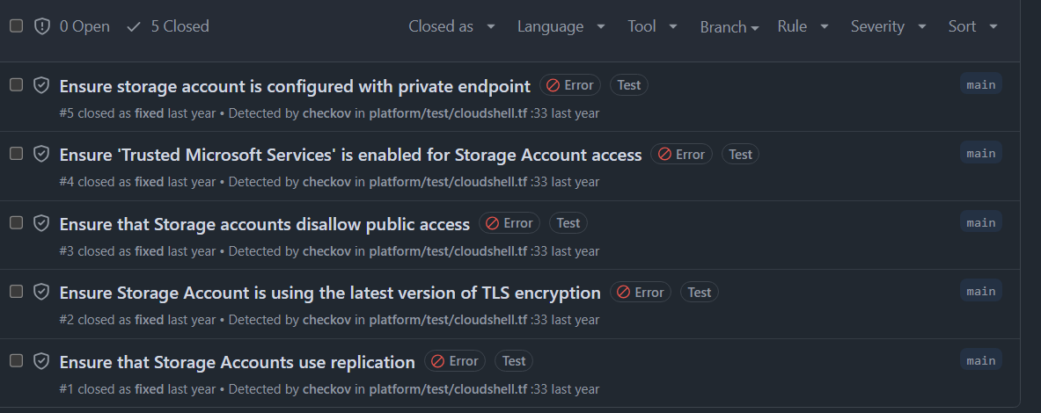
Checkov + Github Actions example

Slide 13
Filtering the noise
Azure Policy
  Not developer-centric, but works great
  Can be used to audit or explicitly deny settings, among other things
  Some policy initatives should ideally be set up at the org level

Slide 14
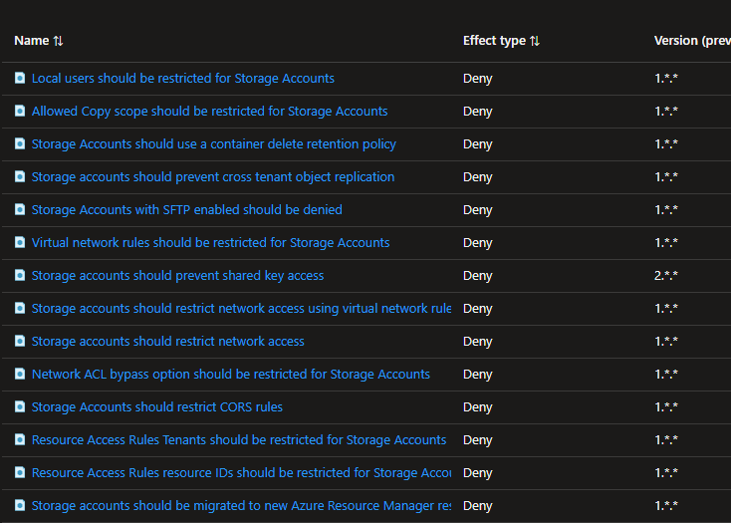
Azure Policy example

Slide 15
Filtering the noise
Infrastructure as code
  Choose the language the org wants, if no preference – set the standard
  Use standardized modules (ideally standardize at the org level)
  Azure Verified Modules

Slide 16
Github config
Github
  RBAC support is not the best, seems to be improving
  Secrets are not shown in clear text – but can be manipulated
GH Advanced Security is good – but costly
  Push protection with custom patterns
  Free on public repos
Github Actions
  Don’t trust every action blindly
  Consider explicitly setting job permissions
  Use tagged versions or commit SHAs

Slide 17
Github config
Repository rulesets
  Rapidly developing
  Superseeds branch protection
  Can protect branches or tags by pattern
Environment protection
  Support «gated» deployments

Slide 18
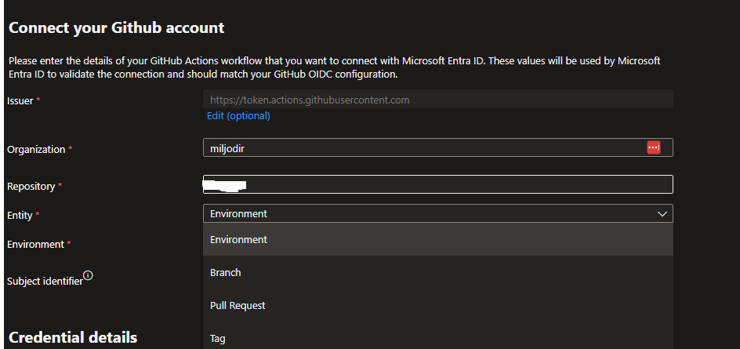
Github config
OIDC
  Default logic is repo + context, can be changed via API

Slide 19
Identity
Identity is a wide topic
  We are focusing on the parts where developers can make a difference

Slide 20
Quick Azure RBAC recap
Access is built on ARM which uses resource providers
  E.g. Microsoft.Web, Microsoft.Storage, Microsoft.Compute
Control plane & data plane
  Actions, NotActions – control plane
  DataActions, NotDataActions – data plane
Role assignments can grant RBAC roles to principals
  Examples - Entra ID groups, users, managed identitites

Slide 21
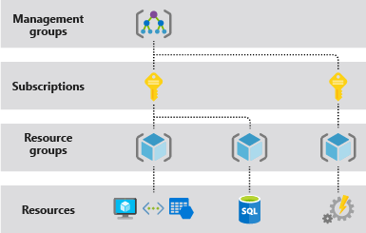
Quick RBAC recap
Role assignments can be granted at different scopes and are inherited in a hierarchy
Notes:
This is outside the presentation scope. I recommend John Savill’s deep dive video on the topic if you are interested.

Slide 22
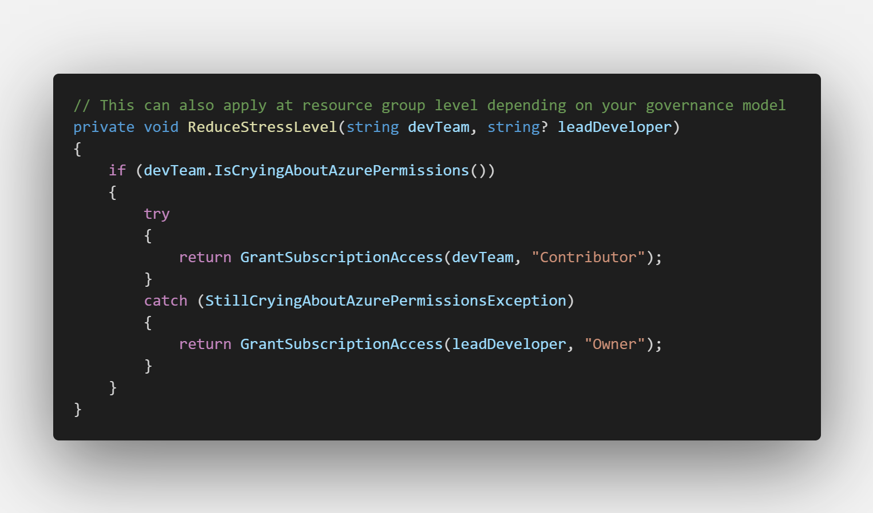
Common RBAC handling
Notes:
Dev teams are assigned «Contributor» at RG / subscription level, some trusted users may be granted «Owner»
Stakeholders are typically granted reader permissions
Platform admins are usually granted permissions contributor / owner / at management group level
Azure Policy DINE assignments often have more granular permissions at management group level
May or may not have implemented PIM

Slide 23
Common RBAC handling
Contributor role
  Used because it is a practical «catch-most» issue handling
    Grants direct permissions to the control plane only
    Grants «back door» access to the data plane
  Some unfortunate accesses most principals shouldn’t have
    PaaS – often involves access to admin credentials towards data plane
    IaaS – reset admin password / SSH key / run command
    CRUD to any* Azure resource. Is this really required?
Notes:
https://learn.microsoft.com/en-us/azure/role-based-access-control/built-in-roles#contributor
Who should be able to delete your databases and all their long term backups?
Who should be able to read, write and delete all your blob storage data?
Who needs write/delete access in general when we use IaC via a CI pipeline?
Who can I trust to delegate access?

Slide 24
Authenticating with the data plane
Nearly all Azure PaaS services support using keys for authentication
    Contributors have access to these keys.
    These keys are often used in app code (with or without Azure Key Vault)
Keys should ideally be removed or disabled
  The best secret is the one which doesn’t need to exist
  Compute services can be assigned one or more managed identities
  Use managed identites in your code whenever possible.
  Assign RBAC roles with the required data plane permissions
Notes:
No need for secret rotation or worrying about leaked secrets
No surprise cloud bills from «it’s just dev» keys in your source code
Allows us to scope permissions in a better manner
Improved logs for usage (which identity did this vs. which key did this)
Aligns with central management of access (Entra ID)

Slide 25
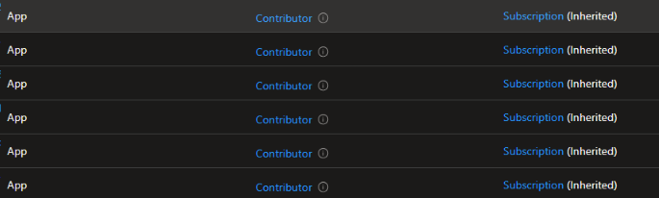
Azure DevOps service connections...
Check if your Sub / RG IAM looks something like this
  This can now easily be improved via a few clicks
  Also consider manual assignment to reduce the permissions

Slide 26
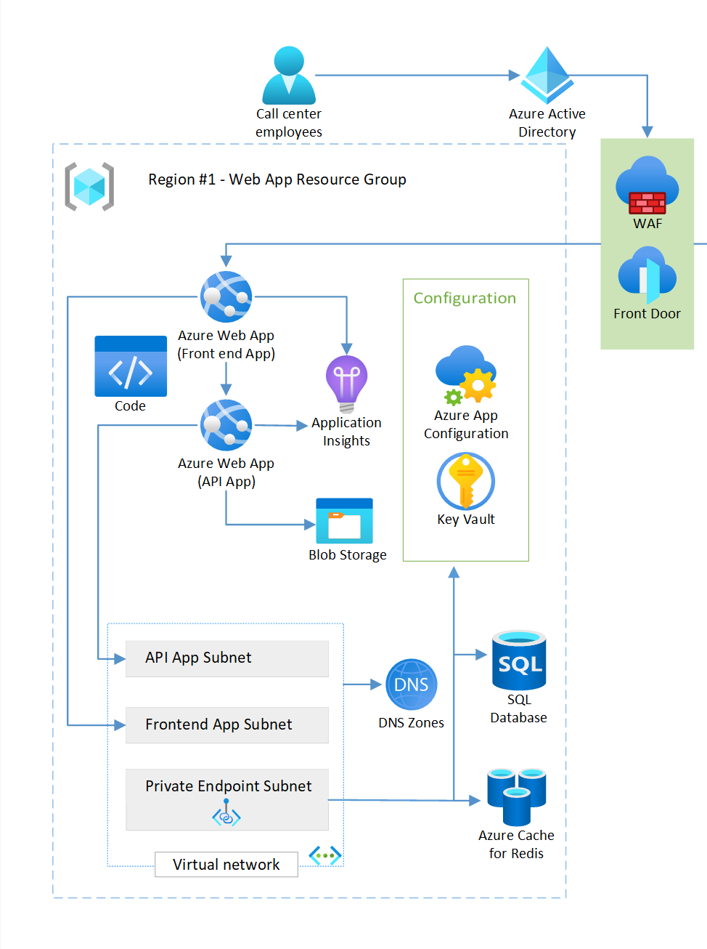
Access keys and Action roles
How many keys and «Action-centric» role assignments are required for your app and developers?
0 Action-centric roles, 1 key (App Insights connection string)
Notes:
Diagram credit: Azure WAF - «Reliable web app pattern for .NET - Plan the implementation»

Slide 27
Least privilege for the API
  Azure RBAC roles
    Storage Blob Data Contributor / Reader
    Monitoring Metrics Publisher + connection string
    Key Vault Secrets User
    App Configuration Data Reader
  Service-specific roles
    SQL database
      "CREATE USER [my-app-name] FROM EXTERNAL PROVIDER; ALTER ROLE(..)»
      Also possible to grant Entra admin at server level if feeling frisky..
    Redis cache - «Data Contributor» or custom access policy
Notes:
https://learn.microsoft.com/en-us/azure/role-based-access-control/built-in-roles
https://learn.microsoft.com/en-us/security/benchmark/azure/security-baselines-overview
See possibilities on «Identity management»

Slide 28
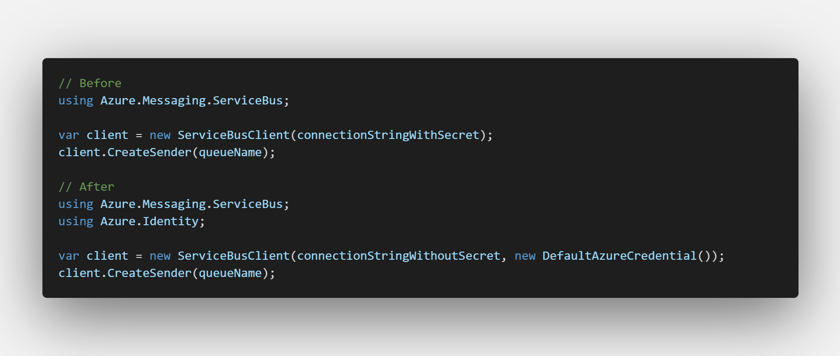
DefaultAzureCredential
Typically you only need to change this part of your app code

Slide 29
OIDC
DefaultAzureCredential
  ManagedIdentityCredential
  AzureCliCredential
  ChainedTokenCredential
WorkloadIdentityCredential
  Kubernetes, Github, Azure DevOps ++
Same principle can work against other Microsoft services
  Microsoft Graph
Notes:
You can also consider using ManagedIdentityCredential() or WorkloadIdentityCredential directly outside local development
Workload Identity means forwarding a token from another IDP, e.g. Github, Azure DevOps, a Kubernetes API server and exchanging it for an Entra ID token
Meaning you can use the same keyless authentication methods from non-Azure services.
The exchanged token also works against other Microsoft services, e.g. Microsoft Graph

Slide 30
Practical implementation in one slide
Strongly consider IaC + Git to make this manageable!
Grant needed roles access to groups and managed identities only
Disable all keys / passwords whereever possible
Suggested role assignments
  Create one or more Entra ID groups with users
    Assign roles based on needs
Managed Identity in Github Actions needs Owner or permissions close to it
Other Managed Identities - assign minimum role assignments required

Slide 31
Network
Network is a wide topic
  And can become very advanced very quickly
  We are focusing on the parts where developers can make a difference

Slide 32
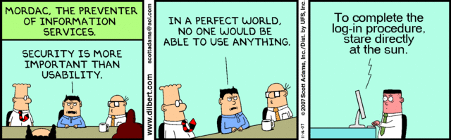
Networking
In an perfect world, only your application and a minimum number of people can reach your services

Slide 33
Networking
Integrate your compute services into Virtual Networks
Azure PaaS based services support local firewall rules for the most part. Use them!
  Allow traffic from selected subnets + specific public IPs
  Or allow traffic via private endpoint + Virtual Desktop / Jumpbox
Manage network rules as code in a Git repo for tracking

Slide 34
Networking
App Gateway with Azure Web Application Firewall (WAF)
Blocks malicious traffic against your web apps & APIs
  Managed rulesets, custom rules
Cons:
  Costly to set up for a single project
  Config can be complicated even when managed in code
  Effort needed to avoid false postives

Slide 35
CI/CD networking
Github and Azure DevOps support simple and cheap Azure VNET integration
  Consider setting it up if needed

Slide 36
Thank you for attending!
Audun Solemdal
solomno/sharing
audun-solemdal
solom.no

