Slide 1

Reducing risk for your Azure resources
Audun Solemdal

Slide 2


About
Audun Solemdal
CEO @
Cloud Consulting
Azure-based Platform
Whatever needs improvement...
solom.no
solomno / audunsolemdal
audun-solemdal

Slide 3
Agenda
Common RBAC assignments and their issues
  Quick recap of Azure RBAC
  Common RBAC handling
  How to get your developers on board
  Practical implementation of least-privilege
New way to reduce scope for Owner / User Access Administrator roles
Blocking resource deletes with DenyAction Azure policies (if time)

Slide 4
Quick RBAC recap
Access is built on ARM which uses resource providers
  E.g. Microsoft.Web, Microsoft.Storage, Microsoft.Compute
Control plane & data plane
  Actions, NotActions – control plane
  DataActions, NotDataActions – data actions
Role assignments can grant RBAC roles to principals
  Examples - Entra ID groups, users, managed identitites etc.

Slide 5
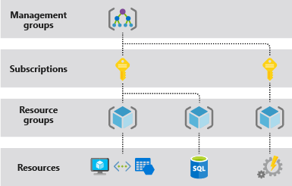
Quick RBAC recap
Role assignments can be granted at different scopes and are inherited in a hierarchy
  Up to recently very challenging to block inheritance*
* Deployment stacks (preview) may finally make this more manageable
Notes:
This is outside the presentation scope. I recommend John Savill’s deep dive video on the topic if you are interested.

Slide 6
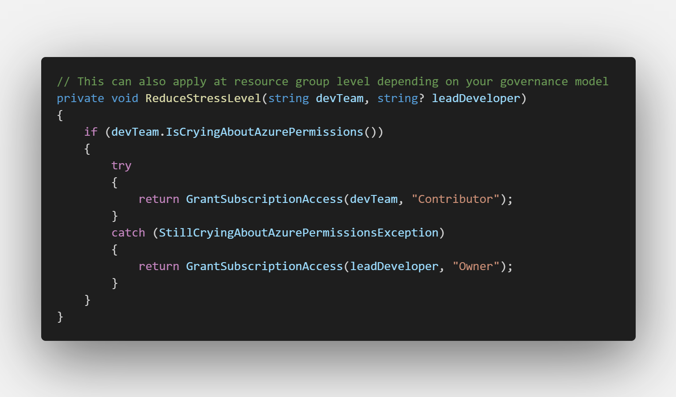
Common RBAC handling
Notes:
Dev teams are assigned «Contributor» at RG / subscription level, some trusted users may be granted «Owner»
Stakeholders are typically granted reader permissions
Platform admins are usually granted permissions contributor / owner / at management group level
Azure Policy DINE assignments often have more granular permissions at management group level
May or may not have implemented PIM

Slide 7
Common RBAC handling
Contributor role
  Used because it is a practical «catch-most» issue handling
    Grants permissions to the control plane only
  Some unfortunate accesses most principals shouldn’t have
    PaaS – often involves access to admin credentials
    IaaS – reset admin password / SSH key / run command
    CRUD to any resource. Is this really required if you use IaC?
Notes:
https://learn.microsoft.com/en-us/azure/role-based-access-control/built-in-roles#contributor
Who should be able to delete your databases and all their long term backups?
Who should be able to read, write and delete all your blob storage data?
Who needs write/delete access in general when we use IaC via a CI pipeline?
Who can I trust to delegate access?

Slide 8
Common RBAC handling
Owner role
  Any action in the control plane possible, no data plane access!
  Essentially everything a contributor can do + more
    Most relevant: Microsoft.Authorization resource provider
      Write and delete role assignments to anyone in your directory
      Create and delete resource locks
      Assign, modify and delete Azure Policy assignments

Slide 9
Authenticating with the data plane
Nearly all Azure PaaS services supports using keys for authentication
    Contributors have access to these keys. Since developers are often granted contributor permissions, these keys are often used in app code (with or without Azure Key Vault)
Keys should ideally be removed or disabled whereever possible
  Assign RBAC roles with the required data plane permissions instead.
  For greenfield development – disable all keys for PaaS services by default
Notes:
No need for secret rotation or worrying about leaked secrets
No surprise cloud bills from «it’s just dev» keys in your source code
Allows us to scope permissions in a better manner
Improved logs for usage (which identity did this vs. which key did this)
Aligns with central management of access (Entra ID)

Slide 10
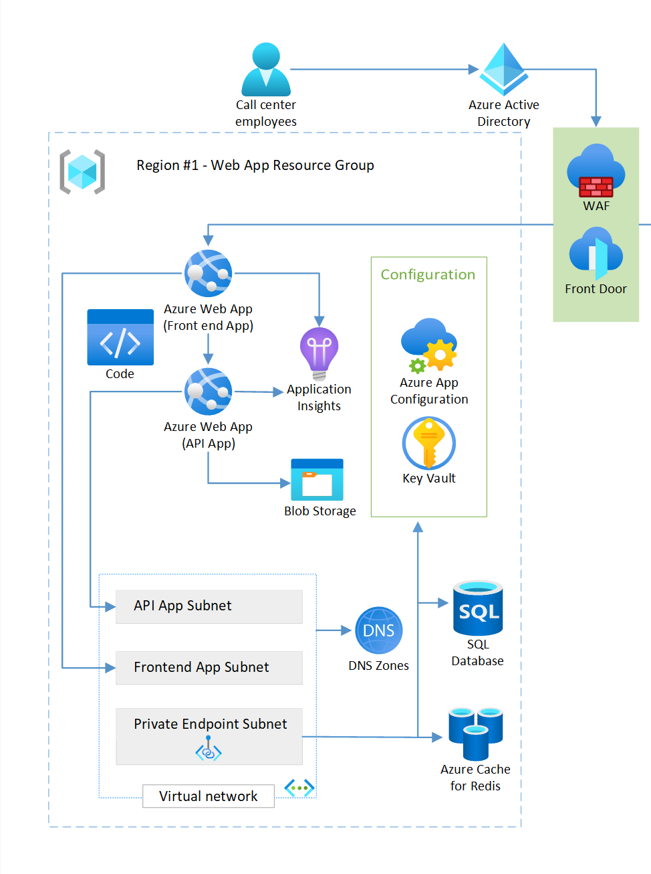
Access keys and Action roles
How many keys or «Action-centric» role assignments are required for your managed identities and developers?
Including preview functionality – 0 Action-centric roles, 1 or 0 keys (app insights connection string from frontend)
Notes:
Diagram credit: Azure WAF - «Reliable web app pattern for .NET - Plan the implementation»

Slide 11
Least privilege for the API
  Azure RBAC roles
    Storage Blob Data Contributor / Reader
    Monitoring Metrics Publisher (preview in SDK versions)
    Key Vault Secrets User
    App Configuration Data Reader
  Service-specific roles
    SQL database
      "CREATE USER [my-app-name] FROM EXTERNAL PROVIDER; ALTER ROLE(..)»
      Also possible to grant Entra admin at server level if feeling frisky..
    Redis cache - (preview) «Data Contributor» or custom access policy
Notes:
https://learn.microsoft.com/en-us/azure/role-based-access-control/built-in-roles
https://learn.microsoft.com/en-us/security/benchmark/azure/security-baselines-overview
See possibilities on «Identity management»

Slide 12
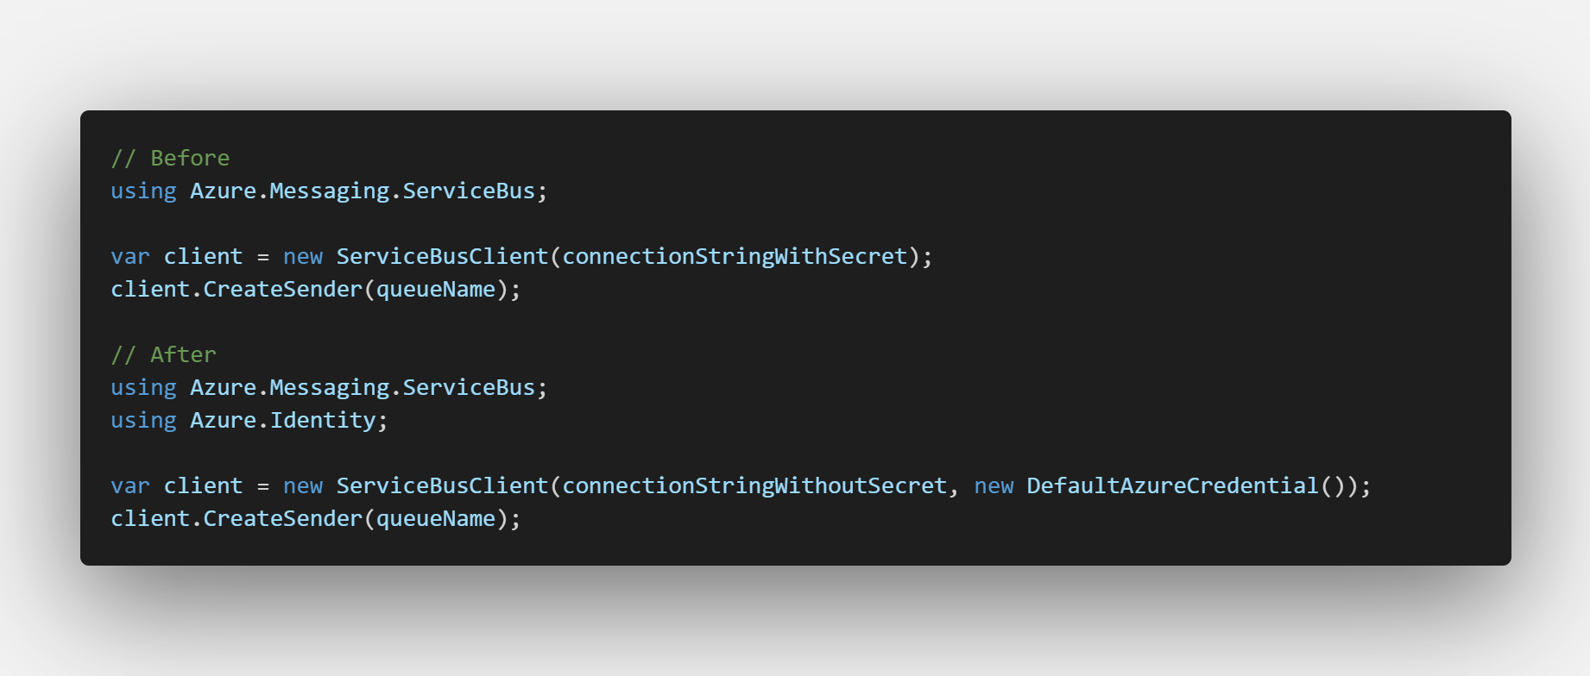
DefaultAzureCredential
Typically you only need to change this part of your app code
    This exact example requires .NET 6 or higher

Slide 13
OIDC
DefaultAzureCredential
  ManagedIdentityCredential
  WorkloadIdentityCredential
  AzureCliCredential
Workload Identity
  Kubernetes, Github, Azure DevOps ++
Same principle can work against other Microsoft services
  Microsoft Graph
Notes:
You can also consider using ManagedIdentityCredential() or WorkloadIdentityCredential directly outside local development
Workload Identity means forwarding a token from another IDP, e.g. Github, Azure DevOps, a Kubernetes API server and exchanging it for an Entra ID token
Meaning you can use the same keyless authentication methods from non-Azure services.
The exchanged token also works against other Microsoft services, e.g. Microsoft Graph

Slide 14

Azure DevOps service connections...
Check if your Sub / RG IAM looks something like this
  This can now easily be improved via a few clicks
  Also consider manual assignment to reduce the permissions

Slide 15
Practical implementation in one slide
  Strongly consider IaC + Git to make this manageable!
  Grant needed roles access to groups and managed identities only
  Inform your developers how to deal with this
  Disable all keys / passwords whereever possible
Suggested role assignments
  Entra ID groups with users
    create two baseline «platform level» custom roles, assign to RG/Sub
    Or Assign every role assignment needed to the group
    In production – consider PIM for Azure resources / PIM for groups
  Managed identity / Entra ID group with identities
    Assign every role assignment needed to the group

Slide 16
Questions regarding part 1?

Slide 17
New ABAC possibilities
Reducing scope of Owner / User Access Administrator roles
The problem with delegating user access is limiting which principals and which roles can be assigned
In preview – great improvements on limiting this
Working Terraform code
  https://github.com/solomno/sharing/tree/main/terraform/rbac
Quick demo..

Slide 18
Questions regarding ABAC?

Slide 19
DenyAction Azure policies
Up to this point we have looked at reducing permissions
In the end, some admins will still need privileged access to resources
How to deal with this

Slide 20
DenyAction Azure policies
Resource locks
  Inheritance based
  Can be bothersome on nested objects
  Only works on resources which support location and tags
  Locks can be removed by Owners / User Access Administrators
  Protection against resource moves(?)

Slide 21
DenyAction Azure policies
DenyAction effect Azure policies
  Supported on non-indexed objects
  Works better with nested objects
  Can only be removed by adjusting central policy
  Does not care what IAM role you are assigned
  Can be used in conjunction with resource locks to fill the gaps

Slide 22
DenyAction Azure policies
Recommended
  Protect resources which should rarely, if ever be deleted
    Azure DNS Zones
    Azure Firewall
    Container Registry
    VWAN / Hub
    WAF
    Public IPs at specific scopes
    LTR SQL backups
    And more..
  Sample policy
    https://github.com/solomno/sharing/tree/main/terraform/policy

Slide 23
Questions regarding DenyActions?

Slide 24
Thank you for attending!
Audun Solemdal
solomno/sharing
audun-solemdal
solom.no

