Slide 1

Reducing risk for your Azure resources
Audun Solemdal

Slide 2

About
Audun Solemdal
CEO @
Cloud Consulting
Azure Platform
Specialized technical training
solom.no
solomno / audunsolemdal
audun-solemdal

Slide 3
Agenda
Common RBAC assignments and their issues
  Quick recap of Azure RBAC
  Common RBAC handling
  How to get your developers on board
  Practical implementation of least-privilege
Reducing scope of Owner / User Access Administrator roles
Blocking resource deletes with DenyAction Azure policies (if time)

Slide 4
Quick RBAC recap
Access is built on ARM which uses resource providers
  E.g. Microsoft.Web, Microsoft.Storage, Microsoft.Compute
Role definitions in Azure have four dimensions for actions
  Actions, NotActions
  DataActions, NotDataActions
  Supports wildcards
Role assignments can grant RBAC roles to principals
  Examples - Entra ID groups, users, managed identitites etc.

Slide 5
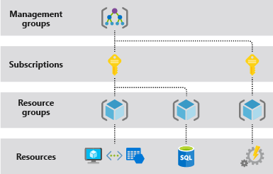
Quick RBAC recap
Role assignments can be granted at different scopes and are inherited in a hierarchy
  Up to recently very challenging to block inheritance*
* Deployment stacks (preview) may finally make this more manageable
  This is outside the presentation scope. I recommend John Savill’s deep dive video on the topic if you are interested.

Slide 6
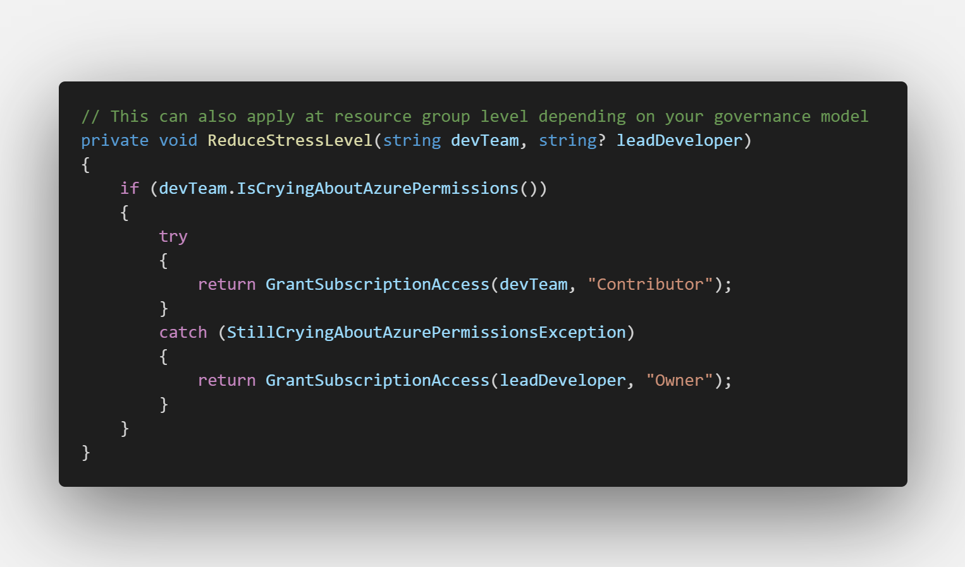
Common RBAC handling
Notes:
Dev teams are assigned «Contributor» at RG / subscription level, some trusted users may be granted «Owner»
Stakeholders are typically granted reader permissions
Platform admins are usually granted permissions contributor / owner / at management group level
Azure Policy DINE assignments often have more granular permissions at management group level
May or may not have implemented PIM

Slide 7
Common RBAC handling
Contributor role
  Used because it is a practical «catch-most» issue handling
    Grants Actions permissions only, no DataActions!
  PaaS – often involves access to admin credentials
  IaaS – reset admin password / SSH key / run command
  Questions to ask yourself about access
    Who should be able to delete your databases and all their long term backups?
    Who should be able to read, write and delete all your blob storage data?
    Who needs write/delete access in general when we use IaC via a CI pipeline?
    Who can I trust to delegate access?
Notes:
https://learn.microsoft.com/en-us/azure/role-based-access-control/built-in-roles#contributor

Slide 8
Common RBAC handling
Owner role
  Every «Action» possible. No DataActions!
  Essentially everything a contributor can do + more
    Most relevant: Microsoft.Authorization resource provider
      Write and delete role assignments to anyone in your directory
        Also check your tenant’s guest invite settings...
      Create and delete resource locks
      Assign, modify and delete Azure Policy assignments

Slide 9
Access Keys
Nearly all Azure PaaS services supports using keys for authentication
    Contributors have access to these keys. Since developers are often granted contributor permissions, these keys are often used in app code (with or without Azure Key Vault)
Keys should be removed or disabled whereever possible
  Assign RBAC roles with the required DataPermissions instead.
  For greenfield development – disable all keys for PaaS services by default
Notes:
No need for secret rotation or worrying about leaked secrets
No surprise cloud bills from «it’s just dev» keys in your source code
Allows us to scope permissions in a better manner
Improved logs for usage (which identity did this vs. which key did this)
Aligns with central management of access (Entra ID)

Slide 10
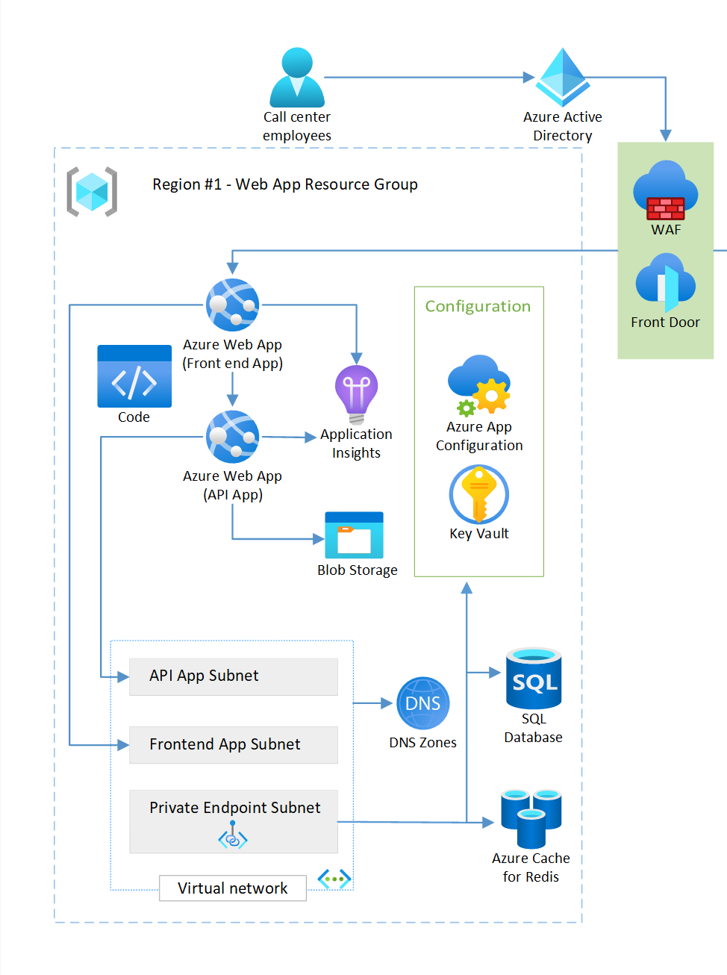
Access keys and Action roles
How many keys and «Action-centric» role assignments are required for your apps and developers?
Including preview functionality – 0 Action-centric roles, 1 or 0 keys (app insights connection string from frontend)
Notes:
Diagram credit: Azure WAF - «Reliable web app pattern for .NET - Plan the implementation»

Slide 11
Least privilege for the API
  Azure RBAC roles
    Storage Blob Data Contributor / Reader
    Monitoring Metrics Publisher (preview SDK version)
    Key Vault Secrets User
    App Configuration Data Reader
  Special roles
    SQL database
      "CREATE USER [my-app-name] FROM EXTERNAL PROVIDER; ALTER ROLE(..)»
      Also possible to grant Entra admin at server level if feeling frisky..
    Redis cache - (preview) «Data Contributor» or custom access policy
Notes:
https://learn.microsoft.com/en-us/azure/role-based-access-control/built-in-roles
https://learn.microsoft.com/en-us/security/benchmark/azure/security-baselines-overview
See possibilities on «Identity management»

Slide 12
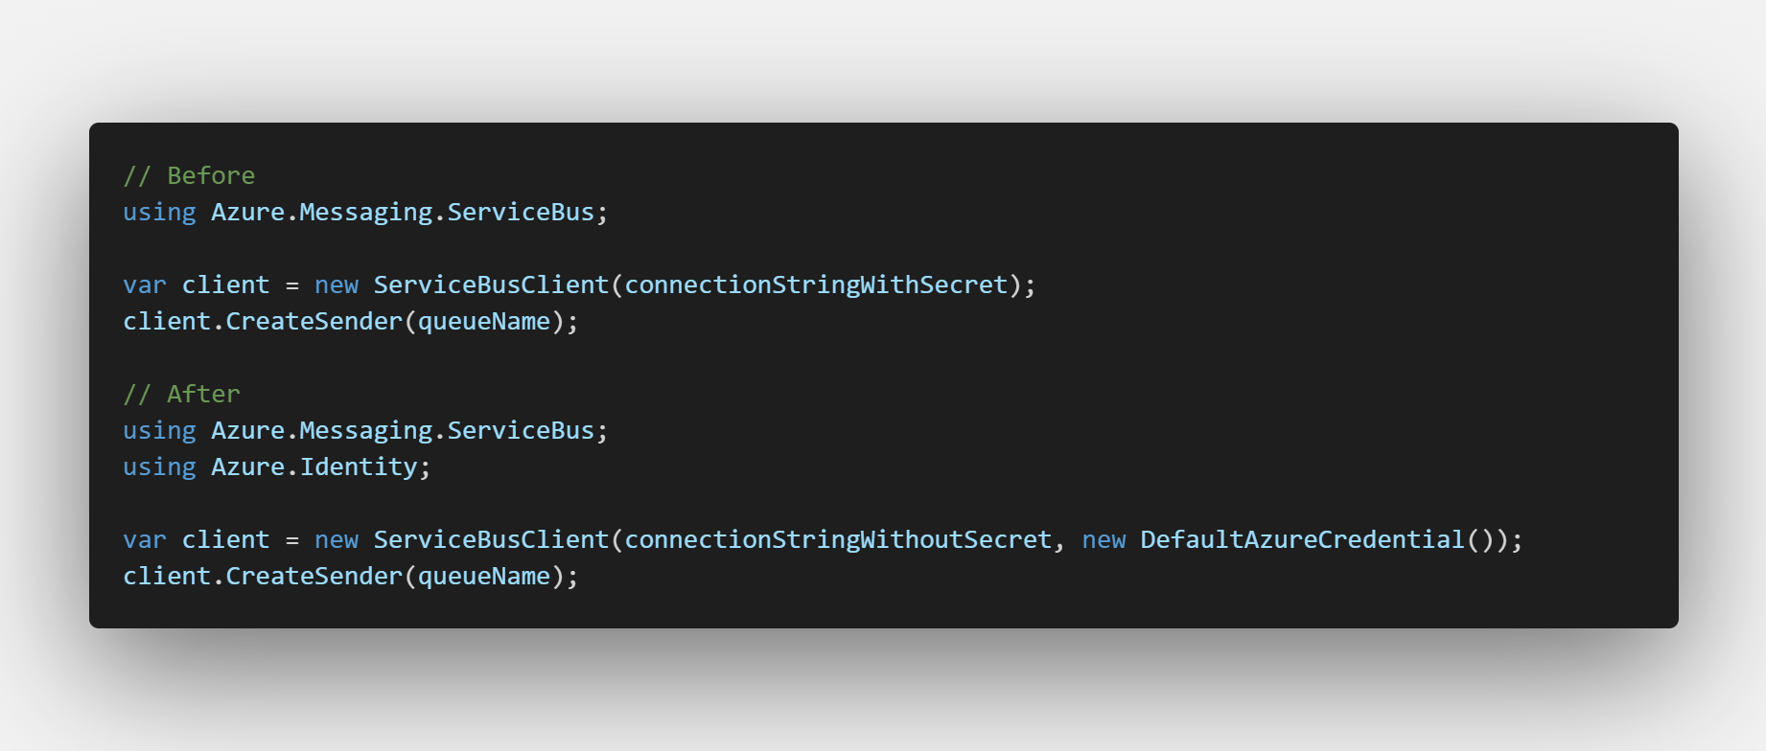
DefaultAzureCredential
Typically you only need to change this part of your app code
    This example requires .NET 6 or higher

Slide 13
OIDC
You can also consider using ManagedIdentityCredential() or WorkloadIdentityCredential directly outside local development
Workload Identity means forwarding a token from another IDP, e.g. Github, Azure DevOps, a Kubernetes API server and exchanging it for an Entra ID token
  Meaning you can use the same keyless authentication methods from non-Azure services.
The exchanged token also works against other Microsoft services, e.g. Microsoft Graph

Slide 14

Azure DevOps service connections...
Check if your Sub / RG IAM looks something like this
  This can now easily be improved via a few clicks
  Also consider manual assignment to reduce the permissions

Slide 15
How to deal with this
Use IaC + Git to make this manageable
Disable all keys / passwords whereever possible
Inform your developers how to deal with this
Grant access to groups and managed identities only
  Optionally place managed identities in Entra ID groups and assign
Suggestion
  Create two custom roles with all data actions needed, assign to RG/Sub
    In production – consider PIM for Azure resources
  Or assign every role assignment needed to the group / managed identity
    In production – consider PIM for groups

Slide 16
Questions regarding part 1?

Slide 17
New ABAC possibilities
Reducing scope of Owner / User Access Administrator roles
The problem with delegating user access is limiting which principals and which roles can be assigned
In preview – great improvements on limiting this
Working Terraform code
  https://github.com/solomno/sharing/blob/main/terraform/abac-owner.tf
Quick demo..

Slide 18
Questions regarding ABAC?

Slide 19
DenyAction Azure policies
Up to now we have looked at reducing permissions
In the end, some admins will still need access, or we do not have the capacity to assign other things than Contributor and Owner roles
DenyAction has recently come out of preview
  This works great for protecting your resources against malicious and accidental deletions

Slide 20
DenyAction Azure policies
Resource locks
  Inheritance based
  Can be bothersome on nested objects
  Only works on resources which support location and tags
  Locks can be removed by Owners / User Access Administrators
  Protection against resource moves(?)

Slide 21
DenyAction Azure policies
DenyAction effect Azure policies
  Supported on non-indexed objects
  Works better with nested objects
  Can only be removed by adjusting central policy
  Does not care what IAM role you are assigned
  Can be used in conjunction with resource locks to fill the gaps

Slide 22
DenyAction Azure policies
Recommended
  Protect resources which should rarely, if ever be deleted
    E.g.
      Azure DNS Zones
      Azure Firewall
      Container Registry
      VWAN / Hub
      WAF
      Public IPs in specific scopes
      LTR SQL backups
Code:
  https://github.com/solomno/sharing/tree/main/terraform/policy

Slide 23
Questions regarding DenyActions?

