Slide 1


Solomon Preston
CLUSTERING WITH
DBSCAN
This presentation delves into the wonderful world of clustering, showcasing a from-scratch Java implementation of DBSCAN.

Slide 2
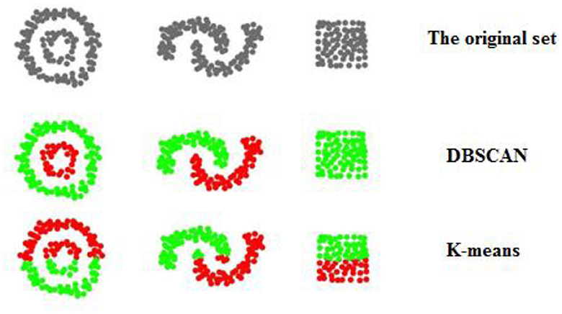
WHAT IS DBSCAN?
Density Based Spacial Clustering of Applications with Noise.
Clustering algorithm that uses Nearest Neighbors.
Makes clusters based on point density.

Slide 3

RESOURCES USED
VSCode
01
Visual Studio Code was used as the main IDE.
Maven
While DBSCAN was implemented from scratch, various resources were used to develop and display the results.
02
Comprehensive project management and build automation tool for Java. Used to manage dependencies.
JFreeChart
03
This is an open source Java library that is used to create charts/graphs.
Draw.io
04
Used to make UML diagrams, flowcharts, and network diagrams. Helped with developing the UML.

Slide 4
UML

Slide 5
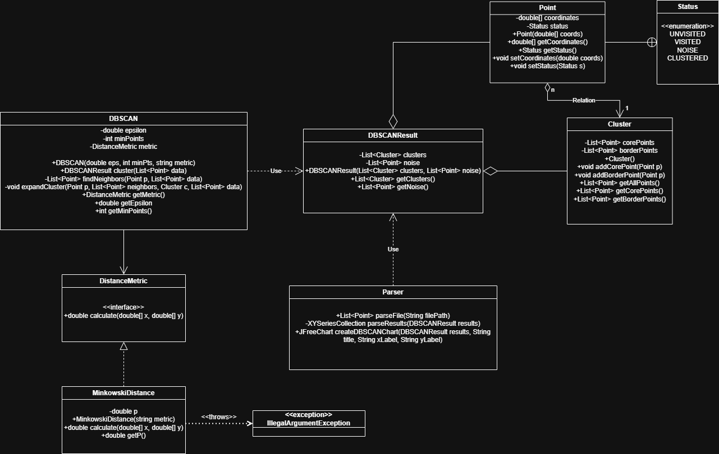

Slide 6
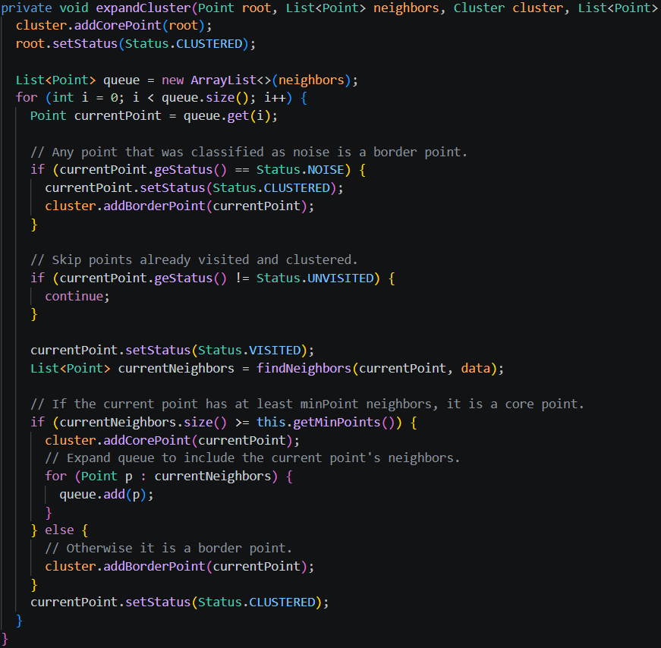
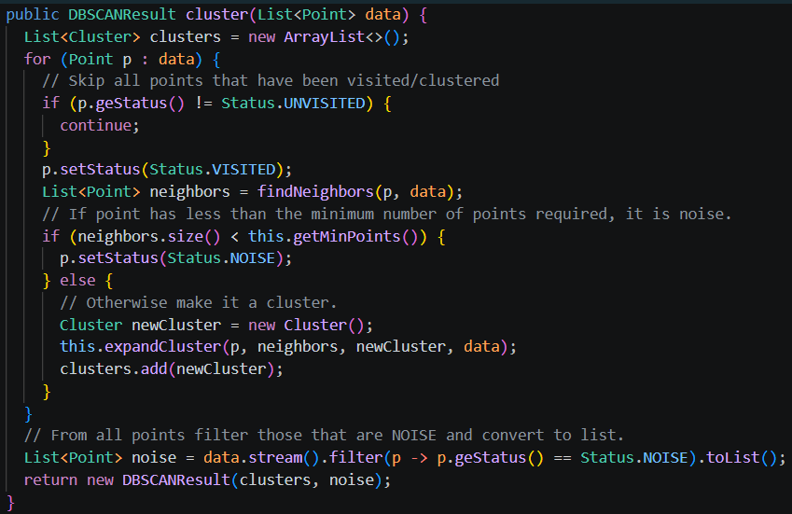
CLUSTERING CODE

Slide 7
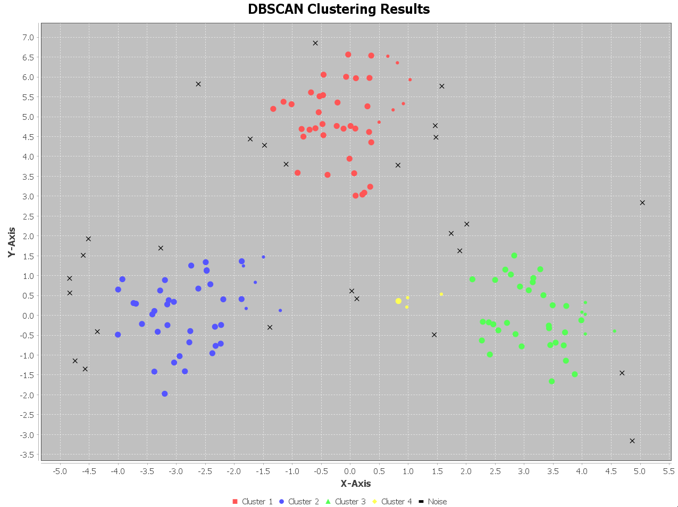
Kaggle Dataset testing
Epsilon: 0.6
Minimum Neighbors: 3
Distance Metric: Euclidean

Slide 8
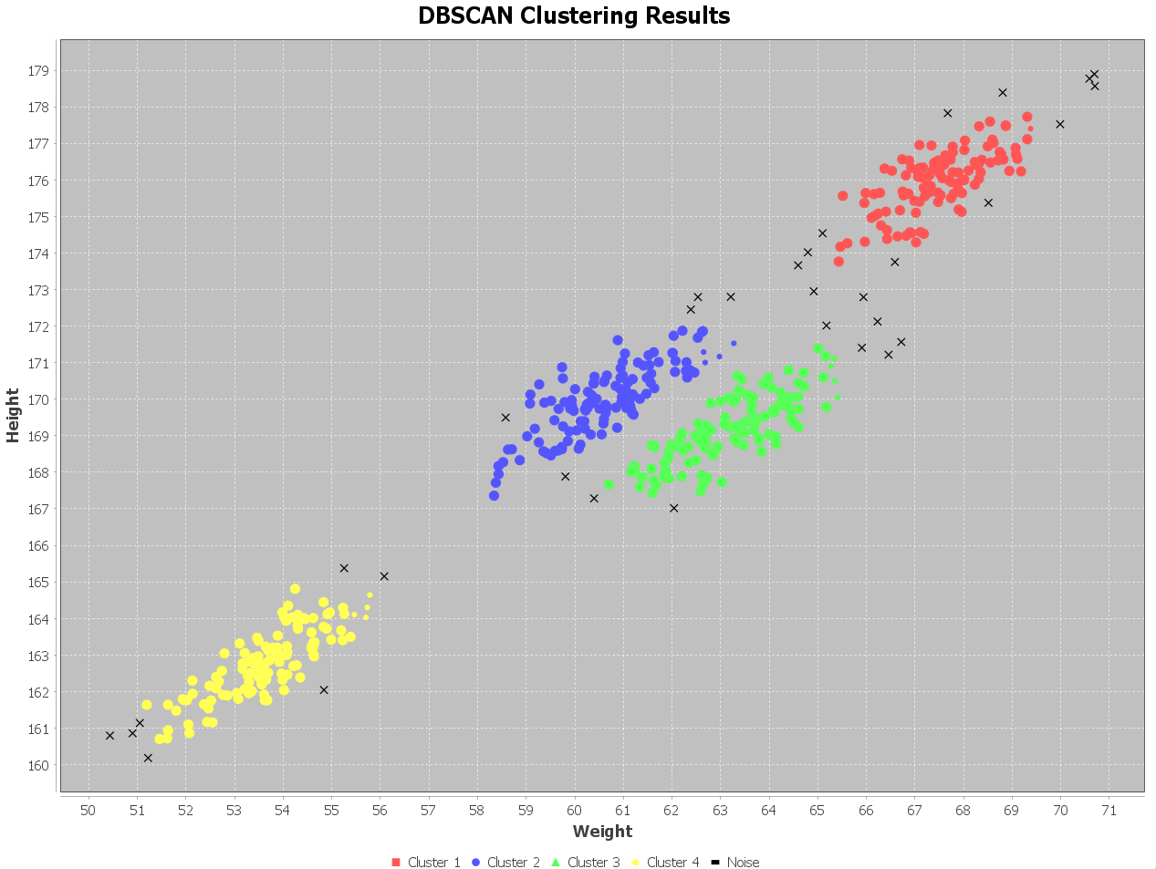
SECOND DATASET
Epsilon: 0.7
Minimum Neighbors: 3
Distance Metric: Manhattan

Slide 9
THANK YOU

