Slide 1
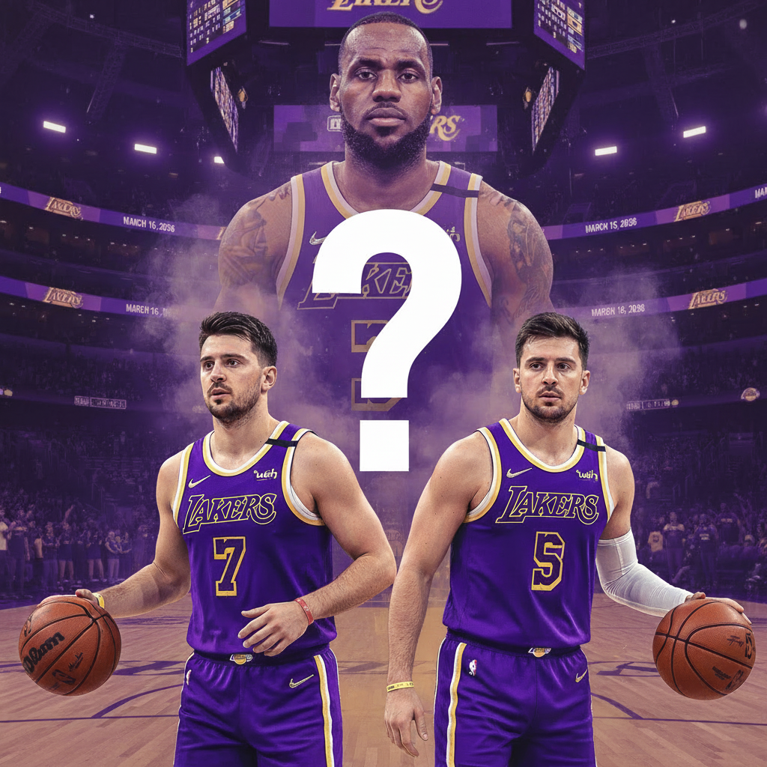
Lakers better without Lebron?
Lakers Lineup Analytics | 2025–26 Season
An Evidence-Based Analysis Using Advanced Statistics
Data Sources: Basketball Reference • NBA.com

Slide 2
THE BIG IDEA
The 2025–26 Lakers are statistically better when Luka Dončić and Austin Reaves share the floor without LeBron James.
This analysis examines lineup net ratings, usage overlap, and spacing data to answer: does adding a third star actually hurt?
+9.2
+19.2
-12.4
Net Rating Edge
Best Lineup
Worst Lineup
LOGOS: Evidence-based analysis • ETHOS: Official NBA data sources • PATHOS: Championship implications

Slide 3
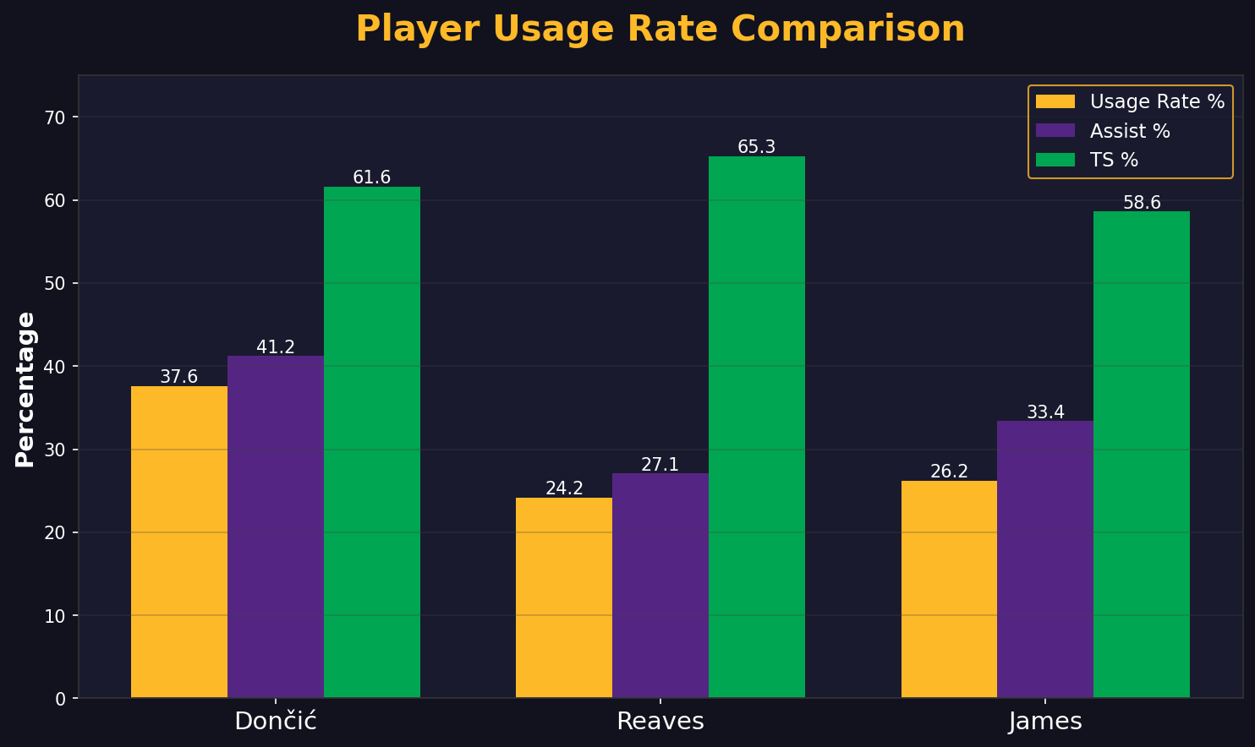
VISUALIZATION 1: Player Usage Rate Comparison
Key Insight: Dončić (41.2%) and LeBron (33.4%) both require high assist rates to be effective. Combined usage creates redundancy.

Slide 4
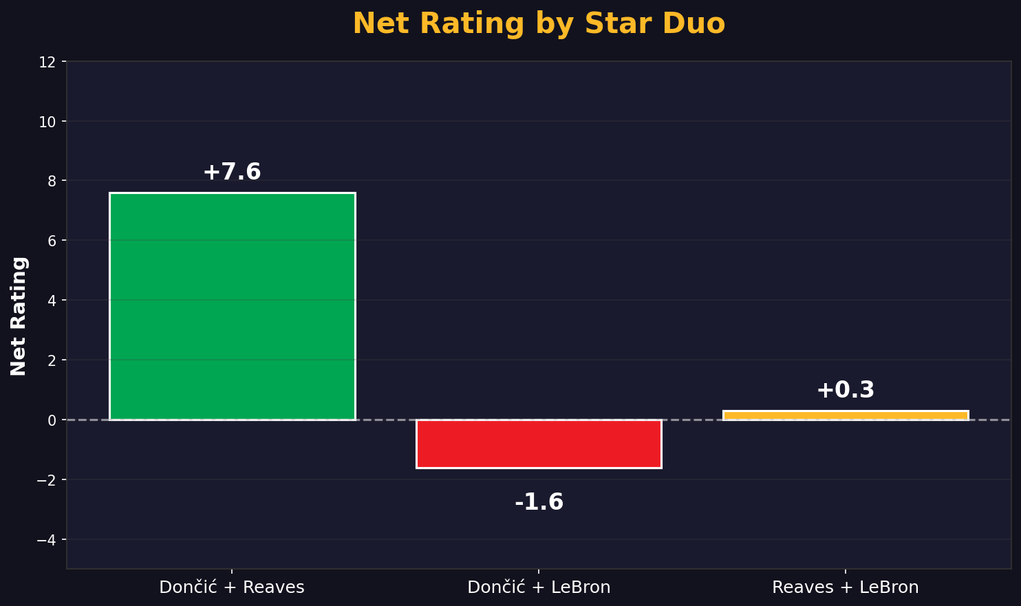
VISUALIZATION 2: Net Rating by Star Duo
Key Insight: Dončić + Reaves (+7.6) outperforms Dončić + LeBron (-1.6) by 9.2 points per 100 possessions.

Slide 5
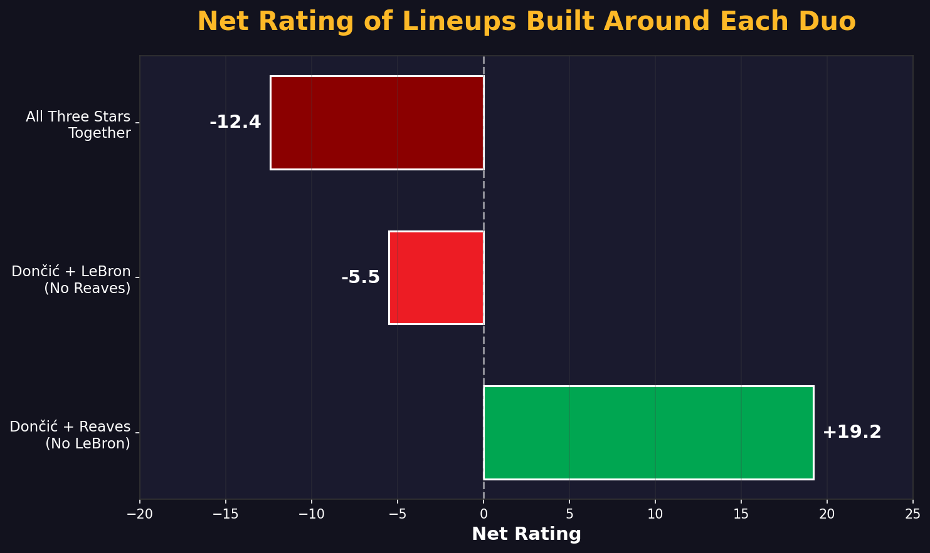
VISUALIZATION 3: Net Rating of Lineups Built Around Each Duo
Key Insight: The gap between best (+19.2) and worst (-12.4) configuration is 31.6 points per 100 possessions.

Slide 6
Why Does This Happen?
1. Ball Dominance Overlap
2. Reaves' Off-Ball Excellence
Dončić and LeBron both need high-touch creation roles. On the court together, one's strength becomes the other's constraint.
At 65.3% TS%, Reaves thrives as a catch-and-shoot weapon — perfectly complementing Dončić's gravity without competing for possessions.
3. Spacing Penalty
4. Defensive Wash
LeBron's 31.0% three-point rate collapses the floor, reducing drive lanes and open looks that Dončić's playmaking generates.
Defensive ratings are nearly identical across all configurations — meaning offense is the entire differentiator.

Slide 7
ETHOS — Data Sources & Credibility
Primary Data Sources:
Sample Sizes
• Basketball Reference — Lakers 2025-26 Season Statistics • NBA.com — Advanced Lineup Data • Regular season data through March 2026
Dončić + Reaves: 795.8 min
Dončić + LeBron: 879.3 min
Reaves + LeBron: 560.4 min
Methodology:
• Net Rating = Offensive Rating - Defensive Rating • Per 100 possessions normalization • Minimum 25 minutes sample threshold

Slide 8
PATHOS — The Championship Implications
For a franchise chasing its 18th championship, every efficiency gain matters.
The numbers tell a story of untapped potential.
31.6
This isn't about benching LeBron — it's about lineup optimization.
Point Swing
Strategic minute staggering could be the difference between a first-round exit and a championship run.
Between optimal and suboptimal lineups
These adjustments don't diminish LeBron - they weaponize all three stars by matching each to the role where the numbers say they win.

Slide 9
Research Question:
Are the Lakers better when Dončić and Reaves play without LeBron?
YES
Recommendations
• Maximize Dončić + Reaves minutes together
• Stagger LeBron to lead second units with fresh legs
• Avoid all three stars on the floor together

Slide 10
Thank You
Lakers Analytics Dashboard
Two Stars Better Than Three? | 2025-26 Season Analysis
Questions?

