Slide 1
Car auction
Team name : United
Team members : Amartuvshin
Solomon
Batbileg

Slide 2
Annotation
Data binding
Validation/Custom Validation
Customer Formatter
Uploading files
Internationalization
Exception Handling
REST/ Ajax
Security/ Login/Authorization
Web socket
MVC Testing

Slide 3
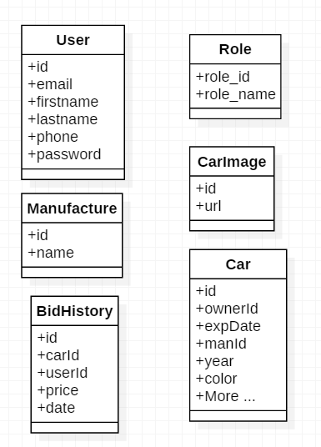
Demo class diagram

Slide 4
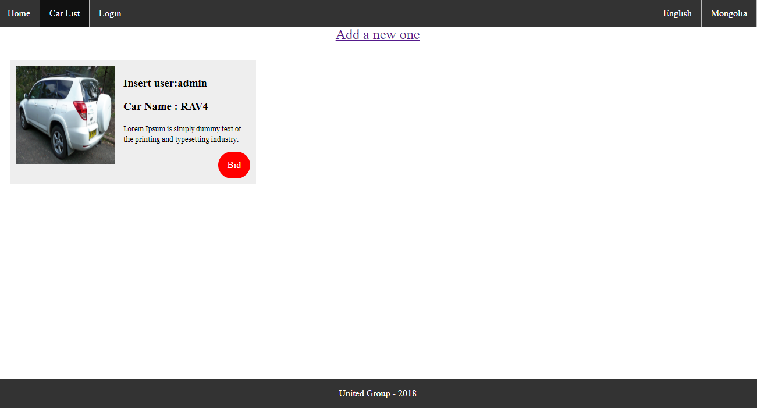
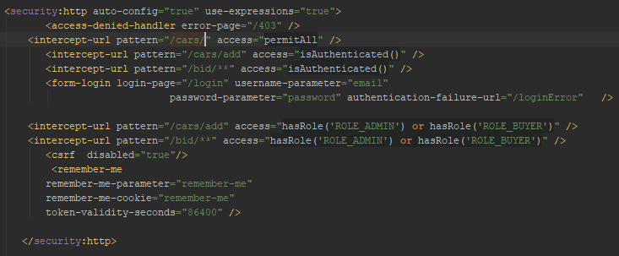
Program Screen -1

Slide 5
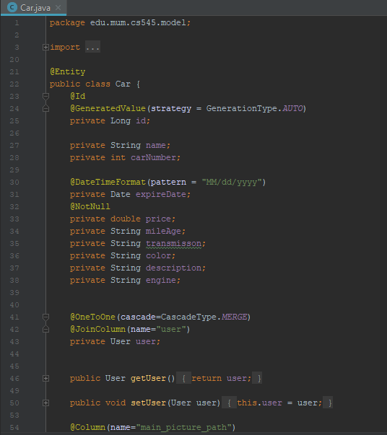
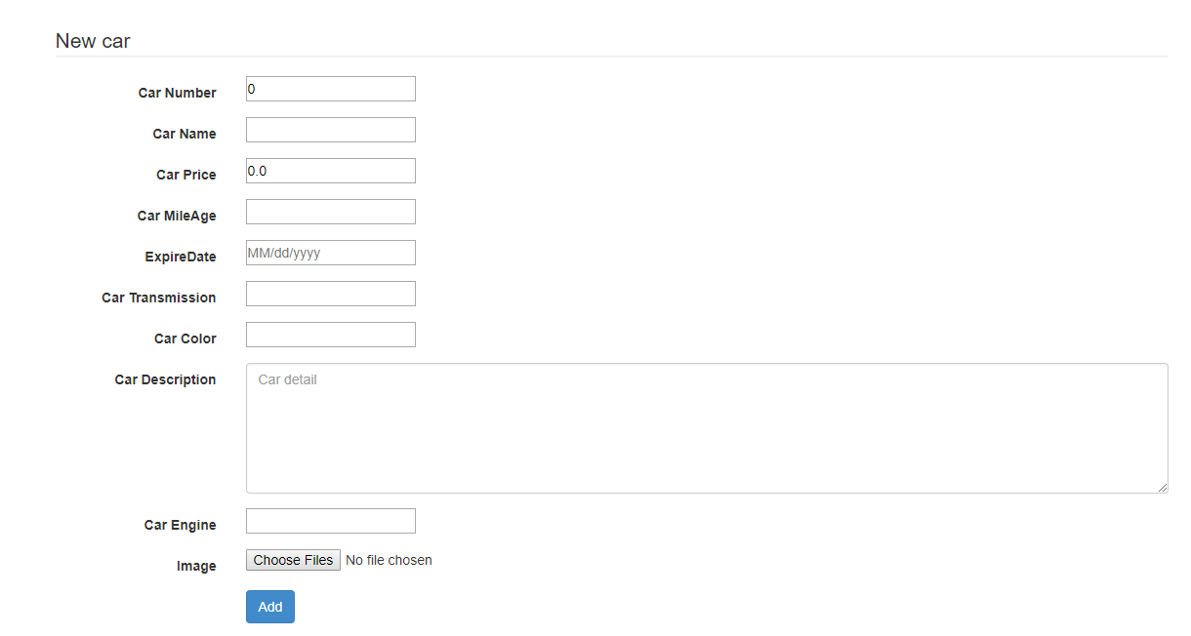
Program Screen-2

Slide 6
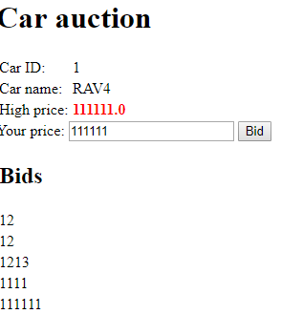
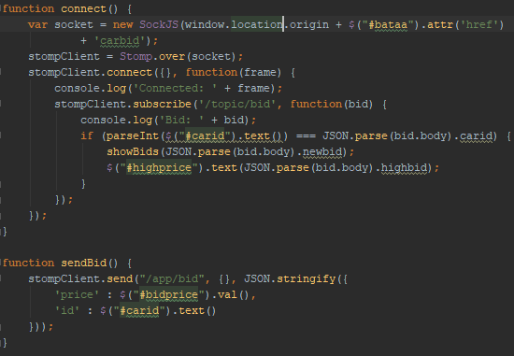
Program Screen-3

Slide 7
Thank you

