Slide 1
GCN (Graph Convolution Network)
https://youtu.be/e_5s4uLw-d8

Slide 2
Graph란
Convolution이란
GCN

Slide 3
Graph란
node와 edge로 이루어진 자료구조
- Undirected Graph <-> Directed Graph
- Weighted Graph
1
2
5
0
3
4

Slide 4
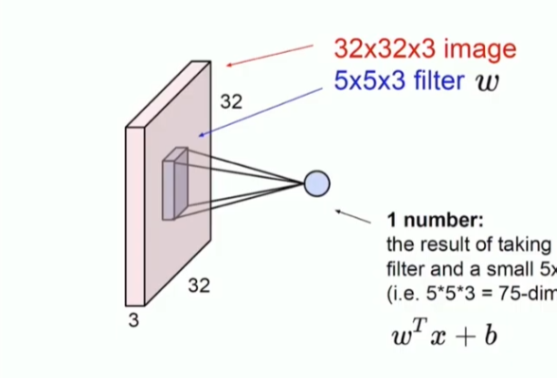

Convolution이란
filter를 이용하여 activation map을 업데이트 하는 layer
- CNN의 Convolution Layer

Slide 5
GCN
CNN과의 공통점
- weight sharing
- reduce the number of parameter
=> less overfitting, low computational cost
- learn local features

Slide 6
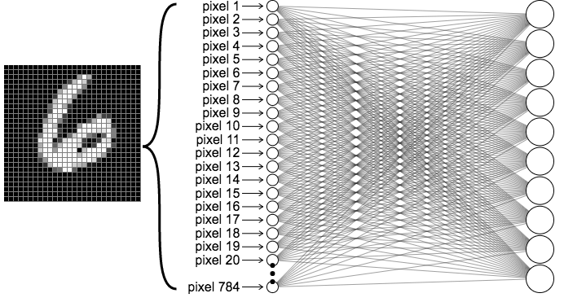
GCN
28x28 image

Slide 7
GCN
목표
Graph에서 feature를 추출하여 각 노드를 update 하는 것
 | 0 | 1 | 2 | 3 | 4 | 5
0 | 0 | 1 | 0 | 1 | 0 | 0
1 | 1 | 0 | 1 | 1 | 0 | 0
2 | 0 | 1 | 0 | 1 | 1 | 1
3 | 1 | 1 | 1 | 0 | 1 | 0
4 | 0 | 0 | 1 | 1 | 0 | 0
5 | 0 | 0 | 1 | 0 | 0 | 0
 | 0 | 1 | 2 | 3 | 4
0 | 255 | 24 | 0 | 13 | 0
1 | 146 | 27 | 75 | 0 | 0
2 | 124 | 0 | 45 | 245 | 0
3 | 86 | 157 | 0 | 56 | 0
4 | 0 | 0 | 13 | 11 | 45
5 | 46 | 0 | 45 | 0 | 34
1
2
5
0
3
4
Adjacency matrix
Node feature matrix

Slide 8
GCN
Convolution
H₄^{(l+1)} = σ(H₂^{(l)}W^{(l)} + H₃^{(l)}W^{(l)} + H₄^{(l)}W^{(l)})
1
2
5
0
3
4
H^{(l+1)} = σ(AH^{(l)}W^{(l)})

Slide 9
GCN
H^{(l+1)} = σ(AH^{(l)}W^{(l)})
64
6
5
 |  |  | ...
 |  |  | ...
 |  |  | ...
 |  |  | ...
1 | 1 | 0 | 1 | 0 | 0
1 | 1 | 1 | 1 | 0 | 0
0 | 1 | 1 | 1 | 1 | 1
1 | 1 | 1 | 1 | 1 | 0
0 | 0 | 1 | 1 | 1 | 0
0 | 0 | 1 | 0 | 0 | 1
255 | 24 | 0 | 13 | 0
146 | 27 | 75 | 0 | 0
124 | 0 | 45 | 245 | 0
86 | 157 | 0 | 56 | 0
0 | 0 | 13 | 11 | 45
46 | 0 | 45 | 0 | 34
6
x
5
x
6
Node feature matrix
H^{(l)}
Weight matrix
W^{(l)}
Adjacency matrix
A
64
=>
6
Node feature matrix
H^{(l+1)}

Slide 10
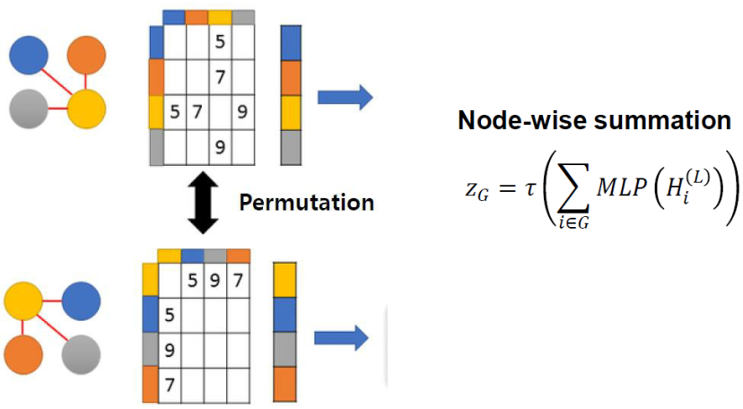
GCN
Readout

Slide 11
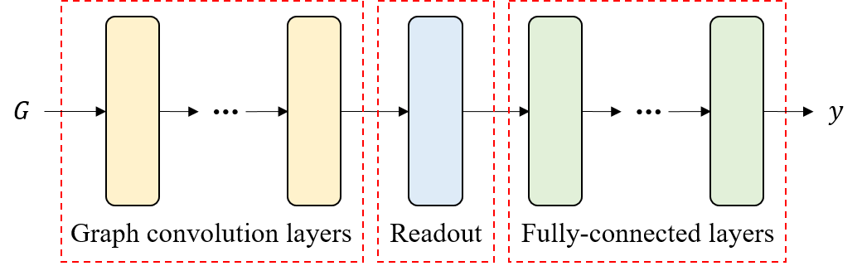
GCN

