Slide 1
Proof-of-Importance
https://youtu.be/B_k6pK6_rAo

Slide 2
PoI (Proof-of-Importance)
Importance Score
Future Work

Slide 3
PoI (Proof-of-Importance)
NEM 암호화폐에서 사용하는 합의알고리즘 (XEM)
PoS(Proof-of-Stake)의 단점을 해결하기 위하여 개발
기득 통화량, 코인 거래량, 노드 간 상호 연결도에 따라 채굴 확률이 증가한다.
즉, 네트워크 내 기여도에 따라서 달라지는 셈
채굴 과정
블록 생성 (블록 당 1분 ±0.5s)
-> 계정의 중요도 점수 계산
-> 조건이 만족되었는지 확인
-> 채굴 완료

Slide 4
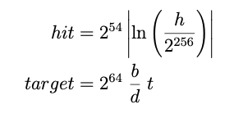
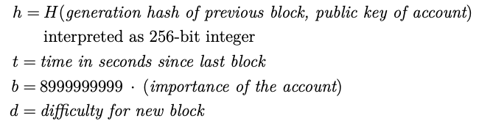
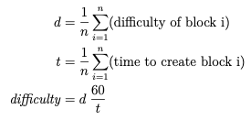
PoI (Proof-of-Importance)
Initial difficulty = 10^14

Slide 5

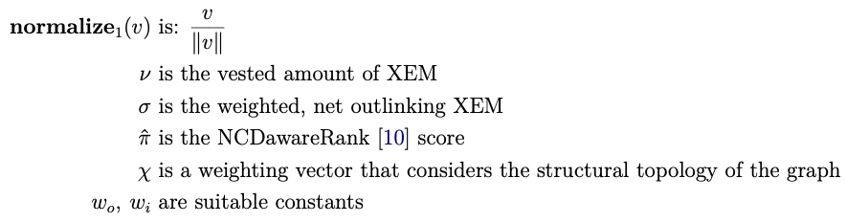
Importance Score
Importance Score, ψ
w_{o} is 1.25 and w_{i} is 0.1337.

Slide 6
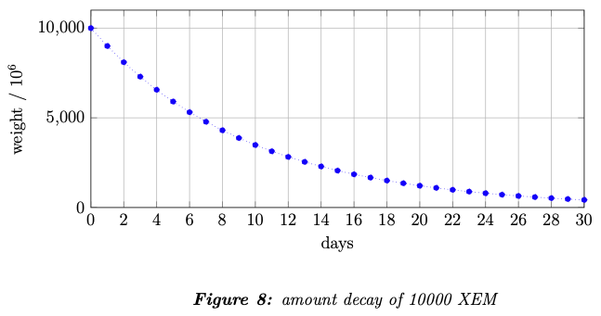
Importance Score
1.
매일 보유 XEM의 10%가 vested됨
* harvester가 되기 위해선 총 10,000 XEM이 vested 되어야 함 *

Slide 7




Importance Score
2.
Transferred an amount of at least 1,000 XEM
Happened within the last 43,200 blocks (approximately 30 days)
Block weight
Weighted net flow => outlink matrix
i, j: account
h: block-height k: k-th Transaction

Slide 8

Importance Score
3.
PageRank와 유사
PageRank에 inter-level proximity matrix와 μ가 추가된 형태
그래프를 분해 가능한 구조로써 활용 가능

Slide 9

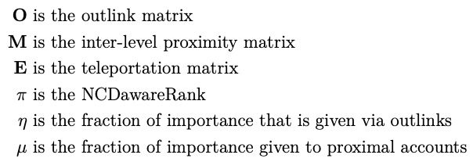
Importance Score
3.
(η is 0.7 and μ is 0.1) in NEM

Slide 10
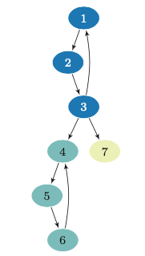
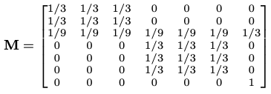
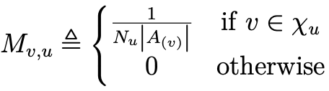

Importance Score
- W is set of all harvesting-eligible accounts.
- For u ∈ W, Gu is the set of account that have received more in value transfers from account “u” than have sent “u”.
- NCD (Nearly Completely Decomposable) blocks of W are defined as {A1, A2, A3, …, AN}.
- Xu is the proximal accounts of each “u”
- Nu is the number of NCD blocks in Xu.

Slide 11


Importance Score
Clustering the transaction graph
- Γ is the set cardinality and the set of structurally connected accounts (inclusive of self)
- σ is the similarity between two accounts “u” and “v”
- N_{ε}(u) is the set of structurally connected accounts that have structural similarity with an account over a pre-determined threshold ε
- K_{ε,μ}(u) are core nodes that used for pivoting and expanding clusters
ε is 0.3 and μ is 4

Slide 12
Importance Score
Direct structure reachability
Account that are two-hops away from the pivot accounts

Slide 13

Importance Score
Aa
“e” is the vector with all components set to 1.
“v⊤” is a teleportation probability vector.

Slide 14
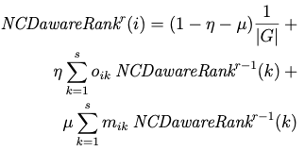

Importance Score

Slide 15
Future Work
-> Shapley Value

