Slide 1
SIMD
Single Instruction Multiple Data
https://youtu.be/XPa5MyFA7-Y

Slide 2
SIMD
Register
a1
+
b1
a1
a2
a3
a4
b1
b2
b3
b4
a2
+
b2
+
+
a3
+
b3
a4
+
b4
[그림] Original Operation
[그림] SIMD Operation
[그림] AVX (Advanced Vector eXtensions)

Slide 3
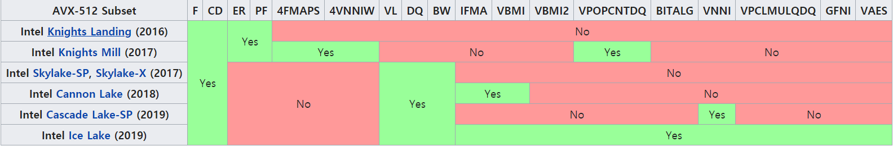
AVX
AVX
128~256bit
Sandy Bridge, 2011 ~
AVX2
256bit
Haswell, 2013 ~
AVX-512
256~512bit
Knght Landing, 2016 ~
Ice Lake, 2019
[그림] Processors supporting AVX-512

Slide 4
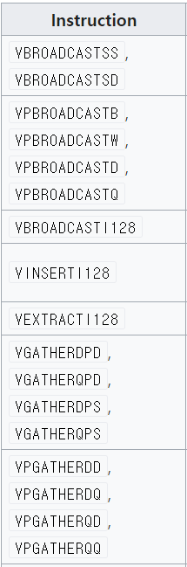
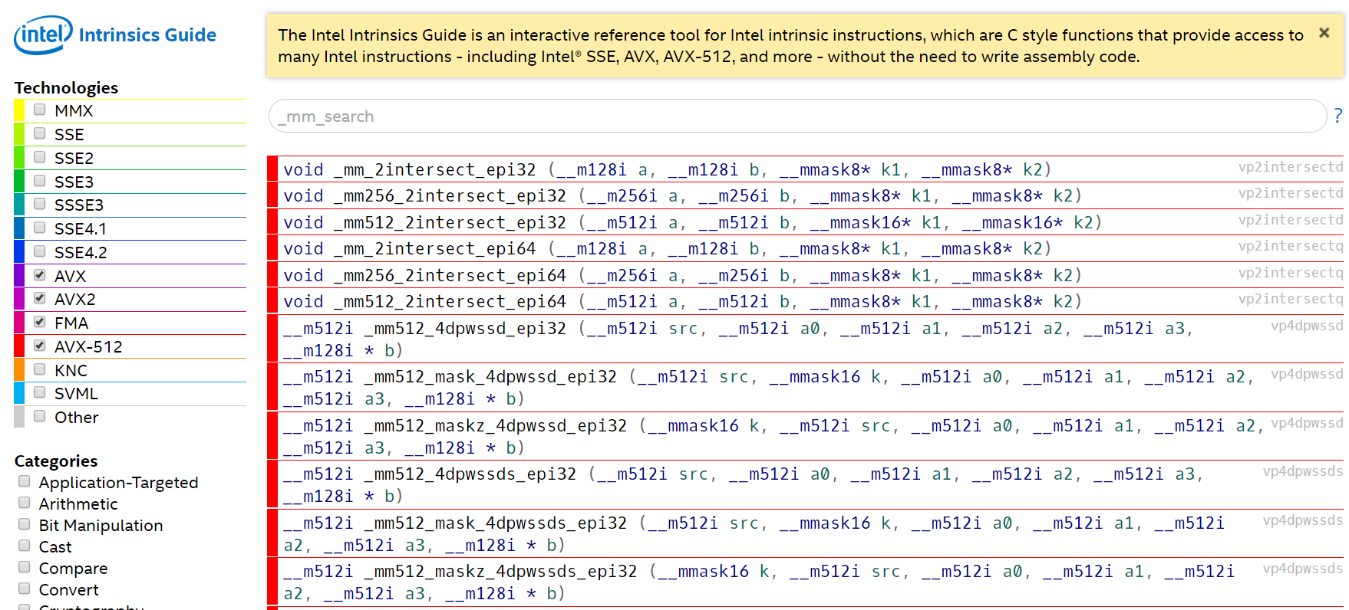
AVX
[그림] Intrinsics
[그림] AVX2 Instructions

Slide 5

Multiplication
Multiplication $\left(x^{1}+3x^{2}+2x^{3}\right)×\left(x^{1}+2x^{2}+3x^{3}\right)$
Multiplication in Ring $(X^{n}+1)$ $\left(x^{1}+3x^{2}+2x^{3}\right)×\left(x^{1}+2x^{2}+3x^{3}\right)$

Slide 6


Lattice Problem
Lattice
LWE ( Learning With Error )
$B=A∗S+E$
[그림] Vector Space
빨간 벡터가 어느 벡터로부터 왔는가?
[그림] a Vector in a Space

Slide 7
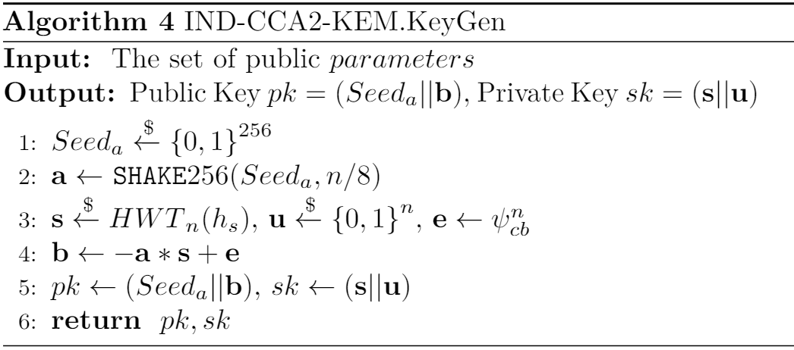
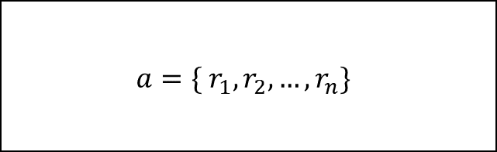
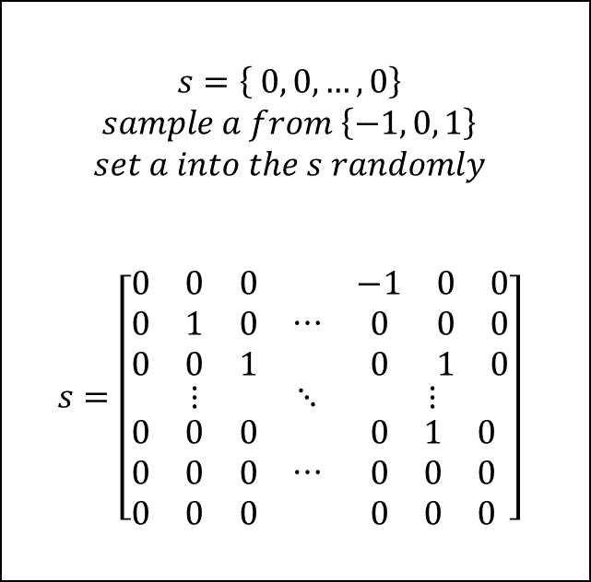
Example: LizarMong
$$a=\{ r_{1}, r_{2}, …, r_{n}\}$$
$$s=\left\{ 0, 0, …, 0\right\}$$
$$sample a from \left\{−1, 0, 1\right\}$$
$$set a into the s randomly$$
$$s=\left[\begin{matrix}\begin{matrix}0 & 0 & 0 \\ 0 & 1 & 0 \\ 0 & 0 & 1\end{matrix} & ⋯ & \begin{matrix}−1 & 0 & 0 \\ 0 & 0 & 0 \\ 0 & 1 & 0\end{matrix} \\ ⋮ & ⋱ & ⋮ \\ \begin{matrix}0 & 0 & 0 \\ 0 & 0 & 0 \\ 0 & 0 & 0\end{matrix} & ⋯ & \begin{matrix}0 & 1 & 0 \\ 0 & 0 & 0 \\ 0 & 0 & 0\end{matrix}\end{matrix}\right]$$
[그림] LizarMong KeyGen Algorithm

Slide 8
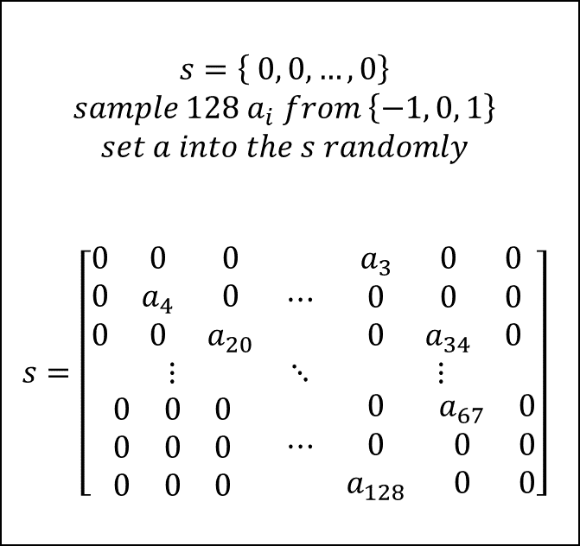

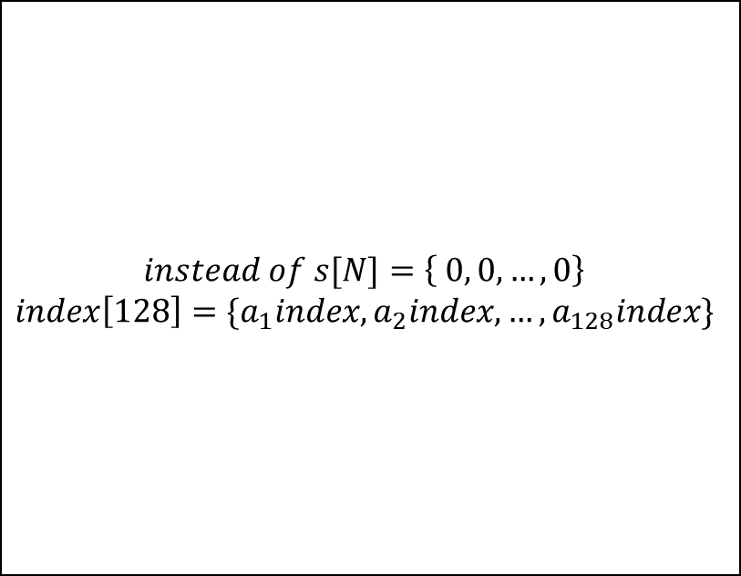

Example: LizarMong
$$a=\{ r_{1}, r_{2}, …, r_{n}\}$$
$$a[N]=\{ r_{1}, r_{2}, …, r_{n}\}$$
$$s=\left\{ 0, 0, …, 0\right\}$$
$$sample 128 a_{i} from \left\{−1, 0, 1\right\}$$
$$set a into the s randomly$$
$$s=\left[\begin{matrix}\begin{matrix}0 & 0 & 0 \\ 0 & a_{4} & 0 \\ 0 & 0 & a_{20}\end{matrix} & ⋯ & \begin{matrix}a_{3} & 0 & 0 \\ 0 & 0 & 0 \\ 0 & a_{34} & 0\end{matrix} \\ ⋮ & ⋱ & ⋮ \\ \begin{matrix}0 & 0 & 0 \\ 0 & 0 & 0 \\ 0 & 0 & 0\end{matrix} & ⋯ & \begin{matrix}0 & a_{67} & 0 \\ 0 & 0 & 0 \\ a_{128} & 0 & 0\end{matrix}\end{matrix}\right]$$
$$instead of s[N]=\left\{ 0, 0, …, 0\right\}$$
$$index\left[128\right]=\{a_{1}index, a_{2}index, …, a_{128}index\}$$

Slide 9










Example: LizarMong
$a×s$ case study
$$s=−1x^{idx}$$
$$s=0x^{idx}$$
$$s=1x^{idx}$$
$$a$$
$$a$$
$$−$$
$$+$$
$$s$$
1, … , 1
$$s$$
1, … , 1

Slide 10
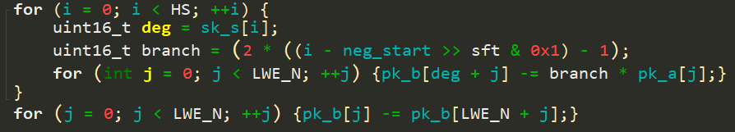

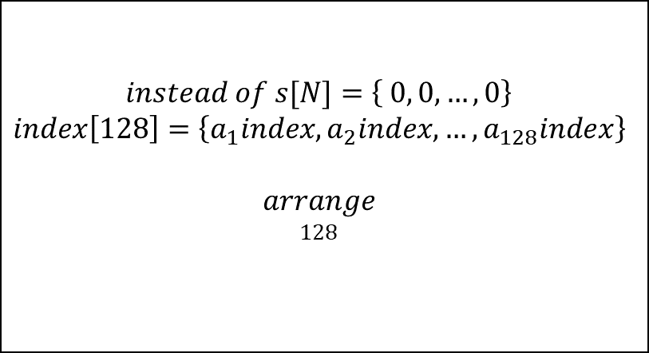






Example: LizarMong
$a×s$ case study
$$instead of s[N]=\left\{ 0, 0, …, 0\right\}$$
$$index\left[128\right]=\left\{a_{1}index, a_{2}index, …, a_{128}index\right\}$$
$$arrange$$
$$128$$
$$a$$
$$−$$
$$s$$
1, … , 1
$$b$$
$$Reduction (X^{n}+1)$$
Indicator
$$s=−1x^{idx}$$
$$s=1x^{idx}$$
[그림] Multiplication Implementation
case1
case2

Slide 11
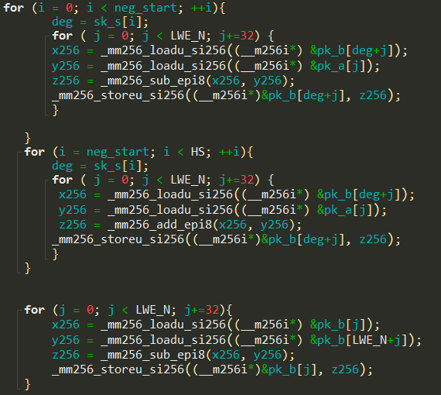
Example: LizarMong
x256
x256
x256
x256
y256
y256
y256
y256
z256
z256
z256
z256
x256
x256
x256
x256
y256
y256
y256
y256
z256
z256
z256
z256
x256
x256
x256
x256
y256
y256
y256
y256
z256
z256
z256
z256
[그림] AVX Implementation

