Slide 1

타 원 곡 선 암 호
Elliptic Curves Cryptography ( ECC )
https://youtu.be/_GOmrsCbNss

Slide 2

Elliptic Curves Cryptography
ECC, ECDH, ECDSA?
→ Internet Security
Name | Example
TLS ( Transport Layer Security ) | HTTPs
SSH ( Security SHell ) | Remote control
PGP ( Pretty Good Privacy ) | E-mail
Cryptocurrencies | Bitcoin

Slide 3
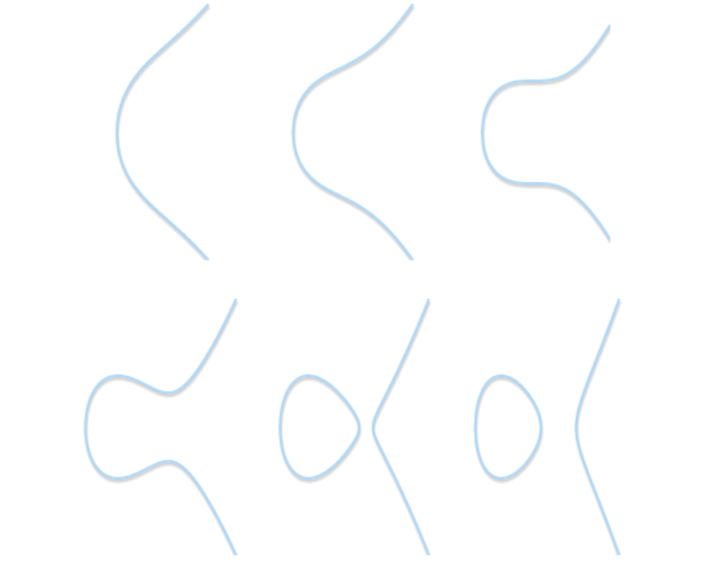
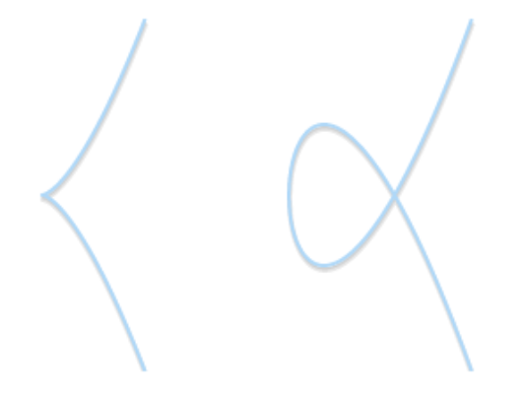


Elliptic Curves
$$y^{2}=x^{3}+ax+b$$
Normal Form
Singularity Form
$$4a^{3}+27b^{2}=0$$

Slide 4
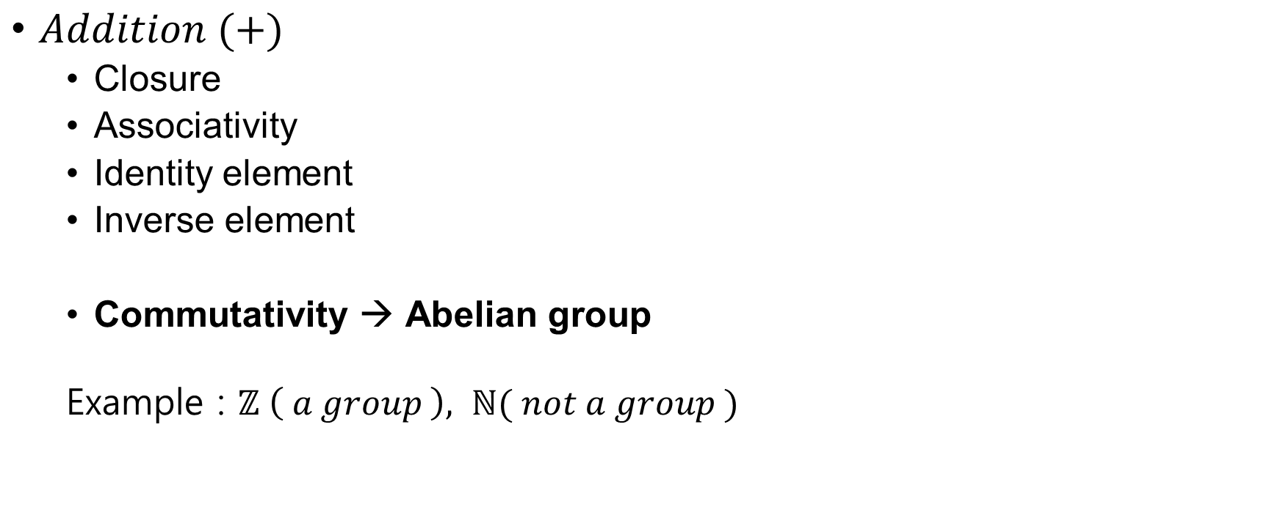
Groups
$Addition (+)$
Closure
Associativity
Identity element
Inverse element
Commutativity → Abelian group
Example : $ℤ \left( a group \right), ℕ( not a group )$
Have
Inverse Element
Doesn’t Have
Inverse Element

Slide 5
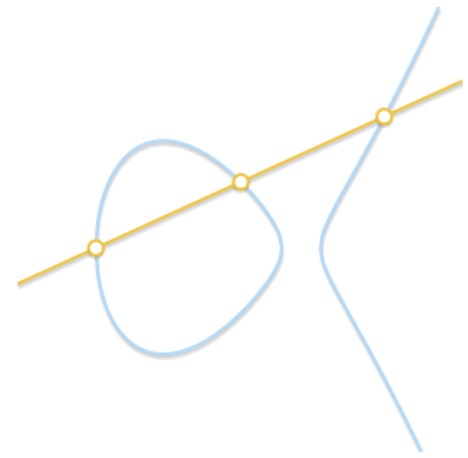
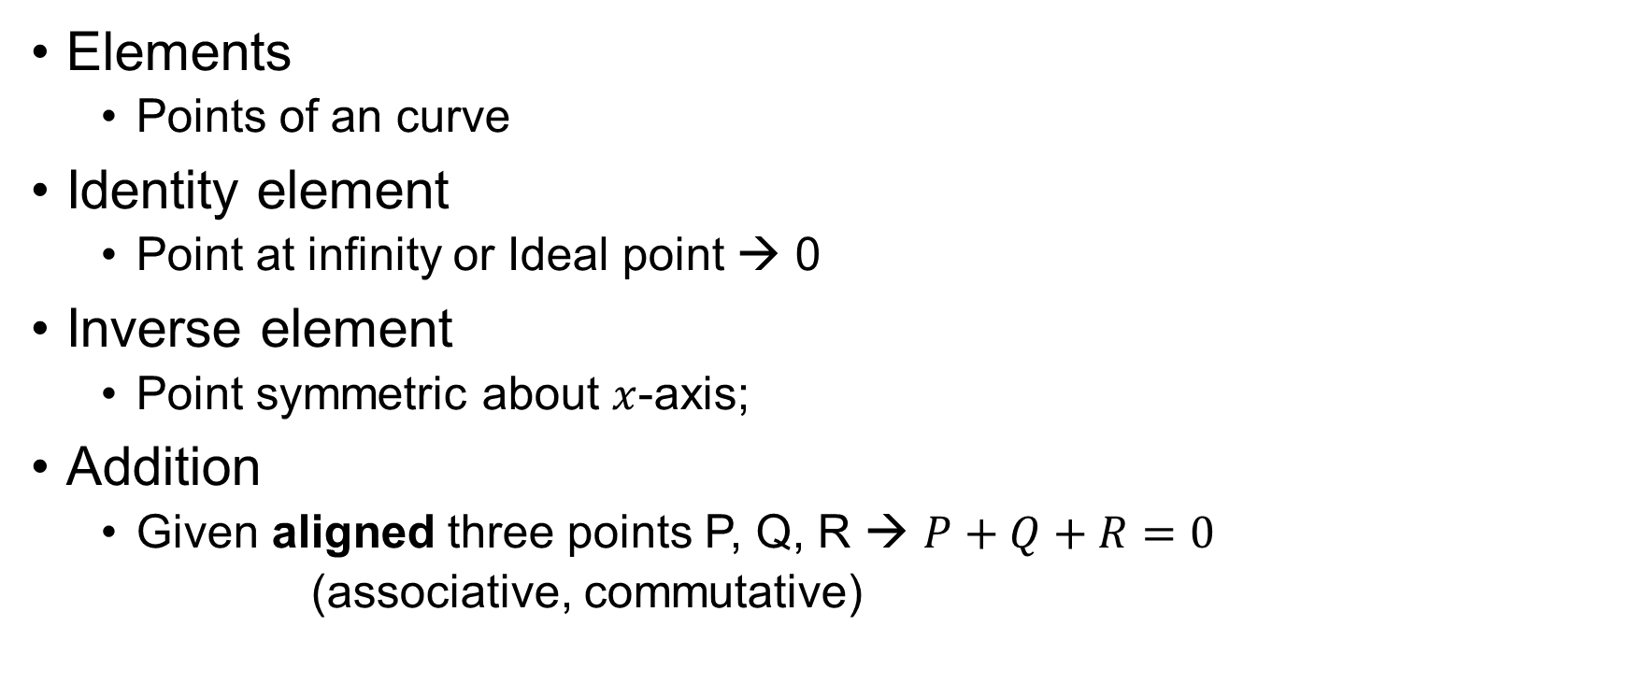
Elliptic Curves over Group
Addition over Elliptic Curves
Elements
Points of an curve
Identity element
Point at infinity or Ideal point → 0
Inverse element
Point symmetric about $x$-axis;
Addition
Given aligned three points P, Q, R → $P+Q+R=0$
(associative, commutative)

Slide 6
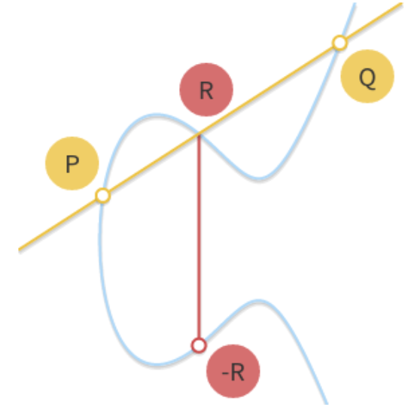

Geometric Addition
$$P+Q+R=0, P+Q=−R$$
$$P=0 or Q=0$$
Identity element
$$P=−Q$$
→ Inverse element
$$P=Q or P≠Q but no R$$
→ Tangency

Slide 7
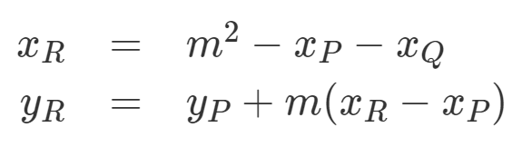
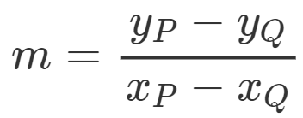

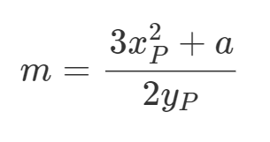

Algebraic Addition
$P+0=0+P=P, P+(−P)=0$
Points P, Q, R
Tangency

Slide 8

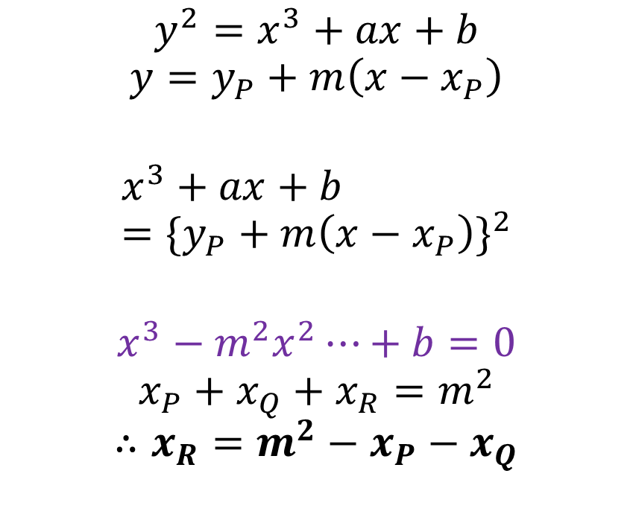
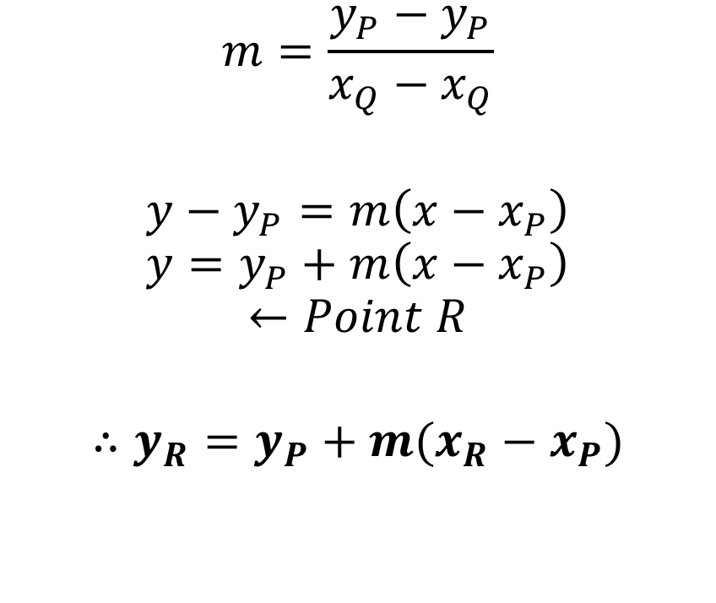

Formula
$$m=\frac{y_{P}−y_{P}}{x_{Q}−x_{Q}}$$
$${y−y}_{P}=m\left(x−x_{P}\right)$$
$$y=y_{P}+m\left(x−x_{P}\right)$$
$$←Point R$$
$$∴y_{R}=y_{P}+m(x_{R}−x_{P})$$
$$y^{2}=x^{3}+ax+b$$
$$y=y_{P}+m\left(x−x_{P}\right)$$
$$x^{3}+ax+b={\{y_{P}+m\left(x−x_{P}\right)\}}^{2}$$
$$x^{3}−m^{2}x^{2}⋯+b=0$$
$$x_{P}+x_{Q}+x_{R}=m^{2}$$
$$∴x_{R}=m^{2}−x_{P}−x_{Q}$$
Roots of the Cubic Equation
$$ax^{3}+bx^{2}+cx+d=0 (a≠0)$$
$$x_{1}=−\frac{b}{3a}−\frac{1}{3a}A−\frac{1}{3a}B$$
$$x_{2}=−\frac{b}{3a}+\frac{1+i\sqrt{3}}{6a}A+\frac{1−i\sqrt{3}}{6a}B$$
$$x_{3}=−\frac{b}{3a}+\frac{1−i\sqrt{3}}{6a}A+\frac{1+i\sqrt{3}}{6a}B$$

Slide 9

Formula
$y^{2}=x^{3}+ax+b$
→

Slide 10
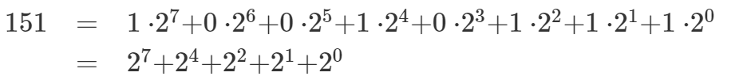

Scalar Multiplication
$$nP=P+P+…+P$$
Double and Add algorithm

Slide 11
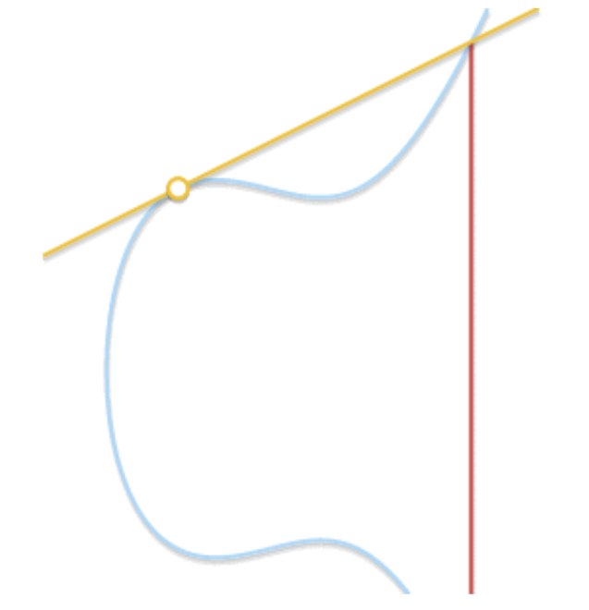
Logarithm

Slide 12
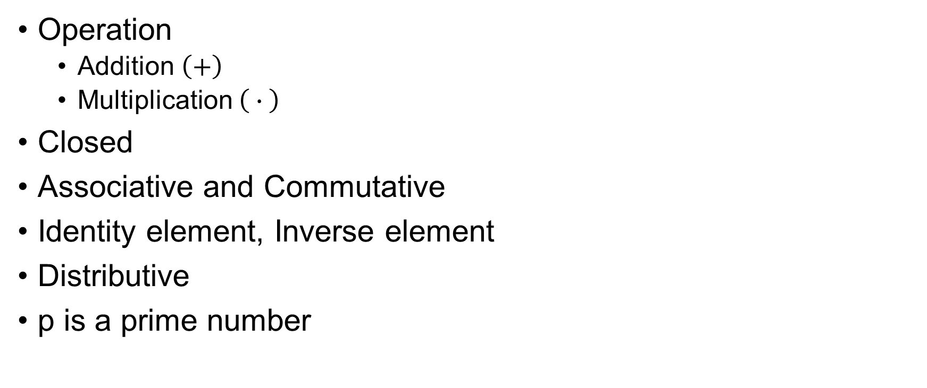

Finite Field $Ϝ_{p}$
Operation
Addition $\left(+\right)$
Multiplication $\left( ∙ \right)$
Closed
Associative and Commutative
Identity element, Inverse element
Distributive
p is a prime number

Slide 13
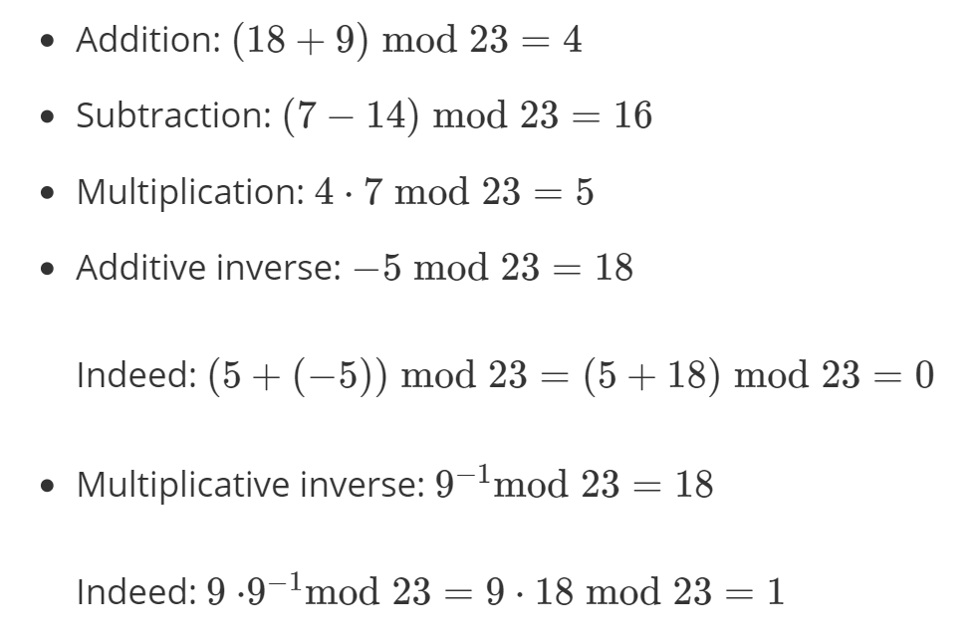
Finite Field $Ϝ_{p}$
Division
Find inverse and perform multiplication
→ Extended Euclidean Algorithm

Slide 14
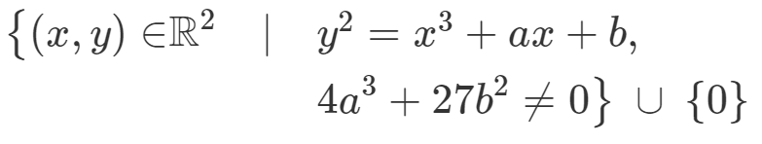
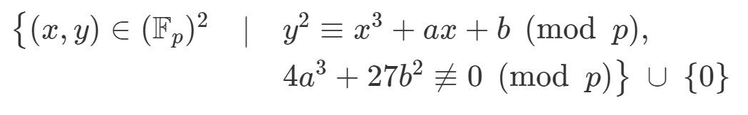

Elliptic Curves over $Ϝ_{p}$

Slide 15
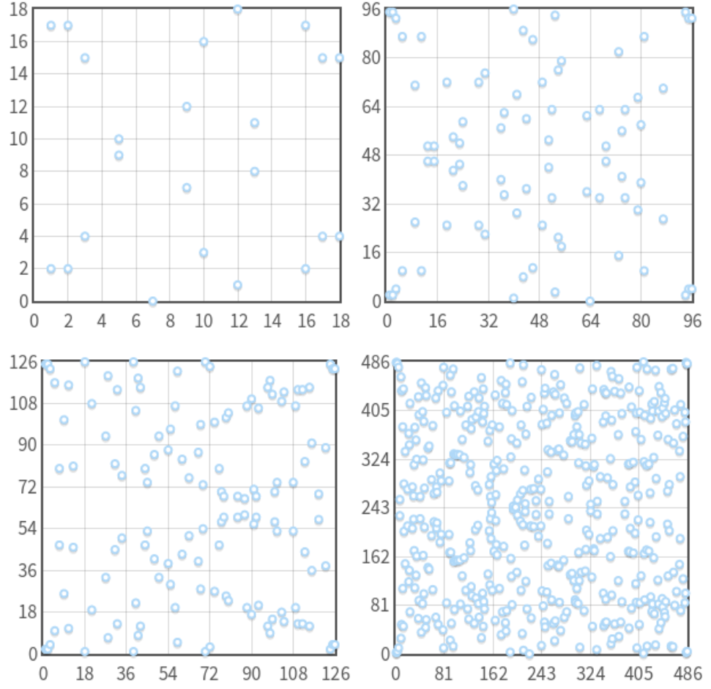
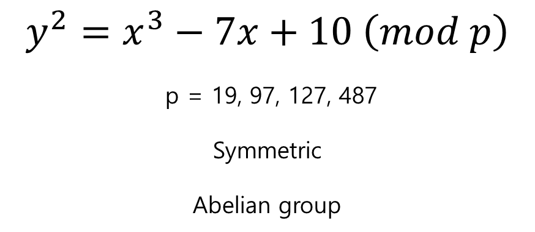
$$y^{2}=x^{3}−7x+10 \left(mod p\right)$$
p = 19, 97, 127, 487
Symmetric
Abelian group

Slide 16
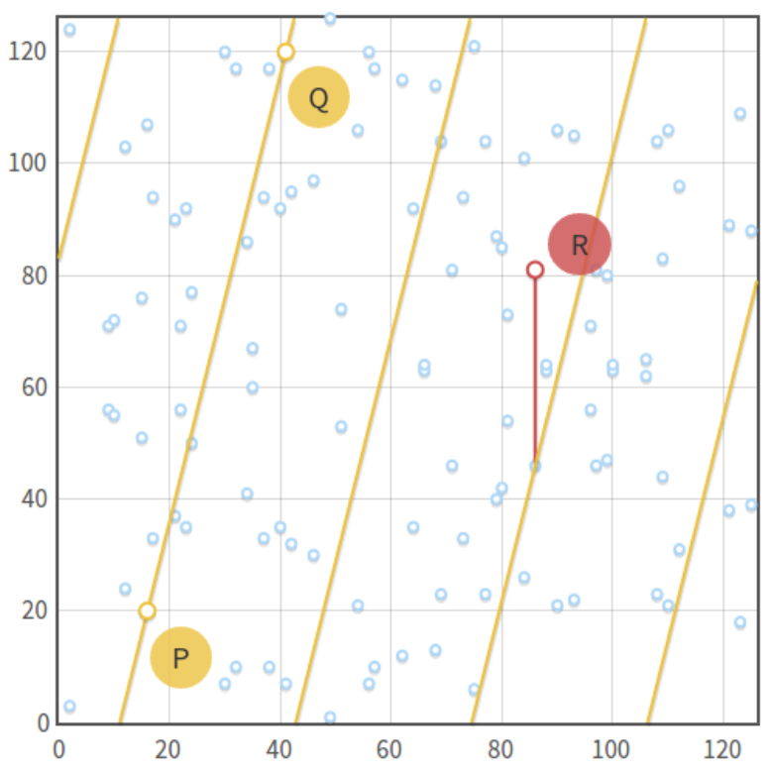
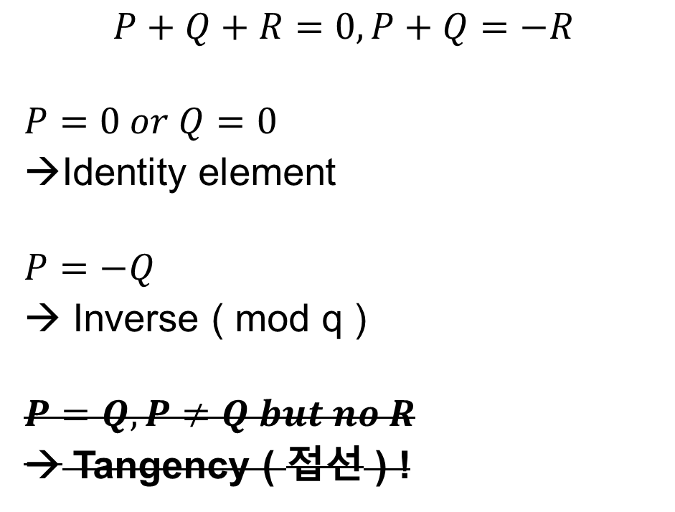
Point Addition
$$P+Q+R=0, P+Q=−R$$
$$P=0 or Q=0$$
Identity element
$$P=−Q$$
→ Inverse ( mod q )
$$P=Q, P≠Q but no R$$
→ Tangency ( 접선 ) !

Slide 17

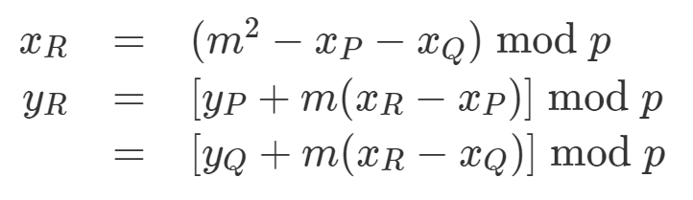

Point Addition

Slide 18
Order
Order
The number of points
Trying all x ( from 0 to p-1 ) is “hard” if p is large
Schoof’s algorithm
Computing the order

Slide 19
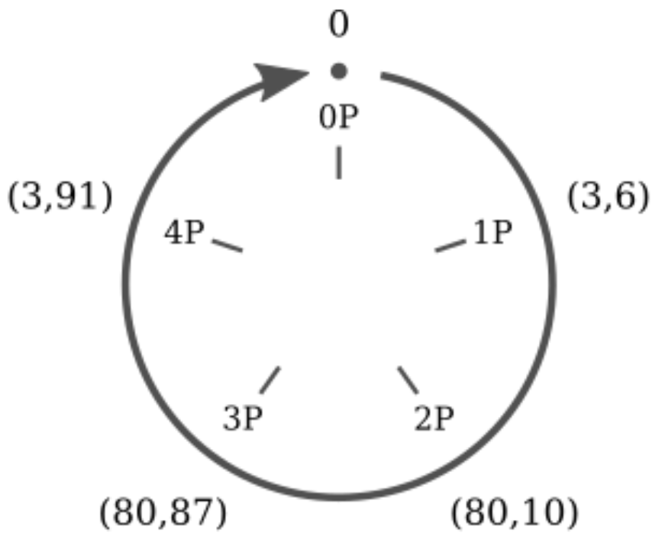

Scalar Multiplication
$$nP=P+P+…+P$$
Double and Add algorithm
Cyclic subgroup
$y^{2}=x^{3}+2x+3 (mod 97)$ $P=(3,6)$

Slide 20
Scalar Multiplication
0P=0
1P=(3,6)
2P=(80,10)
3P=(80,87)
4P=(3,91)
5P=0
6P=(3,6)
...
5kP=0
(5k+1)P=(3,6)
(5k+2)P=(80,10)
(5k+3)P=(80,87)
(5k+4)P=(3,91)
5 points repeated are closed
Subgroup
P is base point (generator)

Slide 21
Subgroup Order
Subgroup order
Minimum n where nP=0
Lagrange’s theorem
The order of subgroup is a divisor or the order of parent group
Find subgroup order
Calculate N
Find out all the divisor of N
Compute nP
Find smallest n such that nP=0

Slide 22
Discrete Logarithm
Given P and Q, finding k such that Q=kP is “harder”
No proof, but there is no known polynomial time algorithm
DSA, DH, ElGamal

