Slide 1
Algebra Fields
최승주
https://youtu.be/sX3FXujOMkk

Slide 2
Finite Fields
Prime Fields
Extension Fields
NTS-KEM

Slide 3
Field in AES
128
AES
X
Y
128/192/256
K
All internal AES operations of AES are based on finite fields

Slide 4
Finite Fields
Finite Field = Galois Field
Basic algebraic structures
+ -
X ()⁻¹
Field
+ -
X
Ring
Group
+ -

Slide 5
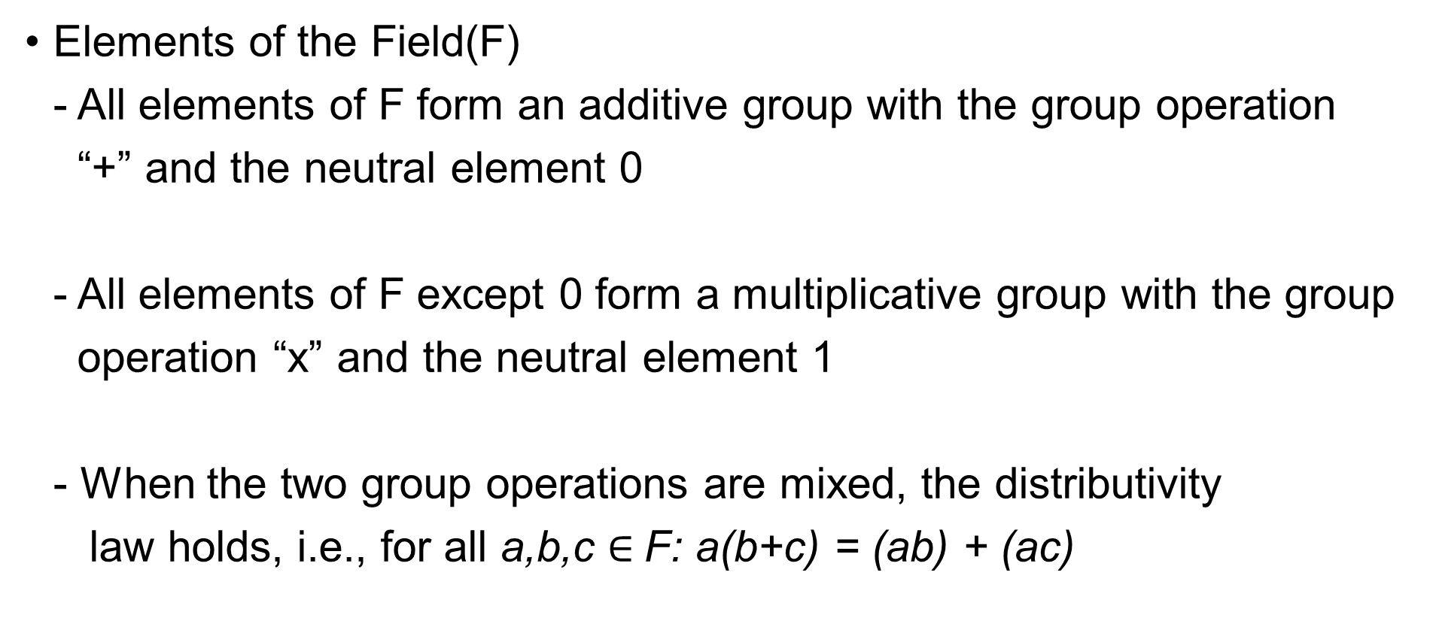
Finite Fields
Elements of the Field(F) - All elements of F form an additive group with the group operation “+” and the neutral element 0 - All elements of F except 0 form a multiplicative group with the group operation “x” and the neutral element 1 - When the two group operations are mixed, the distributivity law holds, i.e., for all a,b,c $∈$F: a(b+c) = (ab) + (ac)

Slide 6
Finite Fields
Field: Set of numbers in which we can add, subtract, multiply and divide
FF only exist if they P^{m} elements ex) (a) There is a FF with 77 → GF(77) (b) There is a FF with 81 → GF(81) = GF(3⁴) (c) There is a FF with 256 → GF(256) = GF(2⁸)
P: prime m: integers
AES Field

Slide 7
Finite Fields
Types of FF
GF(P^{m})
m = 1
m > 1
GF(p)
GF(p^{m})
Prime Fields
Extension fields
GF(2^{m})

Slide 8
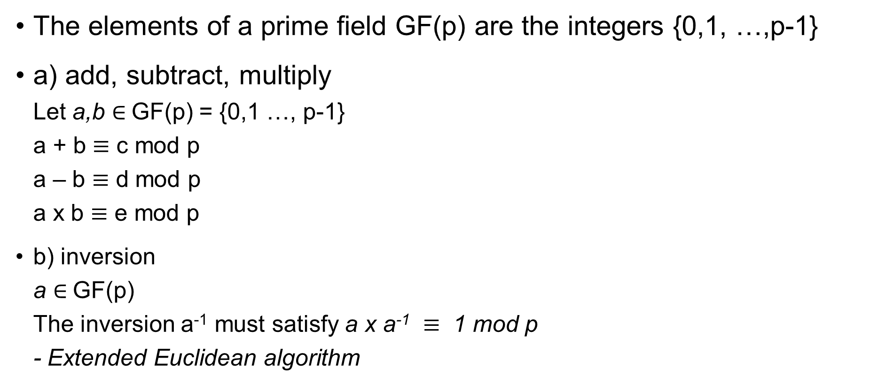
Prime Fields
The elements of a prime field GF(p) are the integers {0,1, …,p-1}
a) add, subtract, multiply Let a,b $∈$GF(p) = {0,1 …, p-1} a + b $≡$ c mod p a – b $≡$ d mod p a x b $≡$ e mod p
b) inversion a $∈$GF(p) The inversion a⁻¹ must satisfy a x a⁻¹ $≡$ 1 mod p - Extended Euclidean algorithm

Slide 9

Extension Fields GF(2^{m})
a) Element representation - The elements of GF(2^{m}) are polynomials a_{m-1}X^{m-1} + … + a₁X + a₀ = A(x) $∈$ GF(2^{m}) - a_{i} $∈$GF(2) = {0,1} → Prime Field

Slide 10

Extension Fields GF(2^{m})
a) Element representation - a_{i} $∈$GF(2) = {0,1} → Prime Field ex) GF(2³) = GF(8) A(x) = a₂X² + a₁X + a₀ GF(2³) = {0, 1, x, x+1, x², x²+1, x²+x, x²+x+1}
(a₂, a₁, a₀)
0 0 0
0 0 1
0 1 0
0 1 1
1 0 0
1 0 1
1 1 0
1 1 1

Slide 11
Extension Fields GF(2^{m})
b) Addition and Subtraction - in GF(2^{m}) → use regular polynomial add or subtraction, where the coefficients are computed in GF(2)

Slide 12
Extension Fields GF(2^{m})
b) Addition and Subtraction - in GF(2^{m}) → use regular polynomial add or subtraction, where the coefficients are computed in GF(2) ex) GF(2³) A(x) = x² + x + 1 B(x) = x² + 1 A+B = (1+1)x² + x + (1+1) = 0x² + x + 0 = x
*Add and Subtraction in GF(2^{m}) are the same operations

Slide 13
Extension Fields GF(2^{m})
c) Multiplication in GF(2^{m}) - Just do regular polynomial multiplication Ex) GF(2³) A x B = (x² + x + 1)(x² + 1) = x⁴ + x³ + x² + x² + x + 1 = x⁴ + x³ + (1+1)x² + x + 1 = x⁴ + x³ + x + 1

Slide 14
Extension Fields GF(2^{m})
c) Multiplication in GF(2^{m}) recall prime fields Ex: GF(7) 3 x 4 = 12
GF(7)’s element: 3,4 *12 is not element of the GF(7) *GF(7) = {0, 1, …,6}

Slide 15

Extension Fields GF(2^{m})
c) Multiplication in GF(2^{m}) recall prime fields Ex: GF(7) 3 x 4 = 12 $≡$ 5 mod 7
GF(7)’s element: 3,4 *12 is not element of the GF(7) *GF(7) = {0, 1, …,6}

Slide 16
Extension Fields GF(2^{m})
c) Multiplication in GF(2^{m}) - Just do regular polynomial multiplication Ex) GF(2³) A x B = (x² + x + 1)(x² + 1) = x⁴ + x³ + x² + x² + x + 1 = x⁴ + x³ + (1+1)x² + x + 1 = x⁴ + x³ + x + 1 = C’(x)
Solution: Reduce C’(x) modulo a polynomial that “behaves like a prime”. These are called irreducible polynomials.

Slide 17

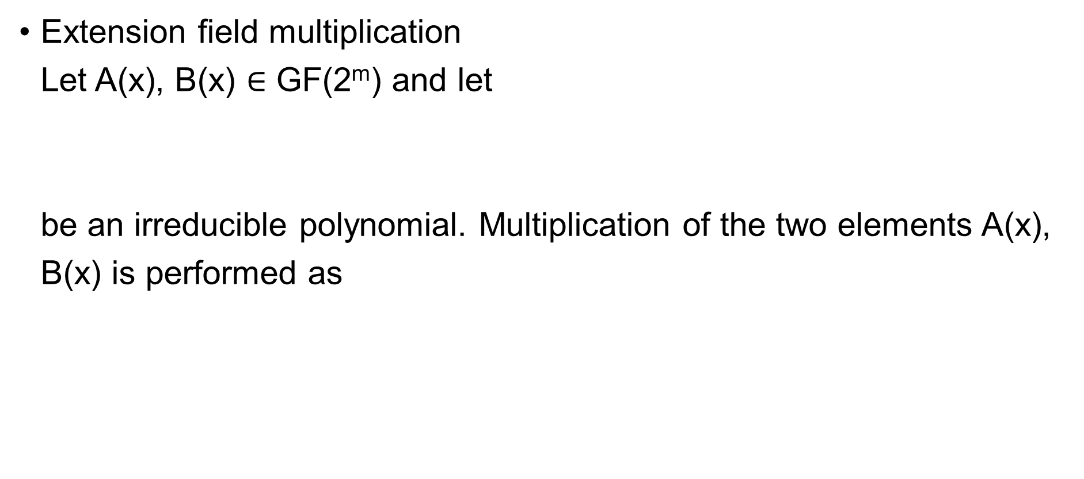
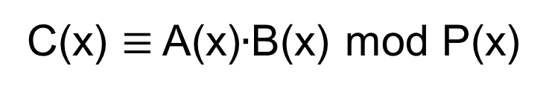
Extension Fields GF(2^{m})
Extension field multiplication Let A(x), B(x) $∈$ GF(2^{m}) and let be an irreducible polynomial. Multiplication of the two elements A(x), B(x) is performed as
P(x)$=\sum_{i=0}^{m}{pixi} , pi∈$ GF(2)
C(x) $≡$ A(x)$∙$B(x) mod P(x)

Slide 18

Extension Fields GF(2^{m})
Irreducible polynomial for GF(2³) P(x) = x³ + x + 1 (x⁴ + x³ + x + 1):(x³ + x + 1) = x + 1 (x⁴ + + x² + 1) x³ + x² + 1 (x³ + x + 1) x² + x $≡$ A$∙$B mod P(x)
+
+

Slide 19
Extension Fields GF(2^{m})
For every field GF(2^{m}), there are several irreducible polynomials - In case of the GF(7), there is only one prime number → 7 - P(x) = x³ + x + 1 - 해당 P(x)가 어떻게 주어지냐에 따라 modular 연산의 결과값이 달라짐 The “AES irreducible polynomial” → P(x) = x⁸ + x⁴ + x³ + x + 1

Slide 20

Extension Fields GF(2^{m})
d) Inversion in GF(2^{m}) - The inverse A⁻¹(x) of an elt, A(x) $∈$ GF(2^{m}) must satisfy - A(x)$∙$A⁻¹(x) $≡$ 1 mod P(x)
Extended Euclidean Algorithm

Slide 21
NTS-KEM
ff.h, ff.c
Implementation of Finite Fields

Slide 22
NTS-KEM(ff.h)
typedef uint16_t ff_unit;
typedef struct FF2m {
int m;
ff_unit (*ff_add)(const struct FF2m* ff2m, ff_unit a, ff_unit b);
ff_unit (*ff_mul)(const struct FF2m* ff2m, ff_unit a, ff_unit b);
ff_unit (*ff_sqr)(const struct FF2m* ff2m, ff_unit a);
ff_unit (*ff_inv)(const struct FF2m* ff2m, ff_unit a);
ff_unit* basis;
#if defined(INTERMEDIATE_VALUES)
ff_unit *log2poly;
ff_unit *poly2log;
#endif
} FF2m;
FF2m* ff_create();
void ff_release(FF2m* ff2m);
#endif

Slide 23
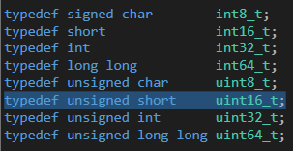
NTS-KEM(ff.h)
typedef uint16_t ff_unit;
stdint.h

Slide 24
NTS-KEM(ff.c)
typedef struct FF2m {
int m;
ff_unit (*ff_add)(const struct FF2m* ff2m, ff_unit a, ff_unit b);
ff_unit (*ff_mul)(const struct FF2m* ff2m, ff_unit a, ff_unit b);
ff_unit (*ff_sqr)(const struct FF2m* ff2m, ff_unit a);
ff_unit (*ff_inv)(const struct FF2m* ff2m, ff_unit a);
ff_unit* basis;
#if defined(INTERMEDIATE_VALUES)
ff_unit *log2poly;
ff_unit *poly2log;
#endif
} FF2m;
#endif

Slide 25
NTS-KEM(ff.c)
ff_unit (*ff_add)(const struct FF2m* ff2m, ff_unit a, ff_unit b);
ff_unit (*ff_mul)(const struct FF2m* ff2m, ff_unit a, ff_unit b);

Slide 26
NTS-KEM(ff.c)
ff_unit (*ff_add)(const struct FF2m* ff2m, ff_unit a, ff_unit b) {
return a ^ b;
}
GF(2^{m})
1 + 1 = 0 1 + 0 = 1 0 + 1 = 1 0 + 0 = 0
X + X = 2X (!X²)

Slide 27
NTS-KEM(ff.c)
ff_unit (*ff_mul)(const struct FF2m* ff2m, ff_unit a, ff_unit b){
uint32_t t;
t = a * (b & 1);
t ^= (a * (b & 0x0002));
t ^= (a * (b & 0x0004));
t ^= (a * (b & 0x0008));
t ^= (a * (b & 0x0010));
t ^= (a * (b & 0x0020));
t ^= (a * (b & 0x0040));
t ^= (a * (b & 0x0080));
t ^= (a * (b & 0x0100));
t ^= (a * (b & 0x0200));
t ^= (a * (b & 0x0400));
t ^= (a * (b & 0x0800));
/* Return the modulo reduction of t */
return ff_reduce_12(t);
}

Slide 28
NTS-KEM(ff.c)
ff_unit (*ff_mul)(const struct FF2m* ff2m, ff_unit a, ff_unit b);
Add Shift Operation
M(11) | C | A | Q(13) | Operation
1011 | 0 | 0000 | 1101 | Init
 | 0 | 1011 | 1101 | 1st A = A + M
 | 0 | 0101 | 1110 | Shift Right CAQ
 | 0 | 0010 | 1111 | Shift Right CAQ
 | 0 | 1101 | 1111 | 3th A = A + M
 | 0 | 0110 | 1111 | Shift-Right CAQ
 | 1 | 0001 | 1111 | 4th A = A + M
 | 0 | 1000 | 1111 | Shift-Right CAQ

Slide 29
NTS-KEM(ff.c)
ff_unit (*ff_mul)(const struct FF2m* ff2m, ff_unit a, ff_unit b){
uint32_t t;
t = a * (b & 1);
t ^= (a * (b & 0x0002));
t ^= (a * (b & 0x0004));
t ^= (a * (b & 0x0008));
t ^= (a * (b & 0x0010));
t ^= (a * (b & 0x0020));
t ^= (a * (b & 0x0040));
t ^= (a * (b & 0x0080));
t ^= (a * (b & 0x0100));
t ^= (a * (b & 0x0200));
t ^= (a * (b & 0x0400));
t ^= (a * (b & 0x0800));
/* Return the modulo reduction of t */
return ff_reduce_12(t);
}
(x² + x + 1)(x² + 1)
x⁴ + x³ + x² + x² + x + 1

Slide 30
NTS-KEM(ff.c)
#if defined(INTERMEDIATE_VALUES)
KATs and Intermediate Values
KATs: known answers test "A publicly available set of parameters and values that allow you to check the correctness of an implementation.“ - 구현한 암호 모듈이 알맞게 구현이 된 것인지 확인해 볼 수 있는 입력 값 세트
NTS-KEM → NIST에서 제공한 코드를 갖고 KATs를 진행
- PQCgenKAT_kem.c, AES-CTR-DRBG 난수 생성기
- KAT, intermediate value: set as 100

Slide 31
감사합니다

