Slide 1
Modular reduction for NIST curves (prime ECC)
https://youtu.be/gD1M7M581mk

Slide 2
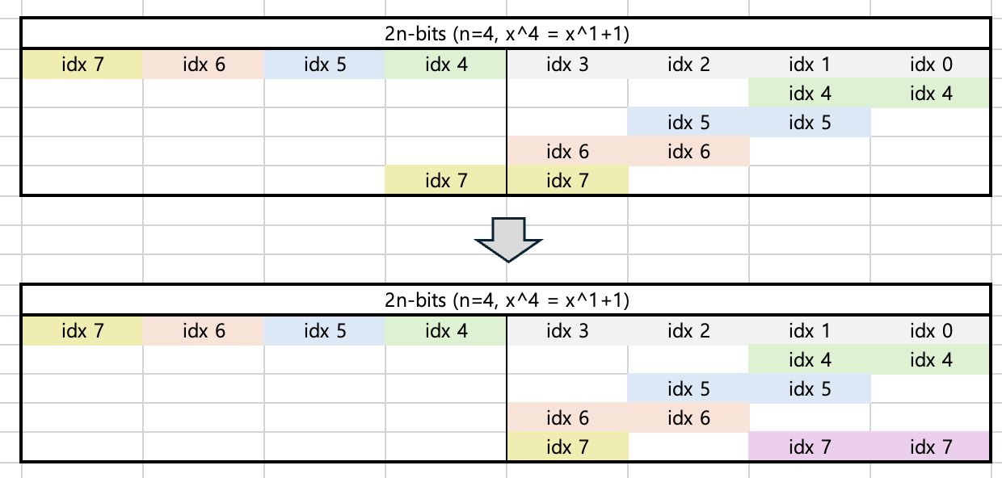
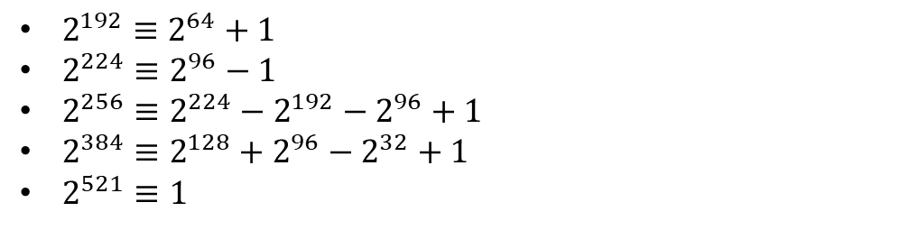

Modular reduction for inversion
Prime of P-curves have these form, and we can use the modular congruence for reduction.
Modular reduction can be performed by addition.
  Example: n=4, $2^{4}≡2^{1}+1$
  input[4] $=$input[1] + input[0]
  input[5] $=$input[2] + input[1]
  …
  input[7] $=$input[4] + input[3]
  → input[7] $=$input[1] + input[0] + input[3]
  1 bit (exceeding $n$) maps to 2~3 bits depending on curve.
$2^{192}≡2^{64}+1$
$2^{224}≡2^{96}−1$
$2^{256}≡2^{224}−2^{192}−2^{96}+1$
$2^{384}≡2^{128}+2^{96}−2^{32}+1$
$2^{521}≡1$
Input[0]~[7]
= input[1] + input[0]

Slide 3

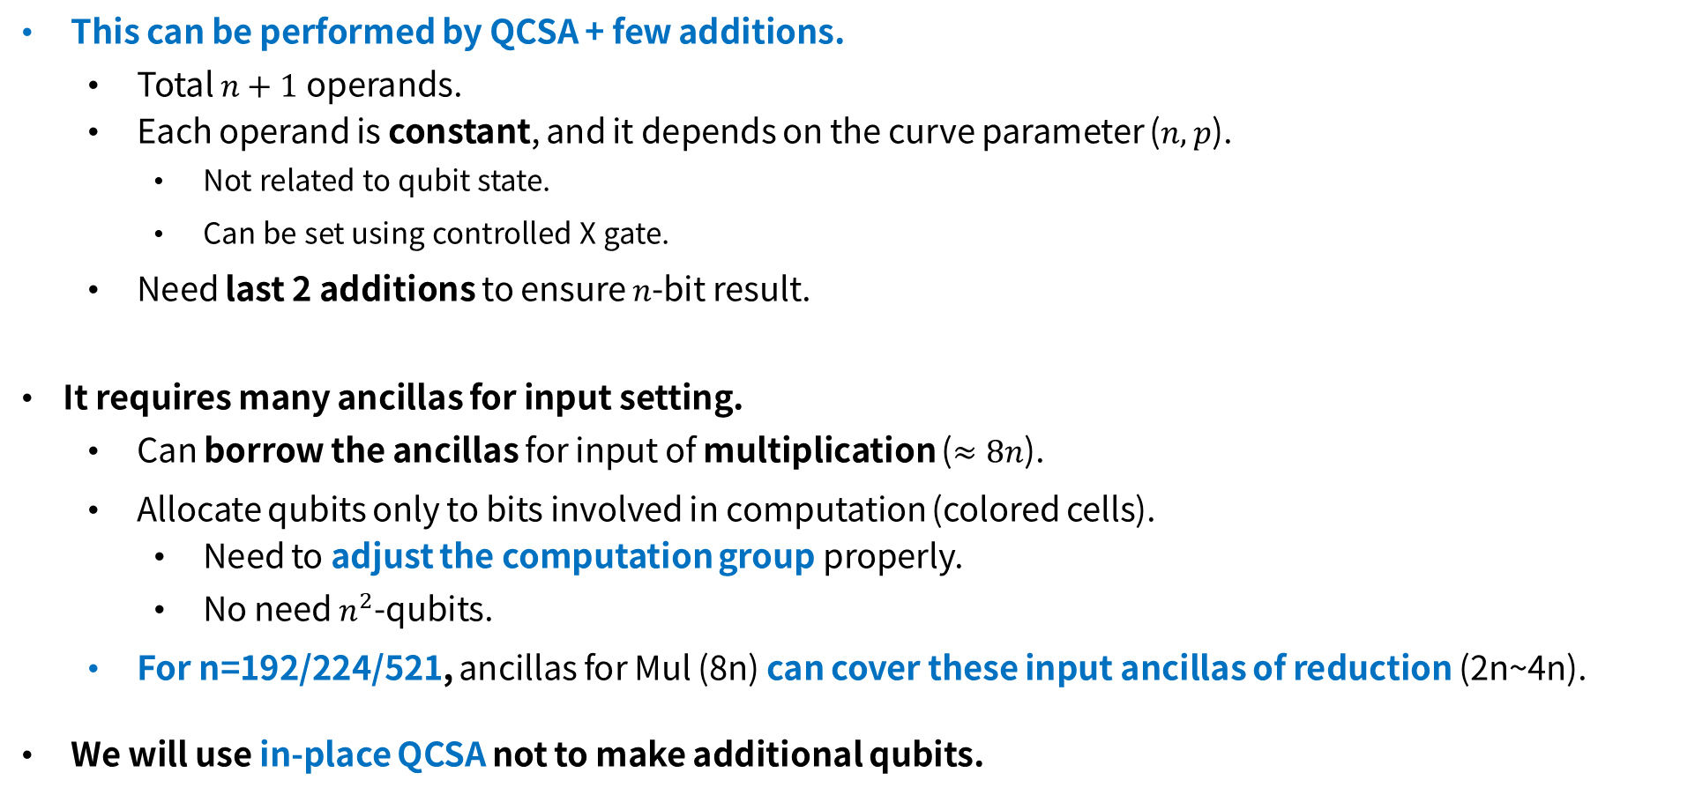



Modular reduction for 2n-bit data
This can be performed by QCSA + few additions.
  Total $n+1$ operands.
  Each operand is constant, and it depends on the curve parameter ($n, p$).
    Not related to qubit state.
    Can be set using controlled X gate.
  Need last 2 additions to ensure $n$-bit result.
It requires many ancillas for input setting.
  Can borrow the ancillas for input of multiplication ($≈8n$).
  Allocate qubits only to bits involved in computation (colored cells).
    Need to adjust the computation group properly.
    No need $n^{2}$-qubits.
  For n=192/224/521, ancillas for Mul (8n) can cover these input ancillas of reduction (2n~4n).
We will use in-place QCSA not to make additional qubits.
Group 3
$$⋯$$
Group 0
Low $n$-bits of input
reduced input [0]
empty
reduced input [1]
QCSA
$$⋮$$
empty
reduced input [$n−1$]
empty
due to the small number of terms (e.g., $2^{64}+1$)
Notes:
다만, 이 방식은 QCSA의 내부 변수인 마지막 두 오퍼랜드 (A,B)를 인플레이스로 더하는 것임
→ 그래서 low n-bit (L)를 오퍼랜드에 넣지 말고 (L=L+A, L=L+B)로 해서 L에 누적하면 추가 큐비트 방지할 수 있을 것 같음 이것도 실구현으로 확인 필요

Slide 4
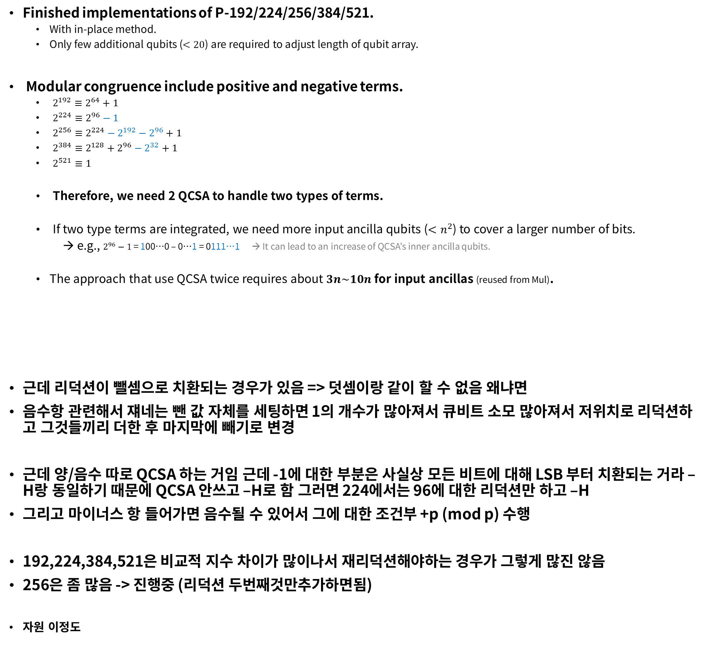
Modular reduction for inversion
Finished implementations of P-192/224/256/384/521.
  With in-place method.
  Only few additional qubits ($<20$) are required to adjust length of qubit array.
Modular congruence include positive and negative terms.
  $2^{192}≡2^{64}+1$
  $2^{224}≡2^{96}−1$
  $2^{256}≡2^{224}−2^{192}−2^{96}+1$
  $2^{384}≡2^{128}+2^{96}−2^{32}+1$
  $2^{521}≡1$
  Therefore, we need 2 QCSA to handle two types of terms.
  If two type terms are integrated, we need more input ancilla qubits ($<n^{2}$) to cover a larger number of bits.
  → e.g., $2^{96}−1$ = 100…0 – 0…1 = 0111…1 → It can lead to an increase of QCSA’s inner ancilla qubits.
  The approach that use QCSA twice requires about $3n\sim 10n$for input ancillas (reused from Mul).
근데 리덕션이 뺄셈으로 치환되는 경우가 있음 => 덧셈이랑 같이 할 수 없음 왜냐면
음수항 관련해서 쟤네는 뺀 값 자체를 세팅하면 1의 개수가 많아져서 큐비트 소모 많아져서 저위치로 리덕션하고 그것들끼리 더한 후 마지막에 빼기로 변경
근데 양/음수 따로 QCSA 하는 거임 근데 -1에 대한 부분은 사실상 모든 비트에 대해 LSB 부터 치환되는 거라 – H랑 동일하기 때문에 QCSA 안쓰고 –H로 함 그러면 224에서는 96에 대한 리덕션만 하고 –H
그리고 마이너스 항 들어가면 음수될 수 있어서 그에 대한 조건부 +p (mod p) 수행
192,224,384,521은 비교적 지수 차이가 많이나서 재리덕션해야하는 경우가 그렇게 많진 않음
256은 좀 많음 -> 진행중 (리덕션 두번째것만추가하면됨)
자원 이정도
-
QCSA 1
for addition of positive terms
QCSA 2
for addition of negative terms
95 ones
Notes:
-H는 인플레이스 뺄셈 한 번 + mod p 보정이 요구됨.
그러나 QCSA로 -1을 세팅할 경우, QCSA 내부 마지막 덧셈과 mod p가 필요함.

Slide 5
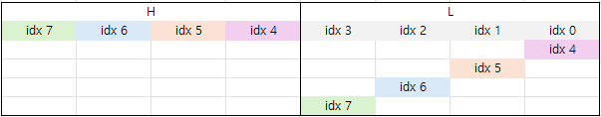
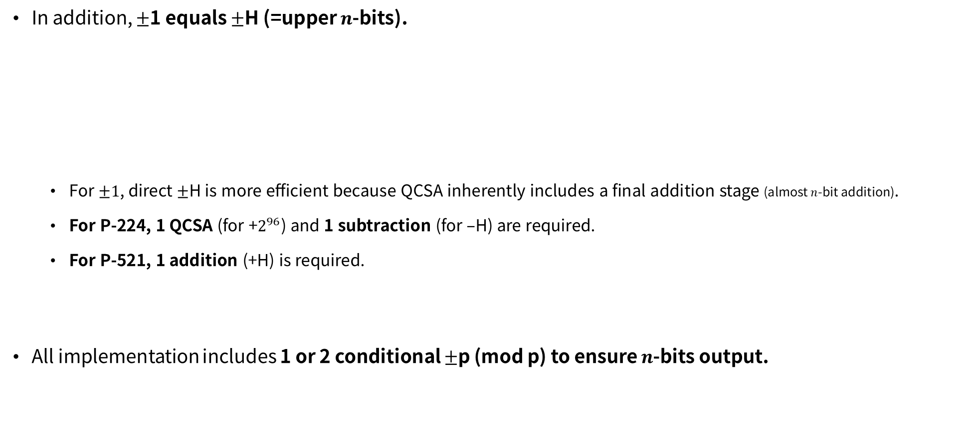

Modular reduction for inversion
In addition, $±$1 equals $±$H (=upper $n$-bits).
  For $±1$, direct $±$H is more efficient because QCSA inherently includes a final addition stage (almost $n$-bit addition).
  For P-224, 1 QCSA (for +$2^{96}$) and 1 subtraction (for –H) are required.
  For P-521, 1 addition (+H) is required.
All implementation includes 1 or 2 conditional $±$p (mod p) to ensure $n$-bits output.
$2^{192}≡2^{64}+1$
$2^{224}≡2^{96}−1$
$2^{256}≡2^{224}−2^{192}−2^{96}+1$
$2^{384}≡2^{128}+2^{96}−2^{32}+1$
$2^{521}≡1$
Notes:
-H는 인플레이스 뺄셈 한 번 + mod p 보정이 요구됨.
그러나 QCSA로 -1을 세팅할 경우, QCSA 내부 마지막 덧셈과 mod p가 필요함.

Slide 6
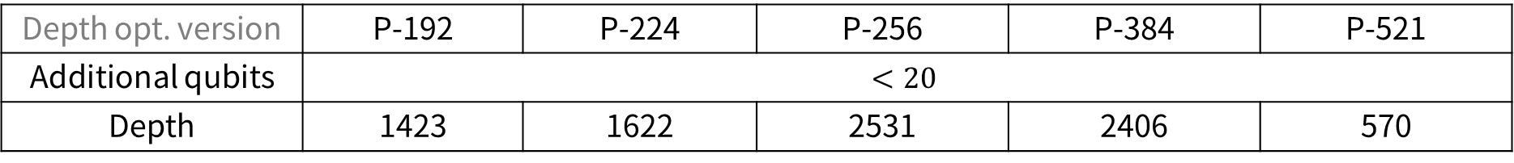
Modular reduction for inversion - resources
Reduction step has a negligible impact on the circuit depth.
For P-256, the depth is slightly higher.
  because it has multiple re-reduction cases.
Input[0]~[7]
Re-reduction case
Depth opt. version | P-192 | P-224 | P-256 | P-384 | P-521
Additional qubits | $$<20$$
Depth | 1423 | 1622 | 2531 | 2406 | 570
Notes:
-H는 인플레이스 뺄셈 한 번 + mod p 보정이 요구됨.
그러나 QCSA로 -1을 세팅할 경우, QCSA 내부 마지막 덧셈과 mod p가 필요함.

Slide 7
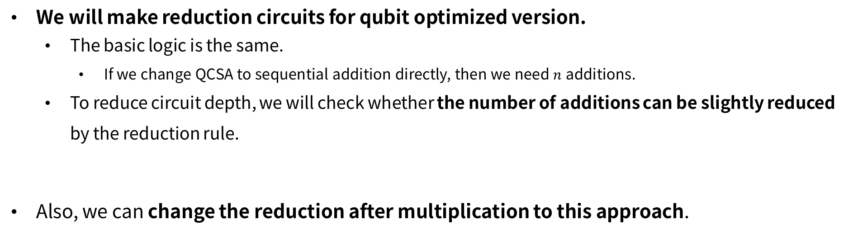
Plan
We will make reduction circuits for qubit optimized version.
  The basic logic is the same.
    If we change QCSA to sequential addition directly, then we need $n$ additions.
  To reduce circuit depth, we will check whether the number of additions can be slightly reduced
  by the reduction rule.
Also, we can change the reduction after multiplication to this approach.

Slide 8
Thank you.
감사합니다.

