Slide 1
SIMON_SPECK
2020.05.17
https://youtu.be/33inn9wMAHA

Slide 2
SIMON SPECK
NSA(National Security Agency)에서 제작한 경량 암호 – 2013
SIMON: 하드웨어에 최적화
SPECK: 소프트웨어에 최적화
Feistel cipher

Slide 3
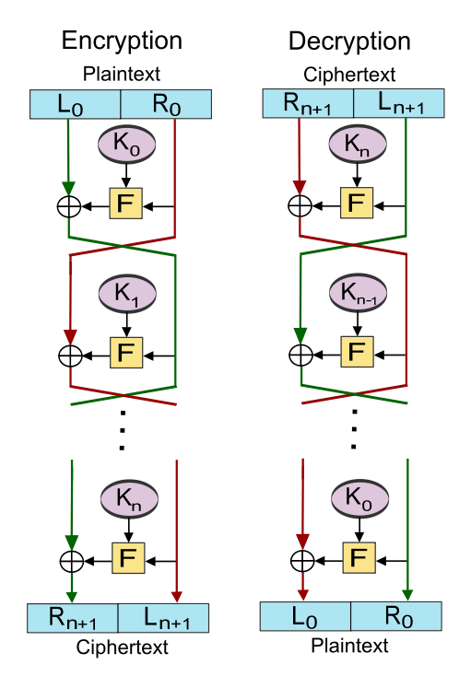
Feistel Cipher
블록 암호를 생성하는 대칭 구조
암호화, 복호화가 매우 유사 - 키의 순서만 다름

Slide 4
SIMON
Block size (bits) | Key size (bits) | Rounds
32 | 64 | 32
48 | 72 | 36
 | 96 | 36
64 | 96 | 42
 | 128 | 44
96 | 96 | 52
 | 144 | 54
128 | 128 | 68
 | 192 | 69
 | 256 | 72

Slide 5
SIMON
Feistel → n bit word
block 길이: 2n
Key multiplier: m (2,3,4)
Simon64/128 → 64bit plaintext block(n=32) + 128 bit key
Simon32/64 → 32bit plaintext block(n=16) + 64 bit key

Slide 6
SIMON
#define ROTL32(x,r) (((x)<>(32-(r))))
#define ROTR32(x,r) (((x)>>(r)) | ((x)<<(32-(r))))
define f32(x) ((ROTL32(x,1) & ROTL32(x,8)) ^ ROTL32(x,2))
define R32x2(x,y,k1,k2) (y^=f32(x), y^=k1, x^=f32(y), x^=k2)

Slide 7
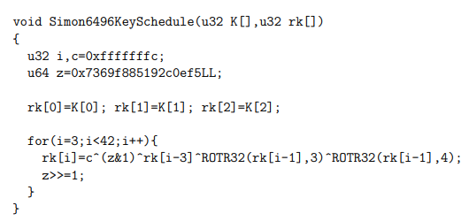
SIMON
rk[0-41] 생성

Slide 8
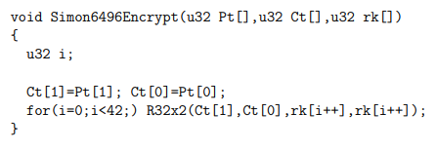
SIMON
define f32(x) ((ROTL32(x,1) & ROTL32(x,8)) ^ ROTL32(x,2))
define R32x2(x,y,k1,k2) (y^=f32(x), y^=k1, x^=f32(y), x^=k2)

Slide 9
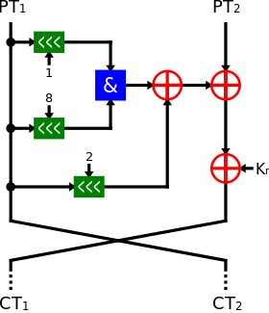
SIMON
define f32(x) ((ROTL32(x,1) & ROTL32(x,8)) ^ ROTL32(x,2))
define R32x2(x,y,k1,k2) (y^=f32(x), y^=k1, x^=f32(y), x^=k2)

Slide 10
SIMON
define f32(x) ((ROTL32(x,1) & ROTL32(x,8)) ^ ROTL32(x,2))
define R32x2(x,y,k1,k2) (y^=f32(x), y^=k1, x^=f32(y), x^=k2)

Slide 11
















SIMON
define f32(x) ((ROTL32(x,1) & ROTL32(x,8)) ^ ROTL32(x,2))
$$a0$$
$$a1$$
$$a1$$
$$a2$$
$$a2$$
$$a3$$
$$a3$$
$$a4$$
$$a4$$
$$a5$$
$$a5$$
$$a6$$
$$a6$$
$$a7$$
$$a7$$
$$a0$$
Left Shift by 1

Slide 12
















































SIMON
define f32(x) ((ROTL32(x,1) & ROTL32(x,8)) ^ ROTL32(x,2))
$$a0$$
TOFFOLI
$$a1$$
$$a0$$
CNOT
$$a1$$
$$a1$$
$$a2$$
$$a1$$
$$a2$$
$$a2$$
$$a3$$
$$a2$$
$$a3$$
$$a3$$
$$a4$$
$$a3$$
$$a4$$
$$a4$$
$$a5$$
$$a4$$
$$a5$$
$$a5$$
$$a6$$
$$a5$$
$$a6$$
$$a6$$
$$a7$$
$$a6$$
$$a7$$
$$a7$$
$$a0$$
$$a7$$
$$a0$$
$$a0$$
$$a1$$
$$a1$$
$$a2$$
$$a2$$
$$a3$$
$$a3$$
$$a4$$
$$a4$$
$$a5$$
$$a5$$
$$a6$$
$$a6$$
$$a7$$
$$a7$$
$$a0$$
Result

Slide 13





















SIMON
define f32(x) ((ROTL32(x,1) & ROTL32(x,8)) ^ ROTL32(x,2))
define R32x2(x,y,k1,k2) (y^=f32(x), y^=k1, x^=f32(y), x^=k2)
$$a0$$
TOFFOLI
$$a1$$
$$a0$$
CNOT
$$a1$$
$$a1$$
$$a2$$
$$a1$$
$$a2$$
$$a2$$
$$a3$$
$$a2$$
$$a3$$
$$a3$$
$$a4$$
$$a3$$
$$a4$$
$$a4$$
$$a5$$
$$a4$$
$$a5$$
$$a5$$
$$a6$$
$$a5$$
$$a6$$
$$a6$$
$$a7$$
$$a6$$
$$a7$$
$$a7$$
$$a0$$
$$a7$$
$$a0$$
$$a0$$
$$a1$$
$$a1$$
$$a2$$
$$a2$$
$$a3$$
CNOT
Y
CNOT
k1
$$a3$$
$$a4$$
$$a4$$
$$a5$$
$$a5$$
$$a6$$
$$a6$$
$$a7$$
$$a7$$
$$a0$$
Result

Slide 14
SPECK
Block size (bits) | Key size (bits) | Rounds
2×16 = 32 | 4×16 = 64 | 22
2×24 = 48 | 3×24 = 72 | 22
 | 4×24 = 96 | 23
2×32 = 64 | 3×32 = 96 | 26
 | 4×32 = 128 | 27
2×48 = 96 | 2×48 = 96 | 28
 | 3×48 = 144 | 29
2×64 = 128 | 2×64 = 128 | 32
 | 3×64 = 192 | 33
 | 4×64 = 256 | 34

Slide 15
SPECK
Feistel → n bit word
block 길이: 2n
Key multiplier: m (2,3,4)
SPECK64/128 → 64bit plaintext block(n=32) + 128 bit key
SPECK32/64 → 32bit plaintext block(n=16) + 64 bit key

Slide 16
SPECK
define ER32(x,y,k) (x=ROTR32(x,8), x+=y, x^=k, y=ROTL32(y,3), y^=x)
define DR32(x,y,k) (y^=x, y=ROTR32(y,3), x^=k, x-=y, x=ROTL32(x,8))

Slide 17
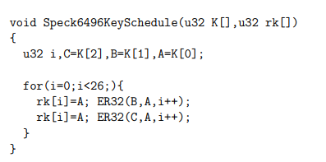
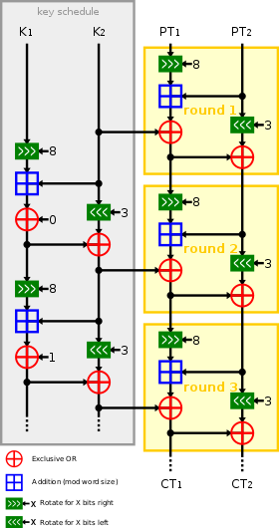
SPECK
define ER32(x,y,k) (x=ROTR32(x,8), x+=y, x^=k, y=ROTL32(y,3), y^=x)
rk[0] = A

Slide 18
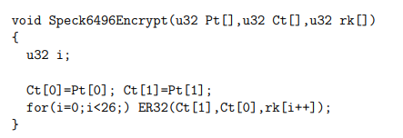
SPECK
define ER32(x,y,k) (x=ROTR32(x,8), x+=y, x^=k, y=ROTL32(y,3), y^=x)

Slide 19
















SPECK
define ER32(x,y,k) (x=ROTR32(x,8), x+=y, x^=k, y=ROTL32(y,3), y^=x)
$$a0$$
$$a1$$
$$a1$$
$$a2$$
CNOT
Addition
$$a2$$
$$a3$$
$$a3$$
$$a4$$
$$a4$$
$$a5$$
$$a5$$
$$a6$$
$$a6$$
$$a7$$
$$a7$$
$$a0$$
Shift

Slide 20
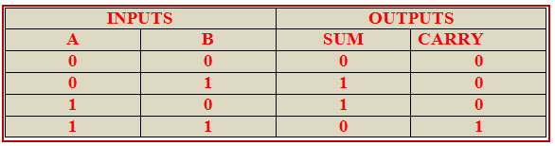
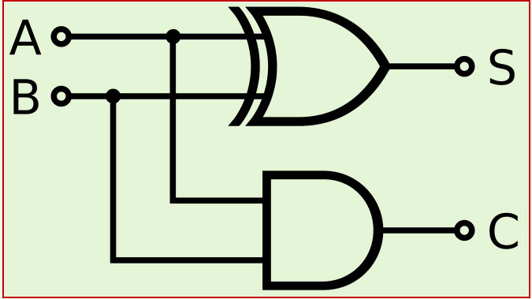
SPECK
Half Adder

Slide 21
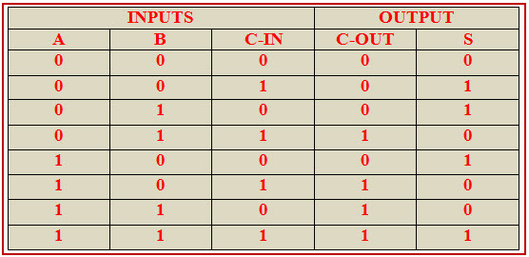
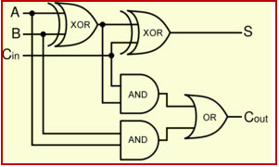
SPECK
Full Adder

Slide 22
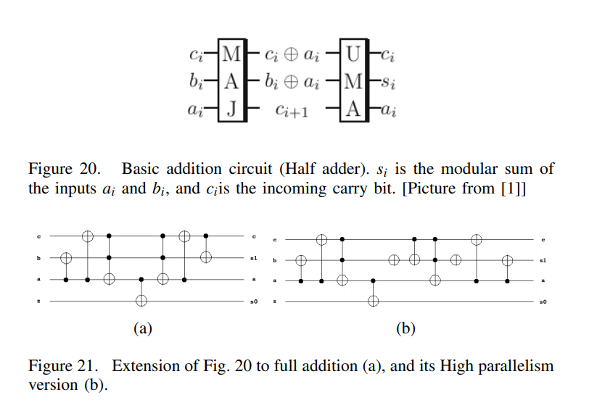
SPECK

