Slide 1
Advanced Encryption Standard (AES)
윤재웅
이정현
석사연구생 : 김경호

Slide 2
CONTENTS
001/ AES란?
002/ 알고리즘
003/ 연산

Slide 3
AES ?
고급 암호화 표준
(Advanced Encryption Standard)
Rijmen과 Daemen에 의해 고안
- DES를 대체한 암호 알고리즘
대칭키 알고리즘
블록 : 128bit, 키 : 128/192/256bit

Slide 4
DES ?
데이터 암호화 표준(Data Encryption Standard)
외부 키(64bit) = 내부 키(56bit) + 거사용 비트(8bit)
16 라운드의 암호화 과정
키 : 56bit → 취약 → AES
대칭키 암호

Slide 5
Plain Text
AddRoundKey
SubBytes
Round * 9
ShiftRows
MixColumns
KeySchedule
AddRoundKey
KeySchedule
SubBytes
No. of rounds | Key Length (bytes)
10 | 16
12 | 24
14 | 32
ShiftRows
AddRoundKey

Slide 6
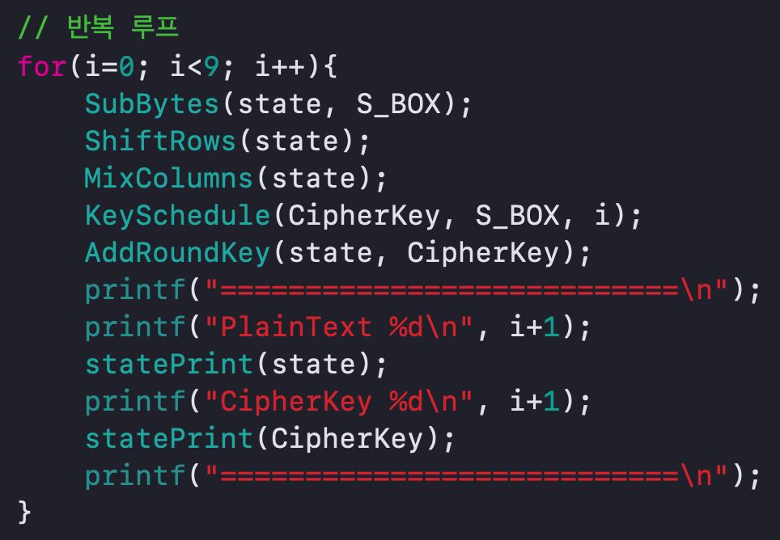
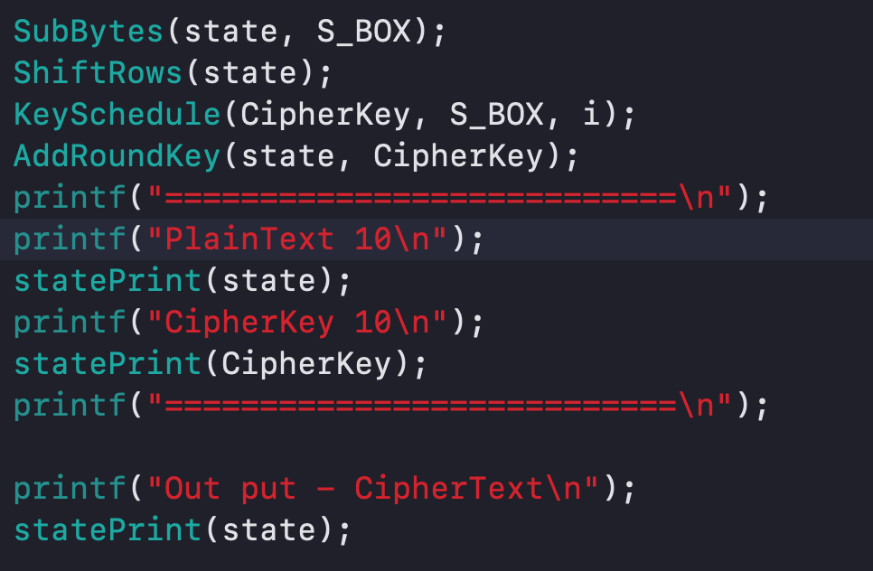

Slide 7
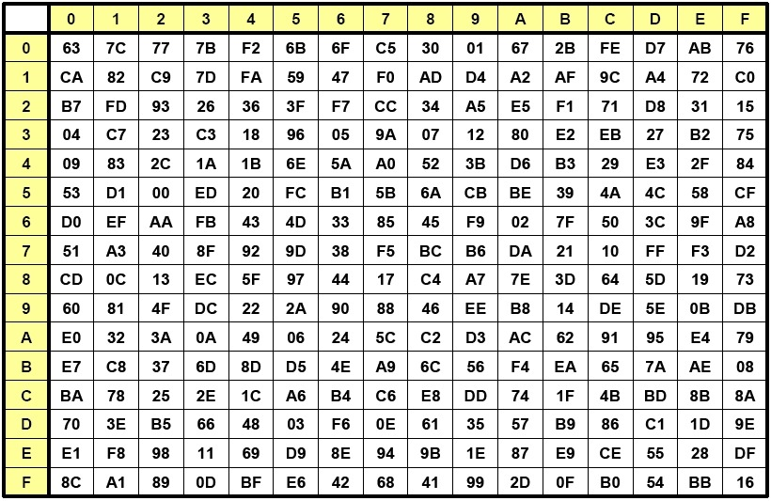
1. SubBytes
d4
19 | a0 | 9a | e9
3d | f4 | c6 | f8
e3 | e2 | 8d | 48
be | 2b | 2a | 08
S-box

Slide 8
1. SubBytes
d4 | a0 | 9a | e9
3d | f4 | c6 | f8
e3 | e2 | 8d | 48
be | 2b | 2a | 08
S-box

Slide 9
1. SubBytes
d4 | a0 | 9a | e9
27 | f4 | c6 | f8
e3 | e2 | 8d | 48
be | 2b | 2a | 08
S-box

Slide 10
1. SubBytes
d4 | a0 | 9a | e9
27 | f4 | c6 | f8
11 | e2 | 8d | 48
be | 2b | 2a | 08
S-box

Slide 11
1. SubBytes
d4 | a0 | 9a | e9
27 | f4 | c6 | f8
11 | e2 | 8d | 48
ae | 2b | 2a | 08
S-box

Slide 12
1. SubBytes
d4 | e0 | 9a | e9
27 | f4 | c6 | f8
11 | e2 | 8d | 48
ae | 2b | 2a | 08
S-box

Slide 13
1. SubBytes
d4 | e0 | 9a | e9
27 | bf | c6 | f8
11 | e2 | 8d | 48
ae | 2b | 2a | 08
S-box

Slide 14
1. SubBytes
d4 | e0 | 9a | e9
27 | bf | c6 | f8
11 | 98 | 8d | 48
ae | 2b | 2a | 08
S-box

Slide 15
1. SubBytes
d4 | e0 | 9a | e9
27 | bf | c6 | f8
11 | 98 | 8d | 48
ae | f1 | 2a | 08
S-box

Slide 16
1. SubBytes
d4 | e0 | b8 | e9
27 | bf | c6 | f8
11 | 98 | 8d | 48
ae | f1 | 2a | 08
S-box

Slide 17
1. SubBytes
d4 | e0 | b8 | e9
27 | bf | b4 | f8
11 | 98 | 8d | 48
ae | f1 | 2a | 08
S-box

Slide 18
1. SubBytes
d4 | e0 | b8 | e9
27 | bf | b4 | f8
11 | 98 | 5d | 48
ae | f1 | 2a | 08
S-box

Slide 19
1. SubBytes
d4 | e0 | b8 | e9
27 | bf | b4 | f8
11 | 98 | 5d | 48
ae | f1 | e5 | 08
S-box

Slide 20
1. SubBytes
d4 | e0 | b8 | 1e
27 | bf | b4 | f8
11 | 98 | 5d | 48
ae | f1 | e5 | 08
S-box

Slide 21
1. SubBytes
d4 | e0 | b8 | 1e
27 | bf | b4 | 41
11 | 98 | 5d | 48
ae | f1 | e5 | 08
S-box

Slide 22
1. SubBytes
d4 | e0 | b8 | 1e
27 | bf | b4 | 41
11 | 98 | 5d | 52
ae | f1 | e5 | 08
S-box

Slide 23
1. SubBytes
d4 | e0 | b8 | 1e
27 | bf | b4 | 41
11 | 98 | 5d | 52
ae | f1 | e5 | 30
S-box

Slide 24
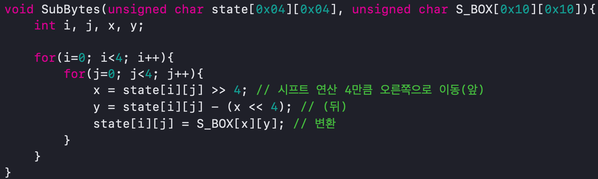

Slide 25
2. ShiftRows
d4 | e0 | b8 | 1e
27
bf | b4 | 41
← rotate over 1 byte
11 | 98 | 5d | 52
ae | f1 | e5 | 30

Slide 26
2. ShiftRows
d4 | e0 | b8 | 1e
bf
b4 | 41 | 27
11
98
5d
52
← rotate over 2 byte
ae | f1 | e5 | 30

Slide 27
2. ShiftRows
d4 | e0 | b8 | 1e
bf
b4 | 41 | 27
5d | 52 | 11 | 98
ae
f1
e5
30
← rotate over 3 byte

Slide 28
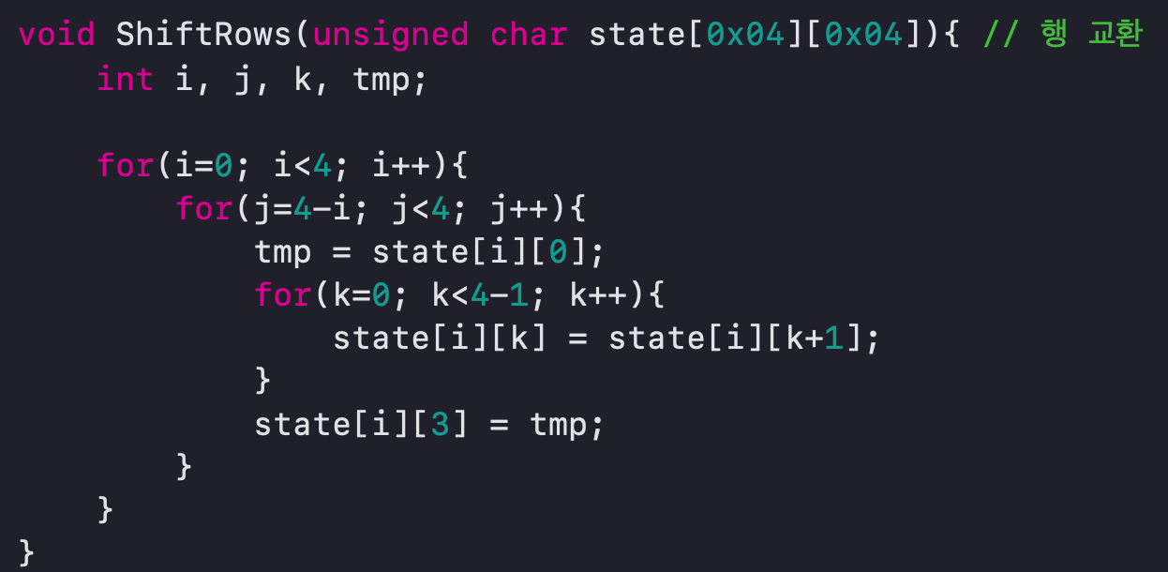

Slide 29
3. MixColumns
d4 | e0 | b8 | 1e
bf | b4 | 41 | 27
5d | 52 | 11 | 98
30 | ae | f1 | e5

Slide 30
3. MixColumns
d4 | e0 | b8 | 1e
bf | b4 | 41 | 27
5d | 52 | 11 | 98
30 | ae | f1 | e5

Slide 31
3. MixColumns
e0 | b8 | 1e
b4 | 41 | 27
52 | 11 | 98
ae | f1 | e5
02 | 03 | 01 | 01
01 | 02 | 03 | 01
01 | 01 | 02 | 03
03 | 01 | 01 | 02
d4
bf
5d
30
MDS Matrix

Slide 32
(02*d4) + (03*bf) + (01*5d) + (01*30)
{03}*{bf} (최상위 비트가 1인 경우)
03 = 11
= 10 XOR 01
{03} . {bf} = {10 XOR 01} . {1011 1111}
= {1011 1111 . 10} XOR {1011 1111 . 01}
= {1011 1111 . 10} XOR {1011 1111}
= 0111 1110 XOR 0001 1011 XOR 1011 1111
= 1101 1010

Slide 33
(01*d4) + (02*bf) + (03*5d) + (01*30)
03*5d (최상위 비트가 1이 아닌 경우)
03 = 11
= 10 XOR 01
{5d} . {03} = {0101 1101 . 02} XOR { 0101 1101}
= 1011 1010 XOR 0101 1101
= 1110 0111

Slide 34
3. MixColumns
e0 | b8 | 1e
b4 | 41 | 27
52 | 11 | 98
ae | f1 | e5
02 | 03 | 01 | 01
01 | 02 | 03 | 01
01 | 01 | 02 | 03
03 | 01 | 01 | 02
d4
bf
5d
30
04
66
81
e5
MDS Matrix

Slide 35
3. MixColumns
d4 | e0 | b8 | 1e
bf | b4 | 41 | 27
5d | 52 | 11 | 98
30 | ae | f1 | e5

Slide 36
3. MixColumns
04 | e0 | b8 | 1e
66 | b4 | 41 | 27
81 | 52 | 11 | 98
e5 | ae | f1 | e5

Slide 37
3. MixColumns
04 | e0 | b8 | 1e
66 | cb | 41 | 27
81 | 19 | 11 | 98
e5 | 9a | f1 | e5

Slide 38
3. MixColumns
04 | e0 | 48 | 1e
66 | cb | f8 | 27
81 | 19 | d3 | 98
e5 | 9a | 7a | e5

Slide 39
3. MixColumns
04 | e0 | 48 | 28
66 | cb | f8 | 06
81 | 19 | d3 | 26
e5 | 9a | 7a | 4c

Slide 40
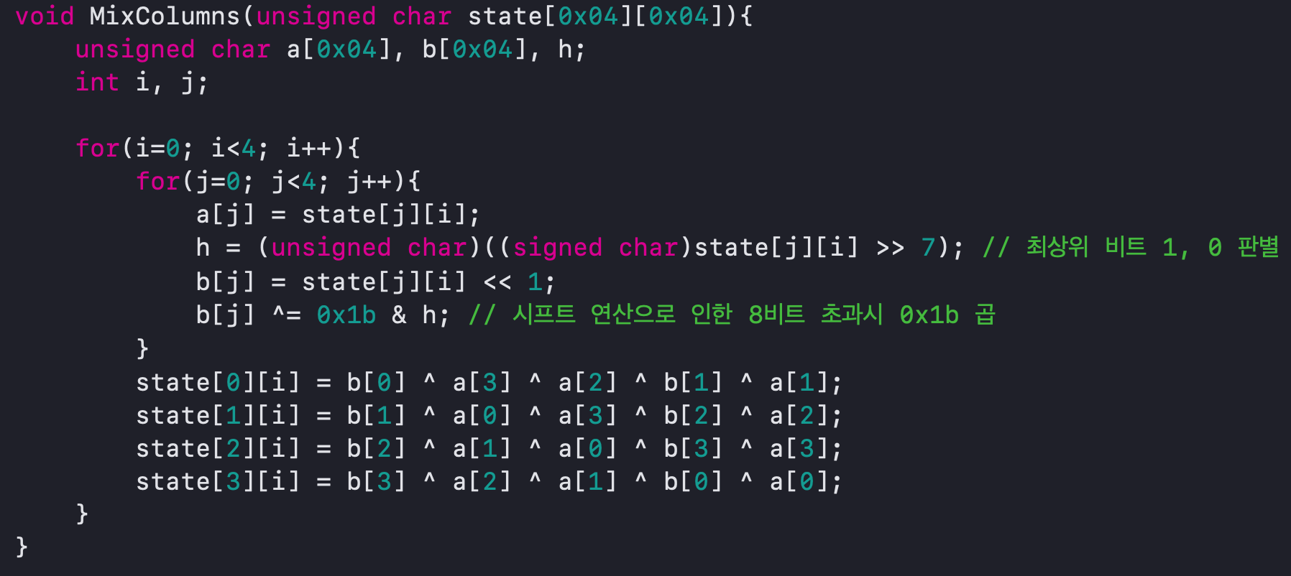

Slide 41
4. AddRoundKey
a4
9c
7f
f2
04
66
81
e5
e0 | 48 | 28
cb | f8 | 06
19 | d3 | 26
9a | 7a | 4c
a0
fe
fa
17
88 | 23 | 2a
54 | a3 | 6c
2c | 39 | 76
b1 | 39 | 05
Round key

Slide 42
4. AddRoundKey
a4
9c
7f
f2
68 | 48 | 28
9f | f8 | 06
35 | d3 | 26
2b | 7a | 4c
23 | 2a
a3 | 6c
39 | 76
39 | 05
Round key

Slide 43
4. AddRoundKey
a4
9c
7f
f2
68 | 6b | 28
9f | 5b | 06
35 | ea | 26
2b | 43 | 4c
2a
6c
76
05
Round key

Slide 44
4. AddRoundKey
a4
9c
7f
f2
68 | 6b | 02
9f | 5b | 6a
35 | ea | 50
2b | 43 | 49
Round key

Slide 45
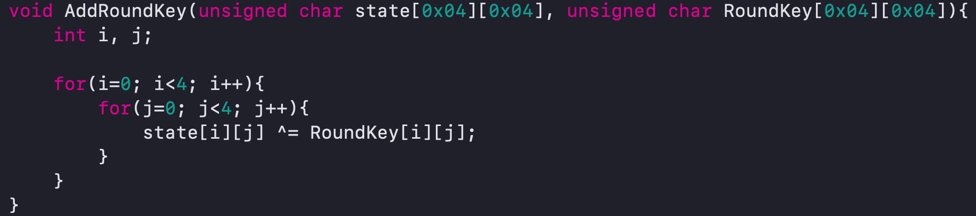

Slide 46
5. KeySchedule
2b | 28 | ab | 09
7e | ae | f7 | cf
15 | d2 | 15 | 4f
16 | a6 | 88 | 3c
Cipher Key

Slide 47
5. KeySchedule
2b | 28 | ab | 09
7e | ae | f7 | cf
15 | d2 | 15 | 4f
16 | a6 | 88 | 3c
09
cf
4f
3c
cf
4f
3c
09
RotWord
Cipher Key

Slide 48
5. KeySchedule
2b | 28 | ab | 09
7e | ae | f7 | cf
15 | d2 | 15 | 4f
16 | a6 | 88 | 3c
09
cf
4f
3c
cf
4f
3c
09
8a
84
eb
01
RotWord
SubBytes

Slide 49
5. KeySchedule
2b | 28 | ab | 09
7e | ae | f7 | cf
15 | d2 | 15 | 4f
16 | a6 | 88 | 3c
09
cf
4f
3c
cf
4f
3c
09
8a
84
eb
01
RotWord
SubBytes
2b
7e
15
16
8a
84
eb
01
01
00
00
00
a0
fa
fe
17
Rcon
01 | 02 | 04 | 08 | 10 | 20 | 40 | 80 | 1b | 36
00 | 00 | 00 | 00 | 00 | 00 | 00 | 00 | 00 | 00
00 | 00 | 00 | 00 | 00 | 00 | 00 | 00 | 00 | 00
00 | 00 | 00 | 00 | 00 | 00 | 00 | 00 | 00 | 00

Slide 50
2b | 28 | ab | 09
7e | ae | f7 | cf
15 | d2 | 15 | 4f
16 | a6 | 88 | 3c
a0
fa
fe
17
28
ae
d2
a6
a0
fa
fe
17
88
54
2c
b1

Slide 51
2b | 28 | ab | 09
7e | ae | f7 | cf
15 | d2 | 15 | 4f
16 | a6 | 88 | 3c
a0 | 88
fa | 54
fe | 2c
17 | b1
28
ae
d2
a6
a0
fa
fe
17
88
54
2c
b1

Slide 52
2b | 28 | ab | 09
7e | ae | f7 | cf
15 | d2 | 15 | 4f
16 | a6 | 88 | 3c
a0 | 88 | 23
fa | 54 | a3
fe | 2c | 39
17 | b1 | 39

Slide 53
2b | 28 | ab | 09
7e | ae | f7 | cf
15 | d2 | 15 | 4f
16 | a6 | 88 | 3c
a0 | 88 | 23 | 2a
fa | 54 | a3 | 6c
fe | 2c | 39 | 76
17 | b1 | 39 | 05
Cipher Key
Round Key1

Slide 54
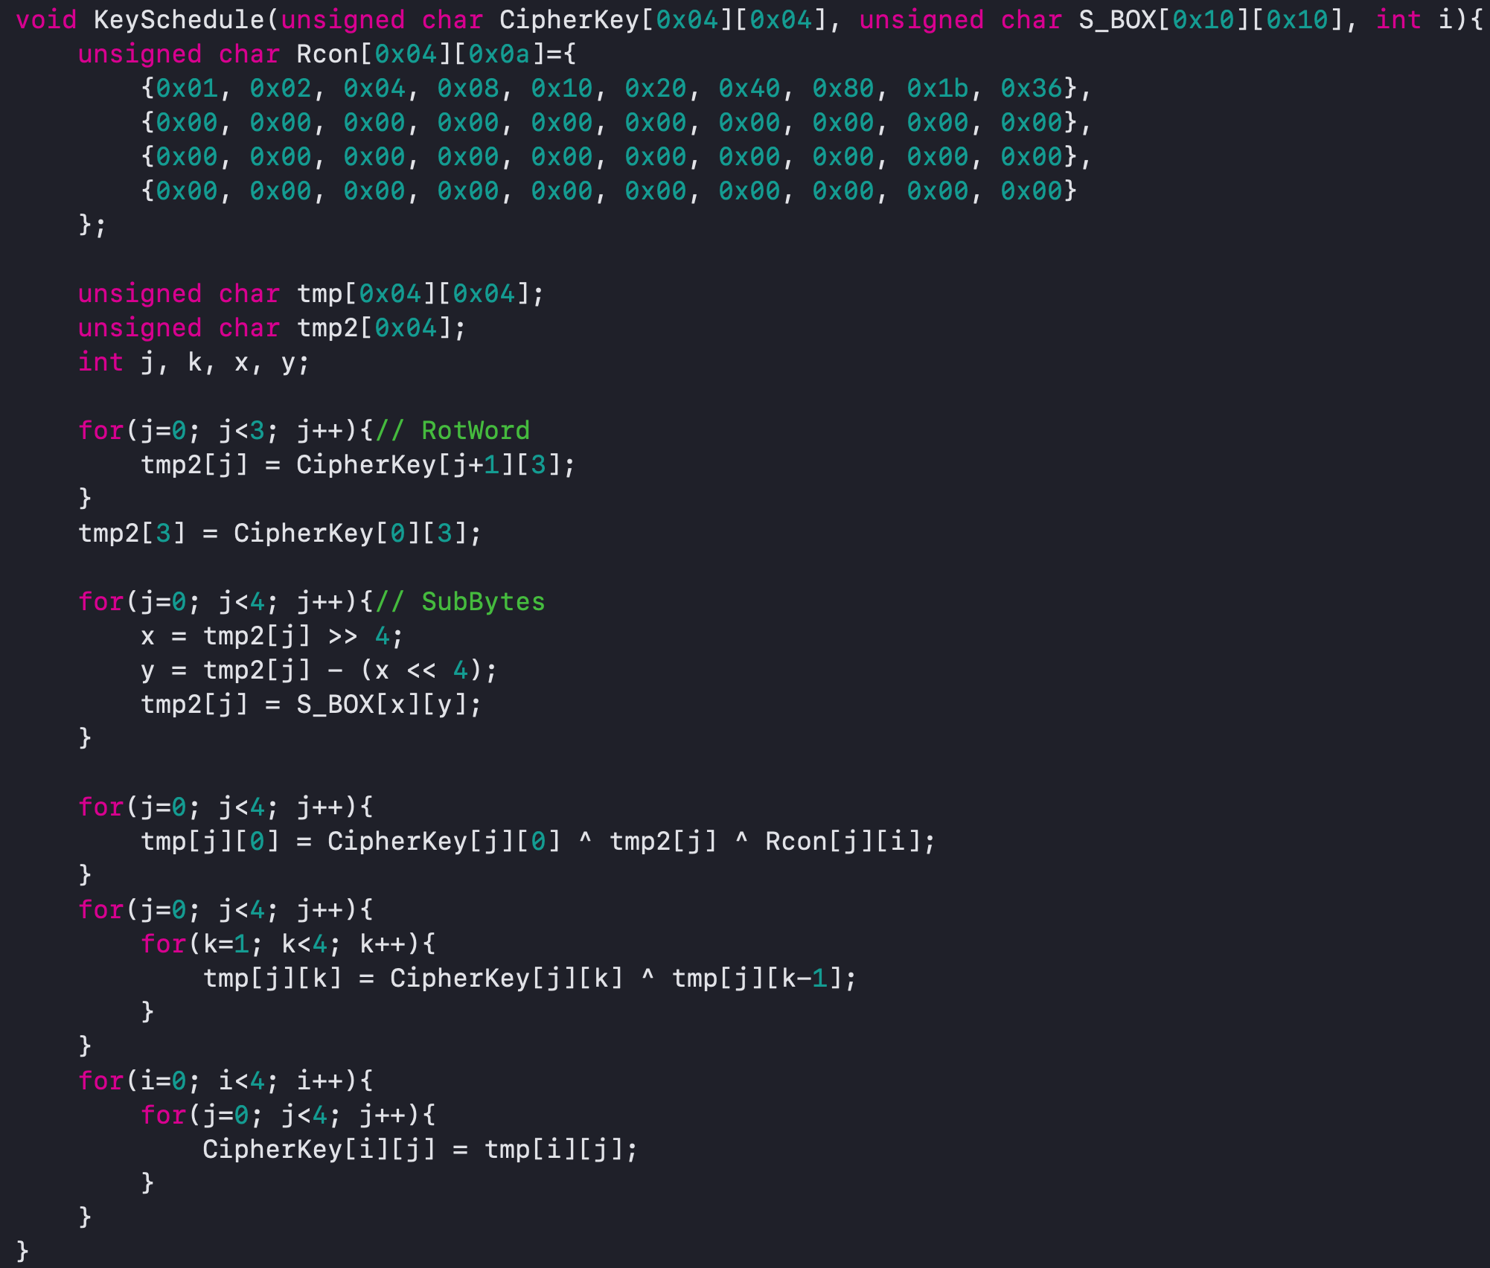

Slide 55
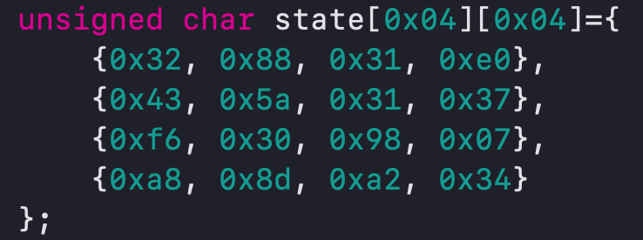
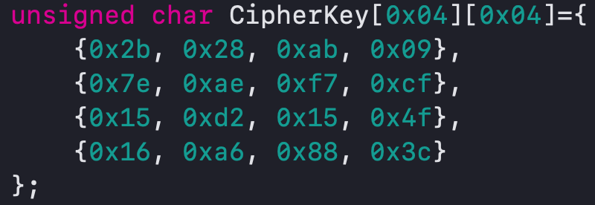
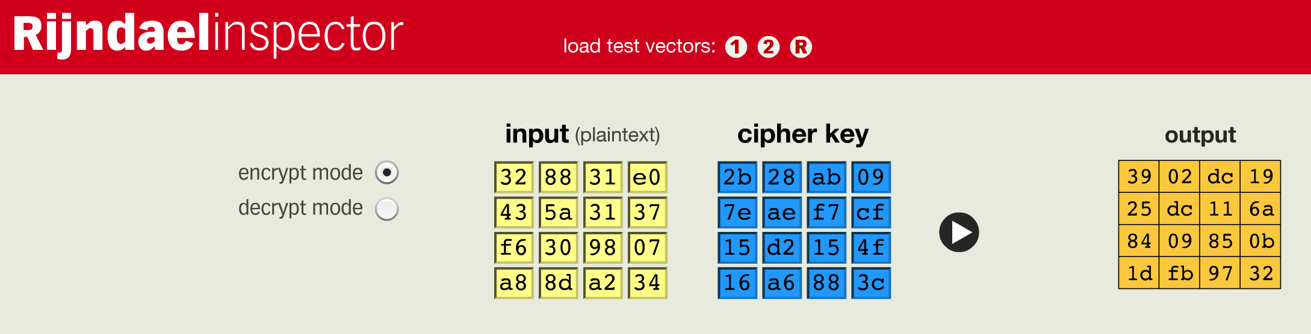
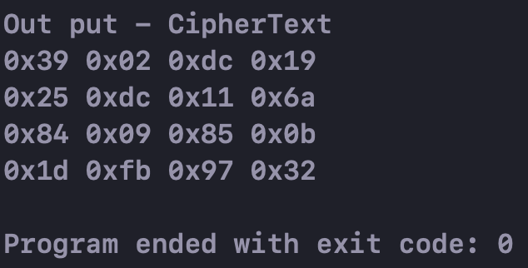
Plain Text
Round Key 1

Slide 56
Thank you ☺
2019.02.15.

