Slide 1
GAN (Generative Adversarial Network)
https://youtu.be/e0QToyeFk7A

Slide 2
GAN이란
Loss function (objective function)
DCGAN

Slide 3

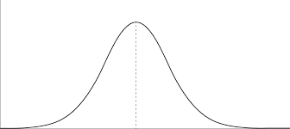
GAN이란
GAN (Generative Adversarial Network)
function
Generator Network
Gaussian
distribution
Random
Noise
z

Slide 4
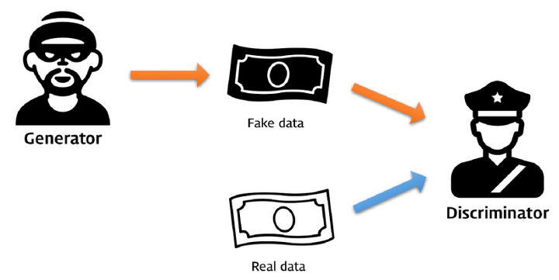
GAN이란
Generative Adversarial Network
Minimax 게임

Slide 5
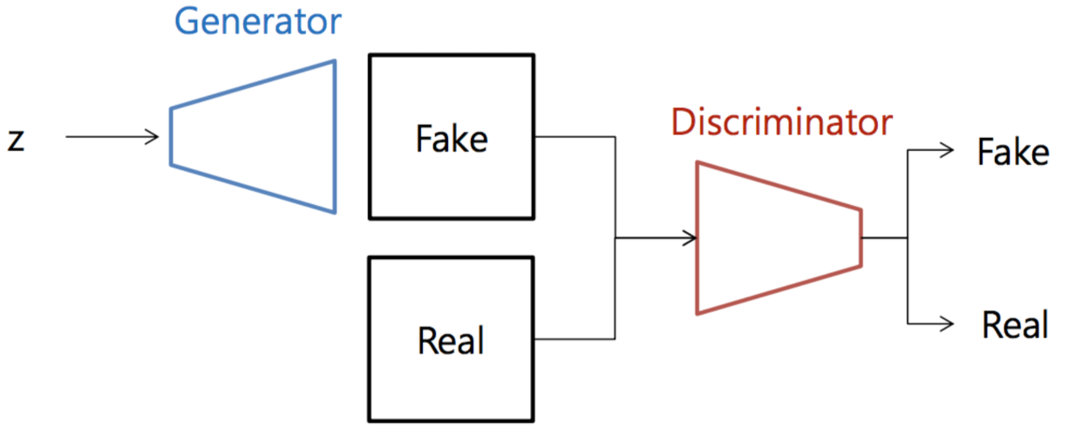
GAN이란
Minimax 게임

Slide 6
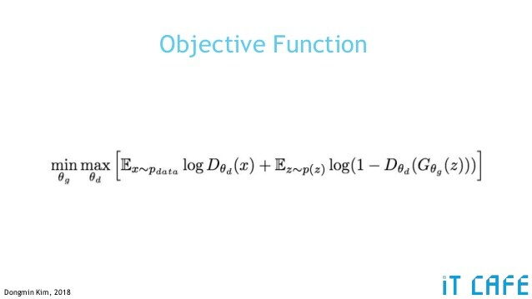
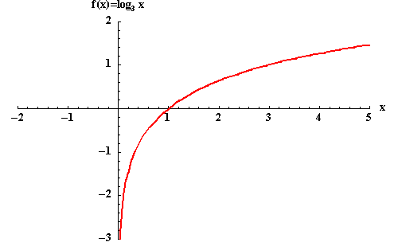
Loss function (objective function)
Loss function
Discriminator output likelihood in (0, 1)
1 = real
0 = fake

Slide 7
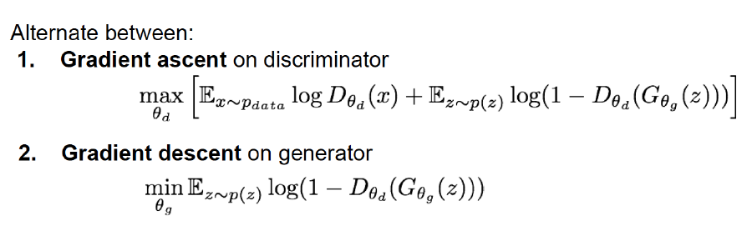
Loss function (objective function)
Optimization

Slide 8
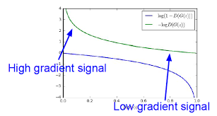
Loss function (objective function)
Optimization
2. Gradient ascent on generator
max(E_{z~p(z)}log(D_{θd}(G_{θd}(z)))

Slide 9
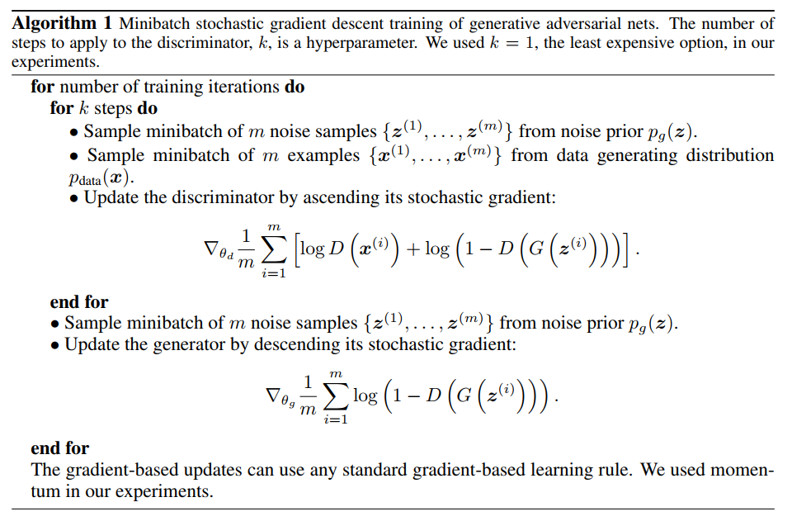
Loss function (objective function)
Optimization

Slide 10
GAN
Well-trained GAN
1/2
1/2

Slide 11
Loss function (objective function)
Model collapse
- 학습의 불균형
WGAN, WGAN-GP

Slide 12
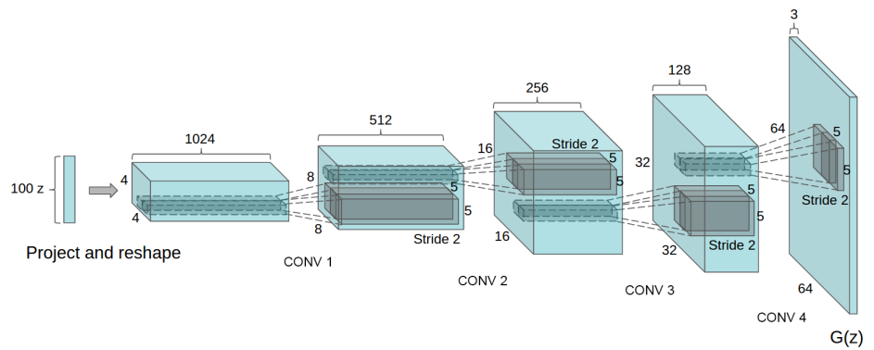
DCGAN
DCGAN - Generator
Deep Convolution GAN

