Slide 1

Post-quantum Cryptography & Quantum Computing [CryptoCraft Lab]
Bcrypt.c
융합보안학과 윤세영
https://youtu.be/LJ4KKabR0Hk

Slide 2
목차
Blowfish.c 코드 분석
Bcrypt.c 코드 분석

Slide 3
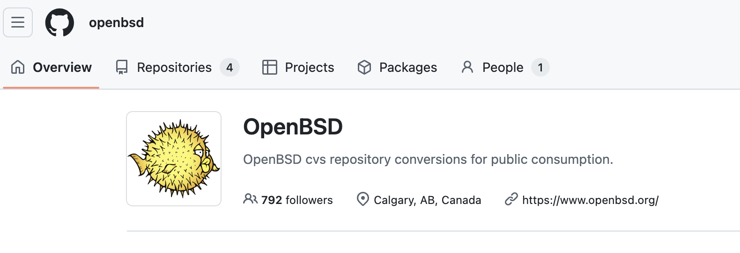
OpenBSD
https://cvsweb.openbsd.org/cgi-bin/cvsweb/src/lib/libc/crypt/bcrypt.c
https://github.com/openbsd/src/blob/master/lib/libc/crypt/bcrypt.c

Slide 4
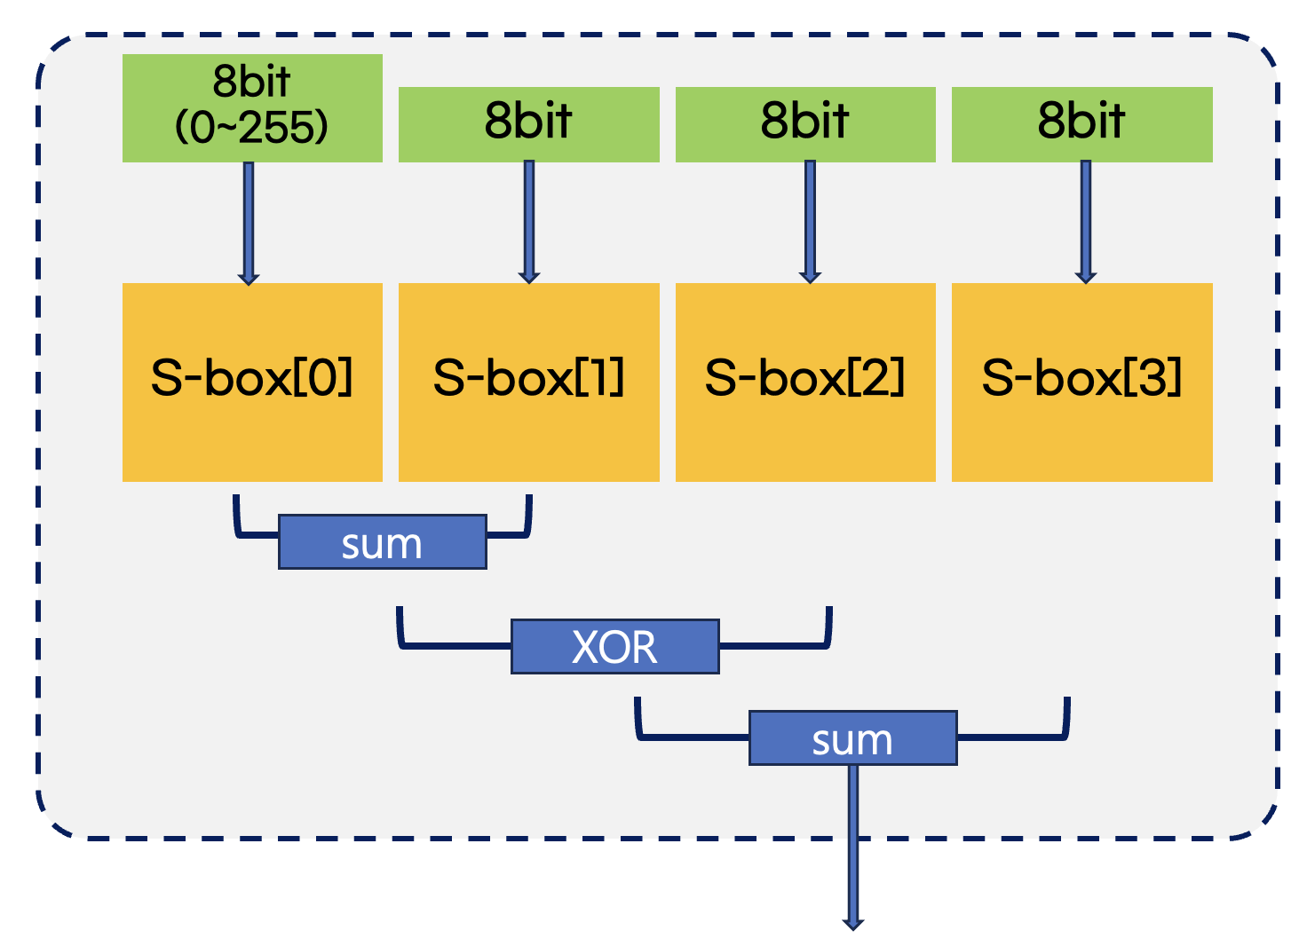
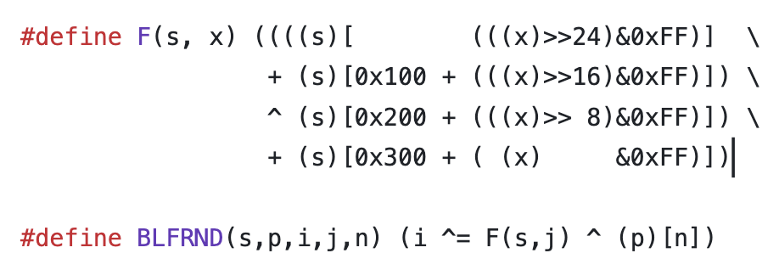
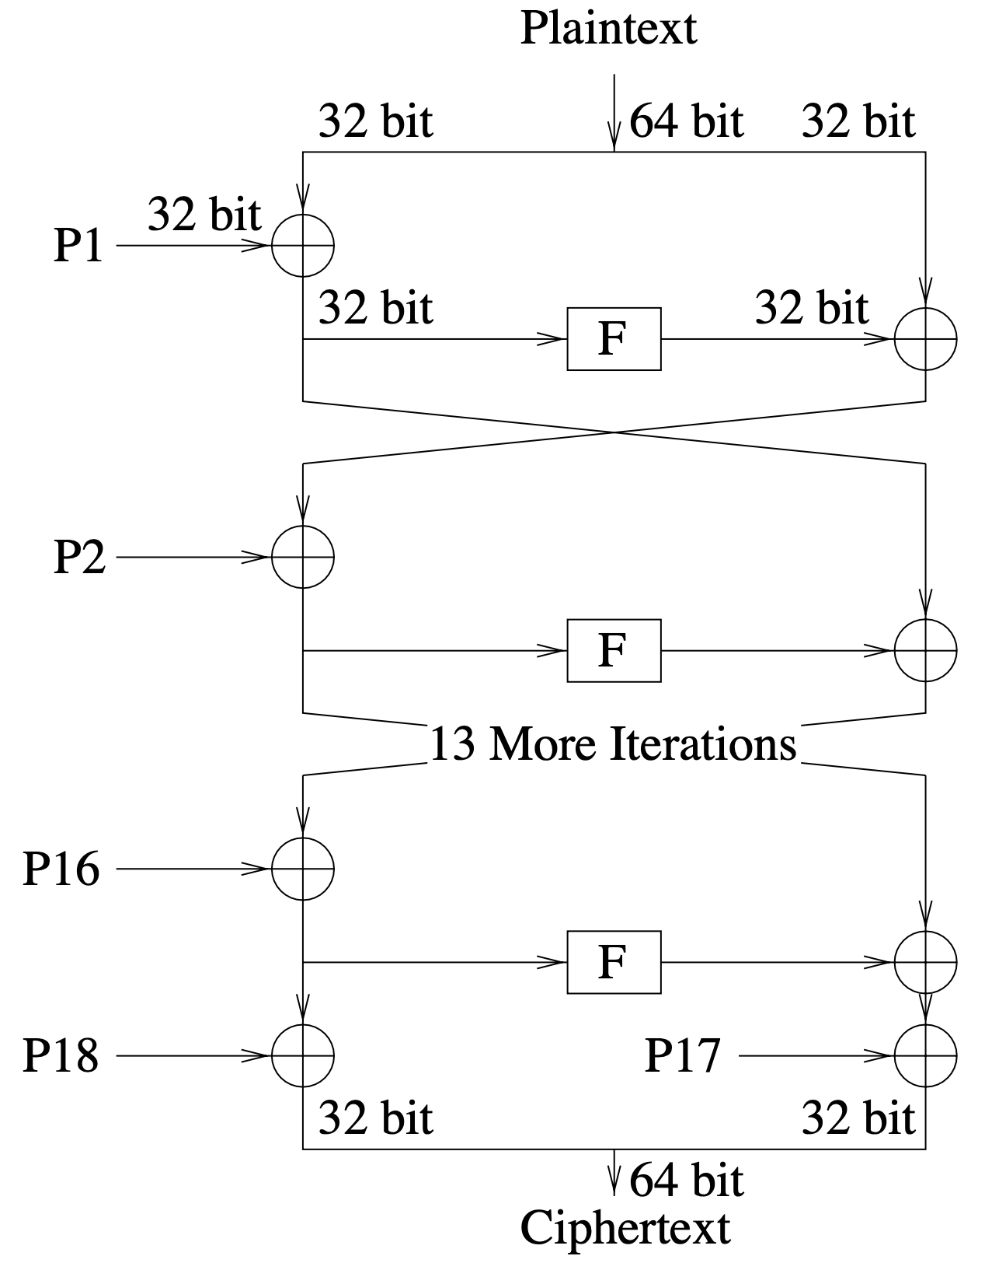
OpenBSD – Blowfish.c. Github : https://github.com/openbsd/src/blob/master/lib/libc/crypt/blowfish.c

Slide 5
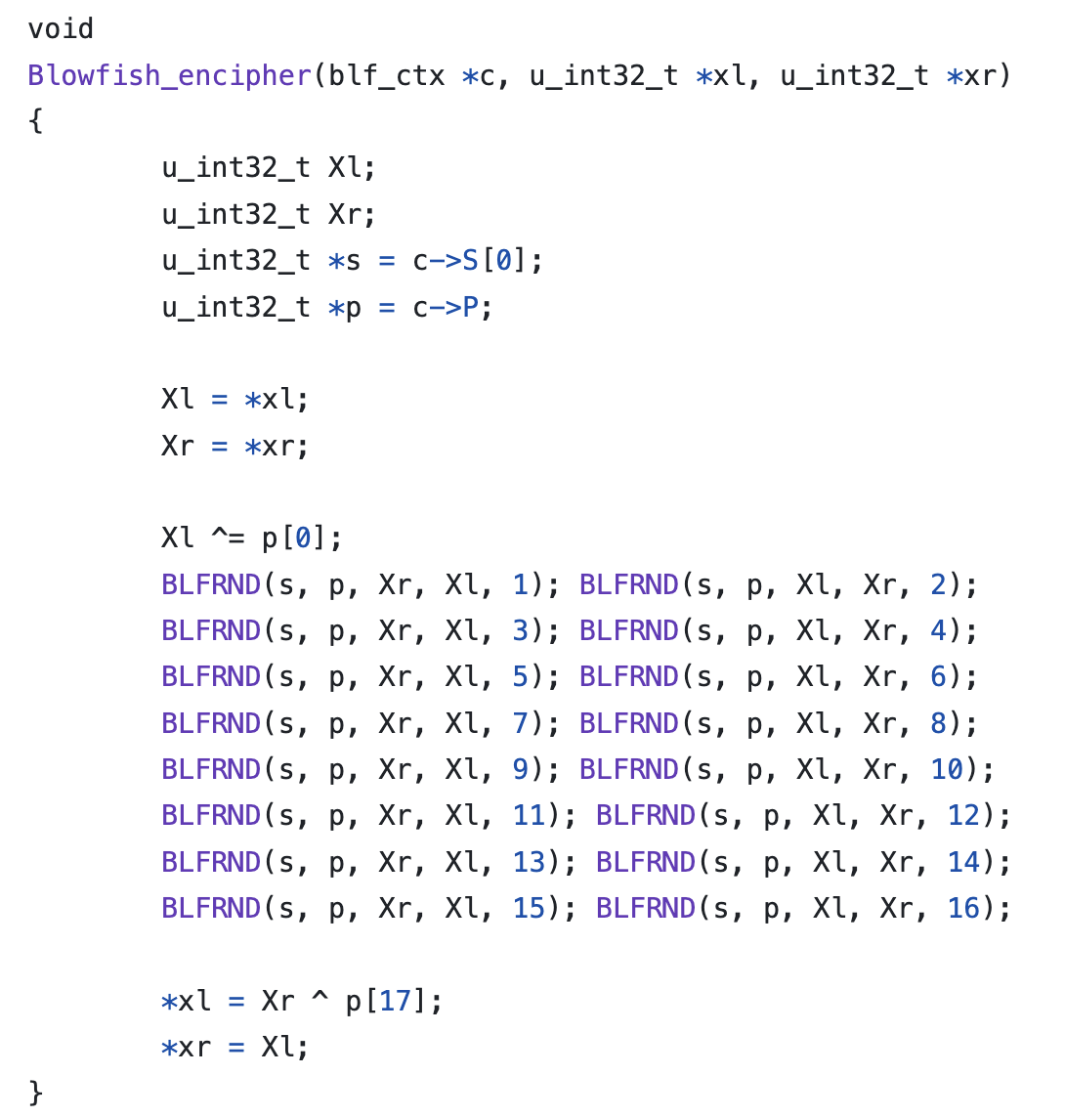
OpenBSD – Blowfish.c. Github : https://github.com/openbsd/src/blob/master/lib/libc/crypt/blowfish.c
Xl(j) ^ P[0] => j
F(s, j(Xl)) ^ i(Xr) ^ P[n=1] => 다음번 i(Xl)

Slide 6
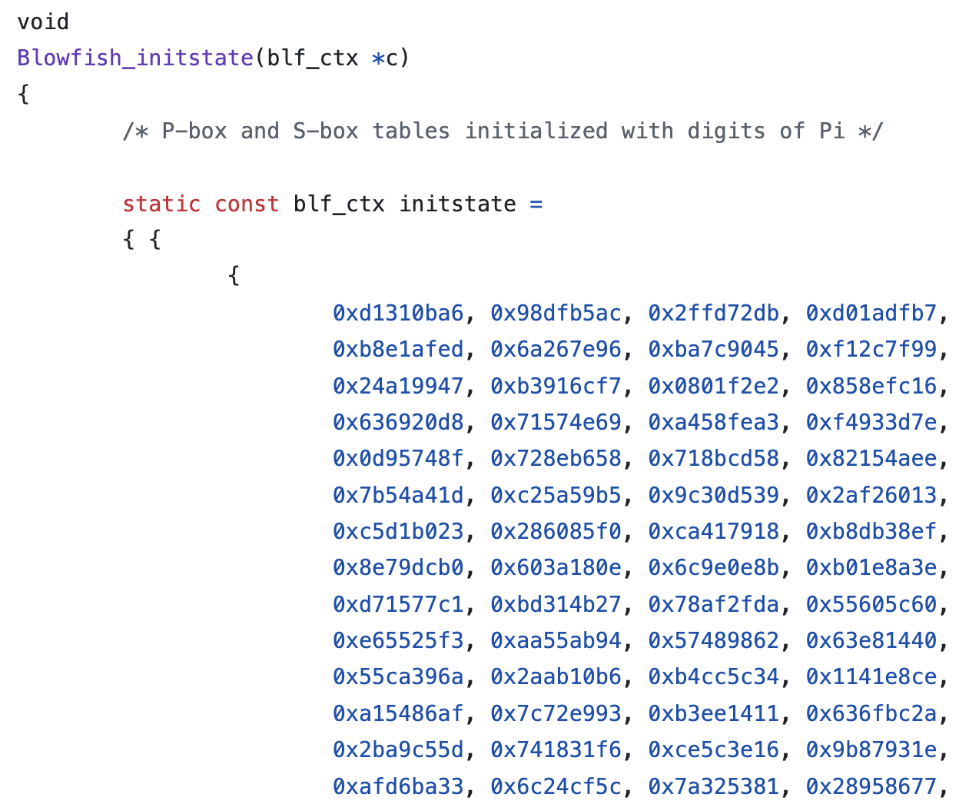
OpenBSD – Blowfish.c. Github : https://github.com/openbsd/src/blob/master/lib/libc/crypt/blowfish.c
S-box[0]
S-box[1]
S-box[2]
S-box[3]
P-array

Slide 7
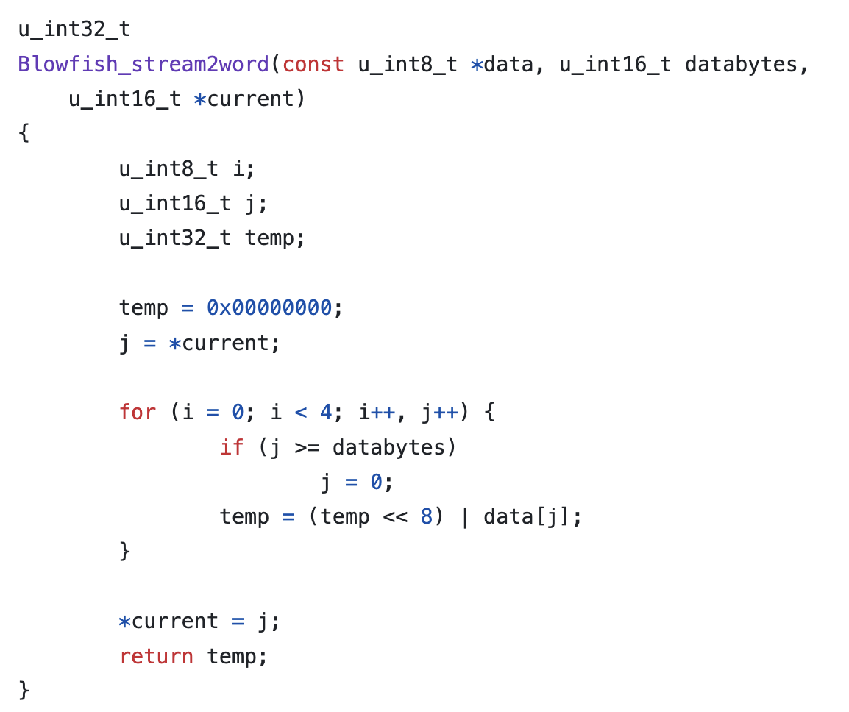
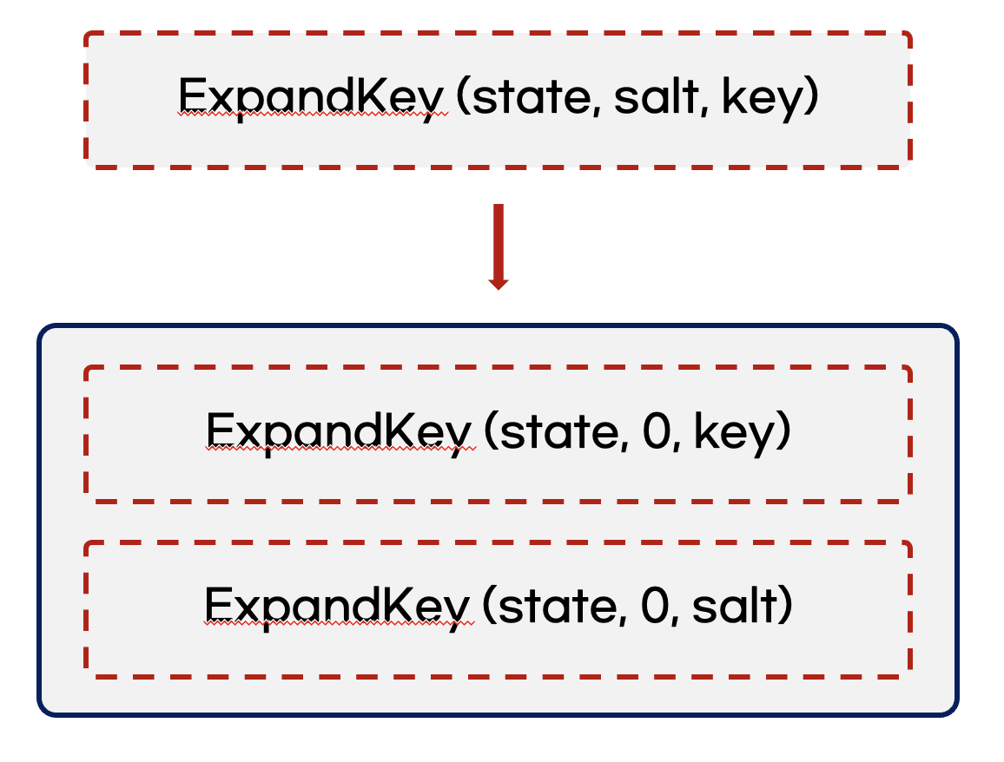
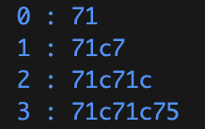
OpenBSD – Blowfish.c. Github : https://github.com/openbsd/src/blob/master/lib/libc/crypt/blowfish.c

Slide 8
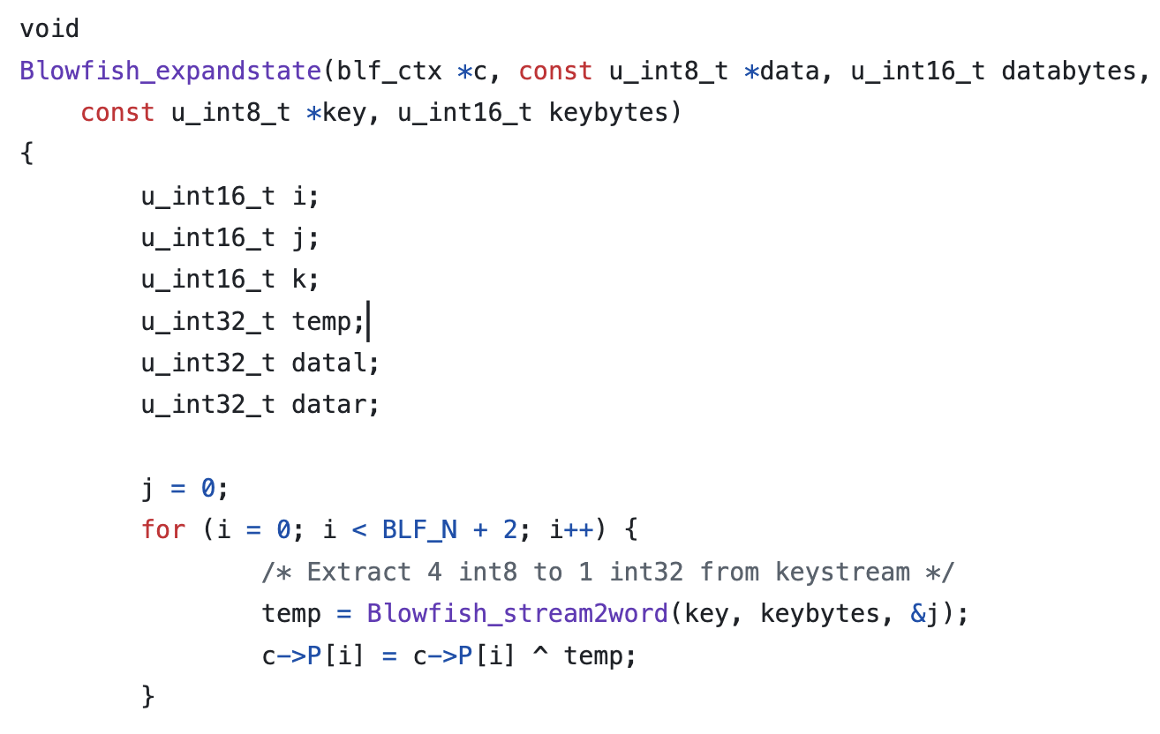
OpenBSD – Blowfish.c. Github : https://github.com/openbsd/src/blob/master/lib/libc/crypt/blowfish.c

Slide 9
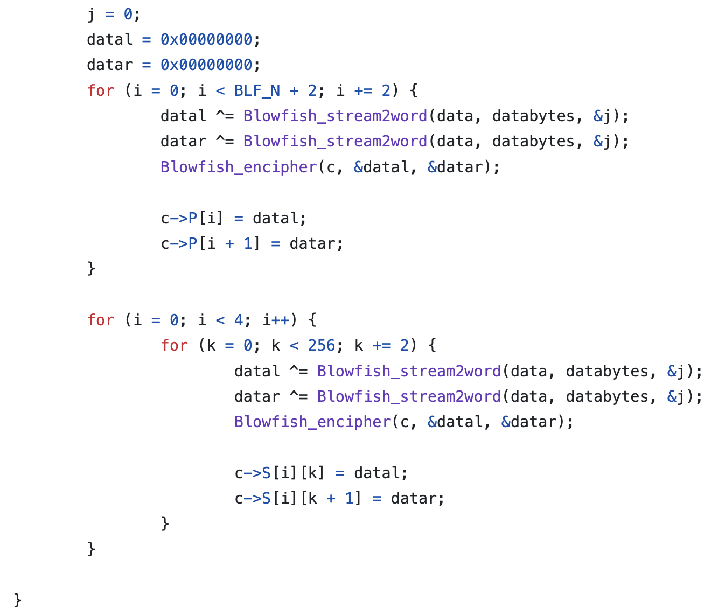
OpenBSD – Blowfish.c. Github : https://github.com/openbsd/src/blob/master/lib/libc/crypt/blowfish.c

Slide 10
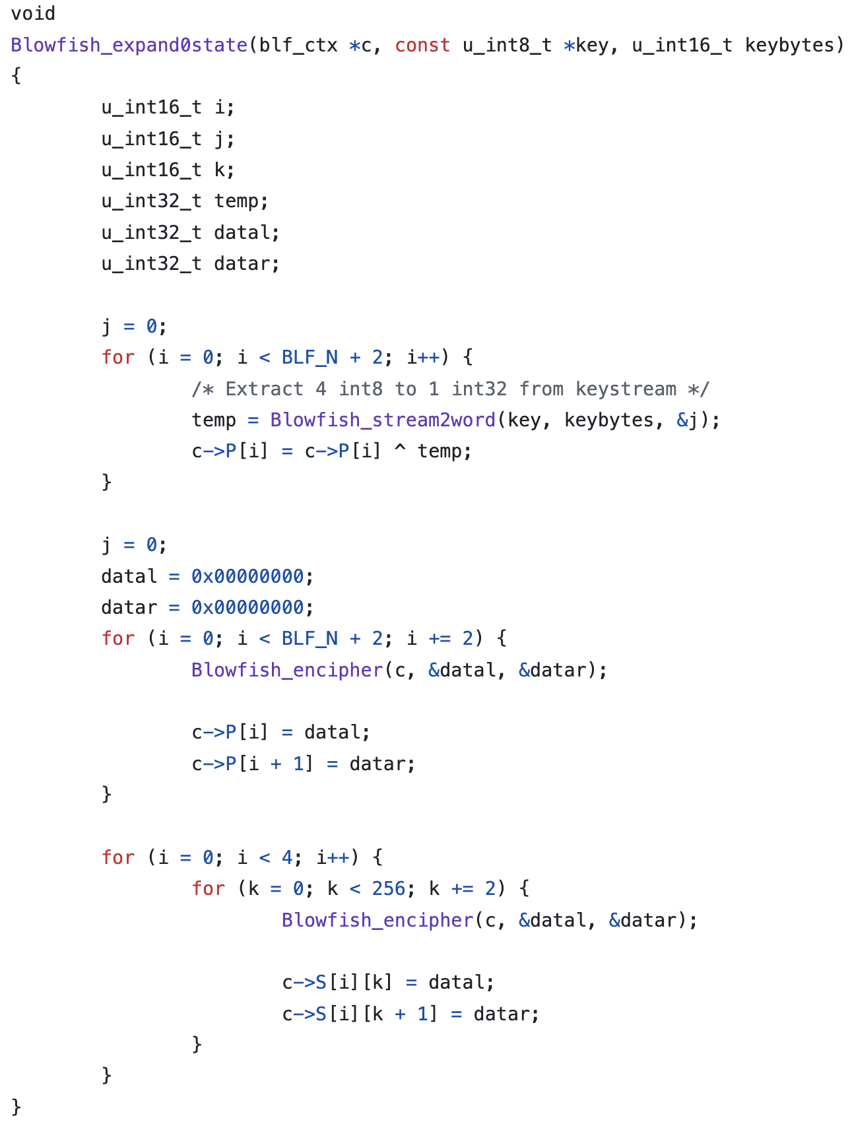
OpenBSD – Blowfish.c. Github : https://github.com/openbsd/src/blob/master/lib/libc/crypt/blowfish.c

Slide 11
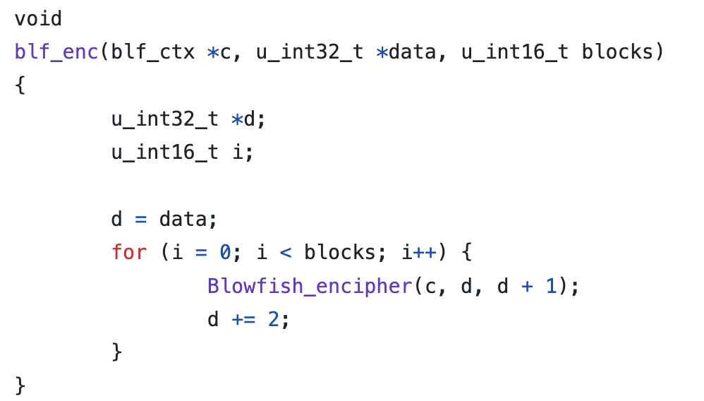
OpenBSD – Blowfish.c. Github : https://github.com/openbsd/src/blob/master/lib/libc/crypt/blowfish.c

Slide 12
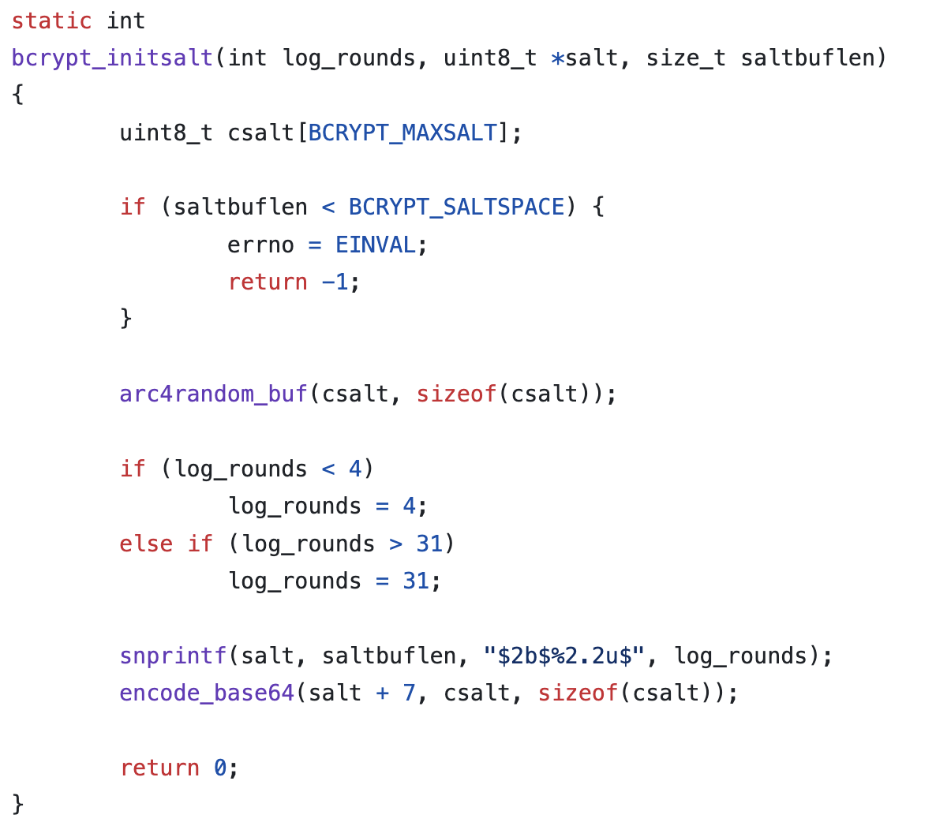
OpenBSD – Bcrypt.c. Github : https://github.com/openbsd/src/blob/master/lib/libc/crypt/bcrypt.c

Slide 13
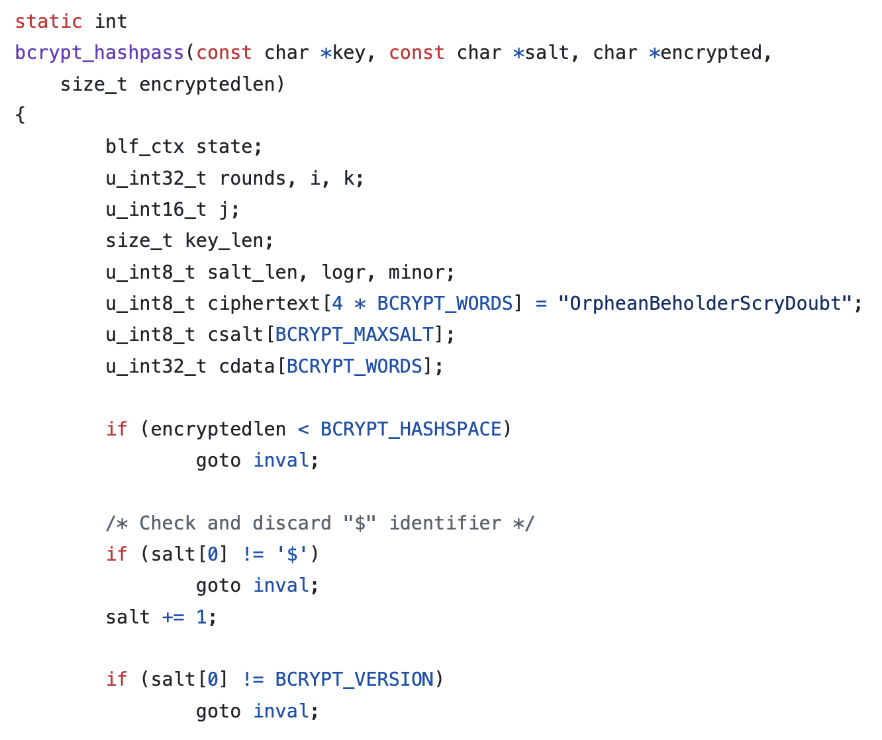
OpenBSD – Bcrypt.c. Github : https://github.com/openbsd/src/blob/master/lib/libc/crypt/bcrypt.c

Slide 14
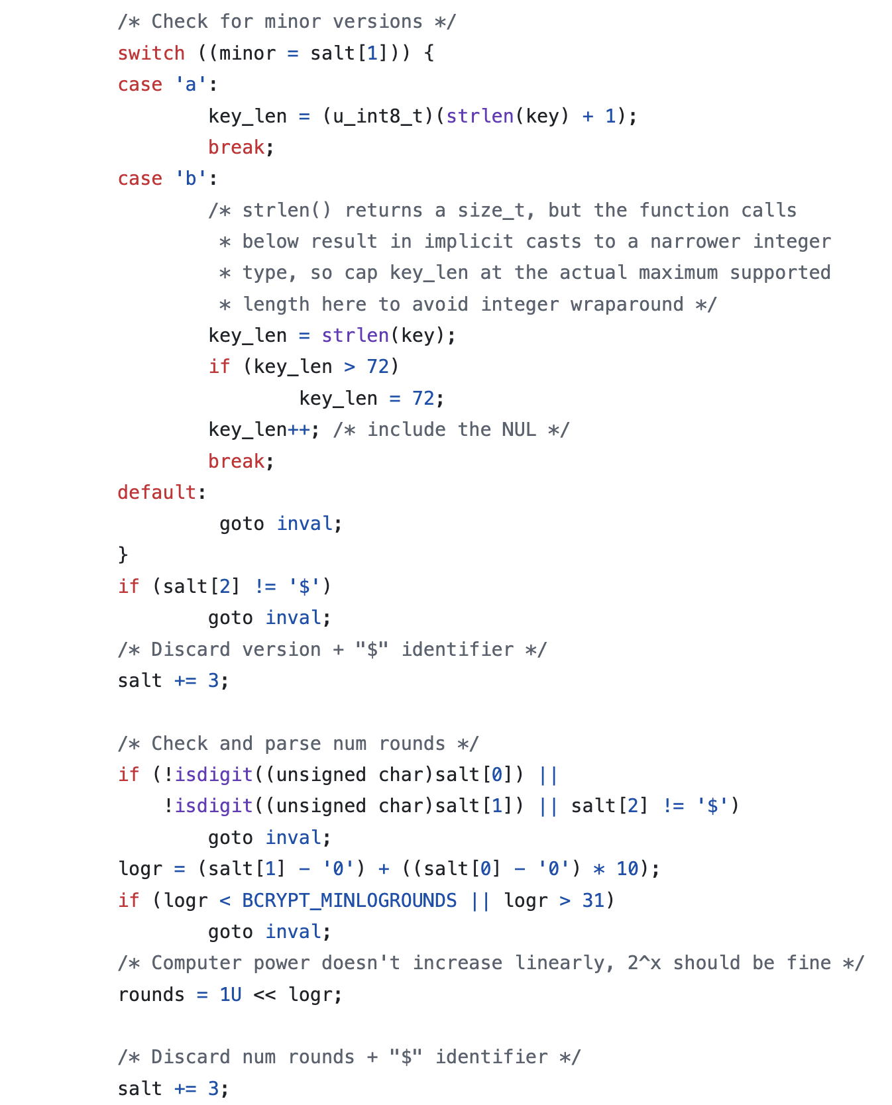
OpenBSD – Bcrypt.c. Github : https://github.com/openbsd/src/blob/master/lib/libc/crypt/bcrypt.c

Slide 15
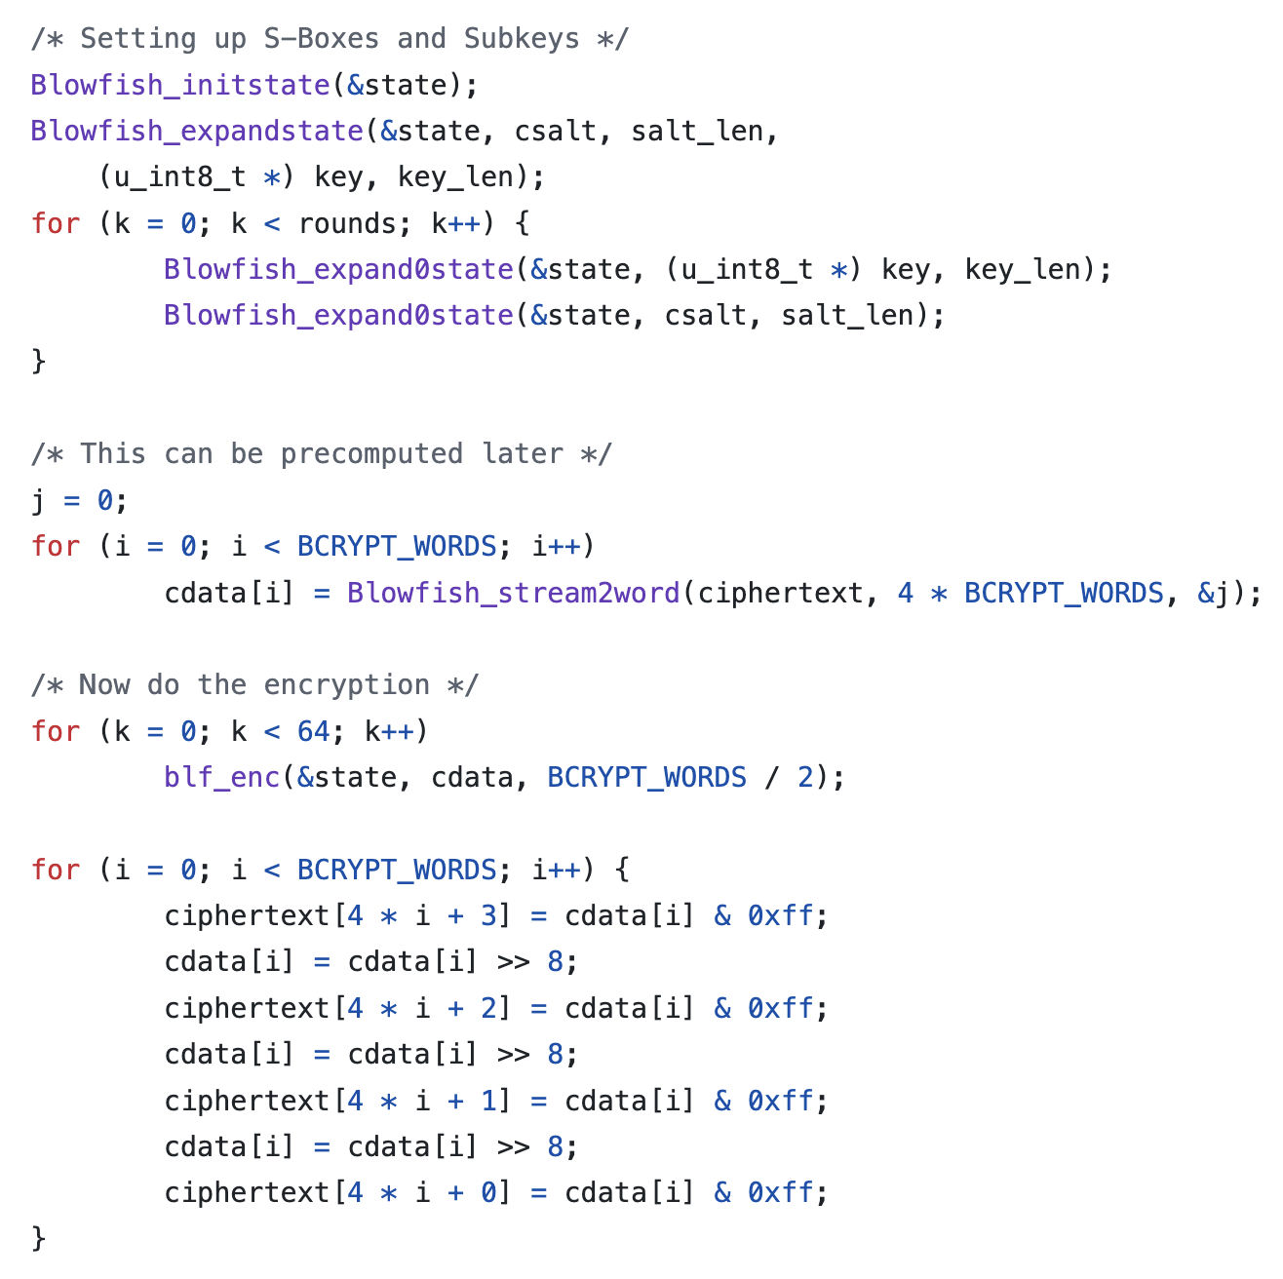
OpenBSD – Bcrypt.c. Github : https://github.com/openbsd/src/blob/master/lib/libc/crypt/bcrypt.c

Slide 16
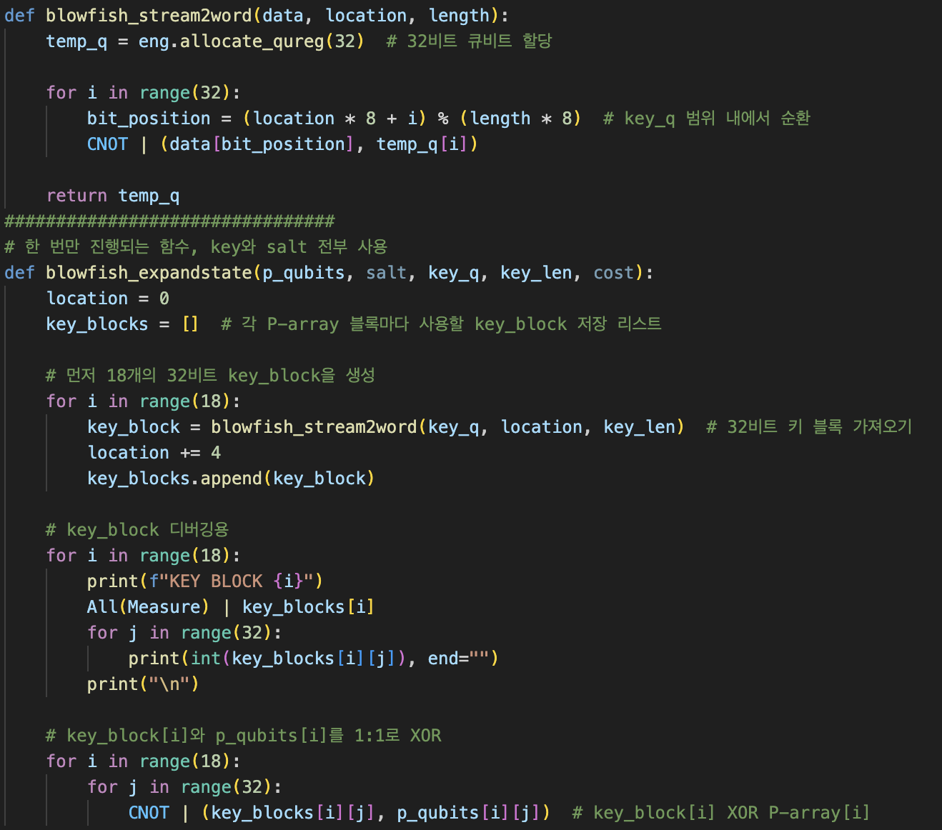
연구 진행 중인 부분

Slide 17
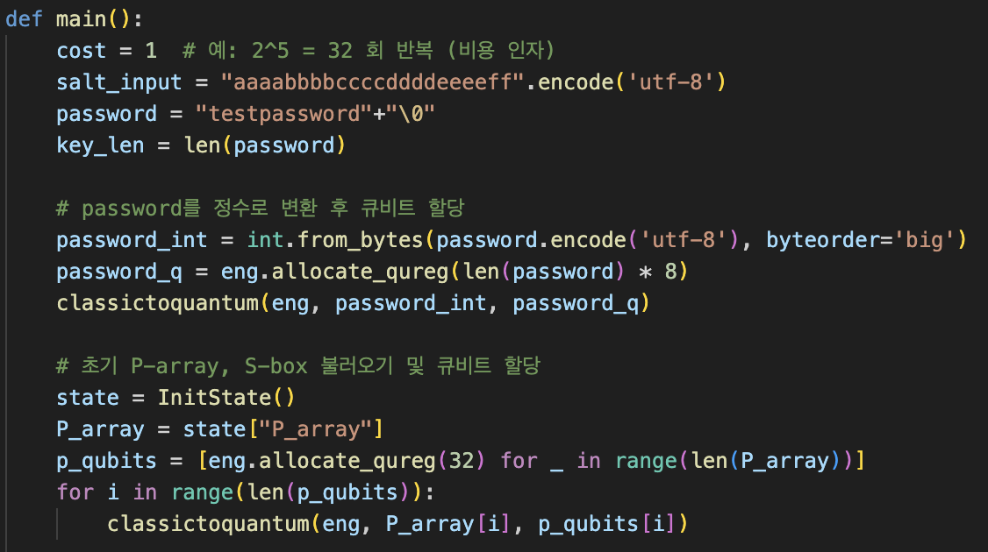
연구 진행 중인 부분

Slide 18
Post-quantum Cryptography & Quantum Computing [CryptoCraft Lab]
감사합니다

