Slide 1
Biometric Authentication
https://www.youtube.com/watch?v=fEWF2zo4tfM&list=PLdOq9g7U6Pdt5ZlWeffEU-ViDUS6j-jFS&index=2&t=0s

Slide 2
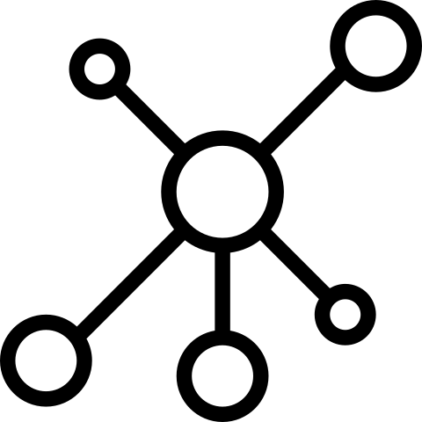
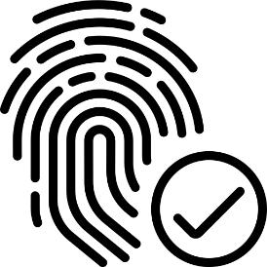
Services Using Biometric Data
1. Sensing
Place Your Thumb
2. Authentication
3. Customized Service

Slide 3


Storing Problem
SAFE?
0xF0469875AB00C354…

Slide 4
Leakage Problem
Can Be Me
Normal Problem When We Lost Key
Can Know Me
Additional Problem

Slide 5


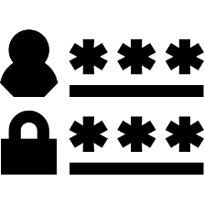



In spite of these Problem
No Need To
Have, Memorize
> CONVENIENT

Slide 6

In spite of these Problem
Public, Private Services
Using Biometric Authentication

Slide 7
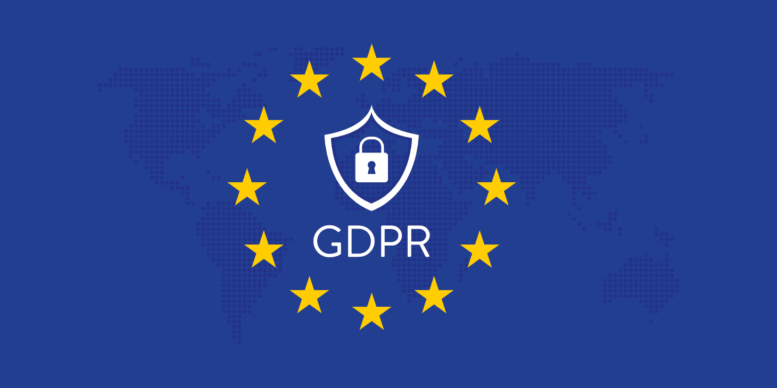
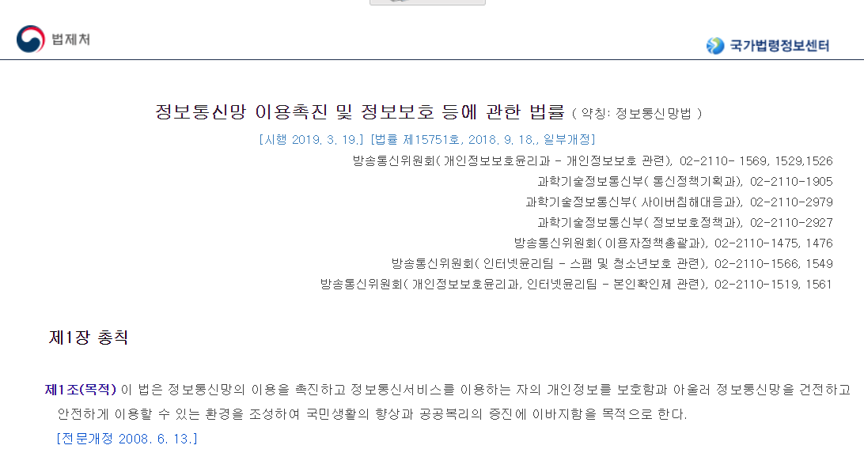
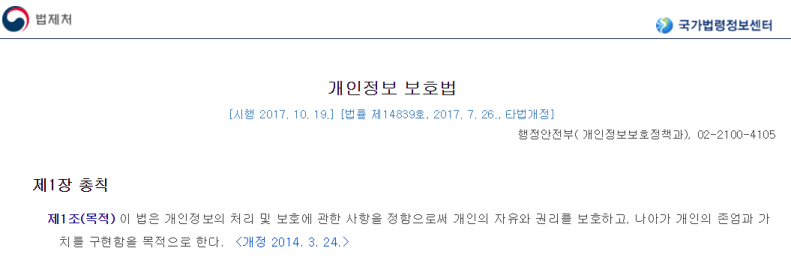
Importance Of Biometric Data
GDPR(General Data Protection Regulation)
Biometric Data
→ Categorized as a Special Kind of Private Data
Domestic Law
Many Suggestion like GDPR

Slide 8





If You Lost Biometric Data
Problem 1 as a Key Data
→ Can’t Use Anymore
Problem 2 as a Privacy Data
→ Can Profiling Someone Well
Problem 3 as a Sensitive Data (Health, Genetic Data)
→ Can Misuse

Slide 9
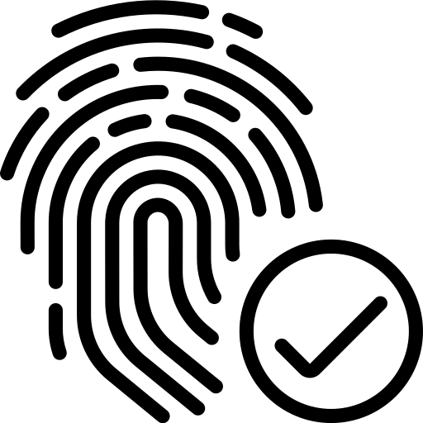
Fingerprint Data
Optical Method
Capacitance Method
Ultrasonic Method
False Rate
1/100000000000 but

Slide 10
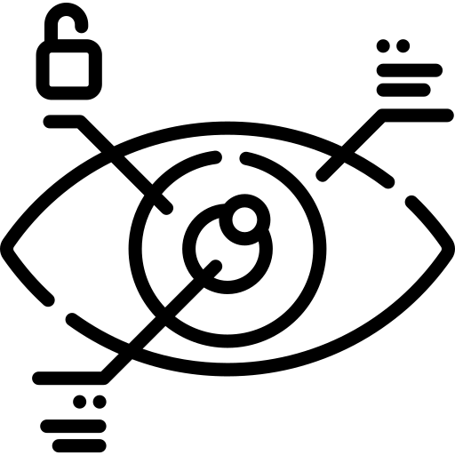
Iris Data
Camera Method
False Rate
1/1000000 for a Eye
1/1000000000000 for Eyes

Slide 11
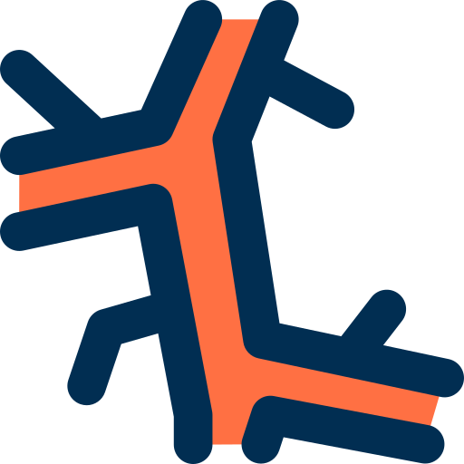
Vein Data
Infrared Ray Method
False Rate
1/10000

Slide 12
Biometric Authentication Technology
Authentication Using Physiological / Behavioral Data

Slide 13
Biometric Data
Biometric Data | Method | Traits
Fingerprint* | Shape of Fingerprint | Convenient to use, Small Sensor, Rely on Environment
Iris/Retina* | Color, Shape, Pattern for Iris Pattern of Capillaries for Retina | Low FR, Hard to Forge
Vein* | Pattern of Vein | High Cost, Hard to Forge
Face* | Shape of Eyes, Nose, Mouth | Low Cost, Aging, Environment
Signature** | Speed & Pressure of Signature | Low Cost, Easy to Forge
Voice** | Pattern of Voice | Environment, Record Attack
Physiological Data*
Behavioral Data**

Slide 14
Requirement of Biometric Data
Universality
Uniqueness
Permanence
…

Slide 15
Behavioral Data
Recently, Most Services Use Physiological Data for Authentication
Difficult to Gain, Process
Affected by Environment

Slide 16
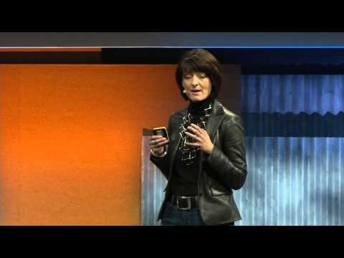
Behavioral Data
Abacus Project(Google)
A Project to Replace Password
Use Behavioral Data
Trust Score
API

