Slide 1
DCGAN
https://youtu.be/9RgBhAdaEmY

Slide 2
CNN
DCGAN
DCGAN code

Slide 3
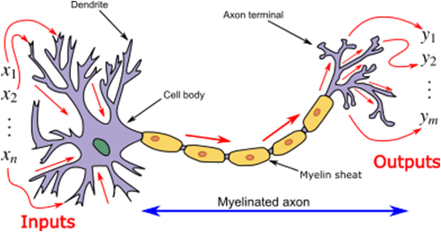
Neural Network
인간의 뉴런의 구조에서 착안

Slide 4
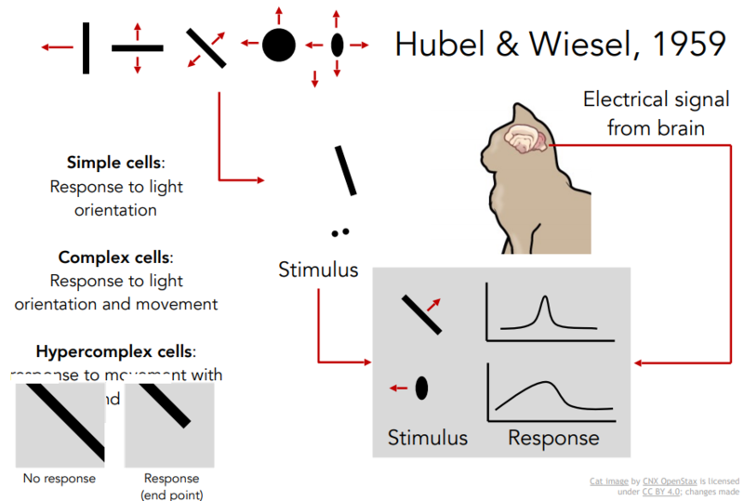
Neural Network

Slide 5
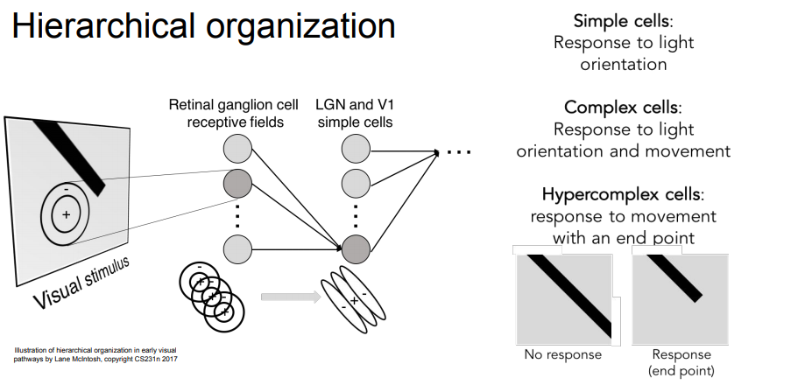
Hierarchical Structure

Slide 6
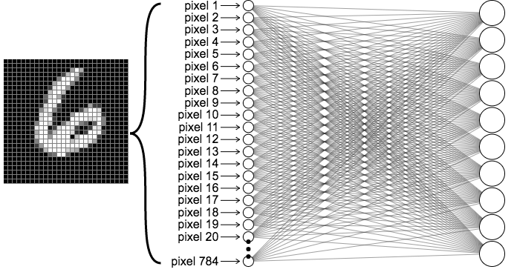
Fully Conneted Layer
28x28 image

Slide 7
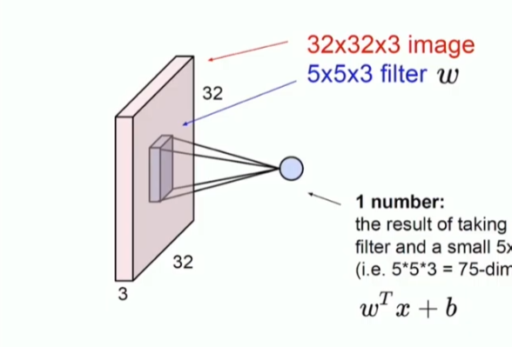

Convolution Layer
filter

Slide 8
Convolution Layer
filter
3
1
1
0
0
1
0
1
0
1
0
1
1
0
0
1
1
3

Slide 9
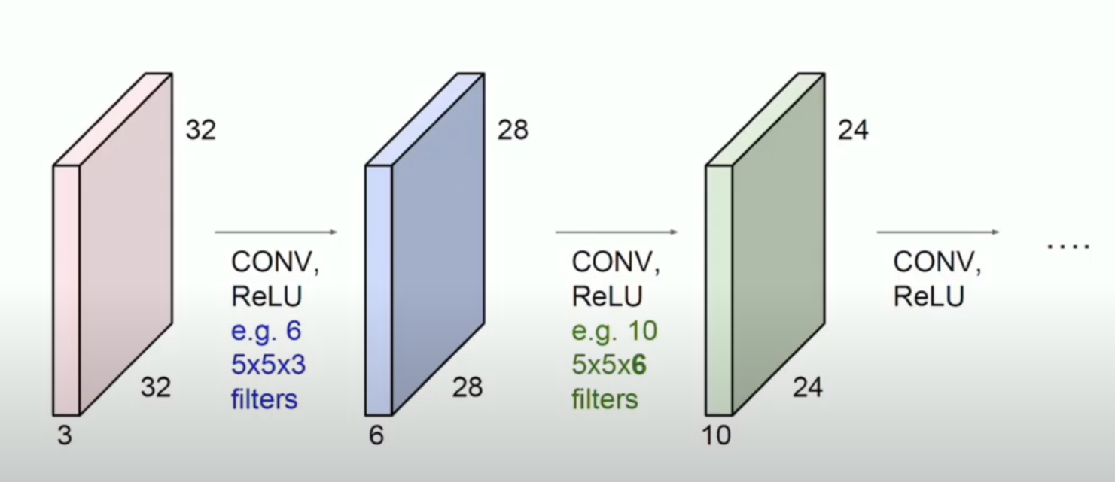
Convolution Layer

Slide 10
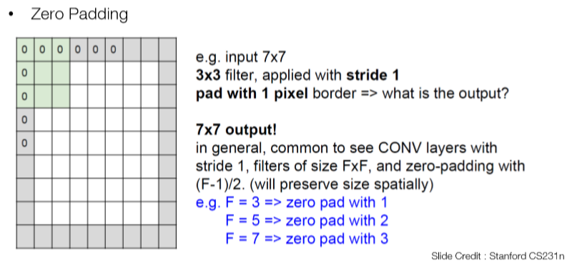
Zero padding

Slide 11
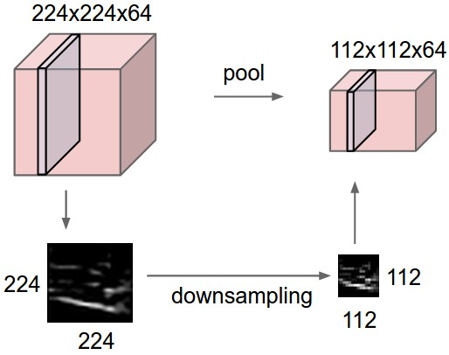
Pooling layer

Slide 12
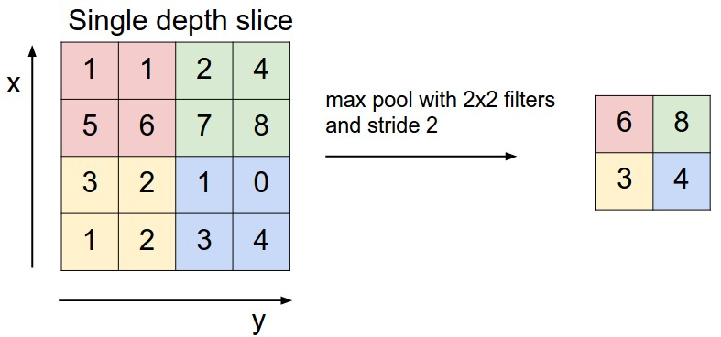
Pooling layer

Slide 13
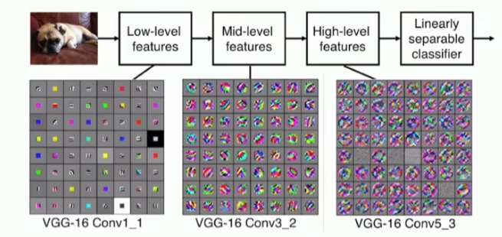
Convolution Neural Network

Slide 14

Convlution Neural Network
전체적인 과정

Slide 15
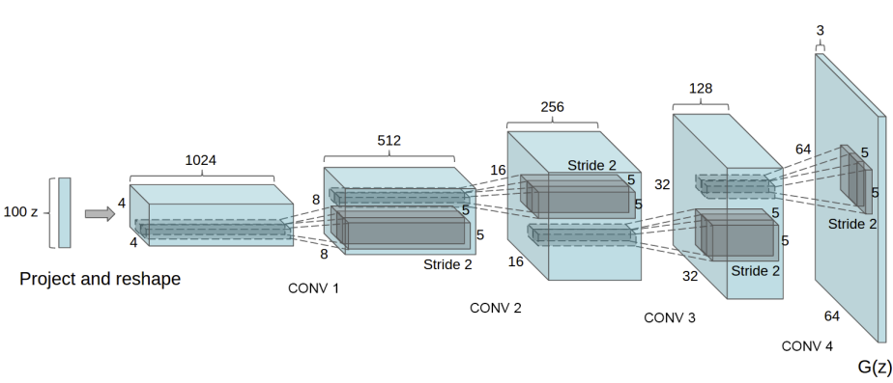
Generator

Slide 16
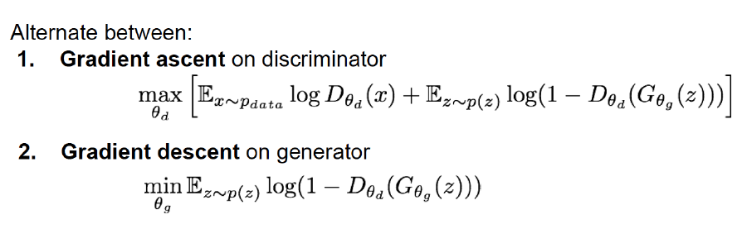
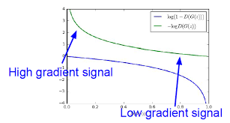
Loss function (objective function)
Optimization
2. Gradient ascent on generator
max(E_{z~p(z)}log(D_{θd}(G_{θd}(z)))

Slide 17
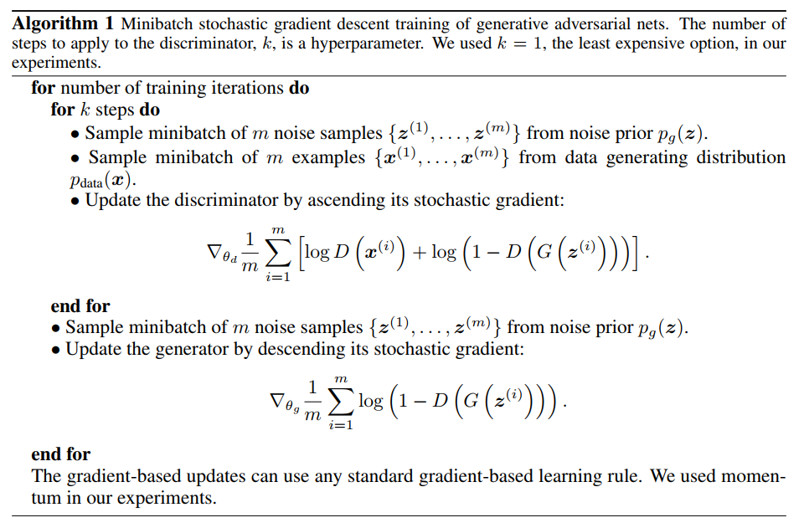
Loss function (objective function)
Optimization

