Slide 1
Implementation of SM4 Block cipher on CUDA GPU and its analysis
Si-Woo Eum, Hyun-Jun Kim, Hyeok-Dong Kwon,
Kyung-Bae Jang, Hyun-Ji Kim, Hwa-Jeong Seo*

Slide 2
1. Introduction
2. Related Work
3. Implementation of SM4 on GPU
4. Conclusion

Slide 3
1. Introduction
SM4 Block cipher is a symmetric key algorithm developed by the China National Cryptographic Authority.
Its simple design can be applied to various smart devices.
Graphics Processing Unit(GPU) have become an integral part of today’s major computing systems.
Various studies using GPU for parallel implementation of block ciphers are also being conducted.
We implement SM4 Block cipher on GPU and its analysis.

Slide 4
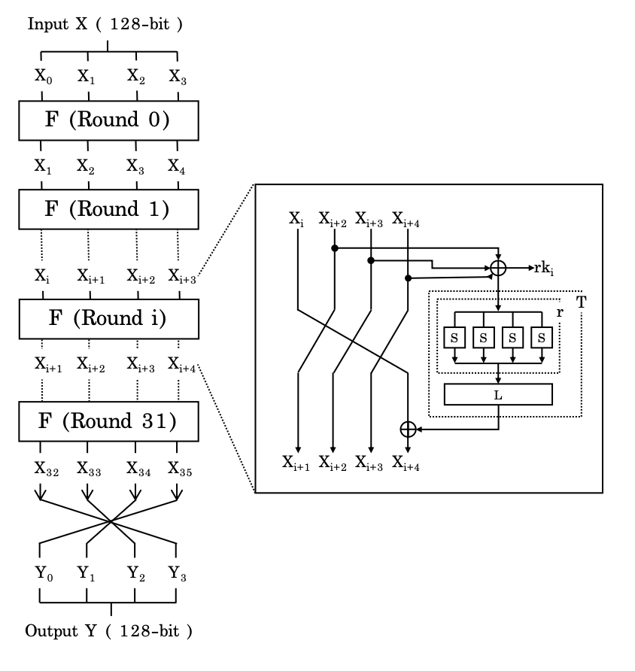
2. Related Work : SM4 Block Cipher
SM4 Block cipher Parameter
Block size : 128-bit
Key size : 256-bit
Rounds : 32 rounds
Round Function
T function : consists of tau and L.
tau function : substituted through Sbox.
L function : a linear substitution function

Slide 5

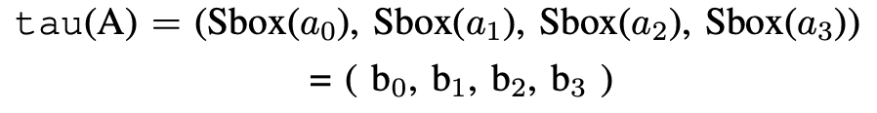
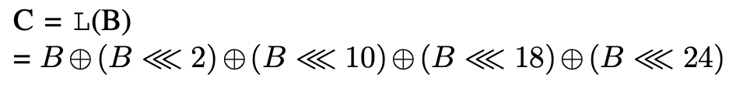
2. Related Work : SM4 Block Cipher
T function
tau function
L function

Slide 6
2. Related Work : GPU
GPU is parallel programmable processor that feature arithmetic and memory bandwidths that exceed CPU.
CUDA (Computing Unified Device Architecture) is a parallel computing platform developed by Nvidia. CUDA comes with a software environment that allows developers to use C as a high-level programming language.
The CUDA GPU architecture includes Thread, Block, Grid, Warp, and Functional kernel running on the GPU

Slide 7
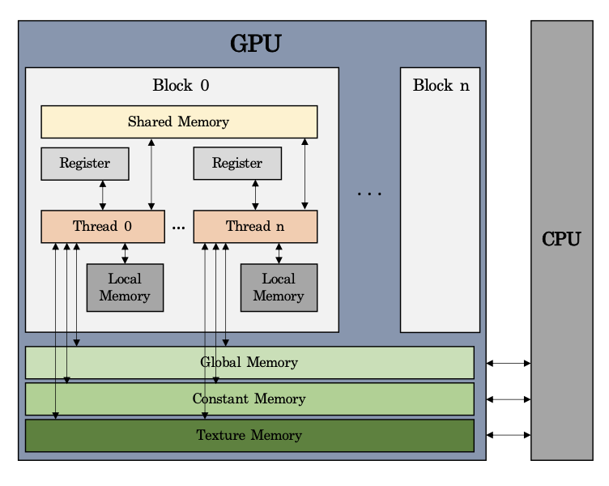
2. Related Work : GPU
GPU provide different types of memory
Global memory
Constant memory
Texture memory
Local memory
Register
Shared memory
Off-chip
On-chip

Slide 8
2. Related Work : GPU
Memory Access Speed
Register > Shared Memory > Global Memory
Memory Capacity
Global Memory > Shared Memory > Register

Slide 9
3. Implementation on GPU : SM4 T-table
SM4 is implemented using 8-bit sbox table(S-table) and 32-bit T-table.
The size of the GPU registers is 32-bit, so using a T-table is expected to give better performance.
The difference between the two implementations is that table size and implementation of T function.
S-table size is 256 Byte. - 1byte * 256
T-table size is 4,096 Byte(4KB). - 4byte * 256 * 4 tables
The implementation of the T function is simplified because the L function is precomputed in the T-table implementation.

Slide 10
3. Implementation on GPU : Constant memory
Constant memory is a read only memory.
Kernel can only read values from constant memory. It is initialized in the Host.
If all threads use values stored at the same address, Constant memory access speed is fast much as shared memory.
HOST(CPU)
Device(GPU)
Master
Key
Key Algorithm
Roundkey
Constant
Cahch
Constant
Memory
cudaMemcpyToSymbol()

Slide 11
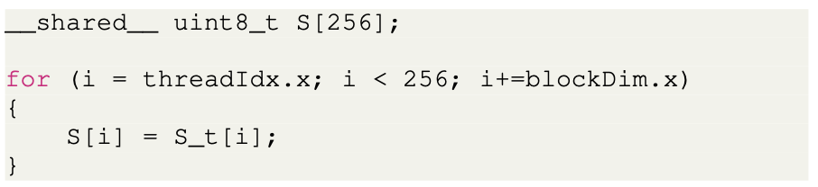
3. Implementation on GPU : Shared Memory
Shared Memory has High bandwidth and low latency.
In tau Function, it is calculated through many memory accesses.
HOST(CPU)
Device(GPU)
Block 0
Block n
Sbox Table
Shared
Memory
…
Shared
Memory
Global
Memory

Slide 12
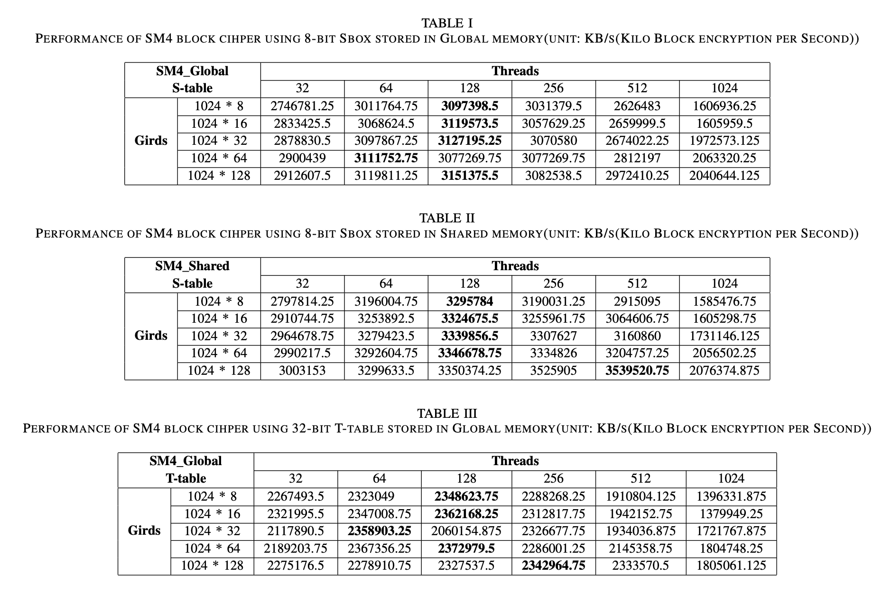
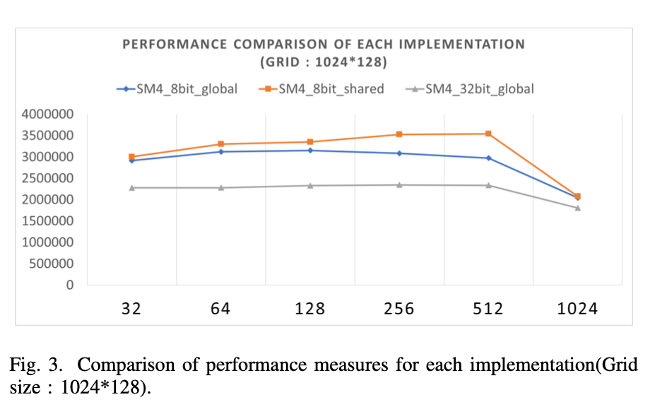
4. Conclusion : Performance comparison

Slide 13
4. Conclusion : Summary
We implement SM4 block cipher on GPU
In this paper, the performance of the implementation using the S-table and using the t-table is presented for comparison. And also, the performance of the implementation using the global memory and using the shared memory is presented for comparison.
We hope that this study will help other block cipher implementations on GPUs.

Slide 14
Thank you
shuraatum@gmail.com

