Slide 1
Accelerating the AIMer Post-Quantum Signature with AVX-512
A Field-Keccak Speedup Analysis
Seung-won Lee, Min-Ho Song, Si-Woo Eum, Ha-Gyeong Kim, Min-Seo Kim, Hwa-Jeong Seo
Presenter: Seung-Won Lee
E-Mail: dkajdfhd1@gmail.com
Notes:
Hello, / I’m Seung-Won Lee / from Hansung University. /
Today, / I will present our work on / “Accelerating(액셀러레이팅) the AIMer Post-Quantum Signature with AVX-512.”

Slide 2

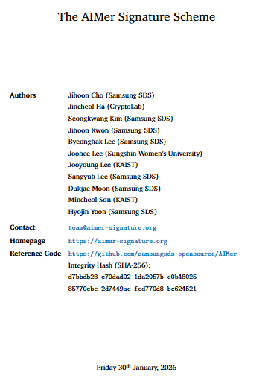
1. Introduction
AIMer: Based on Symmetric-Key One-Way Functions and MPCitH Zero-Knowledge Proofs
Release of AIMer Standard Document and Reference Code by the PQC Research Center (January 30, 2026).
Only the C reference code is released on GitHub, excluding the optimized code.
Utilizing the AVX2 implementation provided by KpqClean.
Integrated the latest reference implementation and the utilized AVX2 code into liboqs.
Scaled up to the AVX-512 implementation post-integration.
"This paper aims to implement an optimized version of AIMer utilizing AVX-512 supported by modern processors."
Notes:
First, / let me explain / the background of this work. //
AIMer is a digital signature scheme. //
It is based on / a Symmetric-Key One-Way Function / and an MPC-in-the-Head Zero-Knowledge Proof. //
The final AIMer Standard Document and Reference Code/ were released On January 30th(써티어스), 2026,. //
However, / the final release included / only the C-based Reference Code. //
It did not include / an optimized implementation.
So, / we used the(디) existing AVX2 implementation / from KpqClean. //
First, / we integrated /the Reference implementation and the AVX2 implementation / into liboqs. //
Then, / we extended this implementation / to AVX-512. //

Slide 3
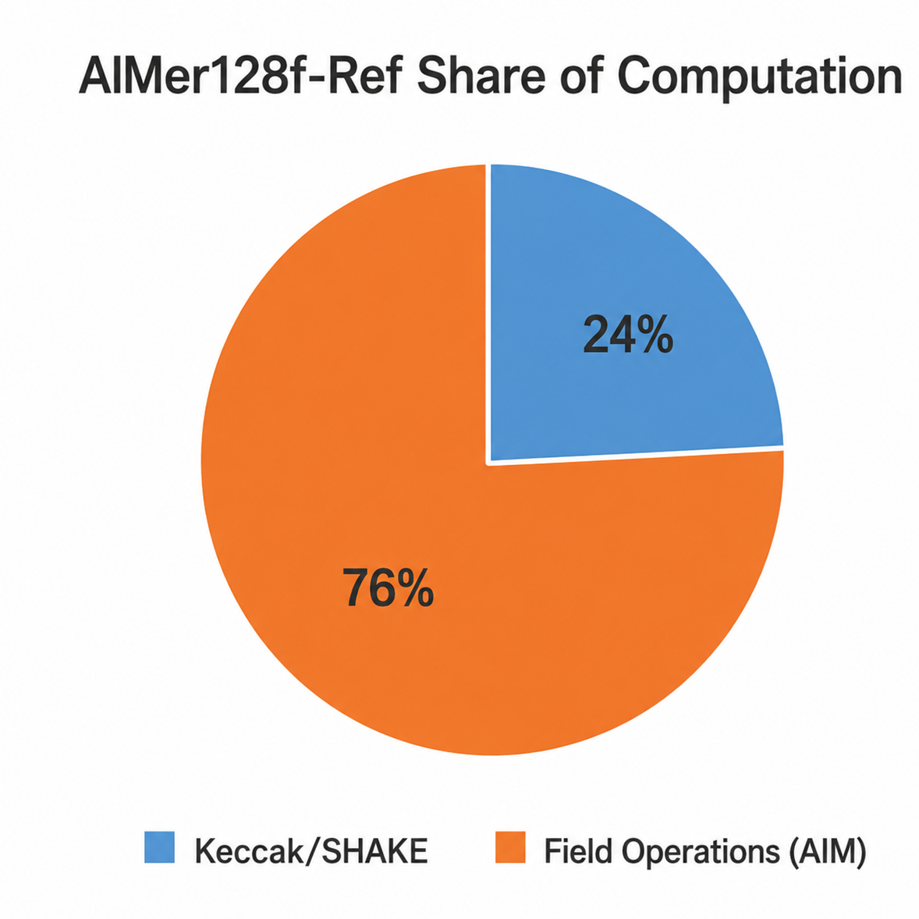
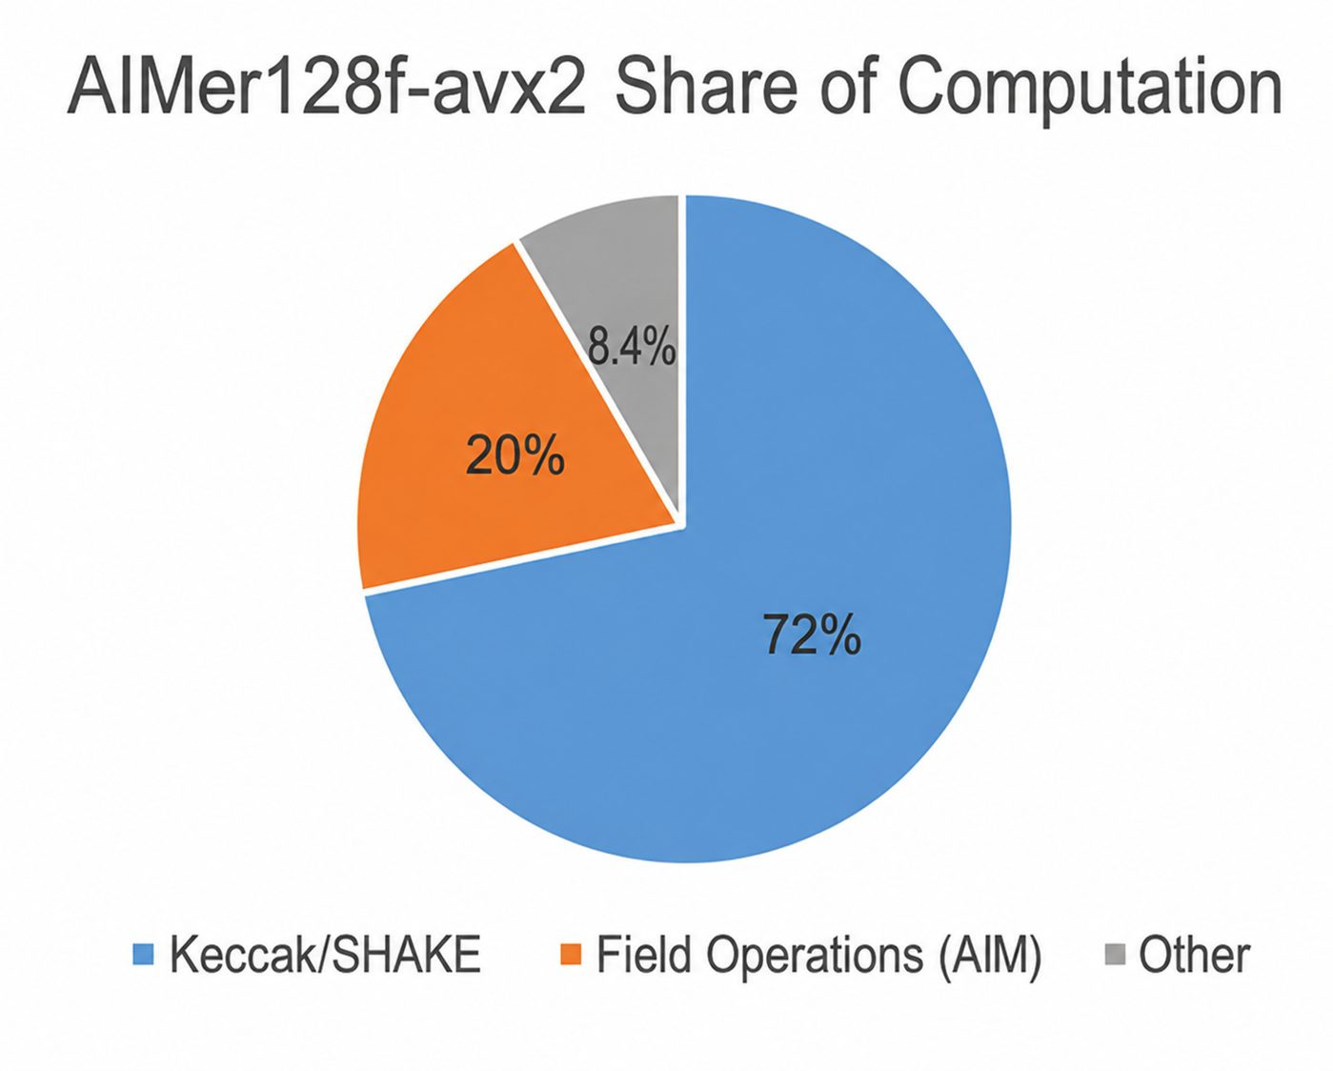
2. AIMer Structure and Optimization Targets
AIMer signing Structure
ref → avx2
Secret Key
Decreased the share of field operations.
76% → 20%
MPCitH
Increased the share of Keccak/SHAKE operations.
24% → 72%
N Virtual Parties
Commitment / Challenge Generation
AIM2 computation
Keccak / SHAKE
Profiling results show that after applying AVX2, the share of Field Arithmetic decreases, while the share of Keccak/SHAKE increases.
Therefore, the AVX-512 implementation optimizes both Field Arithmetic and Keccak/SHAKE, with larger additional performance gains expected from Keccak/SHAKE.
GF(2^λ) operations
Signature
Notes:
Next, / let me explain / the AIMer structure and our optimization targets. //
On the left, / you can see / a simplified AIMer signing structure. //
AIMer uses MPCitH / based on the Secret Key. //
Here, / we have two main repeated operations. //
First, / N Virtual Parties perform / the AIM2 computation. //
During this process, / GF(2^λ) 지에프 오브 투 투 더 람다 Field Operations / are repeated many times.
Second, / Keccak/SHAKE is used many times / for Commitment and Challenge Generation.
So, / we focused on / these two parts. //
Now, / let’s look at the two graphs / on the right. //
For the Reference implementation, / the share of Field Operations is about / 76 percent.
The share of Keccak/SHAKE is about / 24 percent. //
After applying AVX2, / the share of Field Operations drops / to about 20 percent. //
But the share of Keccak/SHAKE rises / to about 72 percent.
This means / AVX2 already optimizes / the Field part quite(콰이트) well. //
So, / Keccak/SHAKE becomes / relatively more important. //
For AVX-512, / we optimize both / Field Arithmetic(애리스매틱) and Keccak/SHAKE. //
And based on this profiling result, / we expect / a larger additional gain / from Keccak/SHAKE. //

Slide 4
3. Field optimization
GF(2^128): AVX2 vs. AVX-512
GF(2^192) Four-Party Packing
ZMM0 (each lane = 128 bits)
AVX2
AVX-512
Party0 (low)
Party1 (low)
Party2 (low)
Party3 (low)
128 bit (XMM0) - Party0
128 bit - Party0
ZMM1 (each lane = 128 bits)
Party0
Party1
Party2
Party3
128 bit (XMM1) - Party1
128 bit - Party1
64bits(high)
64bits Zero Padding
128 bit (XMM2) - Party2
128 bit - Party2
Requires 64bit zero padding per party.
Uses 1.5 lanes per element (1 element = 128 bits + 64 bits)
128 bit (XMM3) - Party3
128 bit - Party3
GF(2^256) Four-Party Packing
ZMM0 (each lane128 bits)
…
512 bit ZMM0
…
Party0 (low)
Party1 (low)
Party2 (low)
Party3 (low)
ZMM1 (each lane128 bits)
PCLMULQDQ (per Party)
Process 1 party per 128 bit register
VPCLMULQDQ (4- Party)
Process 4 parties in parallel using 512 bit register
Party0 (high)
Party1 (high)
Party2 (high)
Party3 (high)
Exact packing across two ZMM registers
Uses 2 lanes per element (1 element = 128 bits + 128 bits)
No padding required
Notes:
First, / let’s look at / Field Optimization. //
On the left, / we have GF(2^128) 지에프 오브 투 투 더 원-투-에이트. //
With AVX2, / each Party uses / one 128-bit XMM register. //
PCLMULQDQ processes / each Party separately. //
So, / Party 0 to Party 3 / are processed separately. //
With AVX-512, / we can use / a 512-bit ZMM register. //
In GF(2^128) ) 지에프 오브 투 투 더 원-투-에이트. , / one Party uses 128 bits. //
So, / we can pack four Parties / into one ZMM register. //
Then, / VPCLMULQDQ processes / all four Parties in parallel. //
Now, / let’s look at / GF(2^192) 지에프 오브 투 투 더 원-나인-투. //
One element is / 128 bits plus 64 bits. //
So, / the(디) actual data takes / 1.5 lanes. //
For four Parties, / we use two ZMM registers. //
The first ZMM stores / the lower 128 bits / of each Party. //
The second ZMM stores / the remaining 64 bits. //
The(디) unused 64 bits / in each lane / are filled with Zero Padding. //
For GF(2^256) 지에프 오브 투 투 더 투-파이브-식스, / the situation is simpler. //
One element uses / exactly two 128-bit lanes. //
So, / four Parties can be packed / into two ZMM registers / without any padding.

Slide 5
4. Linear Layer Optimization
The Linear Layer performs binary matrix-vector multiplication by XORing matrix rows corresponding to input bits of 1.
AVX2 (Baseline)
AVX 512 (Optimization)
Use VPAND instruction
Mask
Mask
AND
Row
=
tmp (Mask^Row)
Row
VPTERNLOGQ
=
New Accumulator
tmp
Accumulator
=
New Accumulator
V: Vector instruction
P: Packed data
TERNLOG: Ternary Logic (= 3-input logical operation)
Q: Qword (=64 bits elements)
XOR
Accumulator
Use VPXOR instruction
AVX2: AND + XOR → Use 2 instructions
AVX512: VPTERNLOGQ → Use 1 instructions
∴ VPTERNLOGQ eliminates the separate intermediate operation and combines AND + XOR into a single instruction
Notes:
Next, / let’s look at / the Linear Layer. //
The Linear Layer performs / Binary Matrix-Vector Multiplication. //
It XORs a Matrix Row / when the corresponding input bit / is one. //
Now, / let’s look at AVX2 / on the left. //
First, / VPAND performs / Mask AND Row. //
This creates / an intermediate value / called tmp. //
Then, / VPXOR performs / Accumulator XOR tmp. //
So, / AVX2 needs / two instructions.
On the right, / AVX-512 uses / VPTERNLOGQ. //
TERNLOG means / Ternary Logic. //
It can handle / three inputs at the same time. //
Here, / the three inputs are / Mask, Row, and Accumulator. //
So, / VPTERNLOGQ combines / AND and XOR / into one instruction. //
In short, / two instructions / become one. //

Slide 6
5. Keccak 4-Way Interleaving Optimization
Memory State
YMM Registers
64 bit
64 bit
64 bit
64 bit
64 bit
64 bit
64 bit
64 bit
ymm 0
A0
B0
C0
D0
= 256 bit
State 0
A0
A1
A2
...
A24
= 1600 bit
ymm 1
= 256 bit
A1
B1
C1
D1
State 1
B0
B1
B2
...
B24
= 1600 bit
ymm 2
= 256 bit
A2
B2
C2
D2
State 2
C0
C1
C2
...
C24
= 1600 bit
…
…
State 3
D0
D1
D2
...
D24
= 1600 bit
ymm 24
A24
B24
C24
D24
= 256 bit
Keccak state = 25 lanes x 64 bit = 1600 bit
4 states exist independently in memory
Repeated Keccak permutation calls increase computational cost
AVX-512 provides 32 vector registers
AVX-512VL enables 256 bit YMM operations
Four 64 bit lanes → one 256 bit YMM registers
A single SIMD instruction processes the corresponding lanes of four Keccak states in parallel
Notes:
Next, / let’s look at / the first Keccak optimization. //
This is / 4-Way Interleaving. //
One Keccak State has / twenty-five 64-bit lanes. //
So, / one State is / 1600 bits(식스틴 헌드레드) in total. //
AIMer calls / the Keccak permutation / many times. //
So, / the Keccak computation cost / keeps adding up. //
In our implementation, / we interleave / four independent Keccak States. //
For example, / we take A0, B0, C0, and D0 / from four different States. //
Each one is 64 bits. //
Four lanes together / make 256 bits. //
So, / we pack them / into YMM0. //
We do the same thing / for the next lanes. //
A1, B1, C1, and D1 / go into YMM1. //
And we continue / up to YMM24. //
AVX-512 provides / 32 vector registers. //
And AVX-512VL lets us use / AVX-512 instructions / on 256-bit YMM registers. //
So, / one SIMD instruction can process / the same-position lanes / from four Keccak States / at the same time.

Slide 7
6. Keccak Permutation Optimization
Keccak Permutation
Theta
Rho (Rotation)
Pi
Chi (Logical operations)
Iota
Rho (Rotation)
Chi (Logical operations)
AVX2 (Baseline)
AVX 512
AVX2 (Baseline)
AVX 512
64 bit Lane (=x)
64 bit Lane
a⊕(~b^c)
a⊕(~b^c)
x << r
x >> (64-r)
NOT
(~b)
a
VPROLQ
AND
(~b∧ c)
Multiple instructions
b
VPTERNLOGQ
OR
Rotate Left
Rotate Left
XOR
a⊕(~b∧c)
c
Result
Use 3 Instructions
No direct vector rotate-left instruction
Use 1 Instructions
VPROLQ performs 64bit rotate-left directly
Three input logical operations require multiple instructions
VPTERNLOGQ combines three input bitwise logic
AVX-512 reduces the instruction count inside the Keccak permutation by using VPROLQ and VPTERNLOGQ
Notes:
On the previous slide, / we showed how four Keccak States / are arranged for parallel processing. //
Now, / let’s look inside / the Keccak Permutation. //
Our goal here is / to reduce / the number of instructions. //
Keccak has five steps.//
Here, / I will focus on / Rho and Chi. //
First, / Rho performs / a 64-bit Rotate Left. //
With AVX2, / there is no direct vector rotate-left instruction. //
So, / we need three instructions like Shift Left, / Shift Right, / and OR. //
With AVX-512, / we can use / VPROLQ. //
VPROLQ performs / the 64-bit Rotate Left / directly. //
So, / three instructions / become one. //
Next, / let’s look at Chi. //
Chi uses / three-input logical operations. //
With AVX2, / we need several instructions, / such as NOT, AND, and XOR. //
With AVX-512, / we use VPTERNLOGQ. //
It can process / three-input bitwise logic / in one instruction. //
So, / we optimize Keccak / in two ways. // First, / 4-Way parallel processing. //
Second, / fewer(쀼얼) instructions / inside the permutation. //

Slide 8
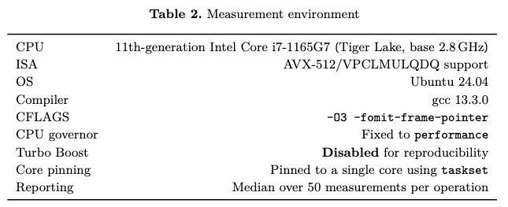
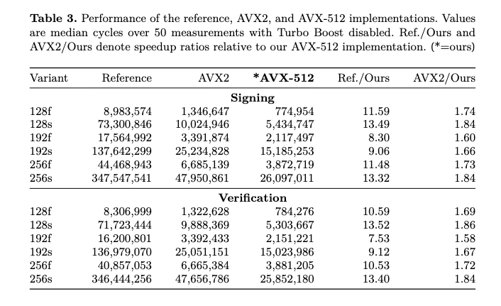
7. Performance
Signing
AVX-512 achieves 1.60–1.84 speedup over AVX2
Verification
AVX-512 achieves 1.58–1.86 speedup over AVX2
192-bit
192-bit variants show the smallest speed up due to zero-padding overhead
Reason the s variants are faster
More MPC parties → more repeated 4-party packing → greater accumulated performance gains
Notes:
Next, / let’s look at / the Performance results. //
On the upper left, / you can see / the Measurement Environment. //
The table below shows / the(디) actual benchmark results. //
We measured each case / 50 times. //
And we report / the median cycle count.
// Now, / let’s look at / the key results on the right. //
For Signing, / AVX-512 achieves / a 1.60 to 1.84 times speedup / over AVX2. //
For Verification, / AVX-512 achieves / a 1.58 to 1.86 times speedup / over AVX2. //
The 192-bit variants / show the smallest speedup. //
The reason is / Zero Padding. //
As I explained earlier, / GF(2^192) 지에프 오브 투 투 더 원-나인-투 has / unused space in the lanes. //
So, / register utilization / is lower. //
The s variants / show larger speedups. //
They have / more MPC Parties. // So, / 4-party packing / is repeated more often. //
And the performance benefit / accumulates more. //
Overall, / AVX-512 achieves a speedup over AVX2 / for all six AIMer variants. //

Slide 9
8. Conclusion
Field Arithmetic
512 bit ZMM Register
1. VPCLMULQDQ: Vectorized Carry-Less Multiplication → Used for binary-field multiplication in Field Arithmetic
2. VPTERNLOGQ: Vectorized Ternary Logic → Used in Linear Layer (AND + XOR) and Keccak logical operation
3. VPROLQ: Vectorized Rotate Left → Used for rotation in Keccak
4. AVX-512VL: AVX-512 Vector Length Extension → Allows AVX-512 instructions on 256 bit YMM register in Keccak
Party0
Party1
Party2
Party3
Pack 4 MPC parties into a 512 bit ZMM register and process in parallel
2. Keccak/SHAKE
256 bit YMM Register
State0
State1
State2
State3
Interleave 4 Keccak states into a 256 bit YMM register and process in parallel
By combining 4-way parallel processing with AVX512 instructions, we achieve significant performance gains over AVX2 for AIMer
Notes:
Finally, / let me summarize / our work. //
We used / two main optimization ideas. //
The first one is / 4-Way Parallel Processing. /
/ For Field Arithmetic, / we pack data from four MPC Parties / into 512-bit ZMM registers. //
Then, / we process the four Parties / in parallel. //
For Keccak/SHAKE, / we interleave four Keccak States / into 256-bit YMM registers. //
And again, / we process them / in parallel. //
The second idea is / AVX-512 instruction optimization. //
VPCLMULQDQ is used / for Binary-Field Multiplication. //
And VPTERNLOGQ is used / in the Linear Layer / and Keccak logical operations. //
VPROLQ is used / for Keccak Rotation. /
And AVX-512VL lets us use / AVX-512 instructions / on 256-bit YMM registers. //
We use this feature / for our 4-Way Keccak implementation. //
So, / by combining / 4-Way parallel processing / and AVX-512 instructions, / we improved AIMer performance / over AVX2. //
That’s all / for my presentation. //

Slide 10
Notes:
Thank you / for listening. //

