Slide 1
Into the Parallage
Harnessing abundance, plurality and divergence in AI translation of ancient texts
Greg Baker | Shirley Chan | Vanessa Enriquez Raido | Greta Hawes
Preliminary pilot finding
Human judgement shows a directional raw signal, but length explains enough that the responsible claim is methodological rather than conclusive.
AI4AS 2026, online mini-conference within DH2026
27 July 2026 | Daejeon, South Korea / remote
Published abstract: theoretical framework, corpus rationale, preliminary pilot findings
Notes:
Open by locating the talk: this is the AI4AS 2026 mini-conference on ancient scripts, held online on 27 July 2026.
The submitted abstract commits us to theory, corpus rationale, and preliminary pilot findings. Vanessa's first-set review gives us the pilot result we can responsibly discuss.

Slide 2
PROBLEM
02
A single fluent translation hides a plural process
Reader sees
Translator does
AI can compress
one clean English surface
one implied authority
one path through ambiguity
alternatives
constraints
purposes
risk management
low-resource uncertainty
fragmentary evidence
cultural specificity
into fluent confidence
The problem is not abundance. The problem is unstructured abundance.
AI4AS 2026 | Into the Parallage | 27 July 2026
Notes:
The abstract begins from translation as situated and purposive, not a lookup task.
Use this slide to set up why one fluent model output is risky for ancient-language work: it removes signs of choice just where the reader most needs them.

Slide 3
METHOD
03
Parallage turns AI abundance into inspectable evidence
A translation pack is not a vote. It is a structured field of alternatives.
literal
readable
interpretive
uncertainty
adversarial
source-facing
control
reader-facing
continuity
scholarly
commitment
marked doubt
and alternatives
challenge case
against fluency
Inspection cues: source-segment alignment | named entities | ambiguity points | differences that matter
AI4AS 2026 | Into the Parallage | 27 July 2026
Notes:
This is the core methodological claim. Parallage is not an attempt to make one better AI translation.
It structures model abundance into a pack that makes interpretive choice visible: literal, readable, interpretive, uncertainty-marked, and adversarial renderings with cues for inspection.

Slide 4
CORPUS
04
The corpus makes reliability hard to outsource
Stephanos of Byzantium, Ethnica
Hanshu Dilizhi
- geographical lexicon
- compressed source tradition
- named entities carry the argument
- pilot analysis available now
- Classical Chinese geography
- dense administrative and cultural categories
- tests the same method outside Greek
- evaluation stream still to complete
Neither case lets a non-source-language reader simply defer to a stable complete English translation.
AI4AS 2026 | Into the Parallage | 27 July 2026
Notes:
The abstract names two corpora: Stephanos and Hanshu Dilizhi.
Make the rationale explicit: these are not just examples; they are contexts where trust and agency become visible because the reader cannot rely on a finished English canon.

Slide 5
PILOT DESIGN
05
The first pilot asks whether expert judgement tracks overlap fragility
n=10
18-268
3
101
Vanessa Set 1 Greek passages
reference words per passage
BLEU, ROUGE-L, 3-gram F1
v3 rows for length model
- Vanessa rated expected divergence from hidden human translations.
- We compared those ratings with sentence-aligned overlap metrics.
- Then we adjusted scores for reference length, because all three metrics worsen on longer documents.
AI4AS 2026 | Into the Parallage | 27 July 2026
Notes:
Explain the design carefully. Vanessa's rating is human judgement about expected divergence.
The automatic scores compare focal machine outputs against approved hidden human translations. They are diagnostic proxies, not ground truth for translation quality.

Slide 6
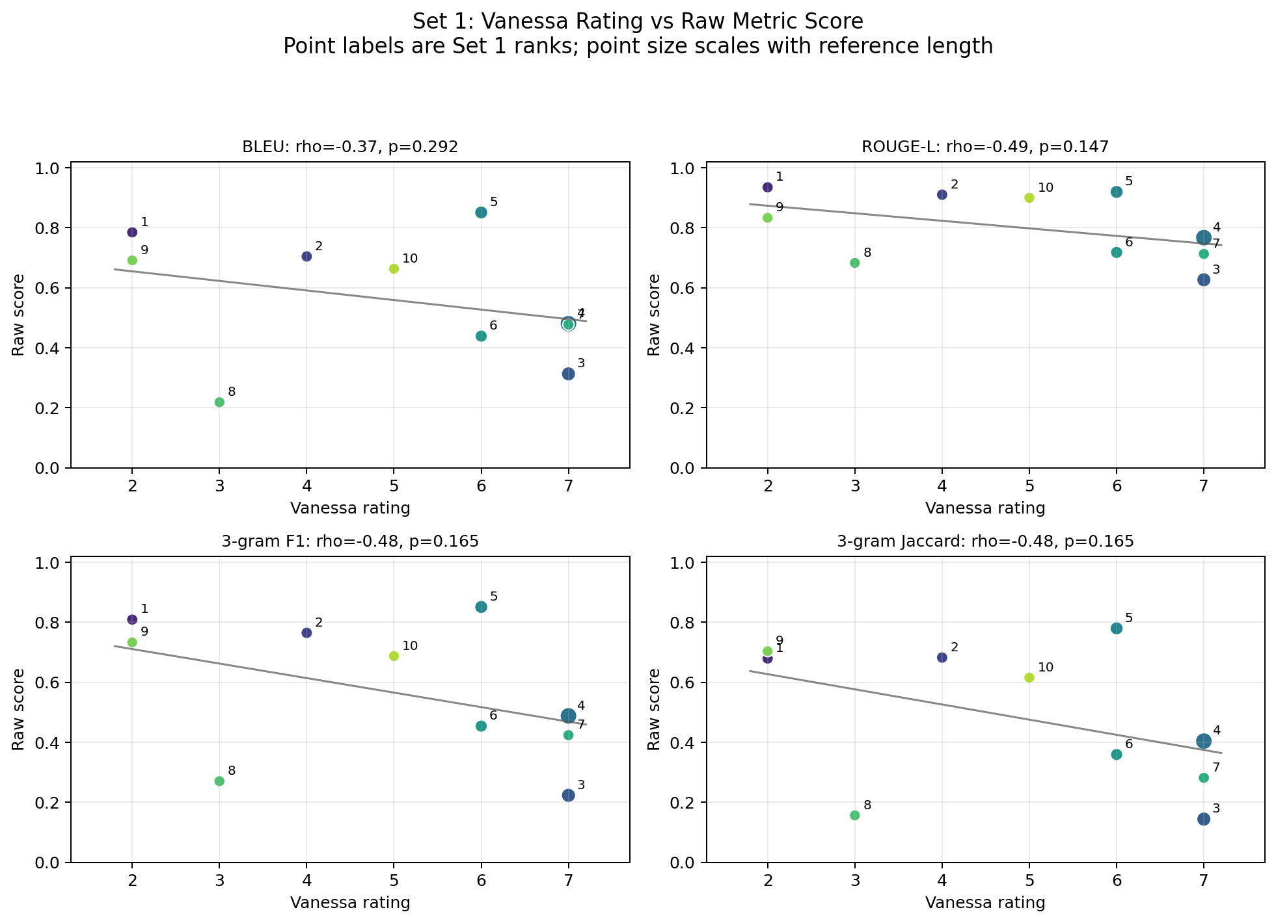
RAW EVIDENCE
06
Raw overlap gives a directional but fragile signal
Spearman r
rating vs raw score
BLEU: -0.37
ROUGE-L: -0.49
3-gram F1: -0.48
Negative is the expected direction: higher human divergence rating, lower lexical overlap.
AI4AS 2026 | Into the Parallage | 27 July 2026
Notes:
This is the answer to the first version of the question: yes, weakly and directionally, Vanessa was often pointing toward lower overlap cases.
But the correlations are modest and the sample is only ten. Treat this as a raw signal, not the conclusion.

Slide 7
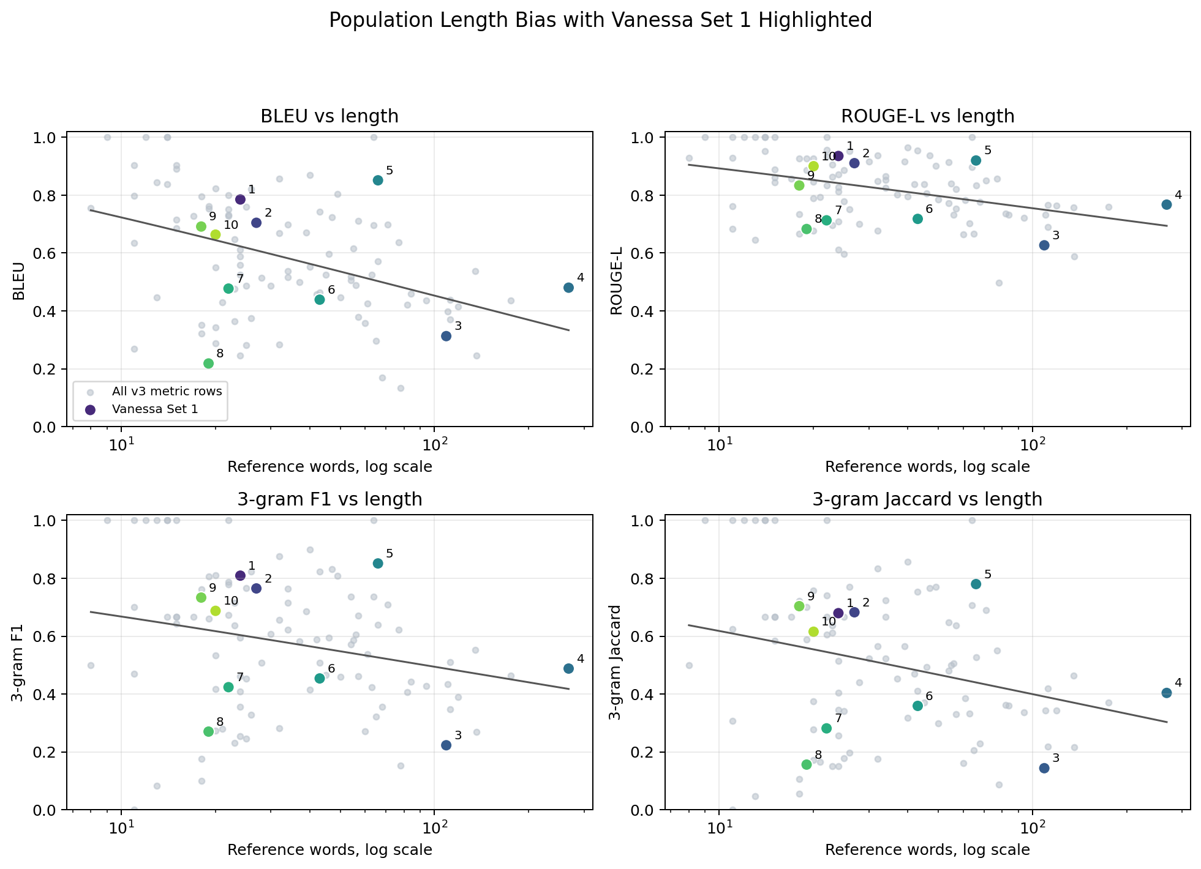
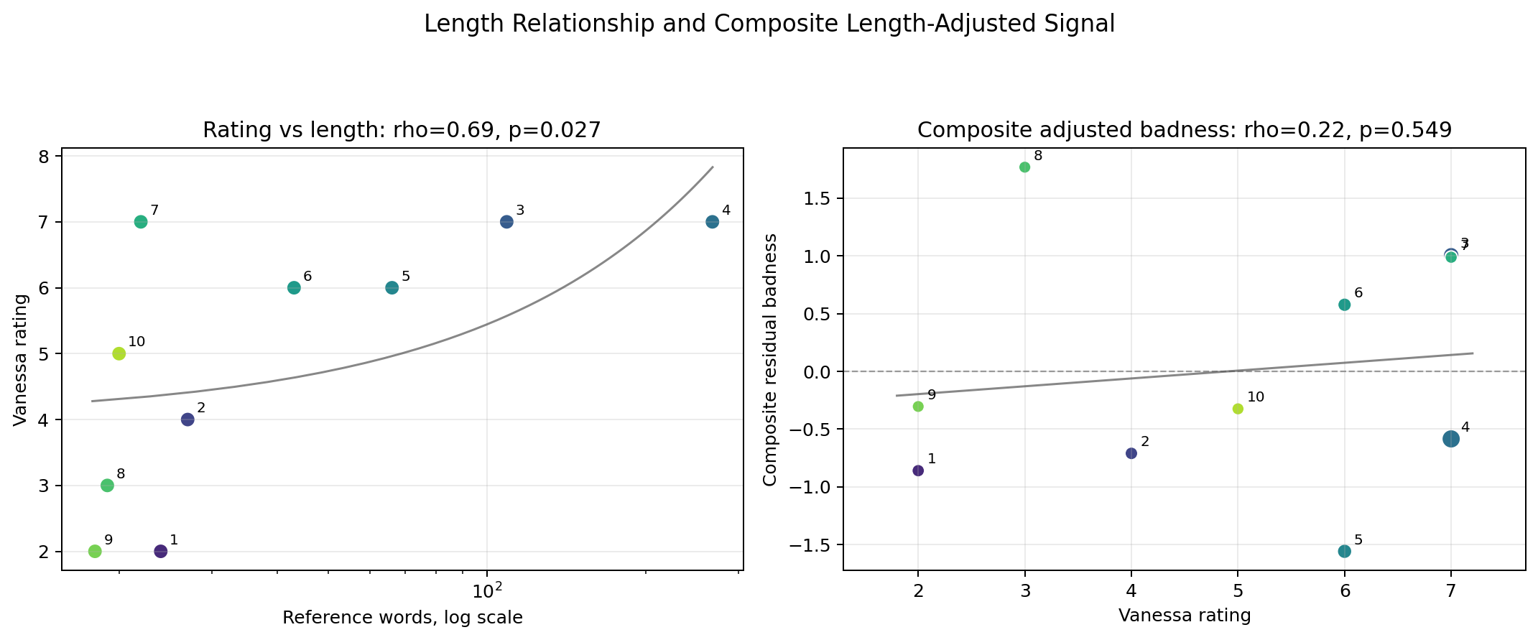
LENGTH CONFOUND
07
Length is a real confound, not a footnote
Set 1 spans 18-268 reference words, and Vanessa's ratings also rise with length.
AI4AS 2026 | Into the Parallage | 27 July 2026
Notes:
All of the overlap metrics do worse on longer documents in the broader population.
That matters because Set 1 is small and Vanessa's ratings also rise with length. If we do not control for length, we overstate what the raw metrics are telling us.

Slide 8
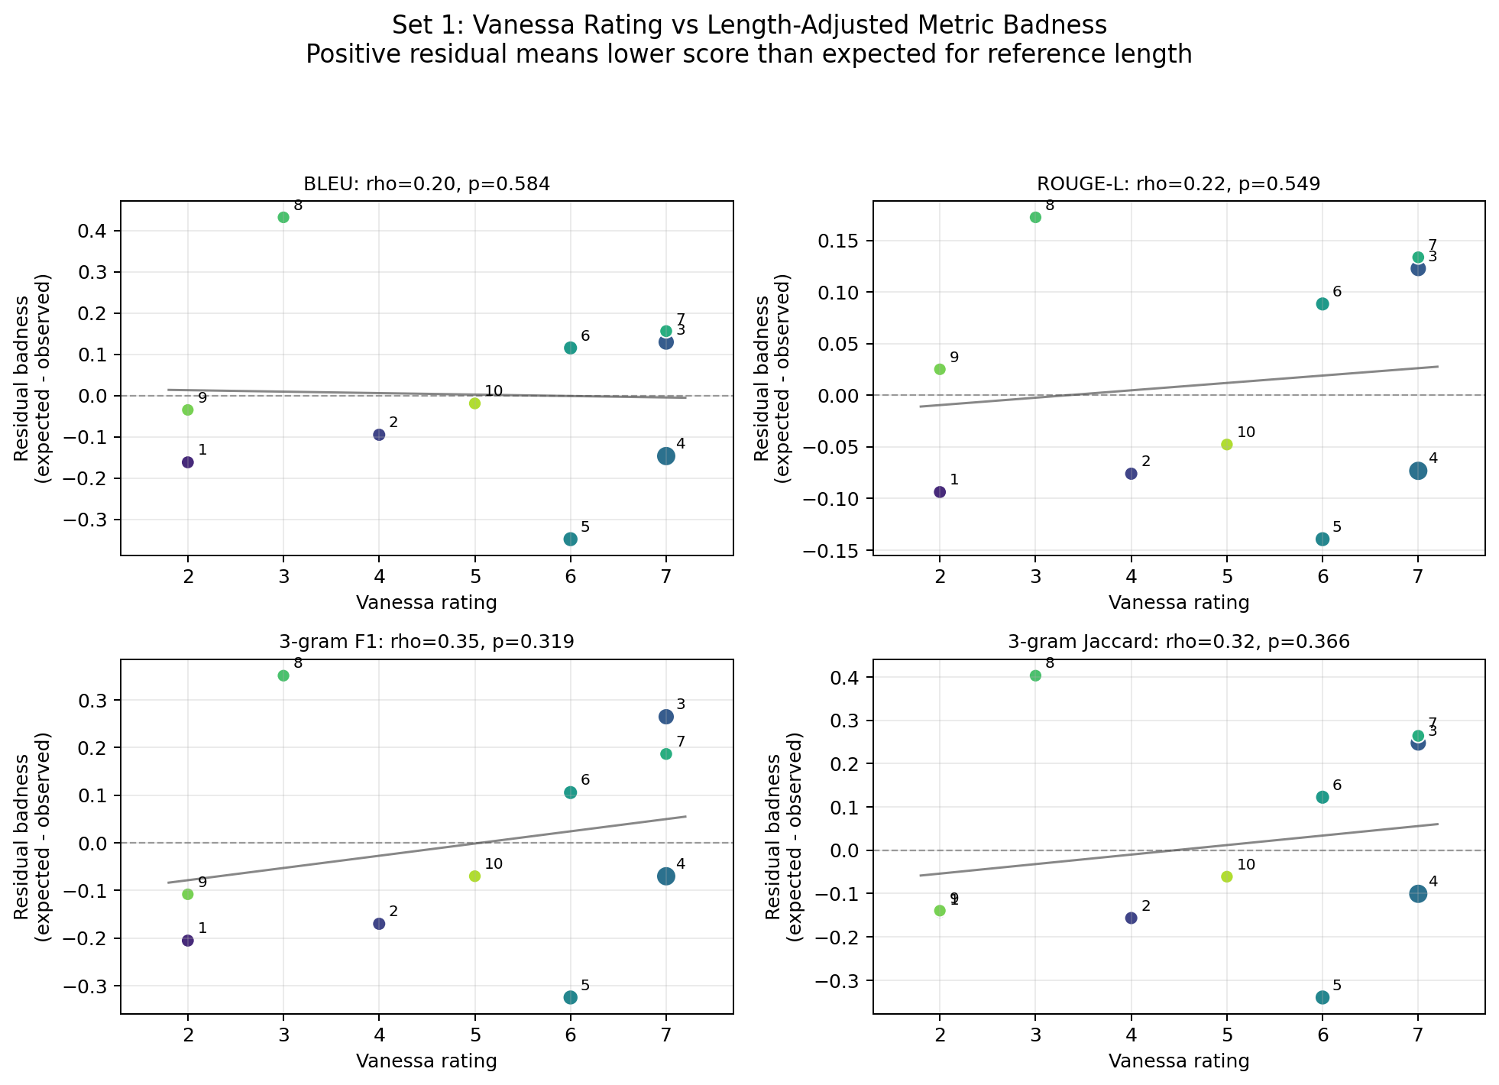
ADJUSTED EVIDENCE
08
After length adjustment, the signal becomes cautious
Spearman r
rating vs residual badness
BLEU: 0.20
ROUGE-L: 0.22
3-gram F1: 0.35
The adjusted direction is positive, but weak at n=10. This is preliminary evidence for workflow value, not proof.
AI4AS 2026 | Into the Parallage | 27 July 2026
Notes:
This answers Greg's follow-up question. Once we account for length, there is still a hint of signal, especially on 3-gram F1 residual badness, but it is weak and not robust.
The right claim is that the review task is producing analyzable judgement data and that the disagreements are diagnostically useful.

Slide 9
DIAGNOSIS
09
The disagreements are the result, not a nuisance
Human high-divergence cases
Worst after length adjustment
What the mismatch tells us
- Καβασσός
- Καρία
- Κυτέριον
- Καδμεία
- Καβασσός
- Κυτέριον
- Καρδαμύλη
- Karia: high rating, length explains much of the low score
- Kadmeia: low rating, poor adjusted overlap
- Kavalis: high rating, strong overlap
These are exactly the cases a pack-based interface should surface for review.
AI4AS 2026 | Into the Parallage | 27 July 2026
Notes:
Use this slide to avoid sounding apologetic about the weak adjusted correlations.
For Parallage, the mismatch between human judgement, overlap metrics, and document length is itself useful: it identifies where a reader or reviewer needs better evidence.

Slide 10
CLAIM
10
What we can responsibly claim at AI4AS
1. Method
2. Pilot
3. Next study
Parallage gives AI translation abundance a visible, auditable structure.
Vanessa's first set shows a raw signal, a length confound, and weak residual signal.
Scale to more reviewers, the Chinese stream, and direct comparison with single-output translation.
The evidence supports a publishable method-in-progress: not proof that the tool is better, but proof that the judgement problem is measurable.
AI4AS 2026 | Into the Parallage | 27 July 2026
Notes:
End with the strongest responsible claim.
Do not claim the pilot proves Parallage improves reliability. Claim that Parallage turns multiplicity into a structured object for judgement, and that the first pilot shows how the judgement data can be analyzed.

Slide 11
SOURCES
11
Evidence base for this version
- AI4AS 2026 programme: the talk is in the 11:00-12:00 AI and Translations session on 27 July 2026.
- Published abstract: Baker, Chan, Enriquez Raido, Hawes, Into the Parallage.
- Macquarie project page: Into the Parallage: harnessing AI abundance in translation tasks.
- Variantum local analysis: Vanessa Set 1 scatter data and generated metric plots.
https://ai4asconference.github.io/2026/abstracts/Session%201/Baker.pdf
outputs/ai4as-2026-parallage/ and analysis/
AI4AS 2026 | Into the Parallage | 27 July 2026
Notes:
Keep this slide as backup rather than presenting it unless questions come up.
It makes the deck self-contained and records where the abstract and pilot evidence came from.

