Slide 1
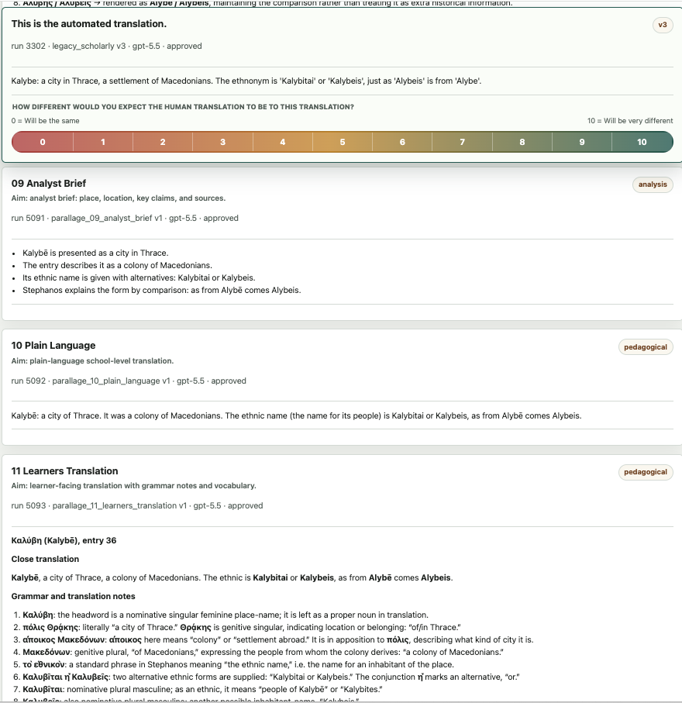
Into the Parallage
Greg Baker | Greta Hawes | Shirley Chan | Vanessa Enriquez Raido
AI4AS 2026, online mini-conference within DH2026
27 July 2026 | Daejeon, South Korea / remote
Variation as a diagnostic: finding the passages that need an expert

Slide 2
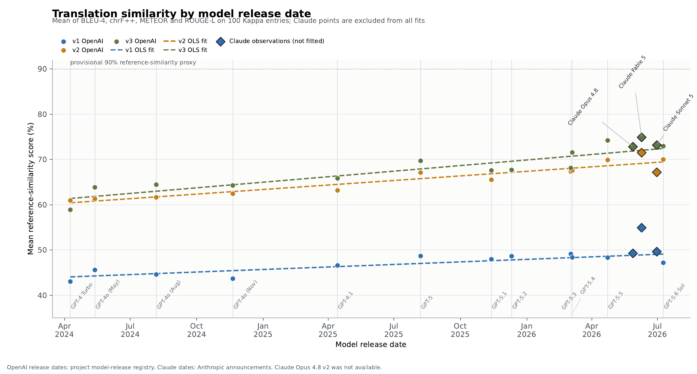
WHY NOW
03
AI4AS 2026 | Into the Parallage | 27 July 2026

Slide 3

METHOD
04

Slide 4
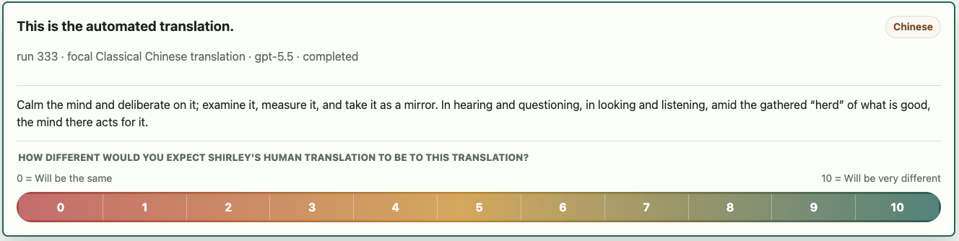
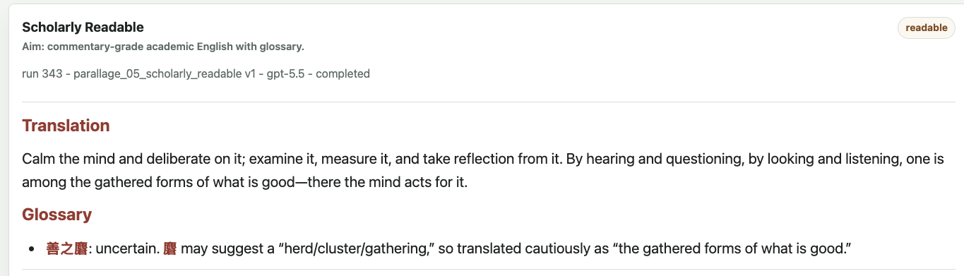
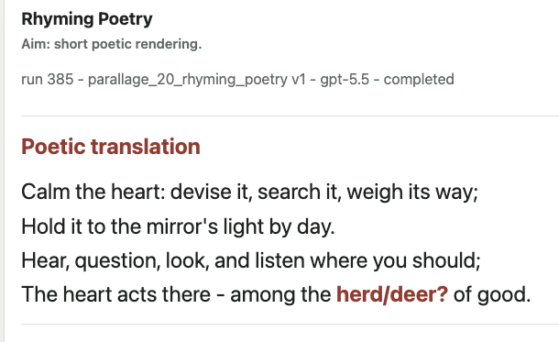
寧心謀之、稽之、度之、鑒之，聞訊視聽，在善之麏，心焉為之。
06
攈
Shirley Chan’s translation:
The tranquil heart-mind deliberates on it, examines it, measures it, and reflects on it. In hearing, questioning, looking and listening, lies within the gathered goodness (for which) the heart-mind thereby acts for it.
AI4AS 2026 | Into the Parallage | 27 July 2026

Slide 5
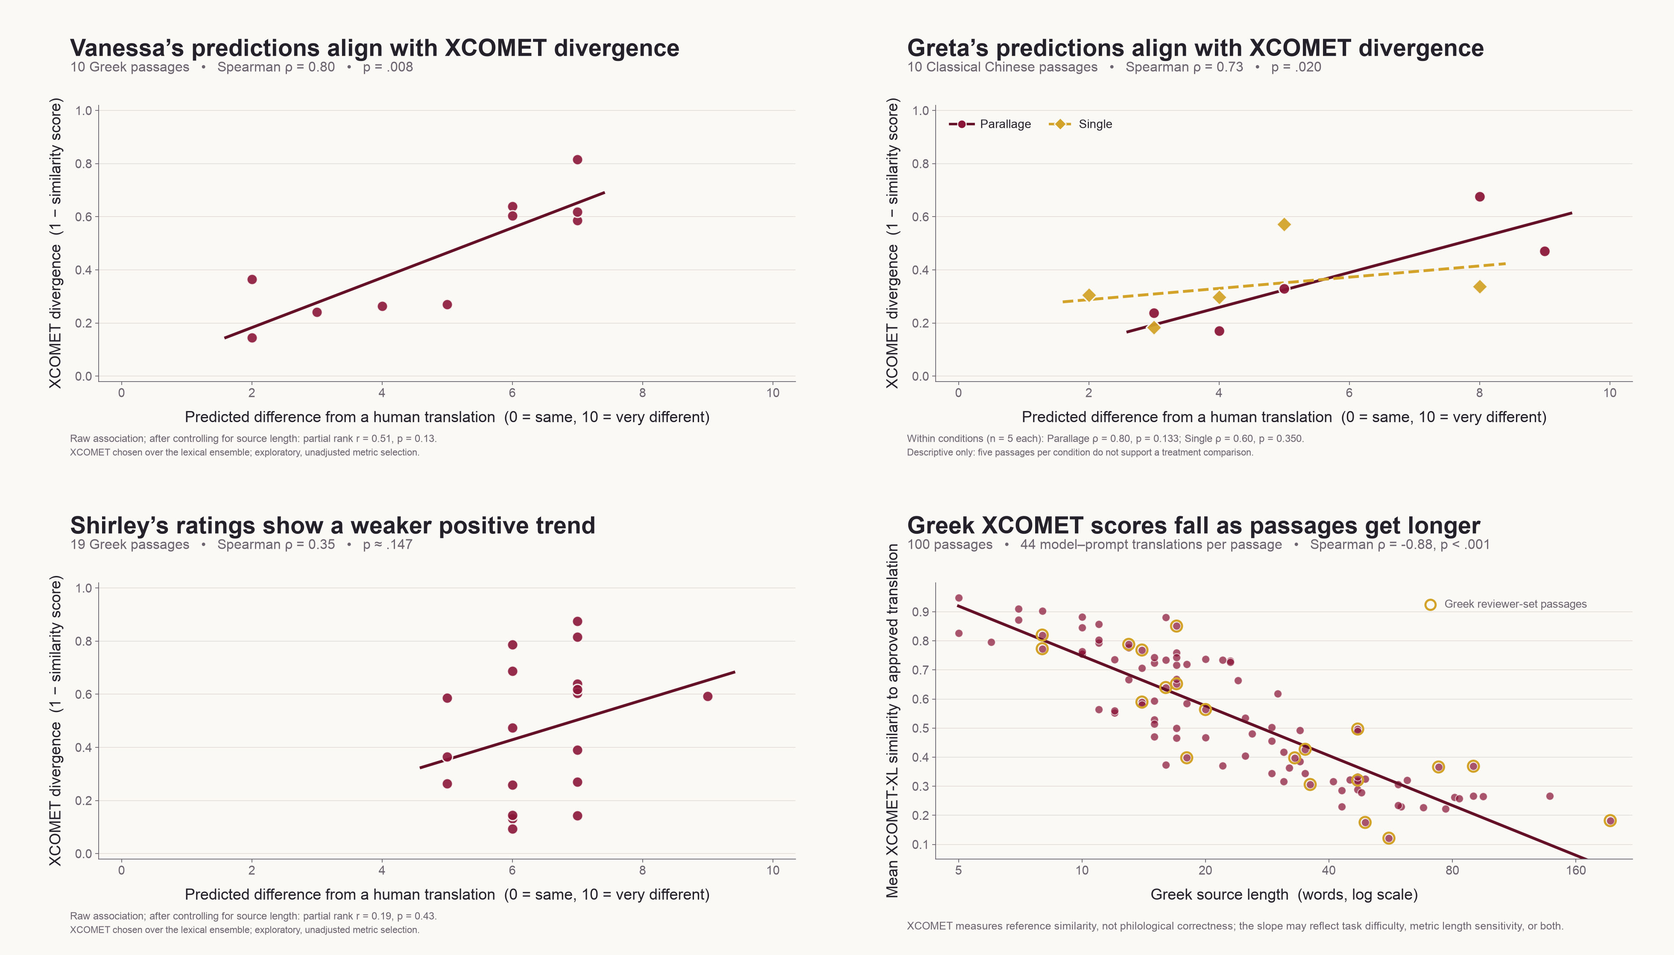
10

Slide 6
Declaring our next study up front
Our hypotheses are:
Answers to “would you trust this translation enough to quote it in an essay?” will be correlated to metric scores for AI similarity to human translation.
Having access to more translations will increase the time on the task, but also make student scores more correlated to the metrics
Only a small number of translation prompts will be useful.
E.g. mnemonic, rhyming couplets and other more exotic translations won't be useful for students.

Slide 7
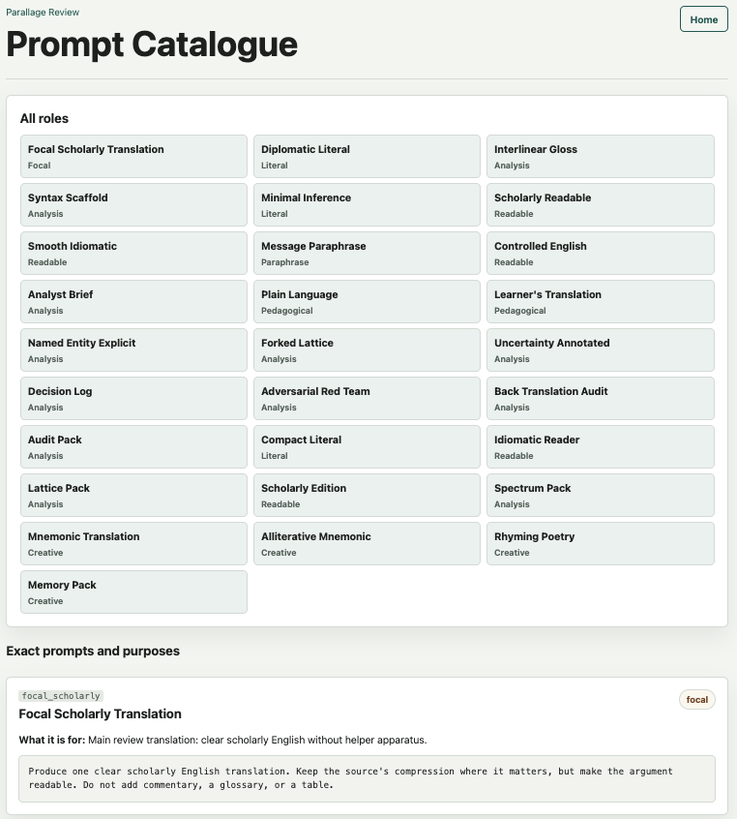
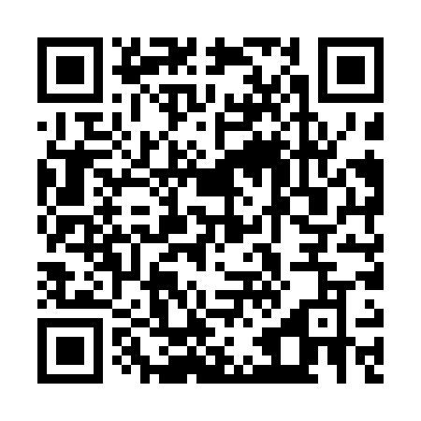
PROMPT LIBRARY
13
https://parallage.symmachus.org/prompts.html
AI4AS 2026 | Into the Parallage | 27 July 2026

