Slide 1
Team Name: IDK
Team Members:-
M.M. Navadeep M. Haritha
BenefitIQ
Know Every Reward. Miss None.

Slide 2
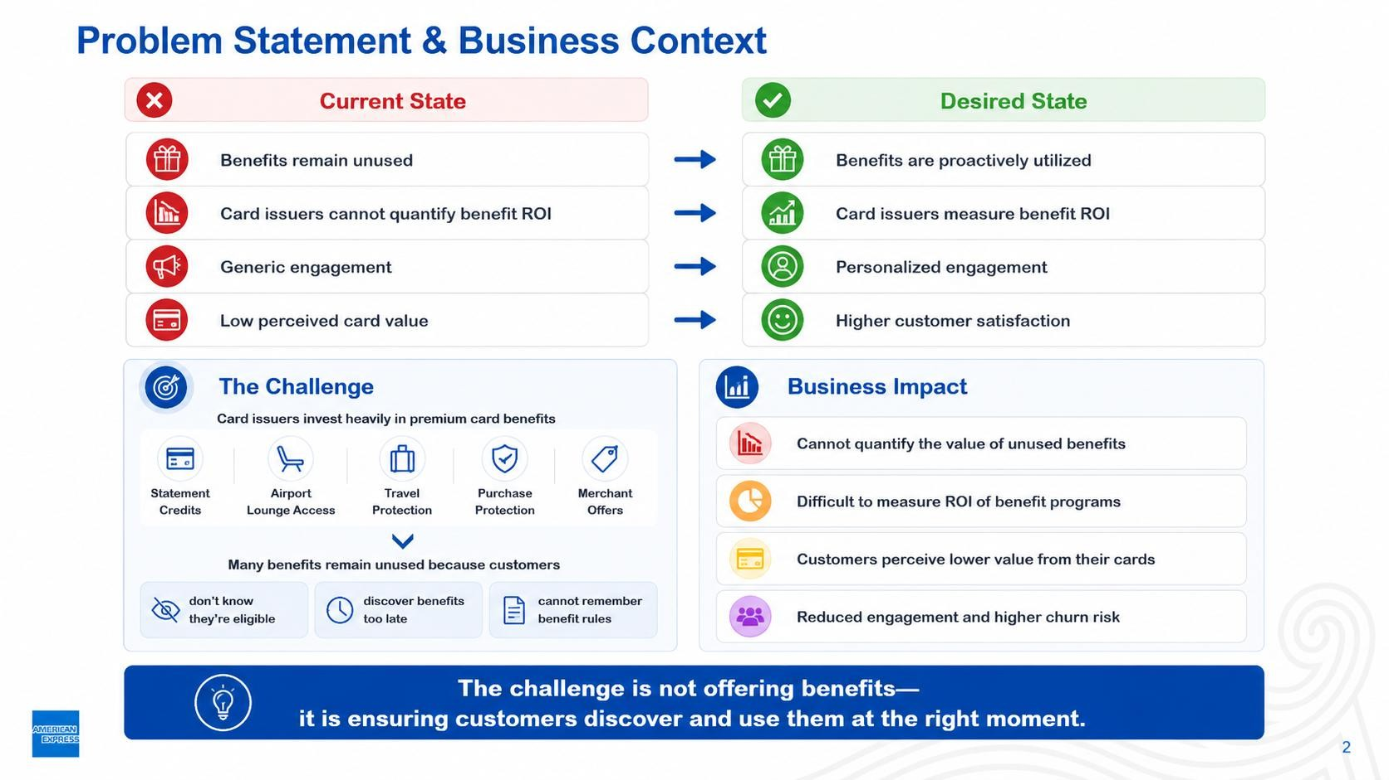
This material contains information that is proprietary and confidential to American Express. It cannot be shared with third parties without
American Express’ written consent. AMERICAN EXPRESS PROPRIETARY & CONFIDENTIAL. DO NOT COPY. DO NOT DISTRIBUTE.

Slide 3
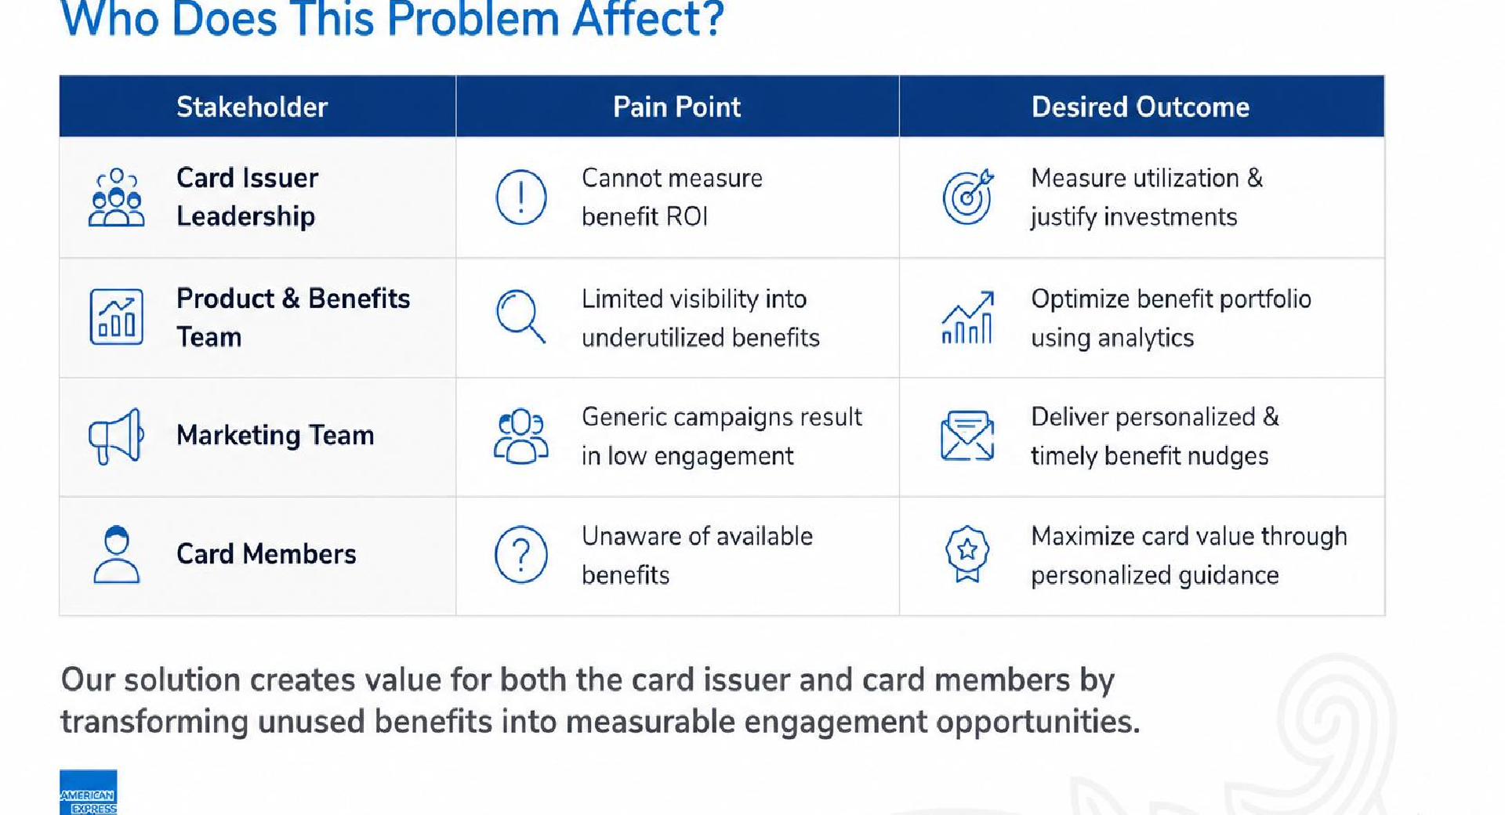
This material contains information that is proprietary and confidential to American Express. It cannot be shared with third parties without American Express’ written consent. AMERICAN EXPRESS PROPRIETARY & CONFIDENTIAL. DO NOT COPY. DO NOT DISTRIBUTE.
3

Slide 4
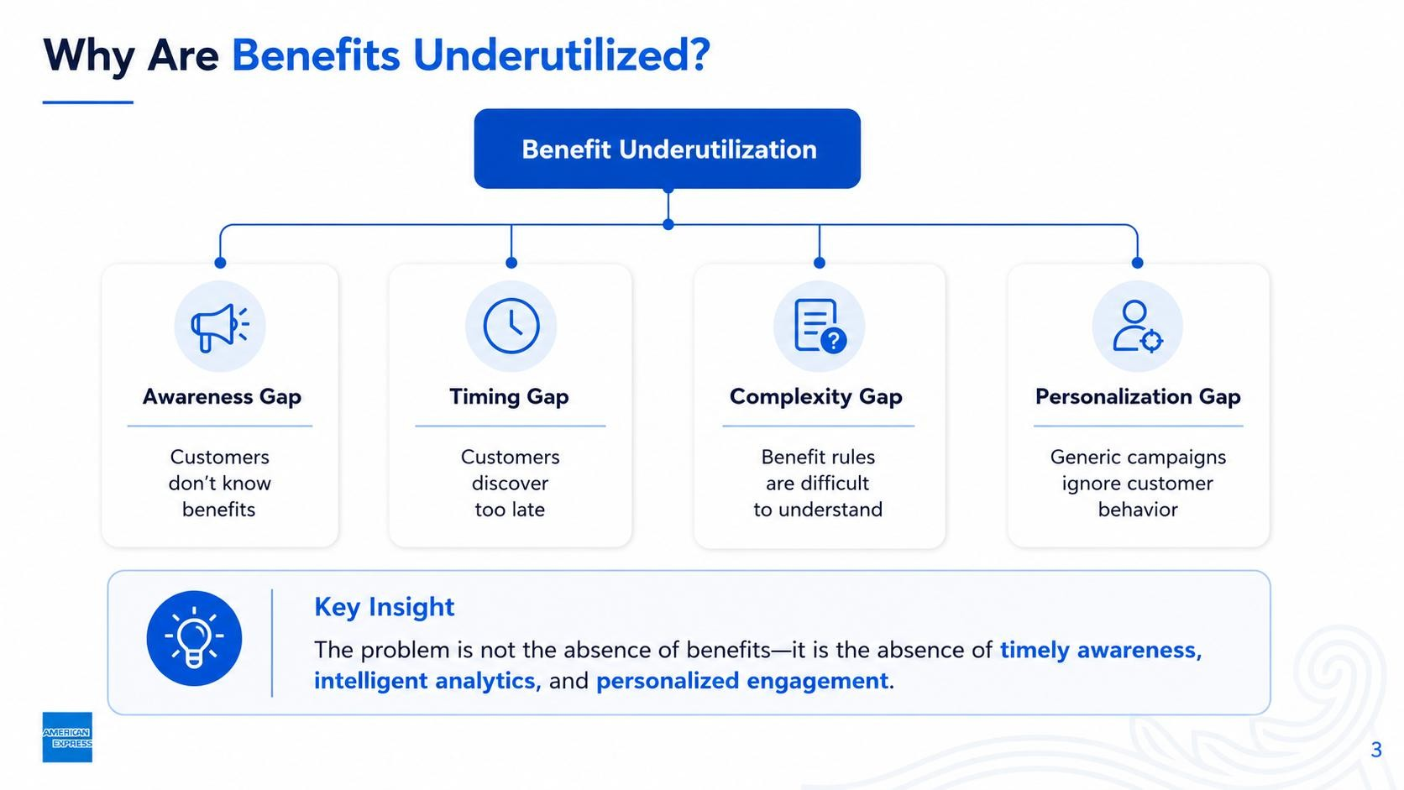
This material contains information that is proprietary and confidential to American Express. It cannot be shared with third parties without
American Express’ written consent. AMERICAN EXPRESS PROPRIETARY & CONFIDENTIAL. DO NOT COPY. DO NOT DISTRIBUTE.

Slide 5
Our Solution
BenefitIQ - A Continuous Benefit Intelligence Platform for Modern Card Issuers
BenefitIQ is a continuous benefit intelligence platform enabling card issuers to identify unrealized benefit value, quantify it, personalize engagement, and continuously measure business impact.
Maps transactions to benefits
Quantifies unrealized value
Personalized recommendations
Continuous optimization
Transforming Benefit Analytics into Continuous Customer Value is our main goal
This material contains information that is proprietary and confidential to American Express. It cannot be shared with third parties without
American Express’ written consent. AMERICAN EXPRESS PROPRIETARY & CONFIDENTIAL. DO NOT COPY. DO NOT DISTRIBUTE.

Slide 6
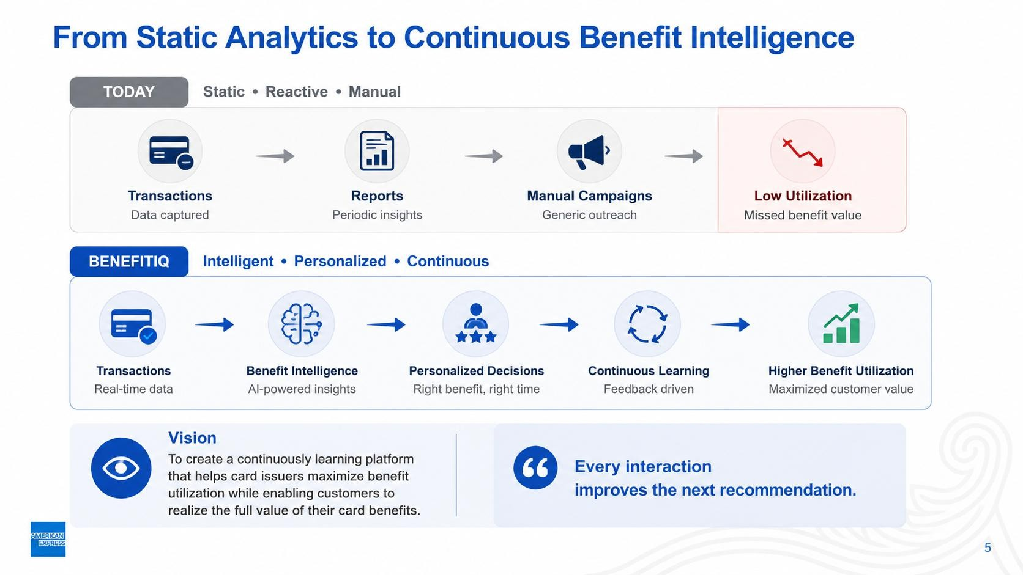
From Static Analytics to Continuous Benefit Intelligence
TODAY
Transactions → Reports → Manual Campaigns → Low Utilization
BENEFITIQ
Transactions → Benefit Intelligence → Personalized Decisions → Continuous Learning
→ Higher Benefit Utilization
Vision
Create a continuously learning platform that maximizes benefit utilization. Every interaction improves the next recommendation.
This material contains information that is proprietary and confidential to American Express. It cannot be shared with third parties without
American Express’ written consent. AMERICAN EXPRESS PROPRIETARY & CONFIDENTIAL. DO NOT COPY. DO NOT DISTRIBUTE.

Slide 7
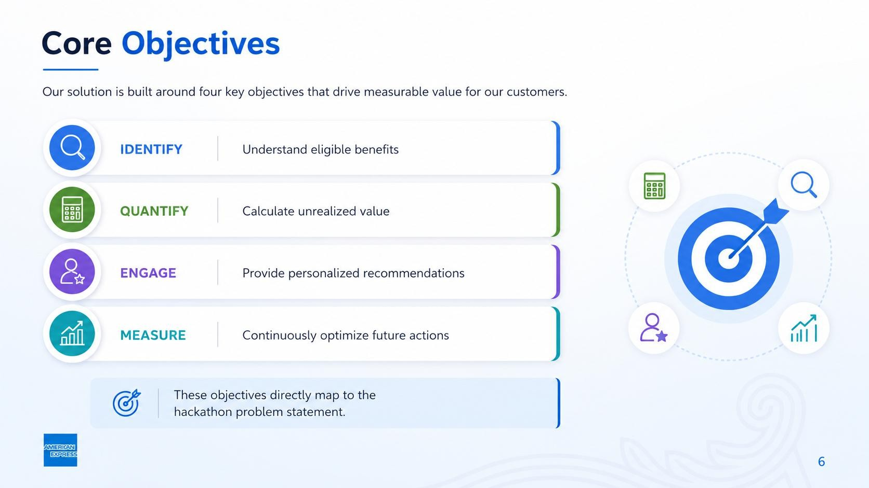
Core Objectives
IDENTIFY
Understand eligible benefits
QUANTIFY
Calculate unrealized value
ENGAGE
Provide personalized recommendations
MEASURE
Continuously optimize future actions
These objectives directly map to the hackathon problem statement.
This material contains information that is proprietary and confidential to American Express. It cannot be shared with third parties without
American Express’ written consent. AMERICAN EXPRESS PROPRIETARY & CONFIDENTIAL. DO NOT COPY. DO NOT DISTRIBUTE.

Slide 8
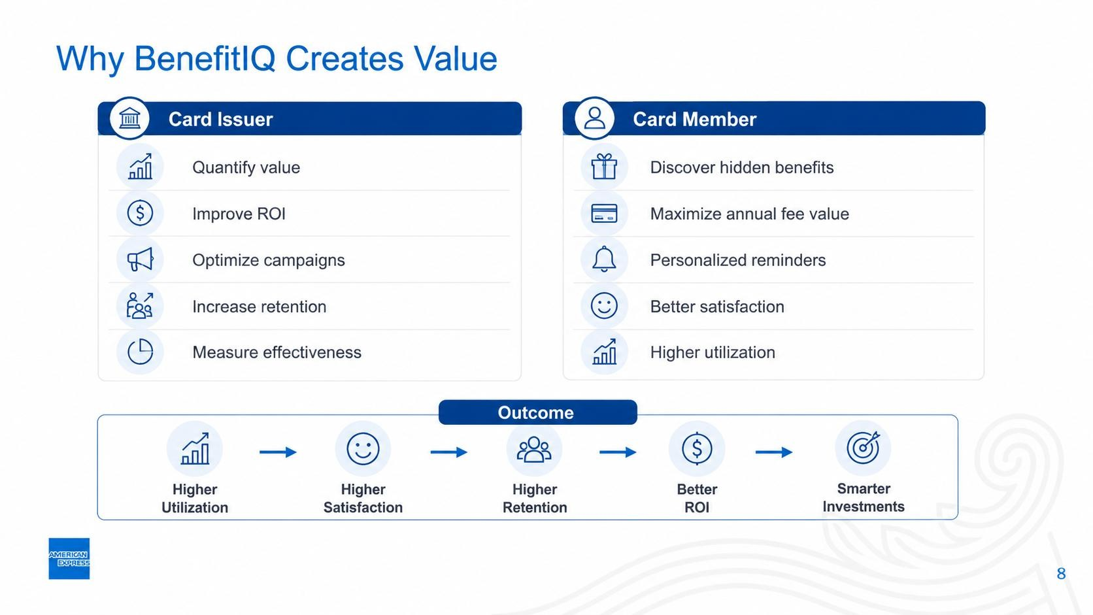
Why BenefitIQ Creates Value
Card Issuer
Quantify value
Improve ROI
Optimize campaigns
Increase retention
Card Member
Discover hidden benefits
Maximize annual fee value
Personalized reminders
Better satisfaction
Measure effectiveness • Higher utilization
Outcome:
Higher Utilization → Higher Satisfaction → Higher Retention → Better ROI → Smarter Investments
This material contains information that is proprietary and confidential to American Express. It cannot be shared with third parties without
American Express’ written consent. AMERICAN EXPRESS PROPRIETARY & CONFIDENTIAL. DO NOT COPY. DO NOT DISTRIBUTE.

Slide 9
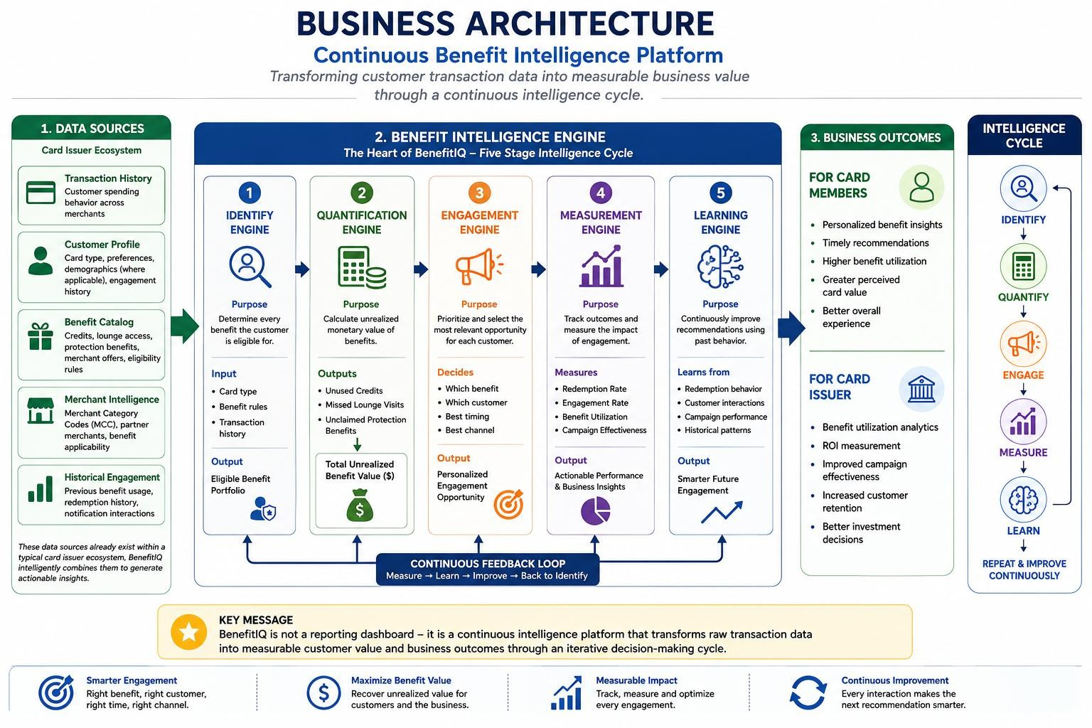
This material contains information that is proprietary and confidential to American Express. It cannot be shared with third parties without
American Express’ written consent. AMERICAN EXPRESS PROPRIETARY & CONFIDENTIAL. DO NOT COPY. DO NOT DISTRIBUTE.

Slide 10
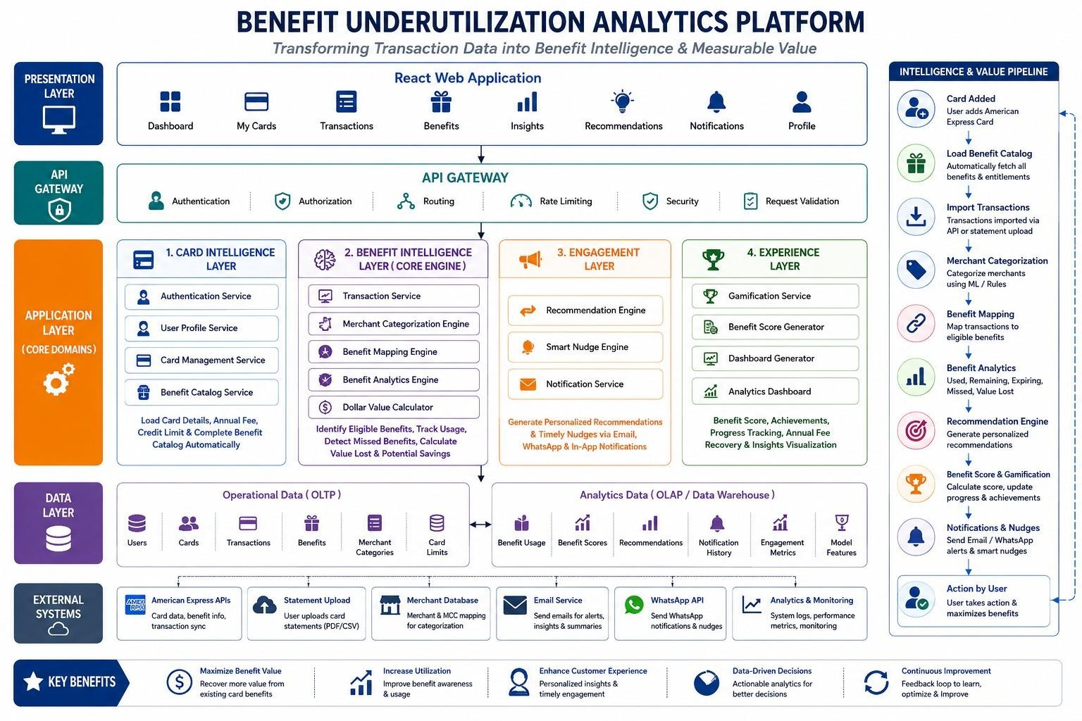
This material contains information that is proprietary and confidential to American Express. It cannot be shared with third parties without
American Express’ written consent. AMERICAN EXPRESS PROPRIETARY & CONFIDENTIAL. DO NOT COPY. DO NOT DISTRIBUTE.

Slide 11
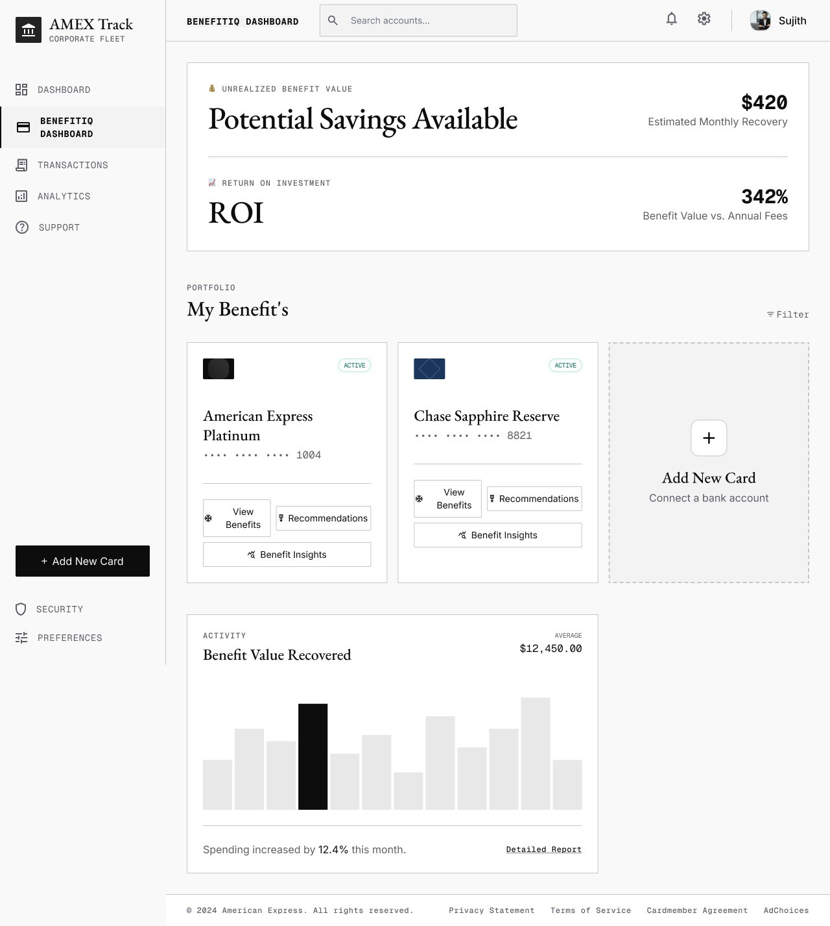
Card User Dashboard
This material contains information that is proprietary and confidential to American Express. It cannot be shared with third parties without
American Express’ written consent. AMERICAN EXPRESS PROPRIETARY & CONFIDENTIAL. DO NOT COPY. DO NOT DISTRIBUTE.

Slide 12
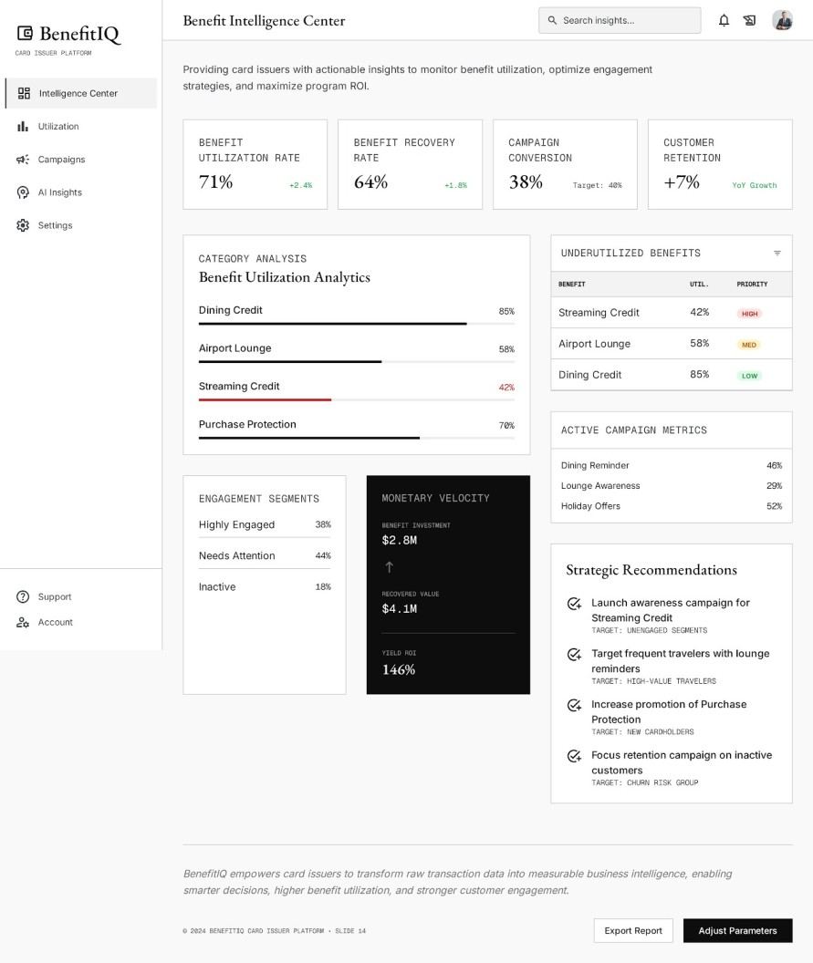
Card Issuer Dashboard
This material contains information that is proprietary and confidential to American Express. It cannot be shared with third parties without
American Express’ written consent. AMERICAN EXPRESS PROPRIETARY & CONFIDENTIAL. DO NOT COPY. DO NOT DISTRIBUTE.

Slide 13
Card Issuer Dashboard
This material contains information that is proprietary and confidential to American Express. It cannot be shared with third parties without
American Express’ written consent. AMERICAN EXPRESS PROPRIETARY & CONFIDENTIAL. DO NOT COPY. DO NOT DISTRIBUTE.

Slide 14
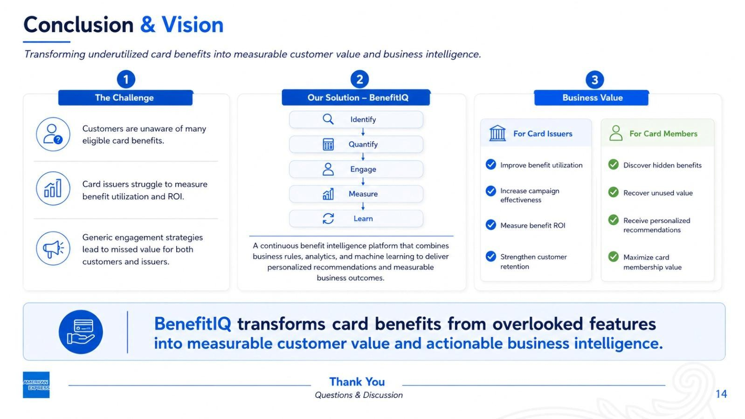
This material contains information that is proprietary and confidential to American Express. It cannot be shared with third parties without
American Express’ written consent. AMERICAN EXPRESS PROPRIETARY & CONFIDENTIAL. DO NOT COPY. DO NOT DISTRIBUTE.

Slide 15
Thank you
Team Members:-
M.M. Navadeep
M. Haritha

