Slide 1
Web Programming
Dr Walid M. Aly
Lecture 5
Java Script Basics

Slide 2
What is JavaScript?
Originally developed by Netscape, as Mocha/ LiveScript
Became a joint venture of Netscape and Sun in 1995, renamed JavaScript
JavaScript is the most popular scripting language on the internet, and works in all major browsers, such as Internet Explorer, Firefox, Chrome, Opera, and Safari.
JavaScript was designed to add interactivity to HTML pages.
A scripting language is a lightweight programming language.
JavaScript is usually embedded directly into HTML pages.
JavaScript is an interpreted language (means that scripts execute without preliminary compilation)
Everyone can use JavaScript without purchasing a license.
Demo2.html
Demo3.html
Notes:
Now standardized by the European Computer Manufacturers Association as ECMA-262
Microsoft javaScript is Jscript.
he final choice of name caused confusion, giving the impression that the language was a spin-off of the Java programming language, and the choice has been characterized by many as a marketing ploy by Netscape to give JavaScript the cachet of what was then the hot new web programming language

Slide 3
Embedding in HTML docs
Either directly, as in
<script>
-- JavaScript script –
</script>
Or indirectly, as a file specified in the src attribute of <script>, as in
<script src = “myScript.js”>
</script>
any code within script tags is ignored
External scripts cannot contain <script> tags
A java script can appear in the HTML Page at the head section or the body Section
It is not possible to hide Javascript from the user, since their browser needs to download it to execute it. The only other option is obfuscation.
<head>
</head>
<body>
</body>
Java script
Old examples may have type="text/javascript" in the <script> tag.
This is no longer required. JavaScript is the default scripting language in all modern browsers and in HTML5.
Java script
Notes:
ript >
<script language="javascript">

Slide 4

alert Function
Alert function is used to display output message to user
Argument passed to function is the message to be shown
…….
<body>
<h1>My First Web Page</h1>
<script >
alert(“Welcome to my site”);
</script>
</body>
</html>
alert(‘Welcome to my site ‘);
alert("Welcome " + "to javascript");
alert(9);
alert(9+1);
alert("3+5 =" + (3+5));
Demo1.html
alert(“welcome”);
alert(“welcome again”);
x
Alert(“hello”);
alert("Welcome"+"\n "+"to javascript");
Notes:
\t tab

Slide 5
JavaScript and Java
JavaScript and Java are only related through syntax of their expressions ,assignments and control statements.
JavaScript is dynamically typed, ex: variable type is not declared
JavaScript’s support for objects is very different
JavaScript is interpreted
Source code is embedded inside HTML doc, there is no compilation

Slide 6
JavaScript Execution
JavaScript scripts are executed entirely by the browser
Transfer of some load from server to client
User interactions through forms
Events easily detected with JavaScript
E.g. validate user input (However, HTML5 can help in validation)
Once downloaded there is no exchange of information with the server
Notes:
NB JavaScript programs can issue HTTP requests and load other pages
JavaScript scripts do not require the Java VM to be loaded
Thus JavaScript scripts tend to be fast
The Document Object Model makes it possible to create dynamic HTML documents with JavaScript
Server side java scripts are rarely used

Slide 7
Syntactic Characteristics
Identifier :
begin with a letter or underscore or $, followed by any number of letters, underscores, and digits, no space allowed.
Identifiers are case sensitive and should not be a keyword
Ex: sum=10;
Comments:
Single line Comment //
MultiLine Comment /* … */
Ex
//document.write(“Hello World”);
Notes:
25 reserved words, plus future reserved words
Scripts are usually hidden from browsers that do not include JavaScript interpreters by putting them in special comments
<!--
-- JavaScript script –
//-->
The comment closer must be on its own line and preceded by two slashes, by this way it is ignored by browser that can not execute java script and executed by browser which can

Slide 8
JavaScript Variables
All primitive values have one of the five types: Number, String, Boolean, Undefined, or Null
JavaScript is dynamically typed – any variable can be used for anything (primitive value or reference to any object)
The interpreter determines the type of a particular occurrence of a variable
Variables can be either implicitly or explicitly declared using the var keyword
Variables implicitly declared should be initialized
Variables declared outside a function, become GLOBAL, and all scripts and functions on the web page can access it.
implicitly
explicitly
sum = 0;
var sum = 0;
today= “Monday”;
var today= “Monday”;
flag= false;
var flag= false,

Slide 9
Java script literals
All numeric values are stored in double-precision floating point.
String literals are delimited by either ' or “, You can use quotes inside a string, as long as they don't match the quotes surrounding the string: ex: var answer = "It's alright";
Boolean values are true and false
The only Null value is null, if an attempt is made to use a value that is null , a runtime error will occur
The only Undefined value is undefined ,it is the default value for the variables that are declared but not assigned

Slide 10
Java Script Object Orientation
JavaScript is NOT an object-oriented programming language
Rather object-based
JavaScript objects are collections of
properties (like the fields of classes in Java)
methods
Notes:
The root object in JavaScript is Object – all objects are derived from Object
Does not support class-based inheritance
Cannot support polymorphism

Slide 11
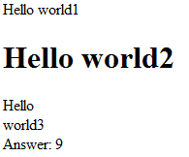
The document Object
JavaScript models the HTML document with the document object
The document object is a property of window object and can be accessed as document or window.document
The document object has a method, write, which dynamically creates content
The parameter of the write method is a string, often concatenated from parts, some of which are variables or any HTML tags
document.write("Hello world1");
document.write("<h1>Hello world2</h1>");
document.write("Hello", "<br/>" ,"world3");
document.write("Answer: ", result, "<br>");
The parameter is sent to the browser, so it can be anything that can appear in an HTML document (any HTML tags)
If the HTML code have attributes, use the escape character \” , or single quotation
document.write(“<img src=\”image.png\” />”);
document.write(“<img src=‘image.png’ />”);
DocumentObjectDemo.html
http://www.w3schools.com/jsref/dom_obj_document.asp
Notes:
The writeln() method is identical to the write() method, with the addition of writing a newline character after each statement.

Slide 12

<!DOCTYPE html>
<html>
<head>
<title> Hello world </title>
</head>
<body>
<script >
document.write("Hello","<br/>"+ "fellow Web programmers!");
</script>
</body>
</html>
hello.html

Slide 13
The window Object
The model for the browser display window is the Window object
The document object is a window prperty and can be accessed by window.document or simply document
The Window object has three basic methods for creating dialog boxes:
alert
confirm
prompt
Calling these methods is done by window.methodName() or simply methodname(….)
Alert
window.alert(“The sum is:” + sum + ”\n");
Parameter is plain text, not HTML
Opens a dialog box which displays the parameter string and an OK button
It waits for the user to press the OK button
http://www.w3schools.com/jsref/obj_window.asp
Notes:
The Window object has two properties, document and window, which refer to the Document and Window objects, respectively

Slide 14
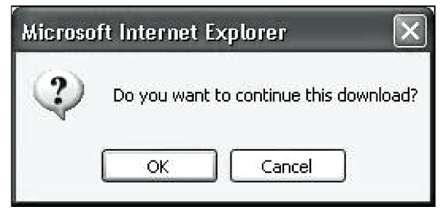
The window Object.....
Confirm
var question = window.confirm("Do you want to continue this download?");
Opens a dialog box and displays the parameter and two buttons, OK and Cancel
Returns a Boolean value, depending on which button was pressed (it waits for one)
confirmDemo.html

Slide 15
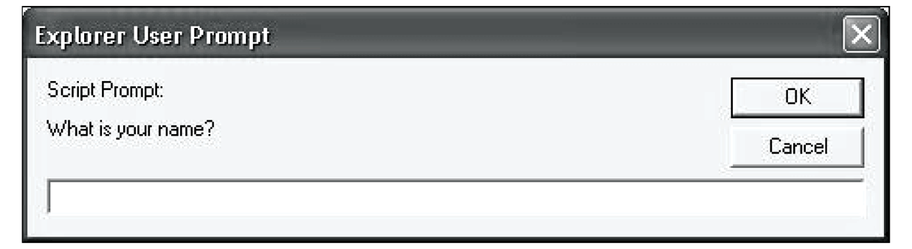
The Window Object.....
Prompt
window.prompt("What is your name?", “ ");
Opens a dialog box and displays its string parameter, along with a text box and two buttons, OK and Cancel
The second parameter is for a default response if the user presses OK without typing a response in the text box (waits for OK)
If the user clicks "OK" the box returns the input value as a string. If the user clicks "Cancel" the box returns null.
If the second argument is omitted , IE shows the word “undefined” , Google chrome shows an empty string

Slide 16
Example: using prompt function
<!DOCTYPE html>
<html>
<head>
<title> Demo </title>
</head>
<body>
<script type = "text/javascript" >
name= window.prompt("what is your name");
window.alert("Hello " + name);
document.write("Hello ",name);
</script>
</body>
</html>
greeting.html

Slide 17
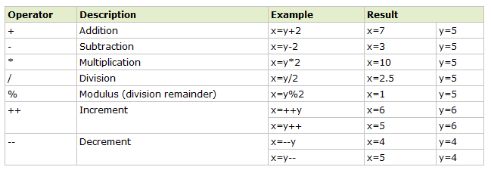
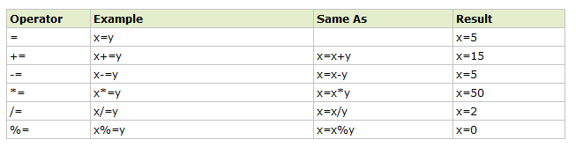
JavaScript Operators
- All operations are in double precision
JavaScript Arithmetic Operators
Arithmetic operators are used to perform arithmetic between variables and/or values.
Given that y=5, the table below explains the arithmetic operators:
JavaScript Assignment Operators
Assignment operators are used to assign values to JavaScript variables.
Given that x=10 and y=5, the table below explains the assignment operators:

Slide 18
JavaScript Operators………..
Adding Strings and Strings
The + operator can also be used to add string variables or text values together.
txt1="What a very "; txt2="nice day"; txt3=txt1+txt2;
After the execution of the statements above, the variable txt3 contains "What a very nice day".
Adding Strings and Numbers
The rule is: If you add a number and a string, the result will be a string!
x=5+5; document.write(x); x="5"+"5"; document.write(x); x=5+"5"; document.write(x);
10
55
55

Slide 19
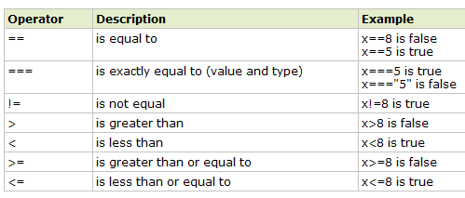
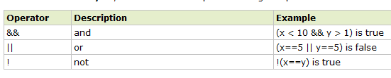
JavaScript Operators………..
JavaScript Comparison and Logical Operators
Comparison and Logical operators are used to test for true or false.
Comparison Operators
x=5;
if (age<18) document.write("Too young");
Logical Operators
Conditional Operator
variablename=(condition)?value1:value2
greeting=(visitor=="PRES")?"Dear President ":"Dear ";

Slide 20
Conditional if-else
if (condition) { code to be executed if condition is true }
if (condition) { code to be executed if condition is true } else { code to be executed if condition is not true }
if (condition1) { code to be executed if condition1 is true } else if (condition2) { code to be executed if condition2 is true } else { code to be executed if neither condition1
nor condition2 is true }
if (answer==10)
{
window.alert “Correct Answer”);
}
Notes:
The control expression can be a number, a string, or a Boolean
- If it is a string, it is true unless it is empty or "0"
- If it is a number, it is true unless it is zero

Slide 21
Example : Simple Question
var inCorrect= “الأجابه غير صحيحه“;
var correct=“الأجابه صحيحه" ;
var answer=window.promptما حاصل جمع 5 و5 ”)”,” “);
if (answer!=10)
{
flag=window.confirm “اجابه خطأ! حاول مره اخري”));
if(flag)
answer=window.promptما حاصل جمع 5 و 5؟“) ”,” “);
}
if (answer==10)
document.write(correct);
else
document.write(inCorrect);
simpleQuestion.html
Notes:
To get the javascript alerts to print right to left, as well as looking OK, you need to go to control panel > regional settings > language tab, and check the box 'install files for complex scripts and right to left languages.' This installs files from the Windows CD. A quick reboot and all is well!

Slide 22
Conditional switch statement
switch(n) { case 1: execute code block 1 break; case 2: execute code block 2 break; default: code to be executed if n is different from case 1 and 2 }
The expression n can be a number or a character or a String
Use the switch statement to select one of many blocks of code to be executed
a single expression n (most often a variable), that is evaluated once. The value of the expression is then compared with the values for each case in the structure. If there is a match, the block of code associated with that case is executed. Use break to prevent the code from running into the next case automatically.
Use the default keyword to specify what to do if there is no match
Notes:
You Can Have more than one Case with the same excuted code.

Slide 23
Example : simple switch case Demo
….
<body>
<script type = "text/javascript" >
var country = prompt("Enter the name of country\n" +"to display its capital city" );
switch (country) {
case "Egypt":
window.alert("Cairo");
break;
case "France":
window.alert("Paris");
break;
case "England":
window.alert("London");
break;
default: window.alert("unknown City");
}
</script>
</body>
</html>
simpleSwitchCaseDemo.html

Slide 24
Example : dynamic setting of table border
<script type = "text/javascript" >
var bordersize;
bordersize = prompt("Select a table border size \n" +
"0 (no border) \n" +
"1 (1 pixel border) \n" +
"4 (4 pixel border) \n" +
"8 (8 pixel border) \n");
switch (bordersize) {
case "0": document.write("<table>");
break;
case "1": document.write("<table border = '1'>");
break;
case "4": document.write("<table border = '4'>");
break;
case "8": document.write("<table border = '8'>");
break;
default: document.write("Error - invalid choice: ",
bordersize, "<br />");
document.write("<table>");
}
</script>
<caption> Clubs </Caption>
<tr><th> Club Name </th>
<th> Establishment Year </th>
</tr>
<tr> <td> zamalek</td><td> 1911 </td> </tr>
</table>
DynamicBorders.html

Slide 25
Loops
Java script has the following structure for loop
for loops
while
do-while
Javascript supports break & continue

Slide 26
Loops
For Loops
for(variable=startvalue;variable<=endvalue;variable=variable+increment) { code to be executed }
Note: The increment parameter could also be negative, and the <= could be any comparing statement
<script type="text/javascript"> for (i=0;i<=5;i++) { document.write("The number is " + i); document.write("<br />"); } </script>
forDemo.html
Notes:
init can have declarations, but the scope of such variables is the whole script

Slide 27
Example: printing different Headers
<script type="text/javascript">
for (i = 1; i <= 6; i++)
{
document.write("<h" + i + ">This is heading " + i);
document.write("</h" + i + ">");
}
</script>
printingHeaders.html

Slide 28
Loops...........
while
<script type="text/javascript">
var i=0;
while(i<=10)
{
document.write("<li>" + "Hello "+ i + " </li>");
i++;
}
</script>
while (variable<=endvalue) { code to be executed }
whileDemo.html
do-while
do { code to be executed } while (variable<=endvalue);
The <= could be any comparing operator.

Slide 29
Functions
A function is a block of code that will be executed by an event or by a call to the function.
Syntax
function functionname(var1,var2,...,varX) { some code }
We place function definitions in the head or body of the HTML document within a java script or in external js files.
JavaScript functions can be called before they are declared(JavaScript Declarations are Hoisted)
Function names are case sensitive (unlike PHP)
function hello()
{
window.alert( “Hello World!”);
}
<script type = "text/javascript" >
hello();
</script>
When using document.write() inside a function, the entire HTML page will be overwritten

Slide 30
Example: calling a method
<!DOCTYPE html>
<html>
<head>
<script type = "text/javascript" >
function hello() {
window.alert( "Hello World!");
}
</script>
<title> FunctionCallDemo1 .html </title>
</head>
<body>
<script type = "text/javascript" >
hello();
</script>
</body>
</html>
Function callDemo1.html
Function callDemo2.html
30
Function callDemo3.html
script

Slide 31
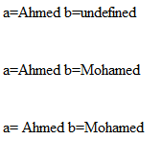
Functions – parameters
There is no type checking of parameters, nor is the number of parameters checked
excess actual parameters are ignored, excess formal parameters are set to undefined
function m(a, b) {
document.write(“a=“+a);
document.write(“b=“+b);
}
// A test driver for function params
m(“Ahmed");
m(“Ahmed", “Mohamed");
m(" Ahmed ", “Mohamed“,“Aly");
parametersDemo.html
it is not possible to overload functions in Javascript
Notes:
Parameters are passed by value, but when a reference variable is passed, the semantics are pass-by-reference
All parameters are sent through a property array, arguments, which has the length property

Slide 32
The return Statement
The return statement is used to specify the value that is returned from the function.
functions that are going to return a value must use the return statement.
If there is no return or if return has no parameter, undefined is returned
<head>
<script type="text/javascript"> function product(a,b) { return a*b; } </script> </head> <body> <script type="text/javascript"> document.write(product(4,3)); </script>
Note: product(3); returns NAN , as undefined multiplied by any number =NAN

Slide 33
Calling Function automatically with events
Event model in html is simple and based on attributes.
Example
onclick="displaymessage()”
Attribute | Value | Description
onload | script | Script to be run when a document load
onunload | script | Script to be run when a document unload
onclick | script | Script to be run on a mouse click
onsubmit | script | Script to be run when a form is submitted
onfocus | script | Script to be run when an element gets focus
onblur | script | Script to be run when an element loses focus
onmouseover | script | Script to be run when mouse pointer moves over an element
HTML documentation shows which event attributes are valid with which tags
http://www.w3schools.com/tags/ref_eventattributes.asp

Slide 34
Example: clicking a button displays a message
…….. <head> <script type="text/javascript"> function displaymessage() { alert("Hello World!"); } </script> </head> <body> <form> <input type="button" value="Click me!" onclick="displaymessage()" /> </form> </body> </html>
simpleEventFuctionDemo.html
<a href="#" onclick="alert(' Hello!');"> click me </a>
simpleEventDemo2.html
<a href=“JavaScript:m() “>click me </a>
<input type="button" value="Click me!" onclick="alert('First Hello!');alert('Second Hello!!')“/>

Slide 35
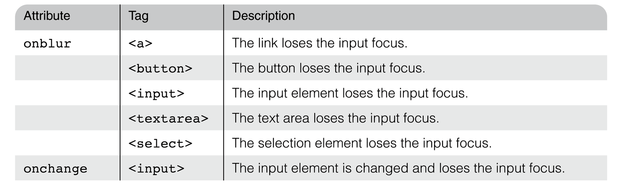
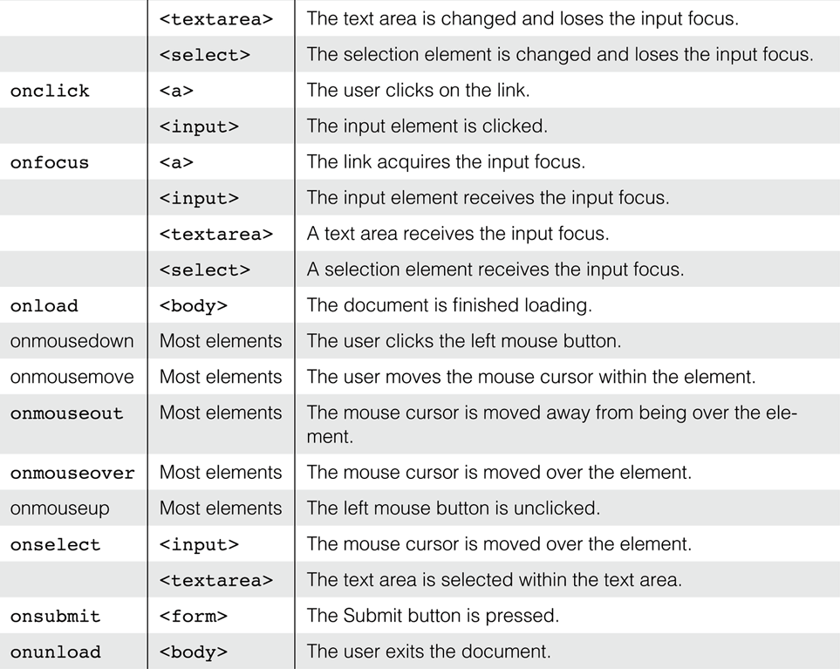
Event attributes

Slide 36
Variable scope in JavaScript
Variables declared in functions using the keyword var are local variables
Variables declared in functions without the keyword var are global
Variables declared outside of a function have global scope. In this case, a function can access not only its locally declared variables but also those variables that are declared outside of the function — global variables
<script>
function m1()
{x=10;}
</script>
<script>
function m2()
{document.write(x);}
</script>
<script> m1();m2();</script>
var counter = 0; function add() { counter += 1; } add();add();add(); // the counter is
//now equal to 3
<script>
function m1()
{var x=10;}
</script>
<script>
function m2()
{document.write(x);}
</script>
<script> m1(); m2();</script>
10

Slide 37
Function Expressions
A JavaScript function can also be defined using an expression. A function expression can be stored in a variable:
var x = function (a, b) {return a * b}; var z = x(4, 3);
The function above is actually an anonymous function (a function without a name).
Functions stored in variables do not need function names. They are always invoked (called) using the variable name.

Slide 38
Self-Invoking Functions
Function expressions can be made "self-invoking".
A self-invoking expression is invoked (started) automatically, without being called.
Function expressions will execute automatically if the expression is followed by ().
You cannot self-invoke a function declaration.
You have to add parentheses around the function to indicate that it is a function expression:
(function () { var x = "Hello!!"; // I will invoke myself })();

Slide 39
JavaScript Nested Functions
JavaScript supports nested functions. Nested functions have access to the scope "above" them.
function add() { var counter = 0; counter += 1; } add();add();add(); // the counter should now be 3, //but it does not work !
function add() { var counter = 0; function plus() {counter += 1;} plus(); return counter; }

Slide 40
JavaScript Closures
A closure is a function having access to the parent scope, even after the parent function has closed.
var add = (
function () { var counter = 0; return function () {return counter += 1;} }
)
();
add();add();add(); // the counter is now 3
The variable add is assigned the return value of a self-invoking function.
The self-invoking function only runs once. It sets the counter to zero (0), and returns a function expression.
This way add becomes a function. The "wonderful" part is that it can access the counter in the parent scope.

Slide 41
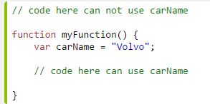
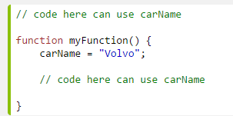
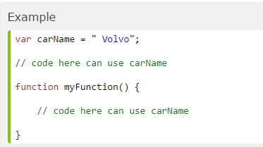
JavaScript variable Scope
Local JavaScript Variables
Automatically Global
Local variables are deleted when the function is completed.
Global variables are deleted when you close the page.
In HTML, the global scope is the window object: All global variables belong to the window object.
Global JavaScript Variables

Slide 42
Example of effect of var on variable scope
external = 5;
function firsttry()
{
var external = 6;
alert("first Try: " + external);
}
function secondtry()
{
external = 7;
alert("second Try: " + external);
}
alert(external); // Prints 5
firsttry(); // Prints 6
alert(external); // Prints 5
secondtry(); // Prints 7
alert(external); // Prints 7

Slide 43
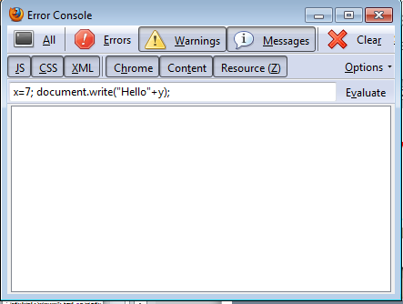
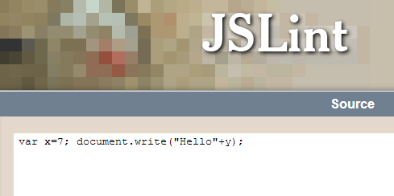
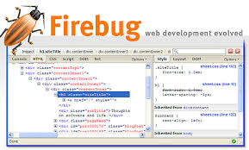
JavaScript Validation
Error Console
http://www.jslint.com/

