Slide 1
Chp. 8 Risk Management
Younis and Thomas

Slide 2
Background Info
Risk means different things to different people
Research shows 1:2 Risk to reward is psychologically most appealing
Key to risk management is careful use of leverage
Using stop losses and constant proportion portfolio insurance (similar to buying call options but not using option contracts)

Slide 3
Optimal Leverage - Assumptions
have to make the assumption that the future probability distribution of returns of the market is the same as in the past.This is usually an incorrect assumption, but this is the best that quantitative models can do
many risk management techniques assume further that the probability distribution of returns of the strategy itself is the same as in the past
probability distribution of returns of the strategy is Gauss- ian

Slide 4
Optimal Leverage
Leverage must always be kept constant in order to optimize growth rate
Can be counterintuitive (if long stock portfolio, and P&L was positive last period, forced to buy more, vice versa if in a loss)
Ex. 100k account with optimal leverage = 5, lose 10k in a day, therefore equity = 90k, portfolio market value = 490k. Must liquidate another 40k
If you make 20k next day, market value = 450 + 20k = 470k, need to long/short 80k more

Slide 5
Kelly Formula
If assumed that probability distribution of returns is gaussian, optimal leverage, f = m/s^2 (m = mean excess return, s^2 = variance of m)
Generates highest compounded growth rate of equity assuming profits are reinvested
No guarantee future mean and variance is same as the past, overestimated mean/underestimated leverage = overleveraged
Many traders use a half-kelly leverage and take the submaximal growth rate
Used as upper bound in practice

Slide 6
Other Use of Kelly Formula
How to optimally allocate buying power to different portfolios/strategies
F = M/C, F = column vector of optimal leverages, C = covariance matrix of returns, M = mean excess returns of portfolio

Slide 7
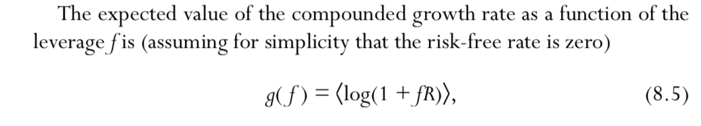
Optimization of Expected Growth Rate Using Simulated Returns
Substitute Gaussian Assumption for another analystic form (ex. Student’s t) for returns distribution to account for fat tails, can still follow deviations of the kelly formula to get optimal leverage

Slide 8
Optimization of Historical Growth Rate
Can optimize with respect to our leverage, just need set of returns that occurs in our backtest (data snooping bias)
Probably won’t be optimal for different realization in the future
Can sometimes get very similar answer to Kelly leverage or Monte Carlo optimiztion

Slide 9
Maximum Drawdown

Slide 10
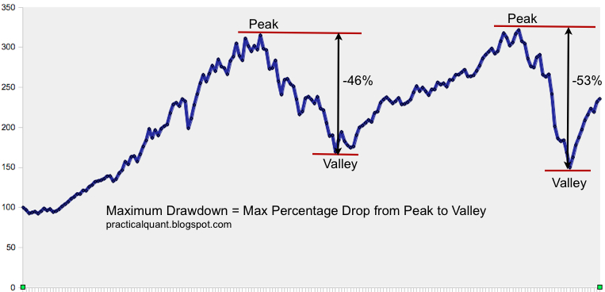
Overview
A percentage identified by risk managers as the maximum a strategy should fall before reaching a new peak
Important to manager so you don’t go bankrupt before you make money
Maximum drawdown needs to be considered as a factor when testing the strategy to determine if leverage is reasonable
Historical and simulated drawdowns don’t always indicate future drawdown

Slide 11
Constant Proportion Portfolio insurance

Slide 12
Overview
One method to guarantee max drawdown is not broken
Consider and account with max drawdown “– D” & Kelly leverage “f”
Set aside D for trading 1-D as cash
Total portfolio will never lose more than D since the rest is in cash
Rebalance when your strategy does well
Notes
Quit if your strategy reaches max drawdown (because it sucks)
Any leverage applied must be applied to the entire portfolio not just the equity component
CPPI only makes sense for single strategy portfolios

Slide 13
Stop Loss

Slide 14
Overview
Other method to guarantee max drawdown is not broken
Sell your position when your losses reach a certain amount
Can re-enter later when conditions improve or not at all
Stop losses work really well with moment strategies
Also work well with mean reverting strategies
Notes
Stop losses can be exploited
Sometimes difficult to exit large positions quickly and totally avoid further loss
Ensure stop losses are set so they don’t trigger in backtesting

Slide 15
Risk Indicators
Before: Current risk indicators – Now: Leading risk indicators

Slide 16
Risk indicators
There’s a whole bunch
VIX – Volatility Index
If it is over 35 then the next day a long equity strategy on average has an annual return of 17.2% and a Sharpe ratio of 1.4
TED Spread
Difference between 3 month LIBOR and 3 month T-Bills
sheep investors who rush to sell T-bills are not as knowledgeable as institutions who set LIBOR rates during a panic
ONN & OFF ETFs
Two mirror ETF’s that measure the risk level in the market
ONN is a risk heavy asset
Orderflow
Other assets
Junk Bonds
Emerging Market currencies
Whoever else gets hammered during a panic

Slide 17
Risk indicators
Notes
Success of leading risk indicators depend on the strategy
The same risk indicator can mean different things
Some strategies have strategy specific risk indicators
Should test all assets to see if they are risk indicators in a banktest

