Slide 1
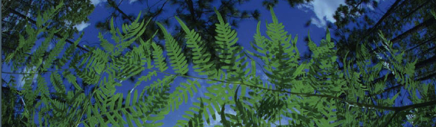



Using Digitized Herbarium Data in Research:
Applications for Exploration,
Taxonomy, and Ecology
Pam Soltis
University of Florida

Slide 2
Topics
Intro to data
Downloading data
Cleaning data
Georeferencing
  GEOLocate
Ecological Niche Modeling
  Maxent
ENM Analysis & Interpretation
Uses of collections data
Discussion/Q&A
R-based methods

Slide 3

Workshop Leaders
Pam Soltis
Makenzie Mabry
Shelly Gaynor
Cameron McMullen
Sarah Ellen Strickland
Elizabeth White
JT Miller
Doug Soltis
Contributions from many previous lab members/colleagues:
  Blaine Marchant, Charlotte Germain-Aubrey, Andre Naranjo, Anthony Melton, Tal Kinser, Maria Kinser, Mike Belitz, Rhett Rautsaw, João Vidal, Jr.

Slide 4
Logistics
HiPerGator – UF’s supercomputer
GitHub repository
  data
  scripts
  presentations
Workshop evaluation survey
  by email
Pace/breaks

Slide 5
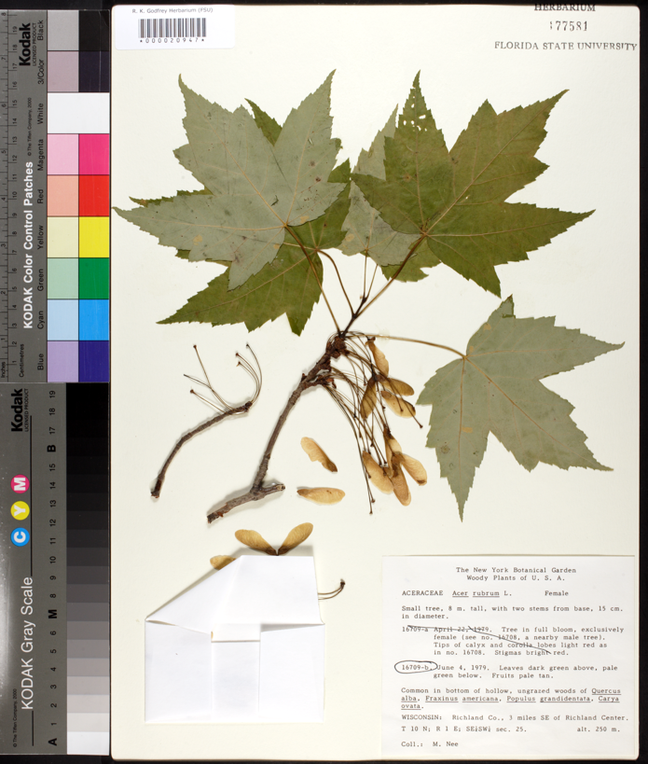
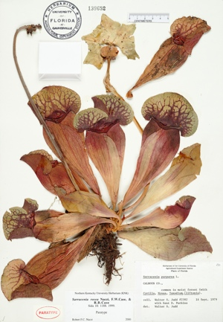
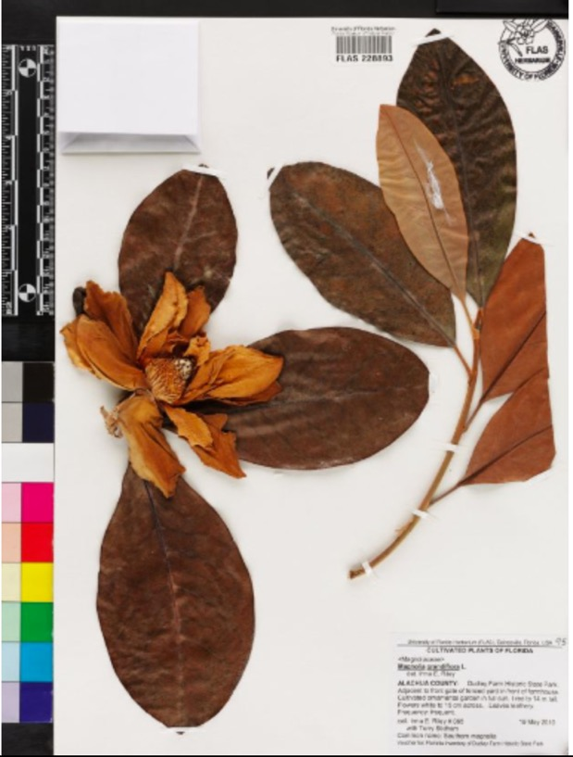
Notes:
As botanists, we’re probably all familiar with herbarium specimens. Here we see specimens of a magnolia, a maple, and a pitcher plant.
Herbarium specimens have been collected for centuries.

Slide 6

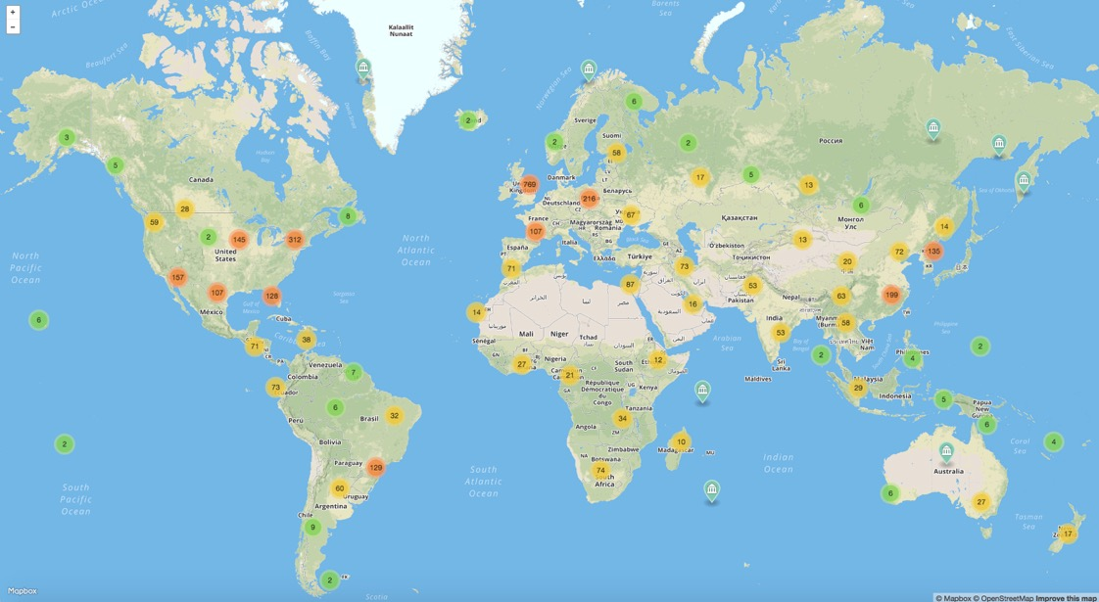
Herbaria Worldwide
3,400 herbaria
400,000,000 specimens!
Notes:
Globally, there are ~3400 herbaria, and they contain an estimated 400,000,000 specimens!
Every one of the world’s herbarium specimens has a story to tell, and what’s more, each specimen is packed with data that can be used in a broad range of scientific studies.

Slide 7
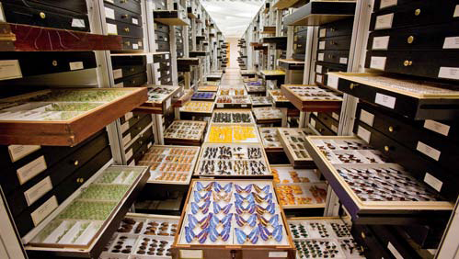
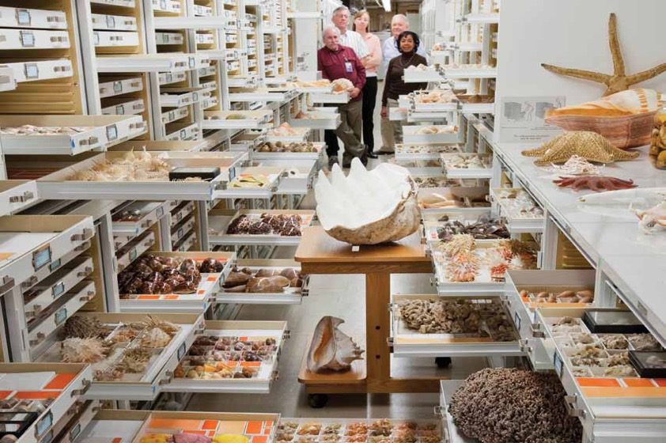
Natural History Collections
~1600 natural history collections in the US, thousands in the world
1-2 billion specimens
in the US
3-4 billion specimens worldwide
Smithsonian
Notes:
Let’s step back from herbaria specifically and consider natural history collections more broadly. ...

Slide 8
Digitization: Data and Images
Scientific name –
including authority
Date
Collector
Location – state, county,
specific site,
GPS coordinates
Associated species
Notes
Notes:
What do we mean by digitization? it refers to both data and images. Each herbarium specimen, although a pressed plant or part of a plant, carries important additional information in its label. Ideally, the label, which is typically located in the lower right corner of the specimen, will contain the scientific name of the plant, the date it was collected, the name of the collector, the location of the collection – in the US, this would include the state, county, specific description, and for recent collections GPS coordinates, any associated species that co-occurred with the plant, other notes – maybe the slope, aspect, and so on – the more, the better! As you can imagine, a detailed record can provide abundant data. Today, this information is being databased so that there are electronic records associated with our specimens.

Slide 9
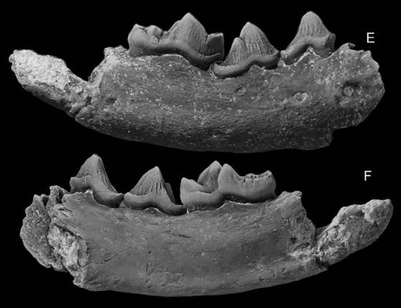
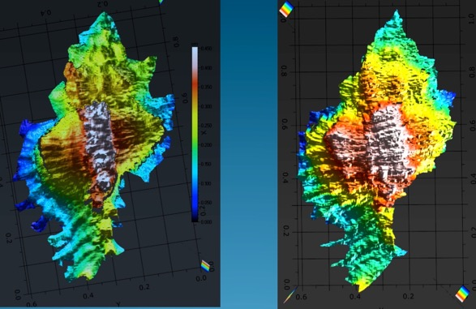
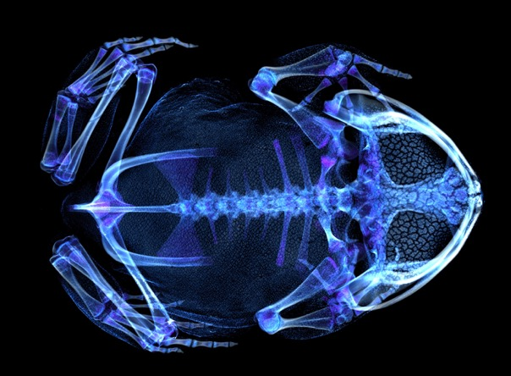
Digitization: Data and Images
Notes:
in addition, images of various types are providing access to the specimens while also revealing new aspects of the specimens themselves.

Slide 10
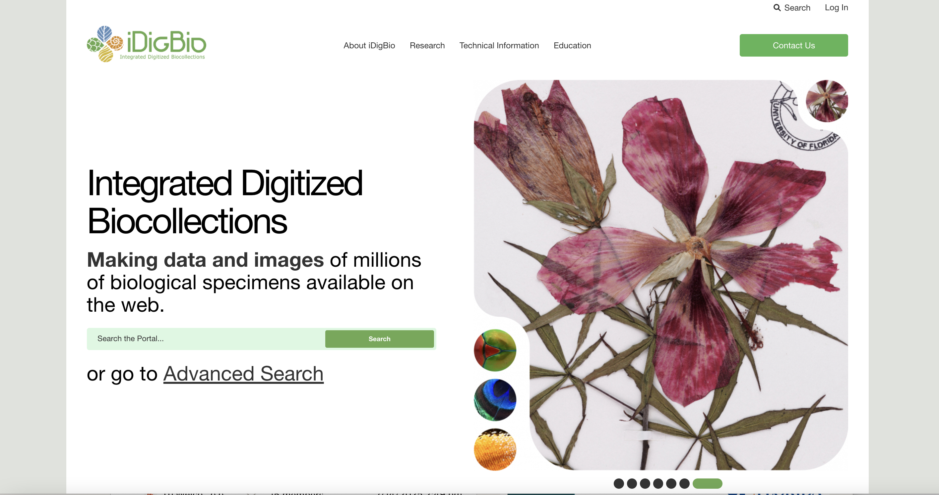

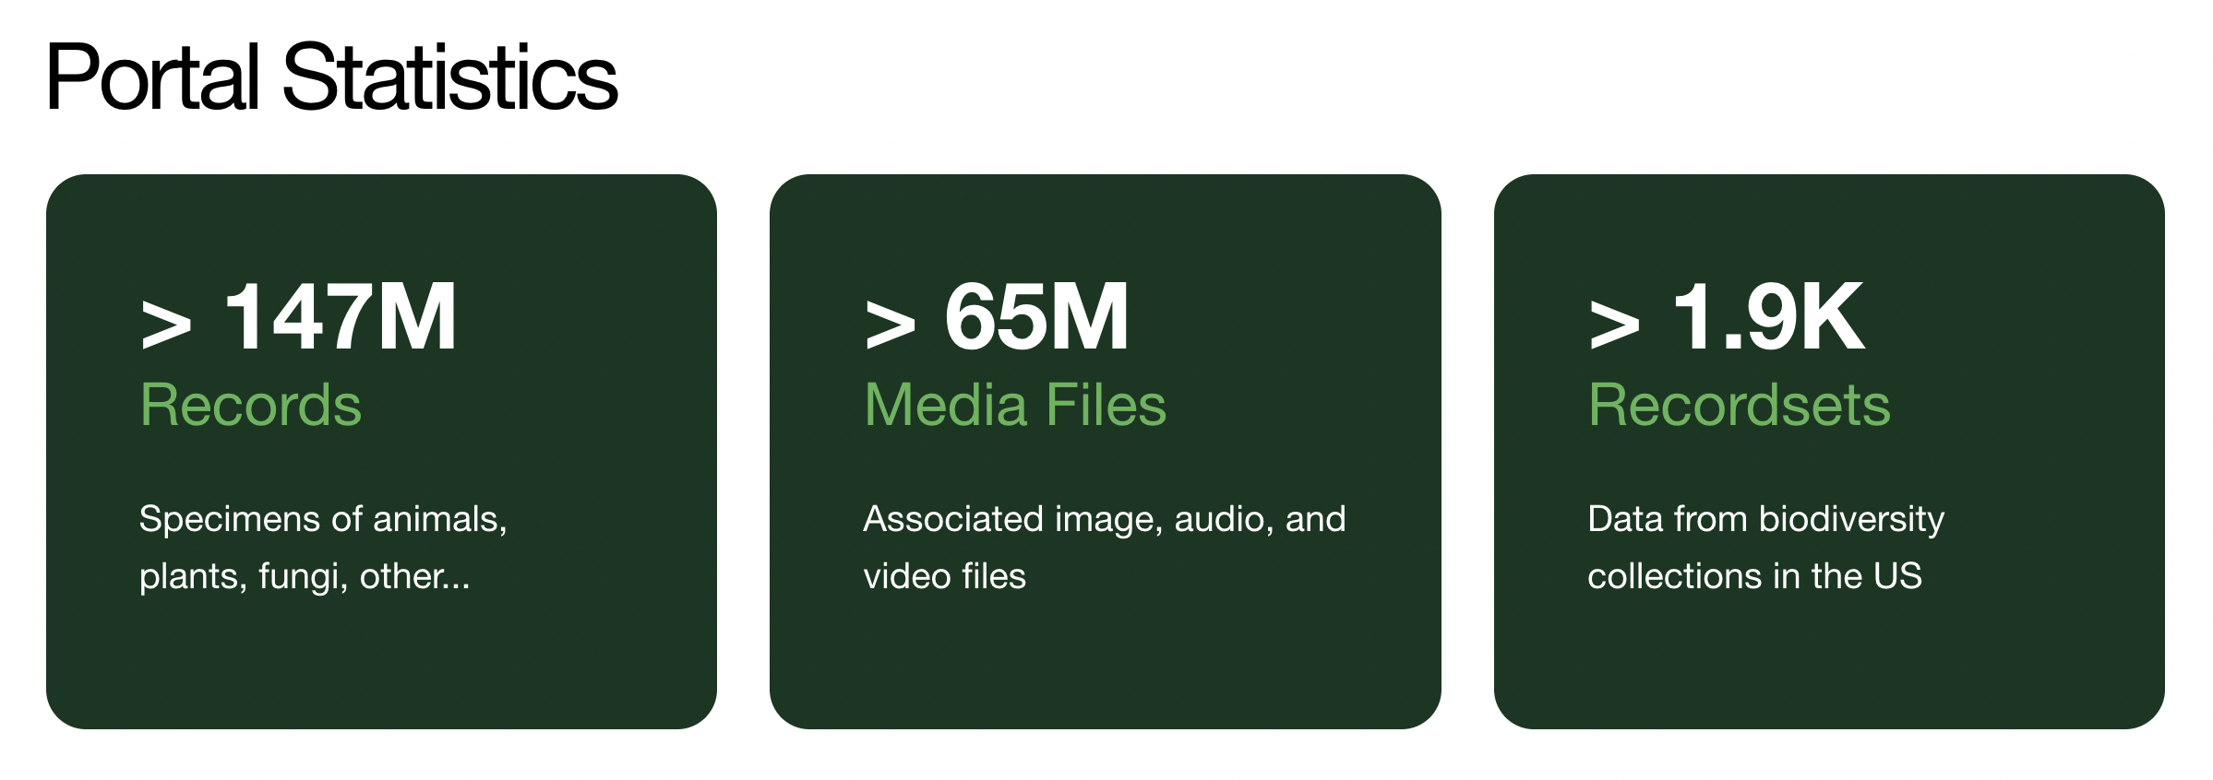
iDigBio: A Source for Specimen Records

Slide 11
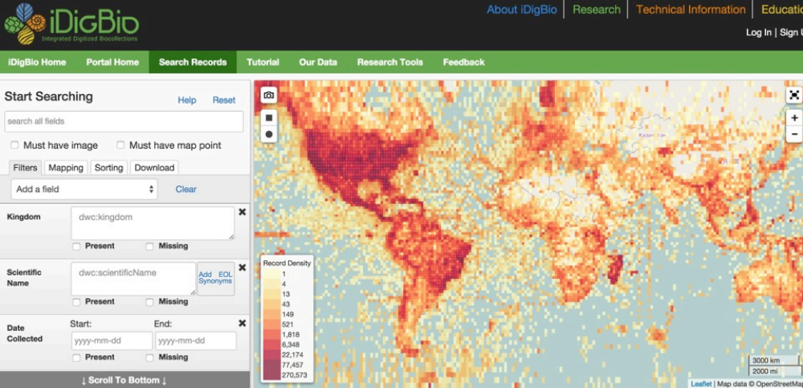
Specimen Occurrences in iDigBio
www.idigbio.org
Notes:
If you go to the iDigBio website – idigbio.org – you’ll see a map that shows the density of specimen coverage – specimens cover most of the globe.

Slide 12
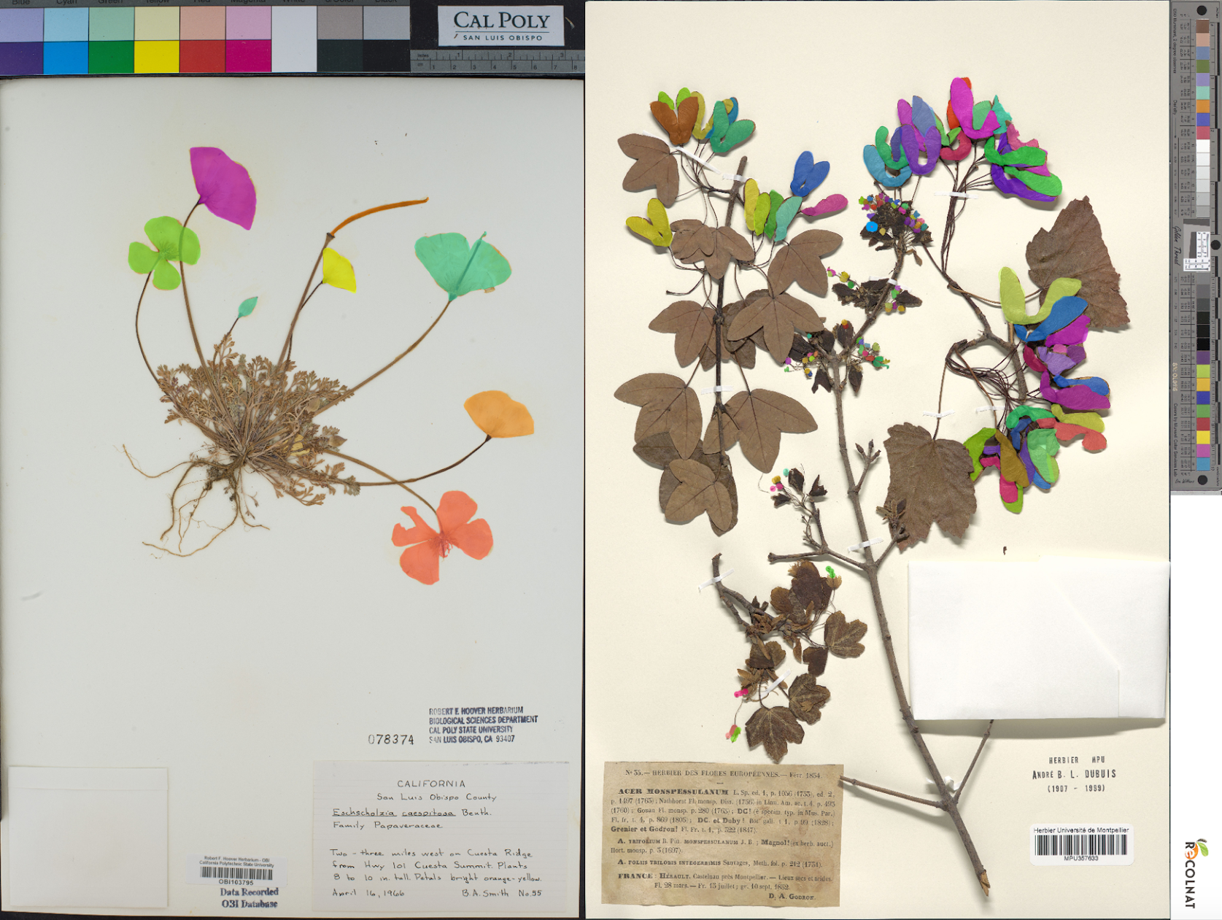
Machine Learning & Biodiversity Research
Pearson et al. 2020
Carranza-Rojas et al. 2017

Slide 13

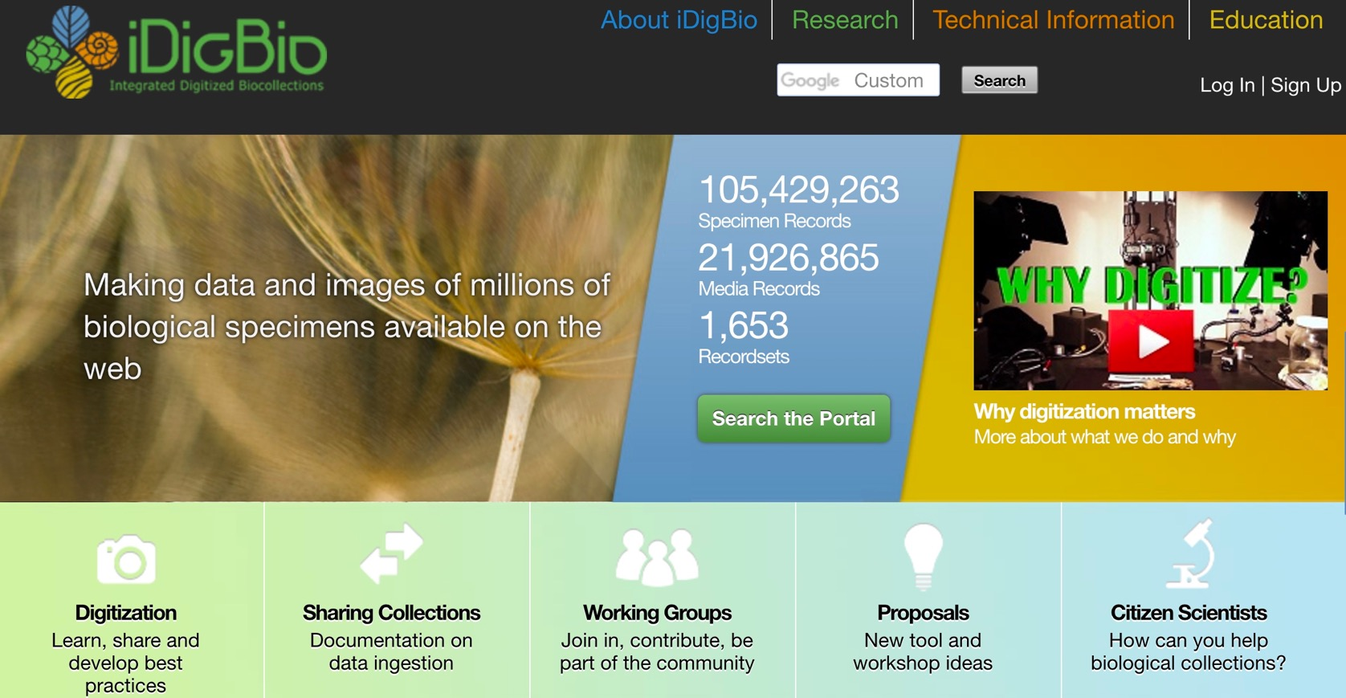

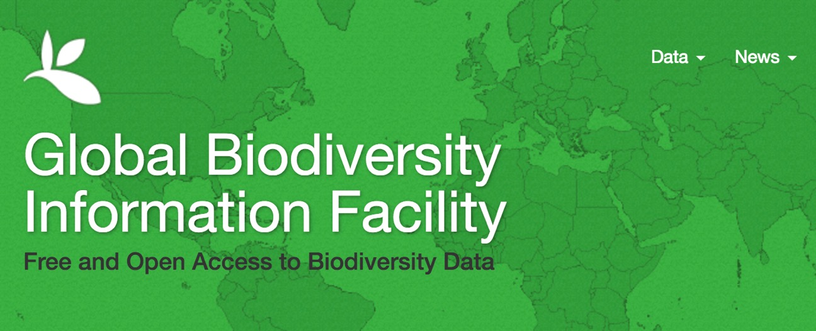



Other Data Aggregators
Notes:
iDB is referred to as a specimen data aggregator – and there are other specimen data aggregators, such as those shown here, so that there is a global network of specimen data.

Slide 14
‘Big Data’ Research in Biodiversity Science
Monitoring shifts in biodiversity
Tracking invasive species
Ecological Niche Modeling, climate change
Past movements and climate change
Tracking phenological shifts
Landscape genetics
Integration of ENM with phylogeny
Community phylogenetics/assembly
Biogeography

Slide 15
Overview of Day’s Activities
8:00 Welcome and Overview of the Workshop – Pam
Darwin Core and Data Fields – Pam
Data Downloading Overview – Pam
8:20 Activity: Manual Data Downloads from iDigBio Portal – Pam
8:30 Intro to HiPerGator – Makenzie
8:35 Data Downloads – Shelly
8:45 Activity: R-based Data Downloads – Shelly
9:00 Data Cleaning – Cameron
9:15 Activity: Data Cleaning
9:30 Georeferencing – Sarah Ellen
10:00 Coffee Break
10:30 Environmental Variables & Data Exploration – Sarah Ellen
10:45 Activity: Environmental Variables & Data Exploration – Sarah Ellen
Notes:
Here is our outline of activities

Slide 16
Overview of Day’s Activities
11:15 Lunch
12:15 Defining Accessible Area + Variable Selection – Makenzie
12:25 Activity: Defining Accessible Area + Variable Selection – Makenzie
12:45 Ecological Niche Models (ENMs) – Elizabeth
1:00 Activity: ENMs – Elizabeth
1:30 Null Models – JT
1:40 Activity: Null Models – JT
2:00 Post ENM analyses + Future Predictions – Elizabeth
2:15 Activity: Post ENM analyses + Future Predictions – Elizabeth
2:45 Phylodiversity and Phyloendemism – JT
3:00 Coffee Break
3:30 Activity: Phylodiversity and Phyloendemism – JT
3:45 Closing with Examples – Doug
4:00 Final Q & A
Notes:
Here is our outline of activities

