Slide 1




Data Standards and Data Fields
Pam Soltis
University of Florida

Slide 2
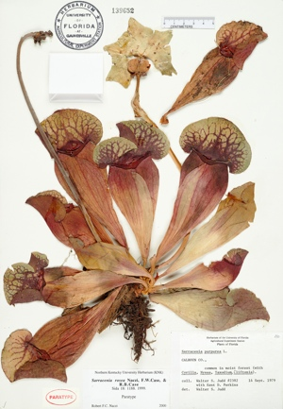
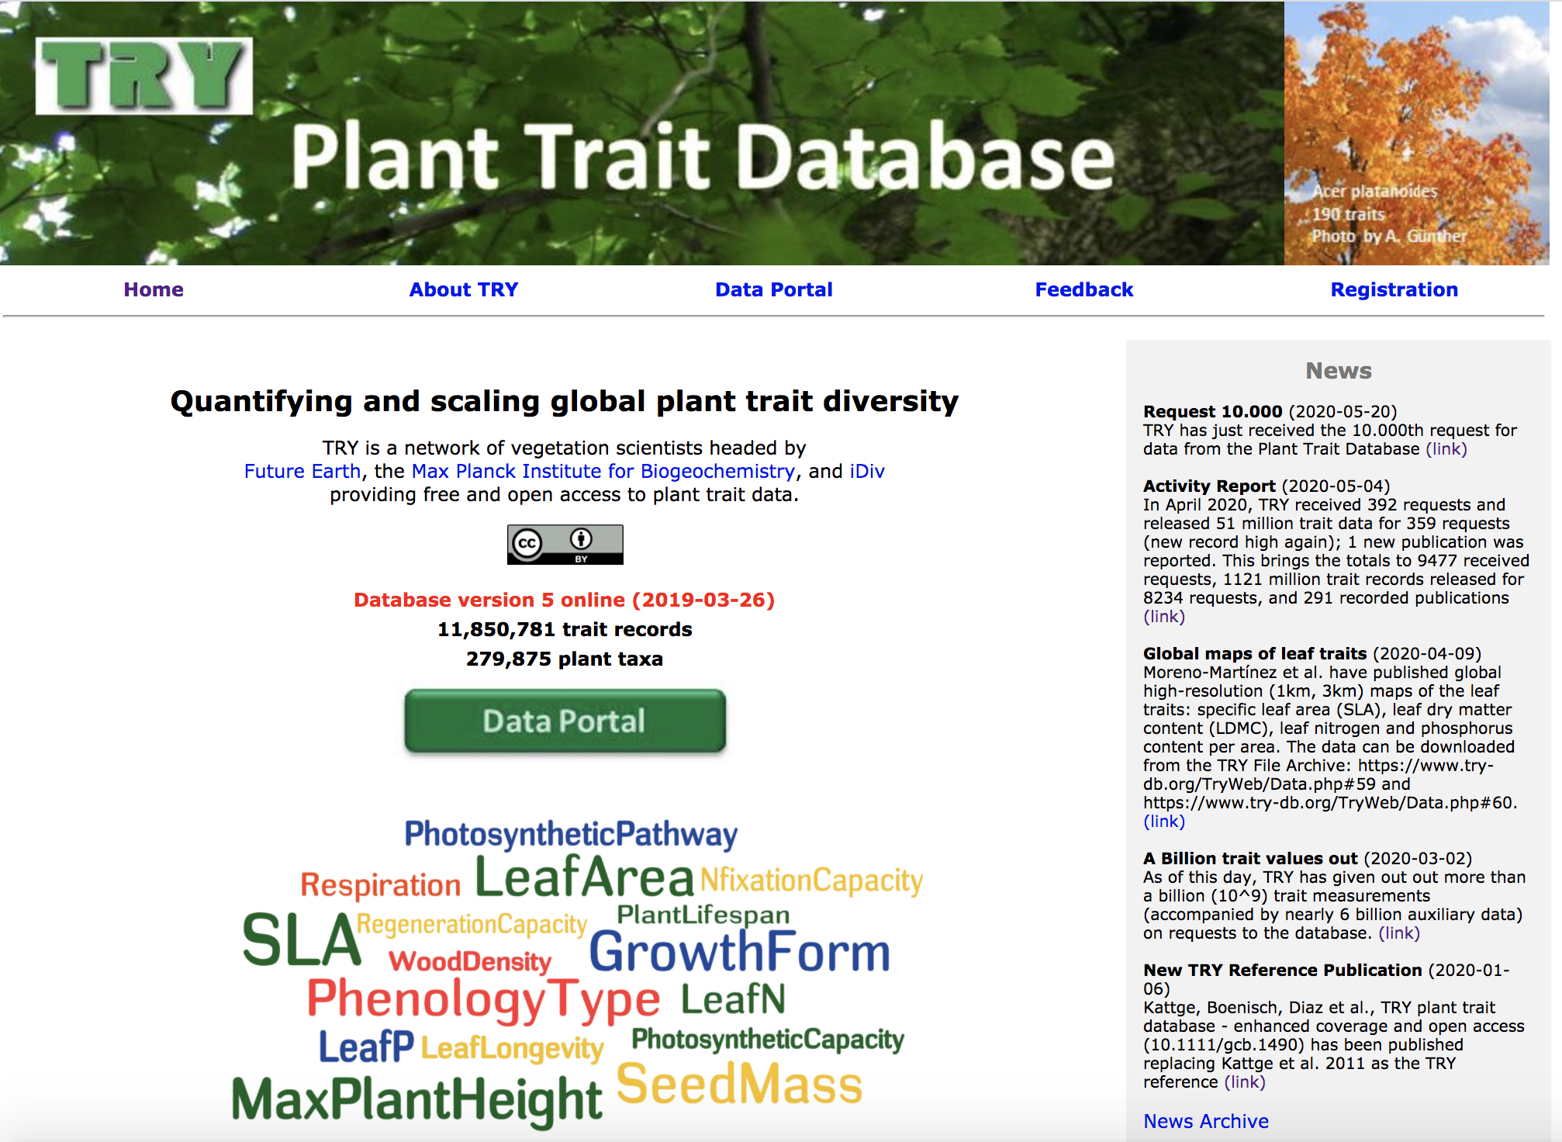



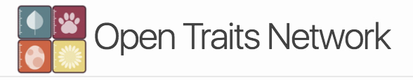





Repositories
Repositories

Slide 3
Standards
Standards

Slide 4
Standards
Standards – ‘Adapters’

Slide 5
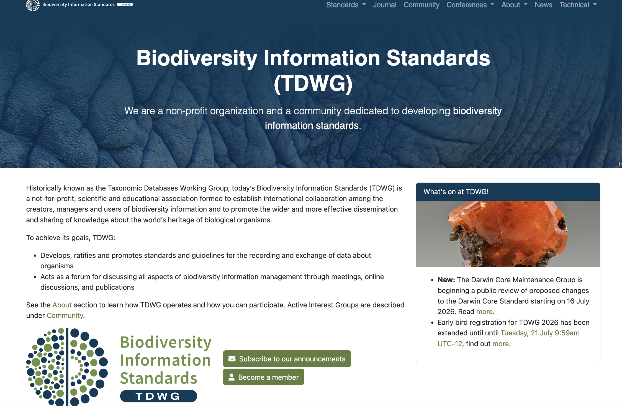
Standards – tdwg.org

Slide 6
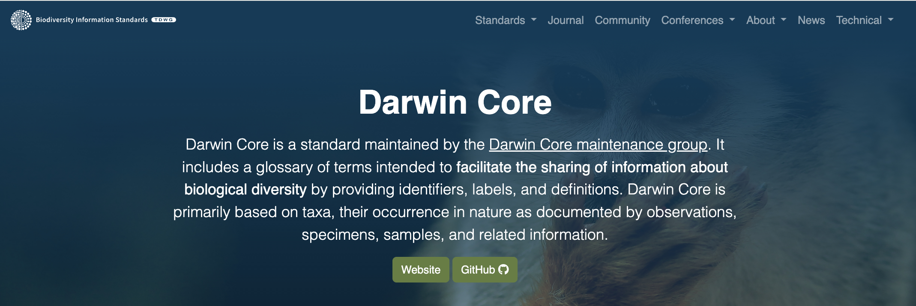
Standards – tdwg.org

Slide 7
Standards – tdwg.org
species name
collector name
date of collection
location of collection – country, state, county, latitude, longitude
etc.

Slide 8
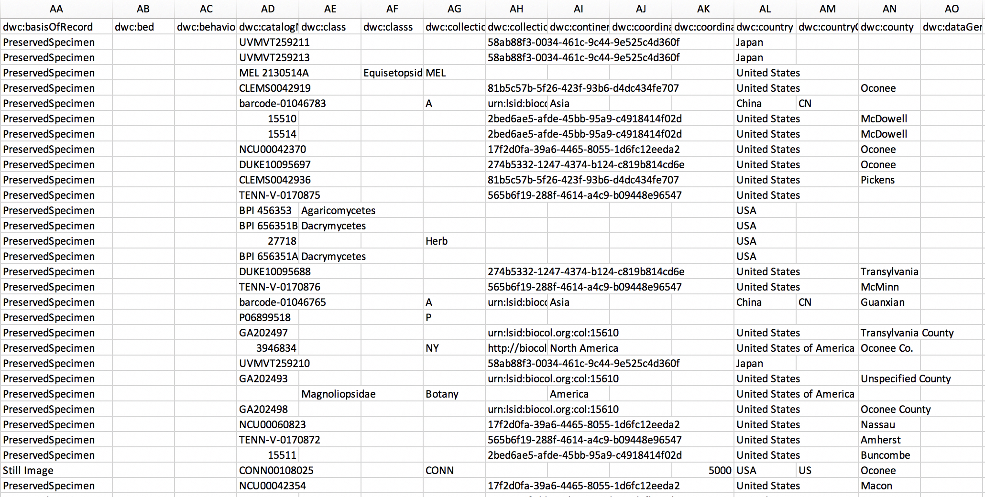
Standards: Darwin Core

