Slide 1




Data Downloads:
Overview and Portals
Pam Soltis
University of Florida

Slide 2
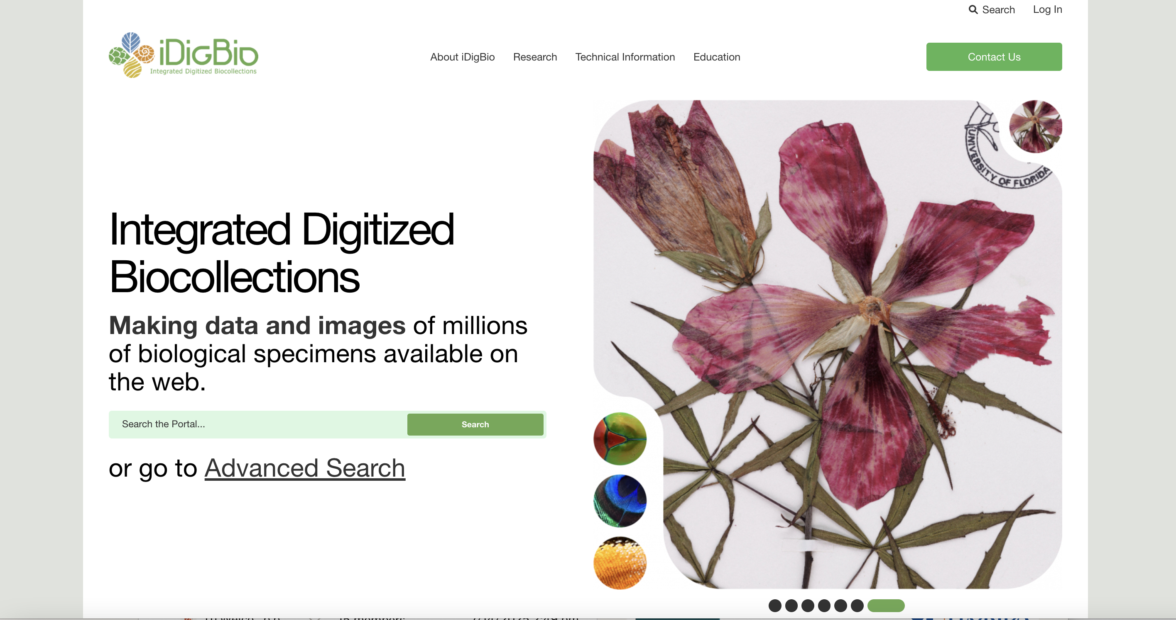

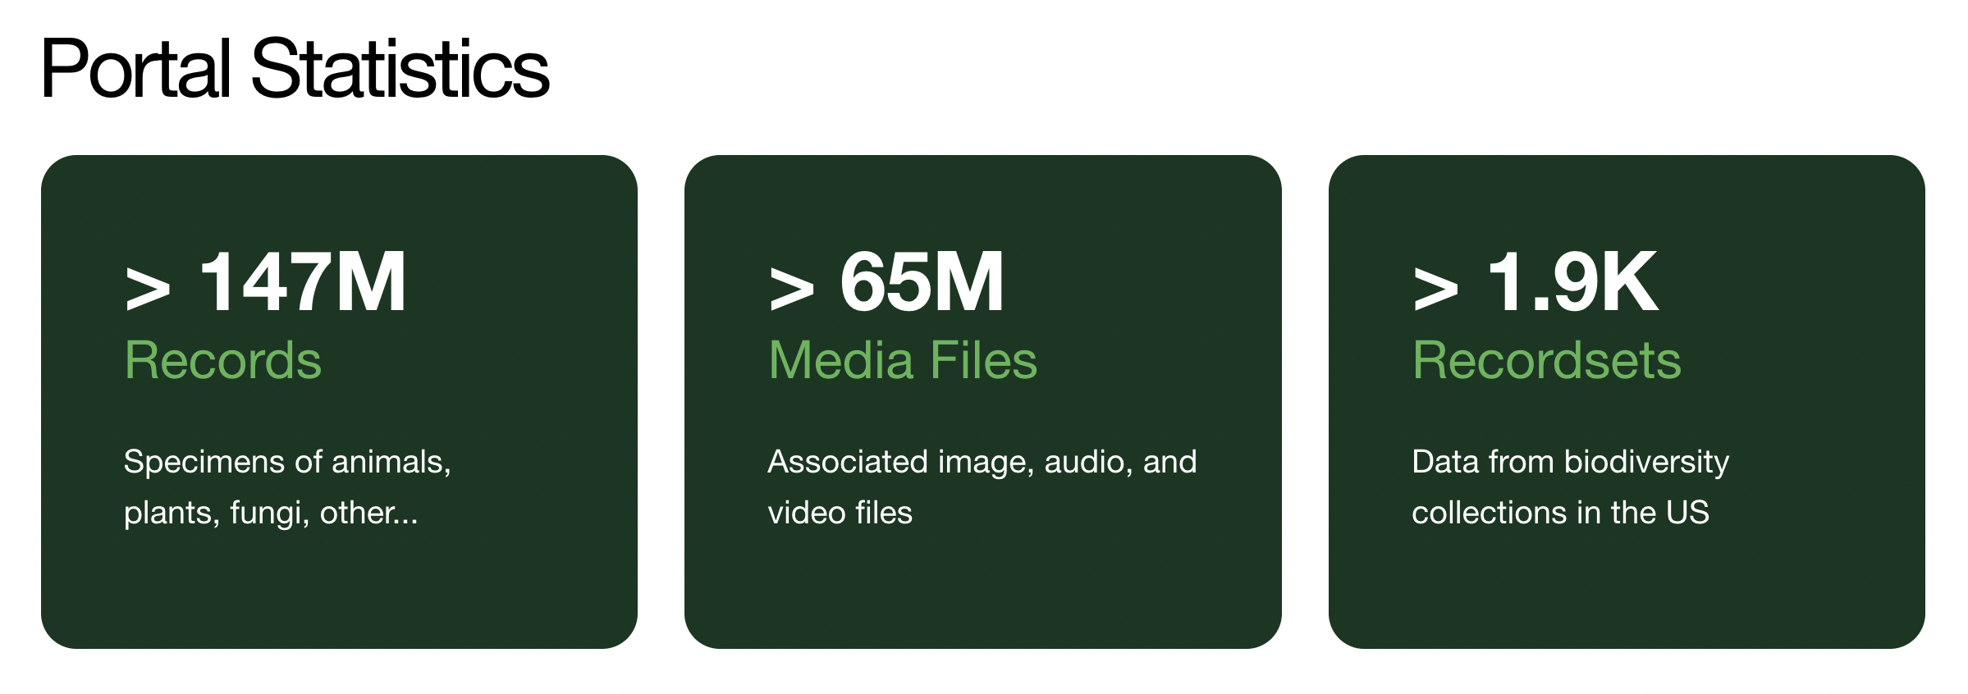
iDigBio: A Source for Specimen Records

Slide 3
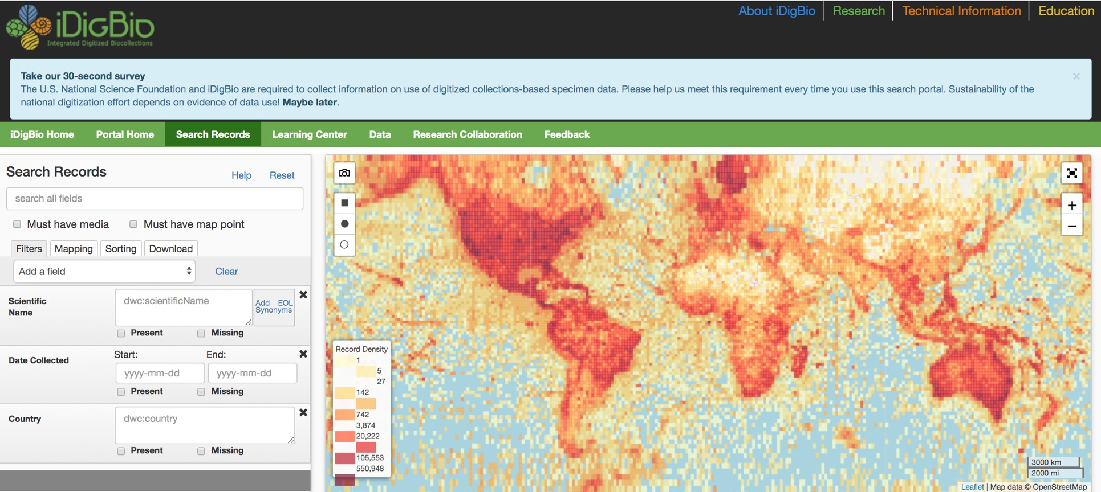
Search the iDigBio Portal

Slide 4
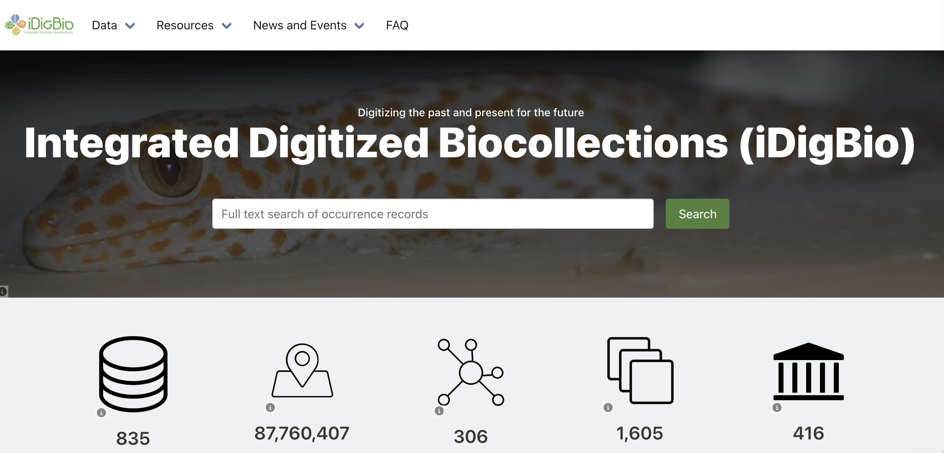
Search the iDigBio GBIF Hosted Portal

Slide 5
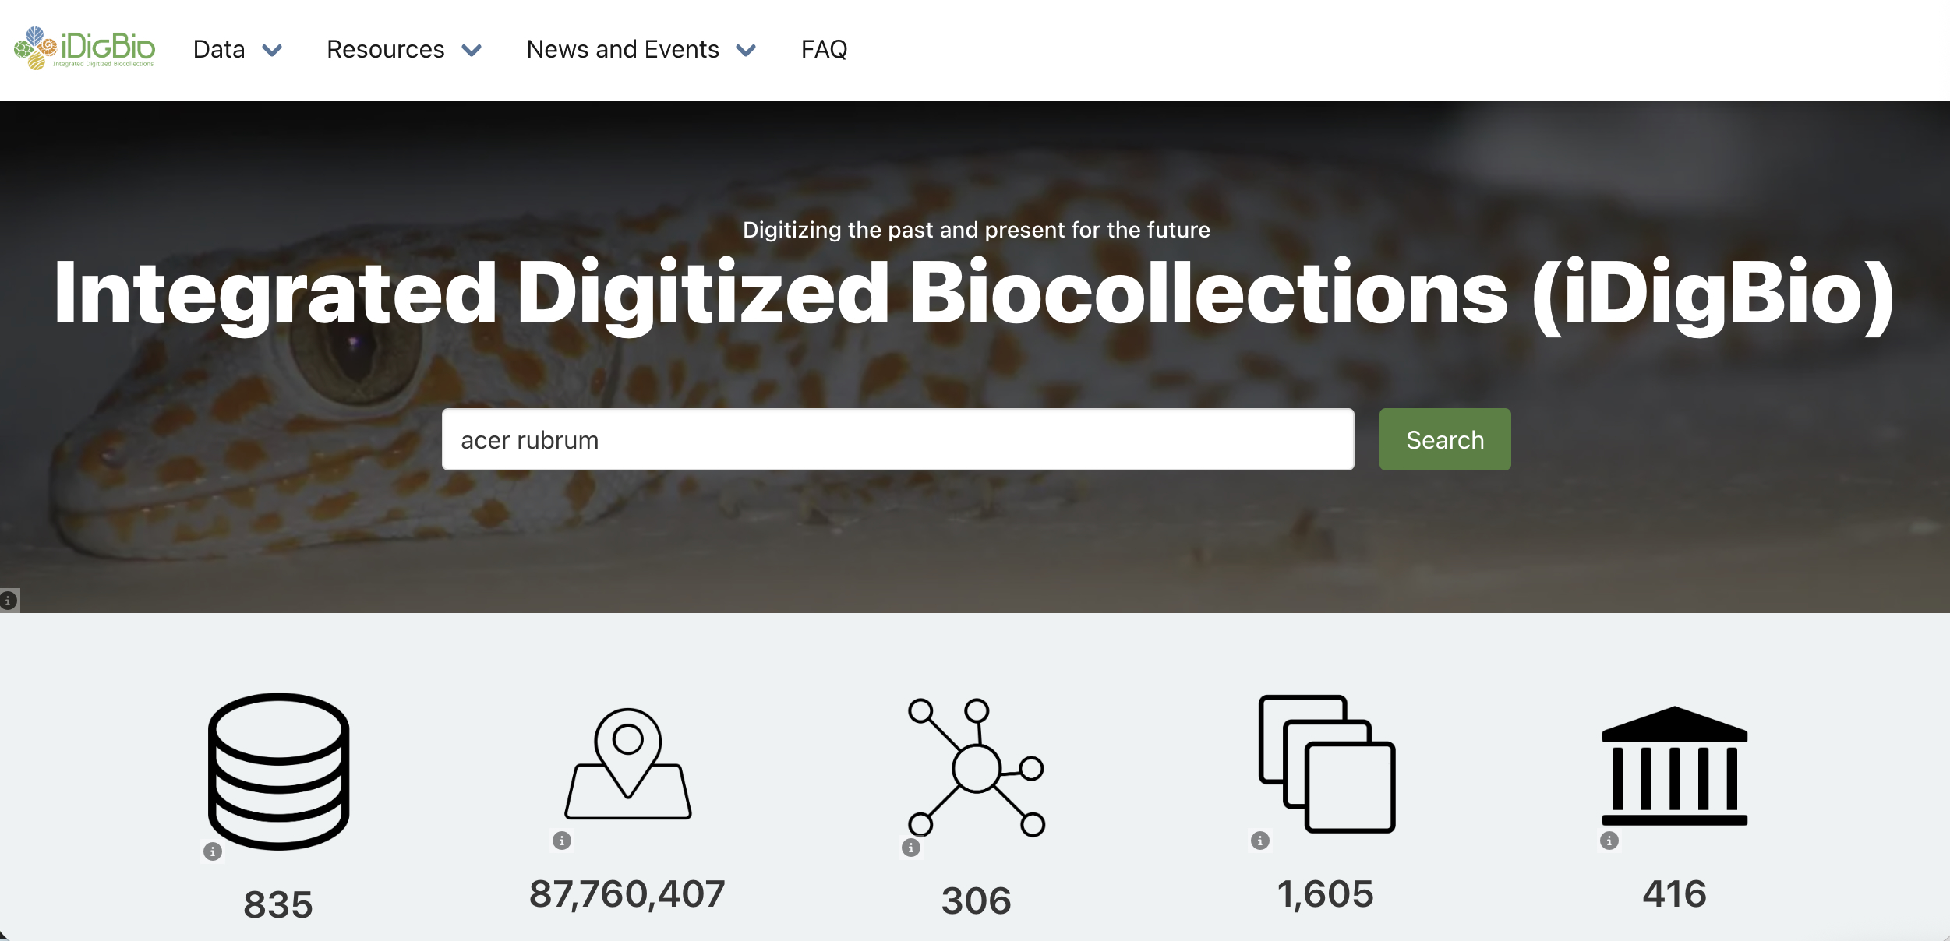
Search the iDigBio GBIF Hosted Portal

Slide 6
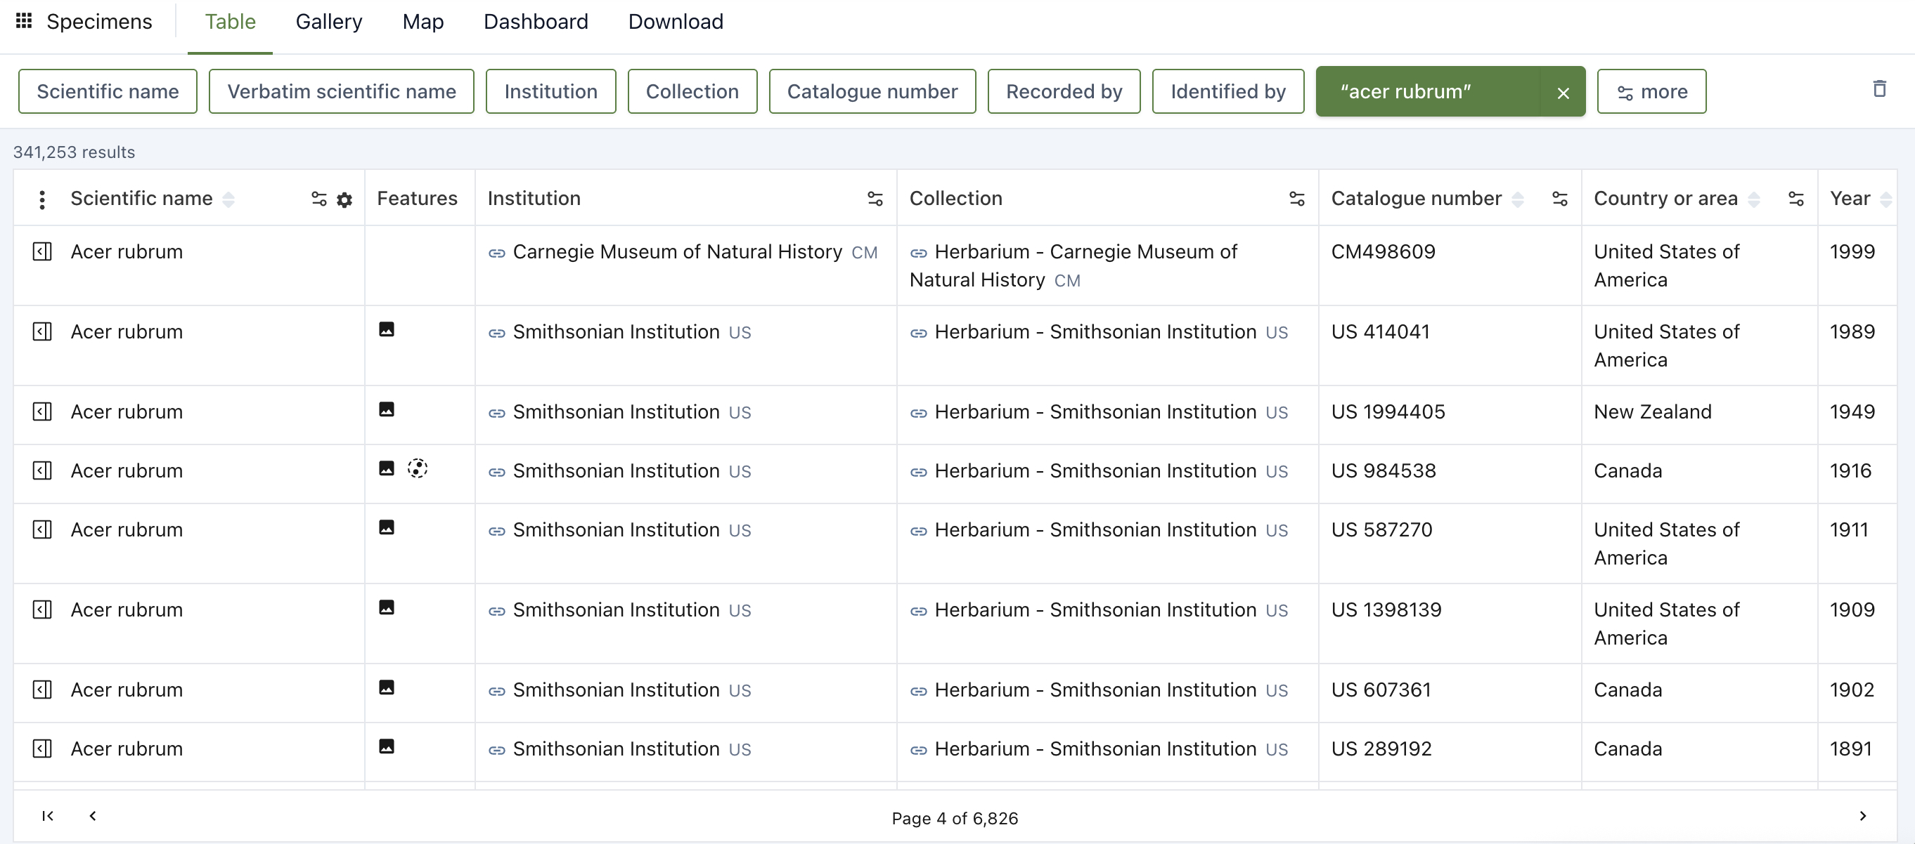
Search the iDigBio GBIF Hosted Portal: Table

Slide 7
Search the iDigBio GBIF Hosted Portal: Table

Slide 8
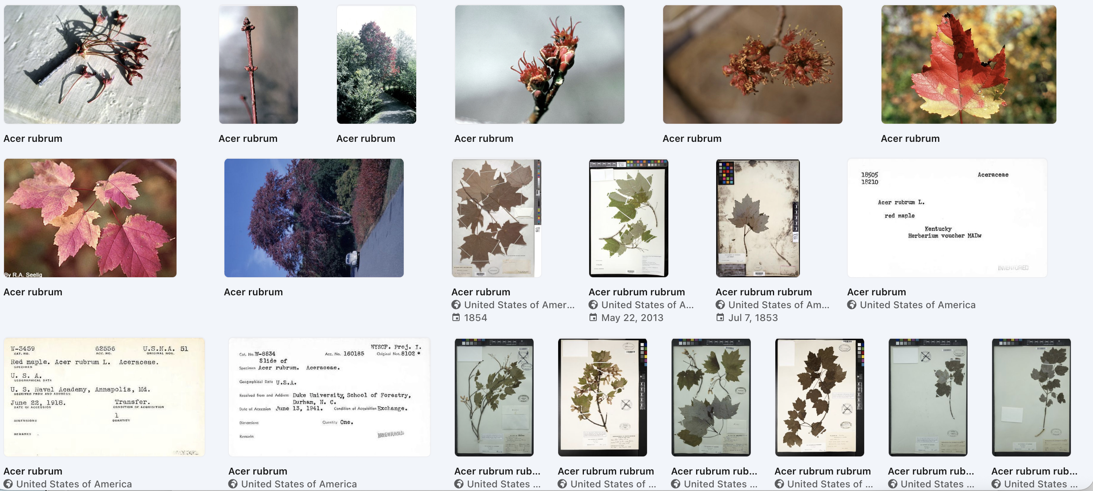
Search the iDigBio GBIF Hosted Portal: Gallery

Slide 9
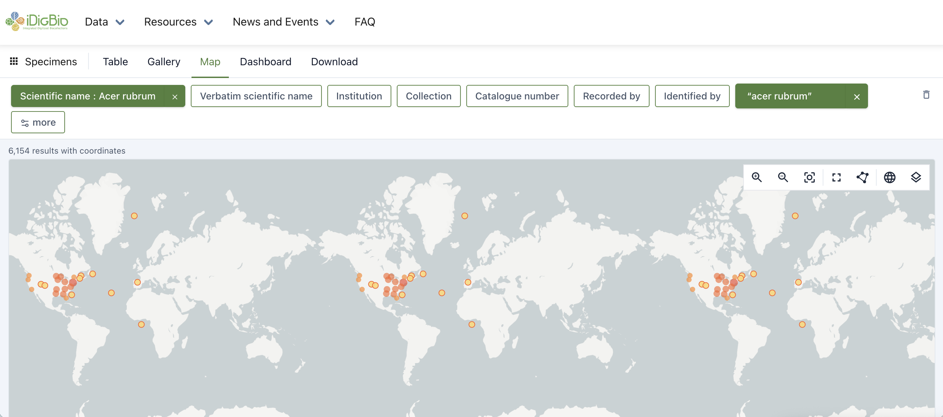
Search the iDigBio GBIF Hosted Portal: Map

Slide 10
Search the iDigBio GBIF Hosted Portal

Slide 11
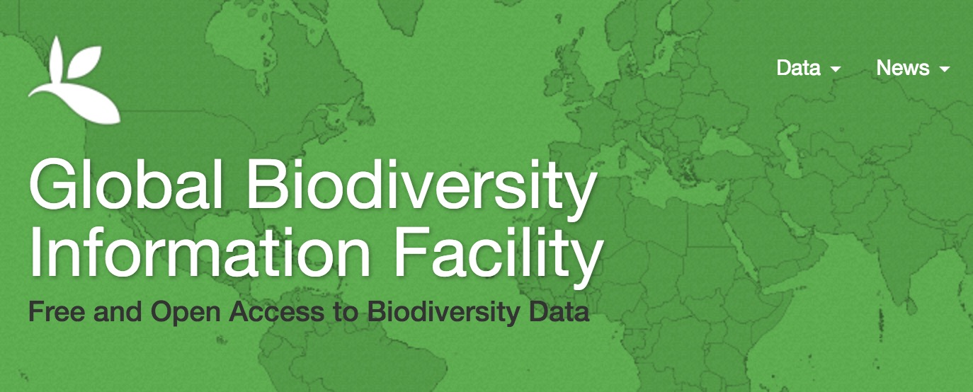

GBIF: gbif.org

Slide 12


Other Options for Data Downloads
API = Application Programming Interface
Allows users to interact with a system
Web Portal
API
Database
Interface

Slide 13

Other Options for Data Downloads: R packages
ridigbio
rgbif
spocc: Interface to Species Occurrence Data Sources
gatoRs: geographic and taxonomic occurrence R-based scrubbing
Patten et al. 2024, APPS

