Slide 1
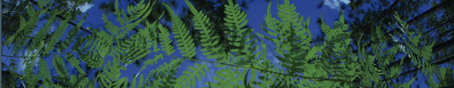

R-based Data Downloads
Shelly Gaynor
University of Florida

Slide 2
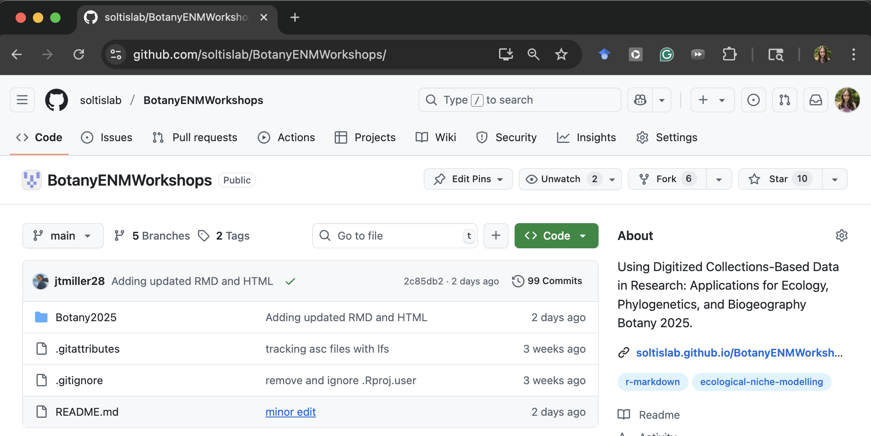
Github: soltislab/BotanyENMWorkshop/
See the code: https://soltislab.github.io/BotanyENMWorkshops/

Slide 3
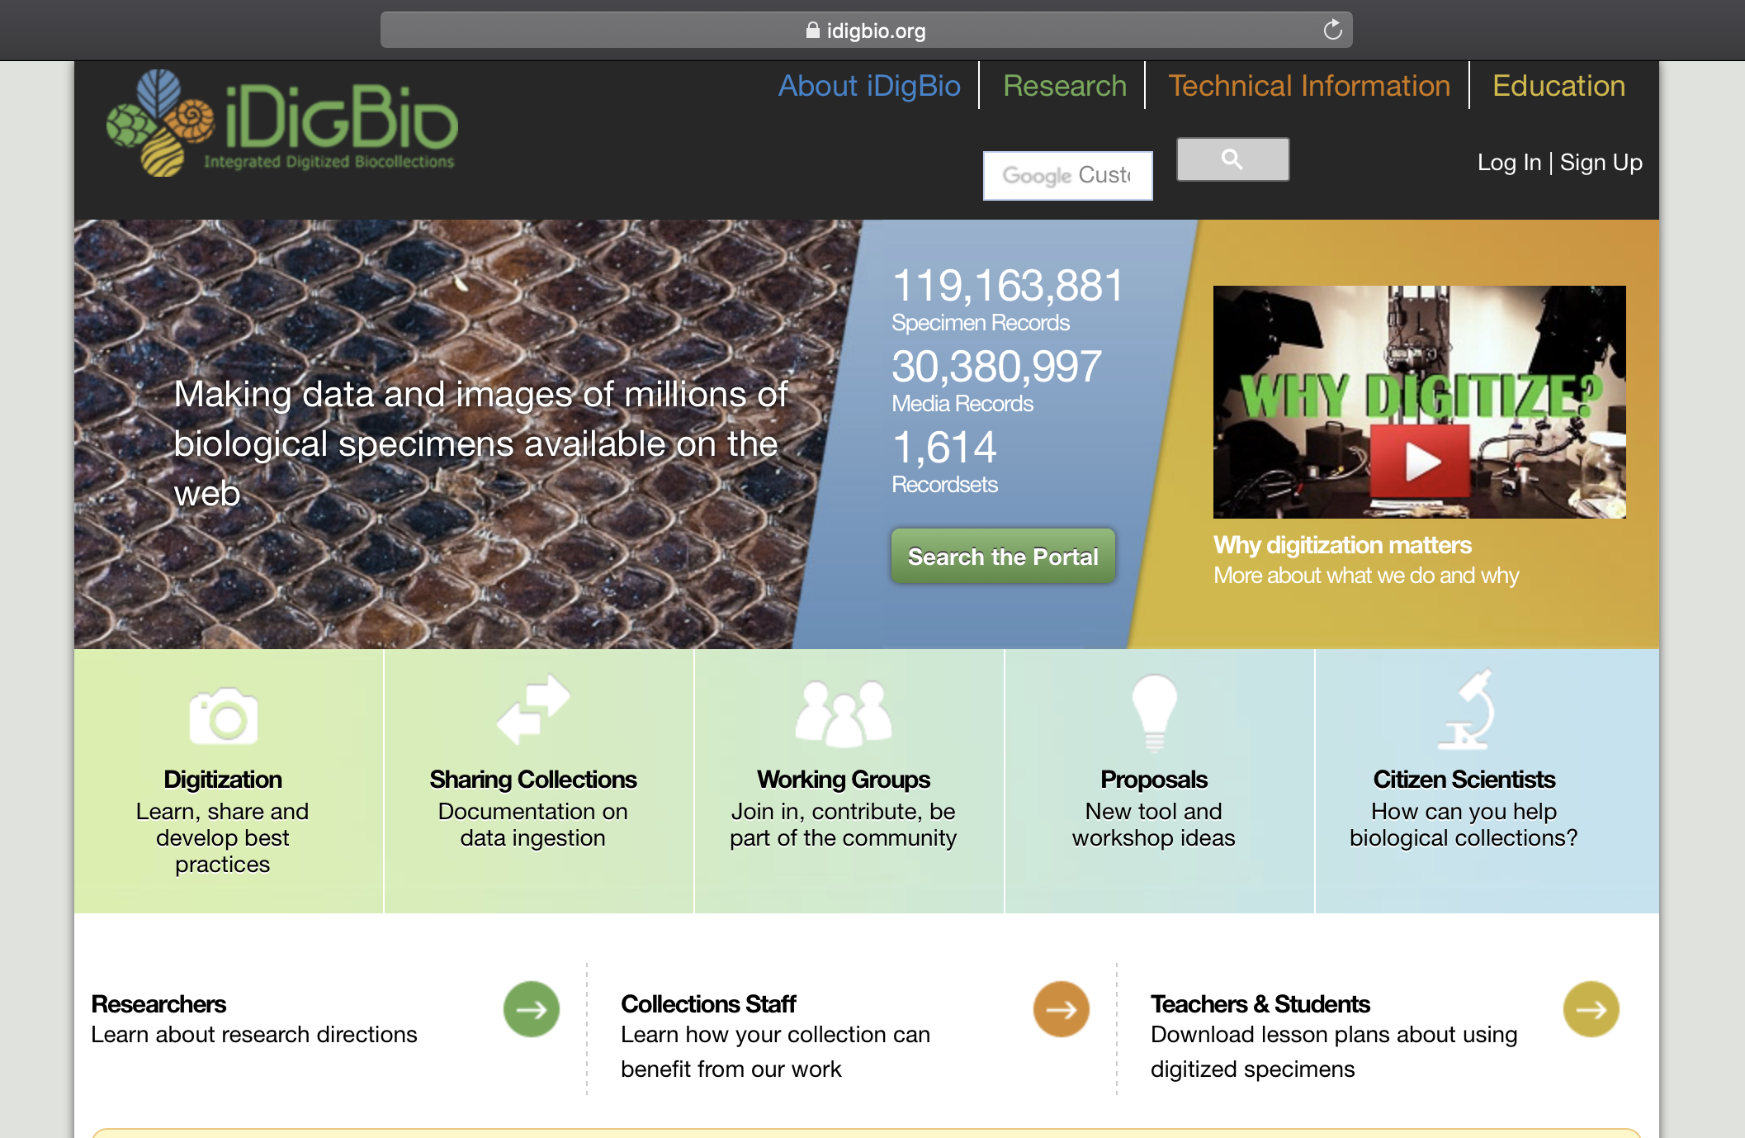


API = Application Programming Interface
Allows users to interact with a system
Web portal
API
Database
Interface

Slide 4
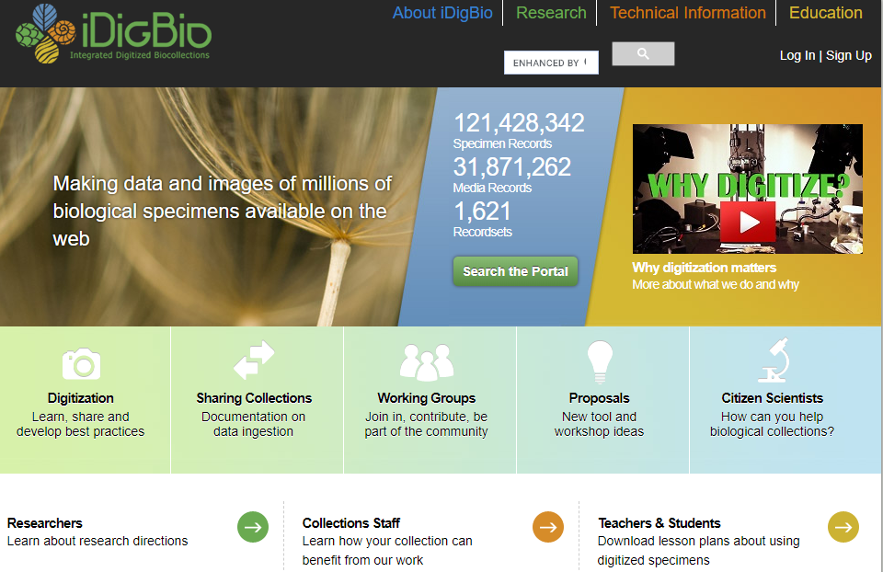

Slide 5

iDigBio API
Multiple ways to access the API:
API Name | Info
Search API | ridigbio R package <100,000 records
Download API | >100,000 records
Record API | Single record
Media API | Single record
biodiversity-specimen-data/specimen-data-use-case

Slide 6
iDigBio API
Multiple ways to access the API:
API Name | Info
Search API | ridigbio R package <100,000 records
Download API | >100,000 records
Record API | Single record
Media API | Single record
biodiversity-specimen-data/specimen-data-use-case

Slide 7

GBIF API
Multiple ways to access the API:
API Name | Info
Registry API | Create, edit, update and search for information about datasets
Species API | Taxonomy API
Occurrence API | Record API
Maps API | Show maps of GBIF
News API | Search papers published using GBIF
https://www.gbif.org/developer/summary

Slide 8
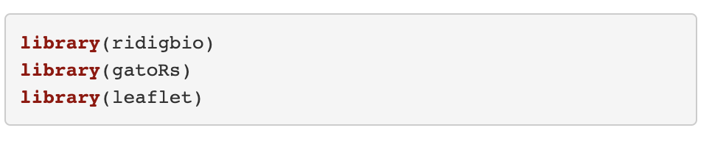



Load Packages
Notes:
spocc- Global Biodiversity Information Facility ('GBIF'), 'USGSs' Biodiversity Information Serving Our Nation ('BISON'), 'iNaturalist', Berkeley 'Ecoinformatics' Engine, 'eBird', Integrated Digitized 'Biocollections' ('iDigBio'), 'VertNet', Ocean 'Biogeographic' Information System ('OBIS'), and Atlas of Living Australia ('ALA'). Includes functionality for retrieving species occurrence data, and combining those data.
Ridigbio-Interface to the iDigBio Data API

Slide 9
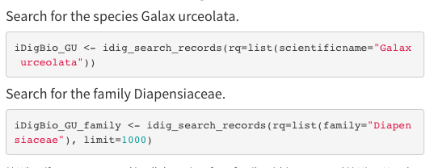
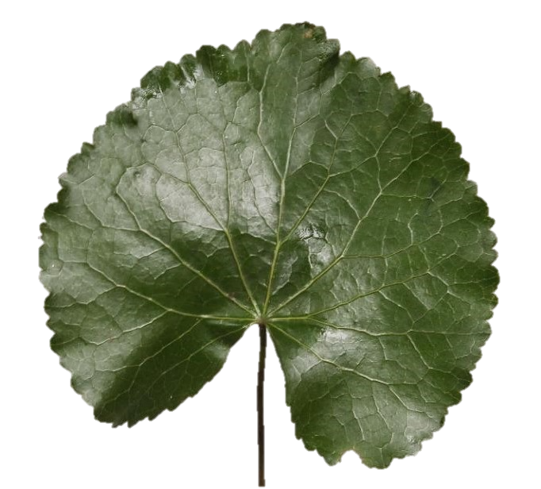
Downloading data using ridigbio
First, we are searching for the species Galax urceolata
Next, download occurrence records for the family Diapensiaceae

Slide 10
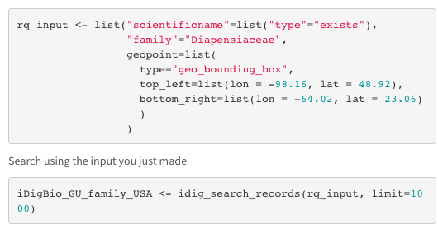
Records only in North America

Slide 11
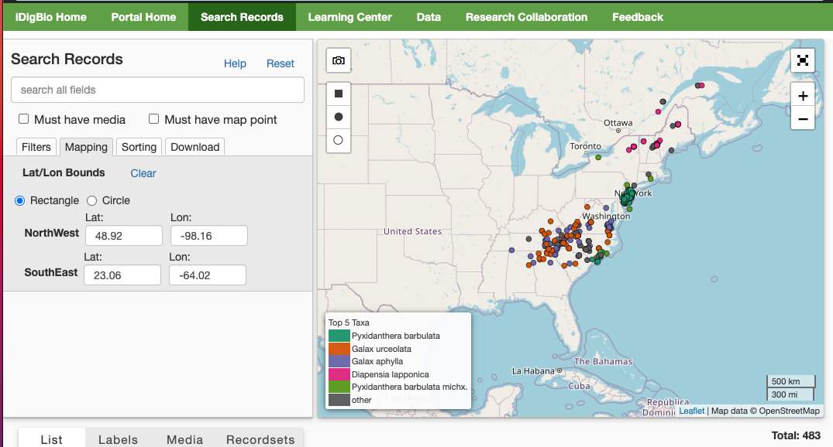

Slide 12
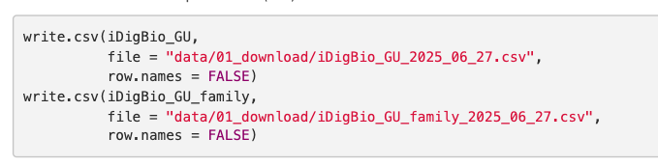
Save as csv

Slide 13




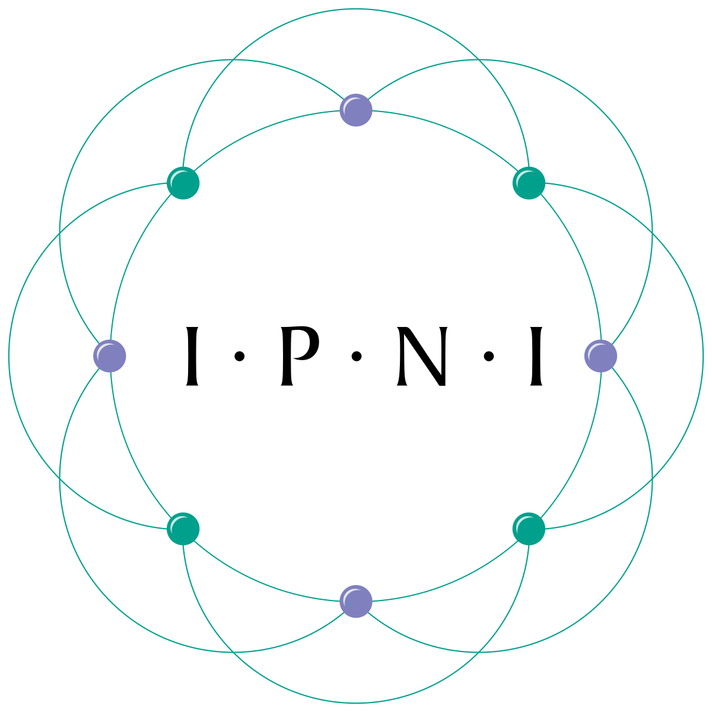


Data download using gatoRs
To pull data from GBIF and iDigBio for a set of synonyms
Identifying synonyms:
  Taxonomic Name Resolution Service
    https://tnrs.biendata.org/
    Used in soltislab/BotanyENMWorkshops 2020
  R package taxize
    20 sources for synonyms
    https://docs.ropensci.org/taxize/
Natalie Patten

Slide 14
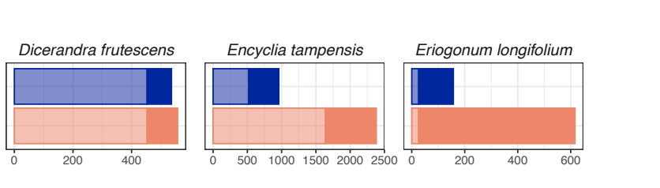

Why should I use gatoRs?
GBIF
iDigBio
Downloaded Records
Patten et al. 2024. Applications in Plant Science.

Slide 15
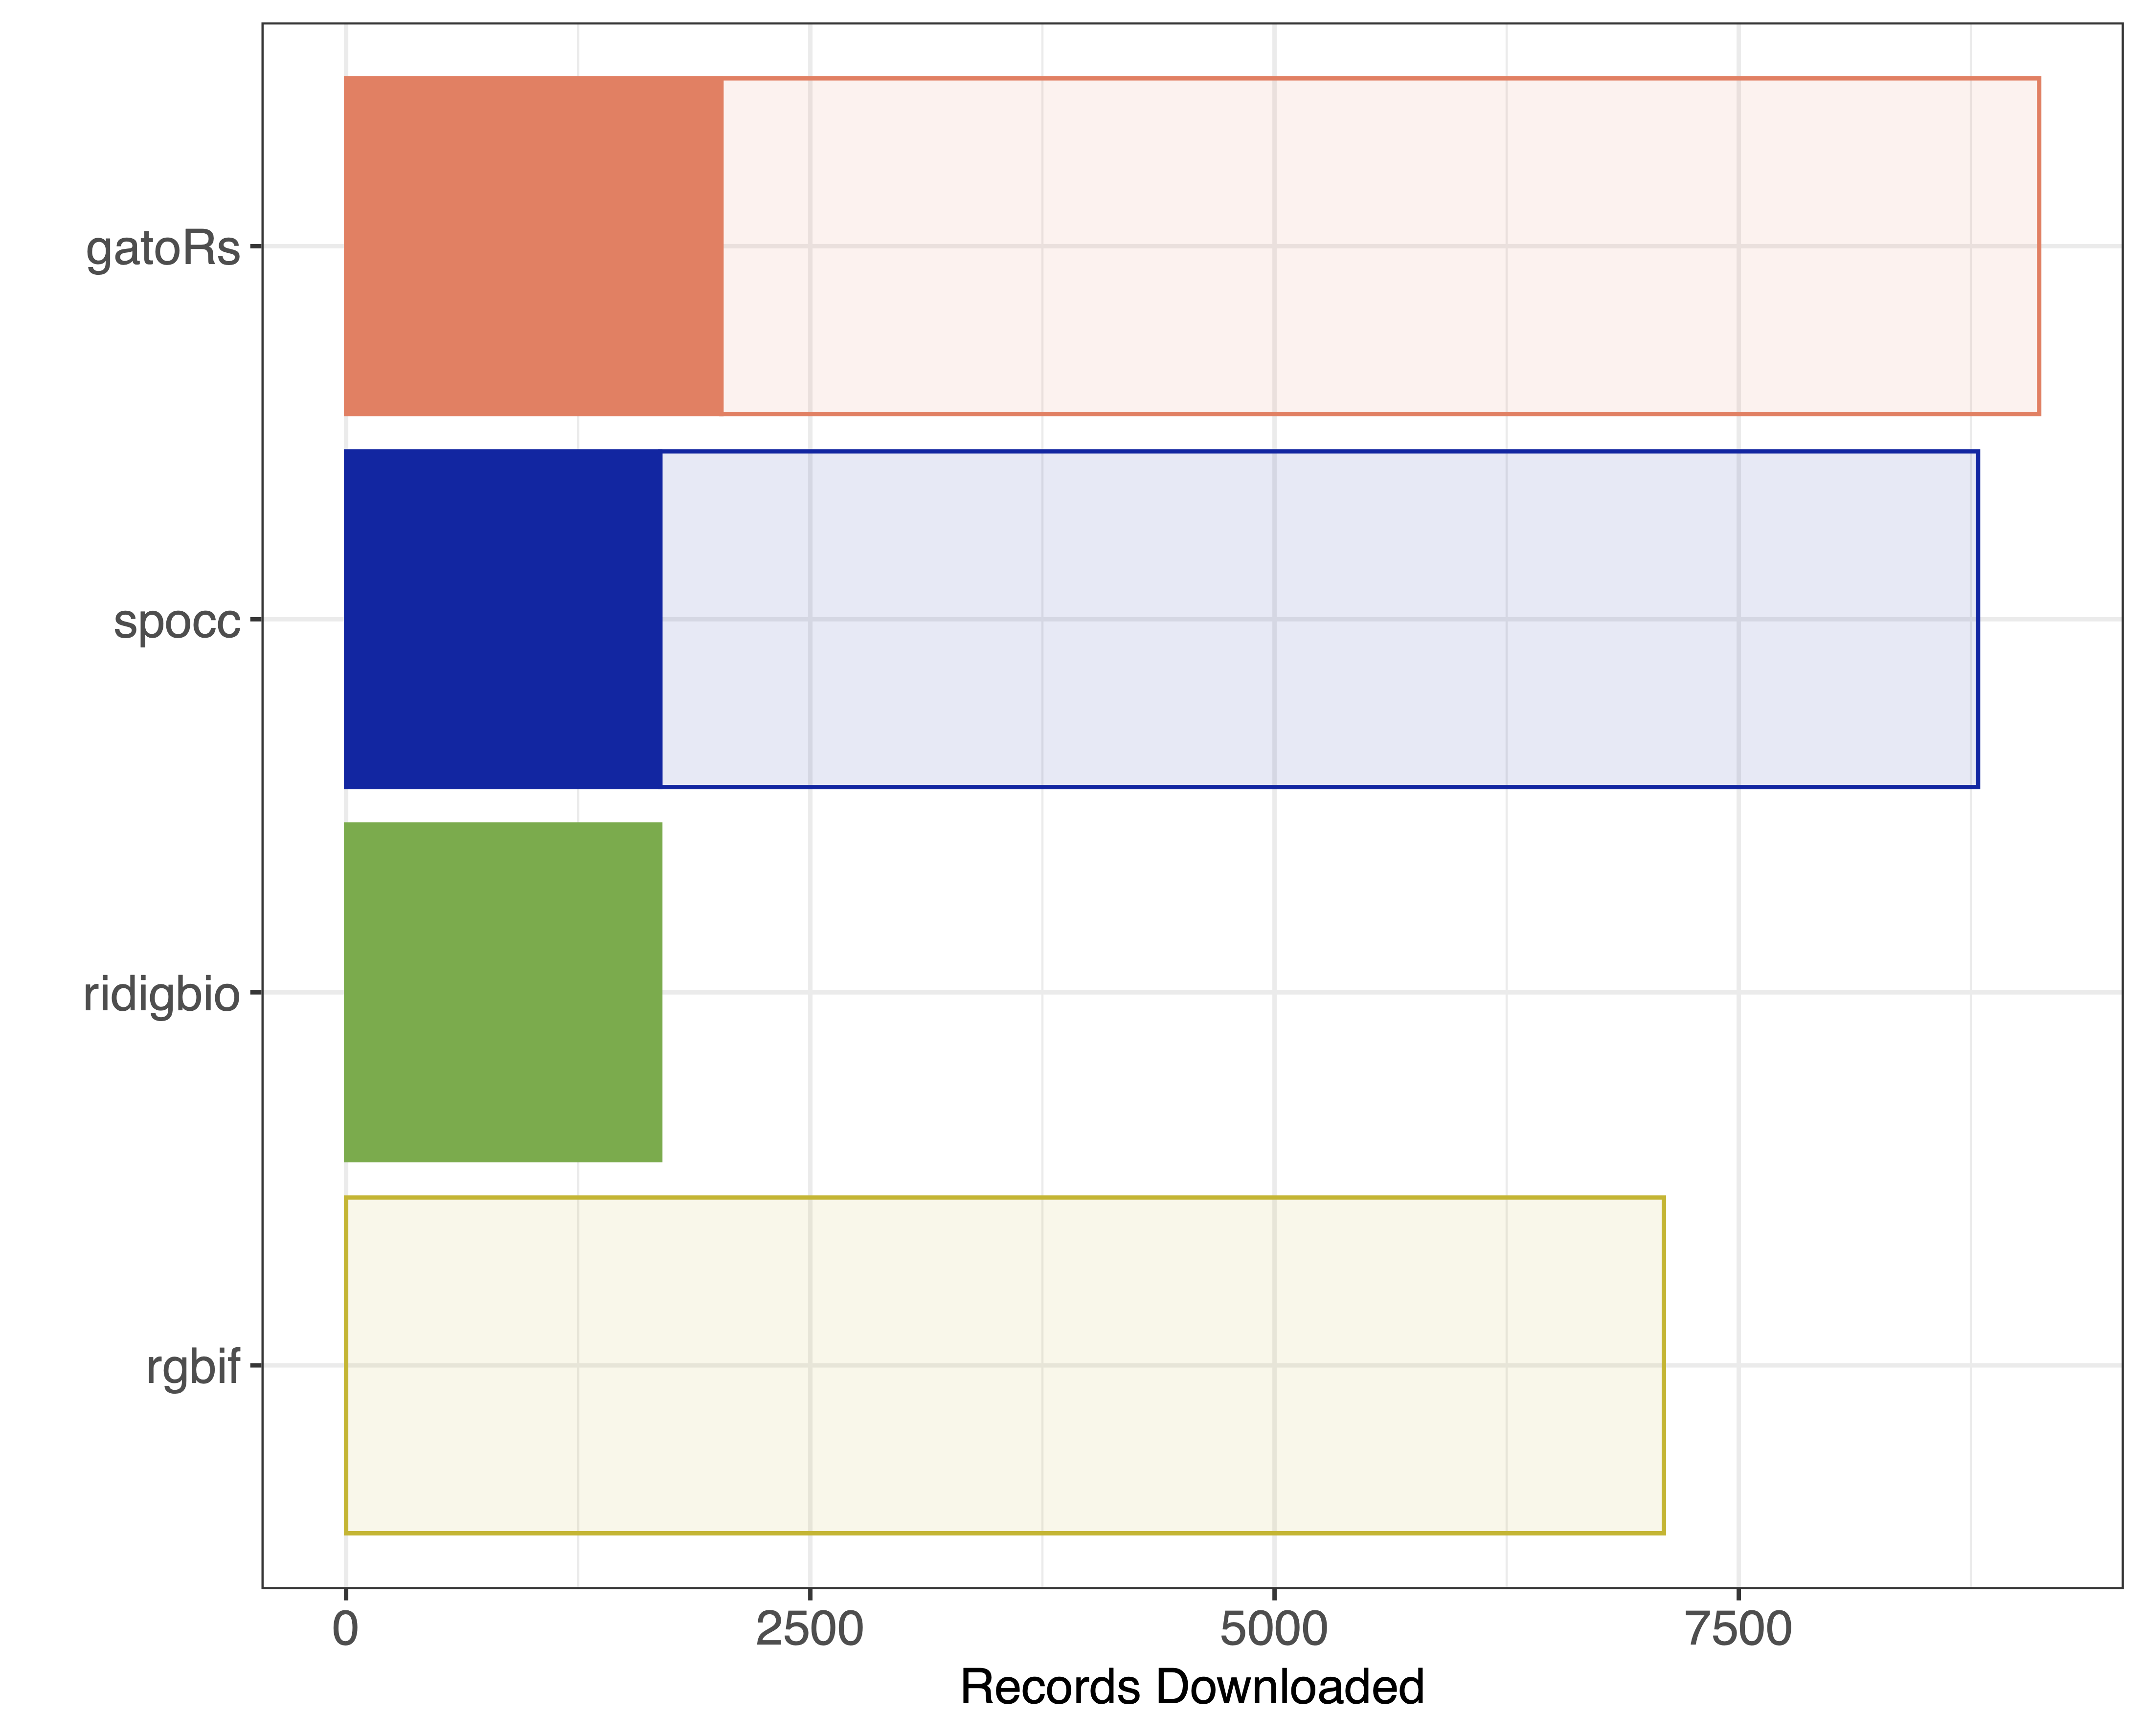
iDigBio
GBIF
iDigBio
GBIF
Galax urceolata
https://mlgaynor.com/DEMO-Gaynor-2024/Gaynor-DEMO01.html

Slide 16
gatoRs Update - iDigBio
In 2026, iDigBio moved to a GBIF hosted portal due to the end of their funding.
A small subset of data providers did not move their recordsets over to the new hosted portal. This includes about 1.7 million records.
In 2026, we modified gators_download() to pull these records from a GitHub-hosted archived download of these recordsets (downloaded on June 28, 2026).
The full archived data set can be found on mgaynor1/OccurrenceArchive.
Increases time to download.

Slide 17
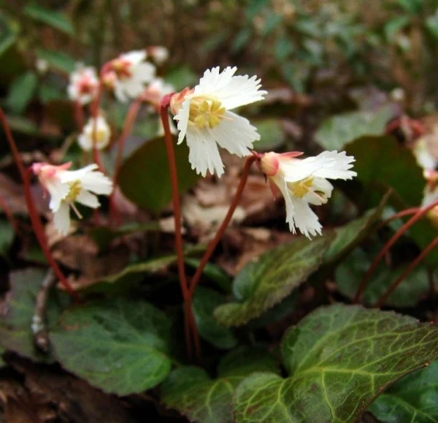
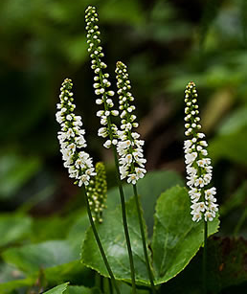
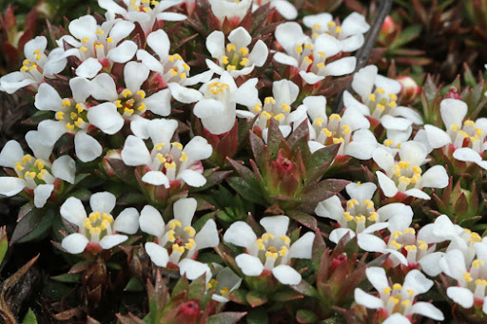
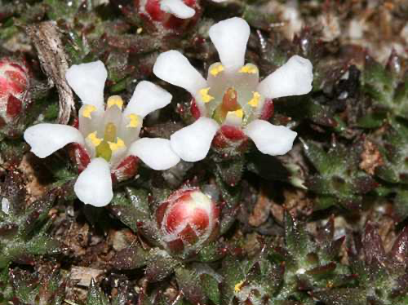
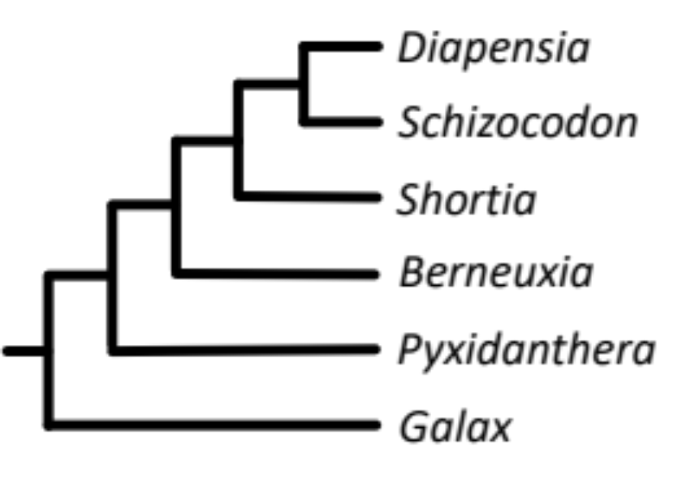
Shortia galacifolia
Galax urceolata
Pyxidanthera barbulata
Pyxidanthera brevifolia
Diapensiaceae
Ericales

Slide 18
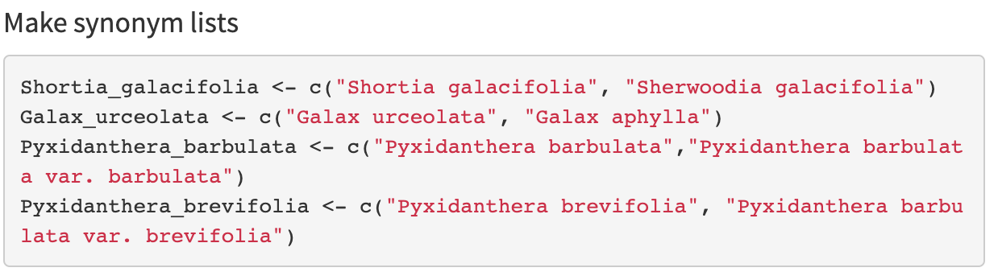
Data download using gator_download
Object
List of strings

Slide 19
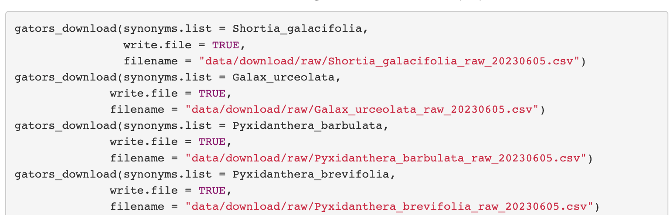
Data download using gators_download
,
Synonym list
Save csv file

Slide 20
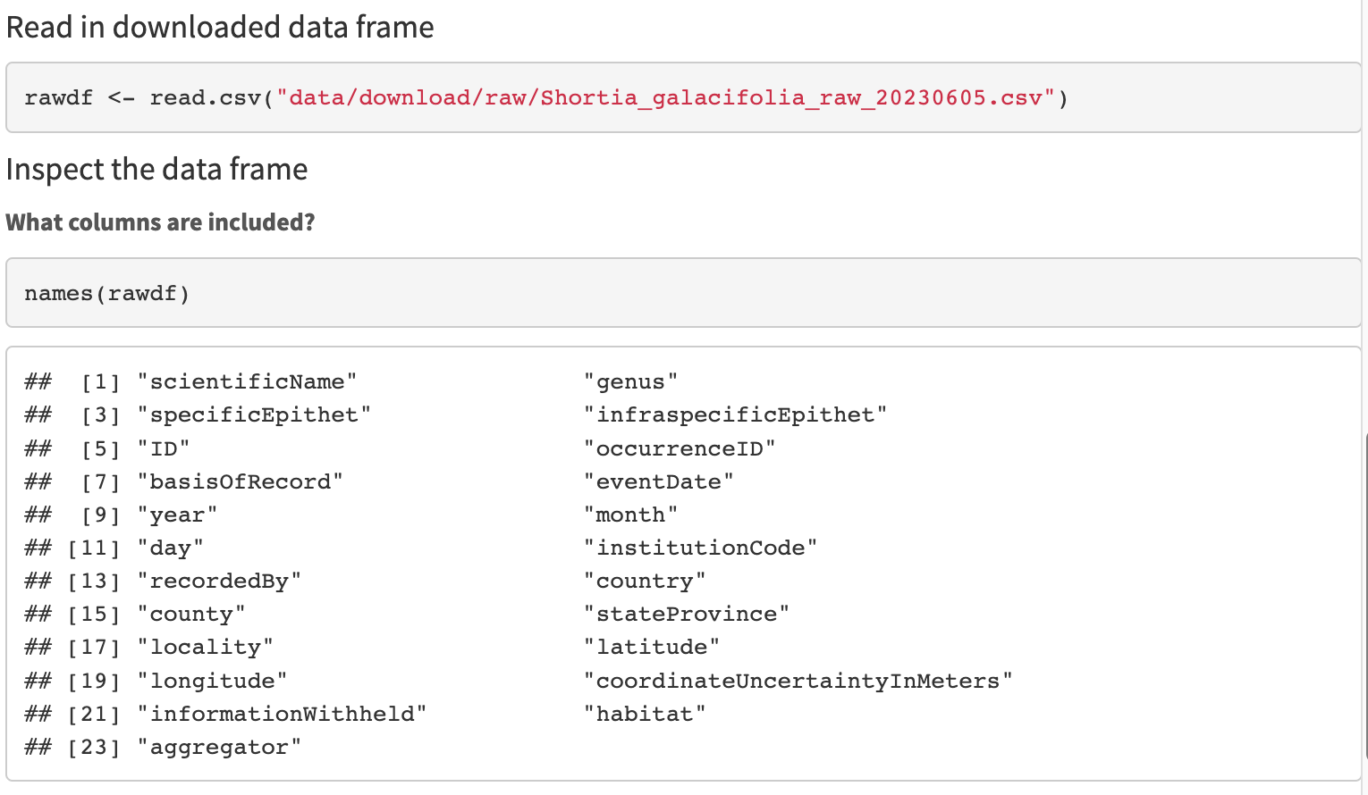
Quick-look at downloaded files

Slide 21
