Slide 1
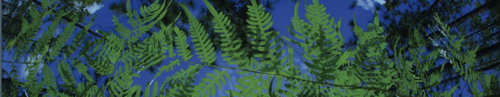

02- Data Cleaning
Cameron McMullen
University of Florida

Slide 2
Hi everyone - Cameron McMullen
Graduated from the University of Florida in April 2026
Majored in Botany
  Specialization in Botanical Research
  Minor in Environmental Science
Worked on ecological niche models (ENMs) of FL Hardwood Forests
Thesis on changes in plant composition of campus natural area undergoing restoration efforts over time across floristic surveys

Slide 3
Data Cleaning
02_Data_Cleaning.R
0. Exploring the Dataset
Taxonomic Harmonization
Clean Localities
  Precision
  Remove Impossible Points
    Most common coordinate: (0.00, 0.00)
    Cultivated zones, botanical gardens, museums, etc.
Flag and Filter Cultivated Records
Duplicate Removal
Spatial Deduplication
Spatial Thinning
Visualize
Save Cleaned.csv
- REPEAT -

Slide 4
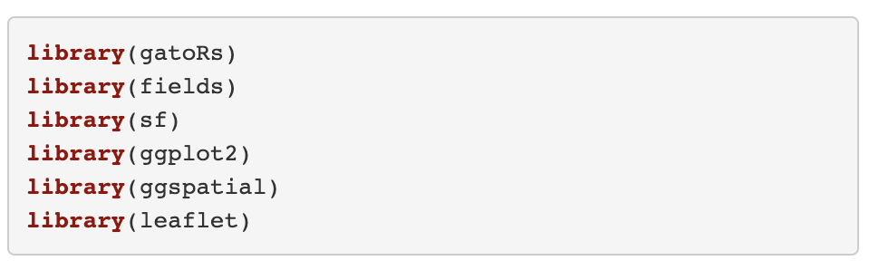
Load Packages
gatoRs is a custom package for processing biodiversity data
Geospatial packages include fields and sf
ggplot2, ggspatial, and leaflet are for visualization (maps)

Slide 5
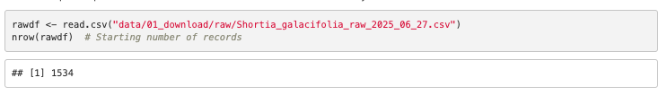
A. Load Data File
read.csv is a base function of R, it reads csv files
nrow prints the number of rows in the raw data

Slide 6
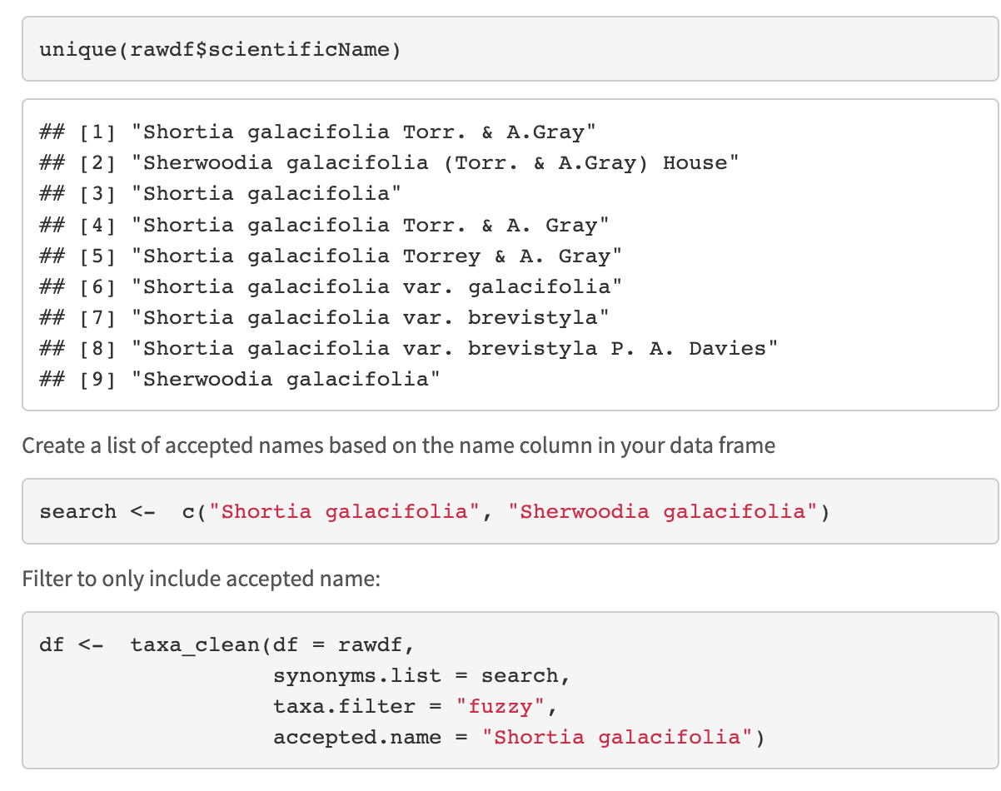
B. Taxonomic Harmonization
unique prints unique values in the column scientific name from the dataframe rawdf
c creates a list stored in the object search that contains “Shortia galacifolia” and “Sherwoodia galacifolia”

Slide 7
B. Taxonomic Harmonization
Harmonize taxonomy to have only accepted name using taxa_clean
This function has three filter options: exact, fuzzy, or interactive
Some synonyms, varieties, and authorships may be different species
Sorting through the taxonomy can take a long time!

Slide 8
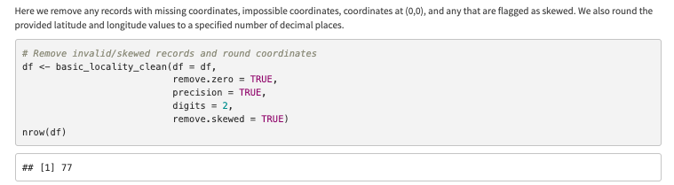
C. Locality Cleaning
basic_locality_clean() is from the package gatoRs
remove.zero = removing (0,0)
precision = changing resolution to match climate layers (0.01 degrees)
remove.skewed = removes any records with skewed coordinates

Slide 9
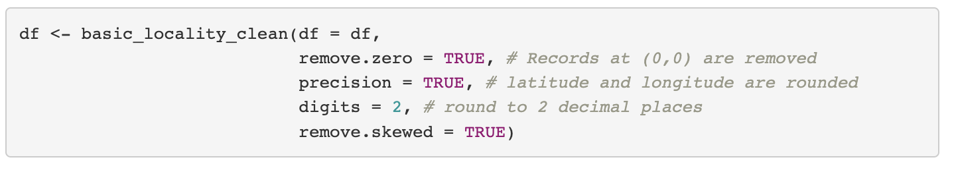
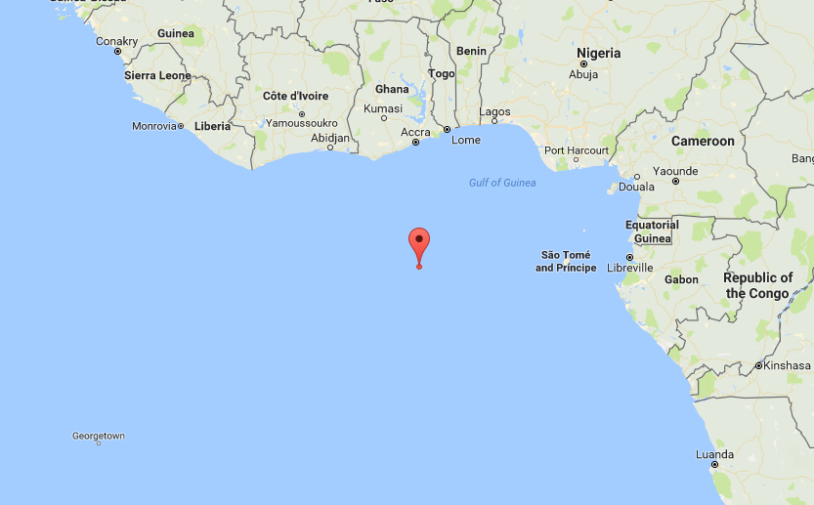
C. Locality Cleaning
Only retains records in the column lat/long that are not (!=) equal to 0.00
“There’s no place like 0,0”
  (in the middle of the ocean)

Slide 10
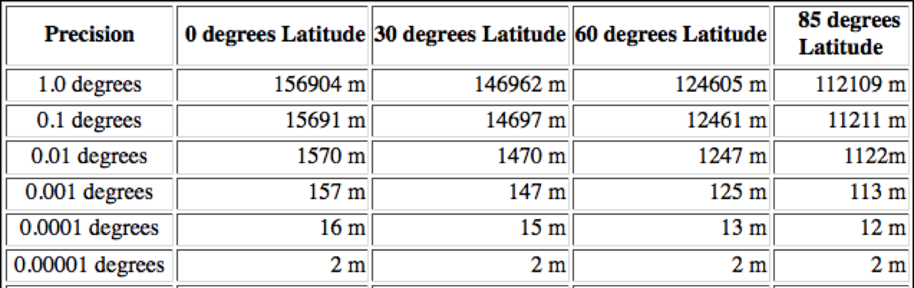
C. Locality Cleaning
Our climate layers are 30 arc-sec resolution or about 1000 meters

Slide 11
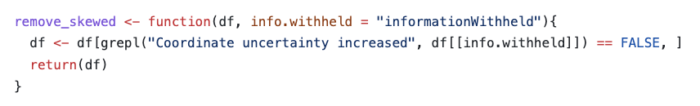
C. Locality Cleaning
The skewed records can be identified with the function based on the ‘InformationWitheld’ column

Slide 12
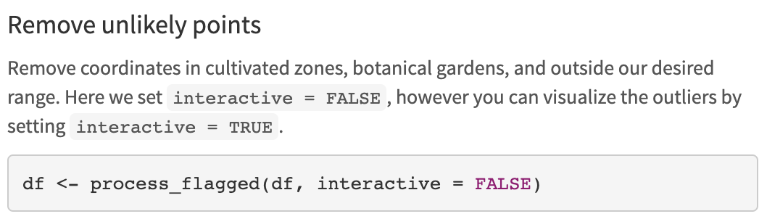
D. Flag and Filter Cultivated Records
process_flagged removes points in a radius around biodiversity institutions (including museums)
  Places that records were not occurring naturally
Zizka et al. 2019. CoordinateCleaner: Standardized cleaning of occurrence records from biological collection databases. Methods in Ecology and Evolution.

Slide 13
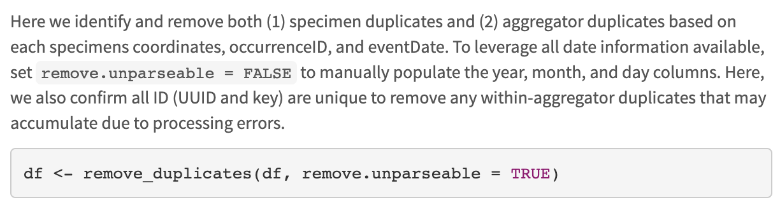
E. Duplicate Removal
parsedate is a beautiful package that parses dates – but it only parses dates after 1970!
  remove.unparable = FALSE to confirm unique records manually
Remove duplicates from overlap between databases

Slide 14
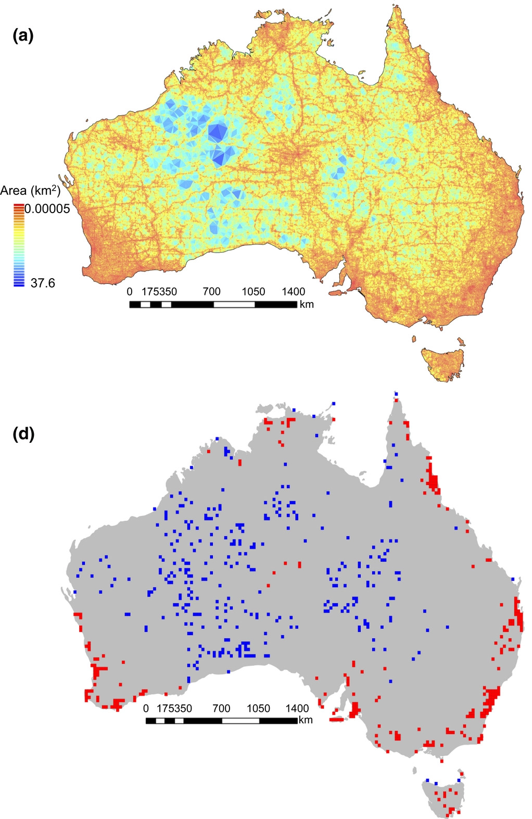
F/G. Spatial Deduplication and Thinning
Sampling bias for
857,245 records
Collection efforts can lead to clustering of points
  Infrastructure (roads, herbaria, etc.)
  Taxon bias (more common/charismatic)
  Temporal bias (periods of high/low effort)
See an under/overrepresentation of areas
Filtering is a procedure to reduce the clustering of species records
  Collection efforts can lead to clustering of points in overrepresented areas
Daru et al. 2017. Widespread sampling biases in herbaria revealed from large-scale digitization. New Phytologist.
Notes:
Filtering is a procedure to reduce the clustering of species records .
Figure shows hotspots related to

Slide 15
F/G. Spatial Deduplication and Thinning
After filtering, there may still be spatial autocorrelation
  Records occurring in close proximity have higher environmental similarity
  This can be accounted for by data partitioning
Distance
Env. Similarity
Sillero N. and A. M. Barbosa. 2020. Common mistakes in ecological niche models. International Journal of Geographical Information Science.
Notes:
Filtering is a procedure to reduce the clustering of species records

Slide 16
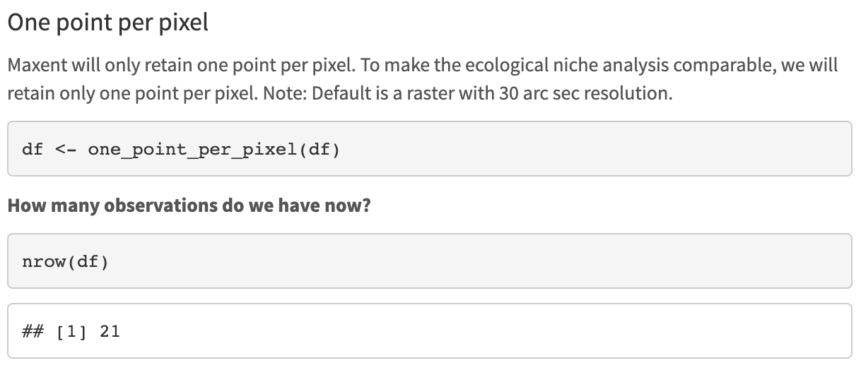
F. Spatial Deduplication
After retaining one point per pixel, our example has 21 observations
Notes:
Filtering is a procedure to reduce the clustering of species records

Slide 17
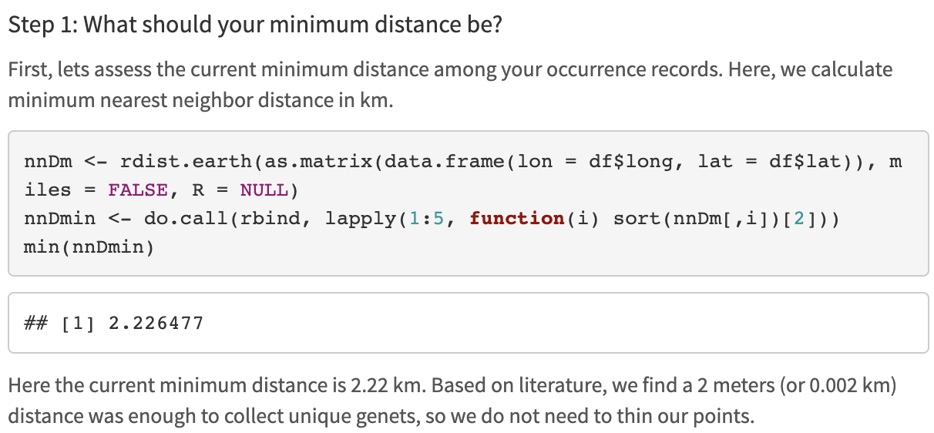
G. Spatial Thinning
rdist.earth can be used to look at nearest neighbor distance in kilometers
do.call applies to a list, rbind binds rows, and the sort is set up to select the lowest value
We want to look at the min distance between points remaining BY SPECIES

Slide 18
G. Spatial Thinning
Use spThin function thin for when minimum nearest neighbor distance is smaller than required to collect unique species genets
Set thin.par = minimum nearest neighbor distance
Next, the function calculates pairwise distance between all records
Then:
  1) For each record, IDs the # of occurrence records within the minimum nearest neighbor distance thin.par
  2) One record of those which share the greatest # from (1) is removed at random
  3) Repeat 1 – 2 till no record has a nearest neighbor closer than the minimum nearest neighbor distance thin.par
Aiello-Lammens et al. 2015. spThin: an R package for spatial thinning of species occurrence records for use in ecological niche models. Ecography.

Slide 19
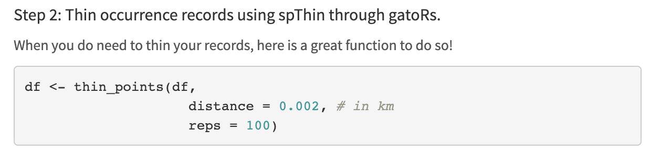
G. Spatial Thinning
Only need to thin records if the minimum nearest neighbor distance is smaller than required to collect unique species genets according to the literature for that species – not necessary for workshop examples

Slide 20
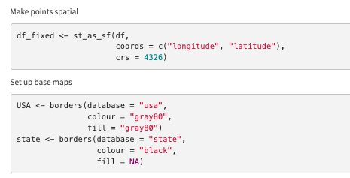
H. Static Map of Cleaned Points
Make points spatial using st_as_sf
  crs = 4326 is WGS84
Using the function borders from the package ggplot2, we download USA country and states basemaps to plot points onto

Slide 21
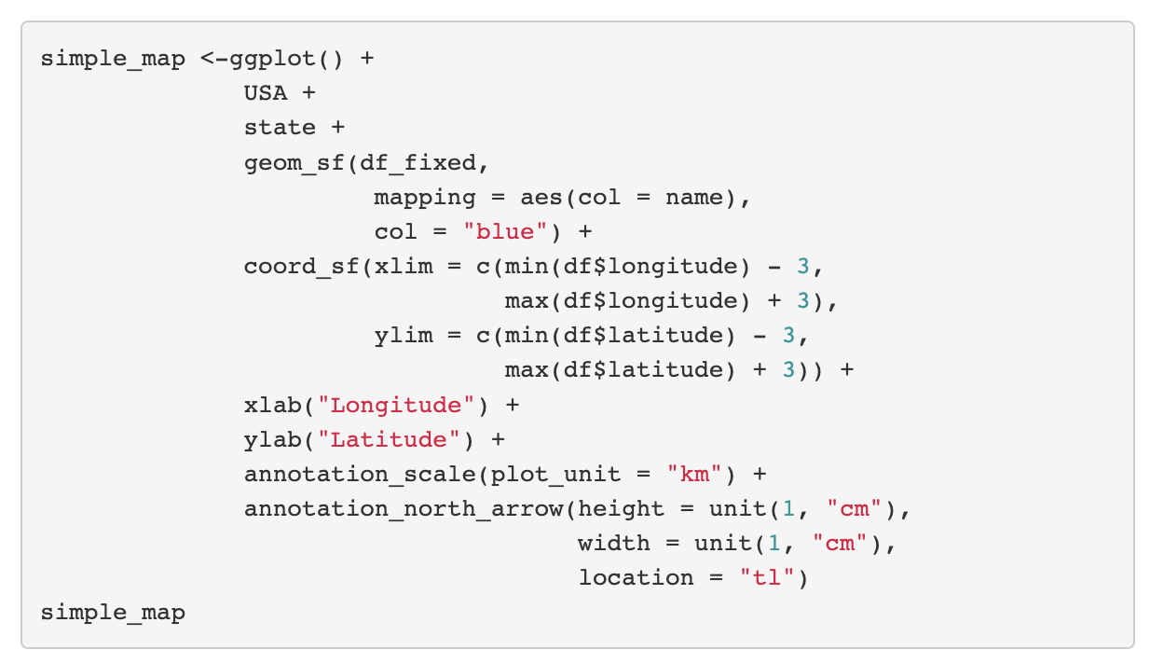
H. Static Map of Cleaned Points
Good for publications and visually confirming data was cleaned properly
1. Add basemaps
2. Add points
3. Zoom in
4. Fix axis labels
5. Add scale and North arrow

Slide 22
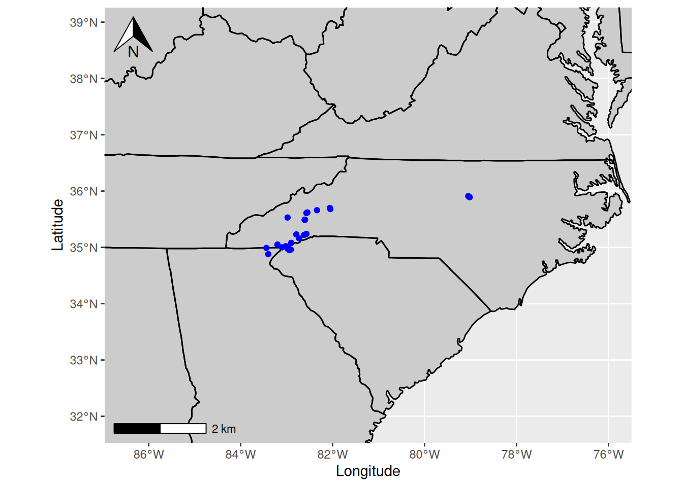
H. Static Map of Cleaned Points

Slide 23
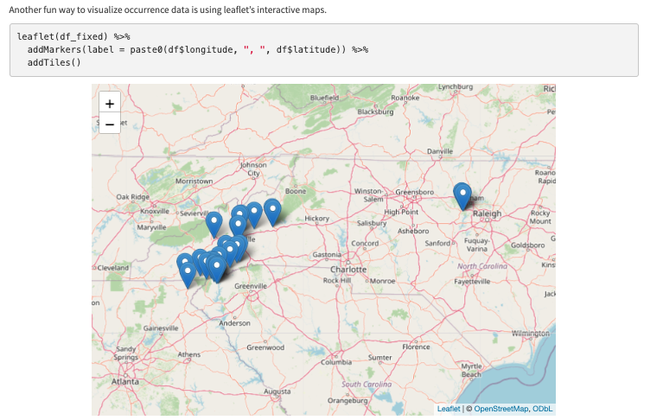
I. Interactive Map with Leaflet

Slide 24
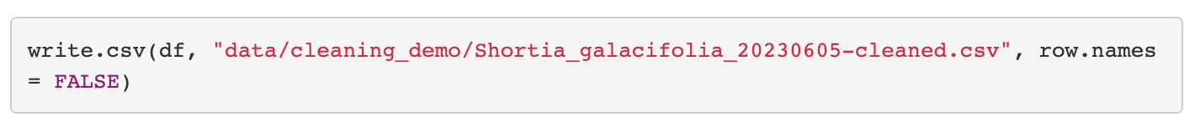
J. Saved Cleaned.csv
Now that data is cleaned, save as a new csv file to use for next steps

Slide 25
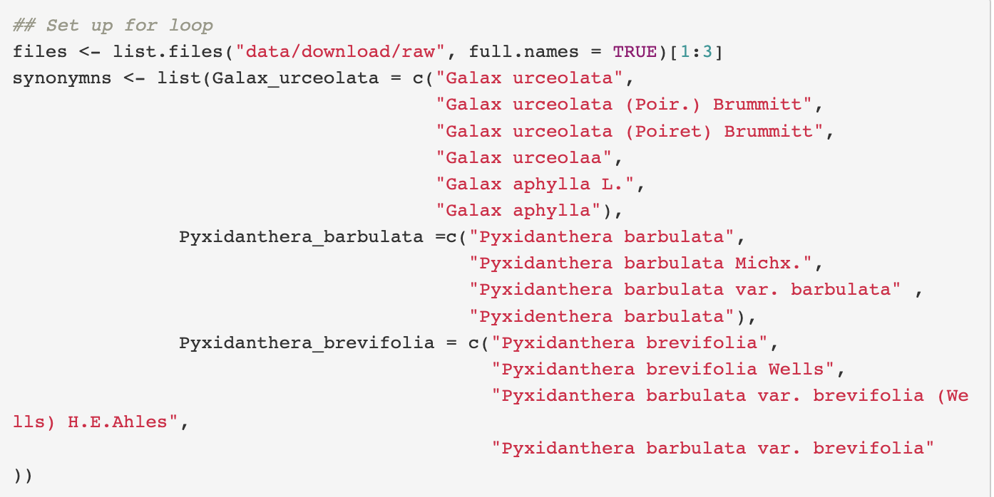
K. Repeat for All Taxa
1. Create list of files with paths
2. Create list of synonyms

Slide 26
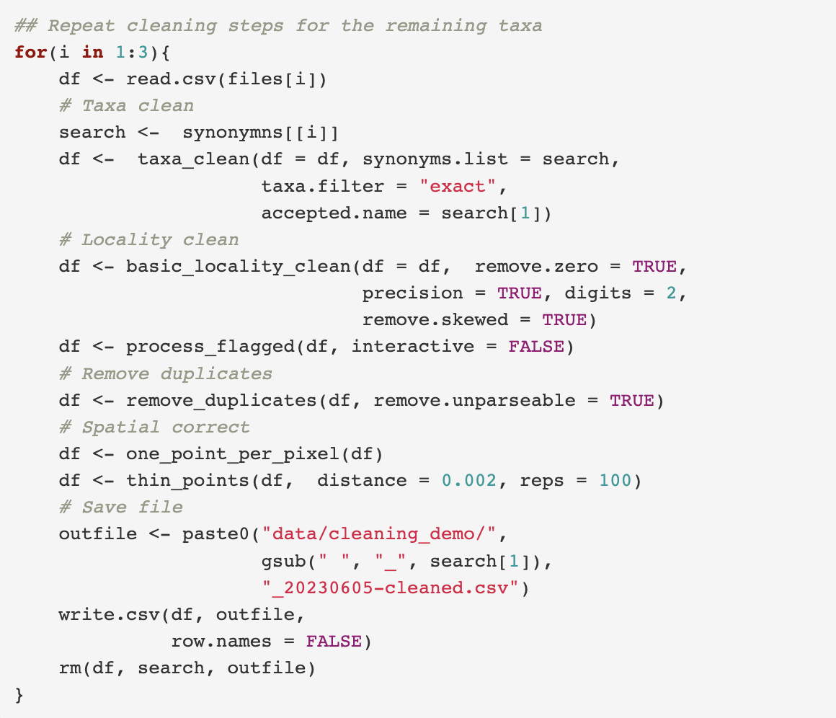
K. Repeat for All Taxa
0. Read in downloaded data
Resolve taxon names
Clean localities
  Precision
  Remove impossible points
    Most common coordinate: (0.00, 0.00)
    Cultivated zones, botanical gardens, museums, etc.
Remove duplicates
Spatial correction
Visualize
Save cleaned.csv

Slide 27
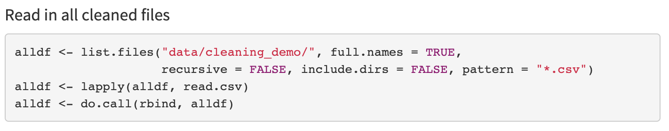
L. Make Maxent Ready

Slide 28
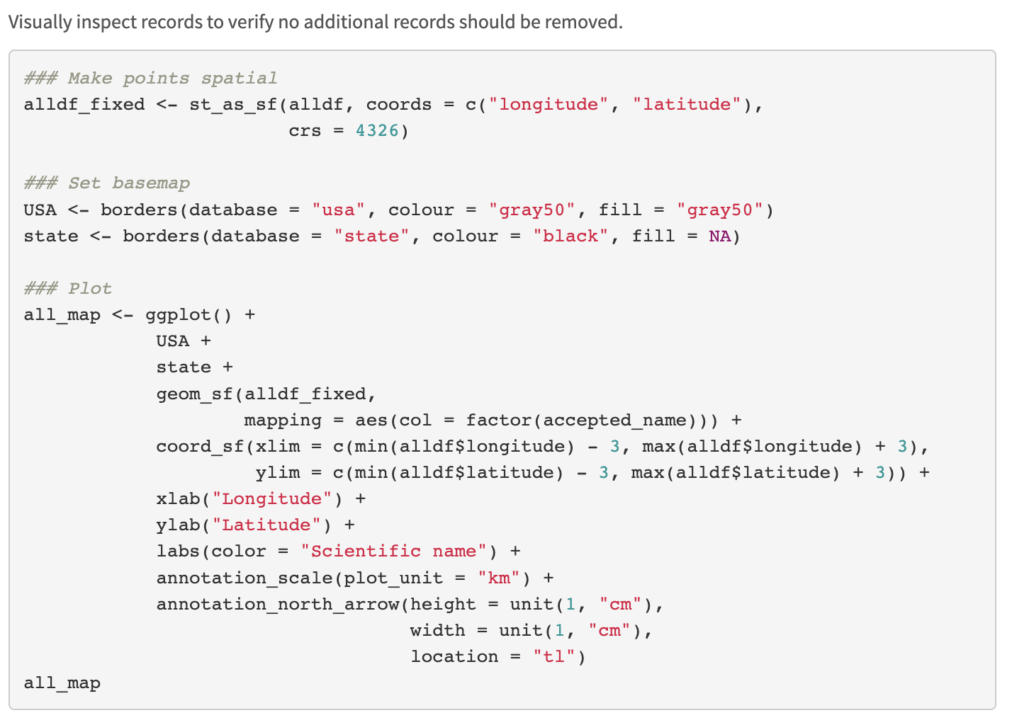
M. Map All Records

Slide 29
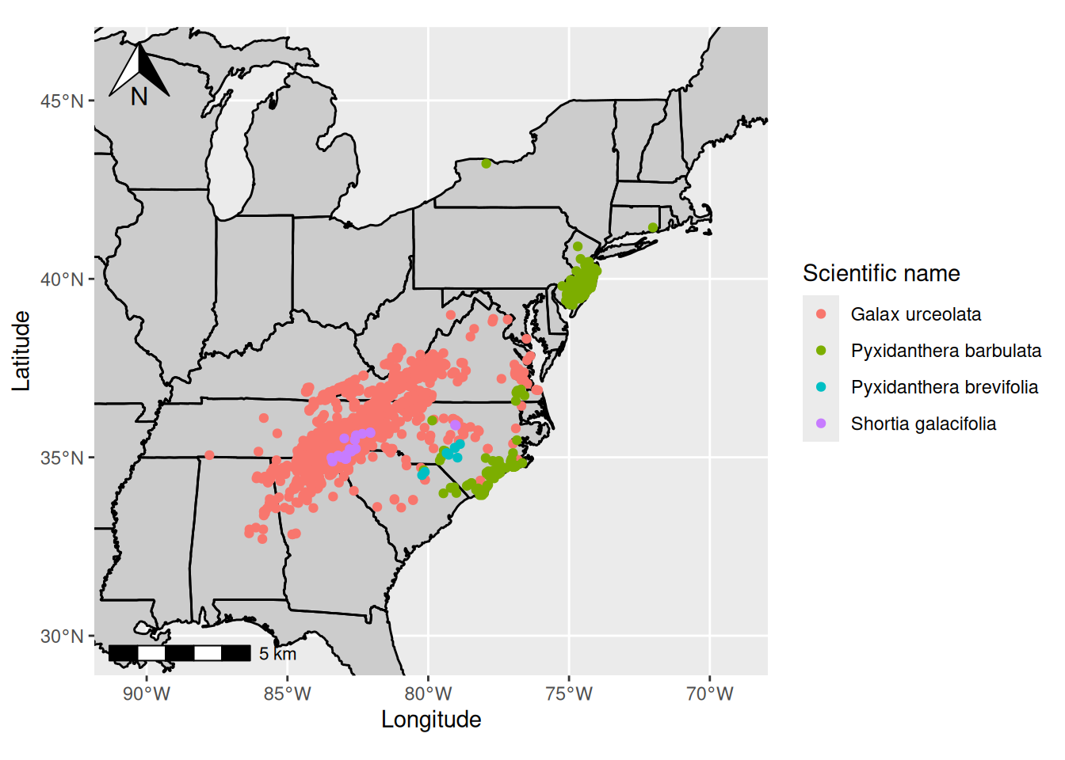

Slide 30
Minimum Occurrence Records
Your points should represent the environmental variability true to your species
  Too few points may not classify your species’ suitable conditions properly
It is not clear the minimum number of points needed
  Might be dependent on the extent of the study area
3, 4, or 5 have been suggested
  5 per environmental variable has also been suggested
  More environmental variables may not significantly change the minimum sample size needed (see study below)
Proosdij et al. 2016. Minimum required number of specimen records to develop accurate species distribution models. Ecography.

Slide 31
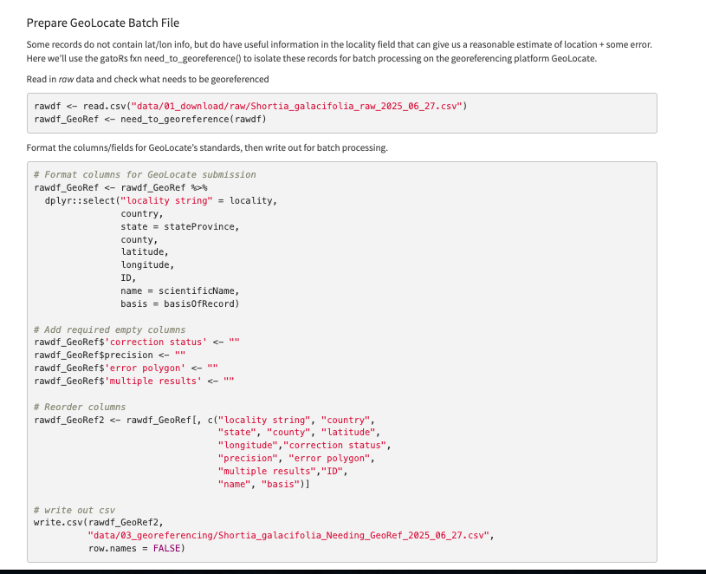
N. Georeferencing

