Slide 1




Environmental Variables &
Data Exploration
University of Florida
Sarah Ellen Strickland

Slide 2
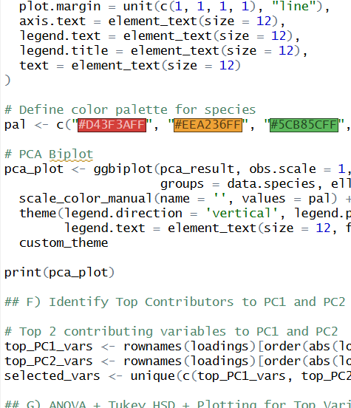
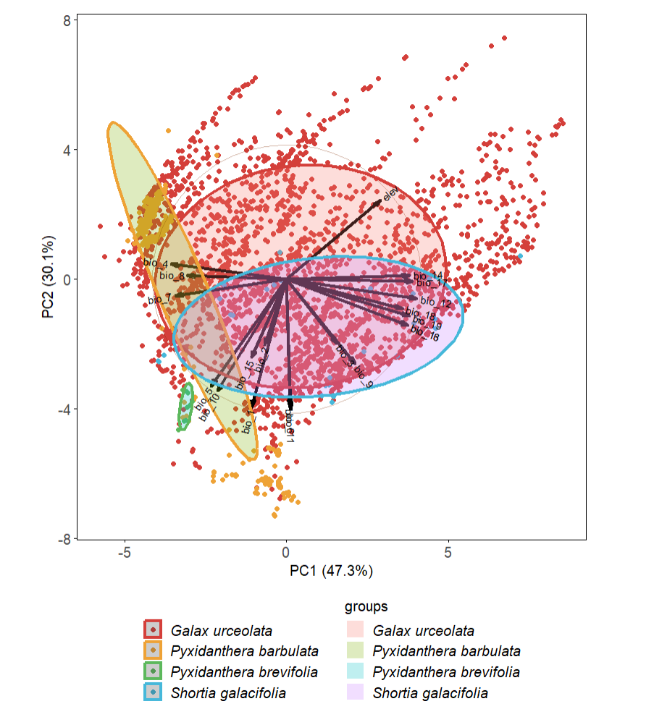
Agenda
Finding Climate/Abiotic Data Layers
Extracting Climatic Variables
PCA
ANOVA
Coding Practical
Notes:
Want to adjust this to make clear – talking about climate/data layer sources

Slide 3
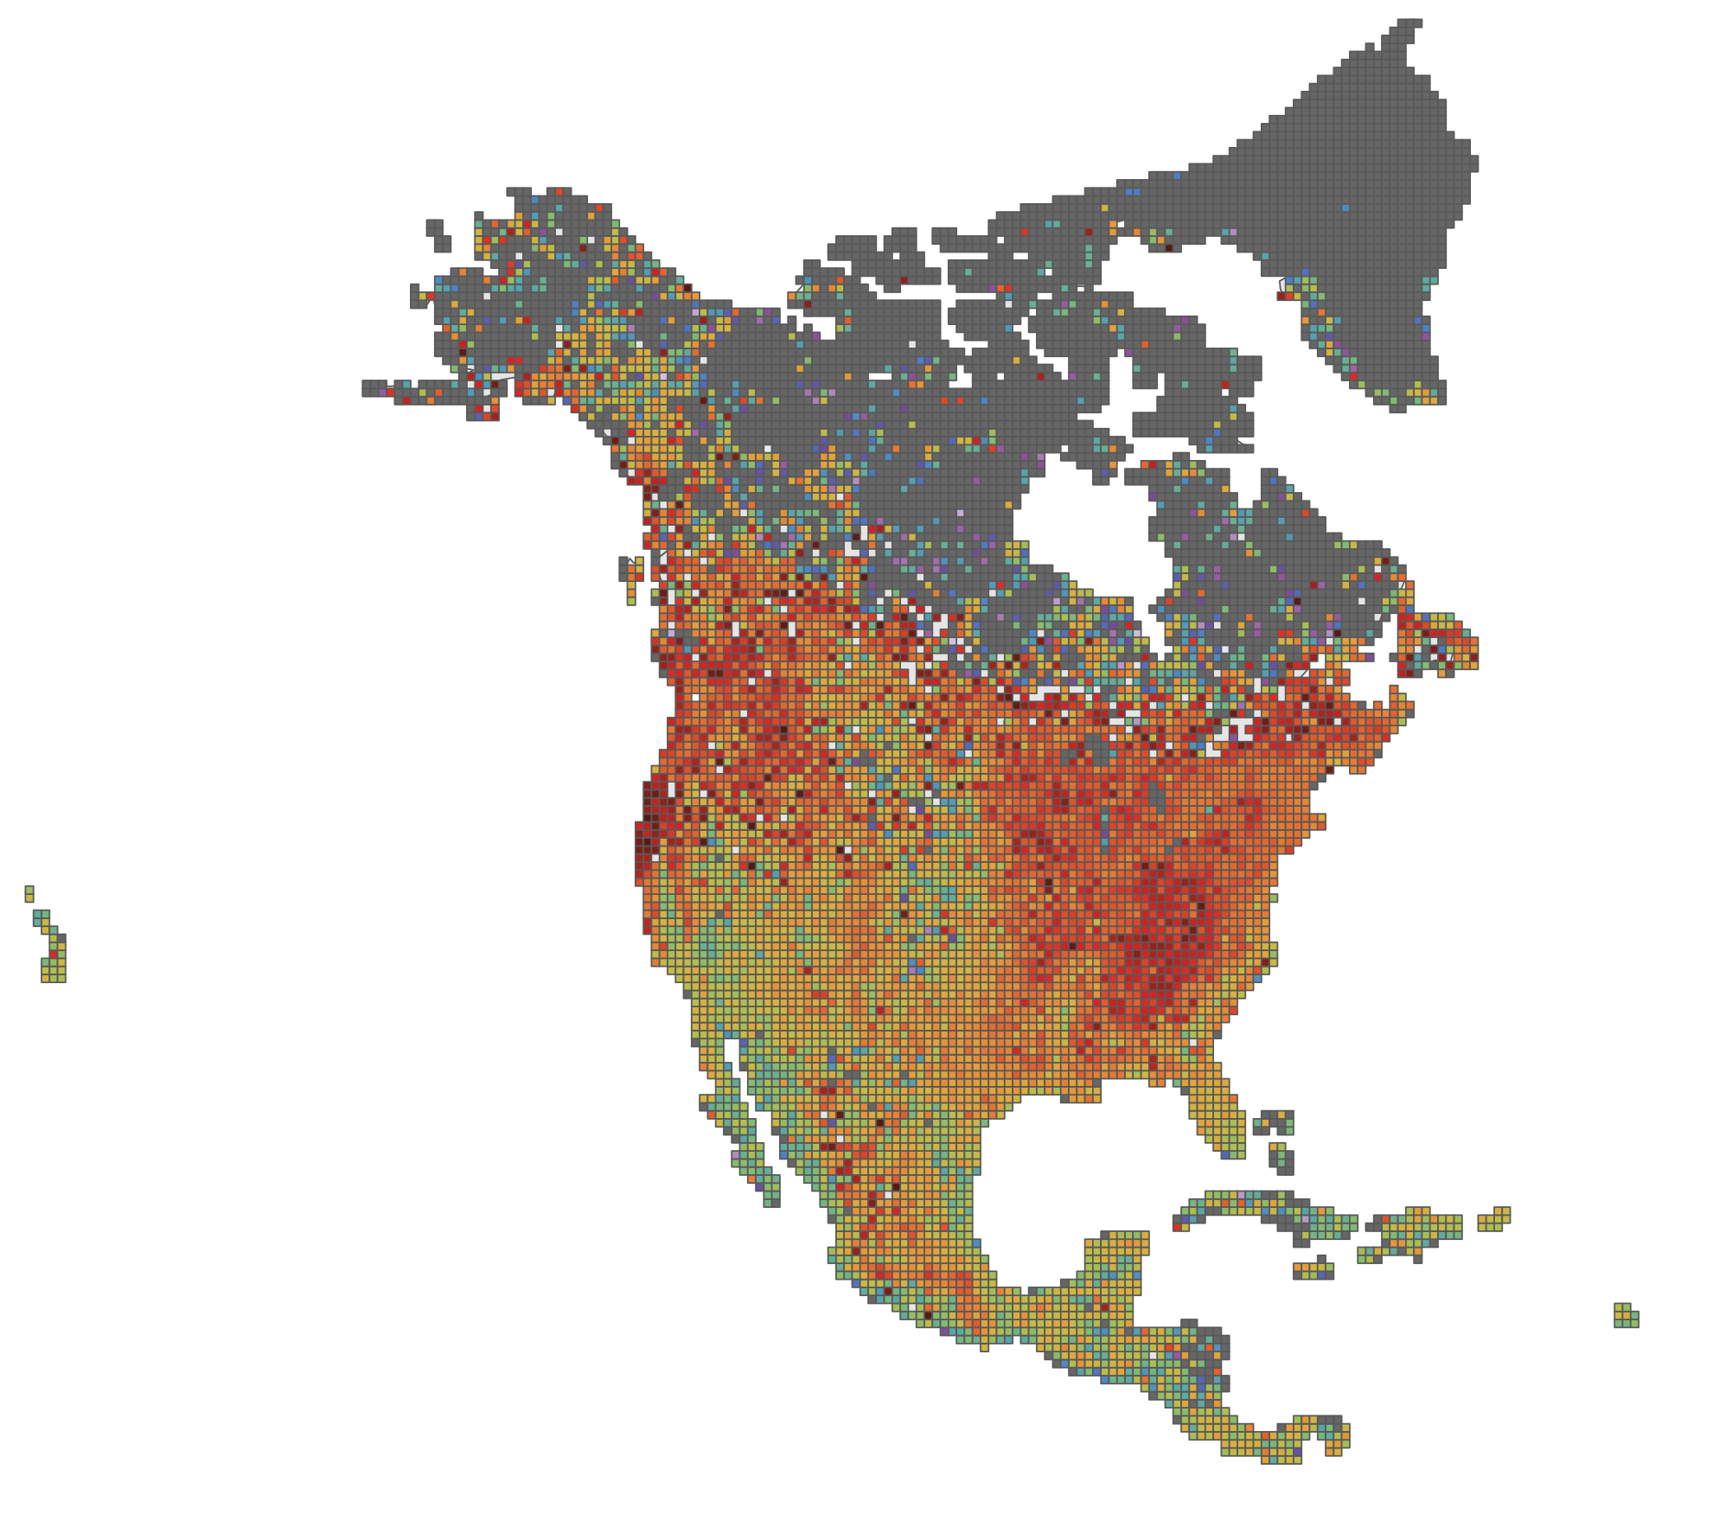
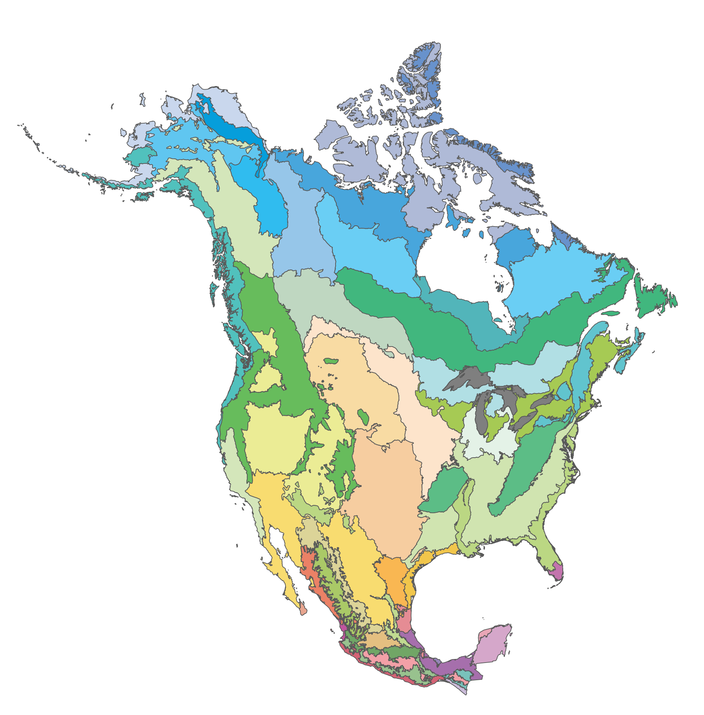
Climatic Variables/Abiotic Data Layers
Rasters
Vectors
“grid data”
“shape data”
Notes:
2 general types of data layers
rasters - store information in a grid
Vectors – store information in a shape

Slide 4
Climatic Variables/Abiotic Data Layers
Rasters
Vectors
“shape data”
“grid data”
Notes:
Most of the layers we are going to be looking at/talking about today are rasters

Slide 5
Climatic Variables/Abiotic Data Layers
Rasters
Raster Resolution Note:
Arc-seconds/minutes
  Easy to work with latitude/longitude data
  Not equal-area
  30 seconds ≈ 1km²
“grid data”
Notes:
And one quick note – some of the data layers we’re using/talking about today (such as bioclim) will have resolution information in arc-seconds/minutes
- easy for working with lat/long – so works well with our data ☺
- But worth noting that not perfectly equal area – pixels get narrower as move north

Slide 6
Climatic Variables/Abiotic Data Layers
What?
Where?
When?
Temperature
Precipitation
Soil
Vegetation
Land use
Local
USA
North America
Global
Past
Current
Future
Notes:
When deciding where to pull data from, want to think about what type of data you want and the scale and time period you want it at

Slide 7
Climatic/Abiotic Data Layer Sources
Worldclim2
PRISM
Soil Grids
Web Soil Survey
What?
Where?
When?
19 bioclimatic variables
Global
Past, Current, Future
Weather data
United States
Past, Current
Soil properties
Global
Current
Soil characteristics
United States
Current

Slide 8

Data Layer Sources: WorldClim(2)
https://www.worldclim.org
What?
19 Bioclimatic variables
  Derived from monthly temperature & rainfall values
  Multiple resolution options!
Where?
Global land area
  Except Antarctica
When?
Past, Current, and Future projections

Slide 9
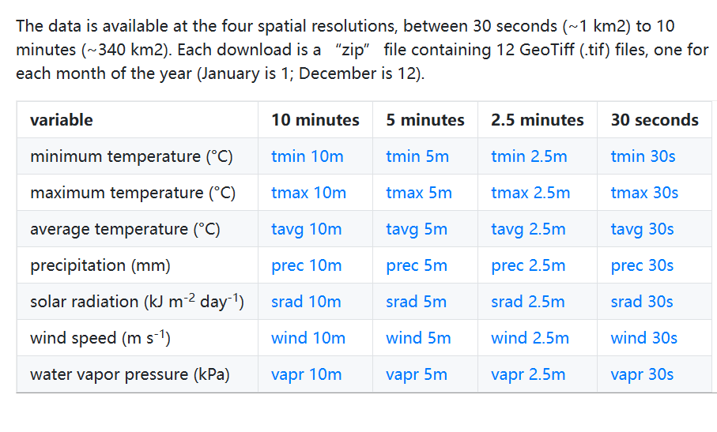
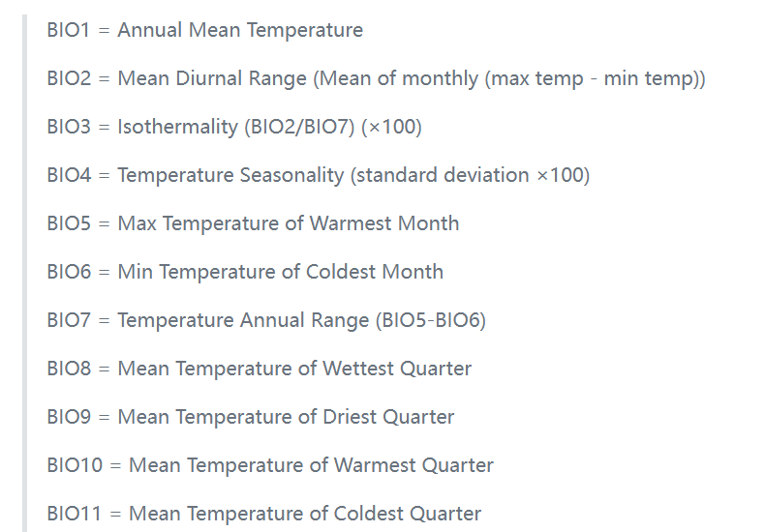
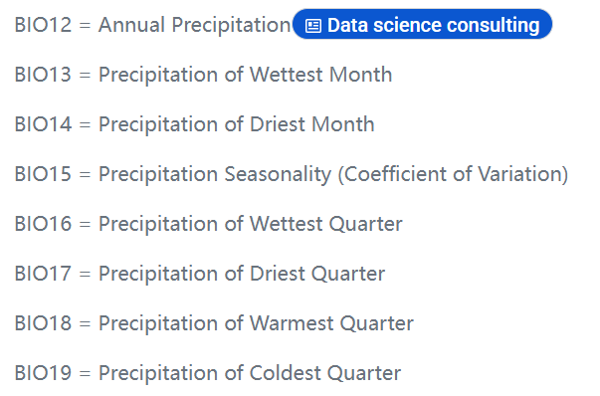
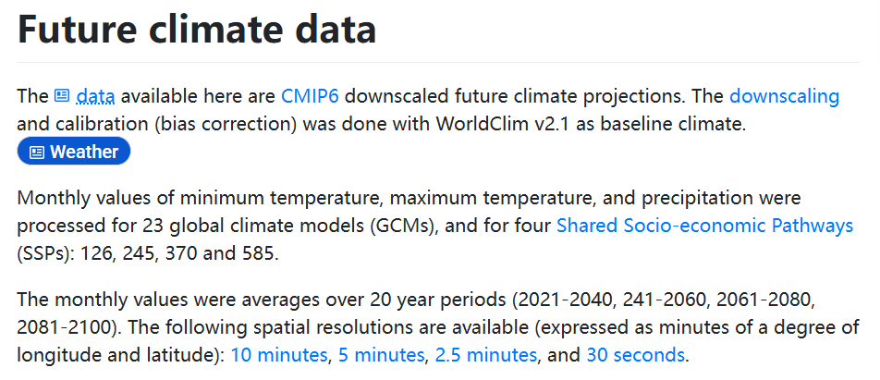
Data Layer Sources: WorldClim(2)
https://www.worldclim.org/data/bioclim.html
What?
19 Bioclimatic variables
  Derived from monthly temperature & rainfall values
  Multiple resolution options!
Where?
Global land area
  Except Antarctica
When?
Past, Current, and Future projections

Slide 10

Data Layer Sources: PRISM
https://www.prism.oregonstate.edu/
What?
Precipitation, temperature, vapor pressure deficit, dewpoint, solar irradiance
  More precise than WorldClim
  Lots of tools to explore!
Where?
United States only
When?
1895 - present

Slide 11
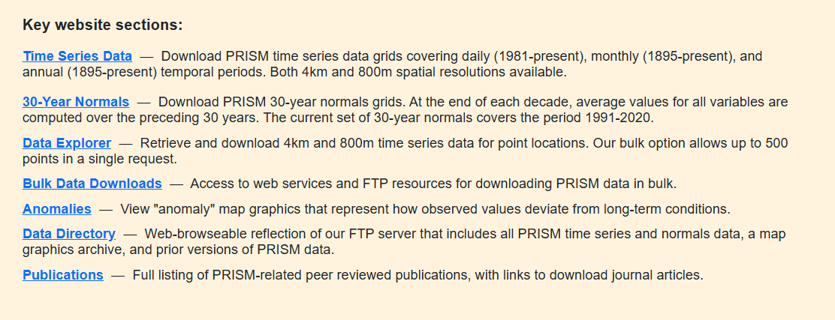
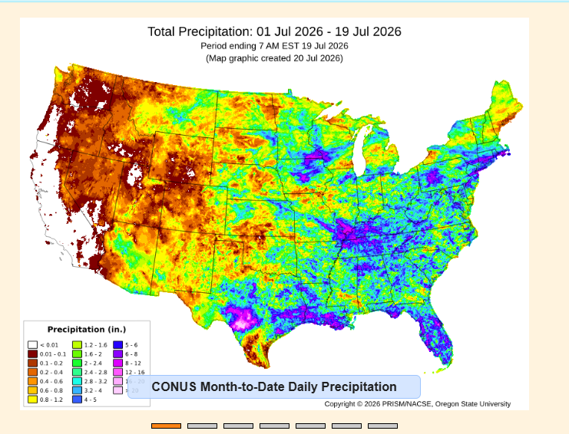
Data Layer Sources
PRISM
What?
Precipitation, temperature, vapor pressure deficit, dewpoint, solar irradiance
  More precise than WorldClim
  Lots of tools to explore!
Where?
United States only
When?
1895 - present

Slide 12

Data Layer Sources: SoilGrids
https://soilgrids.org/
What?
8 physical, 4 chemical, and 2 derived soil properties
  ~ 250 m resolution
  Include predicted values (and uncertainty layers)
Where?
Global soils
When?
Current day

Slide 13
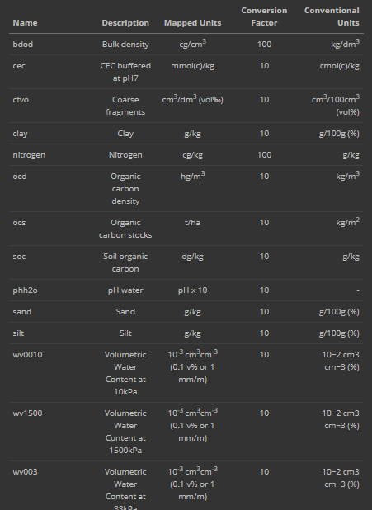
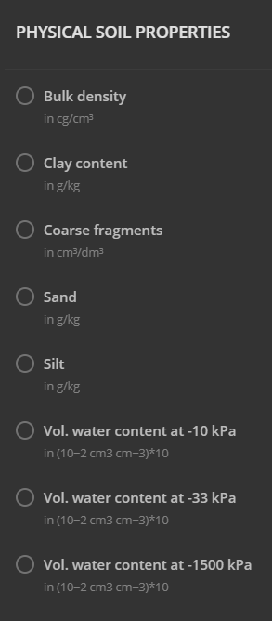
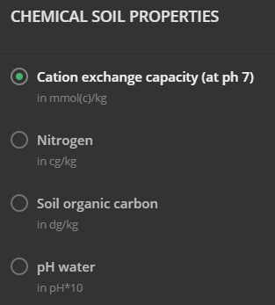
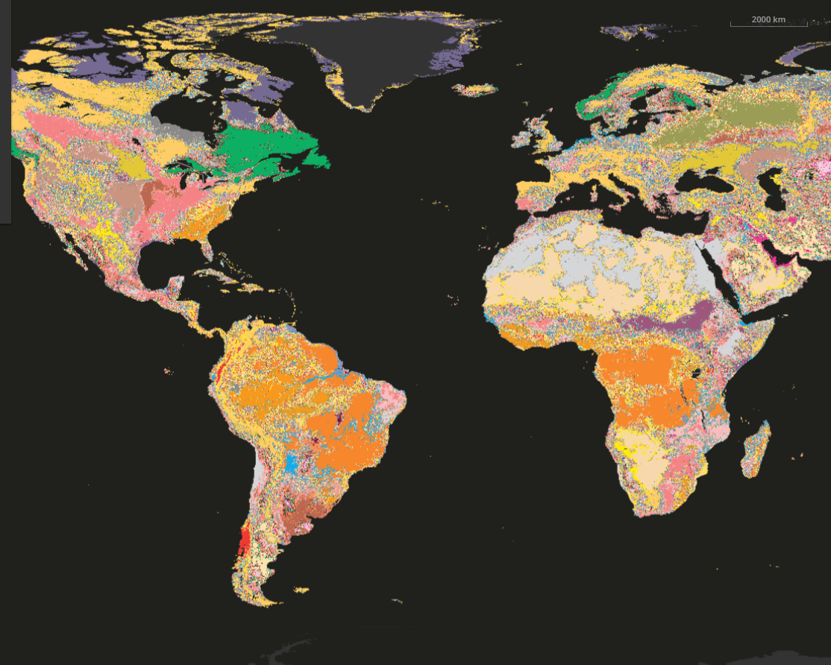
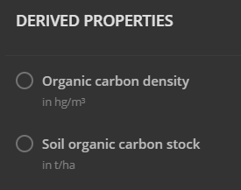
Data Layer Sources: SoilGrids
https://soilgrids.org/
What?
8 physical, 4 chemical, and 2 derived soil properties
  ~ 250 m resolution
  Include predicted values (and uncertainty layers)
Where?
Global soils
When?
Current day

Slide 14

Data Layer Sources: Web Soil Survey
https://websoilsurvey.sc.egov.usda.gov/app/
What?
Site-specific soil characterizations
  Much finer resolution, but hard to get large areas
  Need to Define Area of Interest (vectors, not a raster)
Where?
United States only
When?
Current day

Slide 15
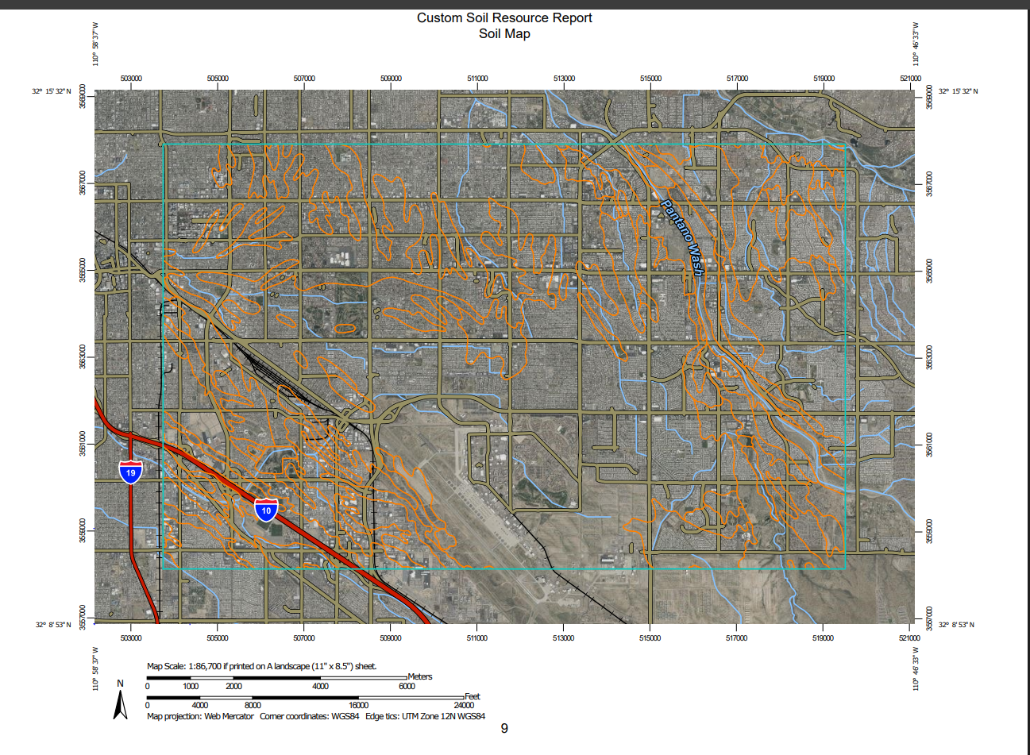
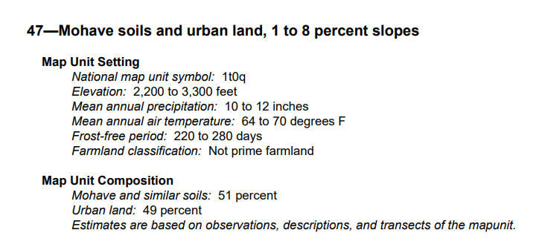
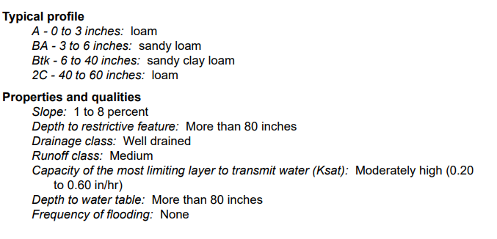
Data Layer Sources: Web Soil Survey
https://websoilsurvey.sc.egov.usda.gov/app/
What?
Site-specific soil characterizations
  Much finer resolution, but hard to get large areas
  Need to Define Area of Interest (vectors, not a raster)
Where?
United States only
When?
Current day

Slide 16

Data Layer Sources: EPA
https://www.epa.gov/enviroatlas
What?
Air quality, bodies of water, land use, boundaries, housing, and much more
  Interactive tool and downloadable data
  Selected high-population regions at higher resolution
Where?
United States only
When?
Current day
  some layers may have historical data

Slide 17

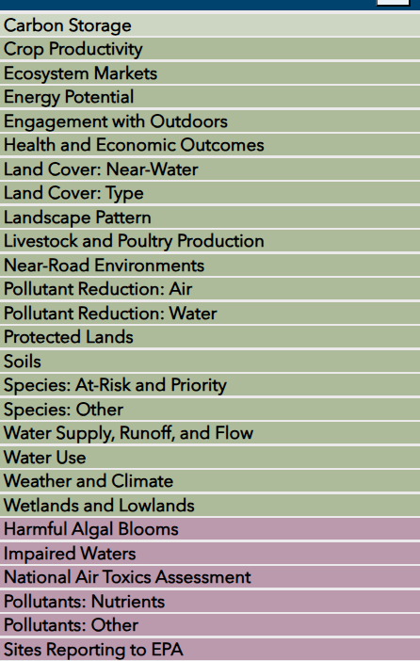
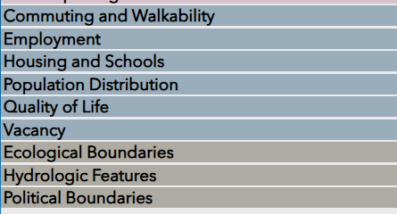
Data Layer Sources: EPA
https://www.epa.gov/enviroatlas
Ecosystem Services and Biodiversity
What?
Air quality, bodies of water, land use, boundaries, housing, and much more
  Interactive tool and downloadable data
  Selected high-population regions at higher resolution
Where?
United States only
Current day
  some layers may have historical data
When?
Pollution Sources and Impacts
People and Built Spaces
Boundaries

Slide 18






Other Data Layer Sources
Paleoclimate data
  NOAA/NCEI: ncei.noaa.gov/products/paleoclimatology
  PMIP: pmip.lsce.ipsl.fr
  PaleoClim: paleoclim.org
  Aquatic Environments
  AquaMaps: aquamaps.org/main/envt_data.php
    Hourly or Daily data
      Daymet: daymet.ornl.gov
      OGIMET: ogimet.com

Slide 19
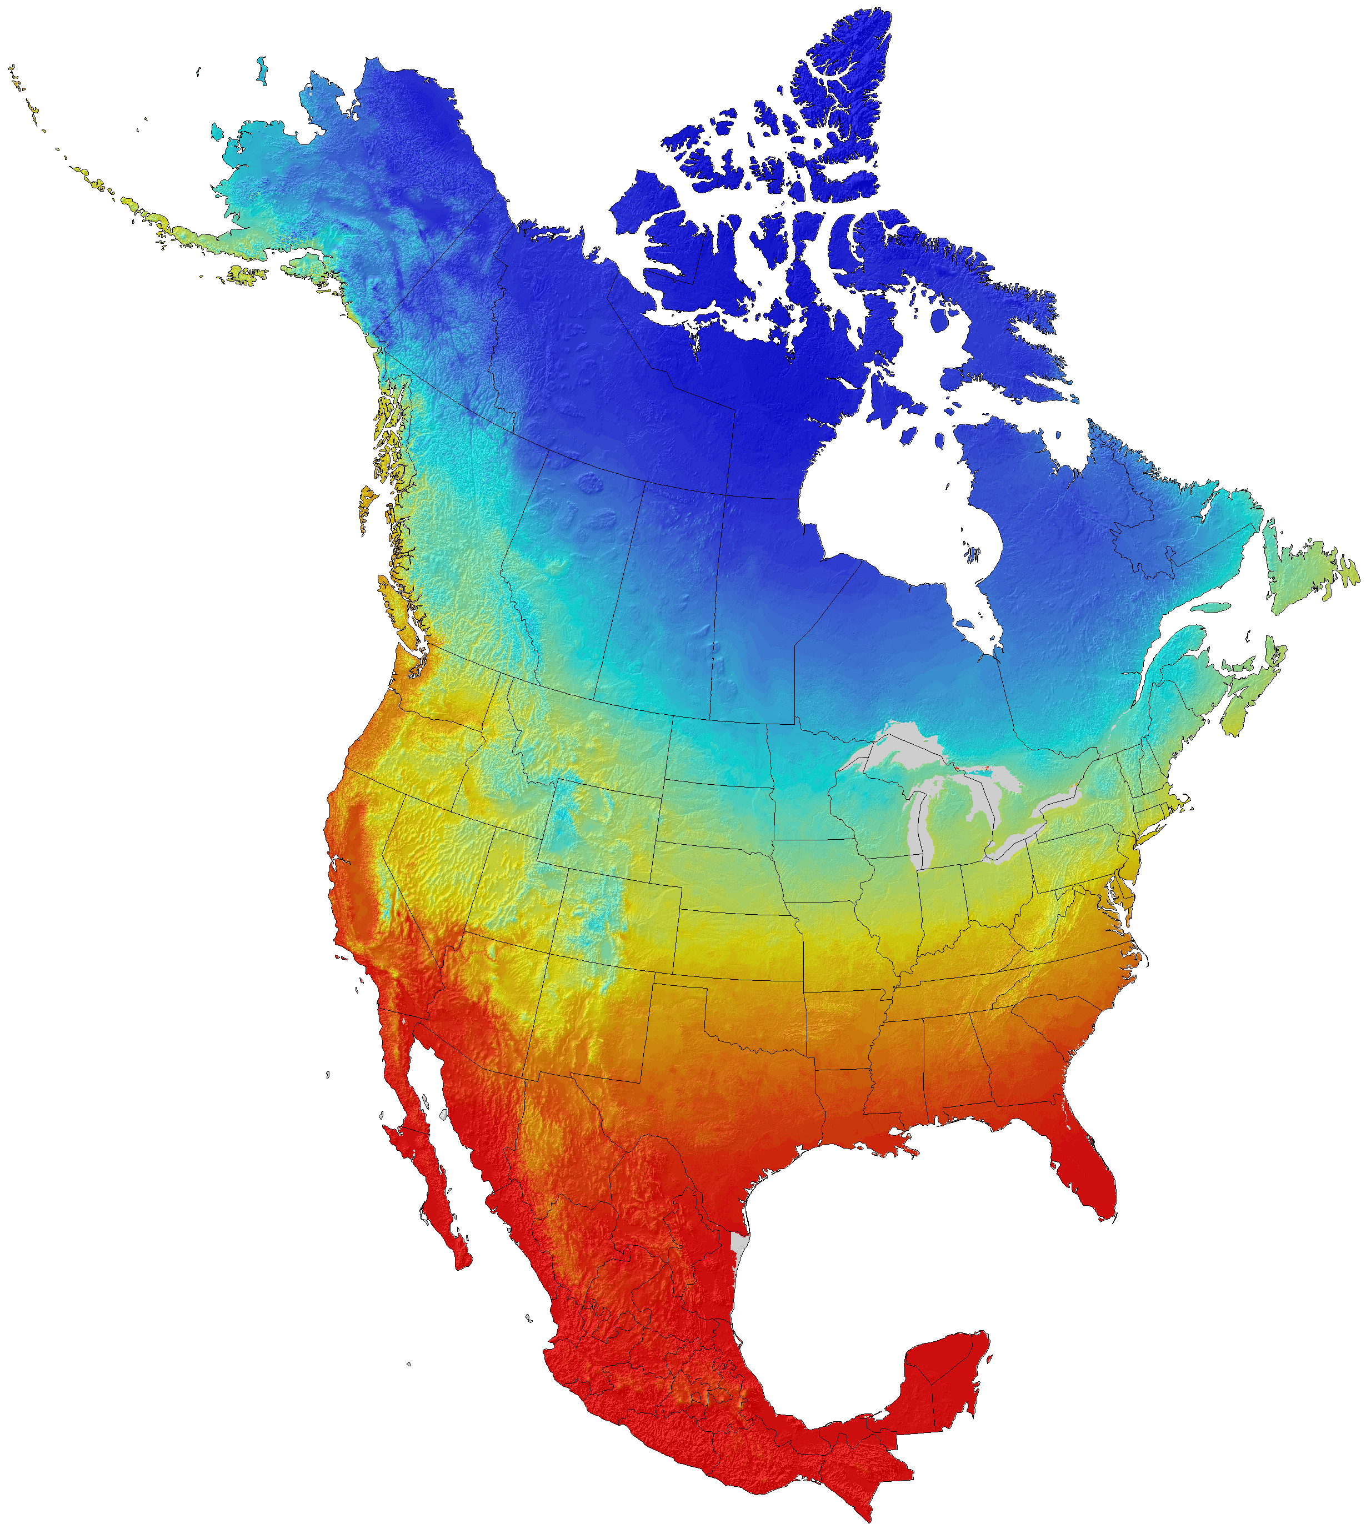
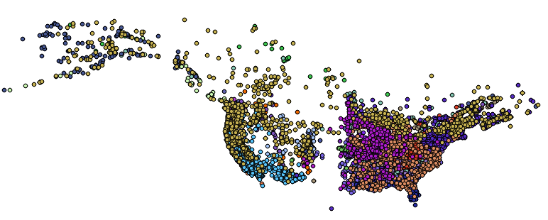
Data Exploration
Goal:
Examine the data to determine variables of interest, possible issues, and developing trends
Using:
Cleaned, georeferenced occurrences
Environmental variables of interest (rasters)

Slide 20
Extracting Climatic Variables at Occurrences
bioclim1
bioclim2
bioclim3
Stack the rasters
y
bioclim3
bioclim2
bioclim1
z
x
Notes:
So first, we get the raster for our variables of interest - and we’re going to load them in as a stack – like cake layers

Slide 21
Extracting Climatic Variables at Occurrences
y
bioclim3
bioclim2
bioclim1
z
x

Slide 22
Extracting Climatic Variables at Occurrences
bioclim3
bioclim2
bioclim1
Extract data from raster for each occurrence point
Notes:
So we determine the grid cells that correspond to our occurrence points

Slide 23
Extracting Climatic Variables at Occurrences
bioclim1
bioclim2
bioclim3
bioclim3
z
bioclim2
bioclim1
Extract data from raster for each occurrence point
Notes:
And extract that value…

Slide 24
Principal Component Analysis
bioclim1
bioclim2
bioclim3
bioclim3
bioclim2
bioclim1
Notes:
Okay – so now we have a dataframe with several variables for each observation….
However, when we go to graph it…. It can be kind of hard to visualize…

Slide 25
Principal Component Analysis
bioclim2
bioclim3
bioclim1
Notes:
So… what the PCA is going to do is simplify this multi-dimensional plot by…

Slide 26
Principal Component Analysis
bioclim2
bioclim3
bioclim1
Notes:
Reducing it down to the two dimensions that allow us to visualize the most variation

Slide 27
Principal Component Analysis
bioclim2
bioclim3
bioclim1
Notes:
Reducing it down to the two dimensions that allow us to visualize the most variation

Slide 28
Principal Component Analysis
bioclim2
bioclim3
Principal Component 2
bioclim1
Principal Component 1
Transforms data into new set of variables, called Principal Components (PCs)
Notes:
These reduced axes are called principal components – so helpfully, the two that let us see the most variation are:
Principal Component 1
Principal Component 2

Slide 29
Principal Component Analysis
bioclim2
bioclim3
bioclim1
Loading: How much of each original variable contributes to a Principal Component

Slide 30
Principal Component Analysis
PC2
bioclim2
bioclim3
bioclim1
PC1
Loading: How much of each original variable contributes to a Principal Component (PC)
Notes:
And continuing with the creative naming… the “loading” basically just tells you how much of each axis you “load” into a given principal component

Slide 31
Principal Component Analysis
PC2
PC1:
bioclim2
Variable Loading
Bioclim2 -1.45636
Bioclim1 0.45256
Bioclim3 0.11324
bioclim3
PC2:
Variable Loading
Bioclim3 2.65567
Bioclim1 2.34566
bioclim1
PC1
Loading: How much of each original variable contributes to a Principal Component (PC)
Notes:
And continuing with the creative naming… the “loading” basically just tells you how much of each axis you “load” into a given principal component

Slide 32
Principal Component Analysis
PC2
PC1:
bioclim2
Variable Loading Relative Loading
Bioclim2 -1.45636 72.0%
Bioclim1 0.45256 22.4%
Bioclim3 0.11324 5.6%
2.0221
bioclim3
PC2:
Variable Loading Relative Loading
Bioclim3 2.65567 53.1%
Bioclim1 2.34566 46.9%
5.00133
bioclim1
PC1
Loading: How much of each original variable contributes to a Principal Component (PC)
Can calculate and examine the relative contribution of each climatic variable to each PC
Notes:
Then using the sum of the absolute values for each variable loading, we can calculate the relative contribution (out of 100%) that each variable contributes to each principal component

Slide 33
Principal Component Analysis
PC2
bioclim2
bioclim3
bioclim3
Principal Component 2
bioclim1
bioclim2
bioclim1
Principal Component 1
PC1
Notes:
Okay so this is nice, but when we have more than 3 dimensions, realistically, we’re not going to look at the left-hand side
FIX THE AXSES FOR THE RIGHT SIDE!!!

Slide 34
Principal Component Analysis
PC2
bioclim2
bioclim3
bioclim3
Principal Component 2
bioclim1
bioclim2
bioclim1
Principal Component 1
PC1
Notes:
Okay so this is nice, but when we have more than 3 dimensions, realistically, we’re not going to look at the left-hand side
….
But we still want some “gut check” information about our variables – which the Principal Components on their own don’t give us…. So we add arrow to our PCA plot that represent the axses for the bioclim varriables

Slide 35
Principal Component Analysis
bioclim3
Principal Component 2 (23.4% explained variation)
bioclim1
bioclim2
Principal Component 1 (46.5% explained variation)
Notes:
When we compress to two dimensions, we do lose some information…. So the axses will also tell you how much of the variation in the data each axsis explains…. And then we can draw rings that represent where most of the variation lies for each group

Slide 36
Principal Component Analysis (PCA)
Reading PCAs:
Points: observations
Arrows: environmental variables
Ellipse groupings: taxon
bioclim3
Principal Component 2 (23.4% explained variation)
bioclim1
PCAs:
Summarize many environmental variables into PCs
Reveal groupings that are not obvious in the raw data
bioclim2
Principal Component 1 (46.5% explained variation)
Notes:
So… in short

Slide 37
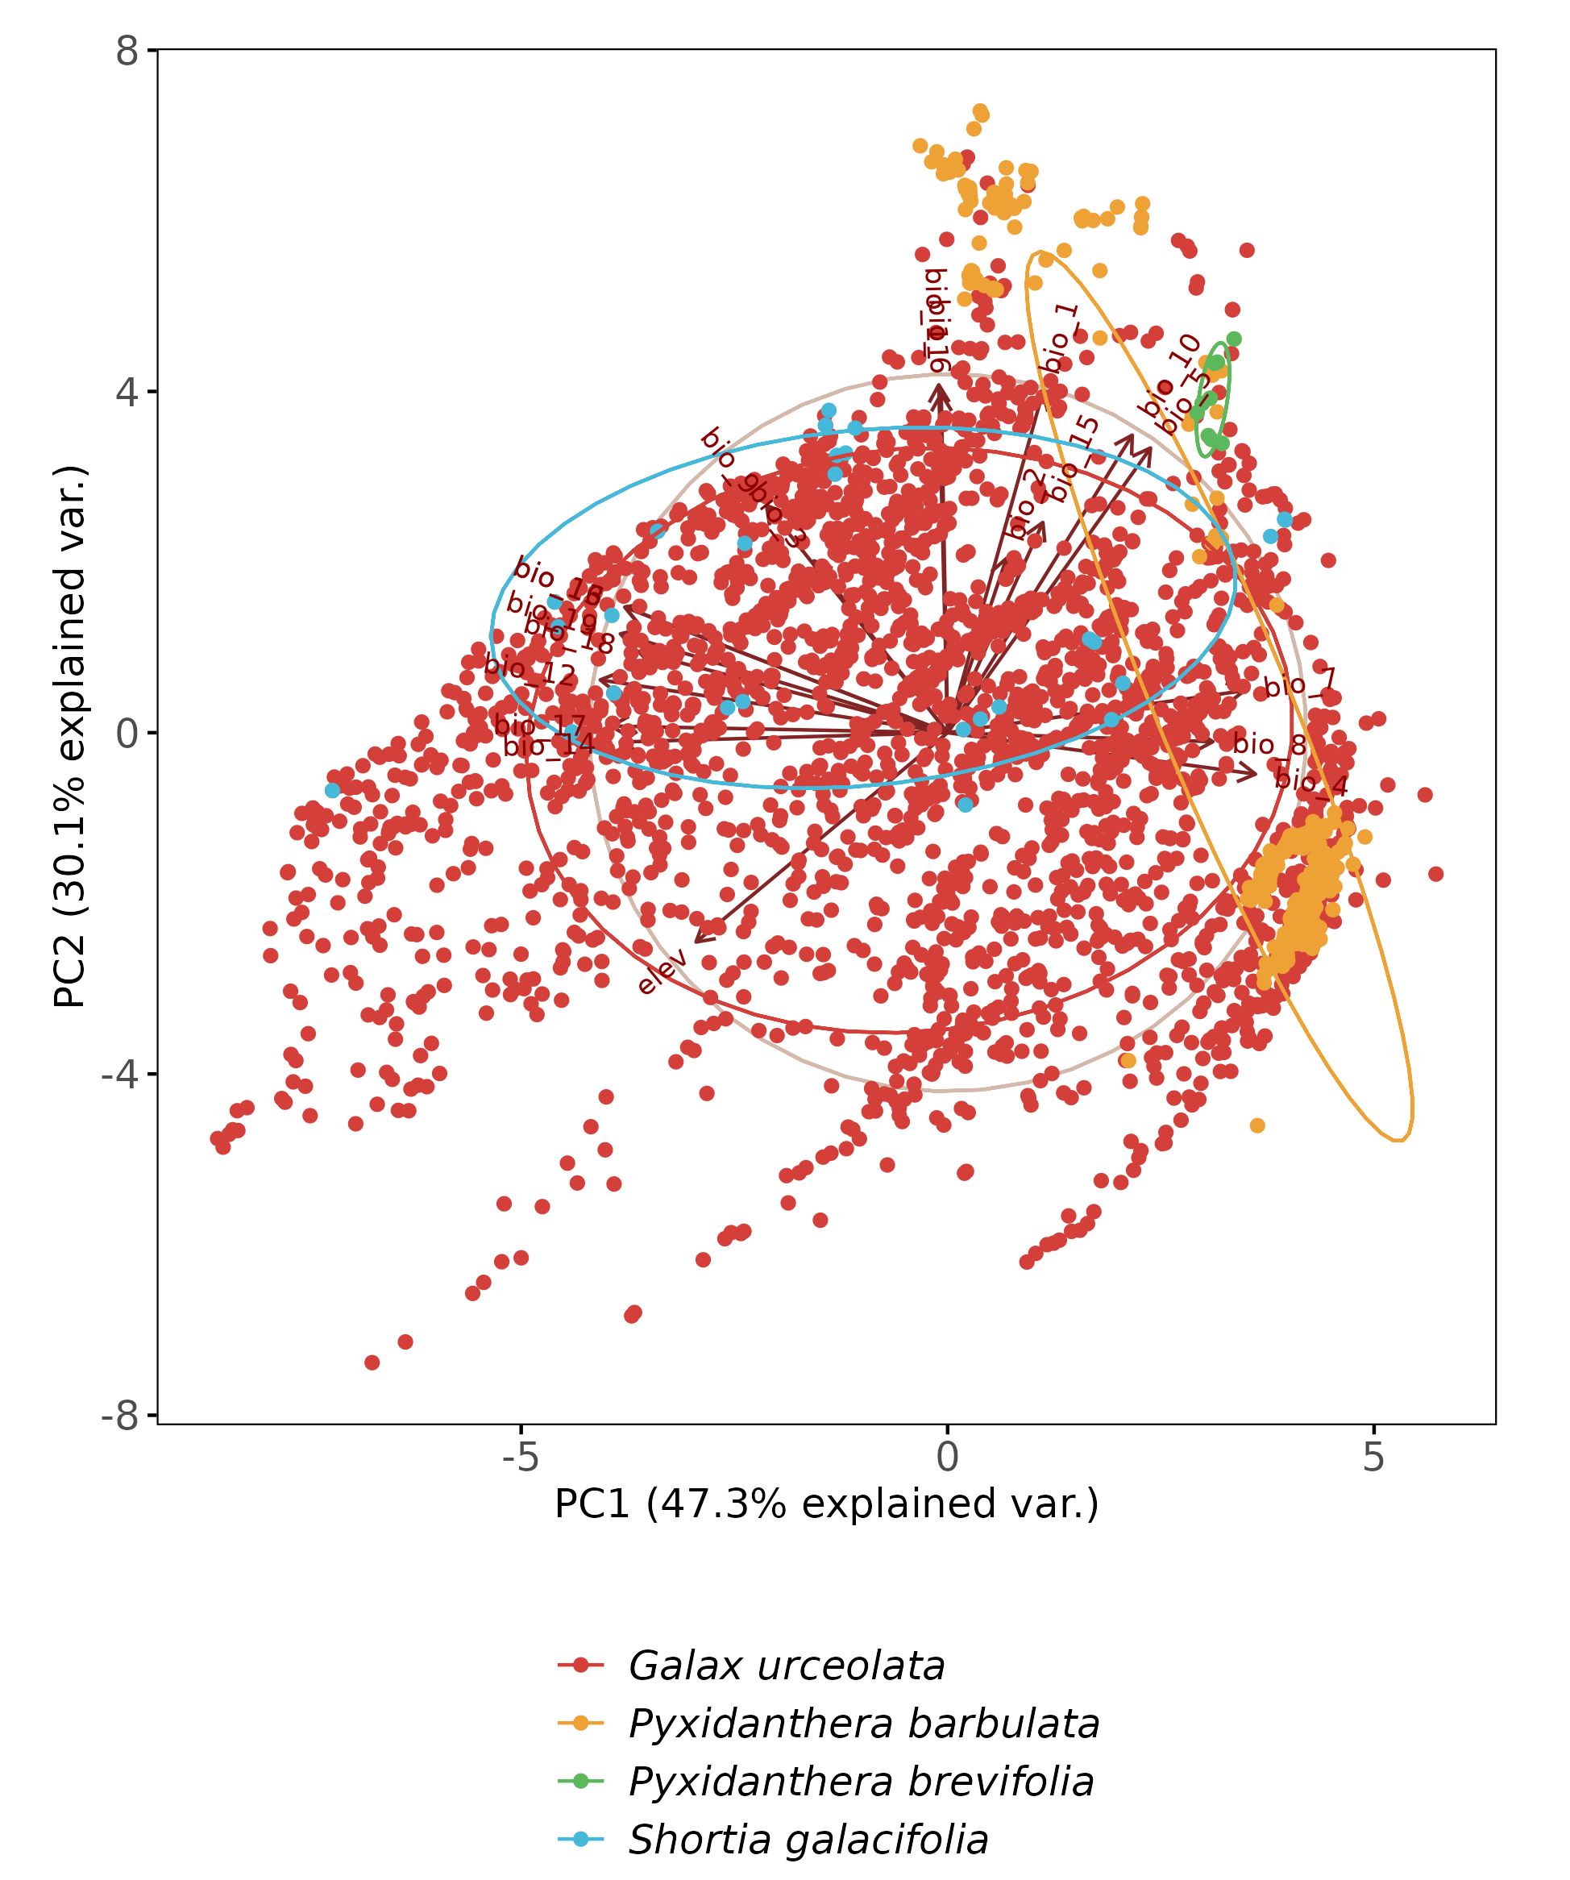
Principal Component Analysis (PCA)
Reading PCAs:
Points: observations
Arrows: environmental variables
Ellipse groupings: taxon
PCAs:
Summarize many environmental variables into PCs
Reveal groupings that are not obvious in the raw data
Notes:
And then a more real example – this is the one we will build in a little bit…

Slide 38
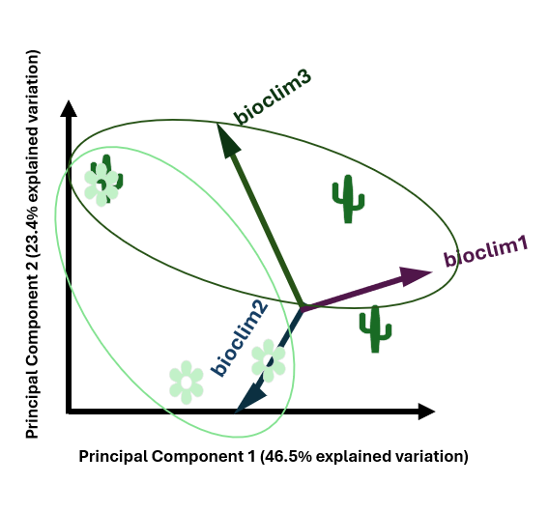
ANOVA
ANOVA Test:
  Select the top two loading variables for the top two principal components
PC1:
PC2:
PC3:
PC4:
46.5% of explained variation
23.4% of explained variation
8.4% of explained variation
5.7% of explained variation
Notes:
So next what we’re going to do

Slide 39
ANOVA
ANOVA Test:
  Select the top two loading variables for the top two principal components
PC1:
PC2:
PC3:
PC4:
46.5% of explained variation
23.4% of explained variation
8.4% of explained variation
5.7% of explained variation

Slide 40
ANOVA
ANOVA Test:
  Select the top two loading variables for the top two principal components
PC1:
PC2:
46.5% of explained variation
23.4% of explained variation
Variable Loading Relative Loading
Bioclim2 -1.45636 72.0%
Bioclim1 0.45256 22.4%
Bioclim3 0.11324 5.6%
Variable Loading Relative Loading
Bioclim3 2.65567 53.1%
Bioclim1 2.34566 46.9%
Bioclim 2
Bioclim 1
Bioclim 3

Slide 41
ANOVA
ANOVA Test:
  Select the top two loading variables for the top two principal components
  For each of these top loading variables, perform an ANOVA test to see if taxa are significantly different
Bioclim2
Bioclim1
Bioclim3

Slide 42
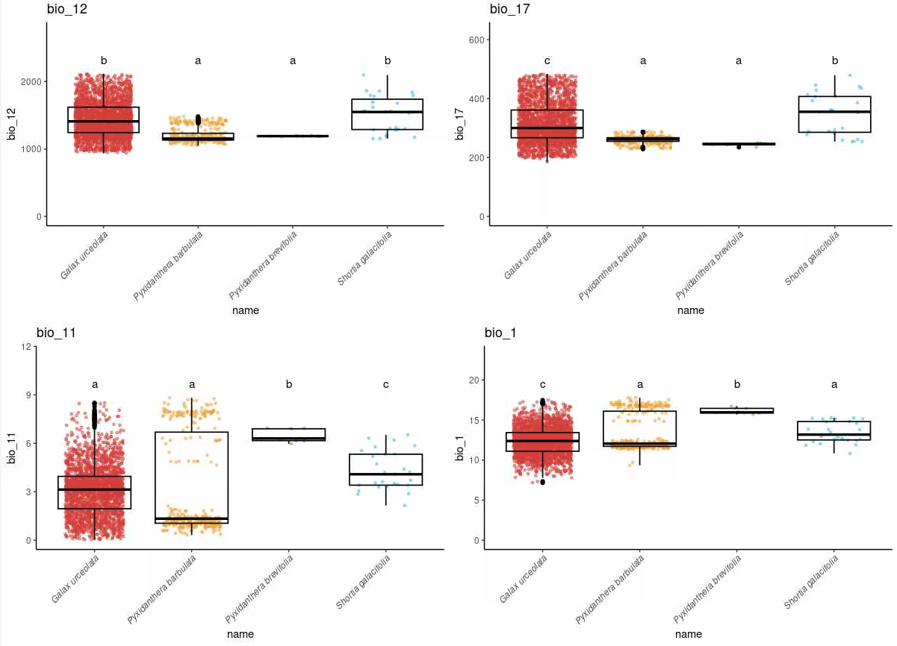
ANOVA
ANOVA Test:
  Select the top two loading variables for the top two principal components
  For each of these top loading variables, perform an ANOVA test to see if taxa are significantly different
Tukey HSD test:
Determines which taxa are significantly similar/different

Slide 43
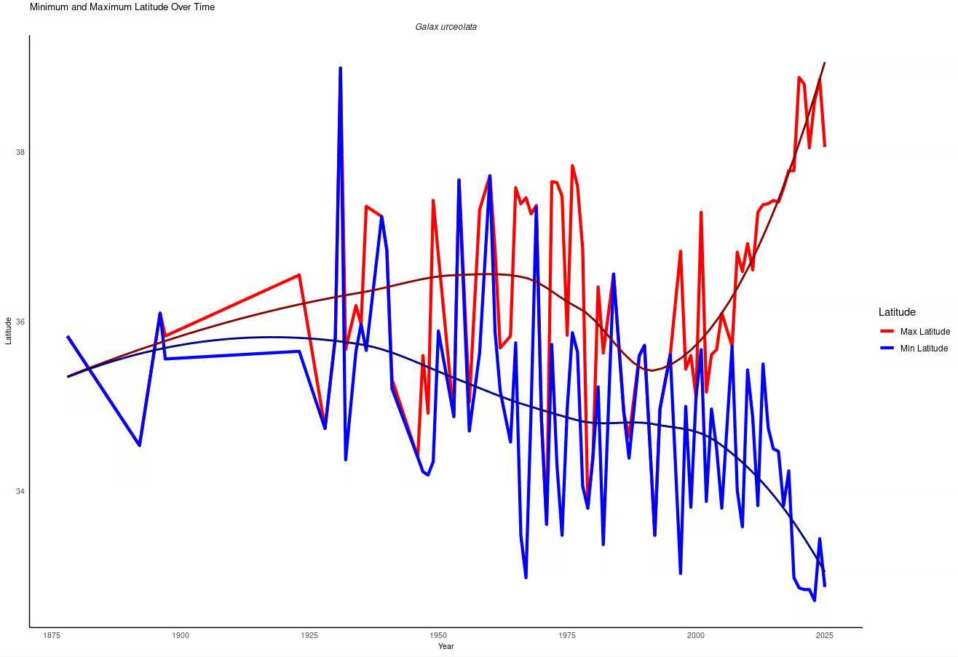
Caution!
Do not just rely on environmental variables
Minimum and Maximum Latitude Over Time
Galax urceolata
Uses dates of occurrence records to identify trends in distribution over time
Consider potential impacts of increases in volume of occurrence records over time
Latitude
Year

Slide 44
Importance
Data Exploration can reveal:
  Potential issues, biases, and discrepancies in raw data
  Trends that are worth exploring further
  Population/species differences
Data exploration allows us to examine the reliability of data before putting it into the ENM models

Slide 45
Coding Practical
03_Data_Exploration.R

Slide 46
ANOVA
Select the top two loading variables for the top two PCs
ANOVA test if taxa are significantly different
Add Tukey HSD test to determine which taxon are significantly similar/different

Slide 47
ANOVA
ANOVA Test:
  Select the top two loading variables for the top two principal components
  For each of these top loading variables, perform an ANOVA test to see if taxa are significantly different
Assumptions:
  Data is normally distributed
  Variance in each group is approximately equal
  All observations are independent

Slide 48
ANOVA
ANOVA Test:
  Select the top two loading variables for the top two principal components
  For each of these top loading variables, perform an ANOVA test to see if taxa are significantly different
Assumptions:
  Data is normally distributed
  Variance in each group is approximately equal
  All observations are independent
Tukey HSD test:
Determines which taxa are significantly similar/different

