Slide 1
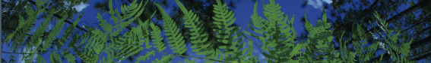



ACESSIBLE AREA + VARIABLE SELECTION
Makenzie E Mabry
University of Florida

Slide 2
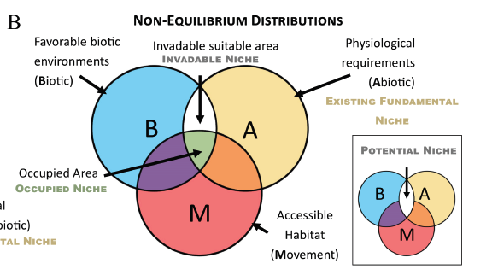
1.Defining Accessible Area
Accessible area can be defined based on:
    species ecology
    dispersal ability
    geographical barriers
Accessible area (M) defines where a species could have dispersed to, given geography and history.
Brown and Carnaval. 2019. A tale of two niche: methods, concepts, and evolution. Frontiers of Biogeography.

Slide 3
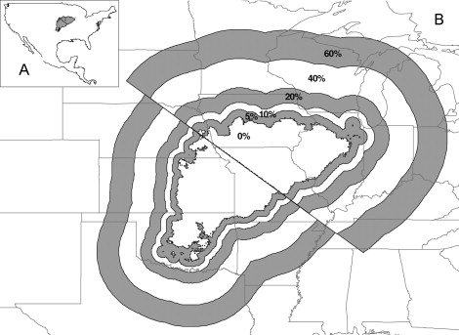
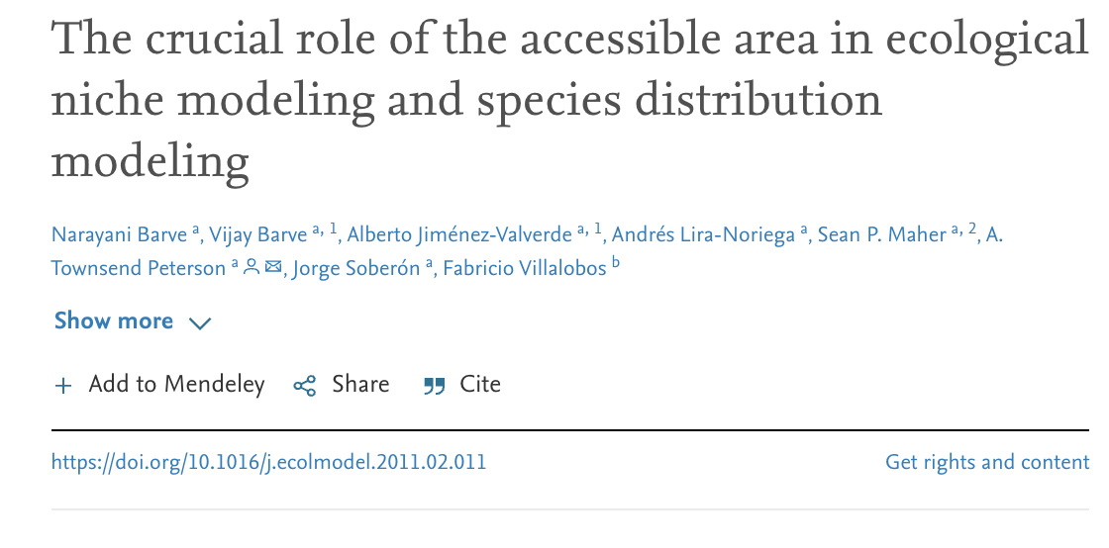
1.The Role of the Accessible Area (M) in ENM
Add a buffer around the species distribution to capture potential movement.

Slide 4
1.The Role of the Accessible Area (M) in ENM
More area, AUC increased.
Higher model significance as buffer size increased.

Slide 5
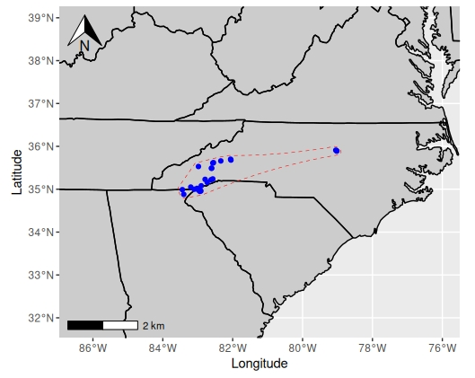
1.Defining the Accessible Area in Practice
Create spatial boundary around species occurrences.
Create a Spatial Buffer around occurrence boundary.
  → Measure pairwise distances between species occurrences.
  → Extract the 80th percentile distance as a buffer radius.
Obtain gridded abiotic data layers.
Crop layers to the shared accessible area.
Select layers for ecological niche modeling.

Slide 6
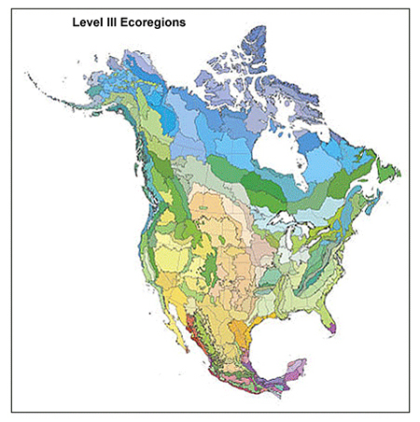
1.Multiple ways to create species boundaries
Convex Hull - Encloses all points in the smallest convex polygon.
        Equivalent to the boundary formed by stretching a rubber band around the outermost points.
Alpha Hull - A flexible, concave boundary estimator controlled by an alpha value.
        Captures non-convex patterns and gaps in occurrence data (e.g., disjunct populations, island distributions). <- we do this today
Ecoregions - Identify clear distributional boundaries and ecoregions using the World Wildlife Fund Terrestrial Ecoregions (see Rautsaw et al. 2022).​
Point-based - Defines species’ accessible area directly from occurrence coordinates.
        Constructs boundaries (e.g., convex or alpha hulls) and buffers using the spatial structure of the occurrence points (see Melton et al. 2022).

Slide 7

1.Defining the Accessible Area in Practice
Create spatial boundary around species occurrences.
Creating a Spatial Buffer Around Occurrence Alpha Hull
  → Measure pairwise distances between species occurrences.
  → Extract the 80th percentile distance as a buffer radius.
Obtain gridded abiotic data layers.
Crop layers to the shared accessible area.
Select layers for ecological niche modeling.

Slide 8
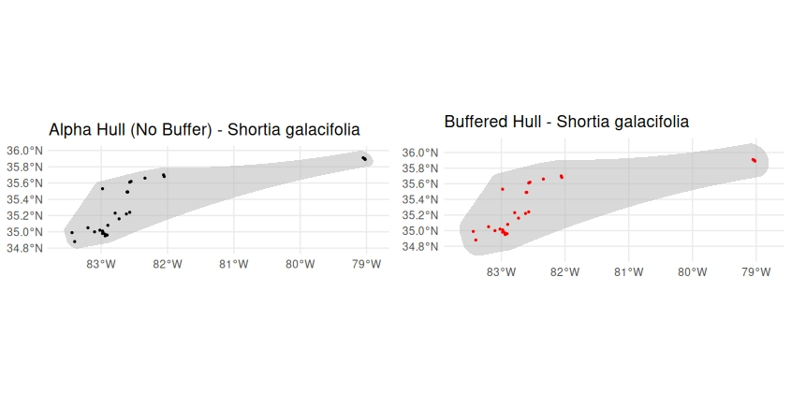
1.Defining the Accessible Area in Practice

Slide 9

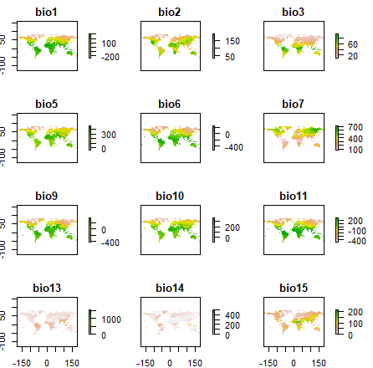
1.Defining the Accessible Area in Practice
Creating a Spatial Buffer Around Occurrence Convex Hull
  → Measure pairwise distances between species occurrences.
  → Extract the 80th percentile distance as a buffer radius.
Obtain gridded abiotic data layers.
Crop layers to the shared accessible area.
Select layers for ecological niche modeling.

Slide 10
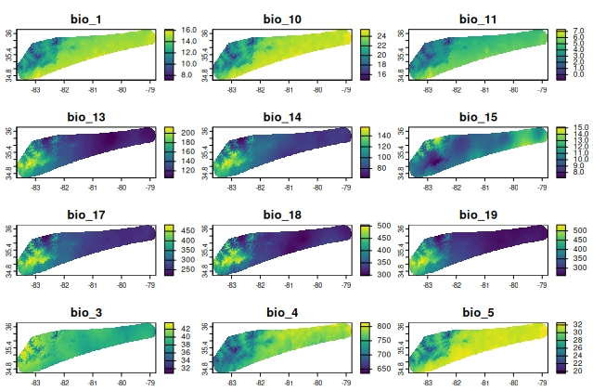
1.Defining the Accessible Area in Practice
Creating a Spatial Buffer Around Occurrence Convex Hull
  → Measure pairwise distances between species occurrences.
  → Extract the 80th percentile distance as a buffer radius.
Obtain gridded abiotic data layers.
Crop layers to the accessible area.
Select layers for ecological niche modeling.

Slide 11
1.Defining the Accessible Area in Practice
Creating a Spatial Buffer Around Occurrence Convex Hull
  → Measure pairwise distances between species occurrences.
  → Extract the 80th percentile distance as a buffer radius.
Obtain gridded abiotic data layers.
Crop layers to the accessible area.
Select layers for ecological niche modeling.

Slide 12
2. Select layers for ecological niche modeling
Method | Threshold | Purpose
PCA | PC1 + PC2 = ~95% | Reduces variables to axis
Pearson correlation | Removes variables > |0.80| | Removes correlated variables
Variable Inflation Factor | Removes variables > 10 | Removes multicollinear variables

Slide 13
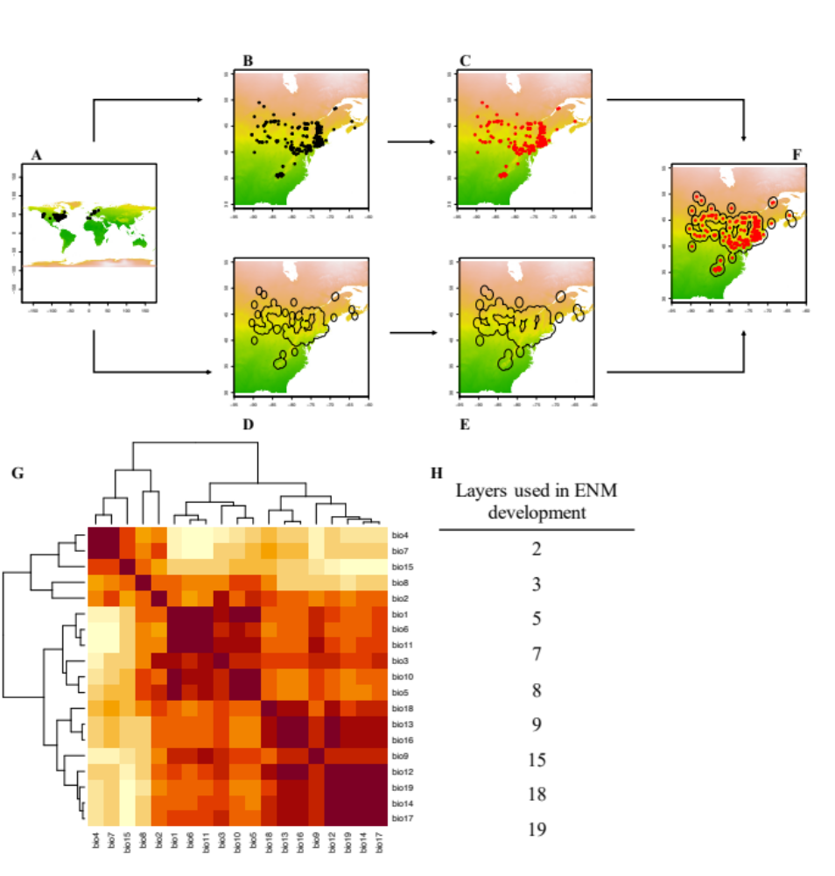
2. Select layers for ecological niche modeling
bio2
bio3
bio5
bio7
bio8
bio9
bio15
bio18
bio19
Pearsons correlation
A correlation test is performed on all 19 BioClim layers.
Removes variables > |0.80|
Melton et al. 2022. Global Ecology and Biogeography.

Slide 14
2. Select layers for ecological niche modeling
Variance Inflation Factor (VIF)
VIF measures how much information is shared between predictor variables.
If two or more variables are very similar, they provide redundant information.
Detects multicollinearity.
BIO1 = Annual Mean Temperature
BIO2 = Mean Diurnal Range (Mean of monthly (max temp - min temp))
BIO3 = Isothermality (BIO2/BIO7) (×100)
BIO4 = Temperature Seasonality (standard deviation ×100)
BIO5 = Max Temperature of Warmest Month
BIO6 = Min Temperature of Coldest Month
BIO7 = Temperature Annual Range (BIO5-BIO6)
BIO8 = Mean Temperature of Wettest Quarter
BIO9 = Mean Temperature of Driest Quarter
BIO10 = Mean Temperature of Warmest Quarter
BIO11 = Mean Temperature of Coldest Quarter
BIO12 = Annual Precipitation
BIO13 = Precipitation of Wettest Month
BIO14 = Precipitation of Driest Month
BIO15 = Precipitation Seasonality (Coefficient of Variation)
BIO16 = Precipitation of Wettest Quarter
BIO17 = Precipitation of Driest Quarter
BIO18 = Precipitation of Warmest Quarter
BIO19 = Precipitation of Coldest Quarter

Slide 15
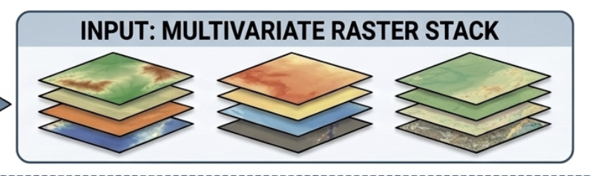

2. Select layers for ecological niche modeling
INPUT:RASTER STACK
STEPWISE VIF LOOP
STEP 1: CALCULATE INDVIVIDUAL VIFs
STEP 2: IDENTIFY AND COMPARE HIGHEST VIFs
STEP 3: COMPARE AGANST THRESHOLD (e.g. >10)

Slide 16
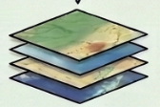
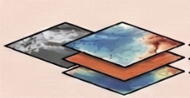
2. Select layers for ecological niche modeling
INPUT:RASTER STACK
STEPWISE VIF LOOP
STEP 1: CALCULATE INDVIVIDUAL VIFs
STEP 2: IDENTIFY AND COMPARE HIGHEST VIFs
STEP 3: COMPARE AGANST THRESHOLD (e.g. >10)
>10
<10
LOOP BACK: RE-EVALUALTE STACK
EXCLUDE REDUNDANT LAYERS

Slide 17
2. Select layers for ecological niche modeling
INPUT:RASTER STACK
STEPWISE VIF LOOP
STEP 1: CALCULATE INDVIVIDUAL VIFs
STEP 2: IDENTIFY AND COMPARE HIGHEST VIFs
STEP 3: COMPARE AGANST THRESHOLD (e.g. >10)
>10
Iteration ceases when the maximum VIF value within the remaining raster stack falls below 10.
<10
LOOP BACK: RE-EVALUALTE STACK
EXCLUDE REDUNDANT LAYERS

Slide 18
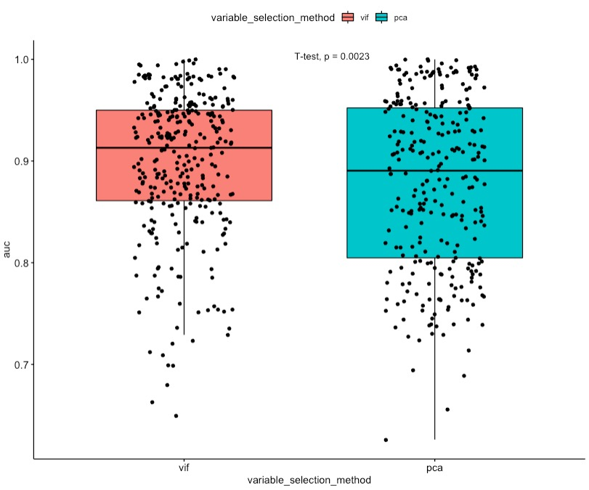
2. Select layers for ecological niche modeling
PCA vs VIF with permutation
AUC was significantly higher in models generated using the VIF method
Based on 109 species in the subfamily Crotalinae (Viperidae)
        PCA with 75% collinearity cutoff, each variable contribution had to be >5%.
        VIF < 10, permutation importance > 1%
Rautsaw et al. 2022. Scientific Data.

Slide 19
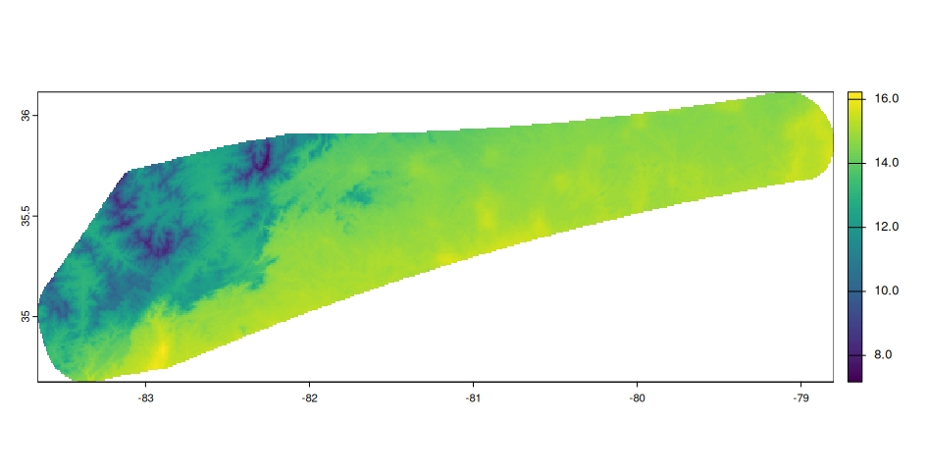
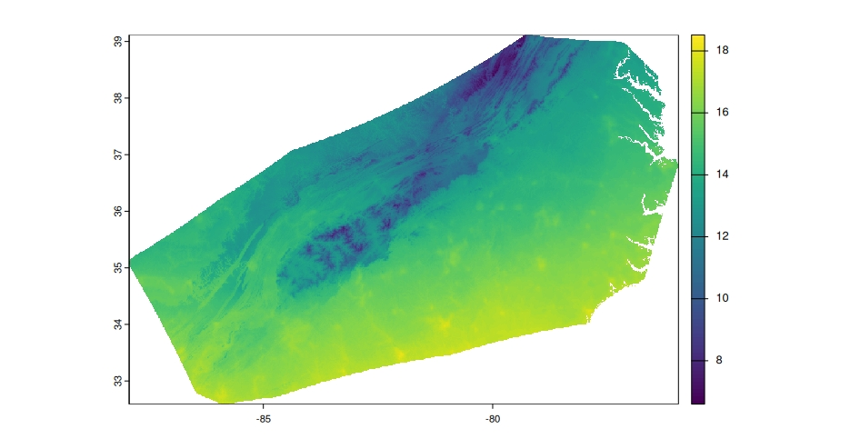
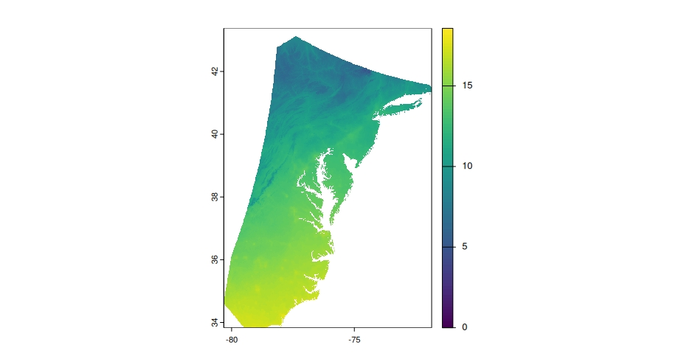
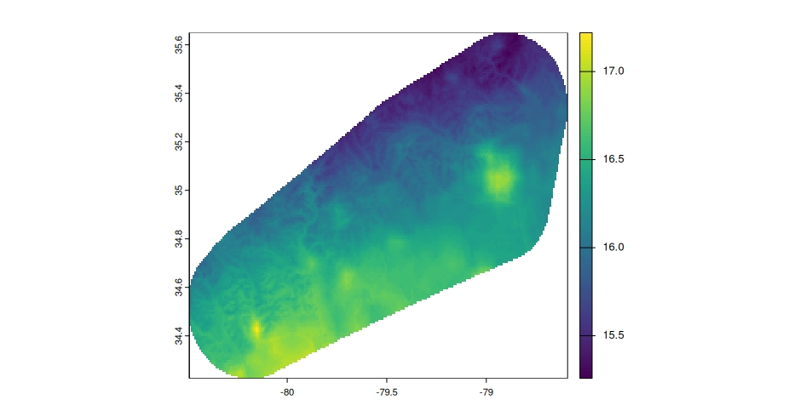
3. Activity
Define the accessible area (M) for each species, crop WorldClim layers accordingly, and select environmental variables using Variance Inflation Factor (VIF) analysis.

