Slide 1




EVALUATING ENM PERFORMANCE
WITH NULL MODELS
Slides by Tyler Radtke
Edited & Presented by JT Miller
University of Florida

Slide 2
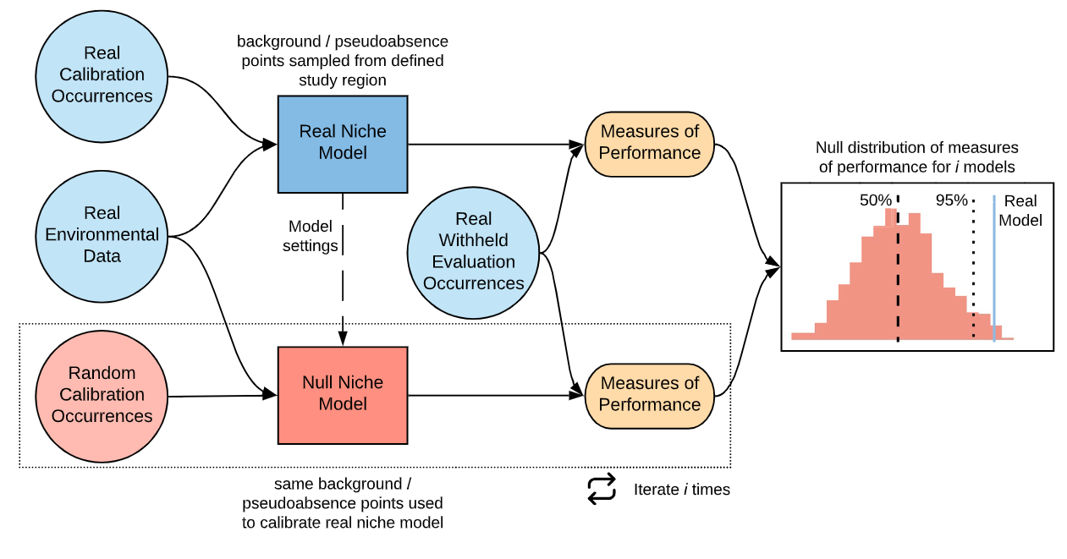
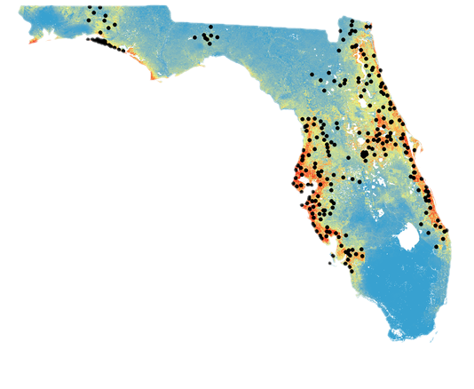
Projection Model
The Typical ENM Process
Bohl, C. L., Kass, J. M., & Anderson, R. P. (2019). A new null model approach to quantify performance and significance for ecological niche models of species distributions. Journal of Biogeography, 46(6), 1101–1111. https://doi.org/10.1111/jbi.13573
Notes:
(CITE IMAGE) So now that we’ve gone through a typical process of conducting an enviromental niche model, we’re going to dive a bit deeper into how to measure these model’s repsective prefromance. We’ve talked about AUC and OR in the previous section, which seek to provide metrics that tell us how well our model is doing given the data we have.

Slide 3
Do these patterns truly exist?
Is there collection bias?
Are our models better than random?
Projection Model
The Typical ENM Process
Bohl, C. L., Kass, J. M., & Anderson, R. P. (2019). A new null model approach to quantify performance and significance for ecological niche models of species distributions. Journal of Biogeography, 46(6), 1101–1111. https://doi.org/10.1111/jbi.13573
Notes:
(CITE IMAGE)

Slide 4
Bohl, C. L., Kass, J. M., & Anderson, R. P. (2019). A new null model approach to quantify performance and significance for ecological niche models of species distributions. Journal of Biogeography, 46(6), 1101–1111. https://doi.org/10.1111/jbi.13573
Notes:
(CITE IMAGE)
Lets talk about Null models. Null models is ecology are a method that are commonly employed to test whether whatever your testing has significant biological signal as compared to a scenario where randomness would produce the same results. In regards to ENMs, this can be done by holding the niche model we’ve built constant, but randomizing the underylign occurrence points from the background over many repetitions, pulling out each metric per iteration to create a null distribution/expectation.

Slide 5
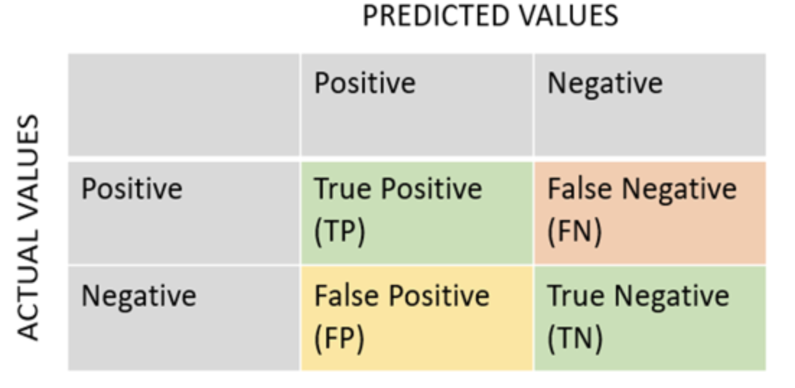
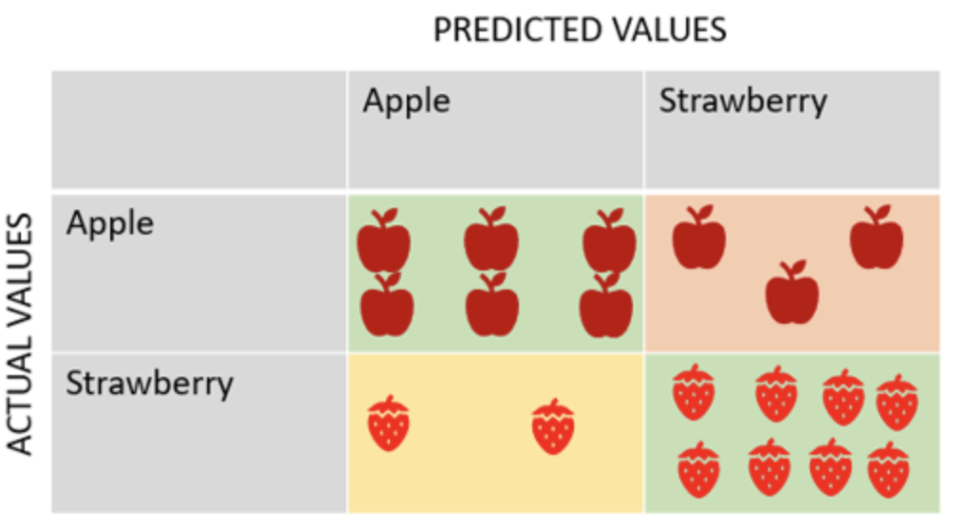
Actual vs. predicted habitat suitability values
Notes:
In regards to how our models perform, you’ll often hear the terms False Positives and True Positives, which are some metrics used to understand how models are preforming. As an example, if I were to train a very basic model designed to identify apples from strawberries, my True Positives would be where I distinguish apples, while my False Positives would be where my model mistakes strawberries as apples.

Slide 6
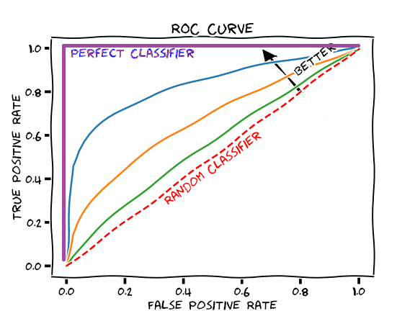
Area Under the Curve (AUC)
False positive rate (1 - specificity) vs. true positive rate (sensitivity)
AUC = 1.0 -> perfect model
AUC = 0.5 -> model performs no better than random
AUC = <0.5 -> a sign of error
AUC evaluates a model’s ability to distinguish between presence/background points
Notes:
The receiver operating characterstic (ROC) curve plots the true positive rate, or sensitivity on the y-axis, against the false positive rate on the x-axis. The area under the curve, or AUC, summarizes how well the model ranks presences above background points. In other words, AUC is the probability that a randomly sampled presence gets a higher predicted suitability than a randomly chosen background point. 1 would indicate 100% probability, 0.5 would indicate you have a 50/50 shot, therefore your model really is just flipping a coin, and anything below random is probably a sign something is wrong.

Slide 7

Omission Rate (OR)
OR = the proportion of test/validation presence points that fall below a specific threshold in training.
Classified as “unsuitable”
Example Threshold:
OR = 0.1
OR > 0.1 Possible Overfitting
OR < 0.1 Doing better than expected
Classified as “suitable”
Notes:
Omission rate is the proportion of validation presences that fall below a threshold set using training presences. Under a 10 percent training presence threshold, about 10 percent omission is expected if the model generalizes well. A higher-than-expected omission rate suggests the model may be overfitting the training data or failing to generalize well to independent points. A lower than expected means the model is predicting validation presences well, but if this looks too good it could also be a sign that your presence data isn’t fully independent.

Slide 8
Continuous Boyce Index (CBI)
Presence-only performance metric based on the relationship between predicted suitability and where presences actually occur.
In ENMeval, its calculated by comparing the distribution of suitability at presences vs background across the continuous suitability range, and is summarized in a Spearman Correlation
CBI: -1:1
Notes:
In ENMeval, CBI is calculated from the predicted values for background records (rather than the full raster), separately for training and validation data, and then summarized across folds for model selection.
computed as the Spearman correlation between habitat suitability & the predicted to expected (P/E) ratio of presences across the suitability range, using model predictions at presence and background points for each cross-validation fold.

Slide 9
Continuous Boyce Index (CBI)
Presence-only performance metric based on the relationship between predicted suitability and where presences actually occur.
In ENMeval, its calculated by comparing the distribution of suitability at presences vs background across the continuous suitability range, and is summarized in a Spearman Correlation
CBI ≈ 1
Presences concentrated in high suitability habitats
Notes:
In ENMeval, CBI is calculated from the predicted values for background records (rather than the full raster), separately for training and validation data, and then summarized across folds for model selection.
computed as the Spearman correlation between habitat suitability & the predicted to expected (P/E) ratio of presences across the suitability range, using model predictions at presence and background points for each cross-validation fold.

Slide 10
Continuous Boyce Index (CBI)
Presence-only performance metric based on the relationship between predicted suitability and where presences actually occur.
In ENMeval, its calculated by comparing the distribution of suitability at presences vs background across the continuous suitability range, and is summarized in a Spearman Correlation
CBI ≈ -1
Presences concentrated in low suitability habitats
Notes:
In ENMeval, CBI is calculated from the predicted values for background records (rather than the full raster), separately for training and validation data, and then summarized across folds for model selection.
computed as the Spearman correlation between habitat suitability & the predicted to expected (P/E) ratio of presences across the suitability range, using model predictions at presence and background points for each cross-validation fold.

Slide 11
Continuous Boyce Index (CBI)
Presence-only performance metric based on the relationship between predicted suitability and where presences actually occur.
In ENMeval, its calculated by comparing the distribution of suitability at presences vs background across the continuous suitability range, and is summarized in a Spearman Correlation
CBI ≈ 0
Suggests random performance
Notes:
In ENMeval, CBI is calculated from the predicted values for background records (rather than the full raster), separately for training and validation data, and then summarized across folds for model selection.
computed as the Spearman correlation between habitat suitability & the predicted to expected (P/E) ratio of presences across the suitability range, using model predictions at presence and background points for each cross-validation fold.

Slide 12
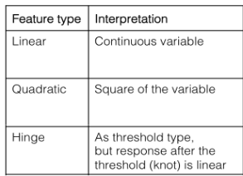

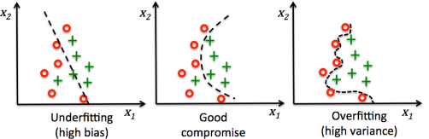
Feature classes and regularization multiplier
Balance complexity and fit
- Feature classes: shape of the expected response curve
- Response curve: the relationship between environmental variables and suitability
- Regularization multiplier: penalty applied to reduce overfitting
Notes:
And here just as a reminder, the feature classes, response curves, & reg multipliers are our underlying tool kit for trying to fit environmental relationships to our data that lead to the suitability map, while penalizing models for overfitting.

Slide 13
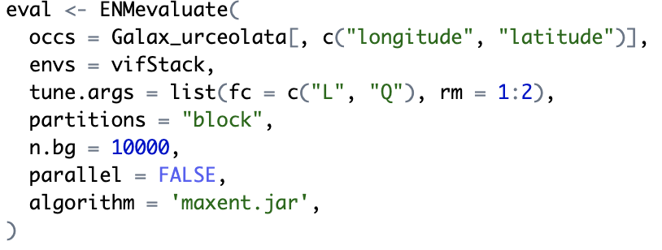
Sample code
ENMevaluate generates models with different combinations of feature classes and RMs
Using tools in the ENMeval package
Notes:
In the model we just fit, we used the Linear and Quadratic feature classes and allowed the RM to be 1 and 2

Slide 14
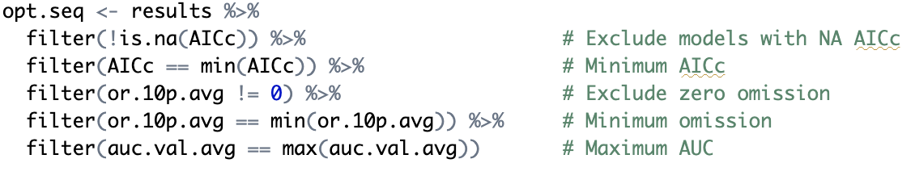
Sample code
Filter the resulting models by selecting for the one with the lowest omission rate and highest area under the curve value. Not ran but optional: select for highest CBI value
Using tools in the ENMeval package
Optimal model parameters:
fc = L, rm = 1
filter(cbi.val.avg == max(cbi.val.avg))
Notes:
What does selection for best models look like in practicality? Well its pretty simple, we just use the filter function from dplyr on our ENMeval results to minimize/maximize for these metrics. You’ll notice that in the code we don’t currently filter for max on CBI but that’s an easy addition if your interested.

Slide 15
How does ENMevaluate generate null models?
1 - Use the same number of presence points as the empirical model, but sample them randomly from the background
2 - Fit models with those random points using the same algorithm and environmental predictors
3 - Evaluate performance using real withheld presence data
4 - Repeat many times to generate a null distribution of performance metrics
5 - Compare the empirical model’s AUC, omission rate, and CBI to the null distribution to assess significance

Slide 16
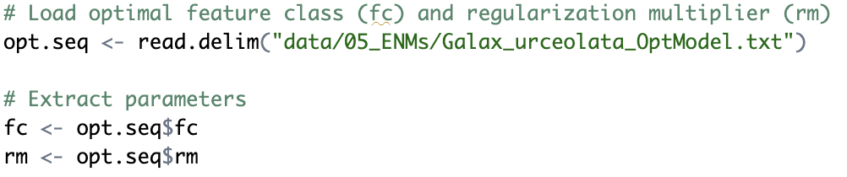
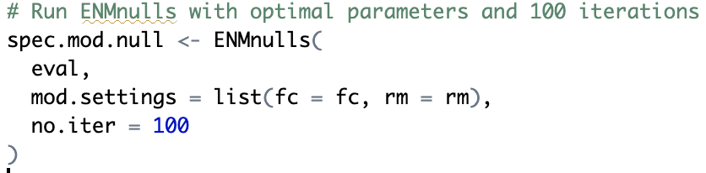
Sample code
Generate null models using parameters from optimal model
Using tools in the ENMeval package

Slide 17
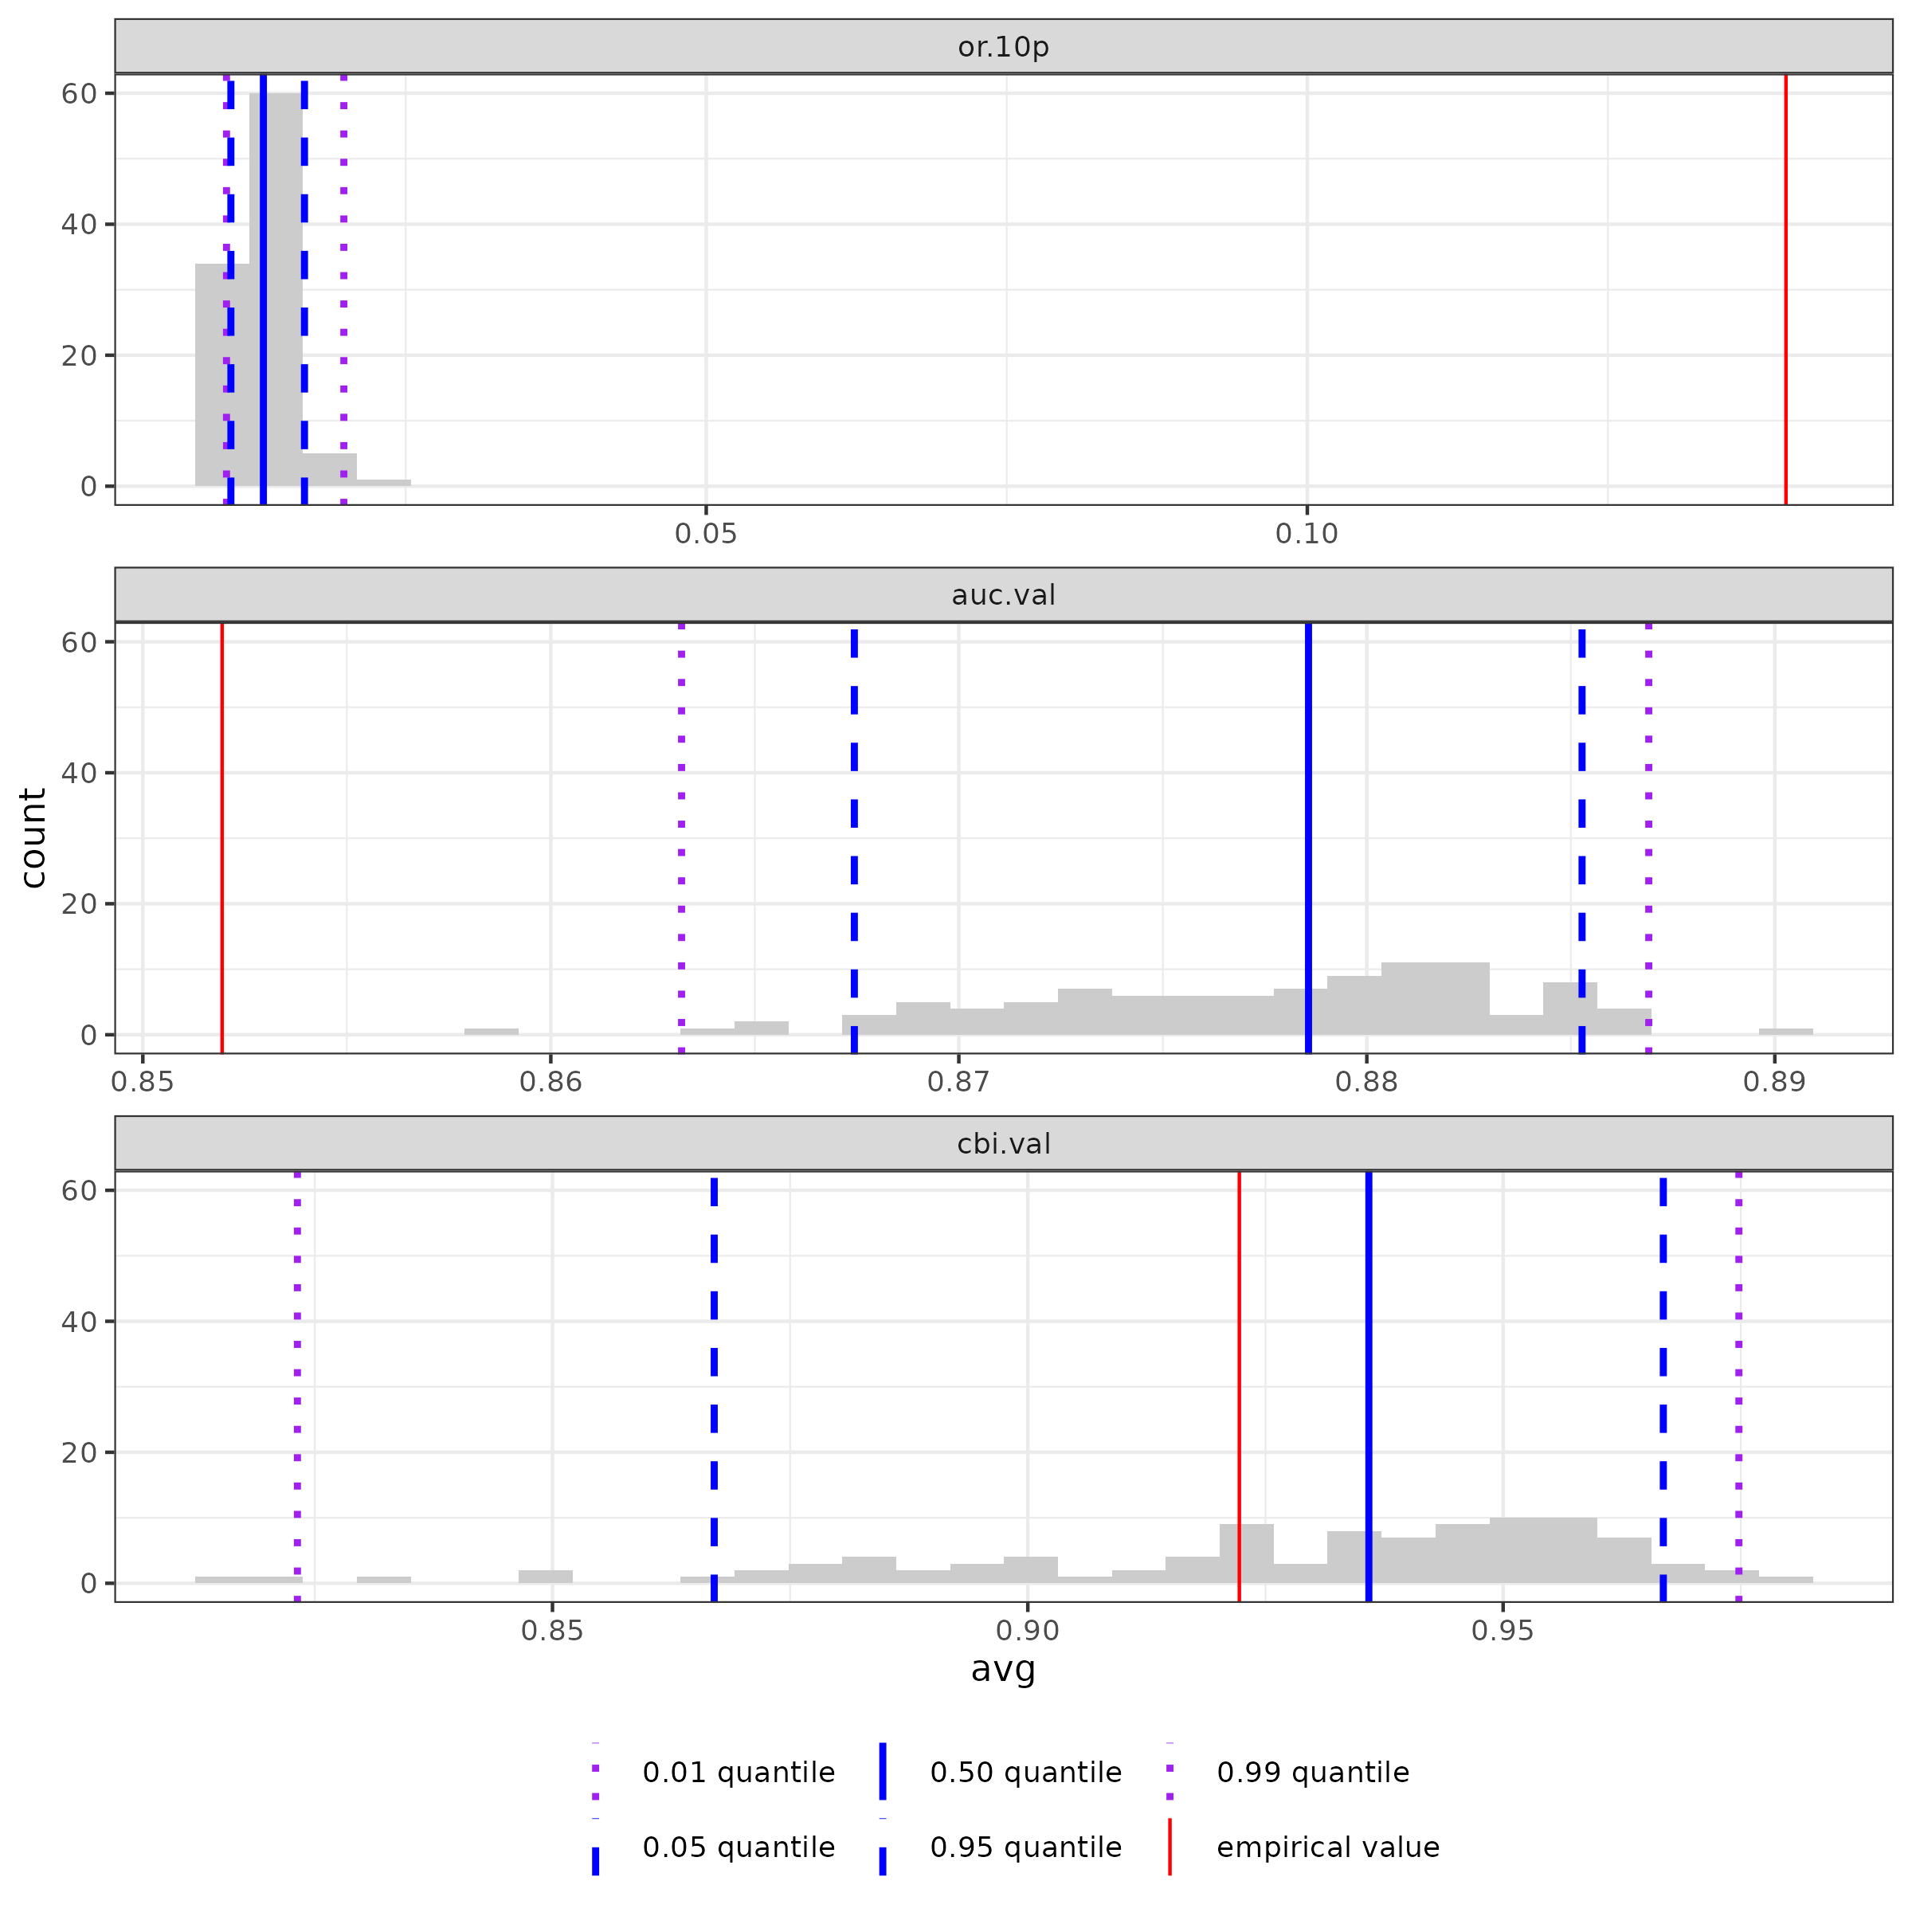
Output:
Omission rate
Plot shows the median AUC value, OR, and CBI for the empirical model (red) against the null distribution Quantiles (blue)
AUC
CBI

Slide 18
Output:
Omission rate
Null Model average
Plot shows the median AUC value, OR, and CBI for the empirical model (red) against the null distribution Quantiles (blue)
AUC
Empirical Model
CBI
Meaning: If its outside the Null Distribution, then it differs significantly from random

Slide 19
Output:
Omission rate
Plot shows the median AUC value, OR, and CBI for the empirical model (red) against the null distribution Quantiles (blue)
AUC
CBI
Meaning: If its outside the Null Distribution, then it differs significantly from random
Notes:
Keep in mind where we’re shooting for on these metrics, the While OR and AUC are significant, they are significantly worse than expectation. CBI is currently preforming near random according to this Null Model.

Slide 20
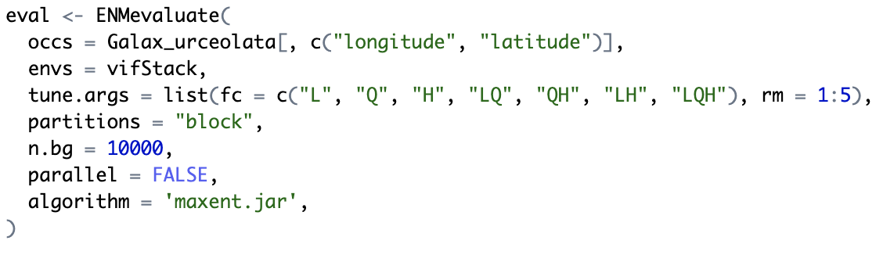
Sample code
Using tools in the ENMeval package
Generate a new suite of models with a wider range of parameters

Slide 21
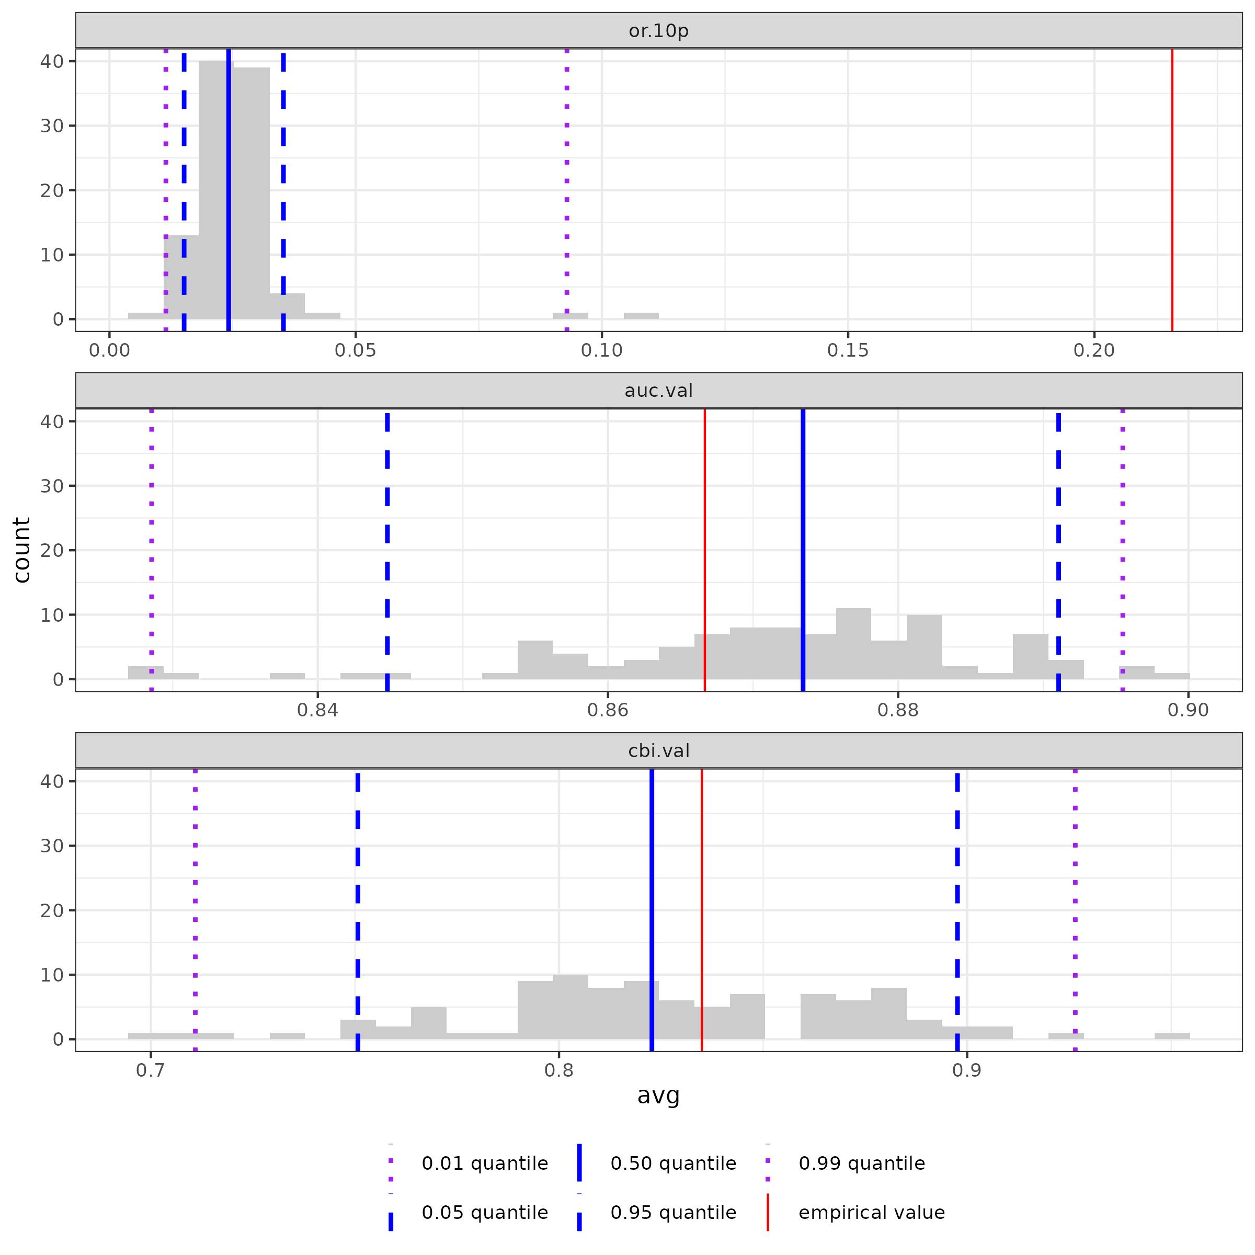
Output:
New optimal model:
fc=LH, rm=1
Significant improvement compared to null models after incorporating a wider range of parameters

Slide 22
Why create null models?
Determine whether model performance is better than expected by chance.
Quantify how much better your model is than a null expectation.
Avoid false confidence by evaluating for bias, spatial autocorrelation and overfitting
Add rigor to model selection and interpretation

Slide 23
Some Caveats
Null models rely on a balance between constraining randomizations
Bohl et al. 2019 (what ENMnulls() methodology uses) uses fake occurrences from the background that are drawn w/out replacement.
Fails to account for spatial autocorrelation and spatial biases, which may inflate Type 1 Error
Risk of Type 1 Error
(Empirical has too easy of a time beating Null) Risks a bad model appearing to have strong ecological signal
Risk of Type 2 Error
(Empirical has too difficult of a time beating Null) Risks a good model appearing to have weak ecological signal

