Slide 1
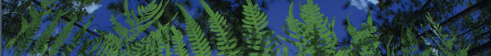



Spatial Phylodiversity & Phyloendemism
JT Miller
University of Florida

Slide 2
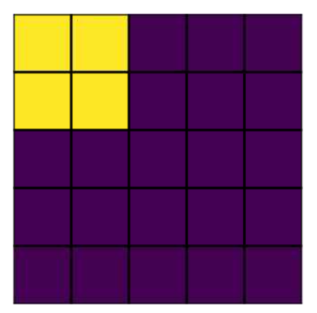
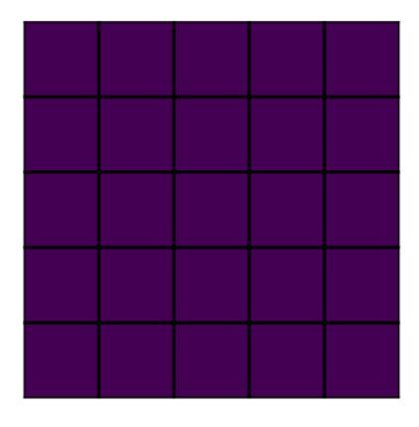
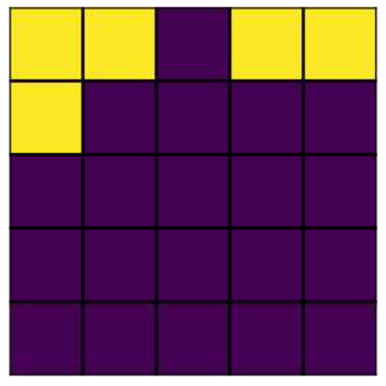
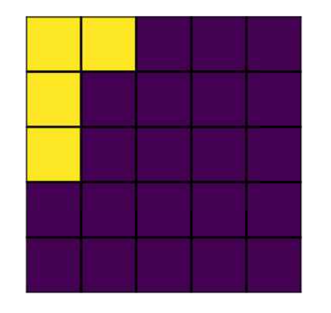
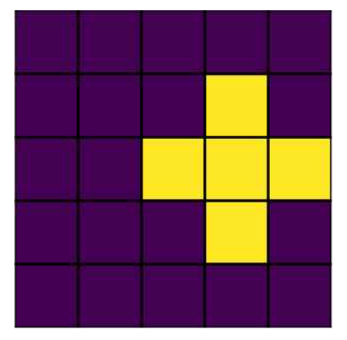
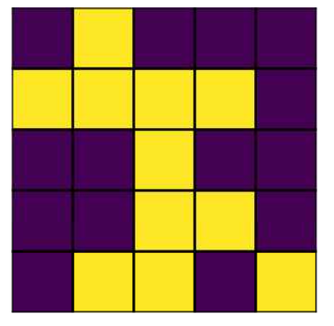
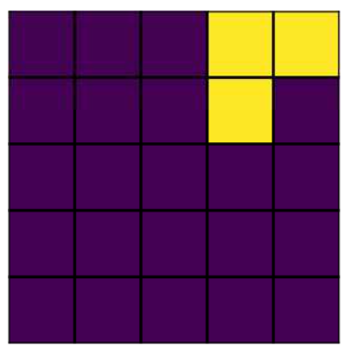
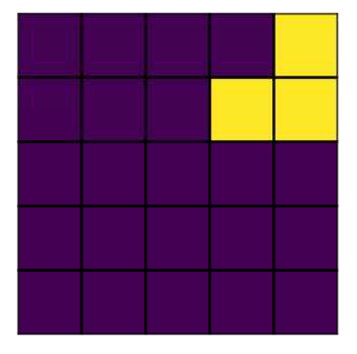
Background: How can we measure Biodiversity?
Presence/Absence Data
  Species Richness (SR)
Area of Interest (AOI)
Sp. A
What do you need?
  1. A study area / (AOI)
  2. Community P/A data
  Yellow = Presence
  Purple = Absence
Sp. B
Sp. C
Sp. D
Sp. E
Sp. F

Slide 3
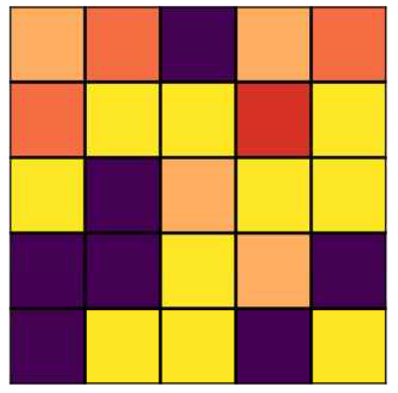
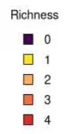
Background: How can we measure Biodiversity?
Presence/Absence Data
  Species Richness (SR)
Area of Interest (AOI)
Sp. A
What do you need?
  1. A study area / (AOI)
  2. Community P/A data
  Yellow = Presence
  Purple = Absence
Sp. B
Sp. C
Sp. D
Sp. E
Sp. F

Slide 4
Background: How can we measure Biodiversity?
SR = 2
Presence/Absence Data
  Species Richness (SR)
Area of Interest (AOI)
Sp. A
SR = 2
What do you need?
  1. A study area / (AOI)
  2. Community P/A data
  Yellow = Presence
  Purple = Absence
Sp. B
Sp. C
Sp. D
Sp. E
Sp. F

Slide 5
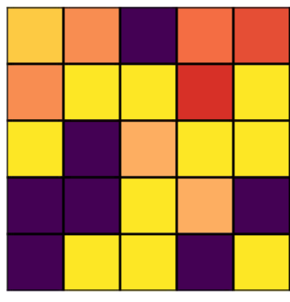

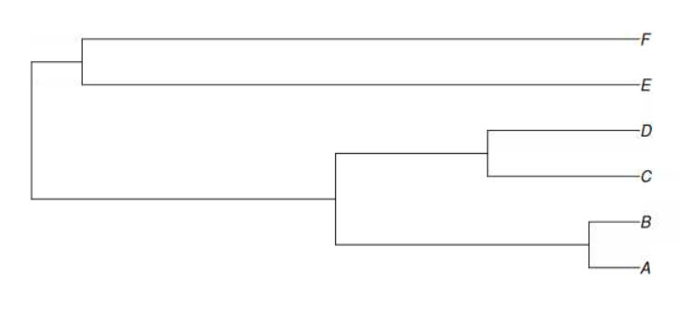
Background: How can we measure Biodiversity?
PD = 65
Presence/Absence Data
  Phylogenetic Diversity (PD)
Area of Interest (AOI)
Sp. A
PD = 120
What do you need?
  1. A study area / (AOI)
  2. Community P/A data
  3. A phylogeny
Sp. B
Sp. C
Sp. D
Sp. E
Sp. F

Slide 6
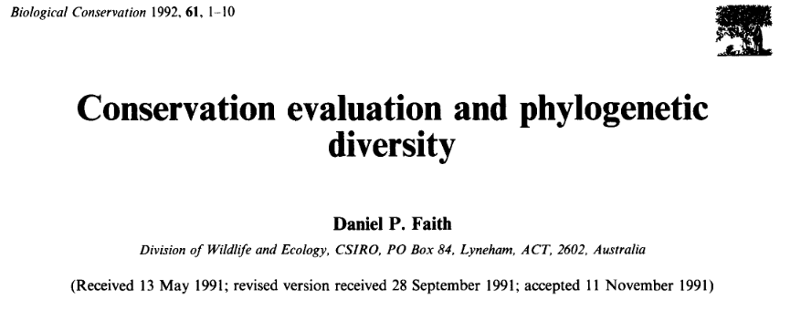
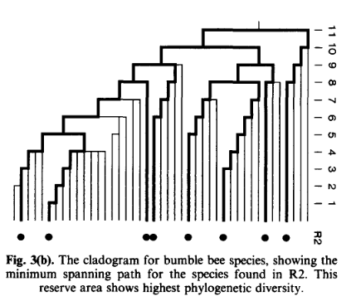
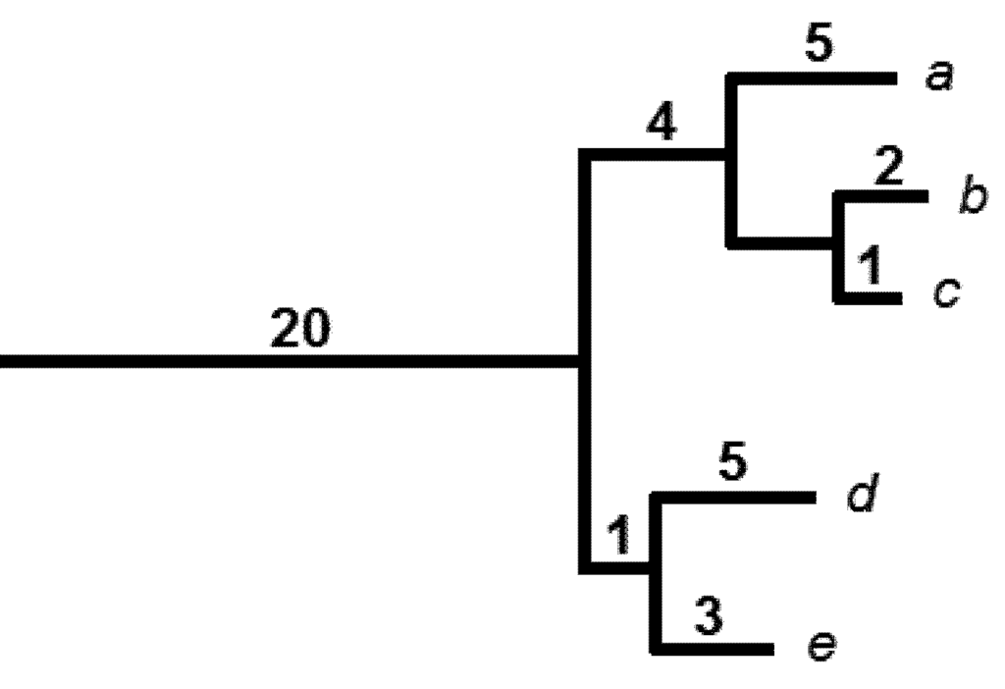
Background: What is Phylodiversity?
How much of the phylogenetic tree/evolutionary history is represented in my sample?
  Uses phylogenetic distance (PD)
Faith & Richards 2012

Slide 7
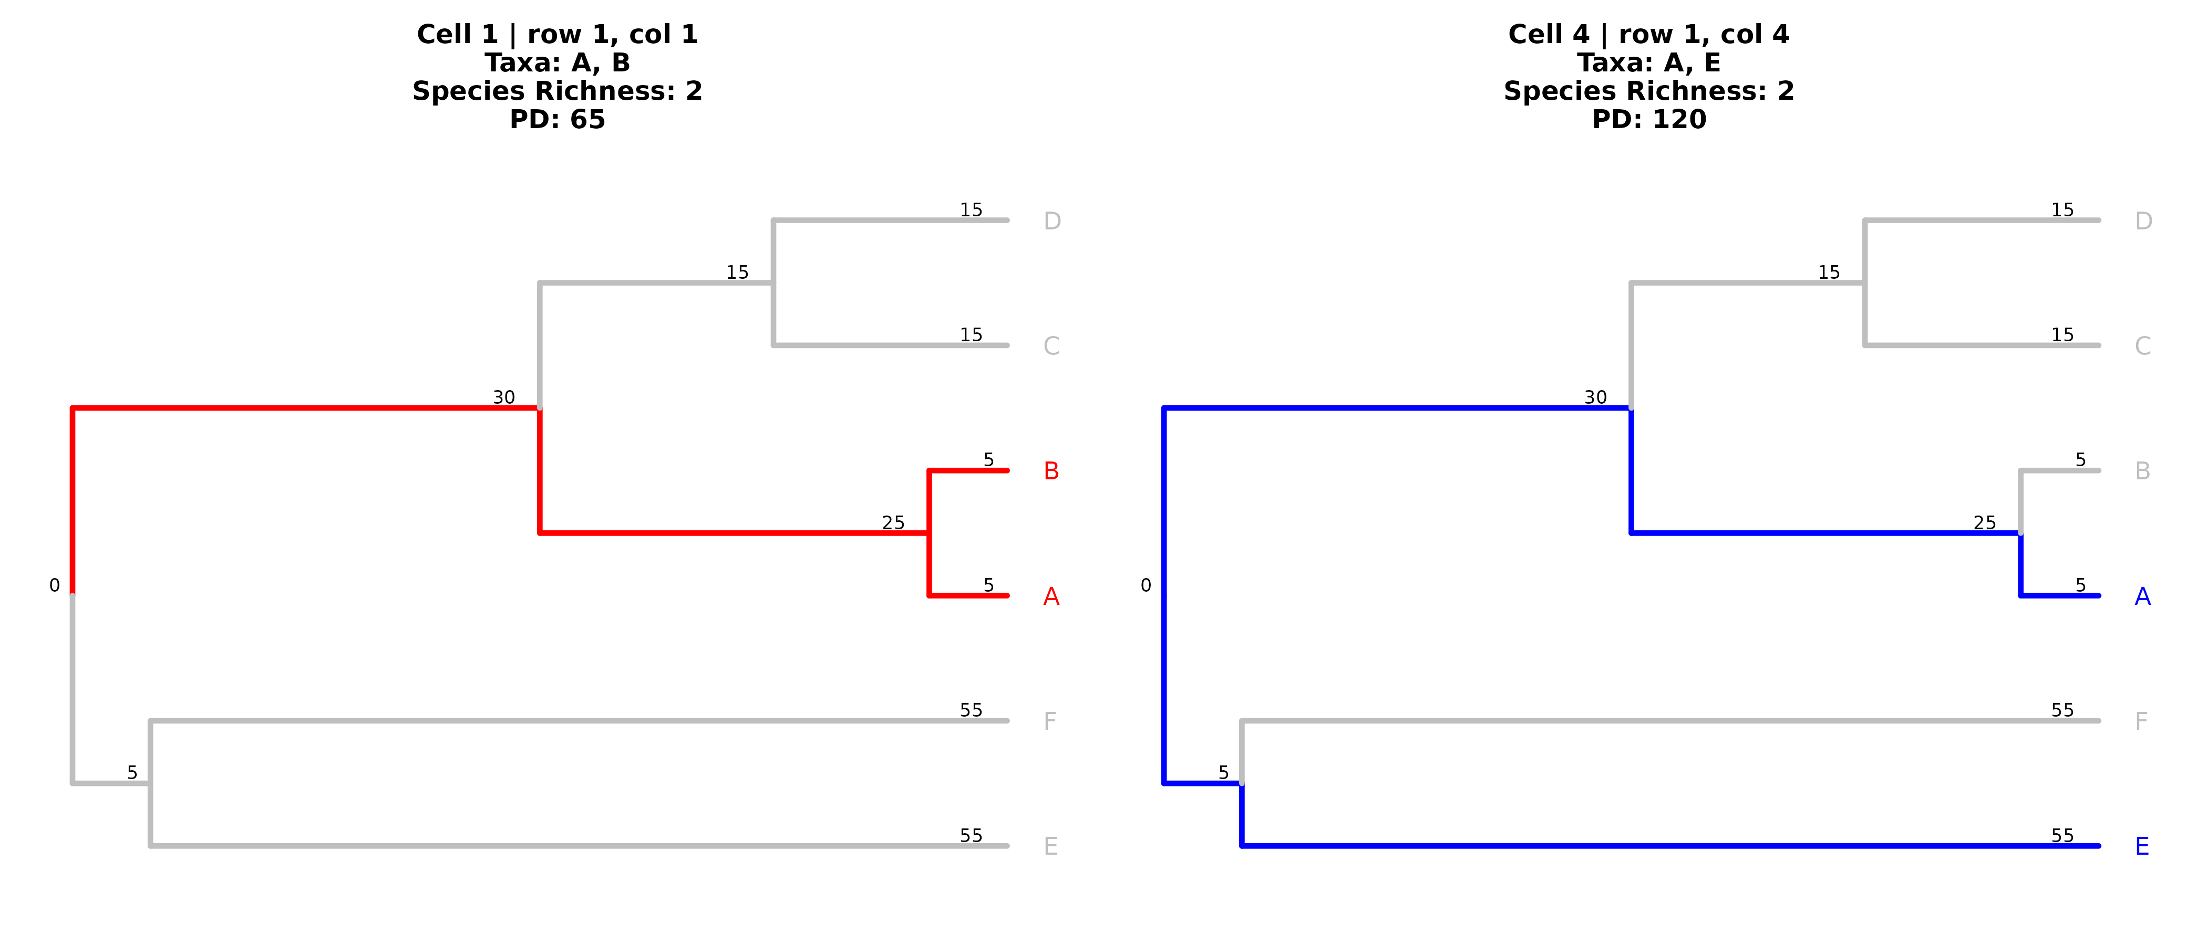
PD Calculation
Sp. A
Sp. B
Sp. C
Area of Interest (AOI)
PD = 65
PD = 120
Sp. D
Sp. E
Sp. F
Notes:
To give a practical example, in cell one (top left in our area of interest), we can note that both Species A & B are present. If we were to sum up all of the branches leading to these taxa, as is highlighted in red, we can calculate the total PD of this cell = 65. If we were to compare this to a different cell, lets say cell 4 in the top row, we can do the same thing, just with taxa A and E. You’ll notice however that we have to trace more of the tree in order to include both of these taxa, so unsurprisingly this means there is more PD in this cell.

Slide 8
PD Calculation
Sp. A
Phylogenetic Clustering
Sp. B
Sp. C
Area of Interest (AOI)
PD = 65
PD = 120
Sp. D
Sp. E
Sp. F
Phylogenetic overdispersion

Slide 9
Background: How can we measure Biodiversity?
Presence/Absence Data
  Weighted Endemism*
    (1/Presence Cells)
Area of Interest (AOI)
Sp. A
What do you need?
  1. A study area / (AOI)
  2. Community P/A data
  Yellow = Presence
  Purple = Absence
Sp. B
Sp. C
Sp. D
Sp. E
Sp. F
Notes:
* You probably have heard the term endemism used in quite a few contexts. E.g. This plant is endemic to Arizona, meaning that it is only found in Arizona. Here, were focused more on quantifying the contributing rarity (in terms of number of cells a taxa is present in) to the overall pattern within our area of interest.

Slide 10
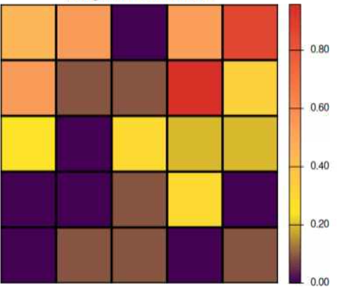
Background: How can we measure Biodiversity?
WE = (1/5) + (1/4) = 0.45
Presence/Absence Data
  Weighted Endemism*
    (1/Presence Cells)
Area of Interest (AOI)
WE = (1/5) + (1/3) ≈ .53
Sp. A = 1/5 WE
What do you need?
  1. A study area / (AOI)
  2. Community P/A data
  Yellow = Presence
  Purple = Absence
Sp. B = 1/4 WE
Sp. C = 1/5 WE
Sp. D = 1/11 WE
Sp. E = 1/3 WE
Sp. F = 1/3 WE
Notes:
* You probably have heard the term endemism used in quite a few contexts. E.g. This plant is endemic to Arizona, meaning that it is only found in Arizona. Here, were focused more on quantifying how range restricted a taxa is, which is 1/its presence cells within our Area of Interest, and using these ratios in sum to find the weighted endemism per cell.

Slide 11
Background: How can we measure Biodiversity?
WE = (1/5) + (1/4) = 0.45
Presence/Absence Data
  Weighted Endemism*
    (1/Presence Cells)
Area of Interest (AOI)
WE = (1/5) + (1/3) ≈ .53
Sp. A = 1/5 WE
What do you need?
  1. A study area / (AOI)
  2. Community P/A data
  Yellow = Presence
  Purple = Absence
Sp. B = 1/4 WE
Sp. C = 1/5 WE
Sp. D = 1/11 WE
Sp. E = 1/3 WE
Sp. F = 1/3 WE
Notes:
* You probably have heard the term endemism used in quite a few contexts. E.g. This plant is endemic to Arizona, meaning that it is only found in Arizona. Here, were focused more on quantifying how range restricted a taxa is, which is 1/its presence cells within our Area of Interest, and using these ratios in sum to find the weighted endemism per cell.

Slide 12
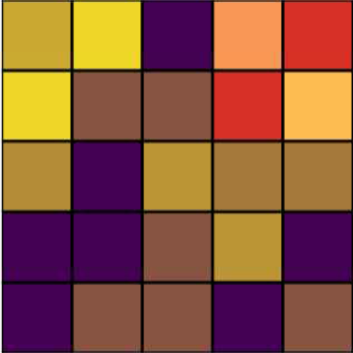

Background: How can we measure Biodiversity?
PE = 8.18
Presence/Absence Data
  Phylogenetic Endemism
Area of Interest (AOI)
PE = 26.48
Sp. A
What do you need?
  1. A study area / (AOI)
  2. Community P/A data
  3. A phylogeny
Sp. B
Sp. C
Sp. D
Sp. E
Sp. F
Notes:
* You probably have heard the term endemism used in quite a few contexts. E.g. This plant is endemic to Arizona, meaning that it is only found in Arizona. Here, were focused more on quantifying how range restricted a taxa is, which is 1/its presence cells within our Area of Interest, and using these ratios in sum to find the weighted endemism per cell.

Slide 13
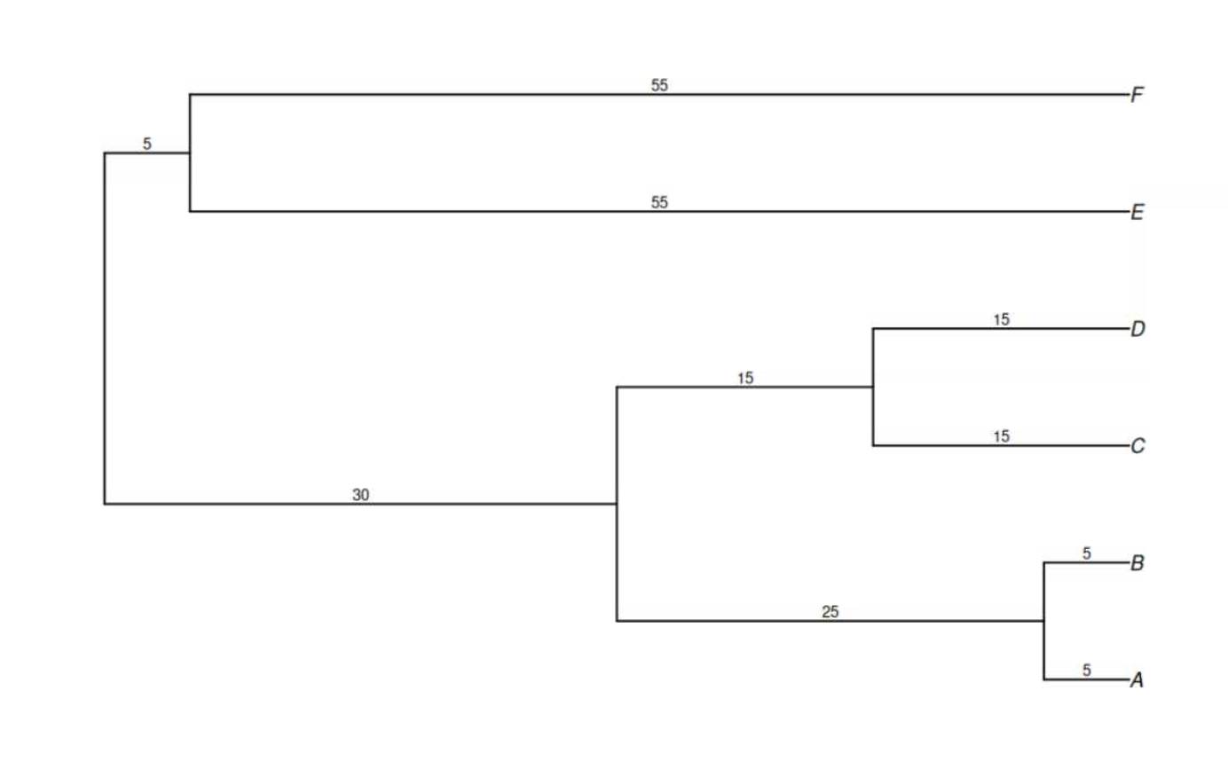
(Weighted) Phylogenetic Endemism
PE is PD on a range weighted tree

Slide 14

(Weighted) Phylogenetic Endemism
PE is PD on a range weighted tree
18.3 ≈ (55/3)
PE = ($\frac{PD}{\# Presence Cells }$)
18.3 ≈ (55/3)
18.3 ≈ (15/11)
3 = (15/5)
1.25 = (5/4)
1 = (5/5)

Slide 15
(Weighted) Phylogenetic Endemism
PE is PD on a range weighted tree
?
18.3 ≈ (55/3)
PE = ($\frac{PD}{\# Presence Cells }$)
18.3 ≈ (55/3)
18.3 ≈ (15/11)
?
3 = (15/5)
?
?
1.25 = (5/4)
1 = (5/5)

Slide 16
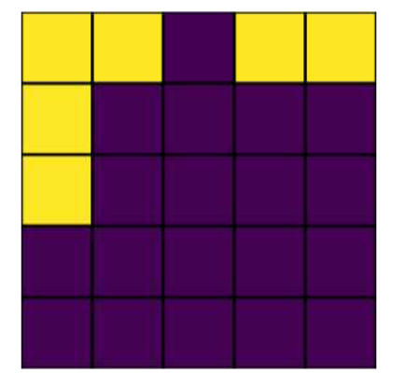
(Weighted) Phylogenetic Endemism
PE is PD on a range weighted tree
?
18.3 ≈ (55/3)
PE = ($\frac{PD}{\# Presence Cells }$)
18.3 ≈ (55/3)
18.3 ≈ (15/11)
?
Union Method
3 = (15/5)
?
1.25 = (5/4)
1 = (5/5)

Slide 17
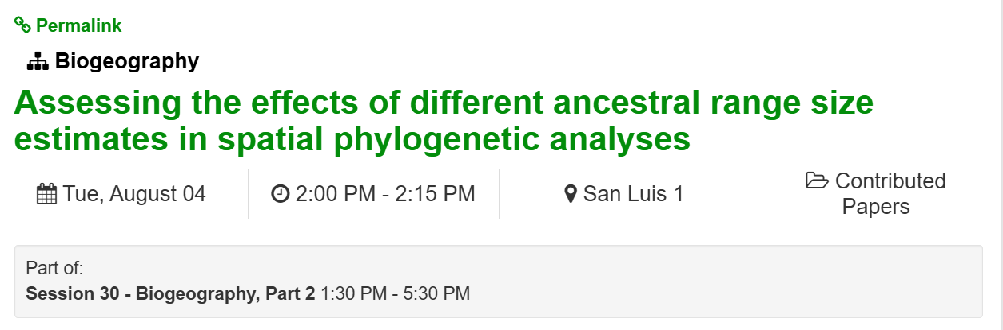
(Weighted) Phylogenetic Endemism
PE is PD on a range weighted tree
?
18.3 ≈ (55/3)
PE = ($\frac{PD}{\# Presence Cells }$)
18.3 ≈ (55/3)
18.3 ≈ (15/11)
?
Union Method
3 = (15/5)
?
1.25 = (5/4)
1 = (5/5)

Slide 18
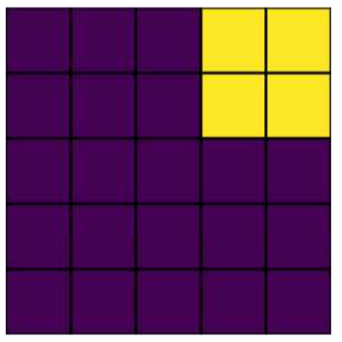
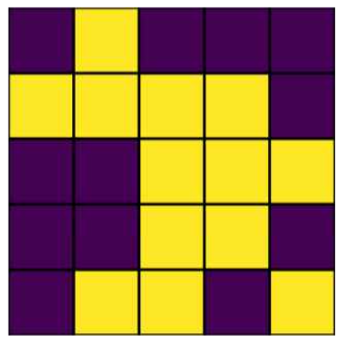
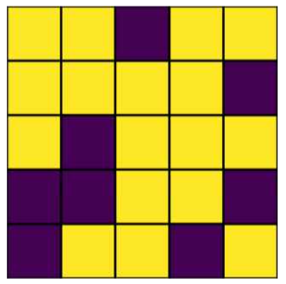
(Weighted) Phylogenetic Endemism
PE is PD on a range weighted tree
18.3 ≈ (55/3)
PE = ($\frac{PD}{\# Presence Cells }$)
18.3 ≈ (55/3)
18.3 ≈ (15/11)
3 = (15/5)
1.25 = (5/4)
1 = (5/5)

Slide 19
(Weighted) Phylogenetic Endemism
PE is PD on a range weighted tree
18.3 ≈ (55/3)
1.25 = (5/3)
PE = ($\frac{PD}{\# Presence Cells }$)
18.3 ≈ (55/3)
18.3 ≈ (15/11)
1.15 ≈ (15/13)
3 = (15/5)
1.76 ≈ (30/17)
1.25 = (5/4)
4.17 ≈ (25/6)
1 = (5/5)

Slide 20
(Weighted) Phylogenetic Endemism
PE is PD on a range weighted tree
18.3 ≈ (55/3)
1.25 = (5/3)
PE = ($\frac{PD}{\# Presence Cells }$)
18.3 ≈ (55/3)
18.3 ≈ (15/11)
1.15 ≈ (15/13)
3 = (15/5)
PE = 8.18 = (1 + 1.25 + 4.17 + 1.76)
1.76 ≈ (30/17)
Area of Interest (AOI)
PE = 26.48
1.25 = (5/4)
4.17 ≈ (25/6)
1 = (5/5)

Slide 21
(Weighted) Phylogenetic Endemism
PE is PD on a range weighted tree
18.3 ≈ (55/3)
1.25 = (5/3)
PE = ($\frac{PD}{\# Presence Cells }$)
18.3 ≈ (55/3)
18.3 ≈ (15/11)
1.15 ≈ (15/13)
3 = (15/5)
PE = 8.18
1.76 ≈ (30/17)
Area of Interest (AOI)
PE = 26.48
1.25 = (5/4)
4.17 ≈ (25/6)
1 = (5/5)

Slide 22
(Weighted) Phylogenetic Endemism
PE is PD on a range weighted tree
18.3 ≈ (55/3)
1.25 = (5/3)
PE = ($\frac{PD}{\# Presence Cells }$)
18.3 ≈ (55/3)
18.3 ≈ (15/11)
1.15 ≈ (15/13)
3 = (15/5)
PE = 8.18
1.76 ≈ (30/17)
Area of Interest (AOI)
PE = 26.48
1.25 = (5/4)
4.17 ≈ (25/6)
1 = (5/5)

Slide 23
Intro to RPD and RPE
Currently an area with high PD/PE can be that way for two reasons
1) There is a lot of taxa (or narrow ranged taxa) in that cell
2) The cell has a disproportionately long or short branches
Relative Phylogenetic Diversity (RPD) and Relative Phylogenetic Endemism (RPE) are designed to standardize PD and PE by comparing them to what would be expected if all branches in the phylogeny were equal length (aka a comparison tree)
Area of Interest (AOI)
1 or 2?
1 or 2?

Slide 24
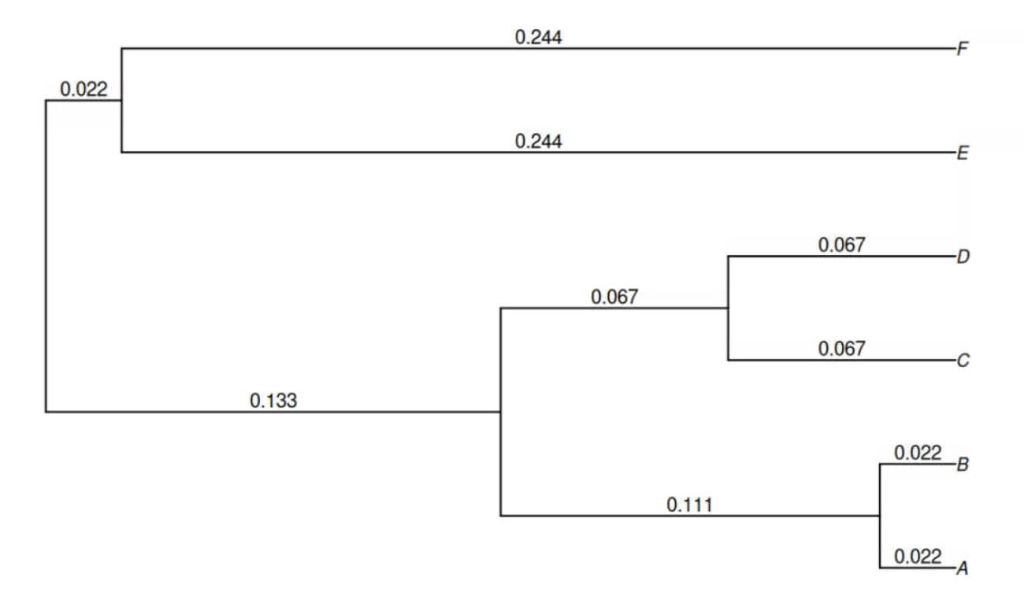
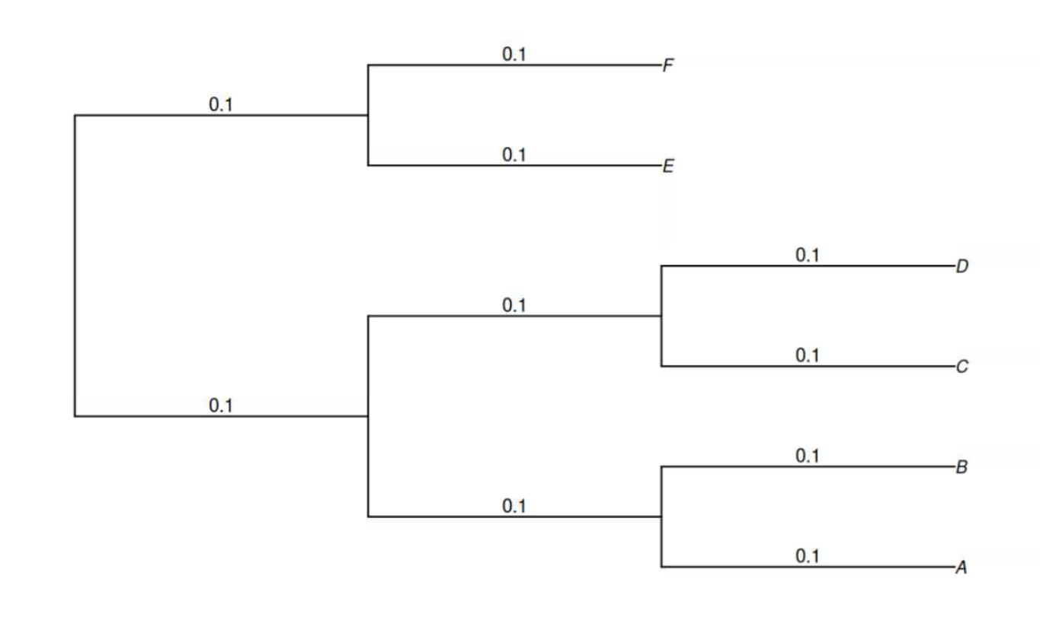
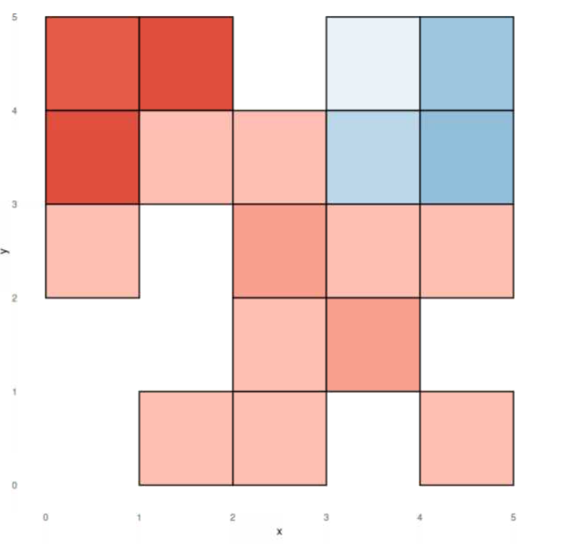

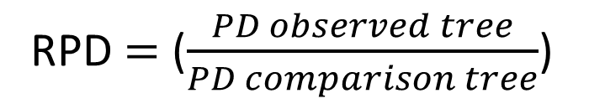
Intro to RPD and RPE
RPD = ($\frac{PD observed tree}{PD comparison tree}$)
RPD > 1 = Cell Contains Longer Branches than Expected
RPD < 1 = Cell Contains Shorter Branches than Expected

Slide 25
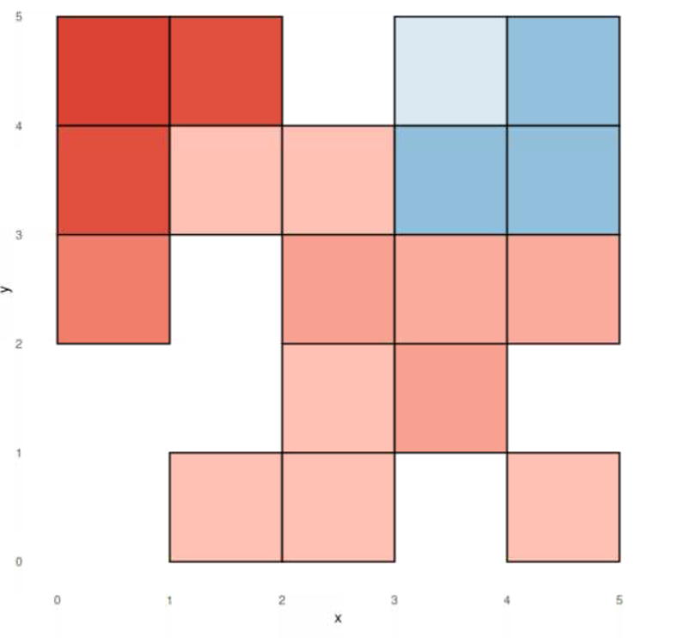

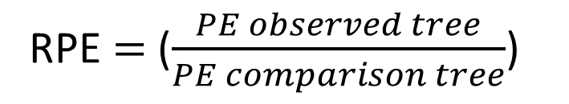
Intro to RPD and RPE
0.081≈ (0.244/3)
RPE = ($\frac{PE observed tree}{PE comparison tree}$)
RPE > 1 = Cell Contains Range Restricted Longer Branches than Expected
RPE < 1 = Cell Contains Range Restricted Shorter Branches than Expected

Slide 26
So Many Metrics…But what is random noise vs biology?
PD
PE
RPD
RPE
More Null Models!

Slide 27
Community Randomizations
Community randomizations are a way to generate a null distribution (the expected values of community metrics under a specific null hypothesis)
“Curveball” algorithm
What remains constant:
  The Phylogenetic Tree Structure
  Species Richness per Cell
  Species Overall Prevalence (Total # Occurrences)
What gets shuffled
  The community matrix
Original Community Matrix
A
A
B
A
A
E
B
D
E
F
A
B
A
B
Extract PD, RPD, PE, and RPE. These are our ‘Observed Values’
D
D
D
F
C
D
B
D
C
C
C
D
D
C
D
D
D

Slide 28
Community Randomizations
Community randomizations are a way to generate a null distribution (the expected values of community metrics under a specific null hypothesis)
“Curveball” algorithm
What remains constant:
  The Phylogenetic Tree Structure
  Species Richness per Cell
  Species Overall Prevalence (Total # Occurrences)
What gets shuffled
  The community matrix
Randomized Community Matrix x1
A
A
B
A
A
D
D
D
C
F
A
B
B
C
A
B
D
C
D
D
Extract PD, RPD, PE, and RPE
B
D
E
D
D
D
D
C
E
F
C

Slide 29
Community Randomizations
Community randomizations are a way to generate a null distribution (the expected values of community metrics under a specific null hypothesis)
“Curveball” algorithm
What remains constant:
  The Phylogenetic Tree Structure
  Species Richness per Cell
  Species Overall Prevalence (Total # Occurrences)
What gets shuffled
  The community matrix
Randomized Community Matrix x999
A
A
B
A
A
D
A
B
D
A
A
A
C
D
C
D
D
D
D
F
A
B
F
D
A
A
A
D
D
C
F
D
D
D
A
B
C
F
D
A
A
A
D
D
A
C
F
A
B
B
D
D
B
C
F
D
A
B
A
B
B
C
D
C
A
B
C
D
D
A
B
A
B
D
F
D
B
D
A
B
C
D
B
C
D
C
C
A
B
D
A
B
A
B
D
D
B
A
B
C
D
D
B
C
C
D
D
D
B
C
A
B
D
A
D
D
B
B
B
C
C
D
Repeat Extraction of PD, RPD, PE, and RPD to collect all the randomized null values per cell
C
D
D
D
B
D
D
E
D
D
E
D
B
C
D
B
D
D
E
D
B
D
D
E
D
D
E
B
D
D
E
D
D
D
D
D
D
D
D
E
D
D
D
D
C
D
C
D
D
D
D
C
D
C
D
C
D
C
E
C
E
F
F
C
C
E
F
C
E
F
C
E
F
C
E
F
C
E
F
C

Slide 30
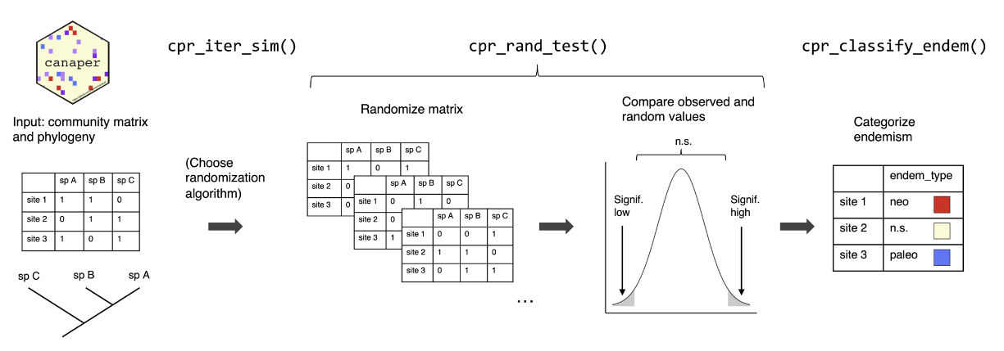
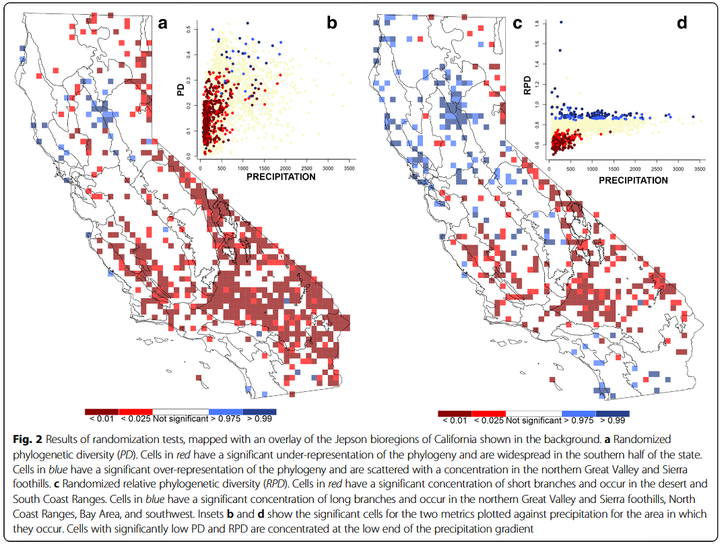
Community Randomizations
Test whether your observed value is in either the lower or upper tail of the null distribution
Thornhill et al. 2017

Slide 31
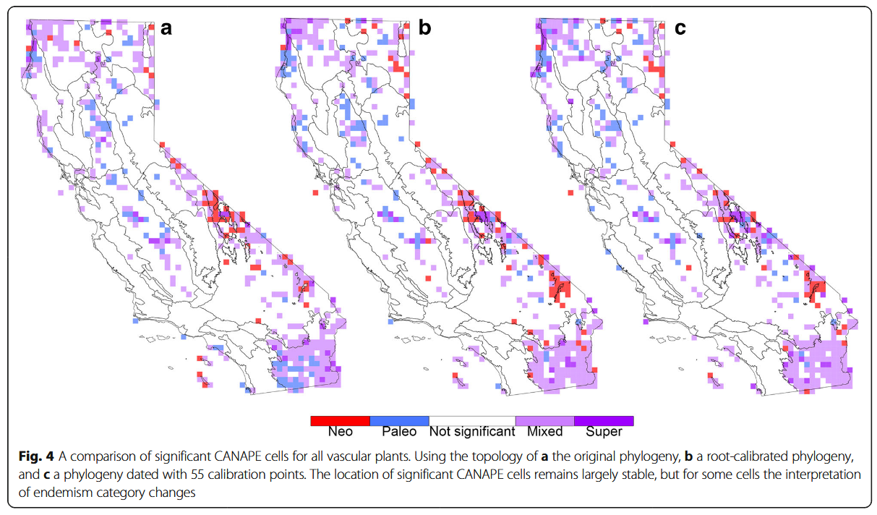
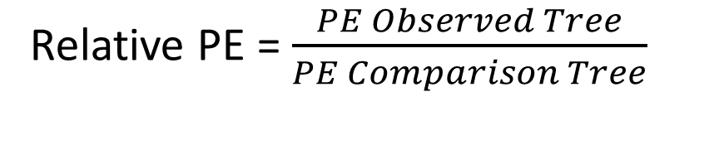
Categorization of Neo- and Paleo Endemism (CANAPE)
Relative PE = $\frac{PE Observed Tree}{PE Comparison Tree}$
Thornhill et al. 2017
CANAPE (Mishler et al. 2014)
1. Is a cell significant for RPE?
2. Two-tailed Test on RPE ratio

Slide 32
Categorization of Neo- and Paleo Endemism (CANAPE)
Relative PE = $\frac{PE Observed Tree}{PE Comparison Tree}$
Thornhill et al. 2017
CANAPE (Mishler et al. 2014)
1. Is a cell significant for RPE?
2. Two-tailed Test on RPE ratio

Slide 33
Categorization of Neo- and Paleo Endemism (CANAPE)
Relative PE = $\frac{PE Observed Tree}{PE Comparison Tree}$
Thornhill et al. 2017
CANAPE (Mishler et al. 2014)
1. Is a cell significant for RPE?
2. Two-tailed Test on RPE ratio

Slide 34

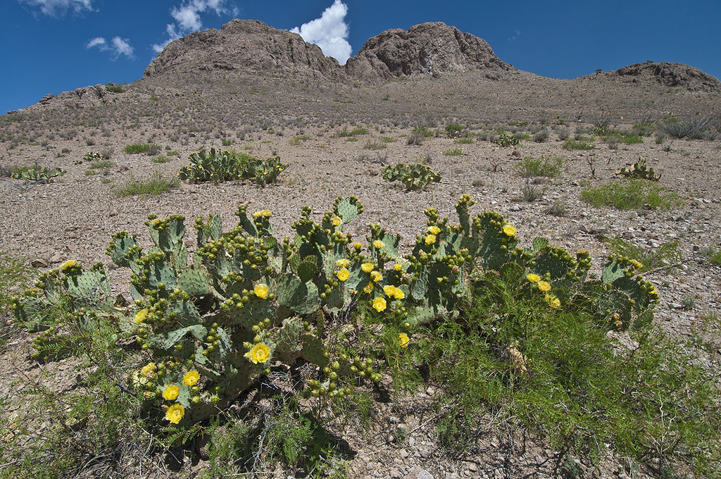
Time for a well-deserved Coffee Break. Then we’ll look at applying these methods to the Sonoran Basin and Range’s Cacti
© Ad Konings
Western Pricklypear (Opuntia orbiculate)

