Slide 1
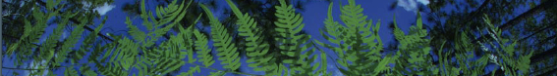



Applications:
An Overview

Slide 2
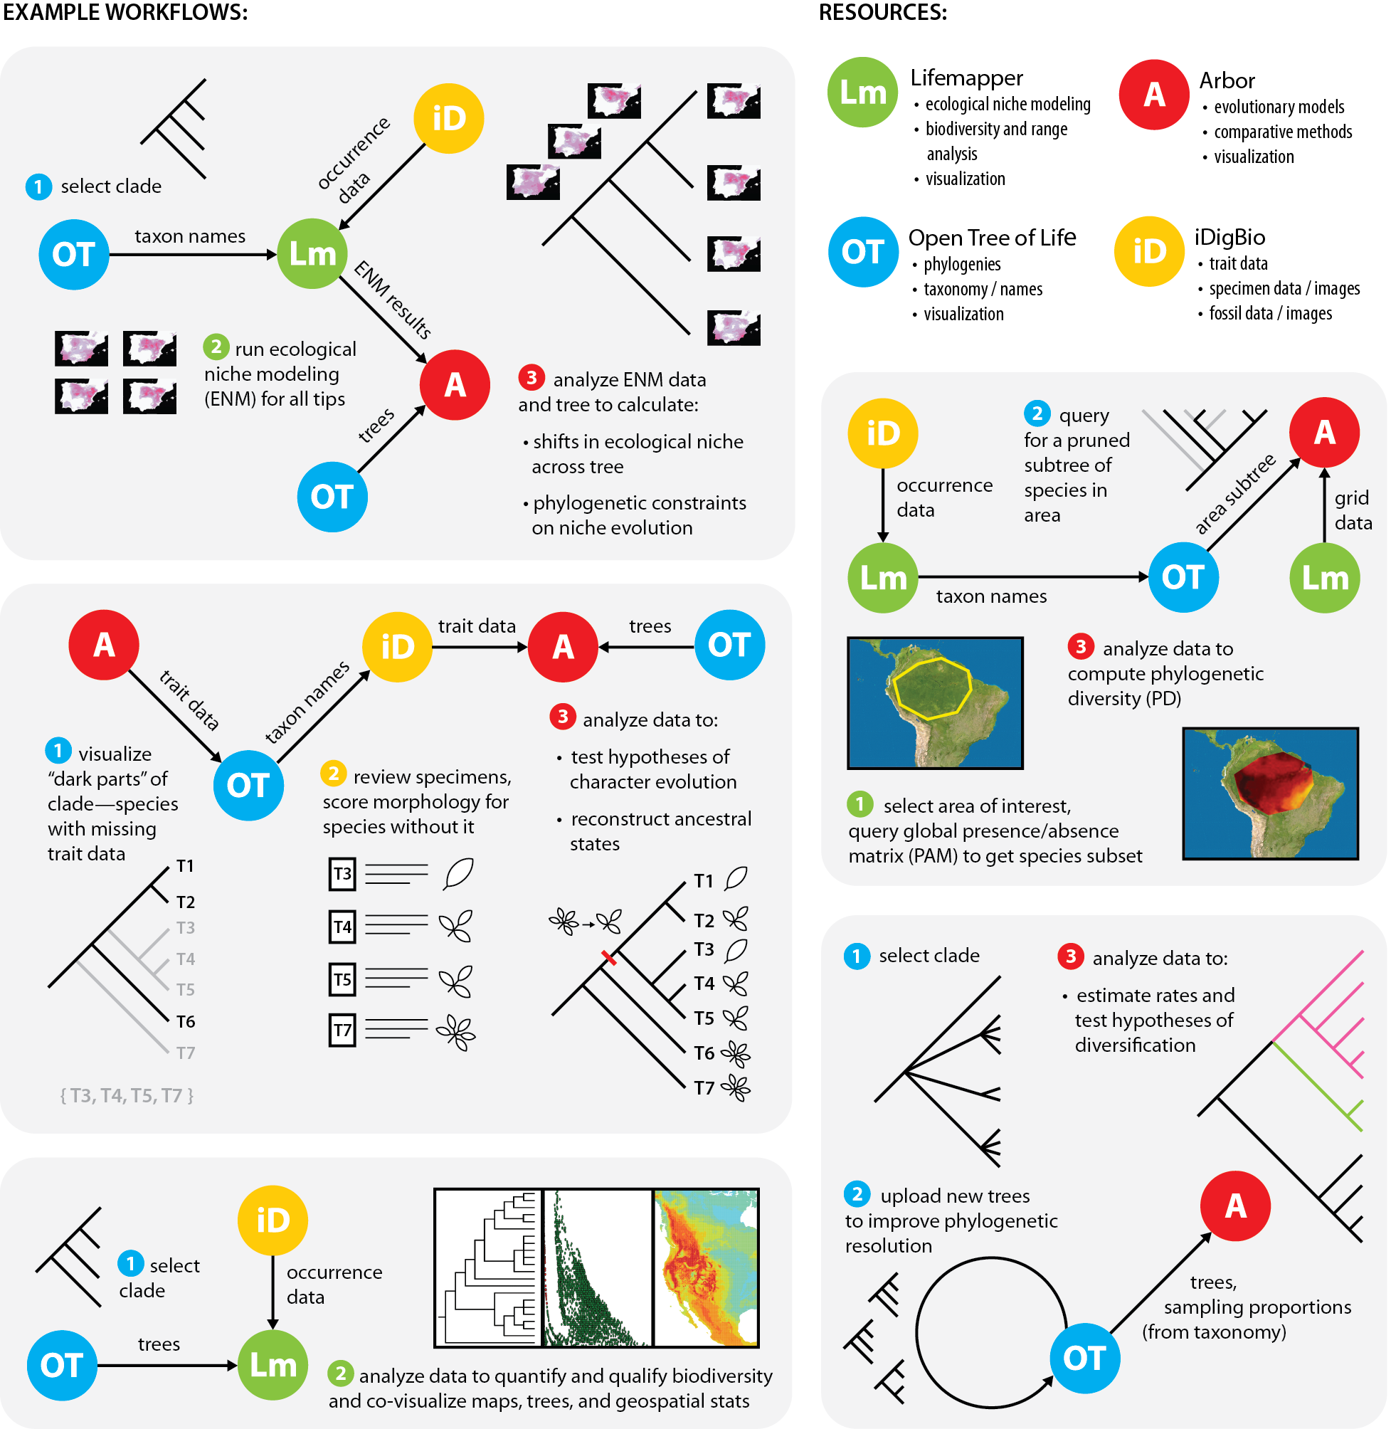
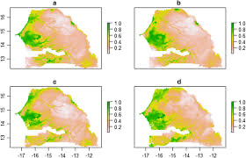
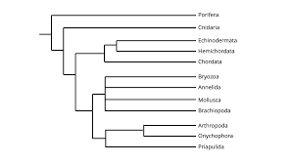
Connecting Specimens, Trees, Niche Models, Tools:
Examples
N
Analytical Tools
Niche Models
Analytical Tools
T
Trees
Notes:
What we want to do today is highlight some of the exciting workflows our team is developing –so that you can see some of the possibilities that you may want to implement yourselves…using our platform deliverables and what ultimately should be easy to use workflows.. As originally conceived the goal of our first NSF-funded Biotaphy project was to connect specimens, trees, tools.. In Biotaphy 2—our current funding—we want to make workflows more accessible to the community

Slide 3
Connecting Specimens, Trees, Niche Models, Tools:
Examples
N
Niche Models
Analytical Tools
Analytical Tools
T
Trees
Allen et al.. 2019. Biodiversity synthesis across the green branches of the tree of life. Nature Plants 5:11-13.
Notes:
What we want to do today is highlight some of the exciting workflows our team is developing –so that you can see some of the possibilities that you may want to implement yourselves…using our platform deliverables and what ultimately should be easy to use workflows.. As originally conceived the goal of our first NSF-funded Biotaphy project was to connect specimens, trees, tools.. In Biotaphy 2—our current funding—we want to make workflows more accessible to the community

Slide 4
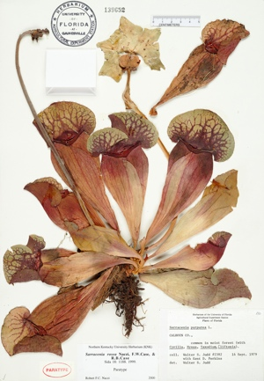
Label Data
(Occurrences)
Scientific name
Date
Collector
Location – state, county,
specific site,
GPS coordinates
Associated species

Slide 5




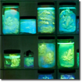


Niche Models
Species Occurrence Data
Predicted Habitat
Environmental Data
Notes:
Lifemapper calculates predicted habitat models using occurrence and environmental data---niche models on the fly

Slide 6
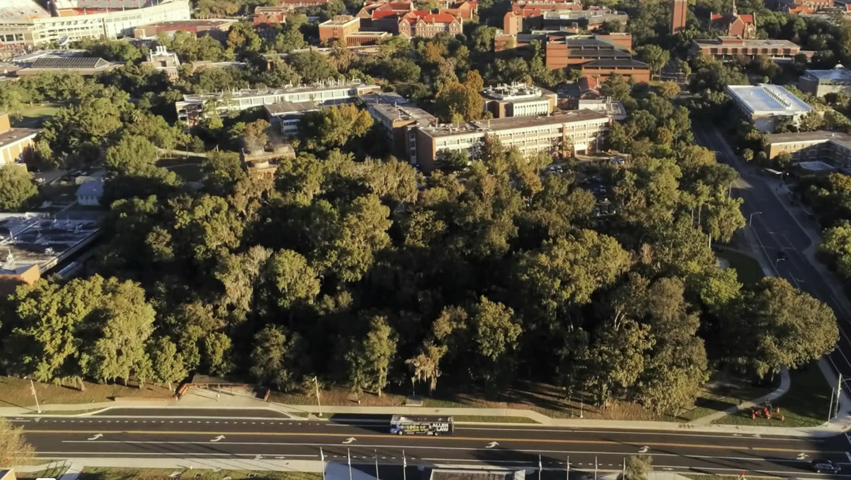
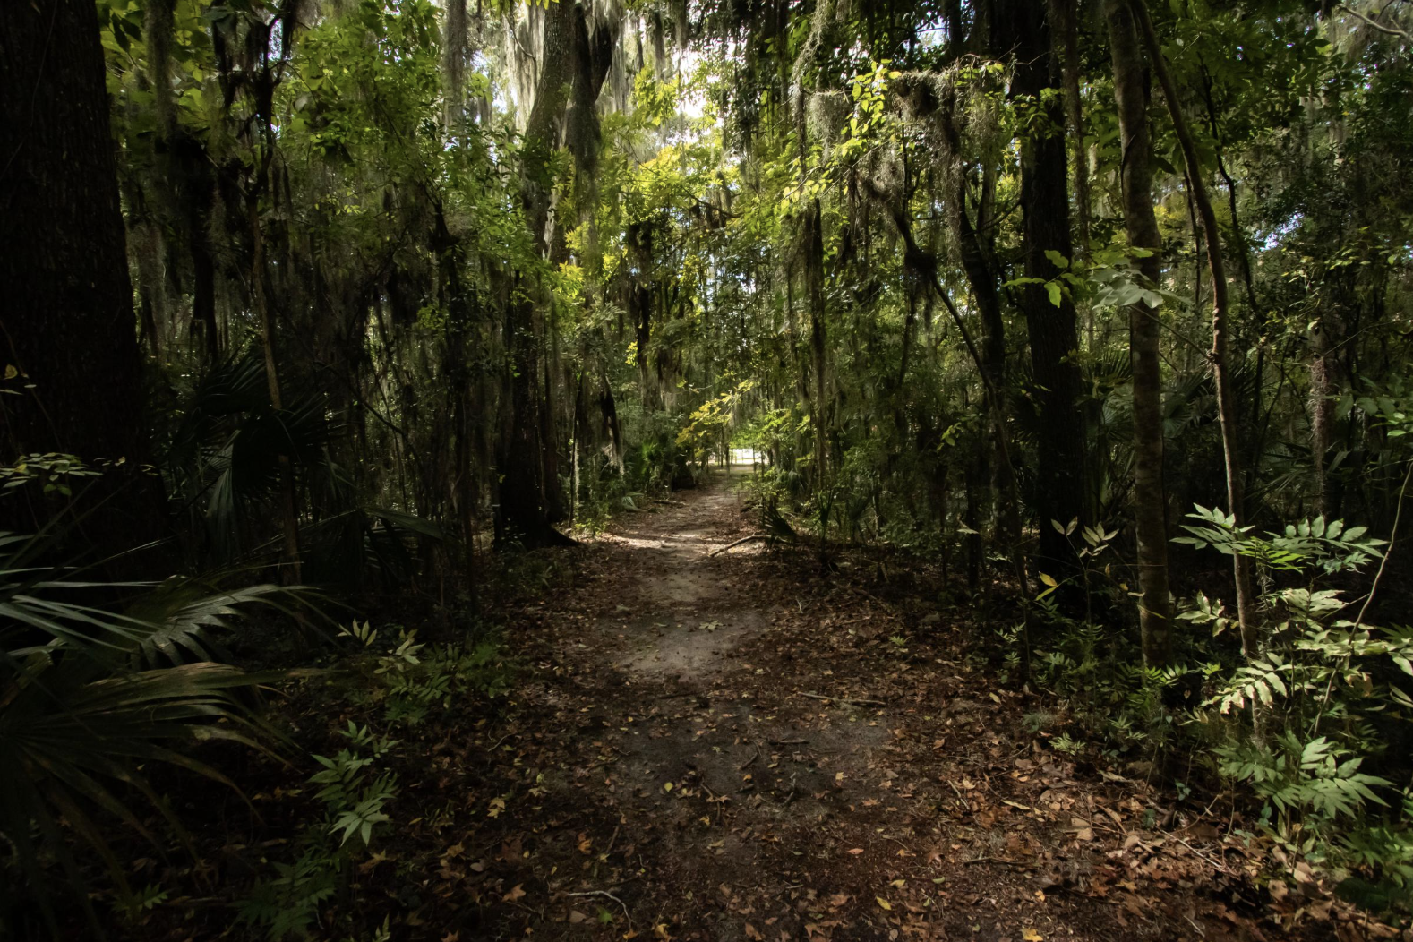
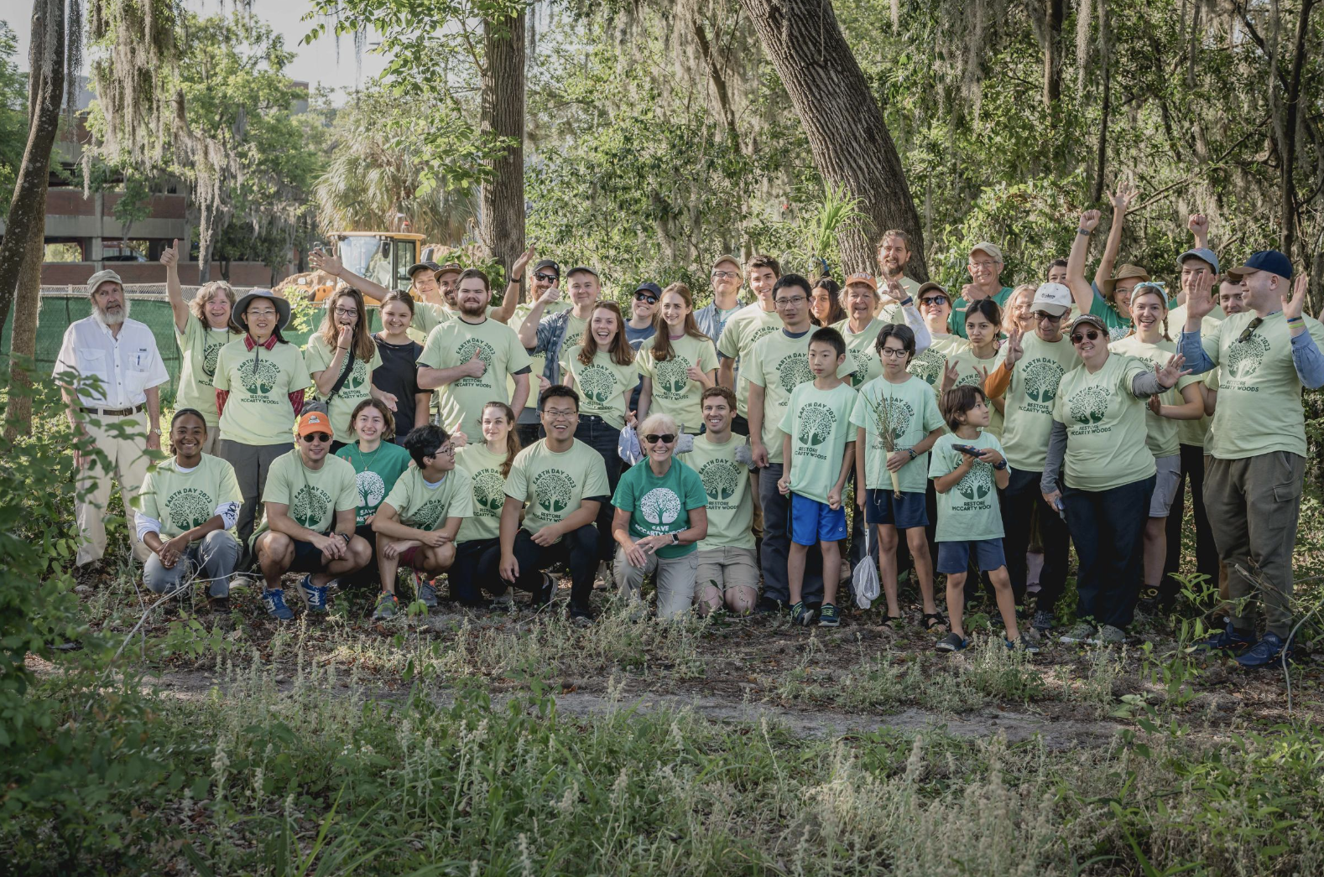
FLORIDA UPLAND HARDWOOD FORESTS
Andres Leon
John Rouse
Mariela Pajuelo
McCarty Woods, University of Florida

Slide 7

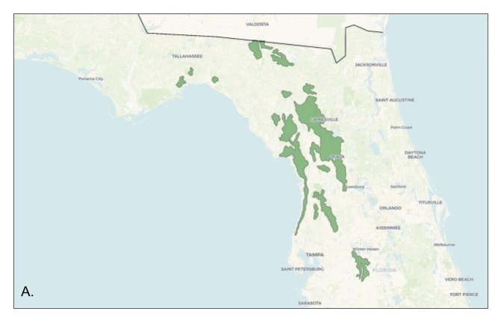
FLORIDA UPLAND HARDWOOD FORESTS
1,248,796 occurrence records for 39 focal species and 32 plant families.
Final cleaned dataset contained 371,253 occurrence records.

Slide 8
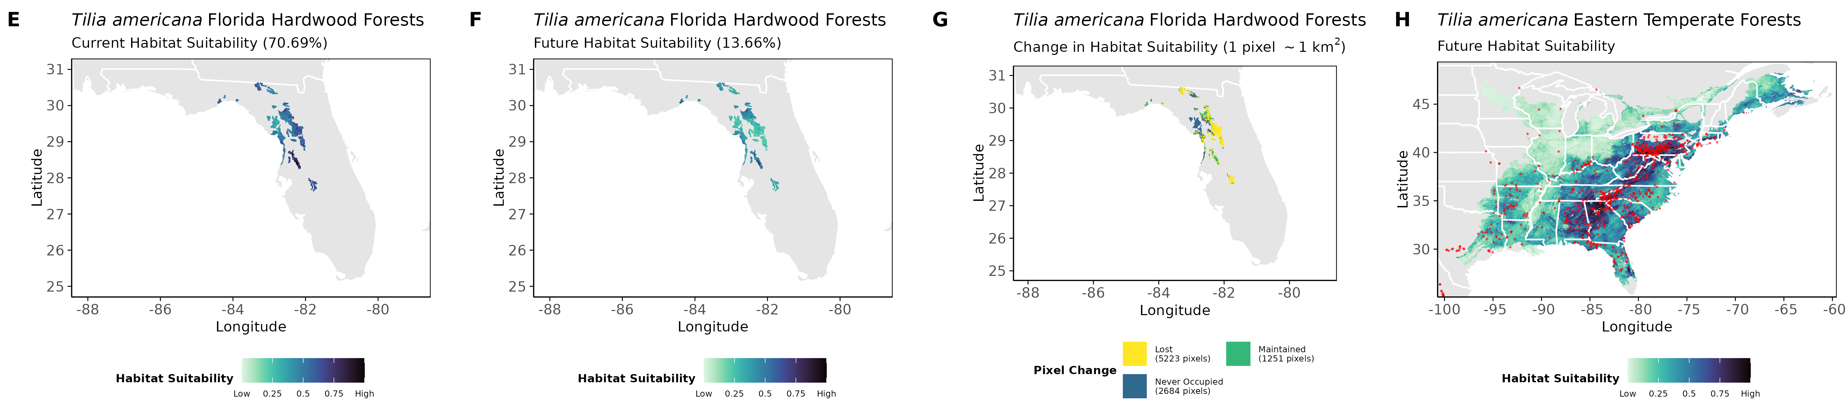
FLORIDA UPLAND HARDWOOD FORESTS | Future Habitat Suitability
Tilia americana and many focal taxa reach southern edge of distribution in Florida.
Projected to lose habitat suitability in Florida Upland Hardwoods
Future projections also indicate broad retention of suitable habitat across its core range.
Results suggest relative climatic stability outside of Florida.

Slide 9
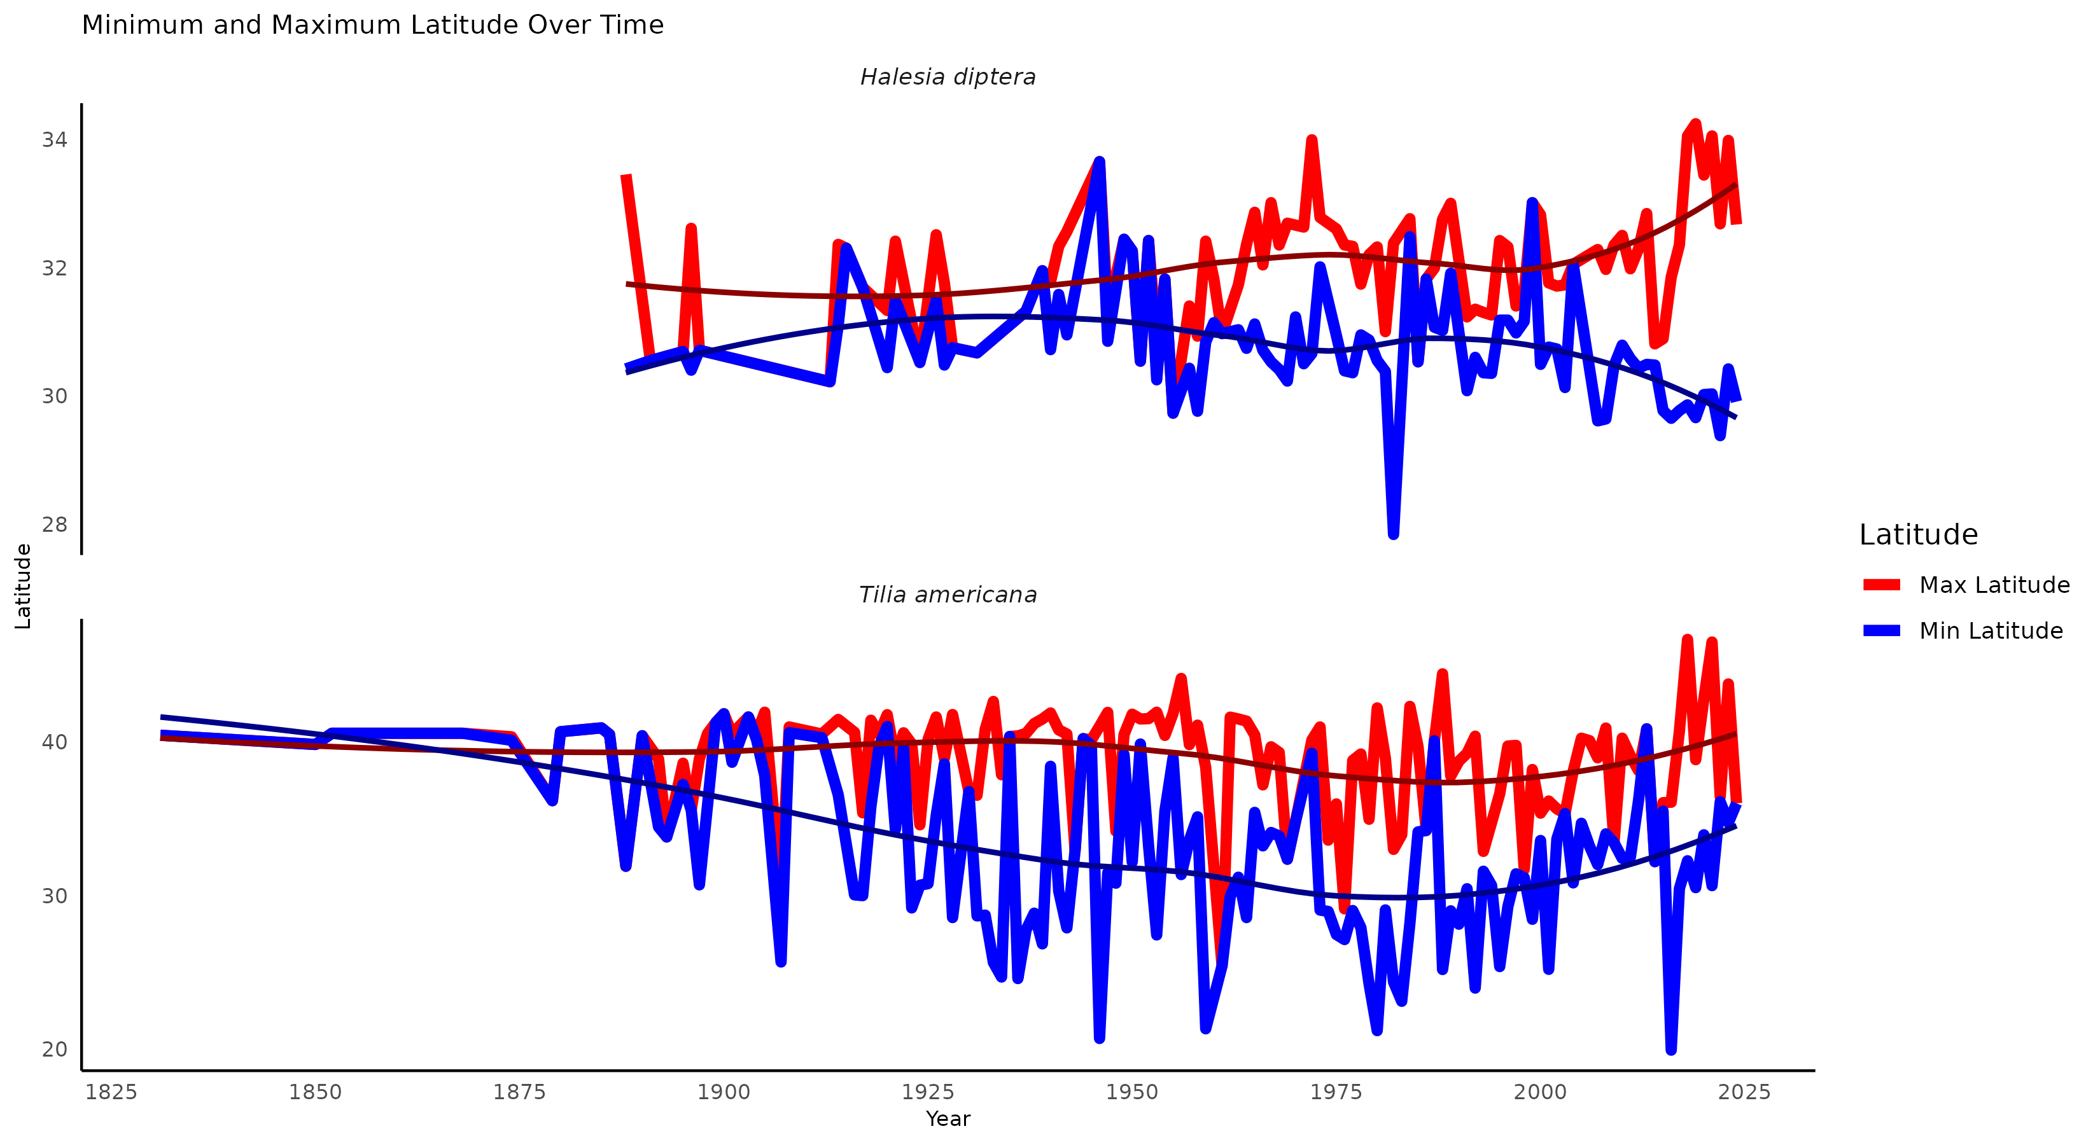
FLORIDA UPLAND HARDWOOD FORESTS | Latitudinal Range Change
Halesia diptera showed a widening latitudinal range over time.
Tilia americana showed a northward retreat of its southern range limit, suggesting trailing-edge contraction.

Slide 10
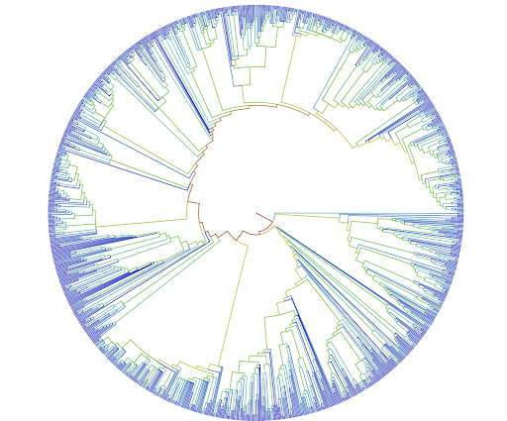
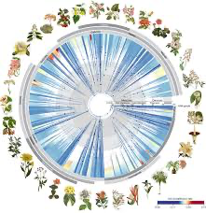
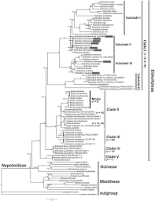
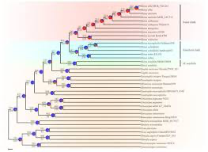
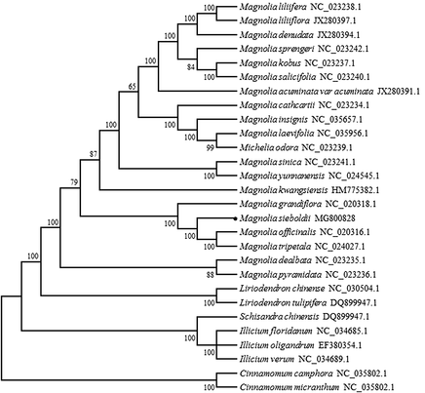
Trees

Slide 11
Connecting Trees, Specimens, Tools
Ancestral Niche
T
N
N
Niche Models
Analytical Tools
Analytical Tools
T
Trees
T
Notes:
One workflow that has been of great interest is to reconstruct ancestral niche. You have a Clade of interest- we need taxon names (OT) and occurrence data (iDigBio)— we can use those data to build niche models for all the tip species We also need a tree (build one or download one) and we can now examine niche shifts across the tree and look at phylogenetic constraints on niche evolution

Slide 12
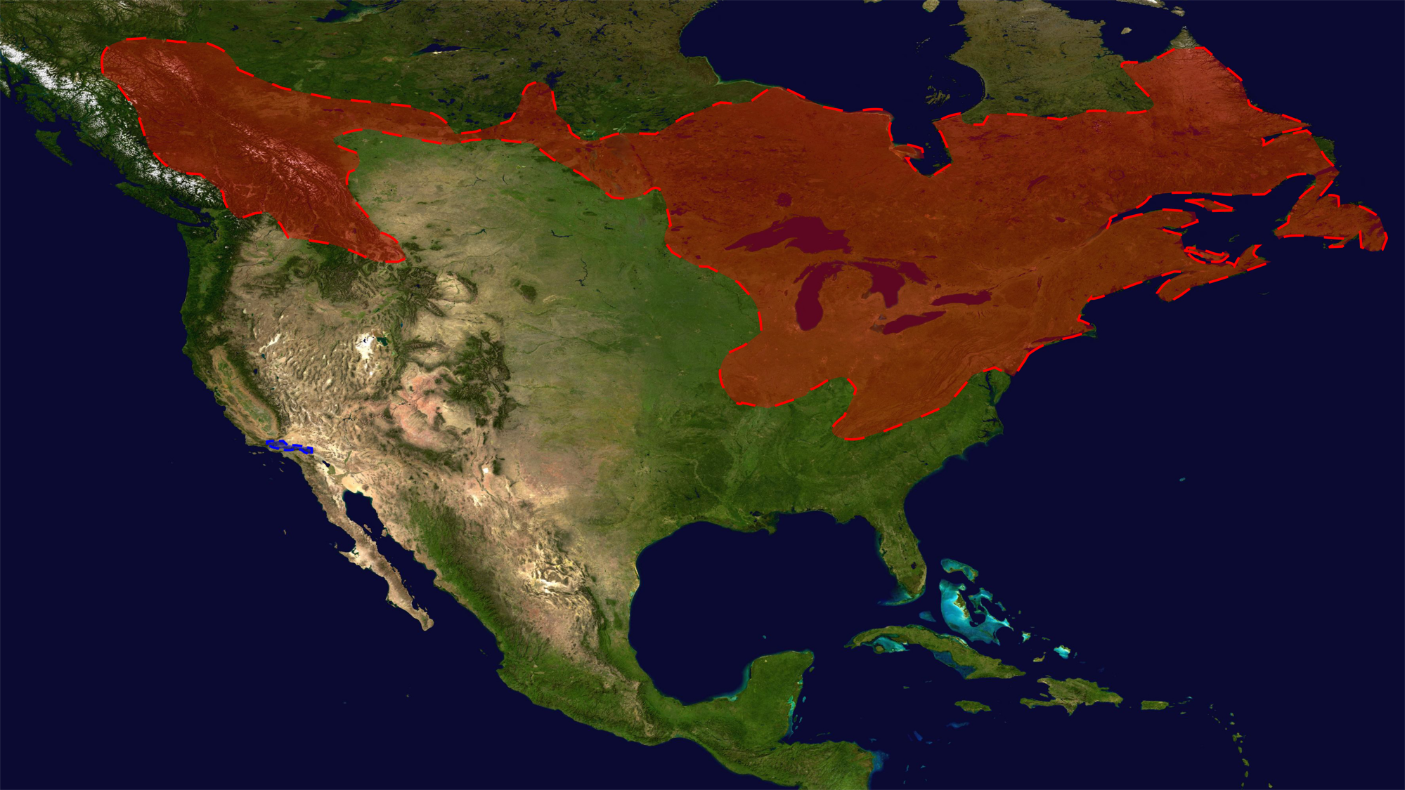
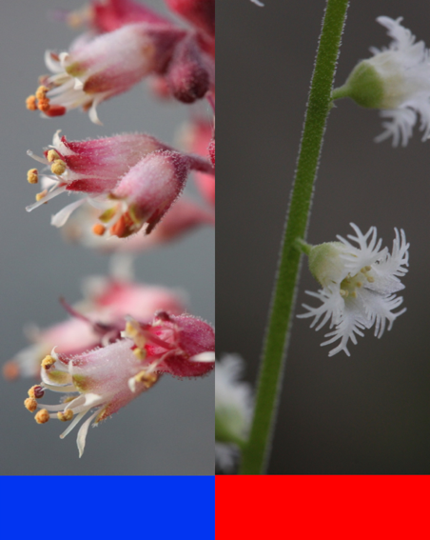

Solving a Hybridization Puzzle
cpDNA capture
Heuchera
Mitella
Ryan Folk

Slide 13
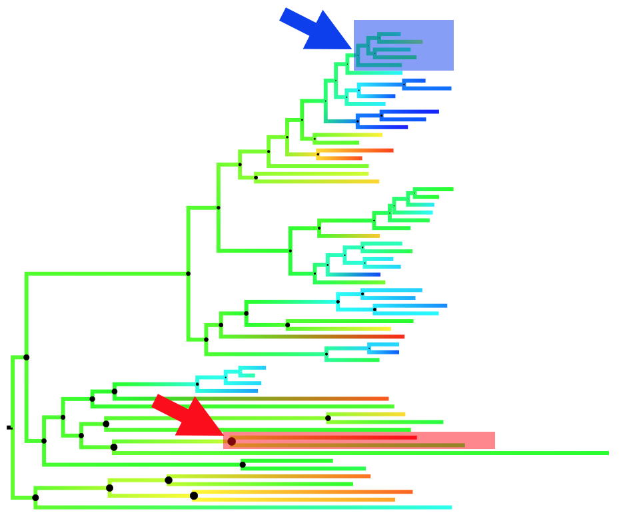
Hybridization & Ancestral Ecological Niche-Space
Heuchera
Mitella
Notes:
Reconstructed the ancestral niche for the clades of heuchera and Mitella—35 layers-custom scripts, Bayestraits….ryan can provide details

Slide 14
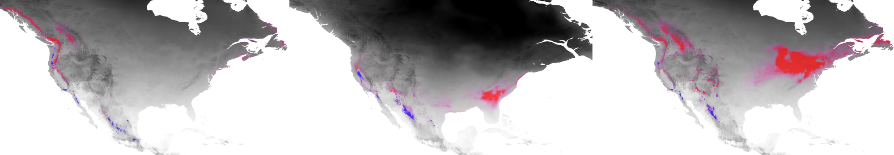

Ancestral Niche Reconstruction
Heuchera
Ryan Folk
Heuchera
Mitella
Folk et al. 2023. Identifying Climatic Drivers of Hybridization with a New Ancestral Niche Reconstruction Method. Syst Biol. 2023;72(4):856-873. doi: 10.1093/sysbio/syad018. PMID: 37073863; PMCID: PMC10405357
Notes:
Then used paleoclimatic projections –worldclim—to assess possible niche overlap through time

Slide 15
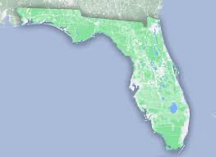
Spatial Phylogenetics
N
T
N
N
Niche Models
Analytical Tools
Analytical Tools
T
Trees
Notes:
Another workflow of interest involves studies of spatial phylogenetics. A researcher selects an area of interest- here the Amazonian region but if could be Florida or a watershed in Ohio. You need a species list - occurrence data for those species. - and you need a tree for just those species. That tree can be obtained by pruning an existing tree to match your species list. You can then compute phylogenetic diversity (PD)-

Slide 16

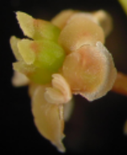
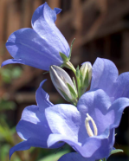
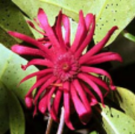
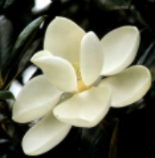
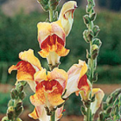

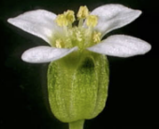
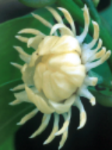
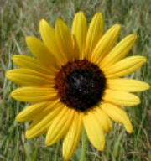
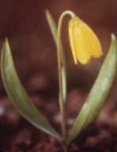
Phylogenetic Diversity (PD):
How much of the Tree of Life is present in an area?
Oaks
Vs.
Notes:
Hannah will tell you more about PD next

Slide 17
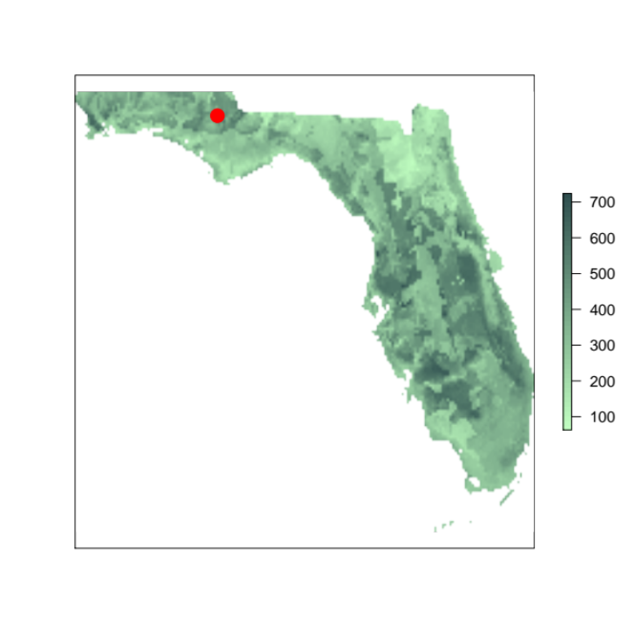
Phylogenetic Diversity (PD):
How much of the Tree of Life is present across Florida?
Notes:
So for any area, such as a small region of the Panhandle, we can ask which species are there, and how much of the tree do they represent?

Slide 18
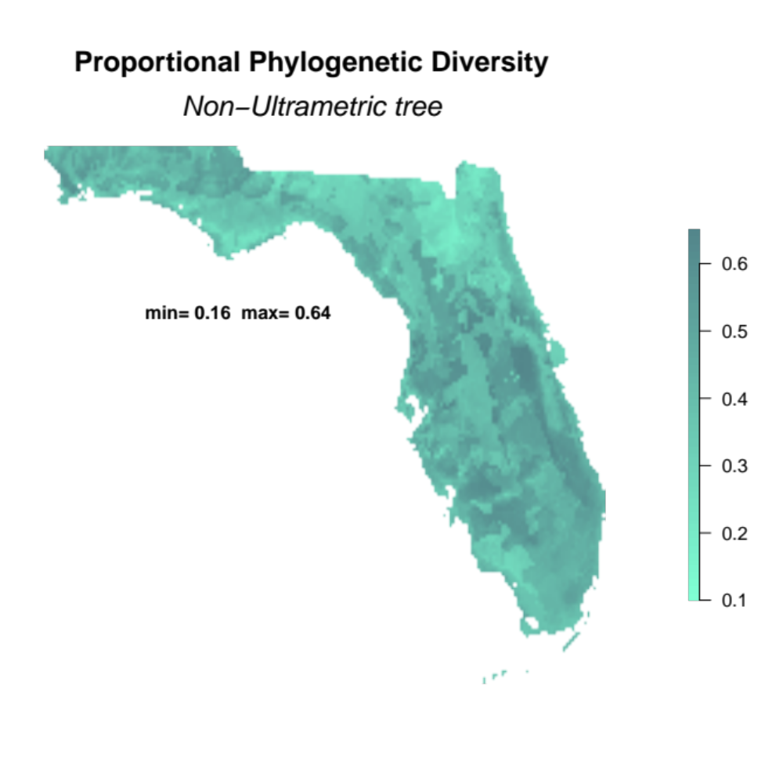
Phylogenetic Diversity
PD = proportion of tree present in cell
Allen et al.. 2019. Spatial phylogenetics of Florida vascular plants: The effects of tree uncertainty and ultrametricity. iScience11: 57–70 https://doi.org/10.1016/ j.isci.2018.12.002
Notes:
Both are highly correlated with each other, and with the alpha diversity map too. Ultramatric is generally lower over the landscape.
This might be due to a low proportion of short deep branches in the tree. These lengthen the overall

Slide 19
Evolutionary History of the Angiosperm
Flora of China
30,000 species vascular plants
3176 genera
92% of genera sampled
26,978 species tree
Lu et al. Nature, 2018

Slide 20
Phylogenetic Diversity: China
Low PD
High PD
Lu et al. 2018 Nature

Slide 21
Conservation: Protected Areas vs. High PD in China
Blue and Pink = conservation areas
Lu et al. 2018
Notes:
This same approach can be applied to much larger geographic regions. Here we, with some Chinese collaborators, applied the same methods to China. And we can see that the regions with the highest PD, in pink and blue – subtropical forests, in S China, are not the regions that are under greatest conservation – these large expanses of green in western China that include grasslands.
Studies using the tree of life have great potential for conservation.

Slide 22
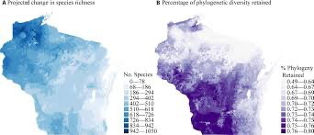
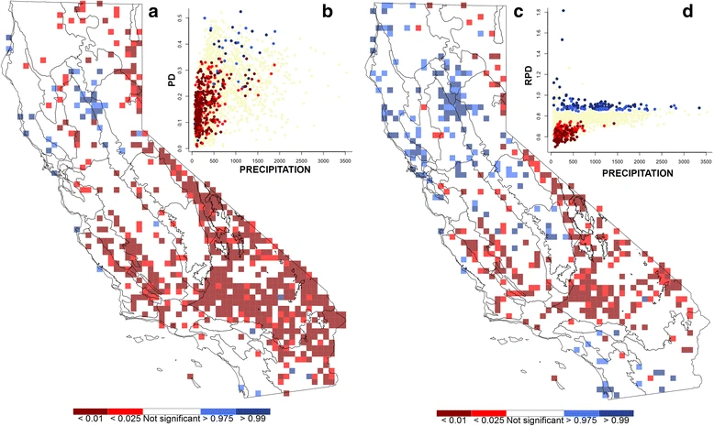
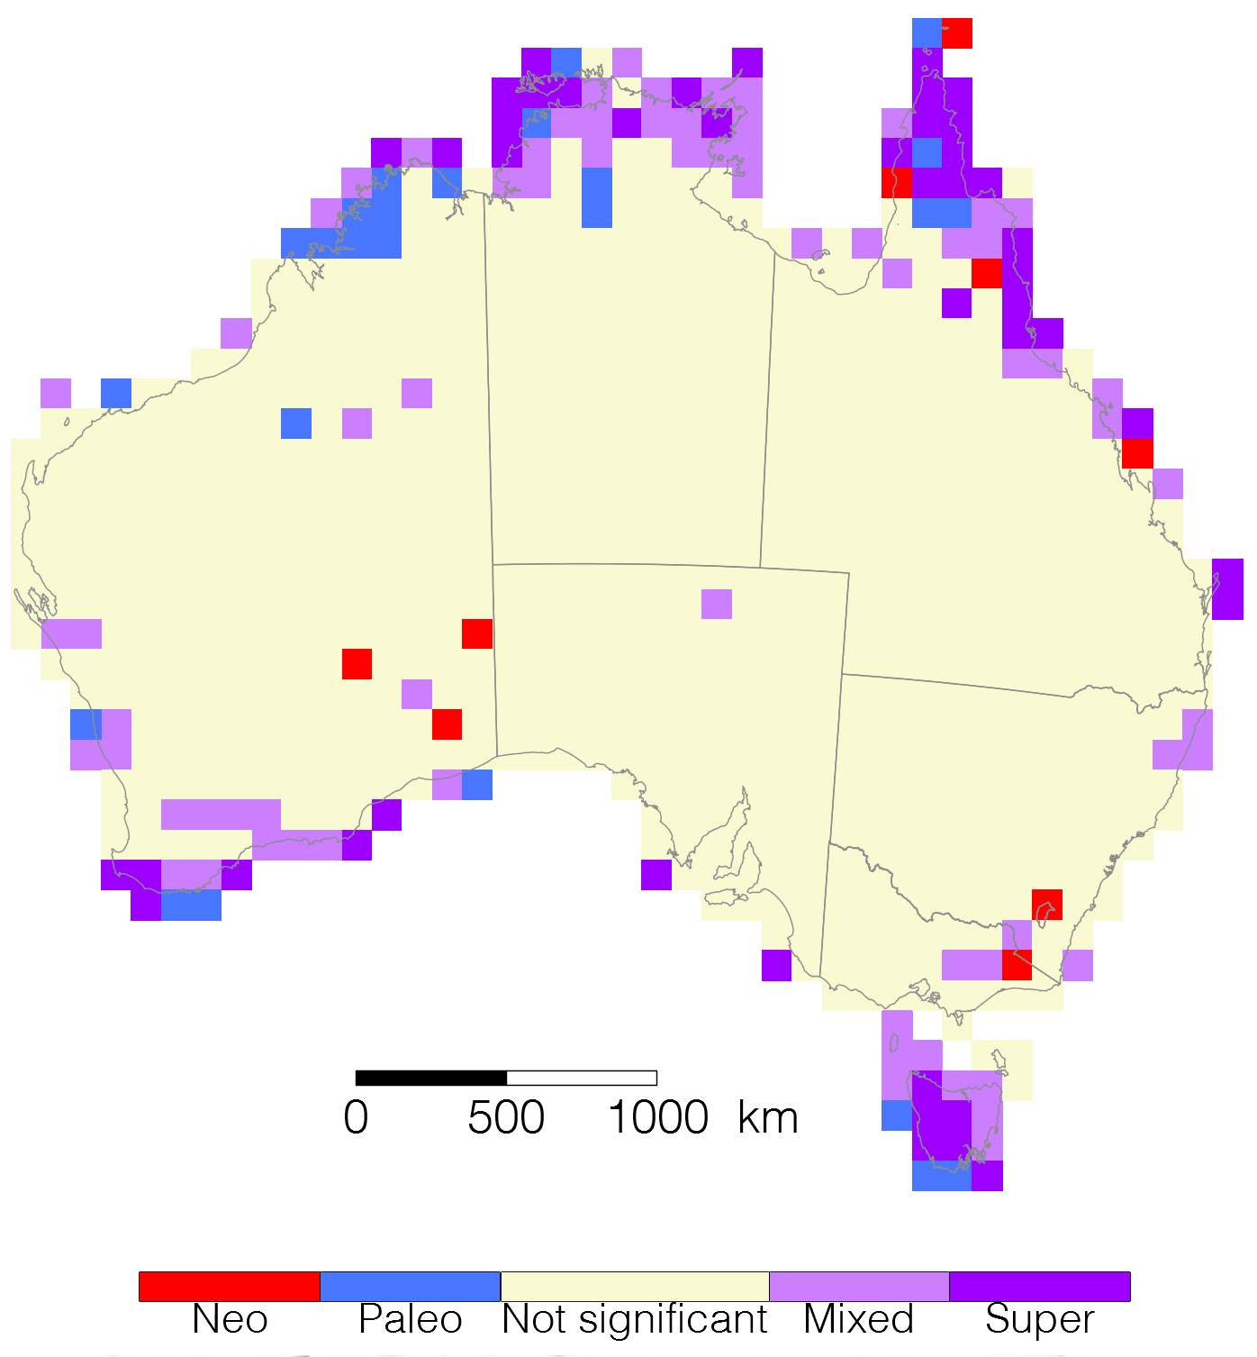
Phylogenetic Diversity
Spalink, D. et al. 2018. Spatial phylogenetics reveals evolutionary constraints on the assembly of a large regional flora. American Journal of Botany 105(11): 1938–1950.
Thornhill et al. Spatial phylogenetics of the native California flora. BMC Biol 15, 96 (2017). https://doi.org/10.1186/s12915-017-0435-x
Mishler et al. Phylogenetic measures of biodiversity and neo- and paleo-endemism in Australian Acacia. Nat Commun 5, 4473 (2014). https://doi.org/10.1038/ncomms5473

Slide 23
Spatial Phylogenetics of the North American Flora
Red = significant concentration of short branches
Blue = significant concentration of long branches
Red = significantly less PD than expected
Blue = significantly more PD than expected
Mishler et al. 2020. J. Syst. Evol., 58: 393-405. https://doi.org/10.1111/jse.12590

Slide 24
Relative Phylogenetic Diversity
    RPD - relative phylogenetic diversity=
    PD on the original tree
    PD on a comparison tree with
    all branch lengths equal
significant concentration of short branches
VS
significant concentration of long branches
RPE is ratio of B/D:
    RPE - relative phylogenetic endemism =
RPD: identify and distinguish areas of phylogenetic overdispersion and
clumping that reflect signals of biogeographic history and
ecological processes
    PD on the range-weighted original tree
    PD on a range-weighted comparison tree with
    all branch lengths equal
Mishler et al., (2014)

Slide 25
Trait Evolution
T
T
N
Niche Models
Analytical Tools
Analytical Tools
T
Trees

Slide 26
Connecting Trees, Specimens, Tools
Ancestral Niche
T
N
N
Niche Models
Analytical Tools
Analytical Tools
T
Trees
T
Notes:
One workflow that has been of great interest is to reconstruct ancestral niche. You have a Clade of interest- we need taxon names (OT) and occurrence data (iDigBio)— we can use those data to build niche models for all the tip species We also need a tree (build one or download one) and we can now examine niche shifts across the tree and look at phylogenetic constraints on niche evolution

Slide 27
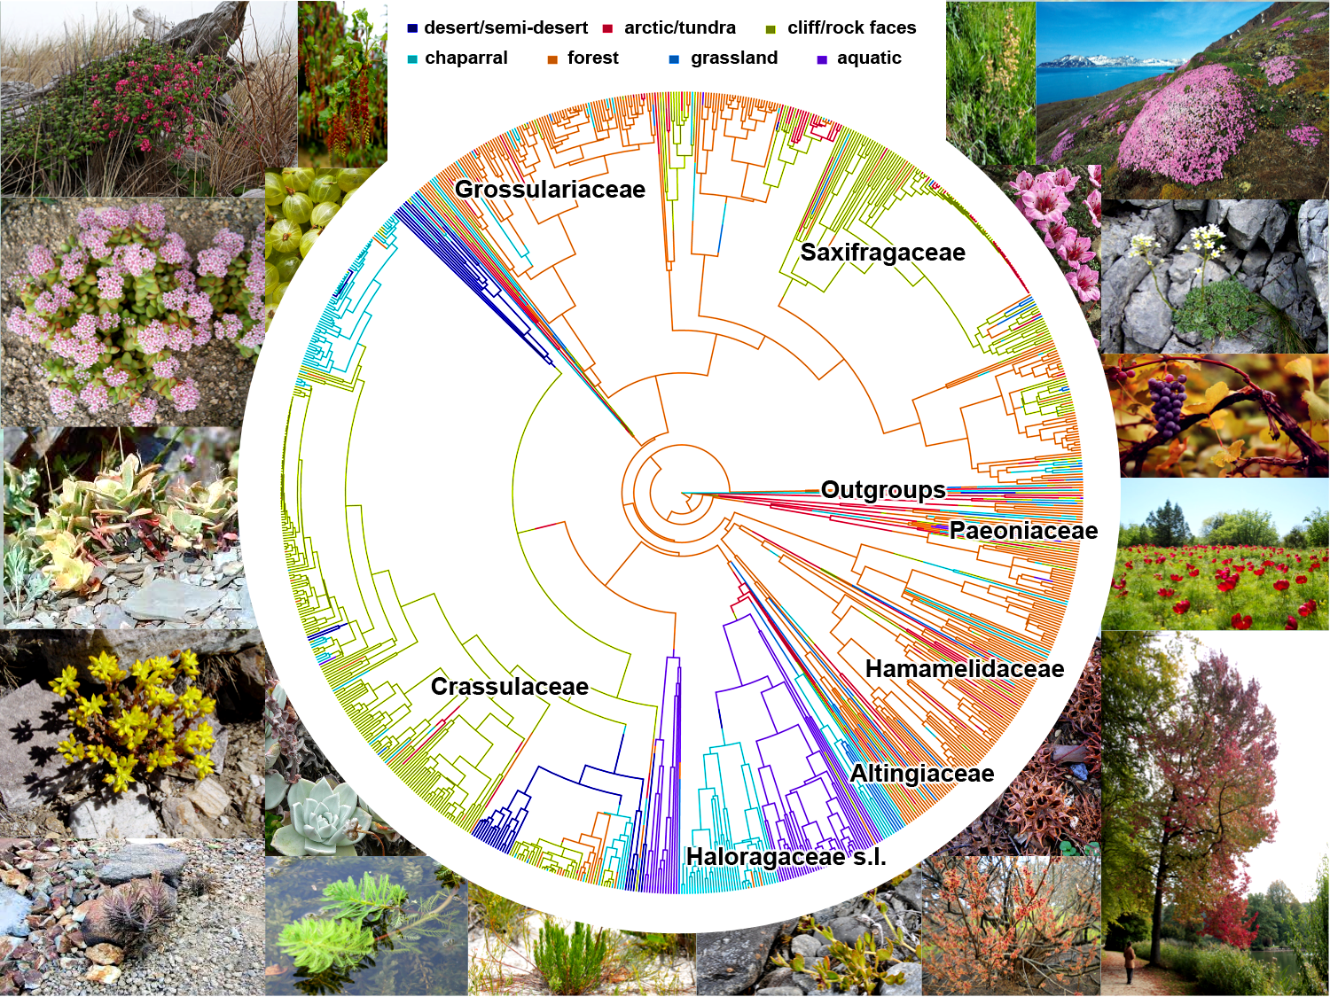
Saxifragales: Hyper-diverse

Slide 28
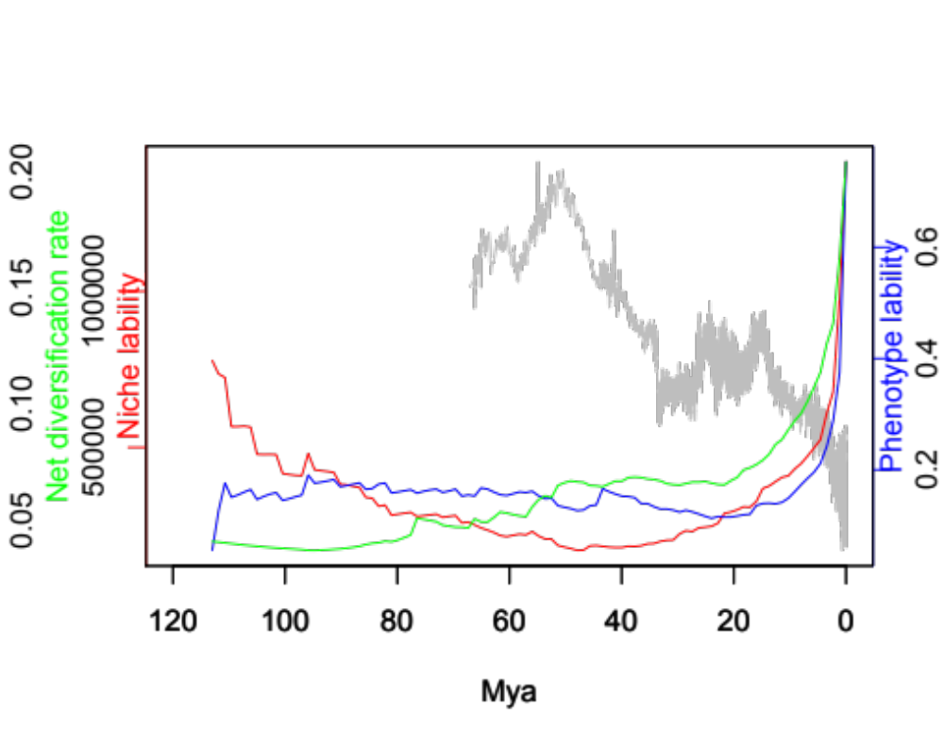
Diversification
A Temperate Radiation:
Mid-Miocene Cooling
Niche
Traits
Global temperature
Folk et al. 2019. Uncoupled diversification, ecological niche and phenotype in a temperate radiation. PNAS 116: 10874-10882.
Notes:
The green curve here represents net diversification through time, since the origin of the Saxifragales ~110 mya. The red curve represents niche lability, the blue curve represents trait lability, and the gray curve represents global historical temperature. Immediately, you can see that there is a strong uptick in macroevolutionary rates from about 15 mya.

Slide 29
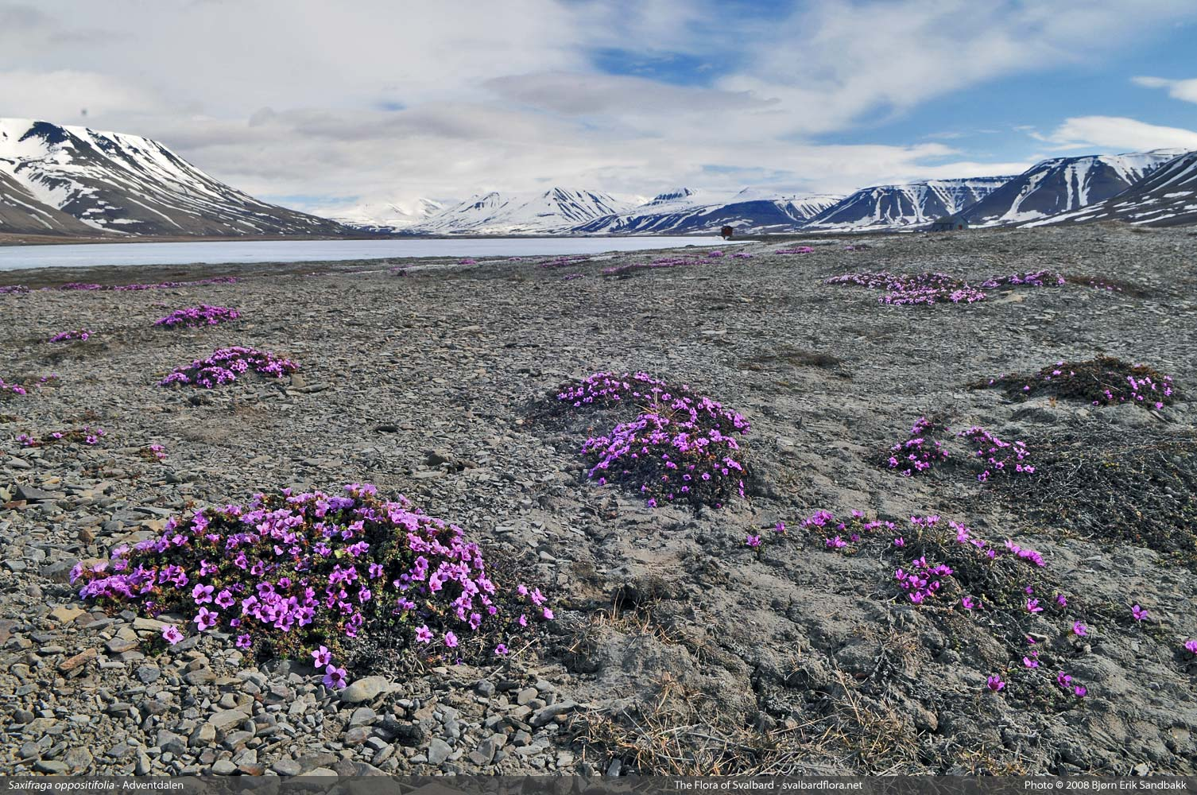
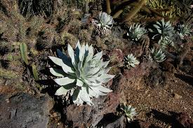
Response of Saxifragales to Climate Change
Mean annual temperature
Shifts are rare
Hot
Cold
Ryan Folk
100 million years
Notes:
Plant group contains peony, sweetgum, stone crops; and some of the most cold tolerant plants (upper right). Temperature shifts are canalizing events; lineages in those states for millions of years…do not switch out

Slide 30
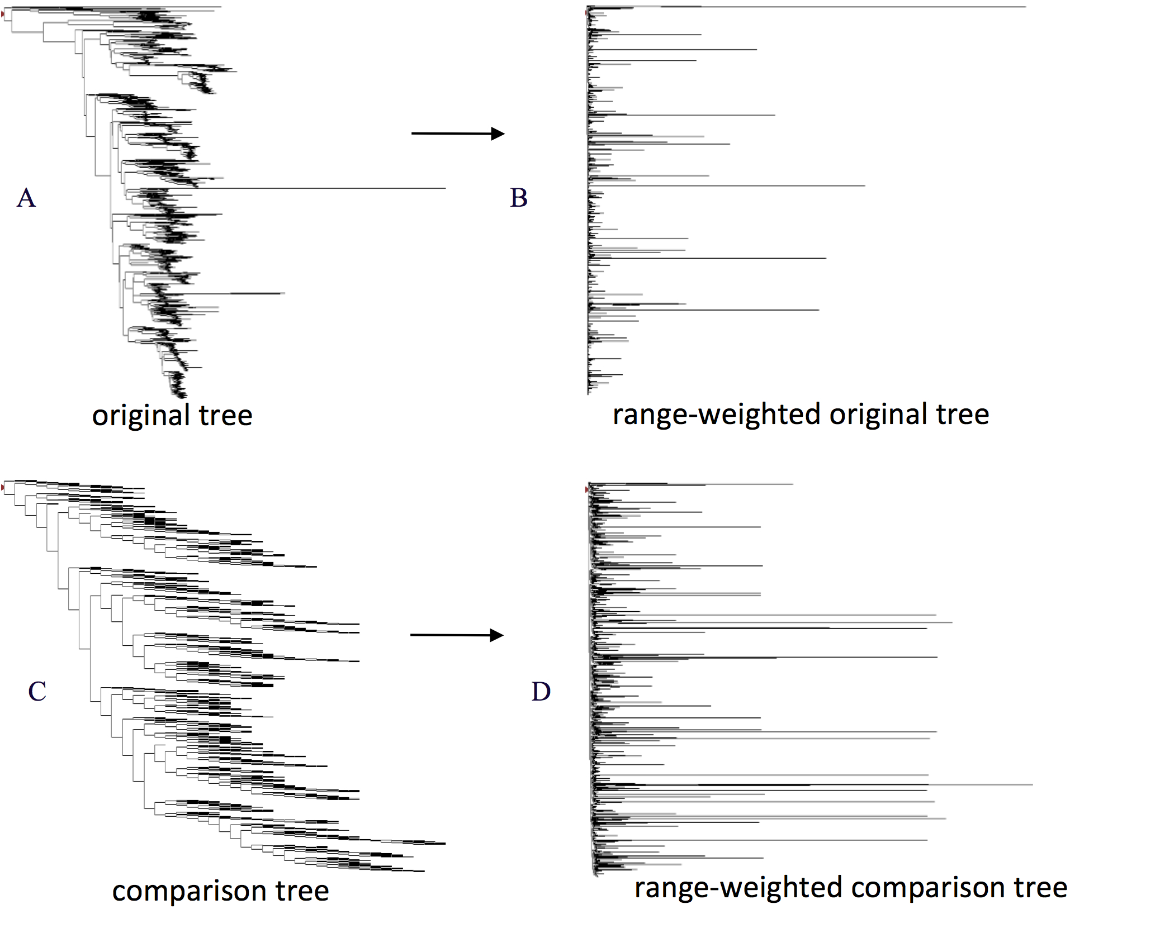
Relative Phylogenetic Diversity and Relative Phylogenetic Endemism
RPD is ratio of A/C:
    RPD - relative phylogenetic diversity=
    PD on the original tree
    PD on a comparison tree with
    all branch lengths equal
RPE is ratio of B/D:
    RPE - relative phylogenetic endemism =
    PD on the range-weighted original tree
    PD on a range-weighted comparison tree with
    all branch lengths equal
Mishler et al., (2014)

Slide 31

Thanks

