Slide 1




ENM Settings Overview
University of Florida
Created by Shelly Gaynor
BiotaPhy

Slide 2
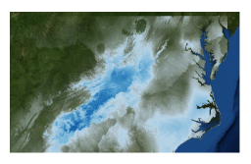
Ecological Niche Modeling
MaxEnt
uses the principle of maximum entropy on presence-only data to predicted the species’ potential geographic distribution (or niche)
Figure from Gaynor et al. 2018

Slide 3
MaxEnt
MaxEnt used only presence and pseudo-absences for model development
No ”best” algorithm for modeling (Qiao et al. 2015, Methods Ecol Evol), but MaxEnt generally performs well across evaluation criteria (Aguirre-Gutierrez et al. 2013, PLoS One)
What does it do?
Makes predictions about the probability that conditions are suitable for a given taxa to occur (does not calculate a true probability of occurrence!)
Models should be chosen that are as similar as possible to prior expectations while also being consistent with the data.
Important notes:
The grids must all have the same geographic bounds and cell size (i.e. all the ascii file headings must match each other perfectly)

Slide 4
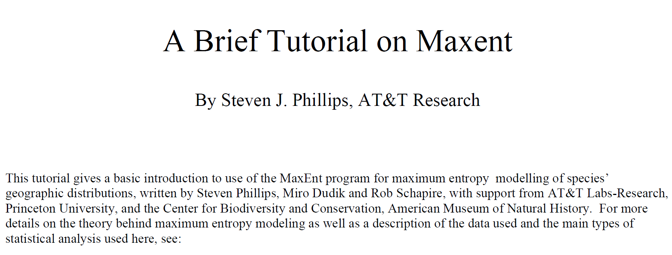
https://biodiversityinformatics.amnh.org/open_source/maxent/Maxent_tutorial2017.pdf

Slide 5
MAXENT SETTINGS
SUMMARY

Slide 6
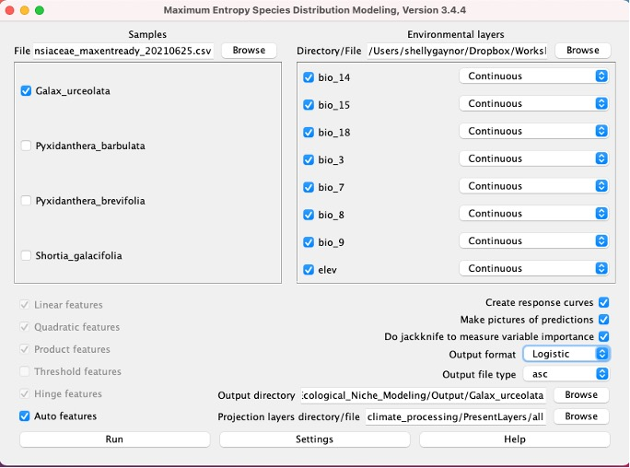
INPUT
Occurrence Records
Training layers
Only one species at a time
Select species specific training layers
Create output directory
Shared layers
Select projection layers

Slide 7
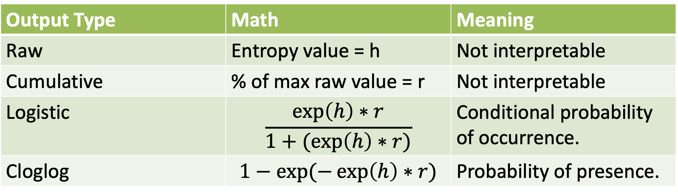
OUTPUT SETTINGS
Output Type | Math | Meaning
Raw | Entropy value = h | Not interpretable
Cumulative | % of max raw value = r | Not interpretable
Logistic | $$\frac{\exp\left(h\right)∗r}{1+(exp\left(h\right)∗r)}$$ | Conditional probability of occurrence.
Cloglog | $$1−exp(−\exp\left(h\right)∗r)$$ | Probability of presence.

Slide 8
OUTPUT SETTINGS
Select logistic
Logistic calculates the conditional probability of occurrence. The probability will be between 0 - 1.

Slide 9
BASIC SETTINGS

Slide 10
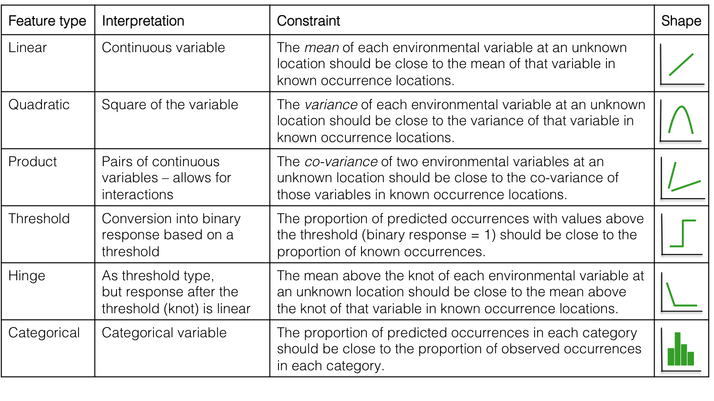
FEATURE CLASS
= used to transform the original predictor
Slide modified from M. Mabry

Slide 11
BASIC SETTINGS

Slide 12
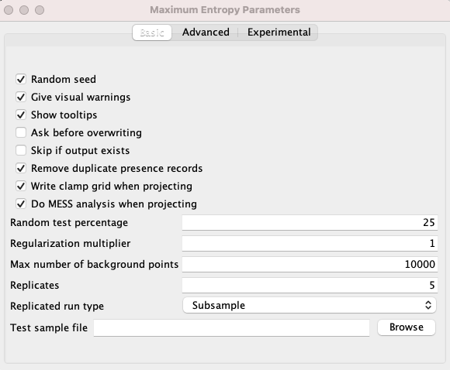
SETTINGS
Subsample: in which the presence points are repeatedly split into random training and testing subsets.
Notes:
Replication!

Slide 13
REPLICATION SETTINGS
Replication Type | Definition
Subsample | Presence points are repeatedly split into random training and testing subsets.
Bootstrap | Presence points are sampled with replacement for equal size training and testing subsets.
Crossvalidate | Presence points are repeatedly split into equal-sized ”folds” of random training and testing subsets.

Slide 14
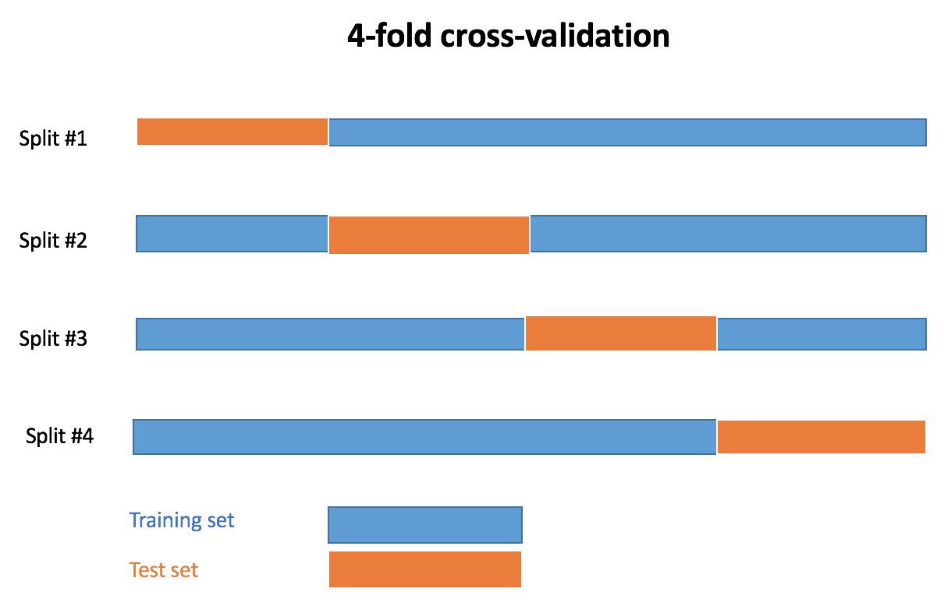
REPLICATION SETTINGS
Cross validation = resampling to evaluate model’s performance with limited data
Slide modified from M. Mabry

Slide 15
SETTINGS
Random test percentage: “randomly set aside 25% of the sample records for testing”
Used to calculate the threshold to make a binary prediction, with suitable conditions predicted above the threshold and unsuitable below!
Notes:
The “25” we entered for “random test percentage” told the program to randomly set aside 25% of the sample records for testing.
This is used to calculate the threshold to make a binary prediction, with suitable conditions predicted above the threshold and unsuitable below

Slide 16
SETTINGS
Regularization multiplier: affects how focused or closely-fitted the output distribution is. Values under 1.0 (low values) may result into overfitting while values over 1.0 (high values) tend to yield less localized prediction
Notes:
The “25” we entered for “random test percentage” told the program to randomly set aside 25% of the sample records for testing.
This is used to calculate the threshold to make a binary prediction, with suitable conditions predicted above the threshold and unsuitable below

Slide 17
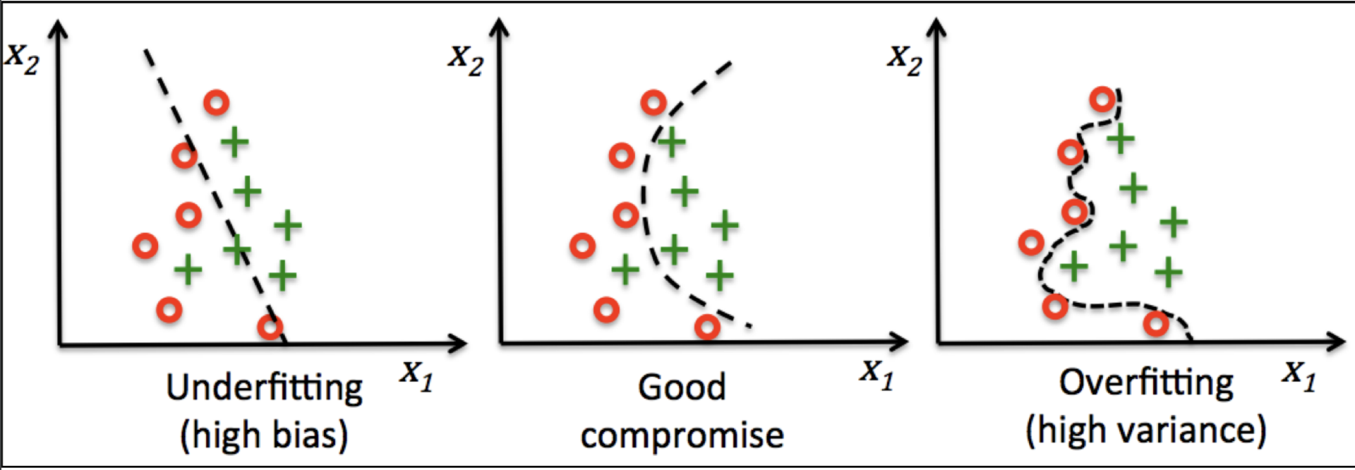
REGULARIZATION MULTIPLIER
Regularization multiplier (rm) then aims to reduce overfitting of the model:
Determines the penalty associated with including variables or their transformations in the model.
rm is too high
rm = 0
Slide modified from M. Mabry
Notes:
The “25” we entered for “random test percentage” told the program to randomly set aside 25% of the sample records for testing.
This is used to calculate the threshold to make a binary prediction, with suitable conditions predicted above the threshold and unsuitable below

Slide 18
SETTINGS
Number of Background Points: Defines the available environmental by sampling X number of points across the study area
Notes:
The “25” we entered for “random test percentage” told the program to randomly set aside 25% of the sample records for testing.
This is used to calculate the threshold to make a binary prediction, with suitable conditions predicted above the threshold and unsuitable below

Slide 19
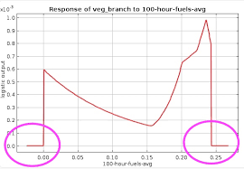
PROJECTION SETTINGS
Clamping treats variables outside the training range as if they were at the limit of the training range.
Clamp grid depicted are the absolute difference between predictions with and without clamping.
Random seed: different random test points each time the it runs
Notes:
Replication!

Slide 20
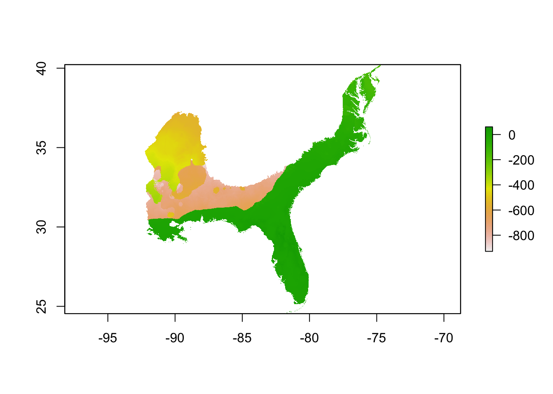
PROJECTION SETTINGS
MESS = Multivariate Environmental Surface Similarity (MESS)
Notes:
For MESS, the more negative the score, the more likely you are to project into novel environments.

Slide 21
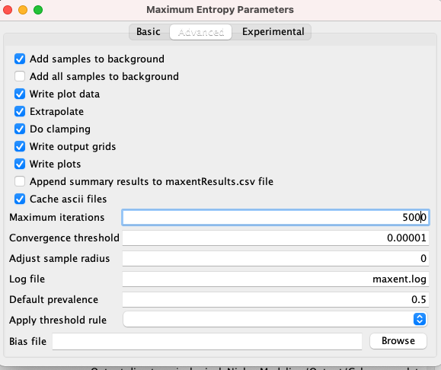
PROJECTION SETTINGS
Extrapolate = extent to estimate
Iterations = allows the model to have adequate time for convergence (coming together)

Slide 22
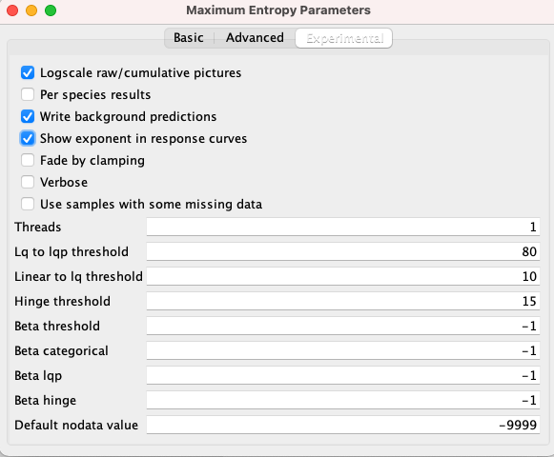
SETTINGS

Slide 23
SETTINGS

Slide 24
MaxEnt Demo
Files for this activity can be found in “Demo/Manual/Ecological_Niche_Modeling/”
Try out the demo!
R-based ENM
Cross-validation and data partitioning
Advance model comparisons
Evaluating ENMs

