Slide 1




EVALUATING ENM PERFORMANCE
WITH NULL MODELS
Tyler Radtke
University of Florida

Slide 2
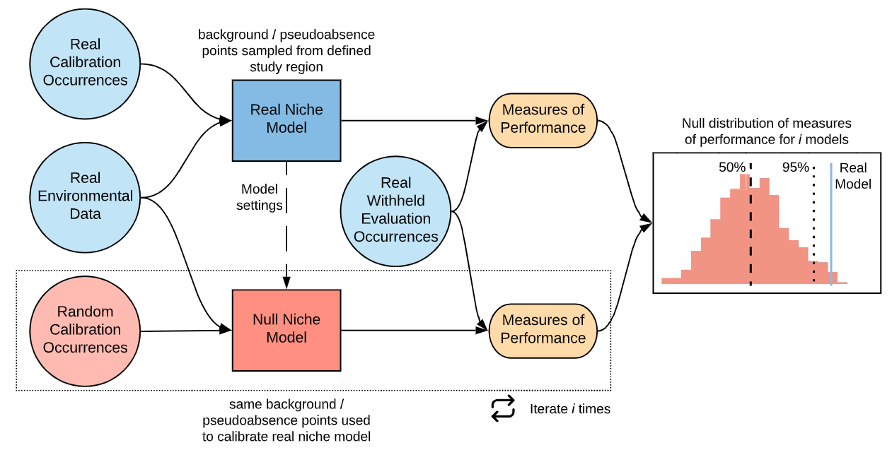
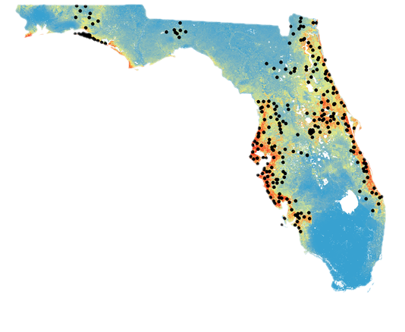
Projection Model
The Typical ENM Process
Bohl, C. L., Kass, J. M., & Anderson, R. P. (2019). A new null model approach to quantify performance and significance for ecological niche models of species distributions. Journal of Biogeography, 46(6), 1101–1111. https://doi.org/10.1111/jbi.13573
Notes:
(CITE IMAGE)

Slide 3
Do these patterns truly exist?
Is there collection bias?
Are our models better than random?
Projection Model
The Typical ENM Process
Bohl, C. L., Kass, J. M., & Anderson, R. P. (2019). A new null model approach to quantify performance and significance for ecological niche models of species distributions. Journal of Biogeography, 46(6), 1101–1111. https://doi.org/10.1111/jbi.13573
Notes:
(CITE IMAGE)

Slide 4
Bohl, C. L., Kass, J. M., & Anderson, R. P. (2019). A new null model approach to quantify performance and significance for ecological niche models of species distributions. Journal of Biogeography, 46(6), 1101–1111. https://doi.org/10.1111/jbi.13573
Notes:
(CITE IMAGE)

Slide 5
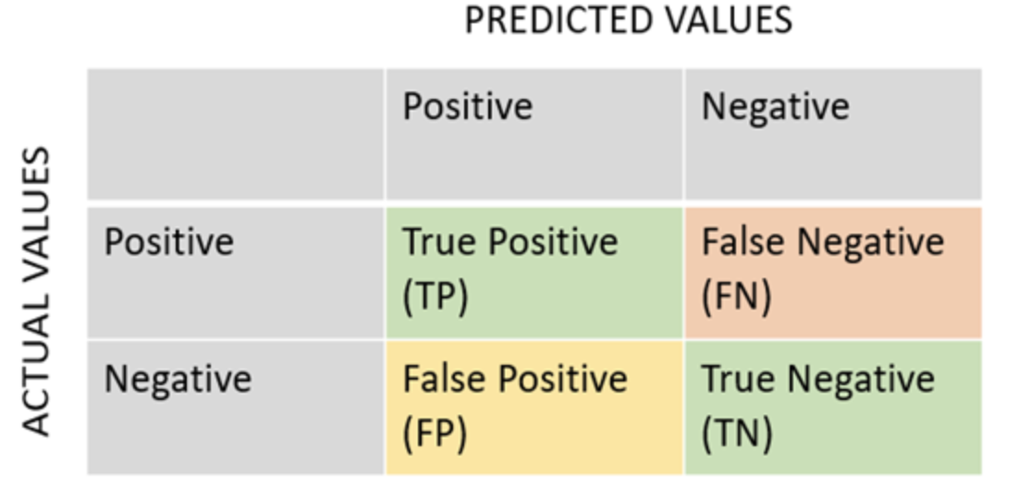
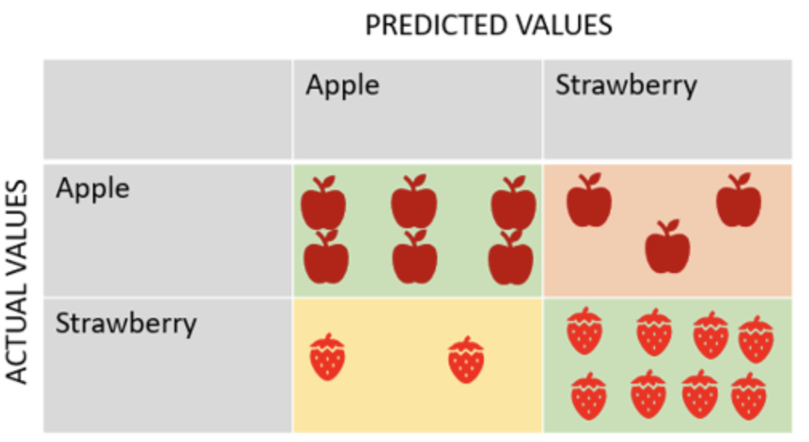
Actual vs. predicted habitat suitability values

Slide 6
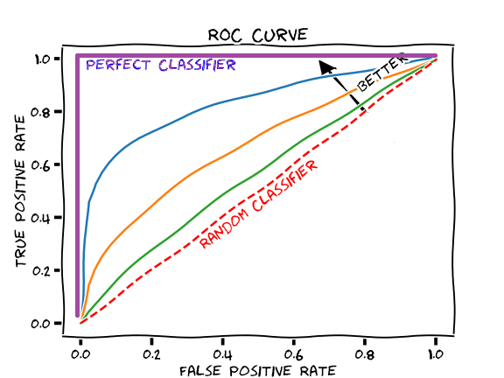
Area Under the Curve (AUC)
False positive rate (specificity) vs. true positive rate (sensitivity)
AUC = 1.0 -> perfect model
AUC = 0.5 -> model performs no better than random
AUC = <0.5 -> a sign of error
AUC evaluates a model’s ability to distinguish between presence/background points

Slide 7

Omission Rate (OR)
OR = the proportion of known presence points that the model fails to predict as suitable
Classified as “unsuitable”
Example:
OR = 0.1
Classified as “suitable”

Slide 8
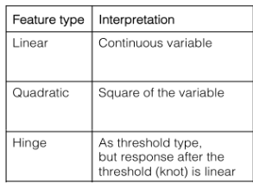

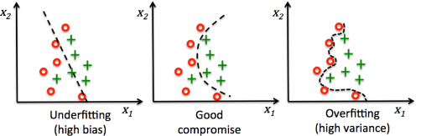
Feature classes and regularization multiplier
Balance complexity and fit
- Feature classes: shape of the expected response curve
- Response curve: the relationship between environmental variables and suitability
- Regularization multiplier: penalty applied to reduce overfitting

Slide 9
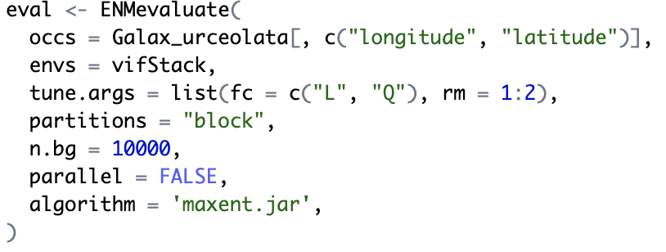
Sample code
ENMevaluate generates models with different combinations of feature classes and RMs
Using tools in the ENMeval package

Slide 10
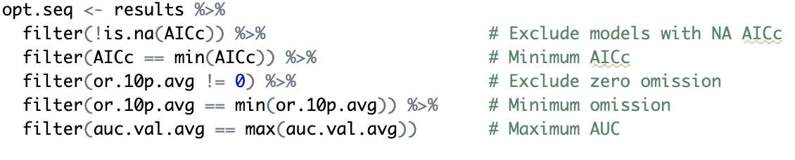
Sample code
Filter the resulting models by selecting for the one with the lowest omission rate and highest area under the curve value
Using tools in the ENMeval package
Optimal model parameters:
fc = L, rm = 1

Slide 11
How does ENMevaluate generate null models?
1 - Use the same number of presence points as the empirical model, but sample them randomly from the background
2 - Fit models with those random points using the same algorithm and environmental predictors
3 - Evaluate performance using real withheld presence data
4 - Repeat many times to generate a null distribution of performance metrics
5 - Compare the empirical model’s AUC and omission rate to the null distribution to assess significance

Slide 12
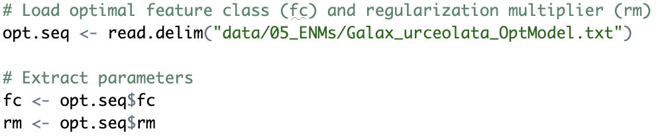
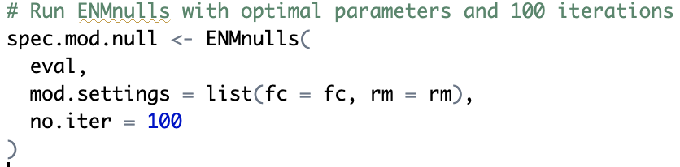
Sample code
Generate null models using parameters from optimal model
Using tools in the ENMeval package

Slide 13
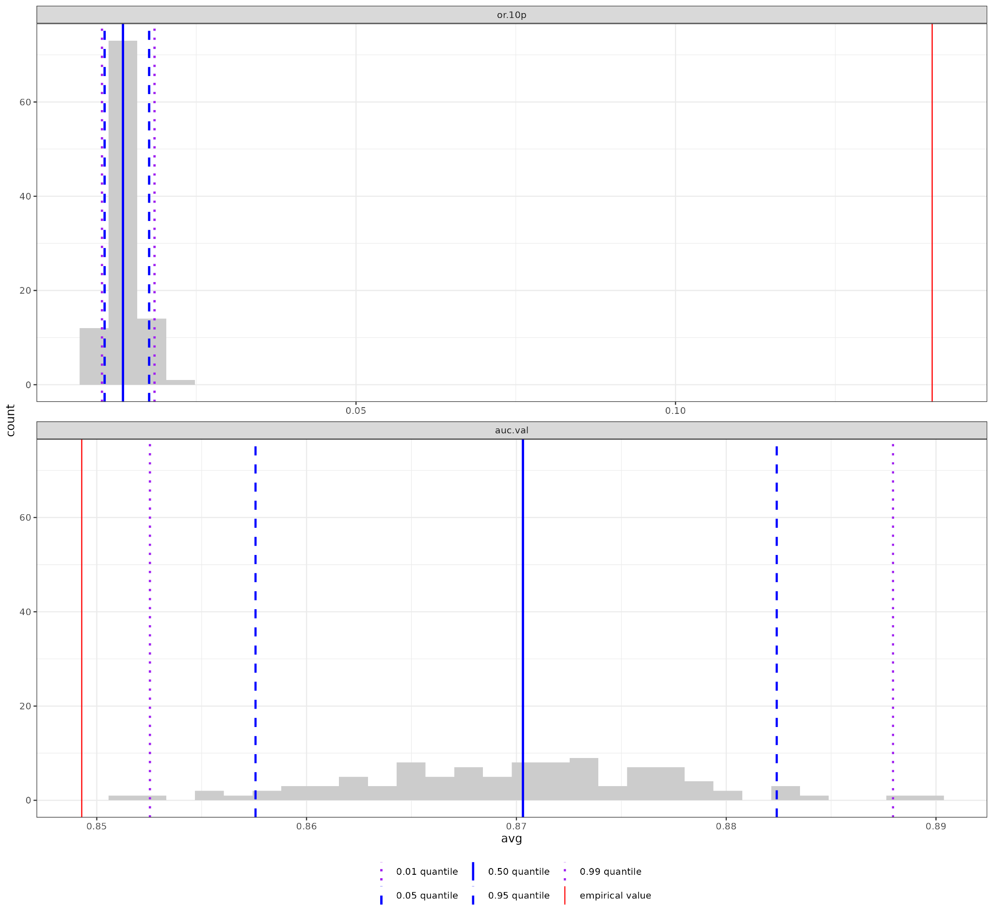
Output:
Omission rate
Null Model average
Plot shows the median AUC value and OR for the empirical model (red) against the null distribution values (blue)
Empirical Model
AUC

Slide 14
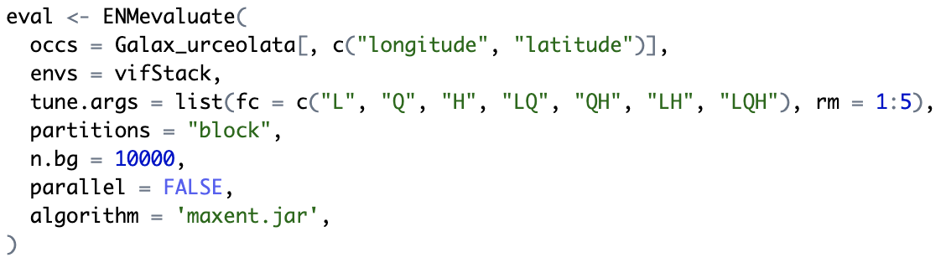
Sample code
Using tools in the ENMeval package
Generate a new suite of models with a wider range of parameters

Slide 15
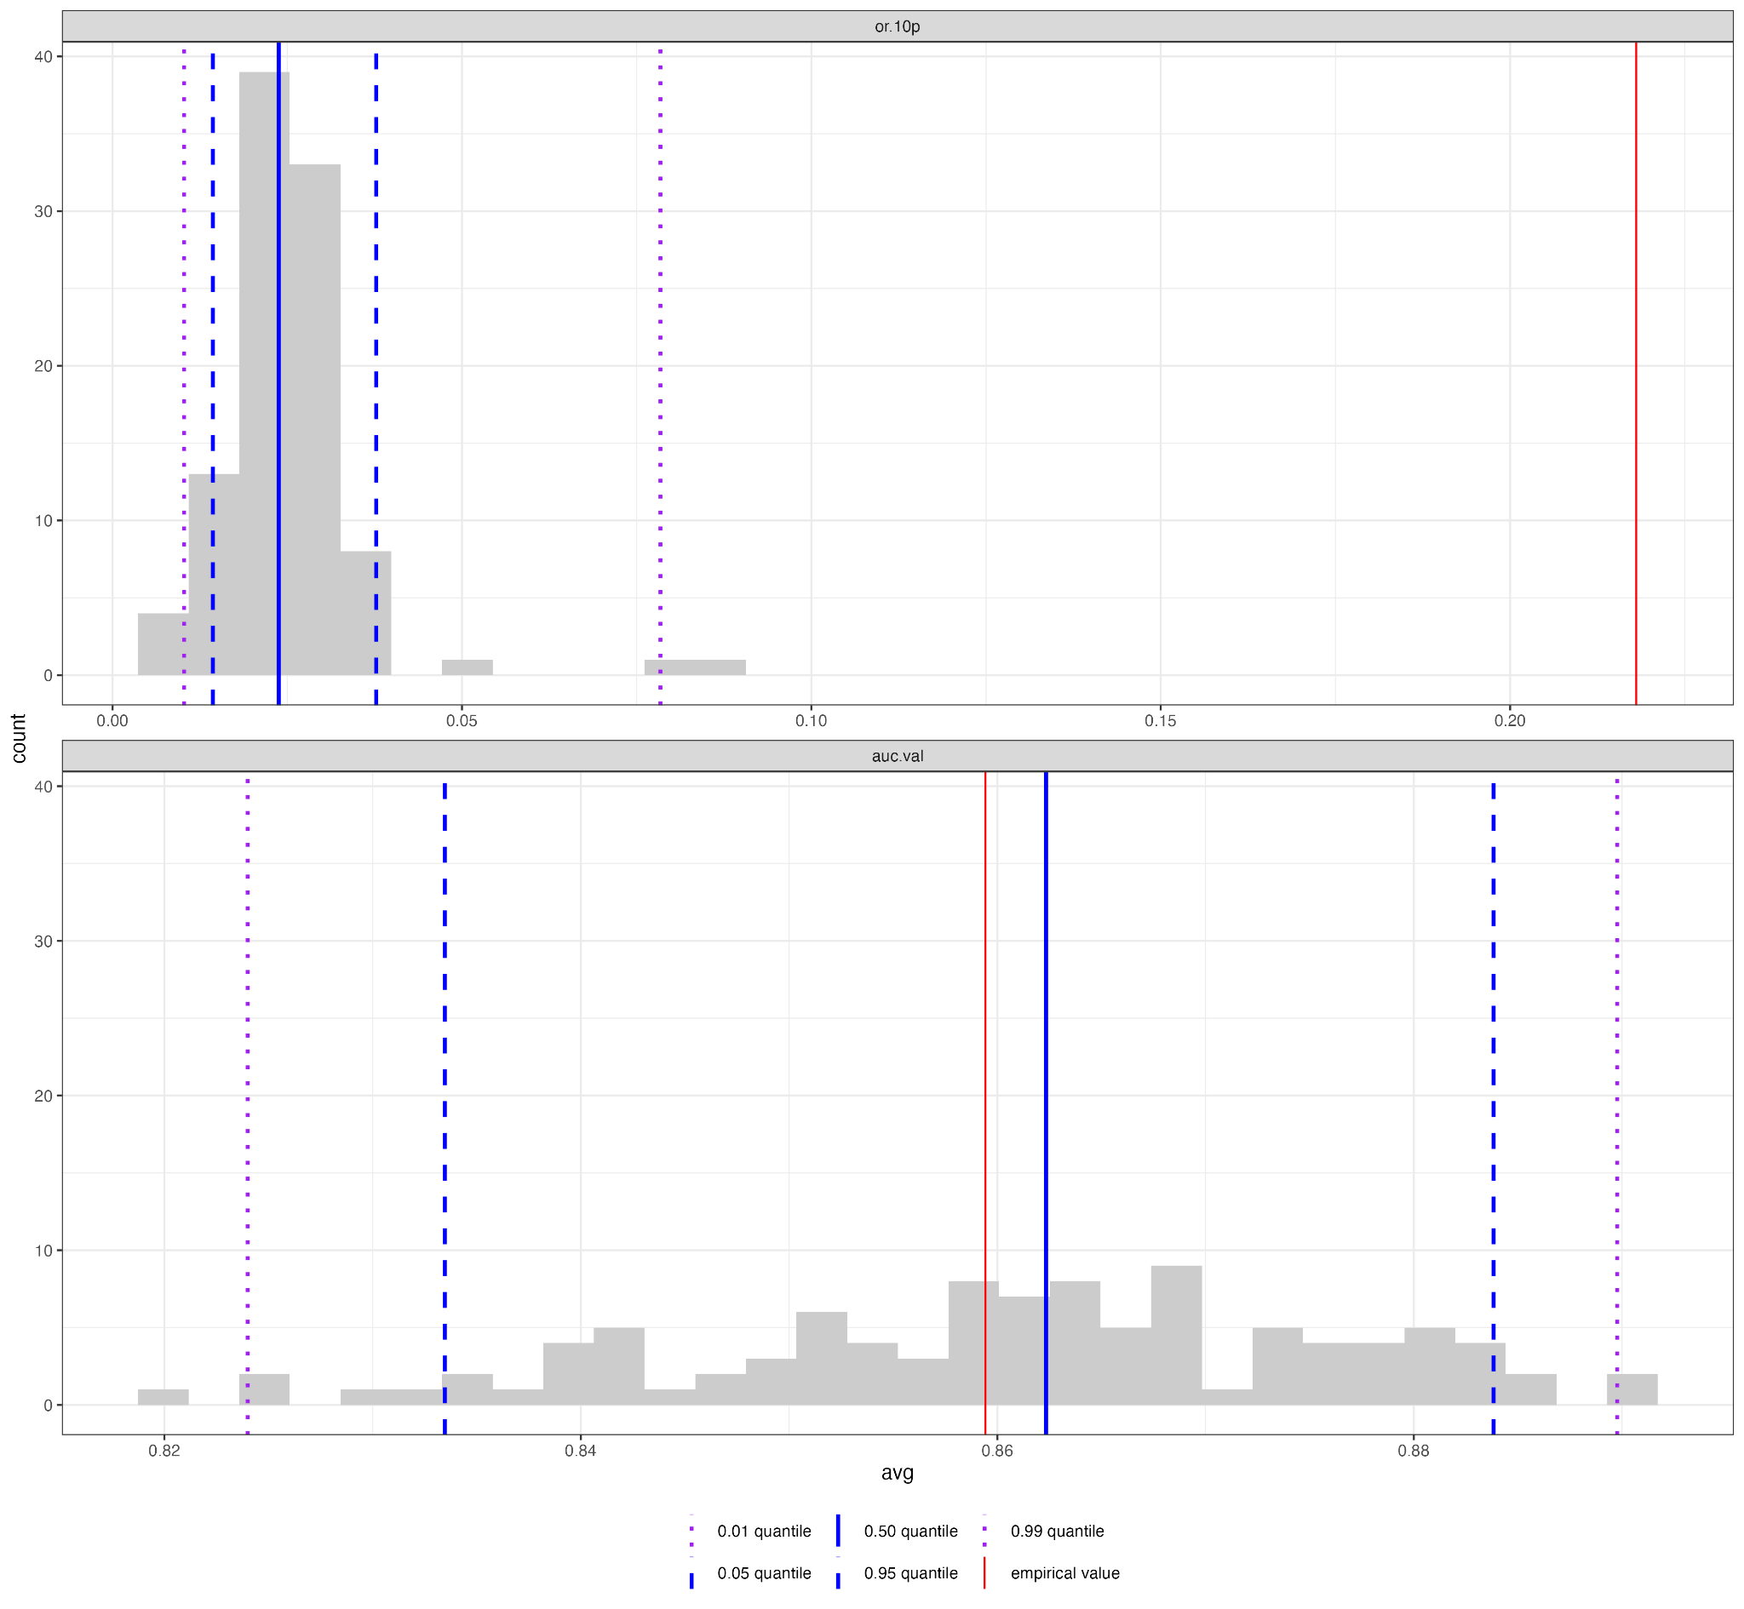
Output:
Omission rate
Null Model average
New optimal model:
fc=H, rm=1
Significant improvement compared to null models after incorporating a wider range of parameters
Empirical Model
AUC

Slide 16
Why create null models?
Determine whether model performance is better than expected by chance.
Quantify how much better your model is than a null expectation.
Avoid false confidence by evaluating for bias, spatial autocorrelation and overfitting
Add rigor to model selection and interpretation

