Slide 1




An Introduction to Occupancy Models with Collections Data
JT Miller
University of Florida

Slide 2
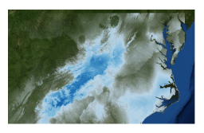
Background: Species Distribution Models
Assumes that areas w/no detections are less suitable.
- Presence Only Data: Presence = More habitable
- Flexibility of these model is limited
- - Subject to Biased Sampling, Detection Unknown
- Niche Conservation (long-term modeling)
Figure from Gaynor et al. 2018

Slide 3
Not the only way to create a species distribution!
Presence only Data
‘Presence/Absence’ Data
‘Presence/Absence’ Data replicated over time
Count Data

Slide 4
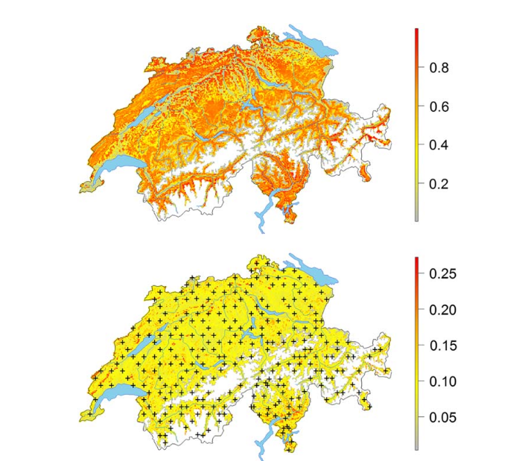
Not the only way to create a species distribution!
ENMs
Occupancy Models (1/0)
Presence only Data
‘Presence/Absence’ Data
‘Presence/Absence’ Data replicated over time
Count Data
N-Mixture Models
Occupancy Modeling with replicates to model intensity
Kery & Royle 2016

Slide 5
Not the only way to create a species distribution!
ENMs
Occupancy Models (1/0)
Presence only Data
‘Presence/Absence’ Data
‘Presence/Absence’ Data replicated over time
Count Data
N-Mixture Models
More Data Rich = Access To More Modeling Methods that allow finer inference
Occupancy Modeling with replicates to model intensity
Kery & Royle 2016

Slide 6

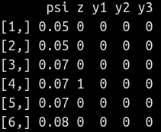
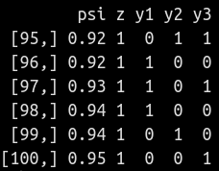
Traditional Occupancy Models
Goal: Estimate the probability that a species is present in a given site, while accounting for detection error

Slide 7
Traditional Occupancy Models
Goal: Estimate the probability that a species is present in a given site, while accounting for detection error
Requires “Presence/Absence” more accurately “Detection/NonDetection” data.

Slide 8
Traditional Occupancy Models
Sites!
Goal: Estimate the probability that a species is present in a given site, while accounting for detection error
Requires “Presence/Absence” or more accurately, “Detection/NonDetection” data.
Replicated Across Sites

Slide 9
Traditional Occupancy Models
Sites!
Time!
Goal: Estimate the probability that a species is present in a given site, while accounting for detection error
Requires “Presence/Absence” or more accurately, “Detection/NonDetection” data.
Replicated Across Sites
Replicated Across Time

Slide 10
Traditional Occupancy Models
Sites!
Ψ
Time!
Goal: Estimate the probability that a species is present in a given site, while accounting for detection error
Requires “Presence/Absence” or more accurately, “Detection/NonDetection” data.
Replicated Across Sites
Replicated Across Time
Helps determine our uncertainty in the probability of detection

Slide 11
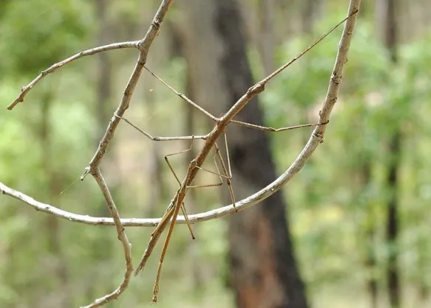
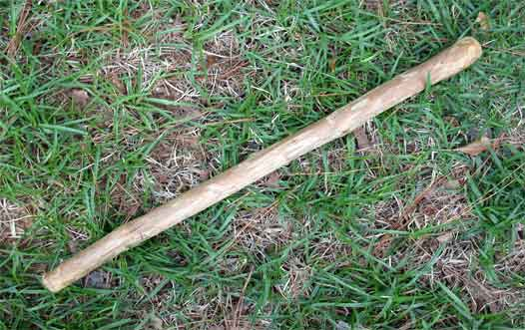
Detection Probability Can Be Quantified
The aim of these occupancy models are to quantify true occurrence, by accounting for detection complexities
NonDetections Namely
Also False Detections if included

Slide 12
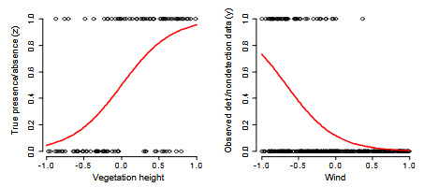
Covariates Can Be Added to the Model
Covariates (things that we think may affect our detection or the P/A of the organism) can also be added to these models
Say vegetation height (+) and wind speed (-)
Kery & Royle 2016 Simulation Unmarked

Slide 13
Not the only way to create a species distribution!
ENMs + Occupancy Models?*
Occupancy Models (1/0)
Presence only Data
‘Presence/Absence’ Data
‘Presence/Absence’ Data replicated over time
Count Data
N-Mixture Models
Occupancy Modeling with replicates to model intensity
Kery & Royle 2016

Slide 14
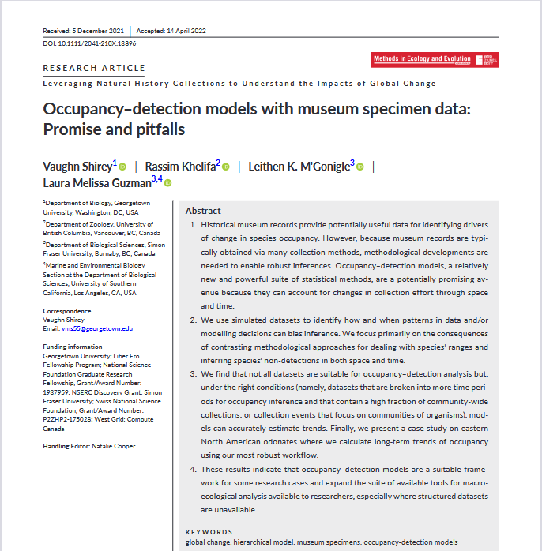

New Methods for Using Museum Specimen Data
Occupancy can be measured under certain conditions with museum/incidental data
Provides a new framework for studying Global Change and Biodiversity across unprecedented scales in both time & space

Slide 15

New Methods for Using Museum Specimen Data
Simulations with specimen/incidental based data suggests that we can reach the gold standard of correctly estimating the probability of detection by using community level observations, if they meet a certain standard
Simulations Suggest:
Estimate Community Visits vs Target Sampling events. 50% safest, 25% can work with many temporal bins
Restrict Analyses to only those places and times where collecting is known or likely to have occurred. Don’t model all species at all sites/time intervals
Infer non-detections from community (multi-species) visit data only, do not infer absence everywhere
Split time across ‘Occupancy Intervals’, the more intervals the better (provided that you check how visit and detection probability changes in these intervals)

Slide 16
New Methods for Using Museum Specimen Data
Simulations with specimen/incidental based data suggests that we can reach the gold standard of correctly estimating the probability of detection by using community level observations, if they meet a certain standard
Simulations Suggest:
Estimate Community Visits vs Target Sampling events. 50% safest, 25% can work with many temporal bins
Restrict Analyses to only those places and times where collecting is known or likely to have occurred. Don’t model all species at all sites/time intervals
Infer non-detections from community (multi-species) visit data only, do not infer absence everywhere
Split time across ‘Occupancy Intervals’, the more intervals the better (provided that you check how visit and detection probability changes in these intervals)
CV
TS

Slide 17
New Methods for Using Museum Specimen Data
Simulations with specimen/incidental based data suggests that we can reach the gold standard of correctly estimating the probability of detection by using community level observations, if they meet a certain standard
Simulations Suggest:
Estimate Community Visits vs Target Sampling events. 50% safest, 25% can work with many temporal bins
Restrict Analyses to only those places and times where collecting is known or likely to have occurred. Don’t model all species at all sites/time intervals
Infer non-detections from community (multi-species) visit data only, do not infer absence everywhere
Split time across ‘Occupancy Intervals’, the more intervals the better (provided that you check how visit and detection probability changes in these intervals)

Slide 18
New Methods for Using Museum Specimen Data
Simulations with specimen/incidental based data suggests that we can reach the gold standard of correctly estimating the probability of detection by using community level observations, if they meet a certain standard
Simulations Suggest:
Estimate Community Visits vs Target Sampling events. 50% safest, 25% can work with many temporal bins
Restrict Analyses to only those places and times where collecting is known or likely to have occurred. Don’t model all species at all sites/time intervals
Infer non-detections from community (multi-species) visit data only, do not infer absence everywhere
Split time across ‘Occupancy Intervals’, the more intervals the better (provided that you check how visit and detection probability changes in these intervals)
?

Slide 19
New Methods for Using Museum Specimen Data
Simulations with specimen/incidental based data suggests that we can reach the gold standard of correctly estimating the probability of detection by using community level observations, if they meet a certain standard
Simulations Suggest:
Estimate Community Visits vs Target Sampling events. 50% safest, 25% can work with many temporal bins
Restrict Analyses to only those places and times where collecting is known or likely to have occurred. Don’t model all species at all sites/time intervals
Infer non-detections from community (multi-species) visit data only, do not infer absence everywhere
Split time across ‘Occupancy Intervals’, the more intervals the better (provided that you check how visit and detection probability changes in these intervals)
?
These non-detections can be modeled more accurately if we know something about the range of the species prior

Slide 20

New Methods for Using Museum Specimen Data
Simulations with specimen/incidental based data suggests that we can reach the gold standard of correctly estimating the probability of detection by using community level observations, if they meet a certain standard
Simulations Suggest:
Estimate Community Visits vs Target Sampling events. 50% safest, 25% can work with many temporal bins
Restrict Analyses to only those places and times where collecting is known or likely to have occurred. Don’t model all species at all sites/time intervals
Infer non-detections from community (multi-species) visit data only, do not infer absence everywhere
Split time across ‘Occupancy Intervals’, the more intervals the better (provided that you check how visit and detection probability changes in these intervals)
Time
Time

Slide 21
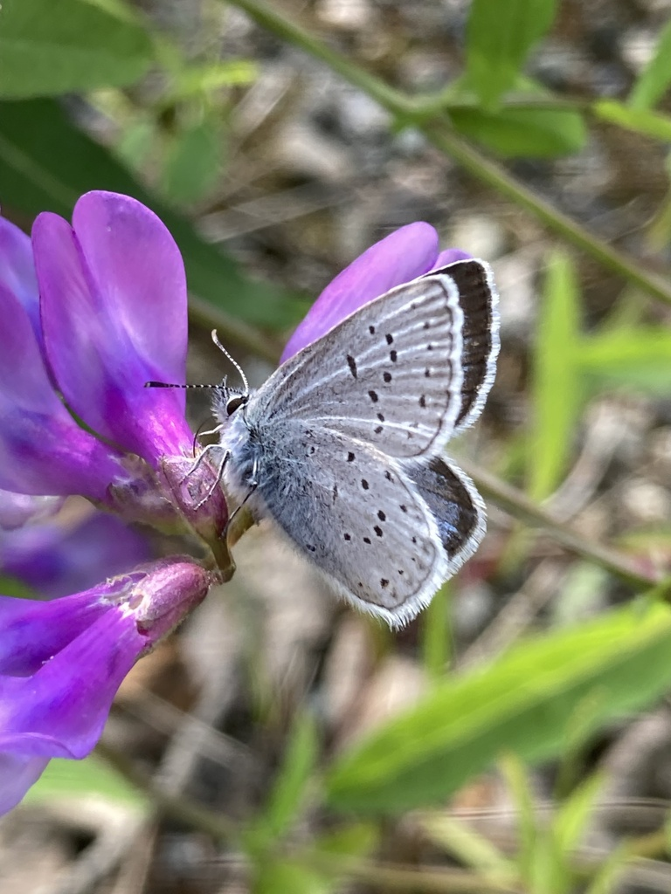
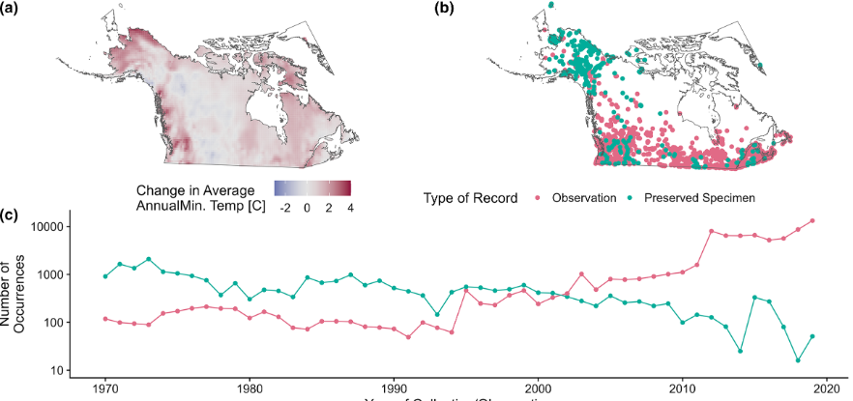
Multi-Species Occupancy Models: Case-study with Arctic or Boreal Butterflies
© Bonnie Zand, some rights reserved (CC-BY-NC)
Shirey et al. 2023
Notes:
Butterflies were used as an indicator species for how biodiversity is being shaped in the rapidly warming high latitude regions.

Slide 22
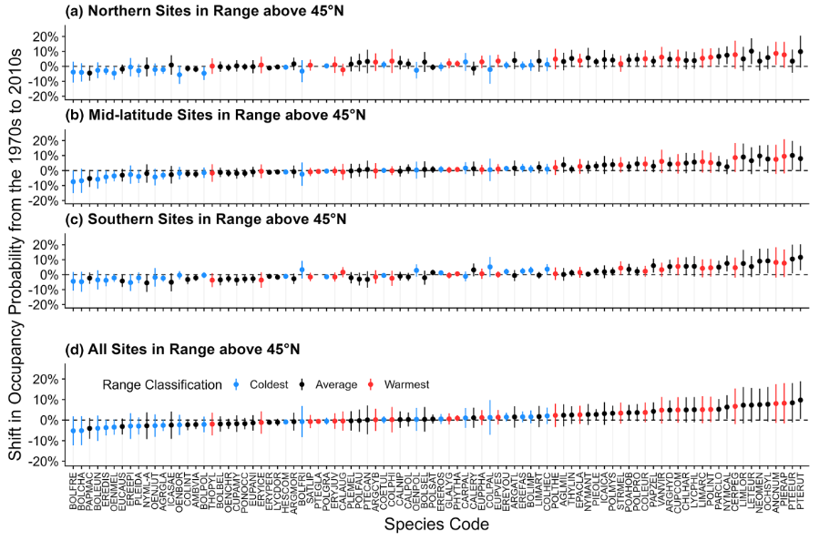
Multi-Species Occupancy Models: Case-study
Used Species Traits & Historical Temperature data as covariates in the model
Shirey et al. 2023
Notes:
Examined 90 species of butterflies over the years of 1970-2019. They used species ranges to infer warm adapted (southern latitudes) and cold adapted (northern latitudes) species, and analyzed how their occupancy has shifted with temperature used as a covariate in the analysis. They found that generally the warm adapted southern species have increased their occupancy across the Northern Arctic sites over time (following the 4oC increase), while the cold-adapted northern species saw sharp declines in occupancy especially in their historic mid-high latitude ranges.

Slide 23
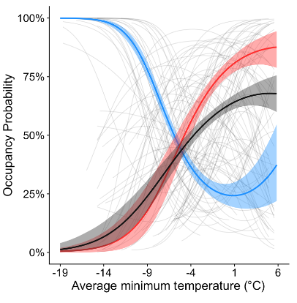
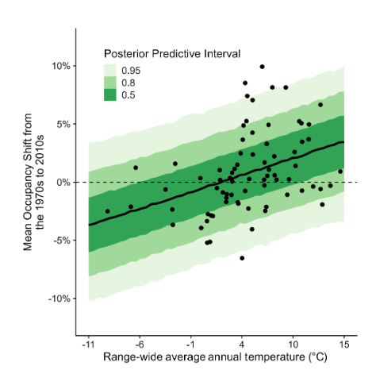
Multi-Species Occupancy Models: Case-study
Used Species Traits & Historical Temperature data as covariates in the model
Range wide average for species is the best predictor for occupancy increase or decrease
“winners & losers” of climate change
Shirey et al. 2023

Slide 24
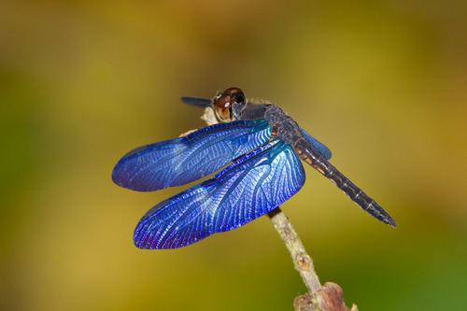
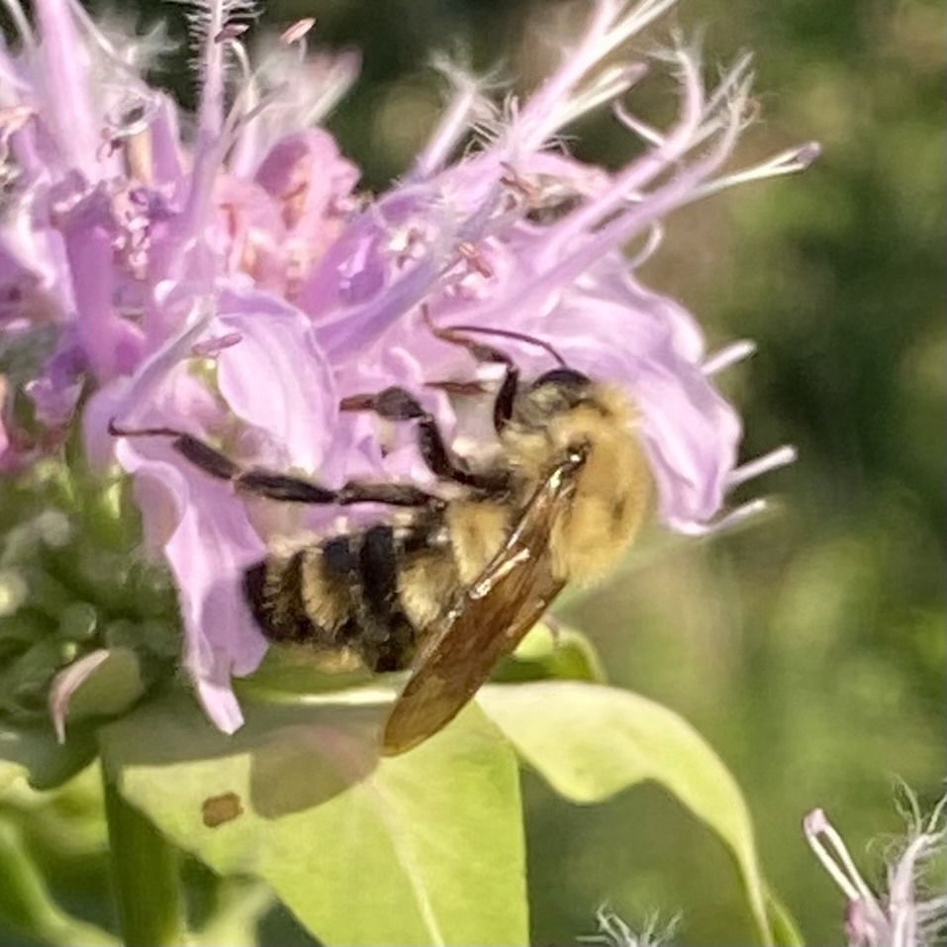
So much to do!
Occupancy modeling is generally rarer in plants than animals, and has yet to be published with this presence-only approach
Endless amount of covariates & hypotheses to test in both what determines detection, and what influences occupancy of species
Species Ranges (SDMs) are highly recommended.
(c) Greg Lasley – some rights reserved (CC BY-NC)
© Michelle Orcutt, some rights reserved (CC-BY)
© Bonnie Zand, some rights reserved (CC-BY-NC)

