Slide 1
Randoms presentation - Innotech Kft.
Bálint Zsolt
Jenei Dávid
TMSZC Perczel Mór Technikum és Kollégium
IT system and application operator

Slide 2
Bálint Zsolt’s works and completed tasks
Managing and supervising the entire project
Developing a project plan and timeline
Configuring and installing network devices
Developing security protocols
Documentation
Other protocols
Telnet, SSH
Domain

Slide 3
Jenei Dávid’s works and completed tasks
Network topology and architecture design
Network infrastructure design (selecting appropriate devices, cabling technology, wireless solutions
Performing cabling or creating a wireless network
Testing
Recording test cases
Error logging

Slide 4
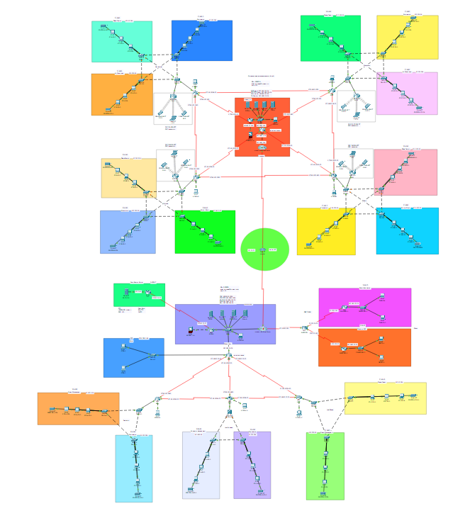

Network structure
Large-scale network
10 locations
Multiple workflows per location
Transparent, clean structure

Slide 5

Our fictional company- Innotech Kft.
Our company is a fictional game developer company
Performing multiple work phases per site :
Engineering
Game Design
Sound and VFX
Marketing
Media Management

Slide 6
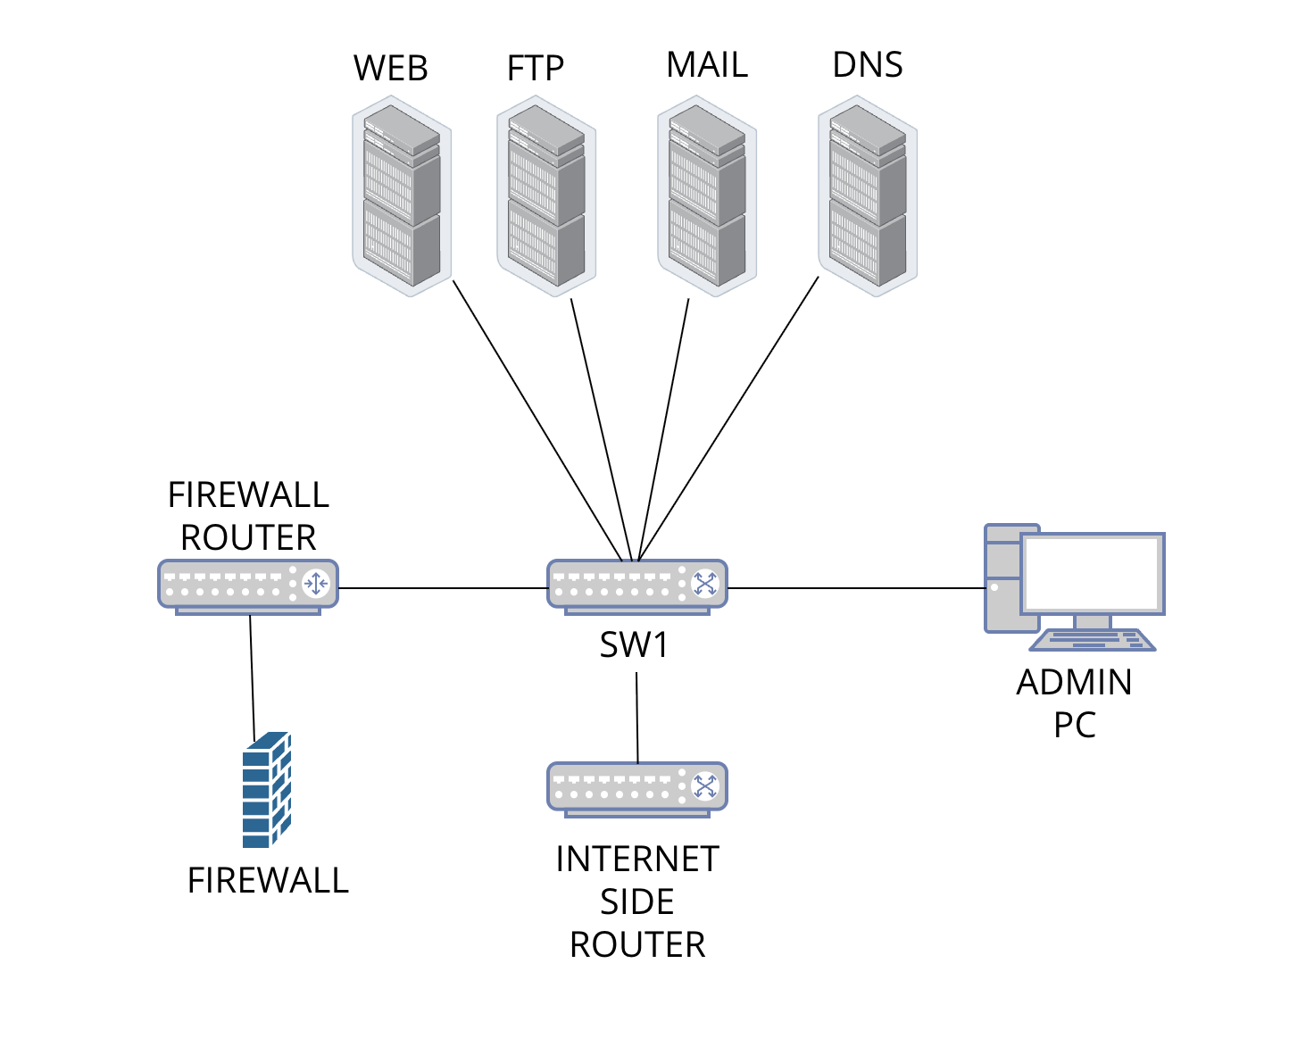
Central server room
Firewall protection for requests coming from the Internet site
WEB, HTTP, MAIL, DNS server
Central Admin PC
Telnet access to central router
The company's website also runs from here (innotech.hu)

Slide 7
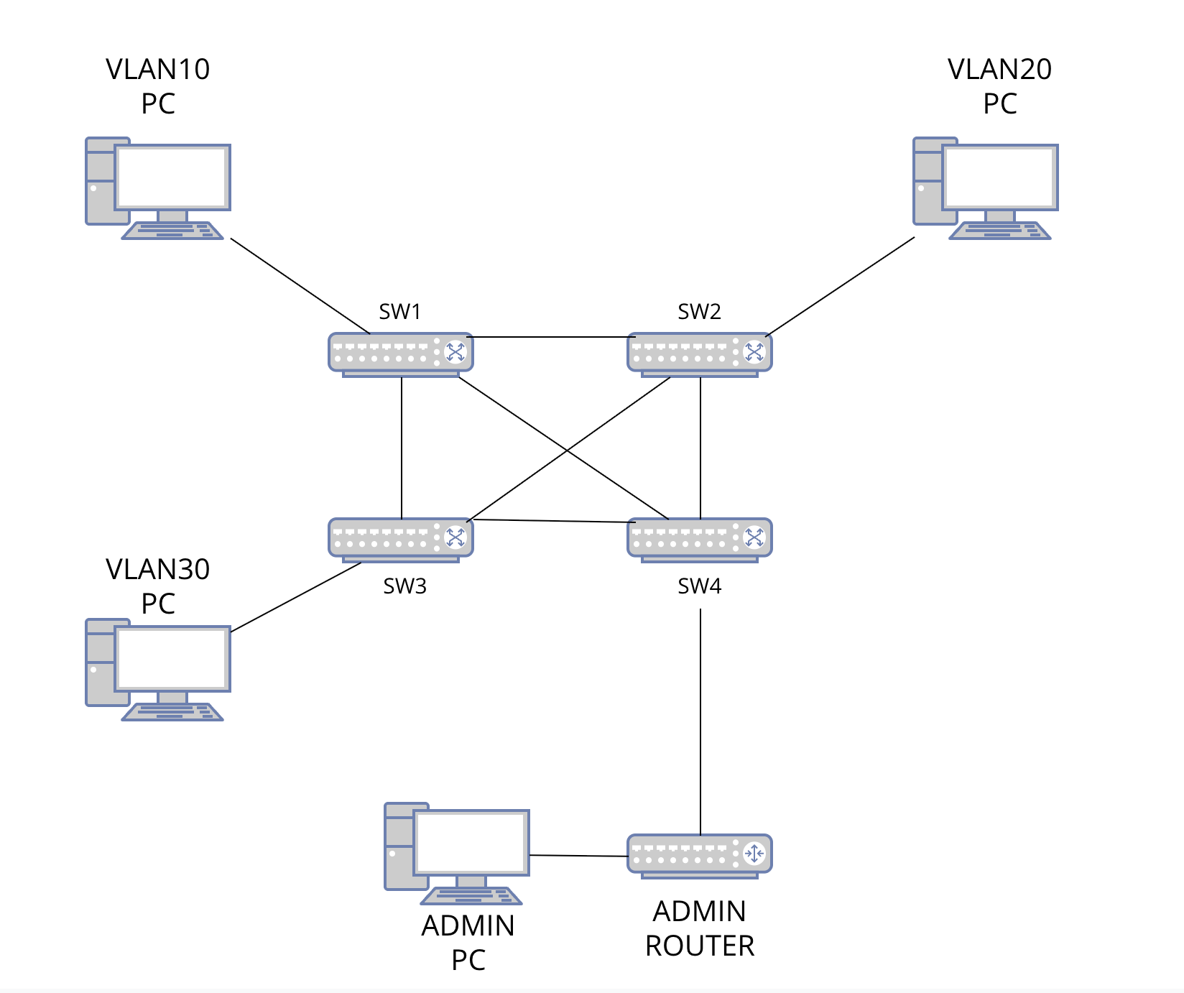
Site structure
3 VLANs on each site
ACL list between VLANs
Separate DHCP pool for each VLAN (e.g. 10.1.10.0/24)
Wireless network
Admin computer

Slide 8
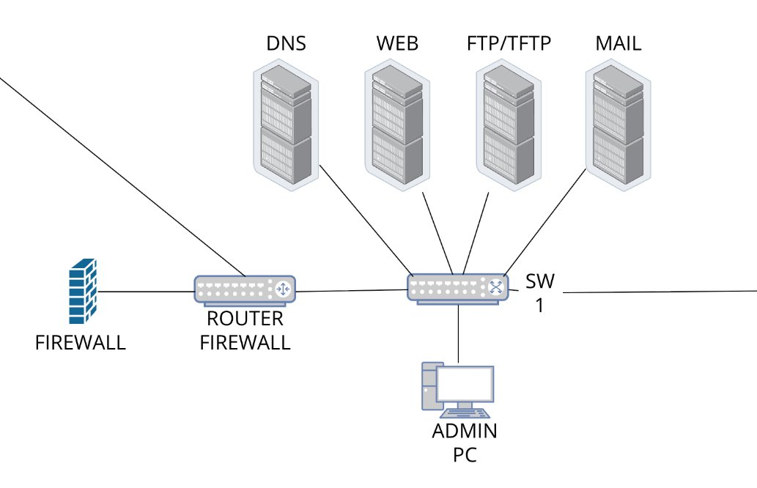
American headquarters
Due to the involvement of foreign workers, there are also locations in America, and just like in Hungary, there is a central location here.
DNS, WEB, FTP, MAIL servers
Firewall to control requests to the ISP
Own website (innotech.com)
Admin PC to manage the entire network

Slide 9
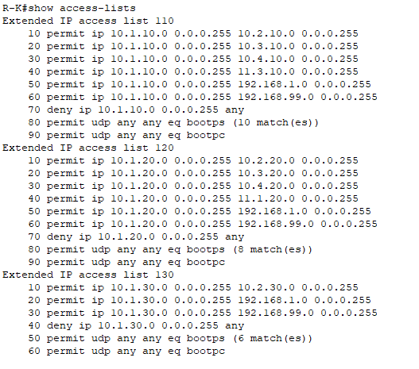

Access List
An Access list is a collection of rules that, in our case, allows different VLANs to not reach each other
The last two lines in each access-list show that DHCP traffic is allowed

Slide 10
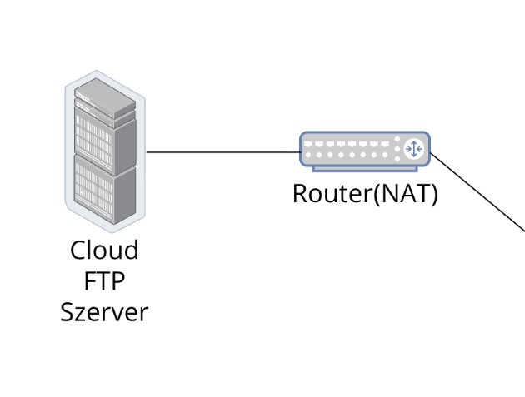
NAT
Cloud FTP Server
Dynamic Address Translation
My own user for the FTP server
For storing designs, graphics, textures

Slide 11
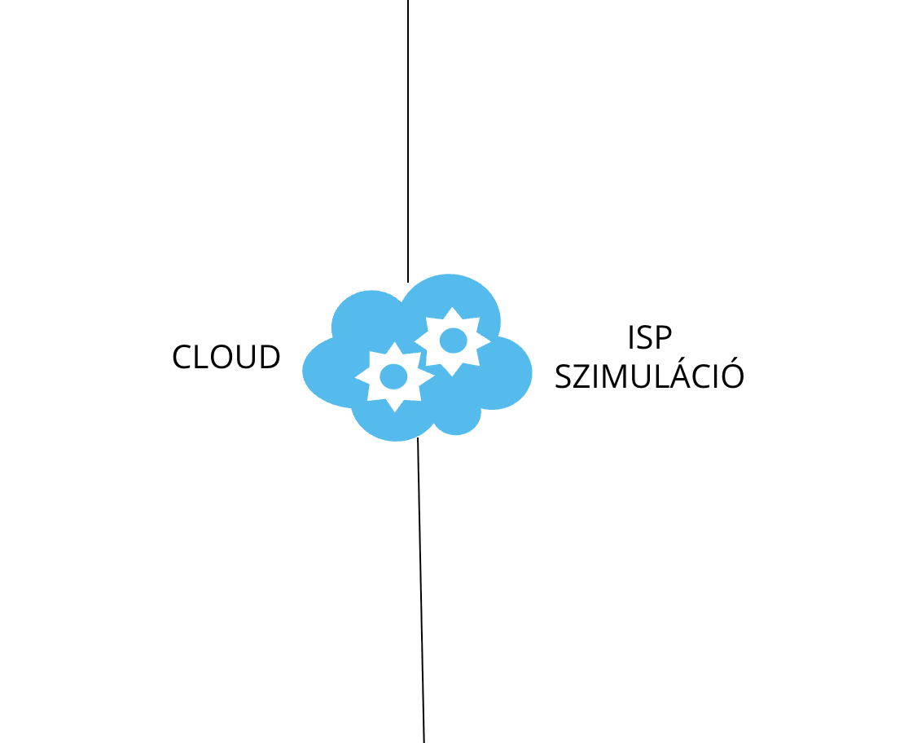
Internet simulation (Cloud)
Connection to the US site is handled by an ISP internet simulation.
Frame Relay in the Cloud.

Slide 12
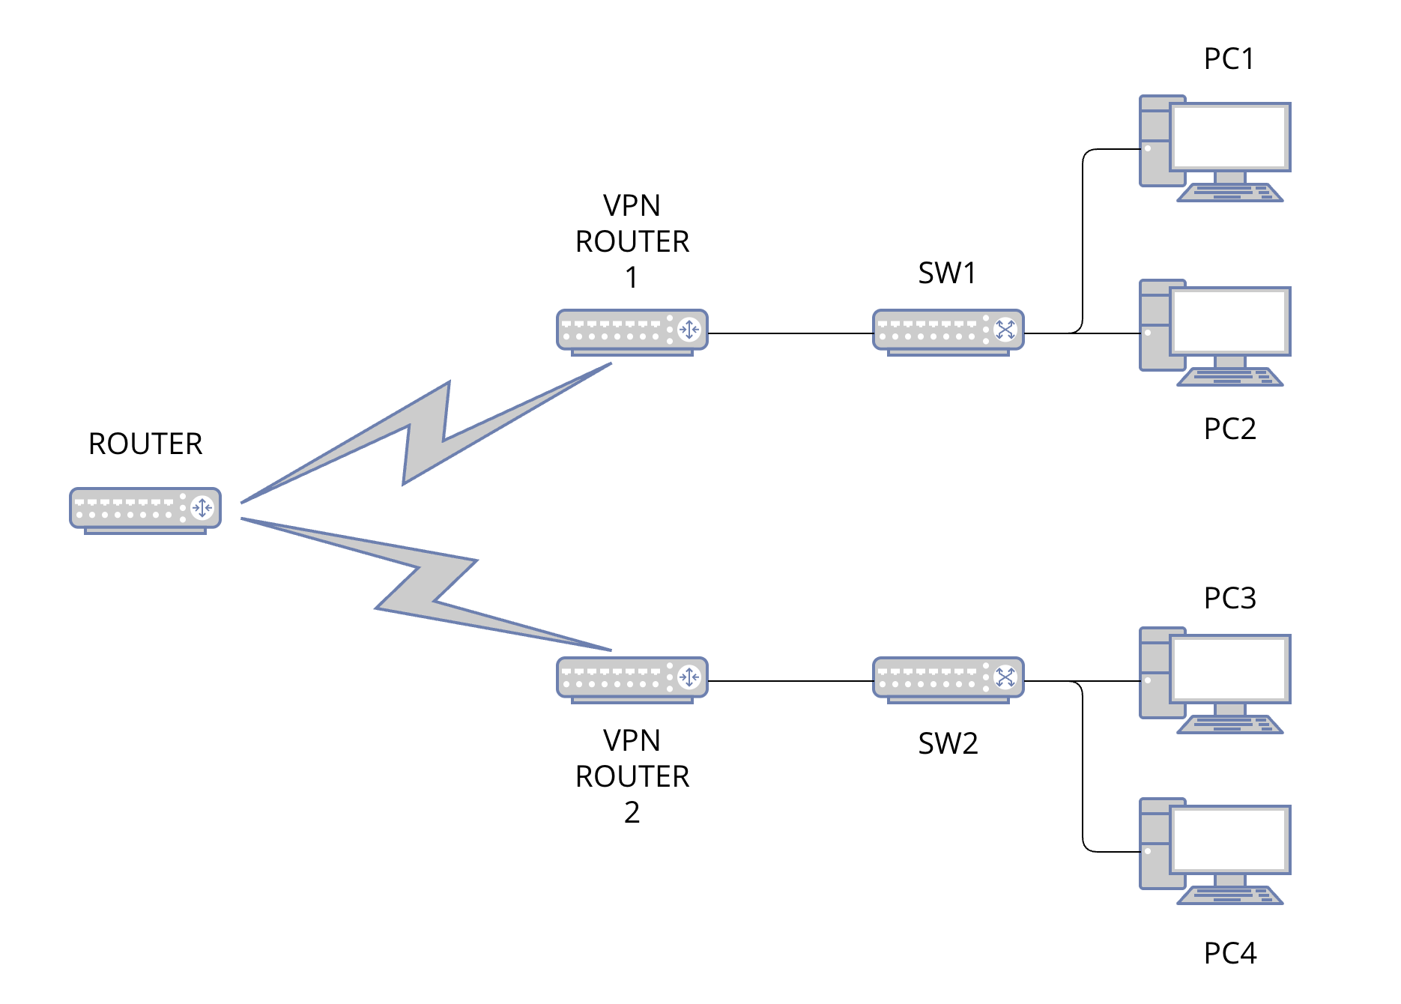
VPN – GRE Tunnel solution
Secure logical connection between VLAN70 and VLAN80
Use of GRE Tunnel between the two routers
Communication between VLANs over public network
Static routing on the tunnel interface
DHCP-based IP address allocation in both VLANs
The solution is scalable and can be expanded with IPsec encryption later

Slide 13
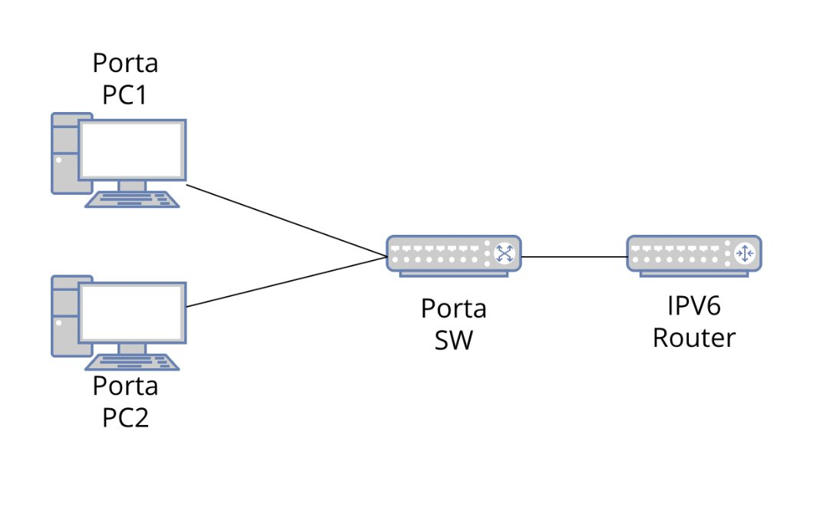
American headquarters location - Porta
In America, there is a port at the headquarters site
IPV6 DHCP address assignment
Not connecting to the network

Slide 14
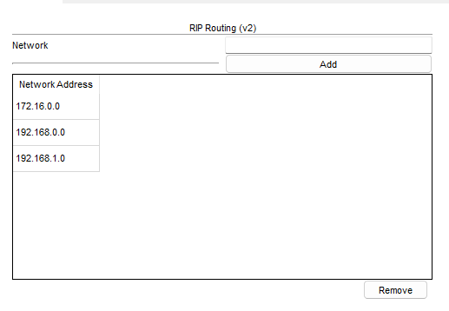
Dynamic routing(RIP V2)
We use RIP V2 protocol for traffic routing between the company's routers.

Slide 15
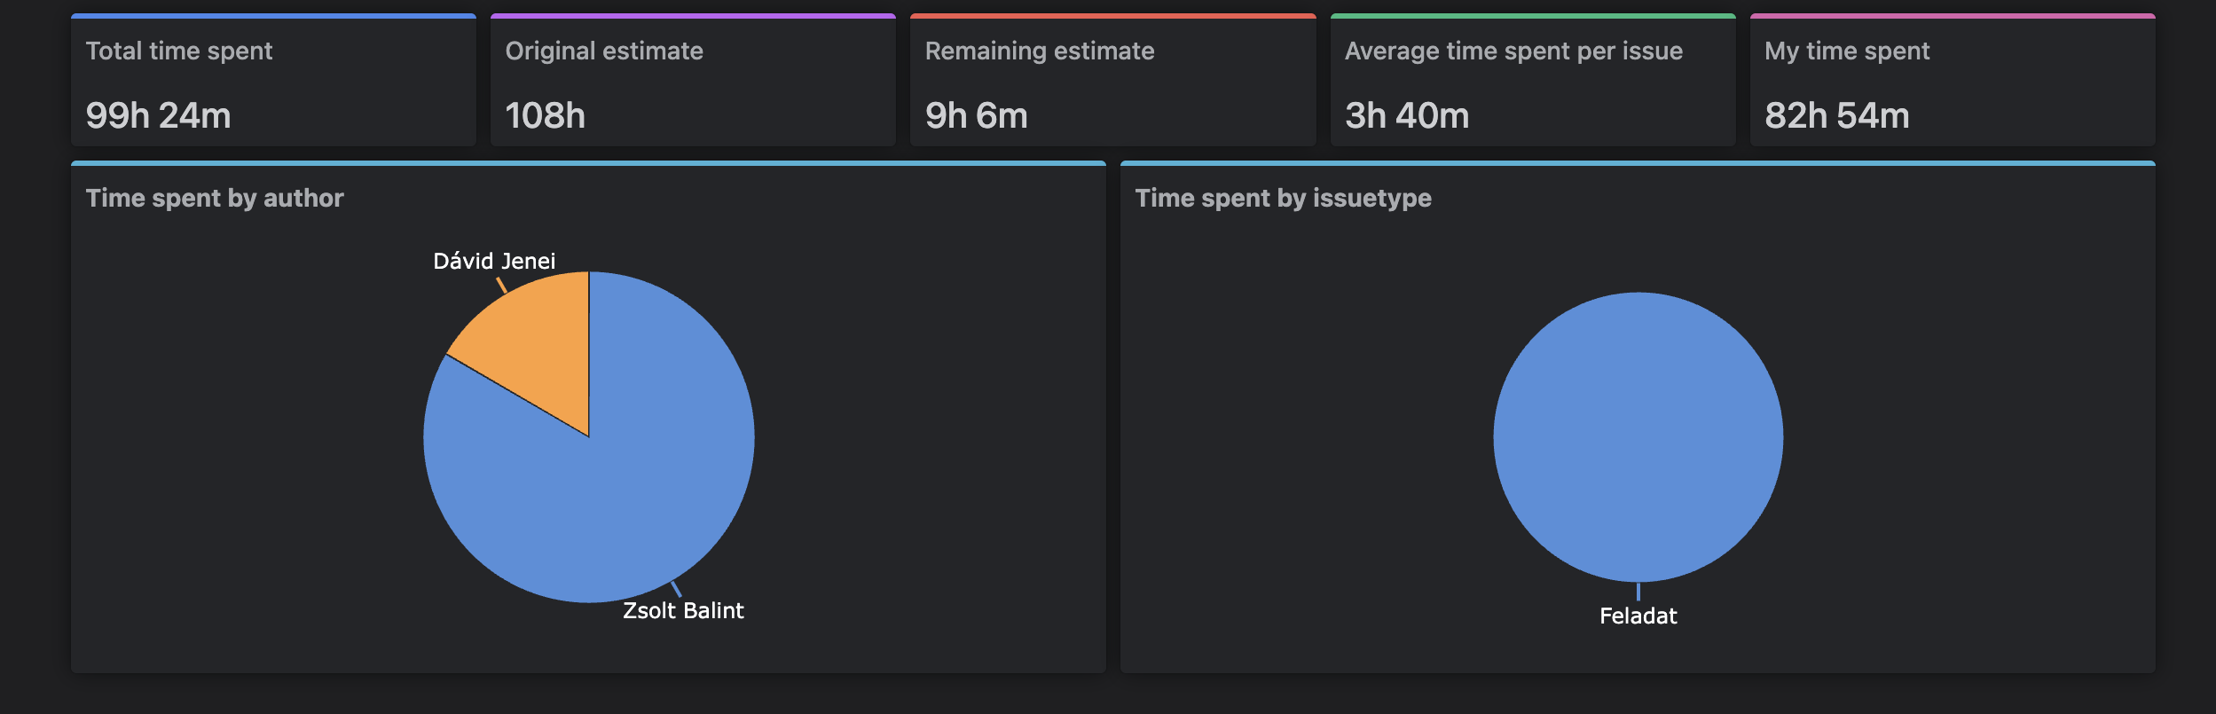
JIRA
Timesheet Tracking extension
Assign tasks
Time logging

Slide 16
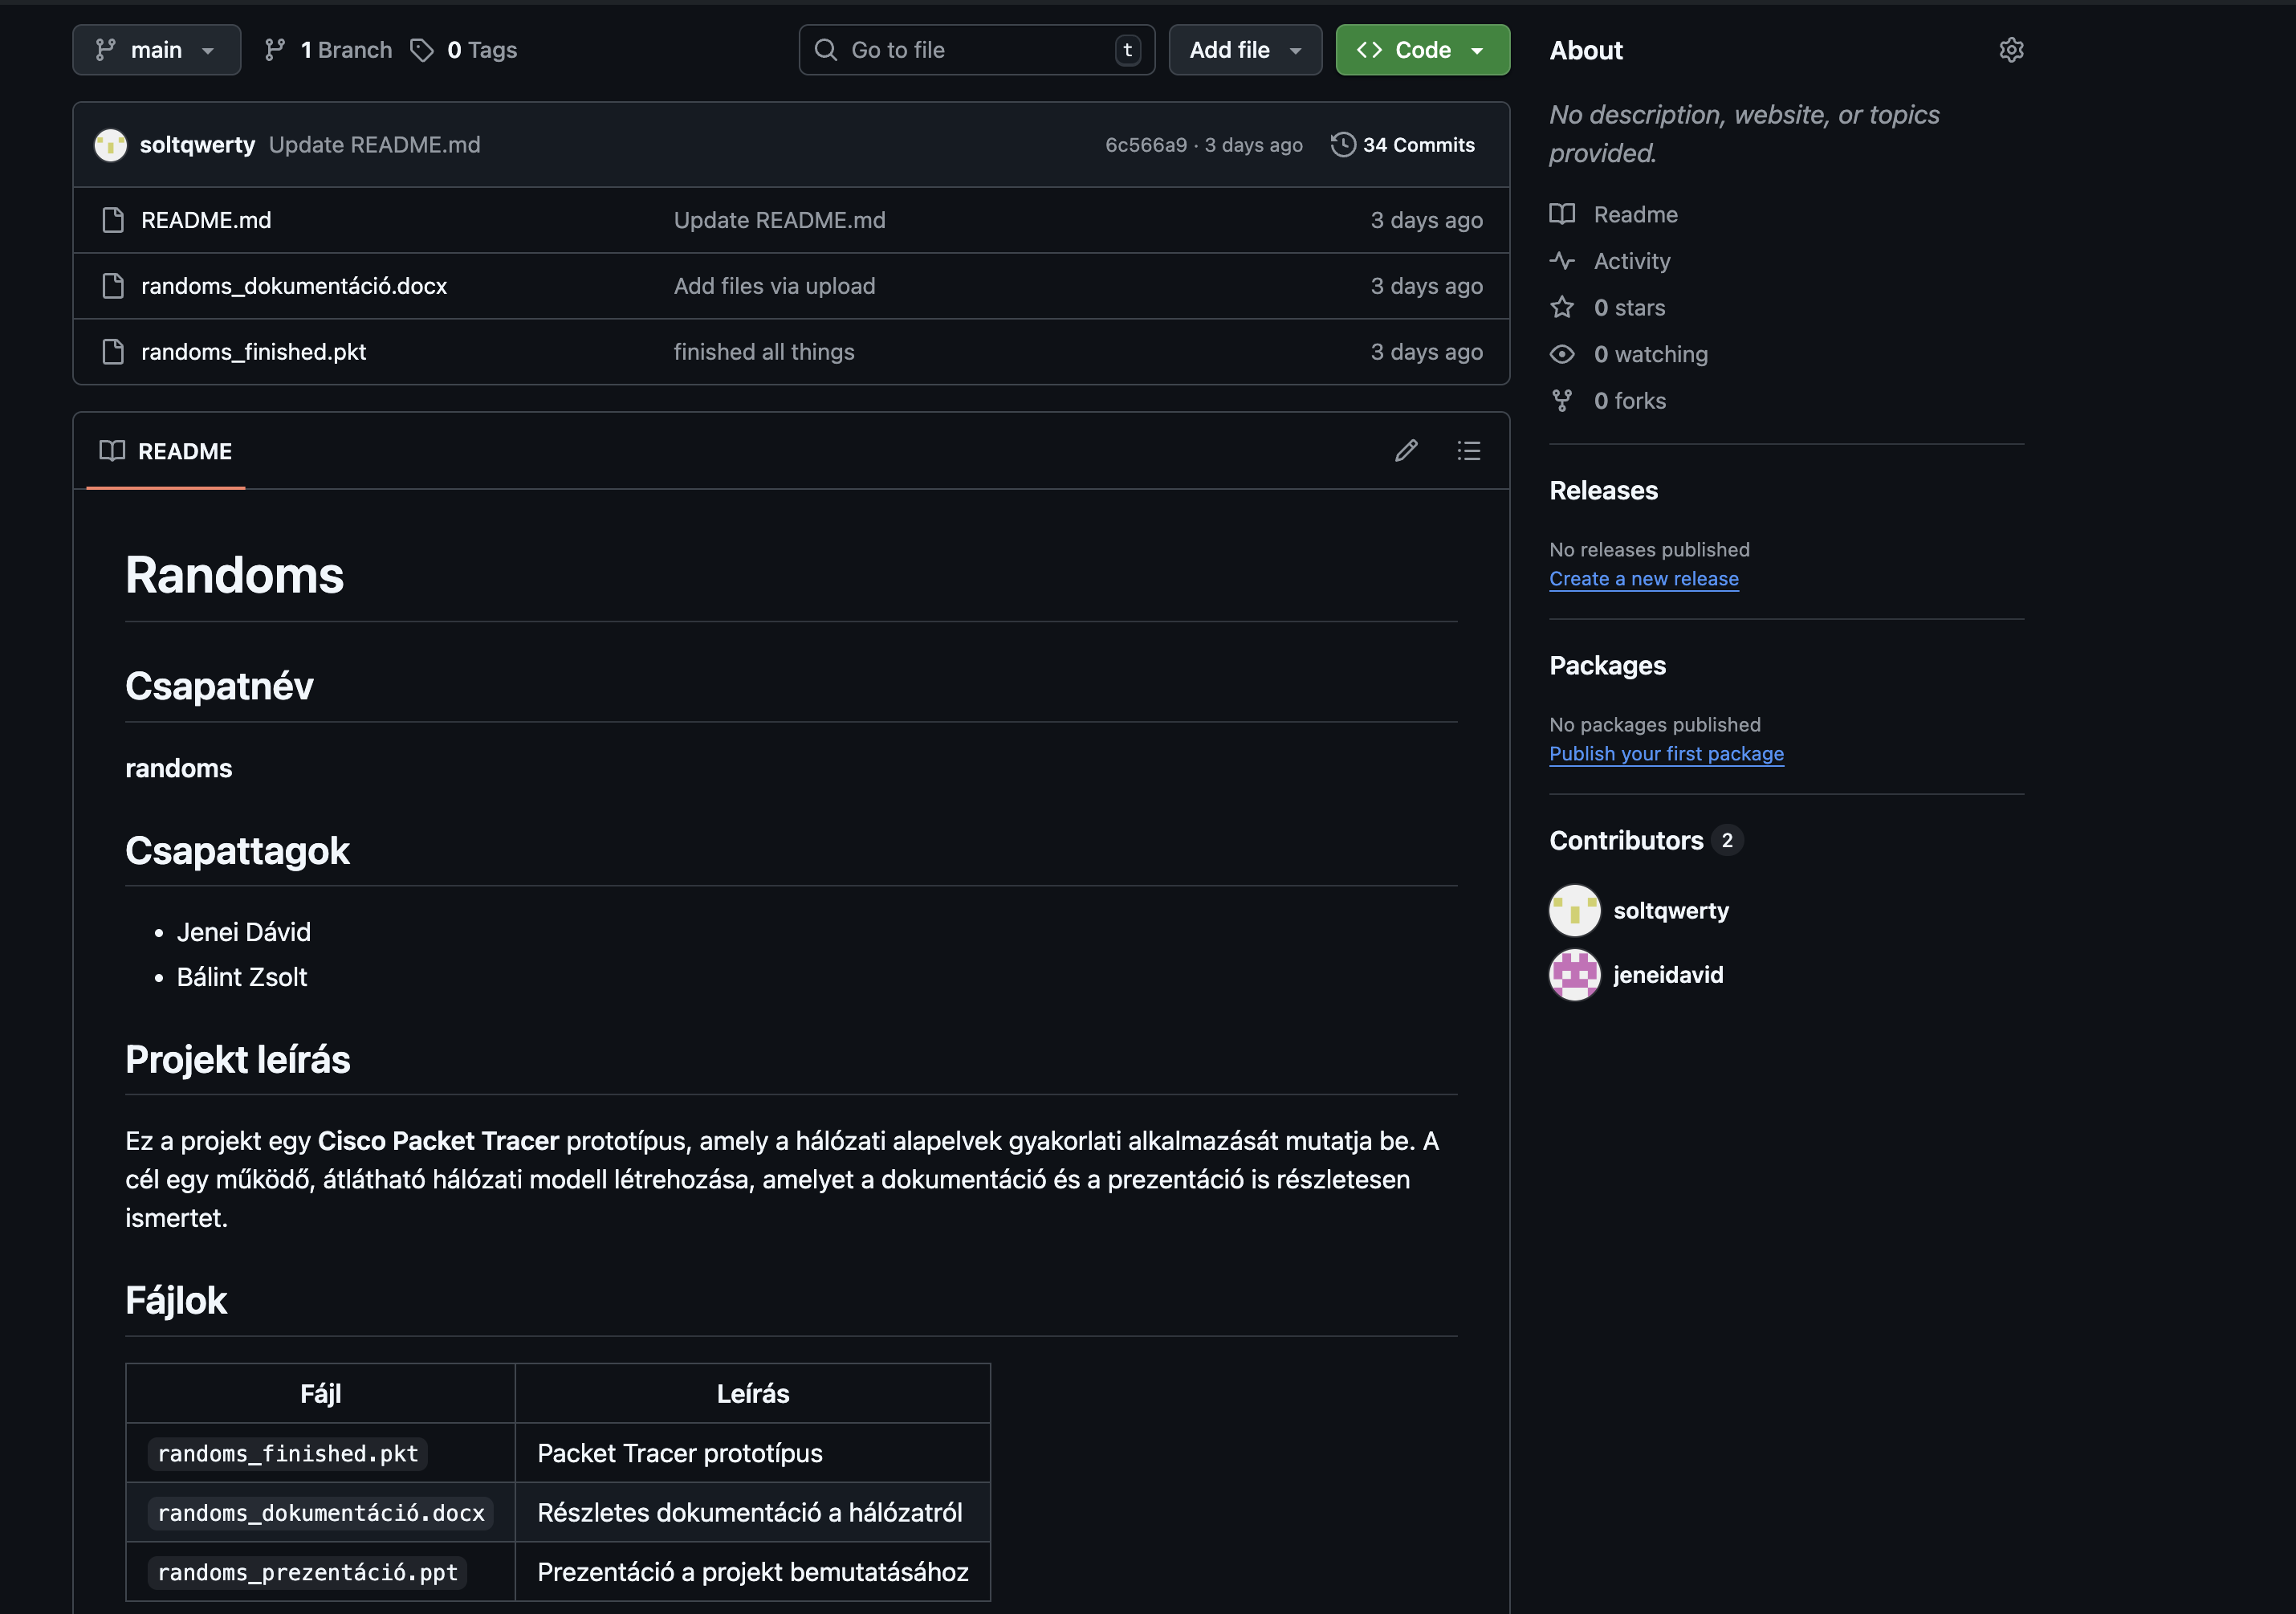
Github
Project File Storage
Backups
Logs

Slide 17
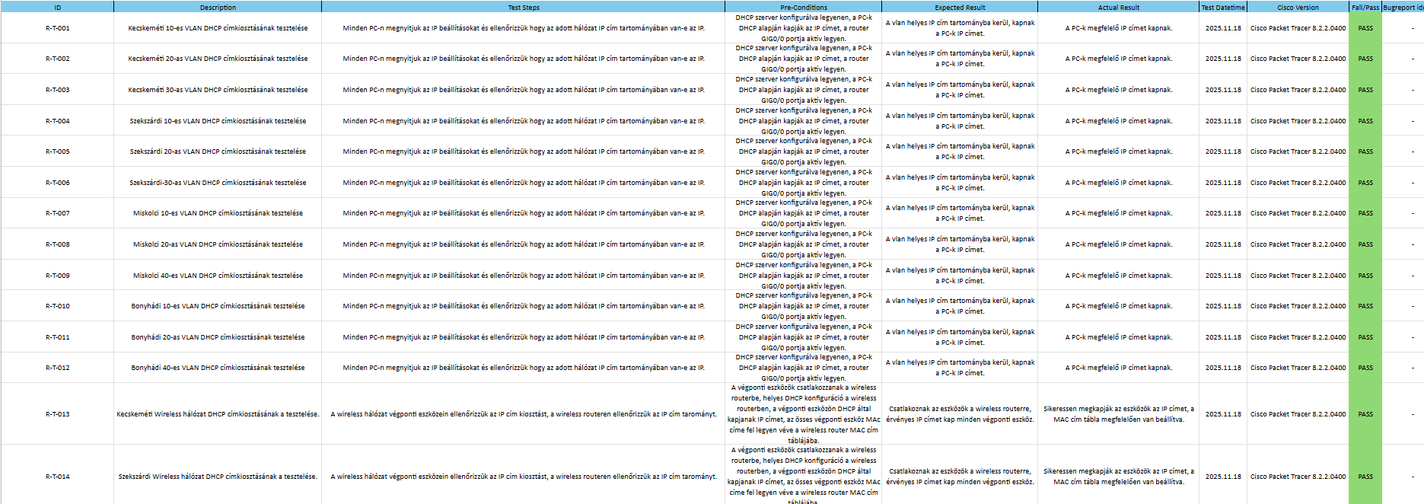
Testing
Total 100 tests
Improved testing in case of failed test
Check entire network

Slide 18
Thank you for your attention!

