Slide 1
How to waste time on facebook (by building your own proxy)
Noah Solnick
Spring barcamp shanghai 2014

Slide 2
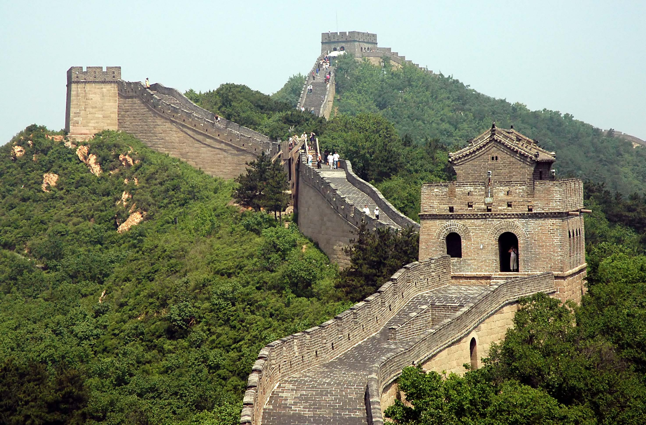

Slide 4
UGLY PICTURE TIME
facebook

Slide 5
UGLY PICTURE TIME
facebook

Slide 6
UGLY PICTURE TIME
facebook
COMPUTER B

Slide 7
UGLY PICTURE TIME
facebook
GOOGLE

Slide 8
UGLY PICTURE TIME
facebook
GOOGLE

Slide 9
What we gonna do
Sign up for Google AppEngine
Download proxy software
Upload software to AppEngine
Set your computer browser

Slide 10
1

Slide 11
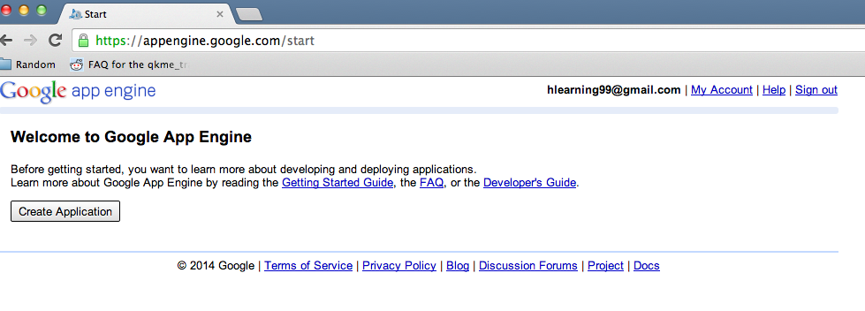

Slide 12
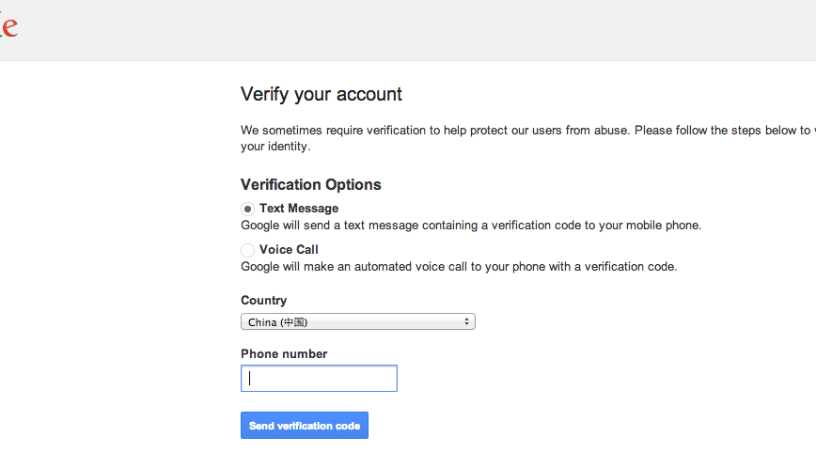

Slide 13
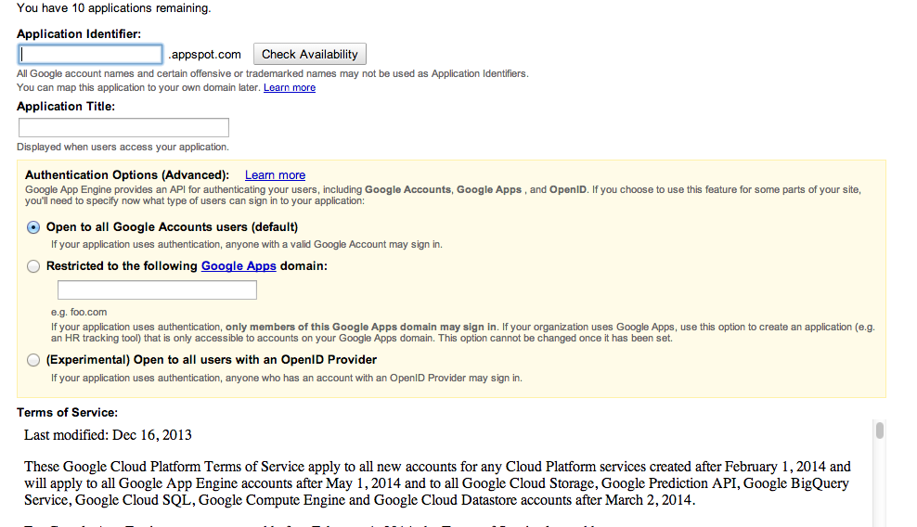

Slide 14
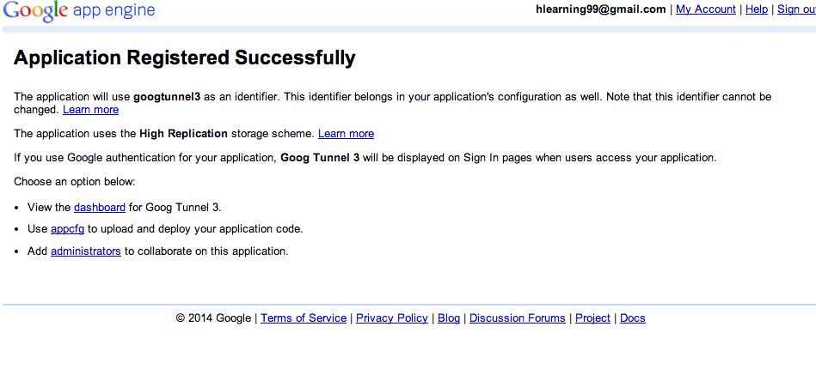

Slide 15
2

Slide 16
DOWNLOAD TIME
https://code.google.com/p/goagent/
Unzip. Remember this directory.

Slide 17
3

Slide 18
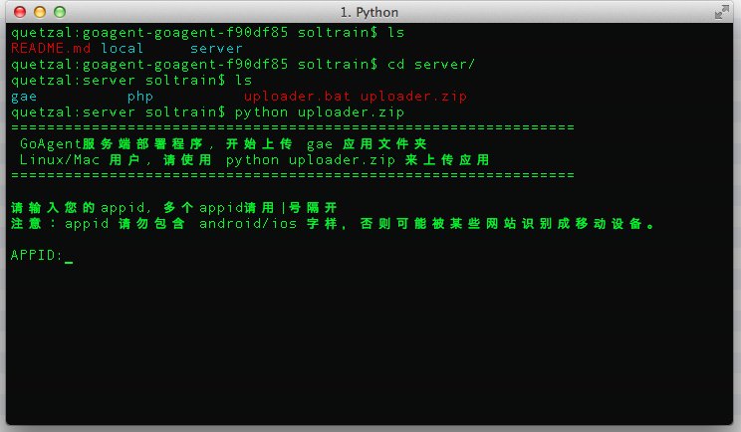
Mac: Use terminal, go to the directory where you unzipped / server/
Type: ‘python uploader.zip’
Windows: directory where you unzipped / server
Click on: uploader.bat

Slide 19
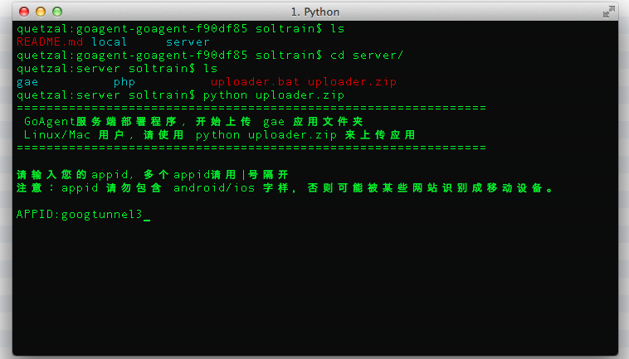

Slide 20
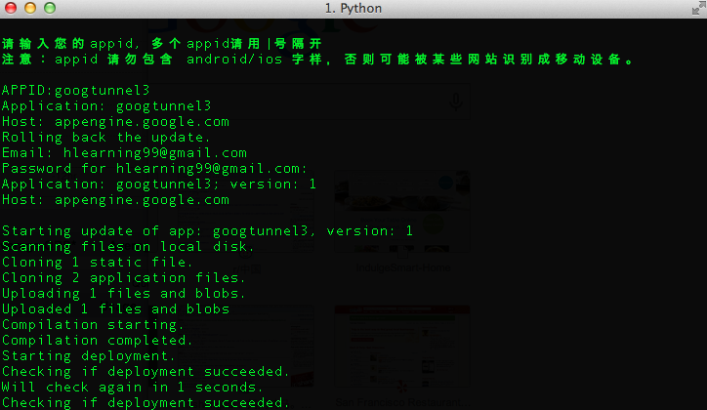

Slide 21
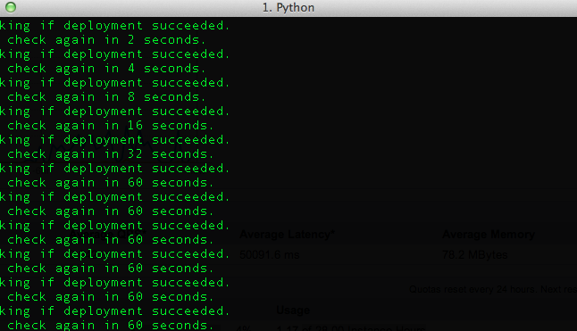
This is normal, don’t worry. Can close the window.

Slide 22
4

Slide 23
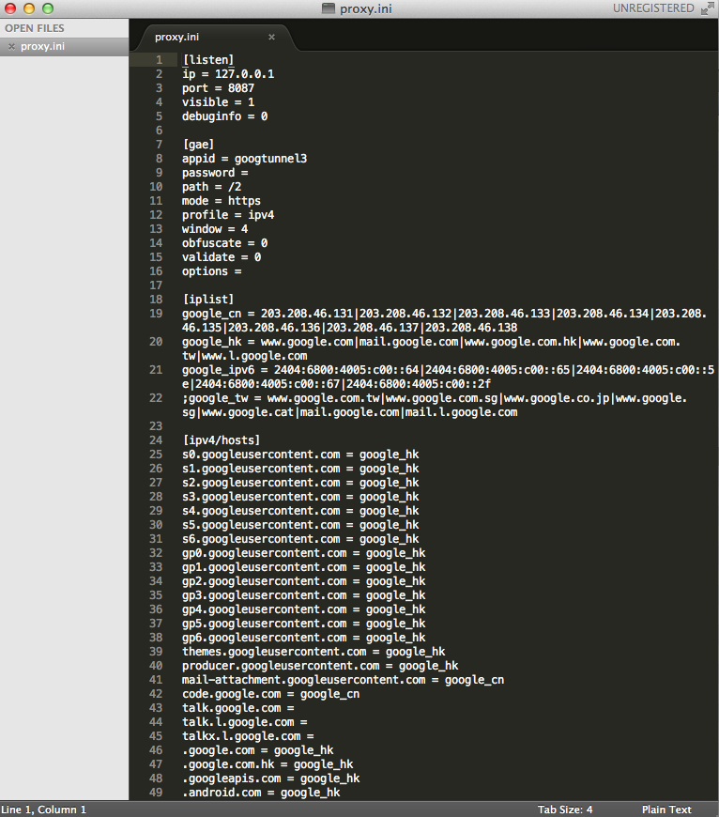
Mac / Windows: directory where you unzipped / local / proxy.ini

Slide 24
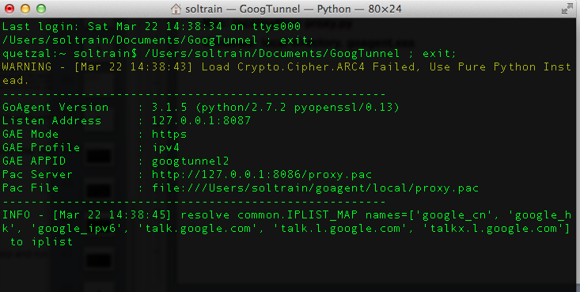
Let’s run this sucka!
Mac: directory where you unzipped / local/
Type: ‘python proxy.py’
Windows: directory where you unzipped / local
Click on goagent.exe

Slide 25
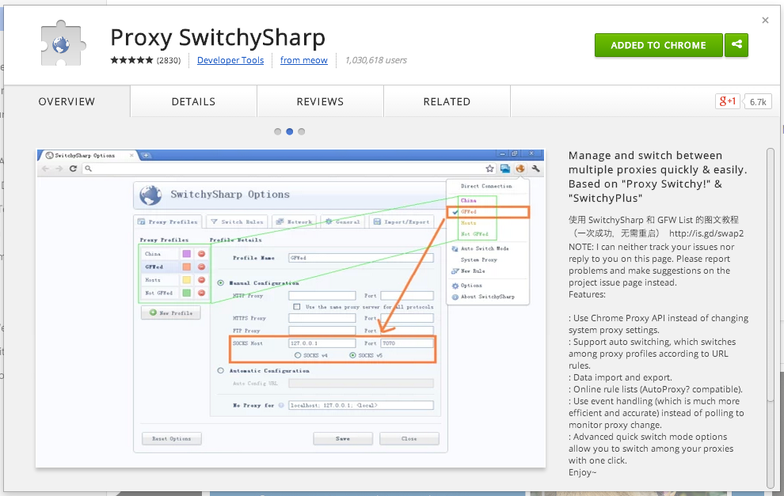
Chrome Extension – Easily turn proxy on and off

Slide 26
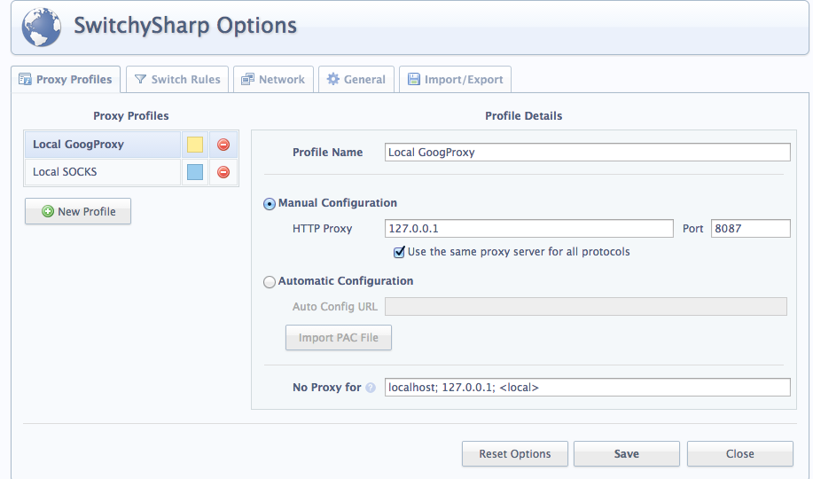

Slide 27
DONE!
Lost? Download this deck! Link will be posted at http://nsolnick.com
Noah Solnick
soltrain@gmail.com

