Slide 1
Building an alternate reality game
Noah Solnick

Slide 2
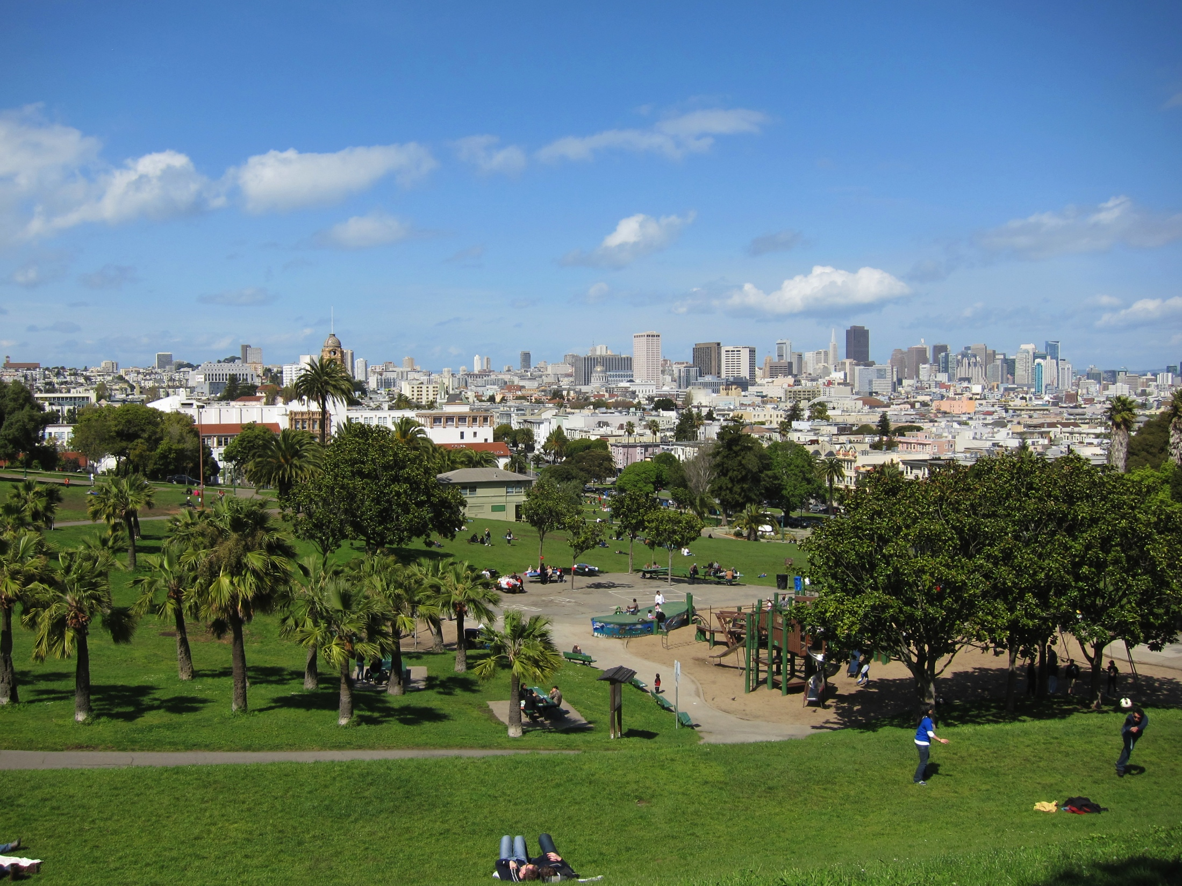

Slide 3


Slide 4
ARG. Not just a word pirates say.
?

Slide 5
What’s it good for?
Humans = Story Absorbing Machines
For Creators: Marketing
Building a brand
Promoting a cause
For Players
Work together as a community
Make reality more engaging

Slide 6



Slide 7
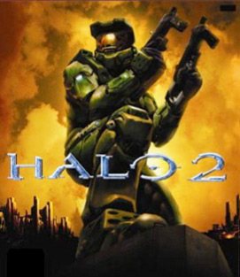
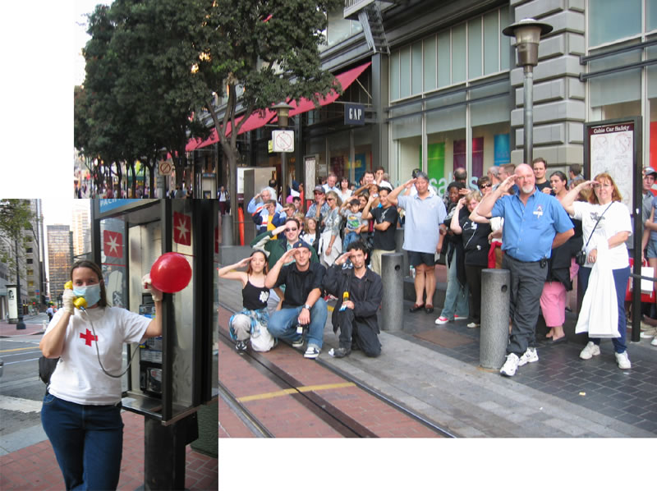
Notes:
Over 9000 players

Slide 8
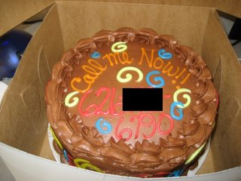

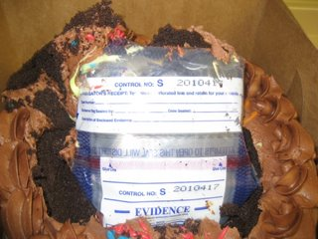
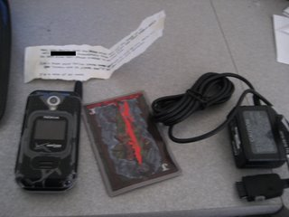

Slide 9
format
Rabbit Hole / Trailhead
Game Events
Progress story via fragments
Endgame
Climax / Tie into related media
Call to action / investigation
Multiple entry points
Player / Tech Interaction
Player / Player Interaction
Player / Designer Interaction

Slide 10
Build an arg
Define your ARG (Scale / Persistent vs. Activity based)
Create the story arc
Select locations
Create a media plan
Create artistic assets
Put together a timeline

Slide 11
Tips
Playtest playtest playtest
Expect audience attrition
T.I.N.A.G. may not work for all audiences
Challenging but not too challenging
Allow for flexibility in story – monitor user base
Create the unexpected

Slide 12
Resources
Hosting
Weebly - http://www.weebly.com/
Squarespace – http://www.squarespace.com
Phone Numbers / SMS
Twilio – http://www.twilio.com
Google Voice – http://voice.google.com
Project Management
Asana – http://www.asana.com
Further ARG Information
Alternate Reality Gaming Network - http://argn.com
ARG blog and wikis for active ARGs - http://wikibruce.com
Unfiction ARG Forums – http://forums.unfiction.com

Slide 13
Thank you! Noah Solnick work in progress: http://www.contactdalian.com

